Slide 1
Precision Science Retreat
Julie Whitmore
10/27/17

Slide 2
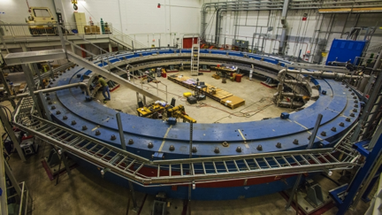
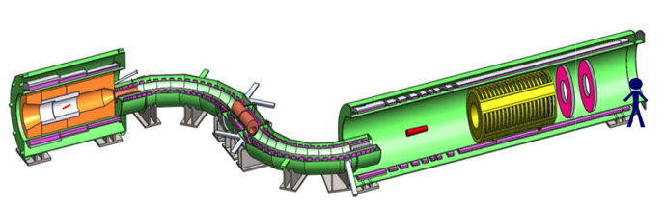
Precision Science
Precision science refers to experiments that attempt to break the established laws of physics by testing predictions to the highest accuracy and searching for phenomena that are either extremely rare or forbidden. Deviations from expectations are an indication of new particles and new interactions.
Mu2e
Muon g-2
Measure muon’s magnetic moment to 140 parts per billion accuracy
Last experiment at Brookhaven indicated we don’t understand muons
Fermilab experiment will allow us to definitely prove we don’t understand muons
(common core particle physics)
Fire 1 trillion protons per second at the experiment
Produce and stop 10 billion muons per second
Find the one out of a billion billion muons that spontaneously converts into an electron.
1 billion billion = number of grains of sand on all the earth’s beaches (D. Glenzinski)

Slide 3
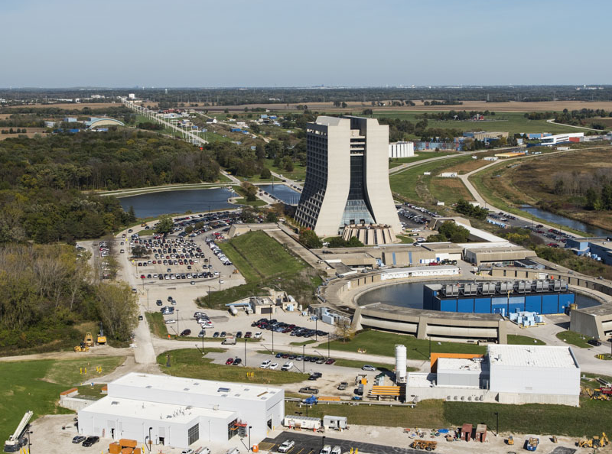
In 10 years, Fermilab will be a world center for muon experiments and on the verge of a major discovery.
Lab Goals (5 years)
Provide high intensity and high quality beams for precision experiments
Perform the most precise measurement of muon g-2
Perform the highest sensitivity search for charged lepton flavor violation
Plan the next generation of precision experiments at Fermilab
Facilitate the growth of a strong and vibrant precision science user community

Slide 4
FY17 objectives
FY17 objective OB-01720: Complete the muon campus AIPs and GPPs by 2017
Needed to update finish date to FY18/2018
FY17 objective OB-01760: Complete the muon g-2 project by 2017
Needed to update finish date to FY18
FY17 objective OB-01730: Deliver first beam to muon g-2 by 2017

Slide 5
FY17 achievements
FY17 Achievements
  OB-01730: Deliver first beam to muon g-2 by 2017
    Completed May 23, 2017: Fermilab's Proton Accelerator Complex delivered beams to the Muon g-2 experiment on schedule and within budget. This represented the culmination of many different efforts as well as capabilities including planning, execution, shut-down work, magnet design/construction/installatrion, safety & QA, facilities support, beam modeling / computing, and back-office skills.
  No listed objective, but….
    Lattice Muon g-2
      Following a successful June 2017 workshop organized by Van de Water and Fermilab Distinguished Scholar El-Khadra, the leading experts on calculations of muon g-2 from around the world have formed two working groups, to improve on current calculations and increase confidence in the residual theory uncertainty estimates.
    Need to add goals/objectives/activities for Theory

Slide 6
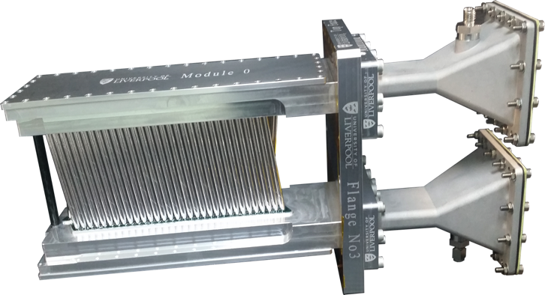
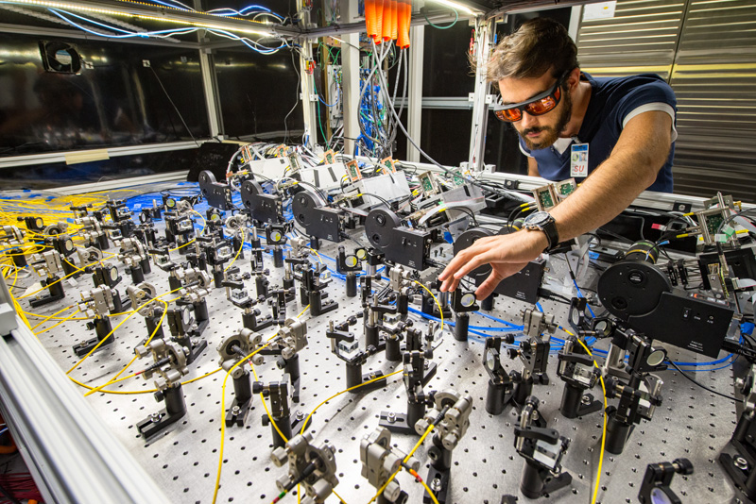
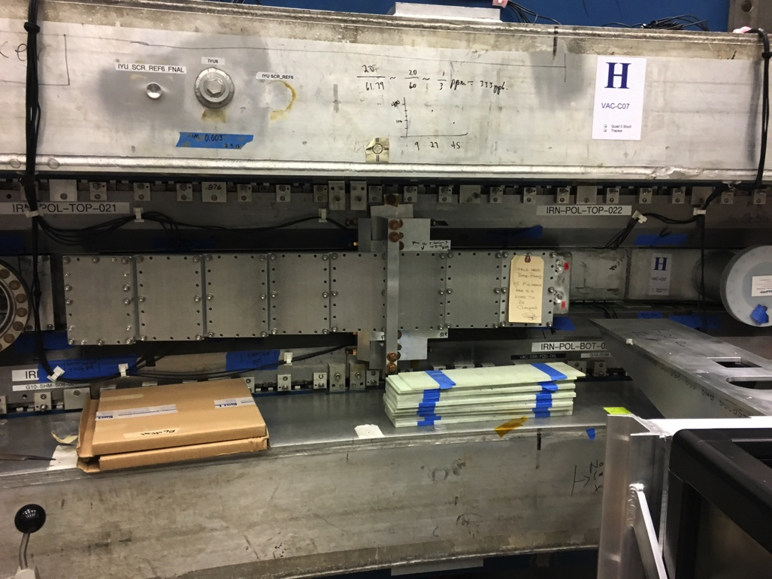
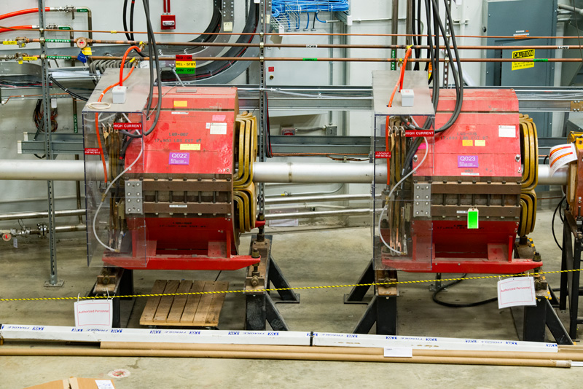
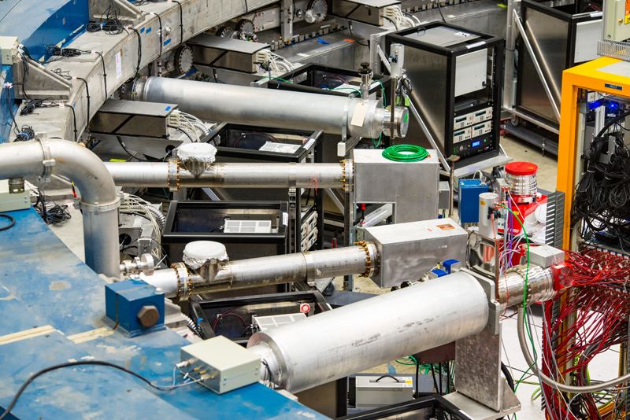
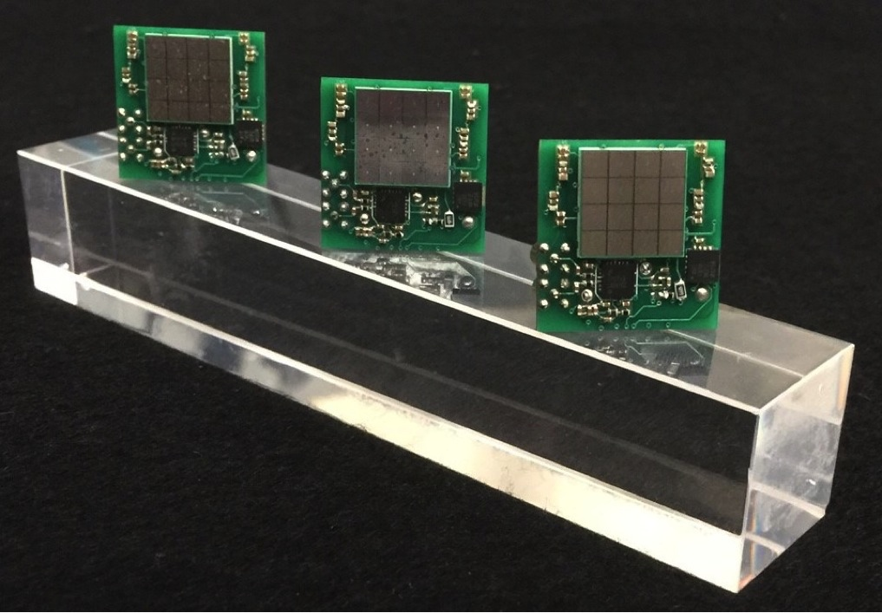
FY17 Precision Science Activities

Slide 7
FY17 Achievements
From P. McBride PPD All Hands
5 week run in June with muons stored for first time
Working on improvements based on engineering run results
Finish commissioning by end of Jan to start physics run in Feb
New PPD leadership roles in scientific collaboration
  Casey – Offline Coordinator
  Kiburg – Run Coordinator
  Nguyen – Ring Ops Manager
  Polly – Co-spokesperson
“Wiggle plot” → Muons in the ring

Slide 8
FY17 Achievements (cont.)
FY17 Achievements
  Mu2e celebrates completion of new experimental hall
    The Mu2e experimental hall is not your normal building. It has nooks, crannies, feedthroughs and labyrinths to accommodate the S-shaped apparatus and the multiple systems required for safe and efficient operations.

Slide 9
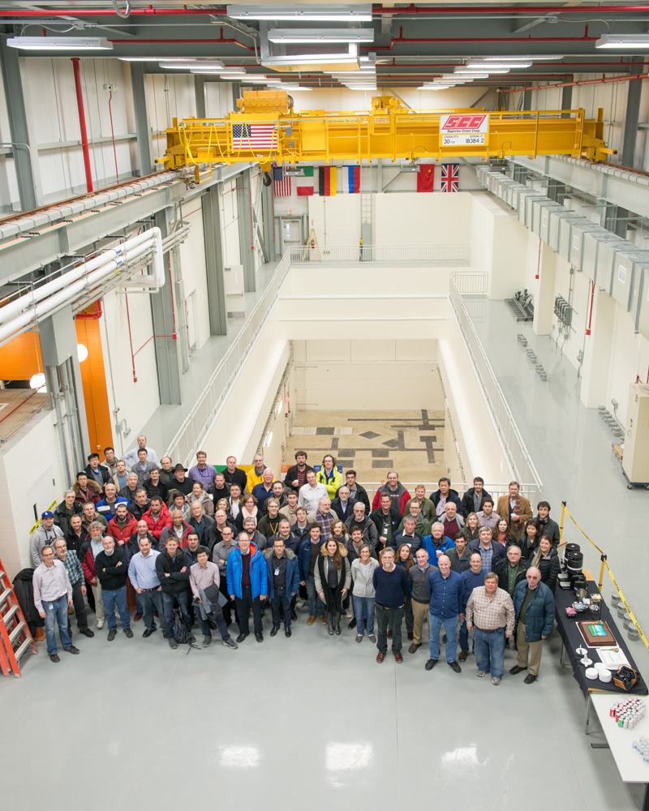
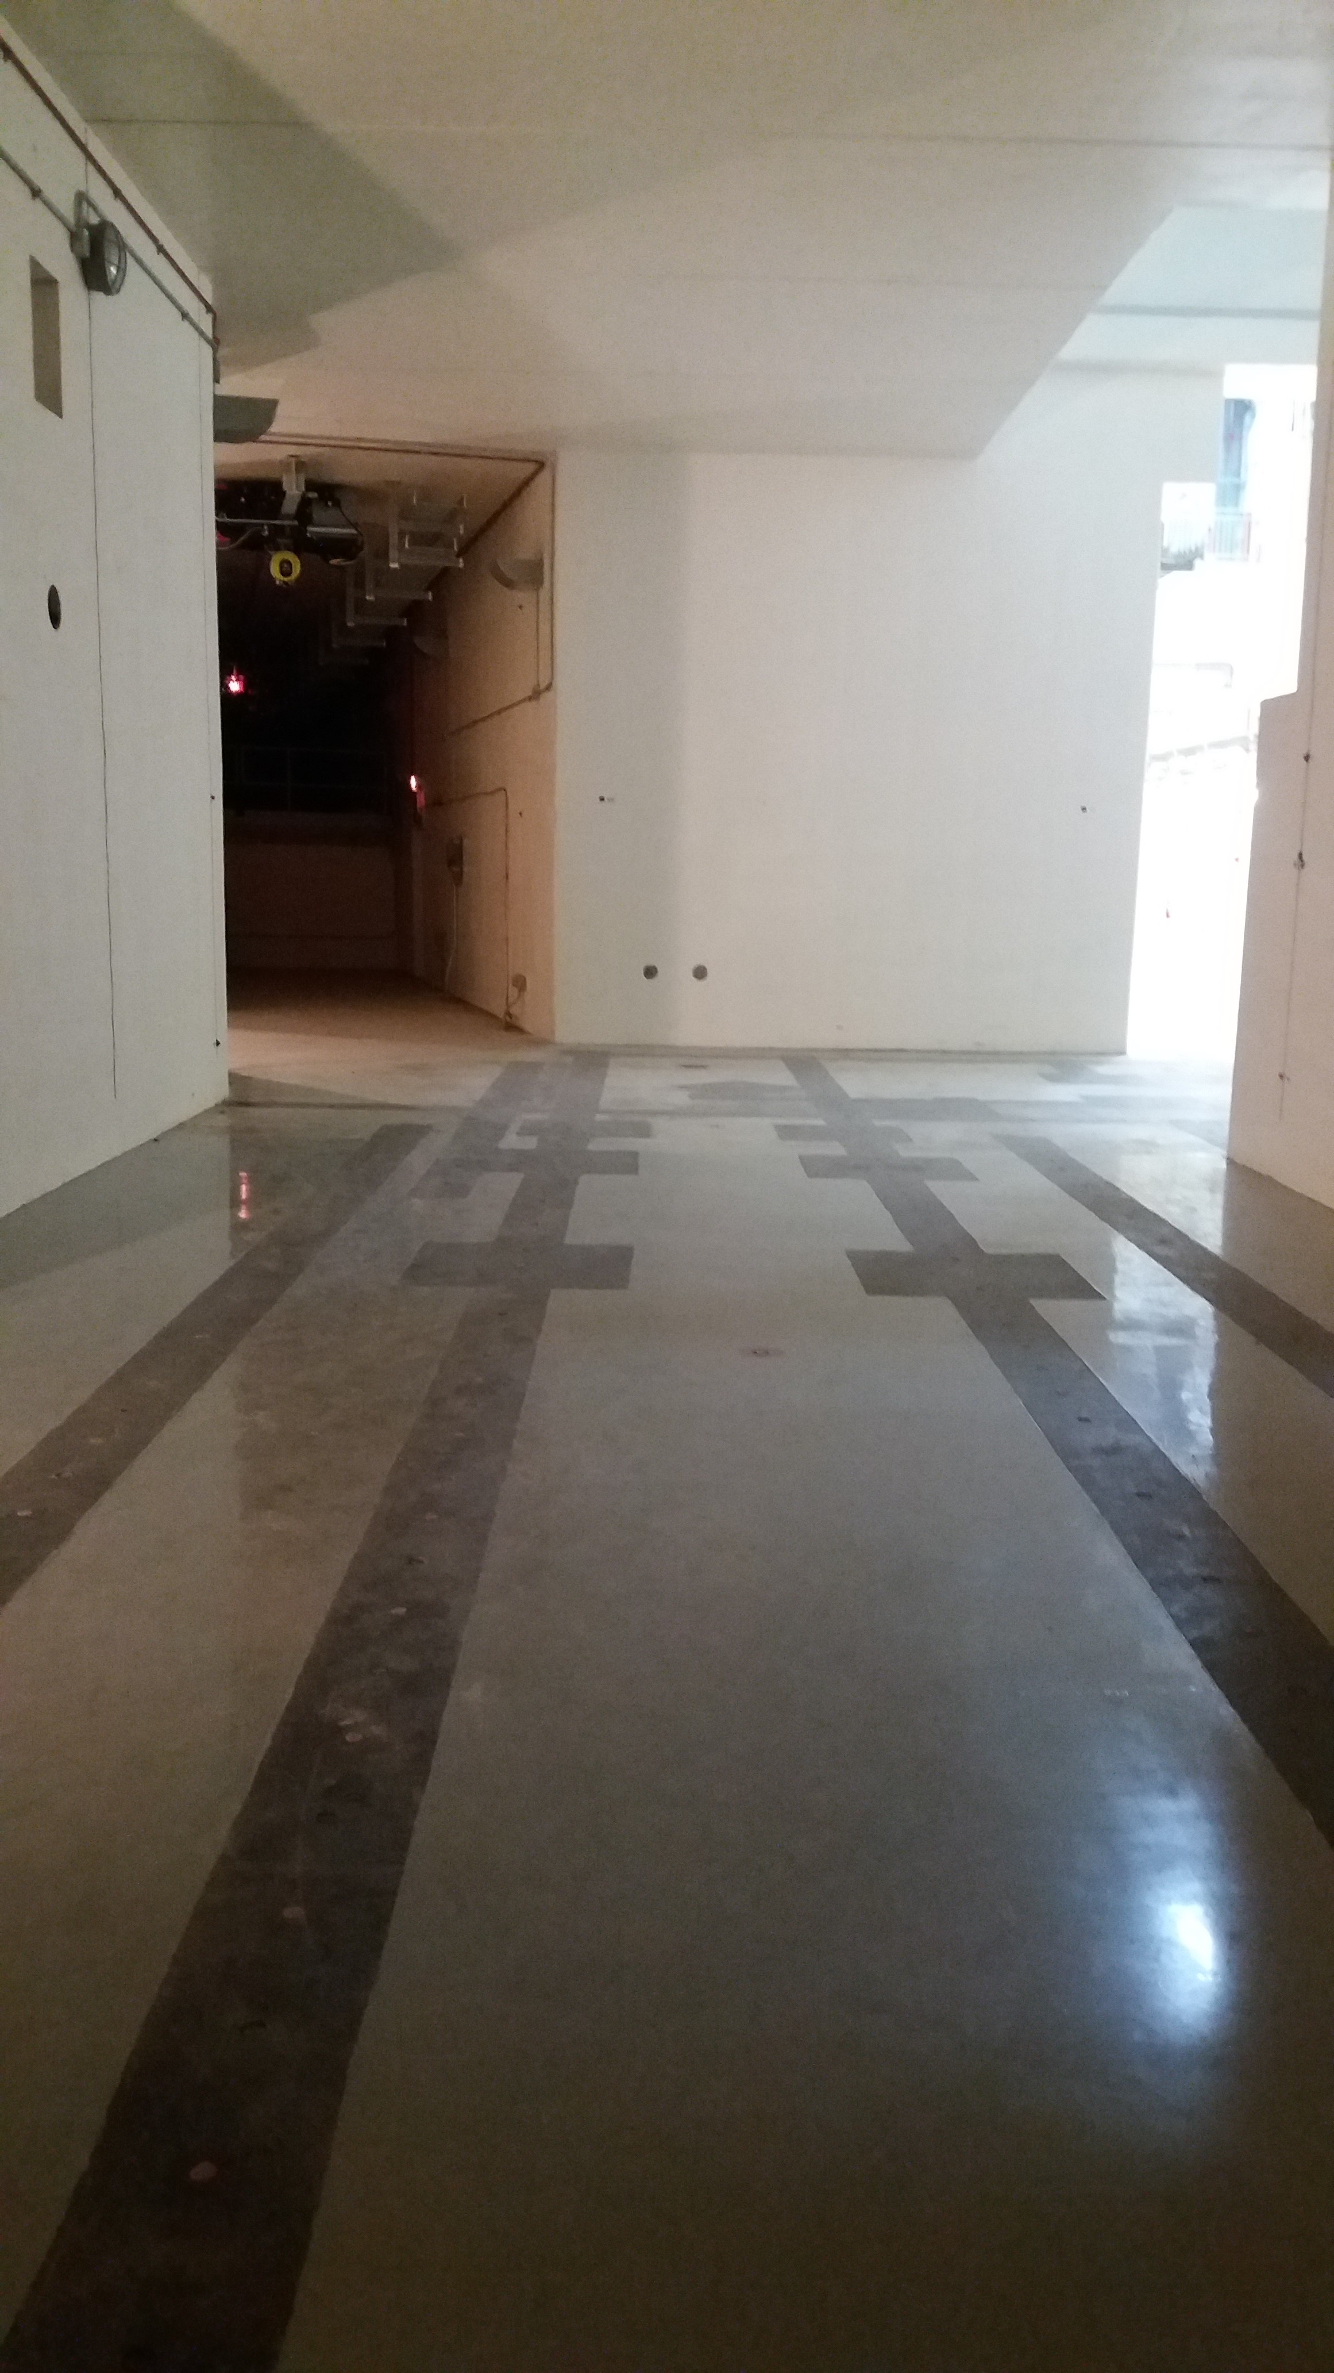
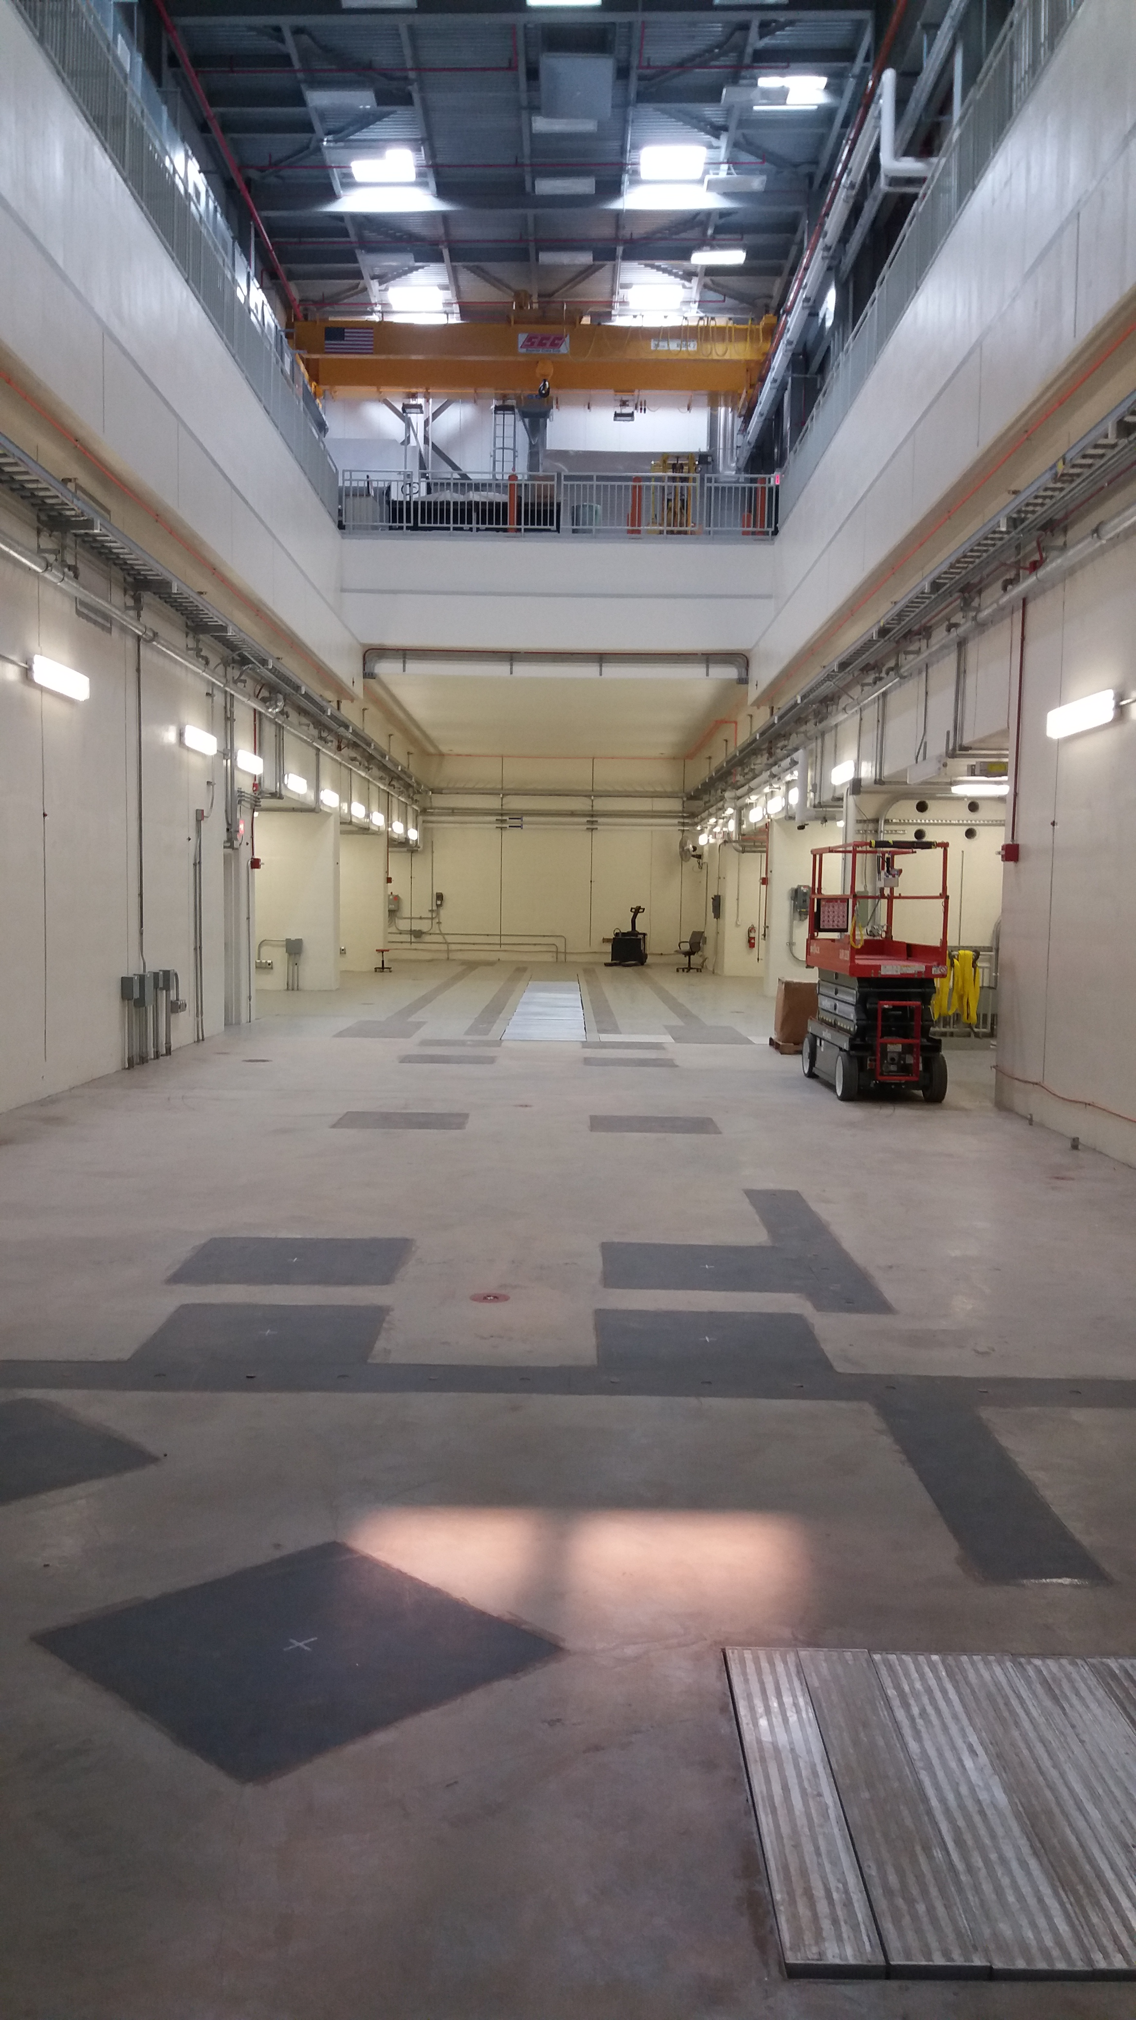
Mu2e Building Acceptance, April 2017

Slide 10
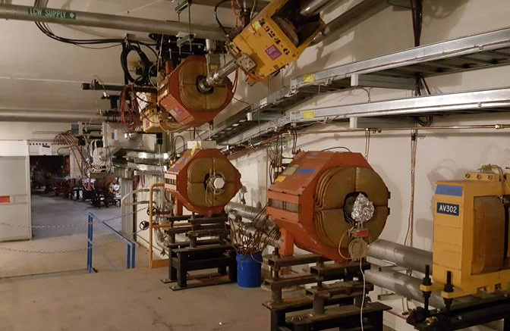
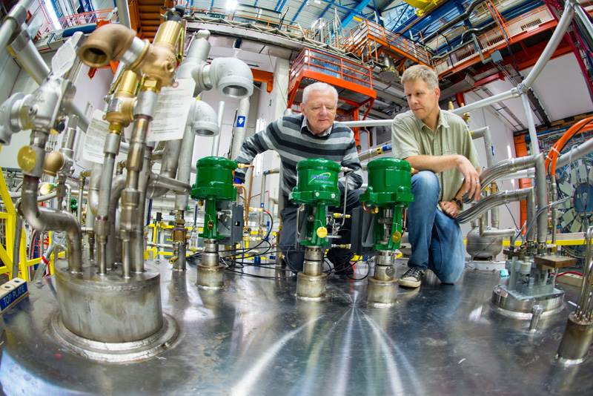
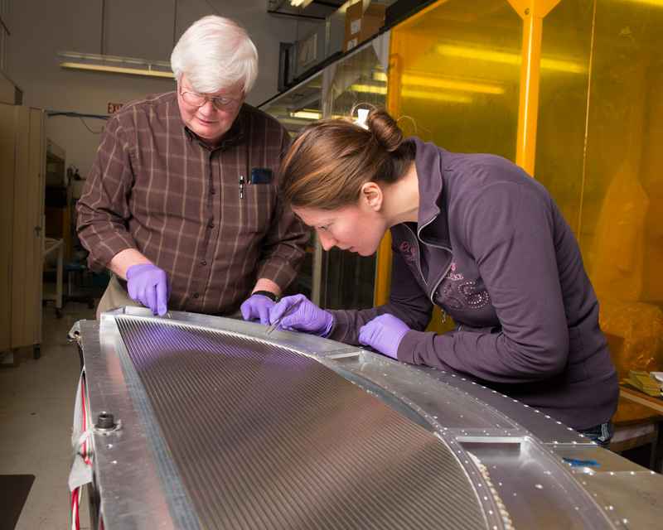
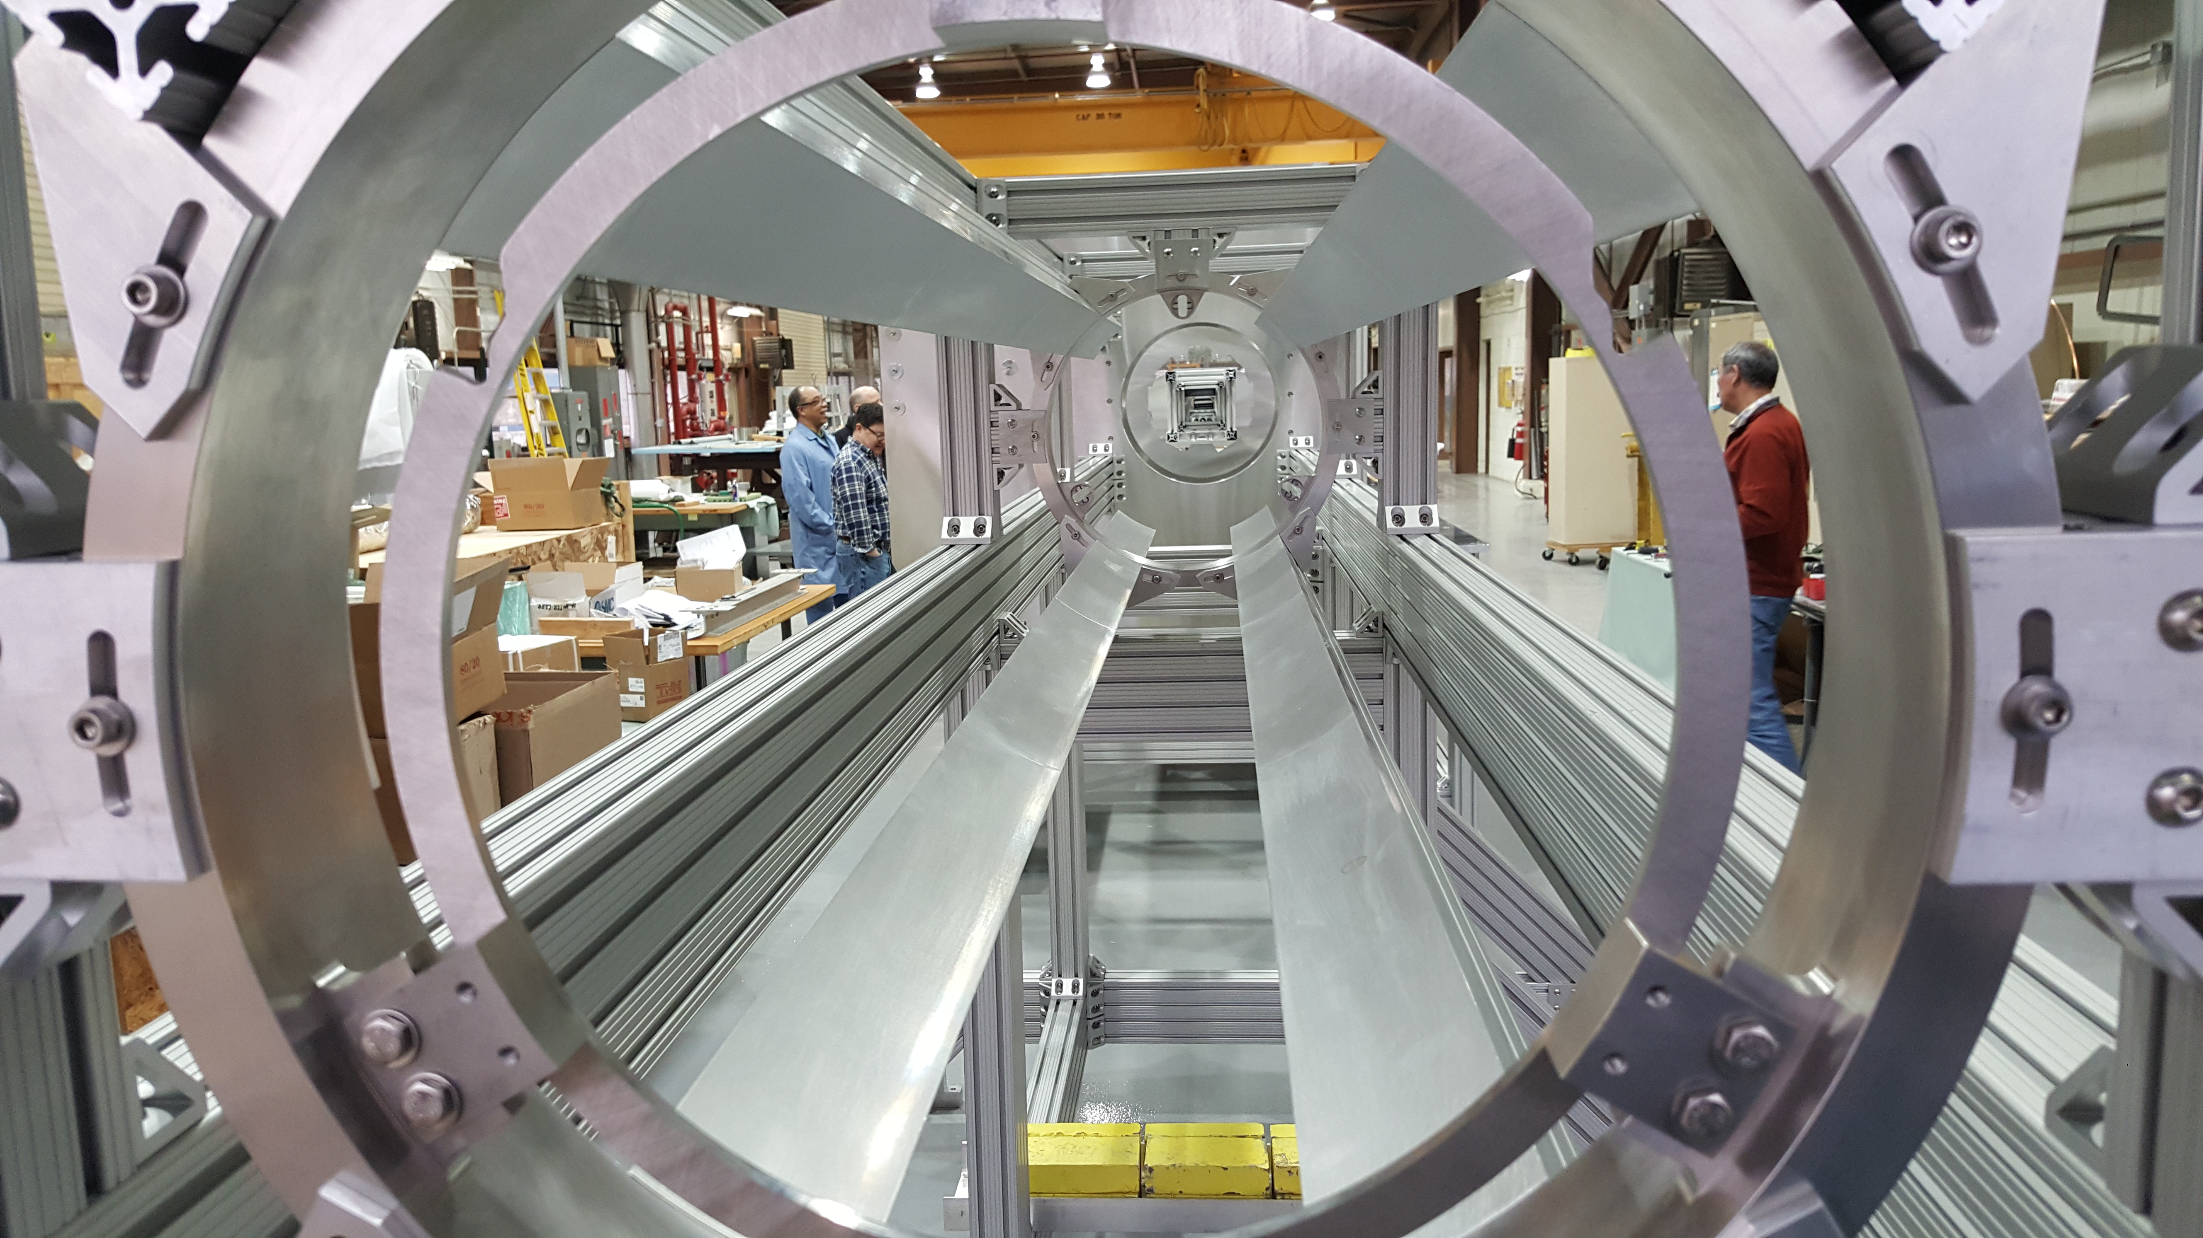
FY17 Precision Science Activities

Slide 11

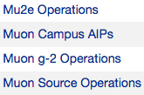




FY18 Lab Activities for Precision Science
Operations
Projects
(Finish by FY18)
(Finish by FY18)
Most important change from last year
Working with lattice group to come up with appropriate goals and objectives
-next gen g-2 needs lattice
-next gen B physics experiments need lattice
Diagonalization along themes needs work
-lots of g-2 phenomenology
-lots of new lattice calculations for neutrinos
-etc
Research
Overhead
LA-01345
QCD Perturbative Theory

Slide 12
Progress towards FY18 objectives (from FY17)
FY18 Objectives
  OB-01760: Complete the muon g-2 project by 2017
    CD-4 Scheduled for Nov 14, 2017
  OB-01720: Complete the muon campus AIPs and GPPs by 2018
    Beamline Enclosure – Walkway over berm from g-2 to Mu2e
    Delivery Ring AIP – Septum installation complete
    Cryo AIP – Waiting for Cryo Distribution Box
      Projected completion by March 2018

Slide 13
Progress towards FY18 objectives
FY18 Objectives
  OB-01770: Collect a data set at least as large as the Brookhaven E821 experiment by 2018
  OB-01840: Provide additional office and lab space for the growing user community as required annually​
  OB-01860: Execute the Research Associate and Associate Scientist hiring plan to provide lab-based leadership in experimental operations and data analysis annually
  OB-ID: Propose Mu2e-II upgrades to the PAC by 2018.​
    Need to assign an ID to this

Slide 14
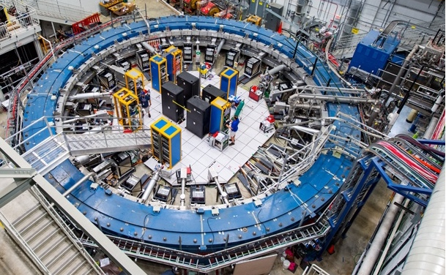
Ramping up to first physics in 2018!
From P. McBride PPD All Hands
Project is done…CD-4 scheduled for Nov 14

Slide 15
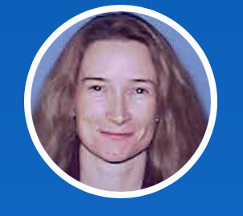
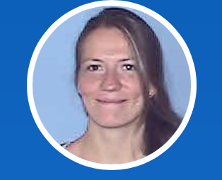
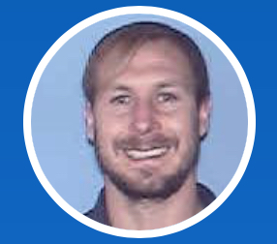
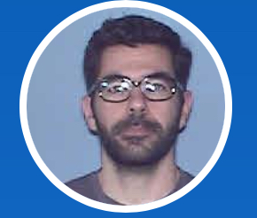
How did we do on FY17 objectives?
FY17 objective OB-01860
  Execute the Research Associate and Associate Scientist hiring plan to ensure lab-based leadership in precision science experimental operations and data analysis
  Karie Badgley Associate Scientist
  Alessandra Luca Research Associate
  Moved from Mu2e to g-2 Analysis
  Jason Bono
  Research Associate
  Manolis Kargiantoulakis
  Research Associate
  Moving from Mu2e to g-2 Analysis
Hiring in 2 more Research Associates in FY18

Slide 16
FY18+ Objectives for g-2 and Mu2e
FY19: Lead efforts to develop user friendly access to data and tools for data processing and analysis sufficient for Muon g-2 by 2018 and for Mu2e by 2019
FY20: Deliver first beam to Mu2e by 2020
FY20: Collect a data set 20x larger than BNL E821 by 2020
FY22: Complete the Mu2e Project by 2022
FY22: Collect a data set as large as Sindrum II by 2022
FY26: Collect the full size Mu2e data set by 2026. This could be as late as 2028, depending on the LBNF shutdown.

Slide 17
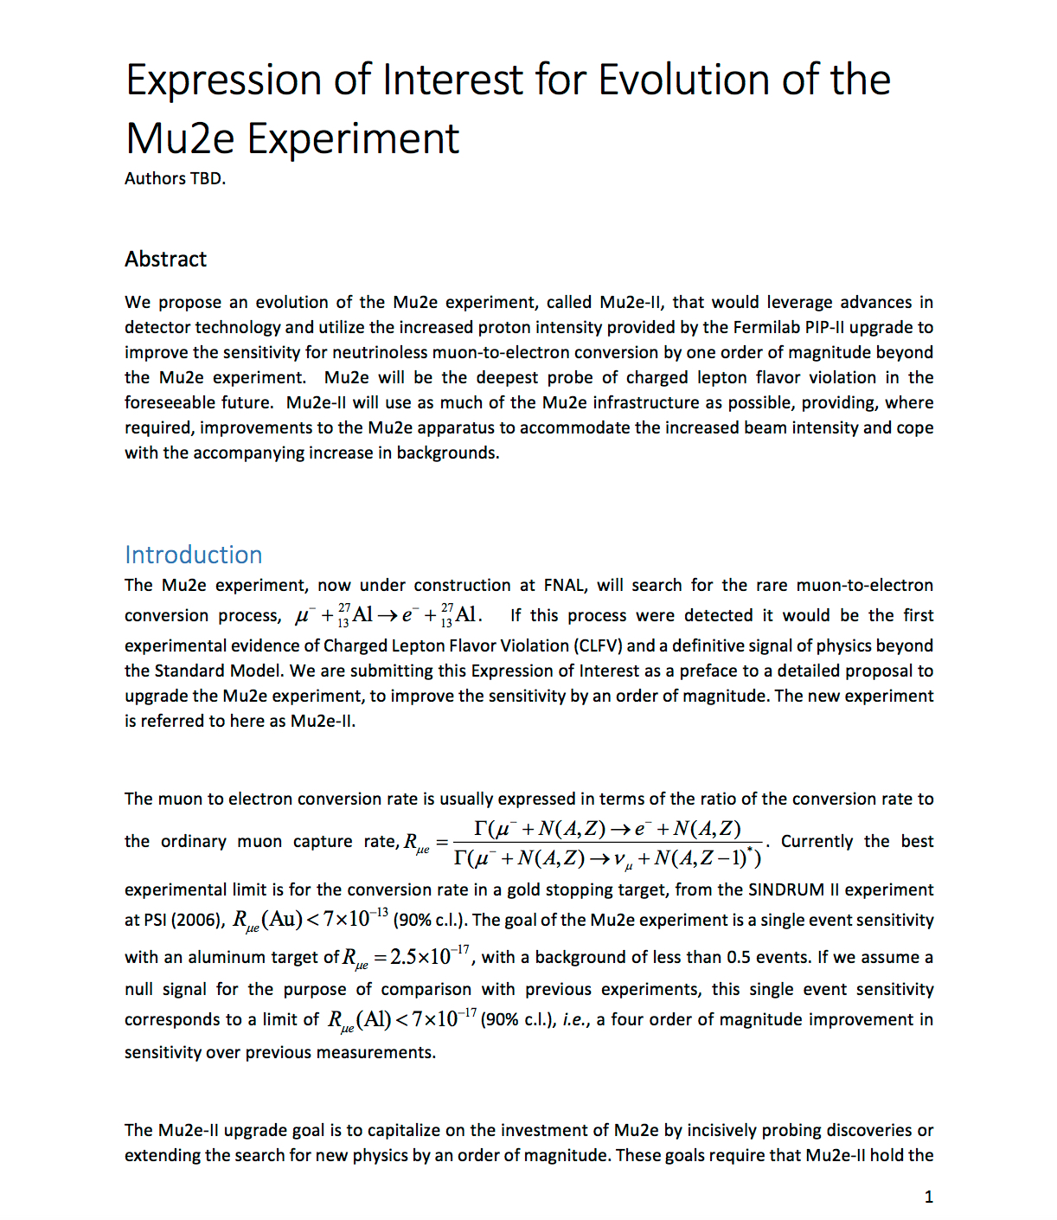
FY18 Objective: Propose Mu2e II Upgrades
FY18: Mu2e-II EOI
  More than 100 signatures so far
  Present to the PAC in January 2018
  (See Doug Glenzinski’s talk)
  https://www.dropbox.com/s/rjg87ob5ecxosfs/Mu2e-II%20EOI%20for%20Signature.pdf?dl=0

Slide 18
FY18+ Objectives
FY19: Investigate new precision experiments for the muon campus as inputs to the Snowmass process
  E.g. REDTOP (See Corrado Gatto’s talk)

