Slide 1
The REDTOP experiment
Rare Eta Decays with a
Tpc for Optical Photons
Corrado Gatto
INFN Napoli and NIU
For the REDTOP Collaboration

Slide 2
REDTOP Experiment Key Points
  A near-4π, fixed target detector sensitive to leptons and γ’s
    Optical-TPC, Multiple-readout calorimeter, Active Muon Polarimeter (all novel technologies), Fiber tracker (new)
    Very fast (Cerenkov and scintillating light from organic only) to sustain event rates in next generation of High Intensity experiments
    Blind to barions
    Not overly expensive (<$40M)
  A CW proton beam with user selectable energy
    All energies in 1.5-8 GeV available
    Extraction line from Delivery Ring to AP50
    Reuses components already available at Fermilab
  The experiment will yield 2 x 10¹³ η mesons/year and 2 x 10¹¹ η’ mesons/year
  Multiple phases with different beam energy/PID - PIPII

Slide 3
Detecting BSM Physics with REDTOP (η/η’ factory)
  Assume a yield 2.5 x 10¹³ η mesons/yr and 2 x 10¹¹η’ mesons/yr
  C, T, CP-violation
  CP Violation via Dalitz plot mirror asymmetry: η → π^{ο} π⁺π⁻
  CP Violation (Type I – P and T odd , C even): η−> 4π^{ο} → 8γ
  CP Violation (Type II - C and T odd , P even): η → π^{ο} l⁺l and η → 3γ
  Test of CP invariance via μ longitudinal polarization: η → μ⁺μ –
  Test of CP invariance via γ∗ polarization studies:η → π⁺π –e⁺e – and η → π⁺π –μ⁺μ –
  Test of CP invariance in angular correlation studies:η → μ⁺μ – e⁺e –
  Test of T invariance via μ transverse polarization: η → πºμ⁺μ – and η → γ μ⁺μ –
  CPT violation: μ polariz. in η → π⁺μ⁻ν vs η → π⁻μ⁺ν and γ polarization in η → γ γ
  New particles and forces searches
  Scalar meson searches (charged channel): η → π^{ο} Η with H→e⁺e⁻ and H→μ⁺μ⁻
  Dark photon searches: η → γ Α’ with Α’ → l⁺l⁻
  Protophobic fifth force searches : η → γ X₁₇ with X₁₇ → e⁺e⁻
  New leptophobic baryonic force searches : η → γ B with B→ e⁺e⁻ or B→ γ π^{ο}
  Indirect searches for dark photons new gauge bosons and leptoquark: η → μ⁺μ⁻ and η → e⁺e⁻
  Search for true muonium: η → γ (μ⁺μ – )|_{2Mμ} → γ e⁺e –
  Other discrete symmetry violations
  Lepton Flavor Violation: η → μ⁺e – + c.c.
  Double lepton Flavor Violation: η → μ⁺μ⁺e – e – + c.c.
  Other Precision Physics measurements
  Proton radius anomaly: η → γ μ⁺μ – vs η → γ e⁺e⁻
  All unseen leptonic decay mode of η / η ‘ (SM predicts 10⁻⁶ -10⁻⁹)
  Non-η/η’ based BSM Physics
  Dark photon and ALP searches in Drell-Yan processes: qqbar → A’/a → l⁺l–
  ALP’s searches in Primakoff processes: p Z → p Z a → l⁺l– (F. Kahlhoefer)
  Charged pion and kaon decays: π+ → μ⁺ν Α’ → μ⁺ν e⁺e– and Κ+ → μ⁺ν Α’ → μ⁺ν e⁺e–
  Neutral pion decay: πº → γA’ → γe⁺e–
  Nuclear models
  Chiral perturbation theory
  Non-perturbative QCD
  Isospin breaking due to the u-d quark mass difference
  Octet-singlet mixing angle
  Electromagnetic transition form-factors (important input for g-2)
  High precision studies on medium energy physics

Slide 4
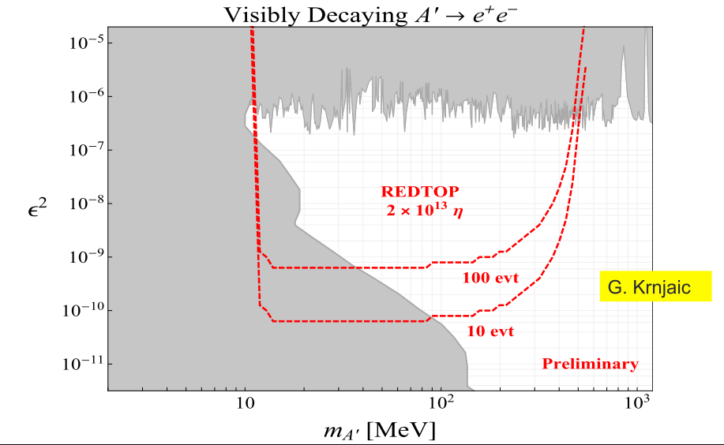
Dark photon searches with 10¹³ η mesons
  η → γ Α’ → γ + l⁺l⁻
4

Slide 5
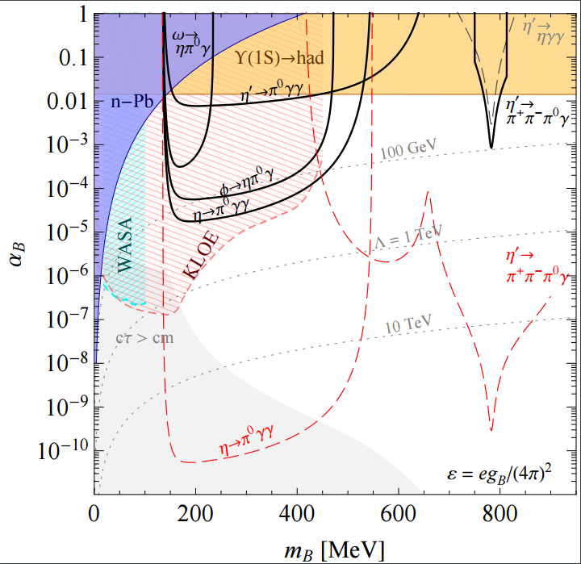
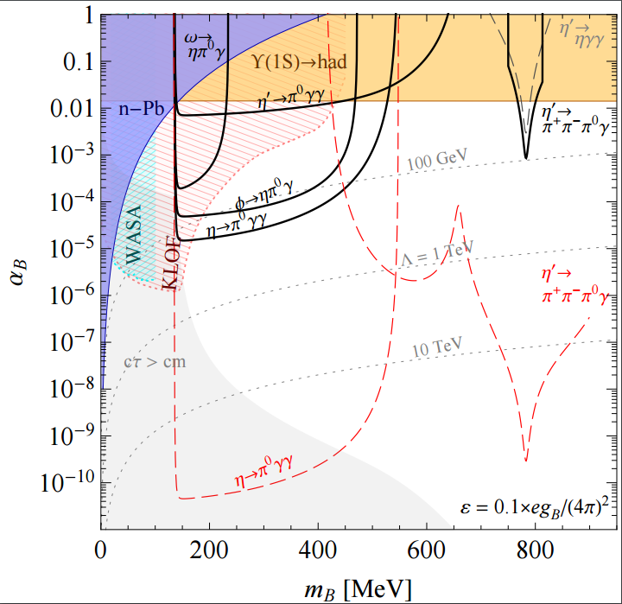
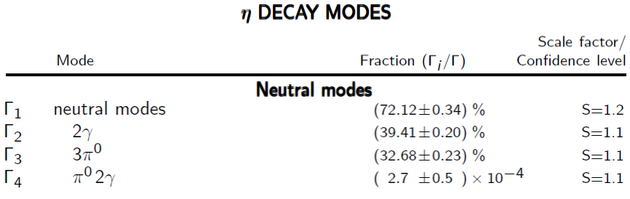
REDTOP Constraints on a new baryonic force (courtesy of S. Tulin – U. York)
REDTOP constraints at the level of BR(η’ → Bγ → π +π −πºγ) < 10⁻⁸
REDTOP constraints at the level of BR(η → Bγ → πºγγ) < 3 × 10⁻⁹
Based on 2.5 x 10¹³ η meson produced
and 1 x 10¹¹ η‘ meson produced

Slide 6
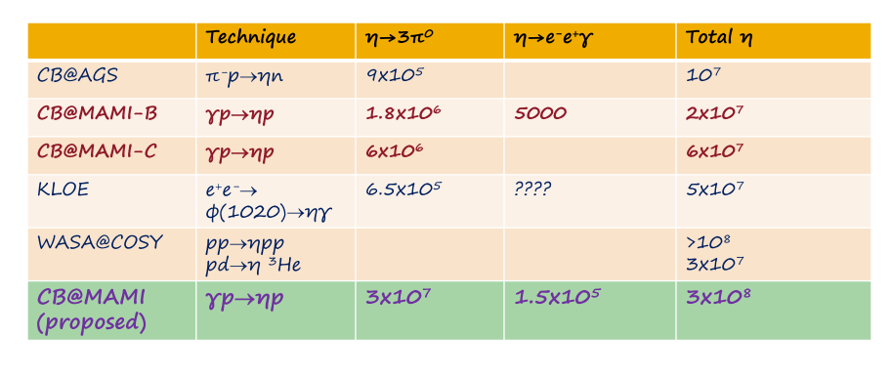
Present η Samples
A. Starostin - UCLA
₉
Near future η Samples
GlueX@JLAB γ_{12 GeV}p → η p → neutrals 4.5x10⁷/yr
(just started)
JEF@JLAB γ_{12 GeV}p → η X → neutrals 3.9x10⁵/day
(recently approved)
REDTOP@FNAL p_{1.9 GeV}N → η pp 2.5x10¹³/yr
(proposing)

Slide 7
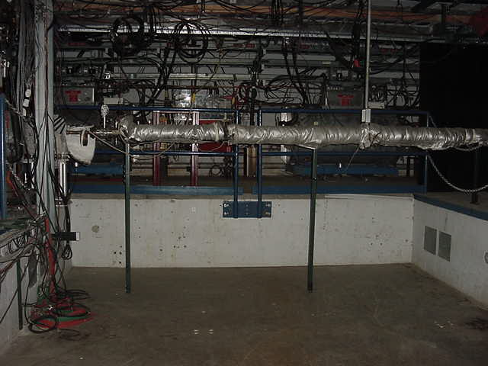
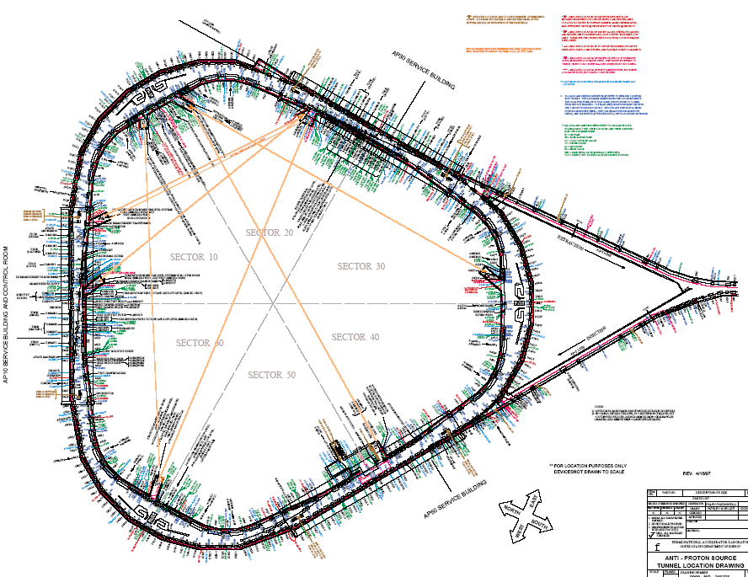
Accelerator complex for REDTOP
Fermilab Option: AP50 hall
Use delivery ring and extract beam at AP50
Decelerate the 8 GeV beam to desired energy.
REDTOP

Slide 8
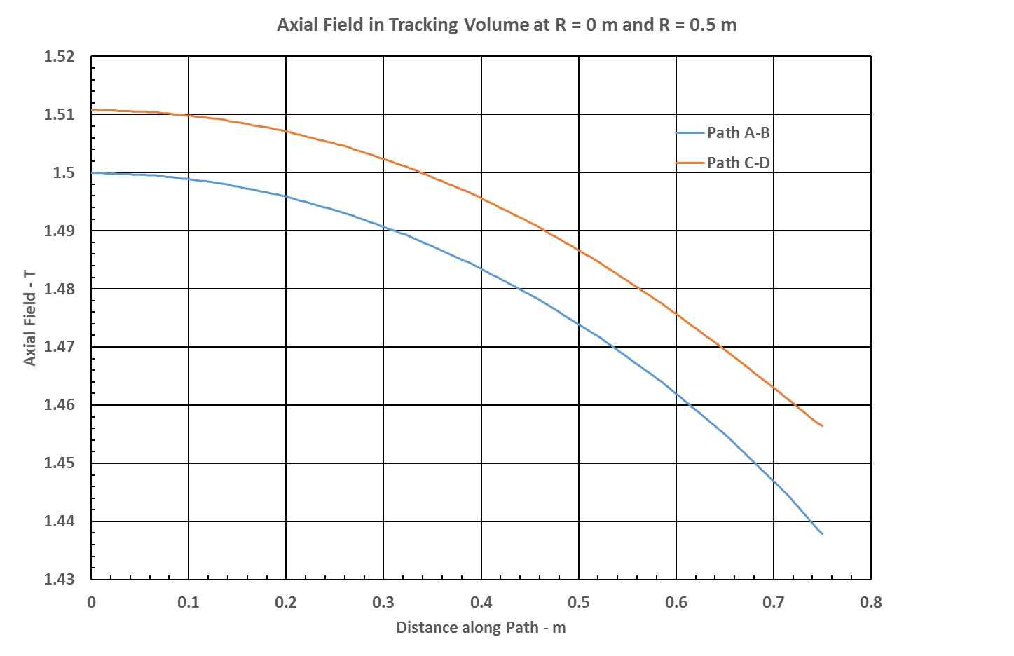
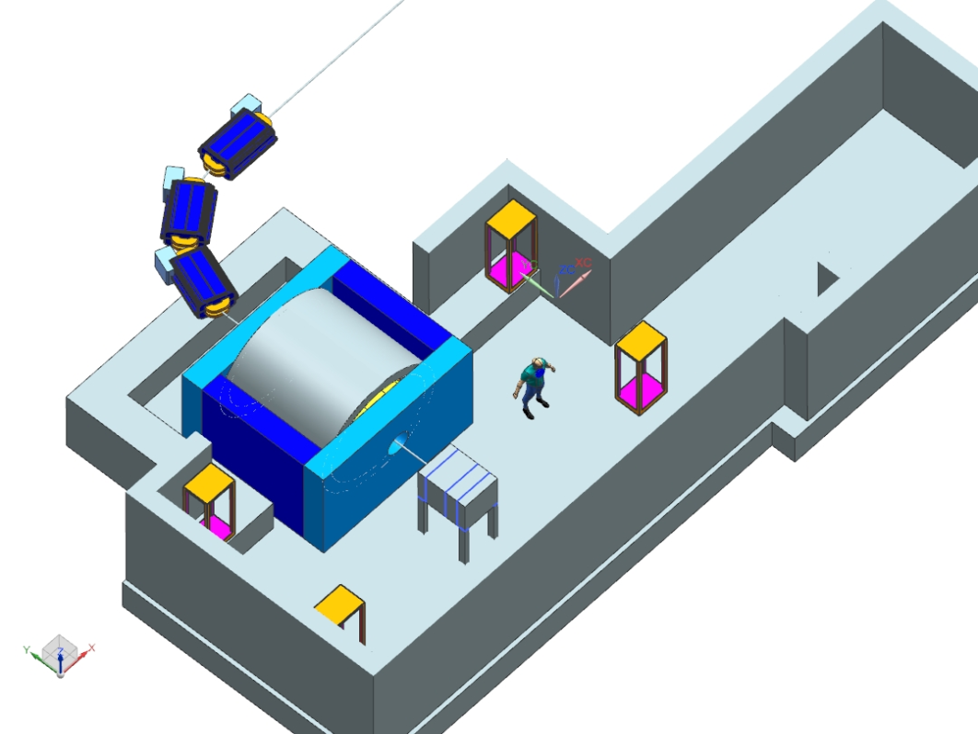
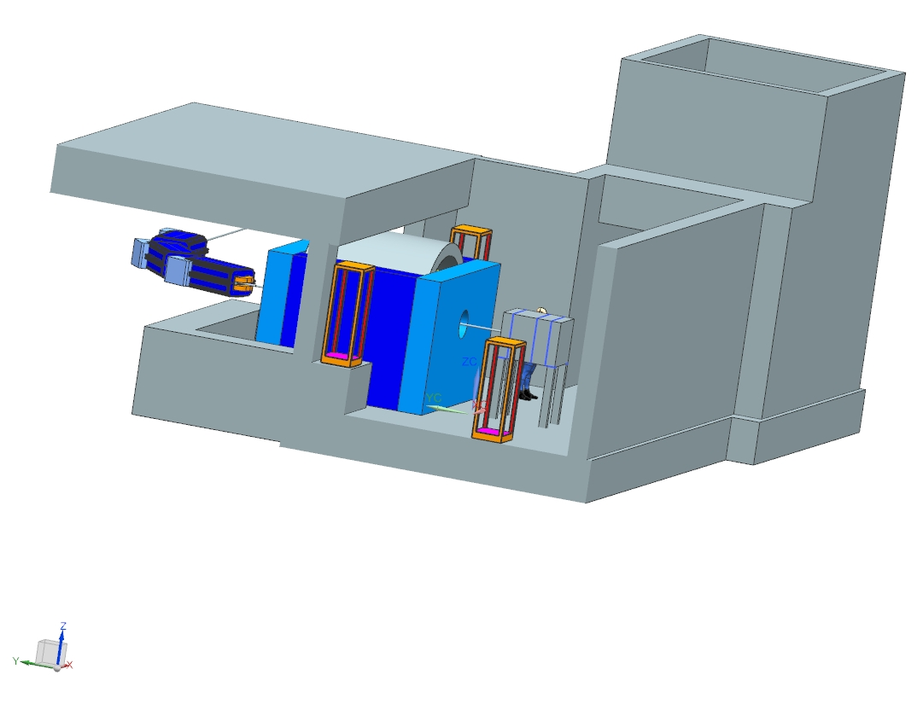
REDTOP detector in AP50
B-field uniformity better than 4.1% over the entire tracking volume
J. Kilmer
J. Rauch
E. Barzi (Solenoid and yoke)
(Many thanks to K. Krempetz, as well)

Slide 9
Acceleration Scheme (M. Syphers)
Single p pulse from booster (≤4x10¹² p) injected in the DR (former debuncher in anti-p production at Tevatron) at fixed energy (8 GeV)
Energy is removed by adding 1-2 RF cavities identical to the one already planned for mu2e (J. Dey). Transitionless deceleration scheme by J. Johnstone (requires MADX confirmation)
Spare RF cavities already existing (owned by mu2e and AD)
Debunching occurs adiabatically inside the DR
Slow extraction to REDTOP over ~40 seconds.
The 270º of betatron phase advance between the Mu2e Electrostatic Septum and REDTOP Lambertson is ideal for AP50 extraction to the inside of the ring. A DEDICATED SEPTUM IS NOT REQUIRED
Total time to decelerate-debunch-extract: 51 sec: duty cycle ~80%
Notes:
there are two types of septa required in the slow-spill system. First, there is an electrostatic septum (ES) made up of a plane of thin wires (few microns) that are held at high voltage and that start the extraction process. The same ES can be used for both Mu2e and for REDTOP. It separates the particles destined for extraction from the stored beam.
The second septum required is a magnetic septum (MS) which is the first magnetic element that guides the particles directly out of the ring. Since REDTOP will extract beam from the AP50 area, while Mu2e will extract beam from the AP30 area, then there needs to be either two separate MS's or, if we run one experiment to completion and then run the other experiment, the MS could be moved. Realistically, separate MS’s is the best solution. Mu2e running will make the septum radioactively hot and will be very difficult to move at that point. Most likely there is a spare MS for Mu2e (I will check on that) and the spare can be installed at the REDTOP location.

Slide 10
The Experimental Apparatus
  Baseline detector
  Beryllium or carbon fiber beam pipe, 10 cm dia x 1.5 m long
  1 cm dia targets disk inside the pipe, spaced 10 cm apart
  Multi-Aerogel around the beam pipe, 3cm thick (for most muons and fast pions detection)
  Optical-TPC 1m diameter x 1.5 m long
  γ-polarimeter in the rear section of the Optical-TPC (optional)
  ADRIANO calorimeter: ~20 Xo (same as ORKA) or 64 cm deep. Inner and outer sections to accommodate the μ-polarimeter in between
  Total detector dimensions: 2.2 m dia x 2.7 m long
  2.7 m long solenoid run at 0.6 T (2.4 m inner diameter) – E. Barzi helping with the design. Asymmetric yoke required
  AP50 cryogenics already in place
  Potential interest from CERN-Geant4 group on instrumenting the fwd and bkg detector regions (for G4 validation of new hadronic models)

Slide 11
The REDTOP Detector (new)
Optical TPC
~ 1m x 1.5 m
CH₄ @ 1 Atm
5x10⁵ Sipm/Lappd
98% coverage
  Beam & Target
Aerogel
Dual refractive
index system
Solenoid
0.6-0.8 T
10x Be targets
0.33 mm thin
Spaced 10 cm
μ-polarizer
Active version (from TREK exp.)
ADRIANO-2 Calorimeter (tiles)
Scint. + heavy glass sandwich
20 X ₀ ( ~ 64 cm deep)
Triple-readout +PFA
96% coverage
Fiber tracker being investigated (for rejection of γ-conversion and vertexing )

Slide 12
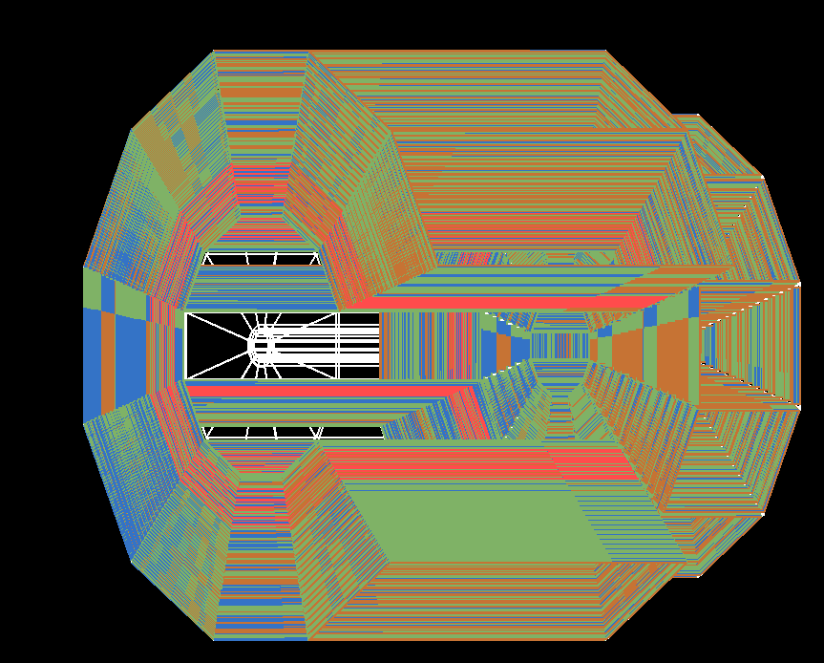
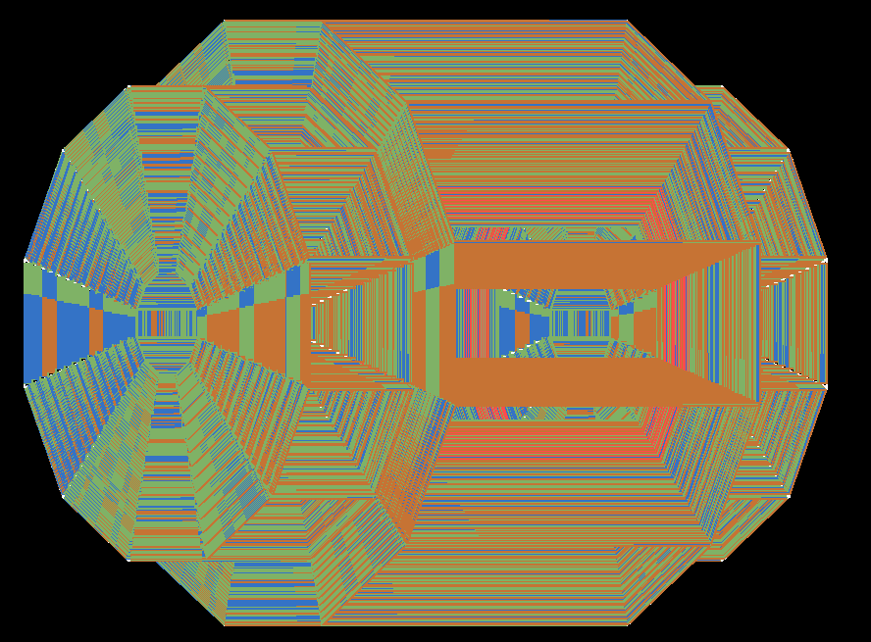
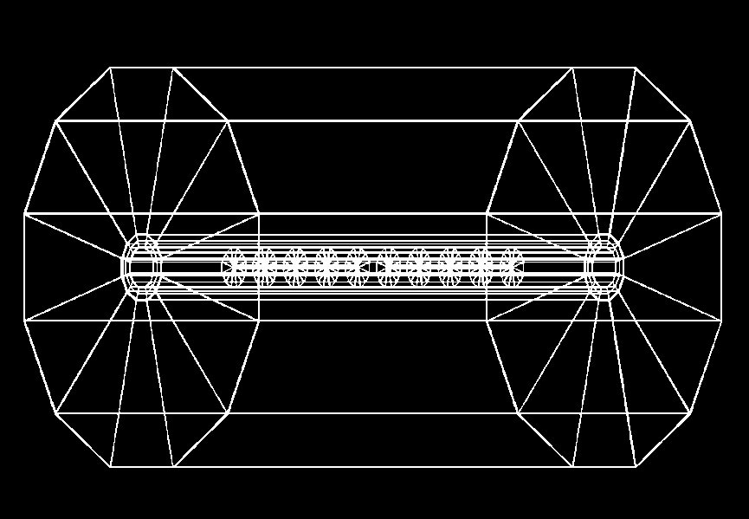
REDTOP detector
2.4 m
1.5 m
2.7 m
1 m

Slide 13
Changes - Issues – R&D required
ADRIANO -> ADRIANO2 (new)
  Add tiles directly coupled to SIPM
  DOE proposal submitted
Sensors of OTPC
  Need to sustain >10 ¹¹ n/cm ² (NEQ)
  LAPPD as possible choice (INCOM is the key)
Trigger
  Need to recognize Cerenkov rings at L1
  L0 from topological analysis of showers (PFA)
Fiber tracker - LHCb style (new)
  Radiation damage
Accelerator Physics Issues
  Transition Energy
  Resonant Extraction
  Vacuum

Slide 14
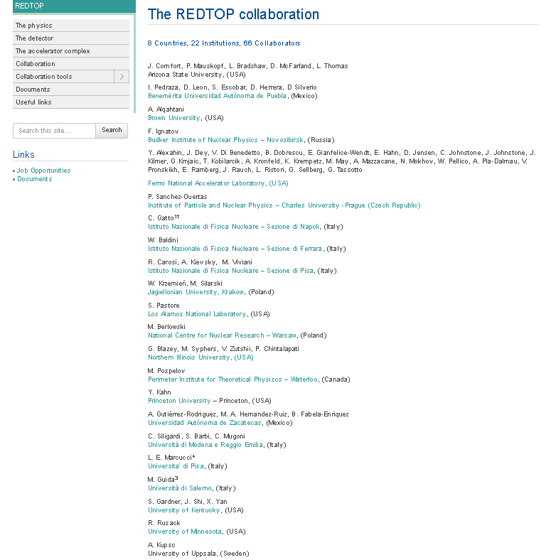
More details at: http://redtop.fnal.gov

Slide 15
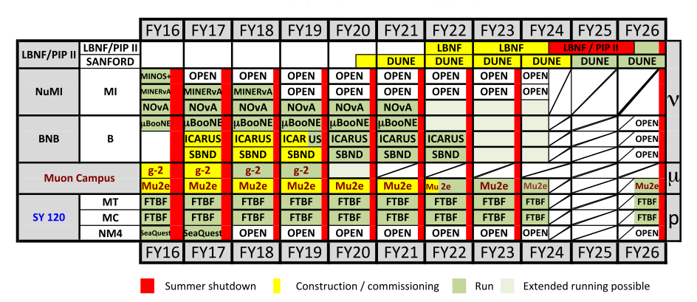
Status and Plans
Nov. 2017: EOI to PAC (Fermilab for now)
CY 2018-2019 : LOI + proposal to PAC (Fermilab for now)
CY 2018-2020: Detector R&D (could be shorter)
CY 2021: Detector construction + engineering run
CY 2022: Start physics run for Phase-I
Successive phases contingent to results of phase I, occupancy of the experimental hall and of the beam
REDTOP

Slide 16
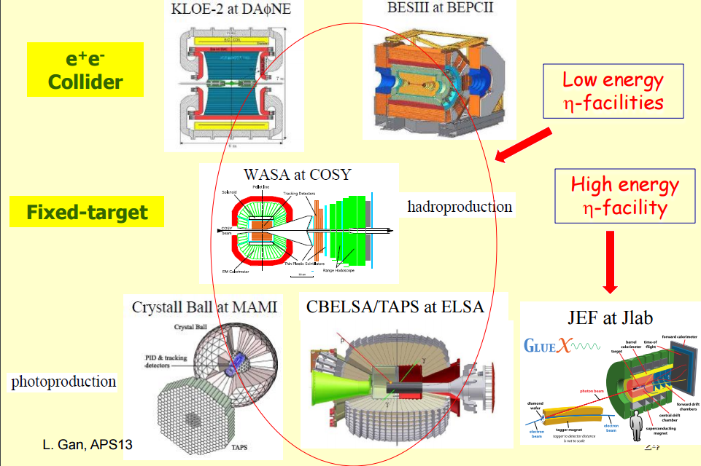
REDTOP Competitors
Notes:
Recent results from the CBELSA/TAPS experiment: barion spectroscopy experiement via photoproduction

Slide 17
Backup slides

Slide 18
REDTOP Running Phases
Phase I: η-factory. Goal is 2.5 x 10¹³ η /yr
  T_{beam}: 1.8-2.1 GeV
  Power: 30 W
  Target: 10 x 0.33 mm Be
Phase II: η ’-factory. Goal is ~ 10¹¹ η’ /yr
  T_{beam}: 3.5-4.5 GeV (to be optimized)
  Power: 60 W
  Target: 10 x 0.33 mm Be
Phase III: Dark photons radiating form muons. Goal is > 1.0 ×10¹³ μ/yr
  (G. Krnjaic and Y. Kahn)
  T_{beam}: 1< <3 GeV (to be optimized)
  Target: H2 gas
Phase IV: Muon Scattering Experiment. Goal is > 2.0 ×10¹² μ/yr
  T_{beam}: 0.2< <0.8 GeV (to be optimized)
  Muon muon yield: >1.6 ×10⁻⁸ μ/p
  Target: 1 x 100 mm graphite
Phase V: tagged REDTOP. Goal is > 2.0 ×10¹³ η/yr
  T_{beam}: 1.2 GeV (to be optimized) at PIP-II
  Muon muon yield: >1.6 ×10⁻⁸ μ/p
  Target: tritium
Phase VI: Rare Kaon Decays: K⁺ → π ⁺ ν ν Goal is > 1×10¹⁴ ΚΟΤ/yr
  T_{beam}: K⁺ from 8 GeV protons
  K⁺/π yield: 1 /13 (neglecting very soft pions – factor 1.8 better than p@92 GeV)
  Target: primary (PT: for K production) + secondary (active: scintillating plastics)
It could be made unnecessary by NA62+ and JPARC

Slide 19
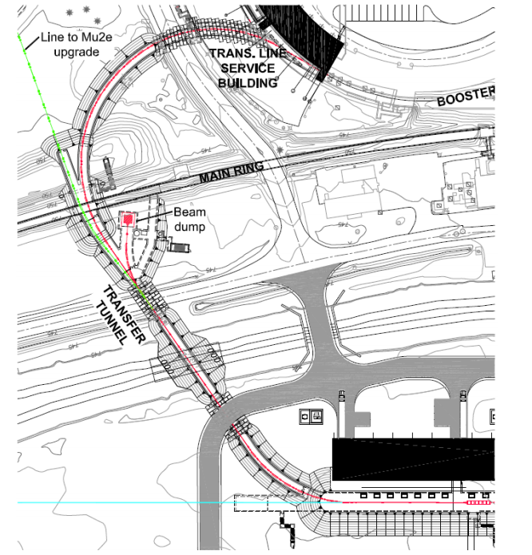
Tagged REDTOP at PIP-II
The ultimate eta factory

Slide 20
Final Considerations
REDTOP physics case is strongly supported by theorists
A new accelerator facility available at hosting lab:
  an energy-variable, CW beam [1.8-8 GeV]
Pre-PIP II detector: will shape the way for a new generation of experiments
  All-new technology detectors
Multiple years running plan:
  Run I: 1.8 GeV beam for η –factory
  Run II: 3.5-4.5 GeV for η’ –factory (after mu2e or before if time slot available)
  Run III: with muon beam for a muon scattering experiment
  Run IV: kaon beam for rare kaons decays studies
Attractive to Universities and graduate students for quick physics and considerable detector R&D
Total cost: < 40 M$ (depending on re-use of existing infra-structure)

Slide 21
Summary & Prospects (I)
The η meson is a fantastic laboratory for studying rare processes
Existing world sample not sufficient for breaching into decays violating conservation laws
REDTOP goal is to produce >2 x 10¹³ η mesons/yr in phase I
Three more phases could extend the lifetime of the experiment considerably
Three golden processes will be studied:
  CP Violation via Dalitz plot mirror asymmetry: η → π^{ο} π⁺π⁻
  Dark photon searches (charged channel): η → γ A’ with A’→ e⁺e⁻ and A’→μ⁺μ⁻
  New baryonic force searches (charged channel): η → γ X with X→ e⁺e⁻
  Scalar meson searches (charged channel): η → π^{ο} Η with H→e⁺e⁻ and H→μ⁺μ⁻
Many other processes also within reach
Fermilab is strongly preferred by the collaboration as hosting lab. BNL has, also, expressed considerable interest

Slide 22
REDTOP Key Points
  The experiment will yield 2 x 10¹³ η mesons/year and 2 x 10¹¹ η’ mesons/year
  That is a consequence of the relatively large η production cross section (10-20 mbar in the 2 GeV beam energy region)
  Requires a detector blind to protons and slow charged pions
  4π-detector can be used with beams of different energy and/or particles

Slide 23
Why the η meson is special?
It is a Goldstone boson
It is an eigenstate of the C, P, CP and G operators (very rare in nature): I^{G} J^{PC} =0⁺ 0⁻⁺
All its additive quantum numbers are zero
All its possible strong decays are forbidden in lowest order by P and CP invariance, G-parity conservation and isospin and charge symmetry invariance.
EM decays are forbidden in lowest order by C invariance and angular momentum conservation
The η decays are flavor-conserving reactions
Symmetry constrains its QCD dynamics
It can be used to test C and CP invariance.
Its decays are not influenced by a change of flavor (as in K decays) and violations are “pure”
It is a very narrow state (Γ_{η}=1.3 KeV vs Γ_{ρ}=149 MeV)
Contributions from higher orders are enhanced by a factor of ~100,000
Excellent for testing invariances
Decays are free of SM backgrounds for new physics search
η is an excellent laboratory to search for physics Beyond Standard Model

