Slide 1
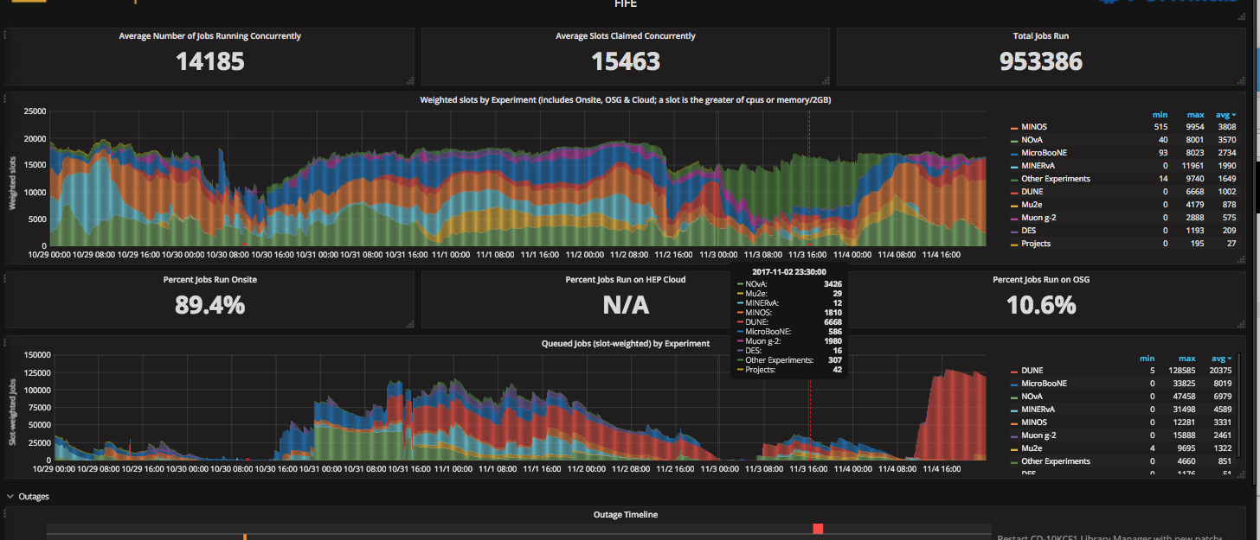
FIFE Operations (combined offsite and onsite)
https://fifemon.fnal.gov/monitor/dashboard/db/scd-summary-fife

Slide 2
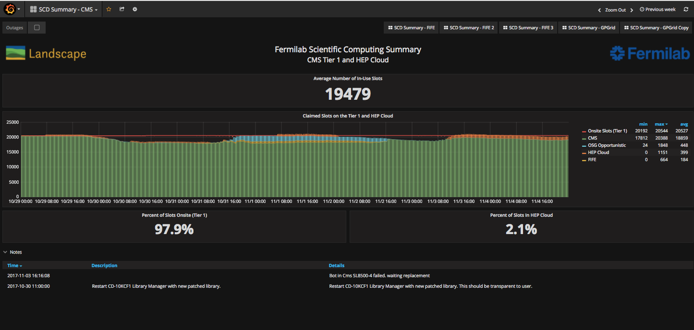
CMS Operations
https://fifemon-pp.fnal.gov/dashboard/db/scd-summary-cms

