Slide 1
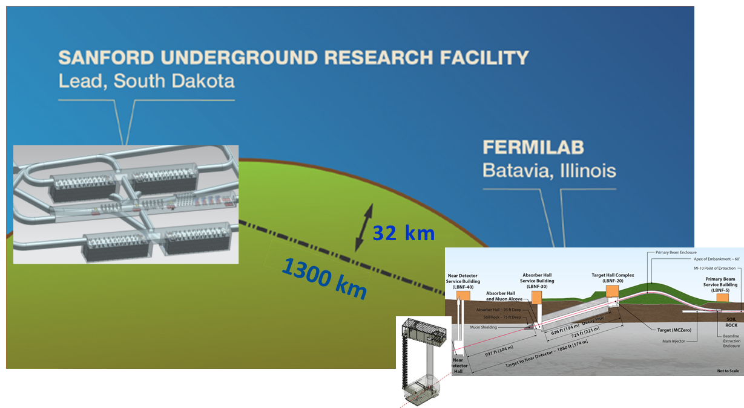
LBNC Report to the PAC
David MacFarlane,
LBNC Chair
Nov 16, 2017

Slide 2
Scope and membership
Scope includes scientific, technical and managerial decisions/preparations of the experiment & facility
Formal charge under discussion with Nigel
Provides continuous oversight, reports to Fermilab Director
Chair, David MacFarlane (SLAC)
Sampa Bhadra (York)
Amber Boehnlein (JLab)
Joel Fuerst (ANL)
Beate Heinemann (DESY)
Patrick Huber (Virginia Tech)
Christiano Galbiati (Princeton)
Peter Jenni (CERN)
Arkadiy Klebaner (FNAL)
Bob Laxdal (TRIUMF)
Mike Lindgren (FNAL)
Ted Lui (FNAL)
Naba Mondal (TIFR)
Jocelyn Monroe (Royal Holloway)
Marco Pallavicini (Genova)
Kevin Pitts (UIUC)
Jimmy Proudfoot (ANL)
Kem Robinson (LBNL)
Nigel Smith (SNOLAB)

Slide 3
Recent modality: established 10 referee subgroups
Move to 3 face-to-face meetings per year:
  March 23-25, 2017 at Fermilab
  June 22-24, 2017 at CERN
  Oct 26-28, 2017 at SURF
Between meetings, referee groups keep up-to-date through regular contact with LBNF/DUNE POCs
  Develop and sustain a high level of referee familiarity and understanding of the assigned systems(s)
  Provide follow-up and/or progress reports on intermediate time scales for issues identified during regular LBNC reviews
  Facilitate preparation for regular LBNC reviews, such as advance discussion of draft documents and development of agendas and focal topics

Slide 4
Feedback and highlights from recent reviews:
June 21-24 meeting at CERN:
  Produced a 30-page written report, final version provided to Fermilab PAC
Oct 26-28 meeting at SURF
  Produced an analogous 29-page written report
  Both organized around referee groups with findings, comments, and recommendations
  Executive summary provides a broad overview and highlights main comments and recommendations

Slide 5
LBNF and DUNE are progressing rapidly.
July 21, 2017: LBNF/DUNE groundbreaking in South Dakota, attended by representatives from the White House, members of Congress, and international funding agencies
August 9, 2017: Contract awarded to Kiewit/Alberici Joint Venture (KAJV) to begin laying the groundwork for the excavation for LBNF
August 15, 2017: DUNE collaboration welcomes 1,000th member- Vitor Prestes Luzio from Brazil
August 28, 2017: As the two protoDUNE cryostats are nearing completion, the first APA module arrived at CERN and will be installed in November, after testing.
September 20, 2017: UK announces $88M in contributions for LBNF/DUNE

Slide 6
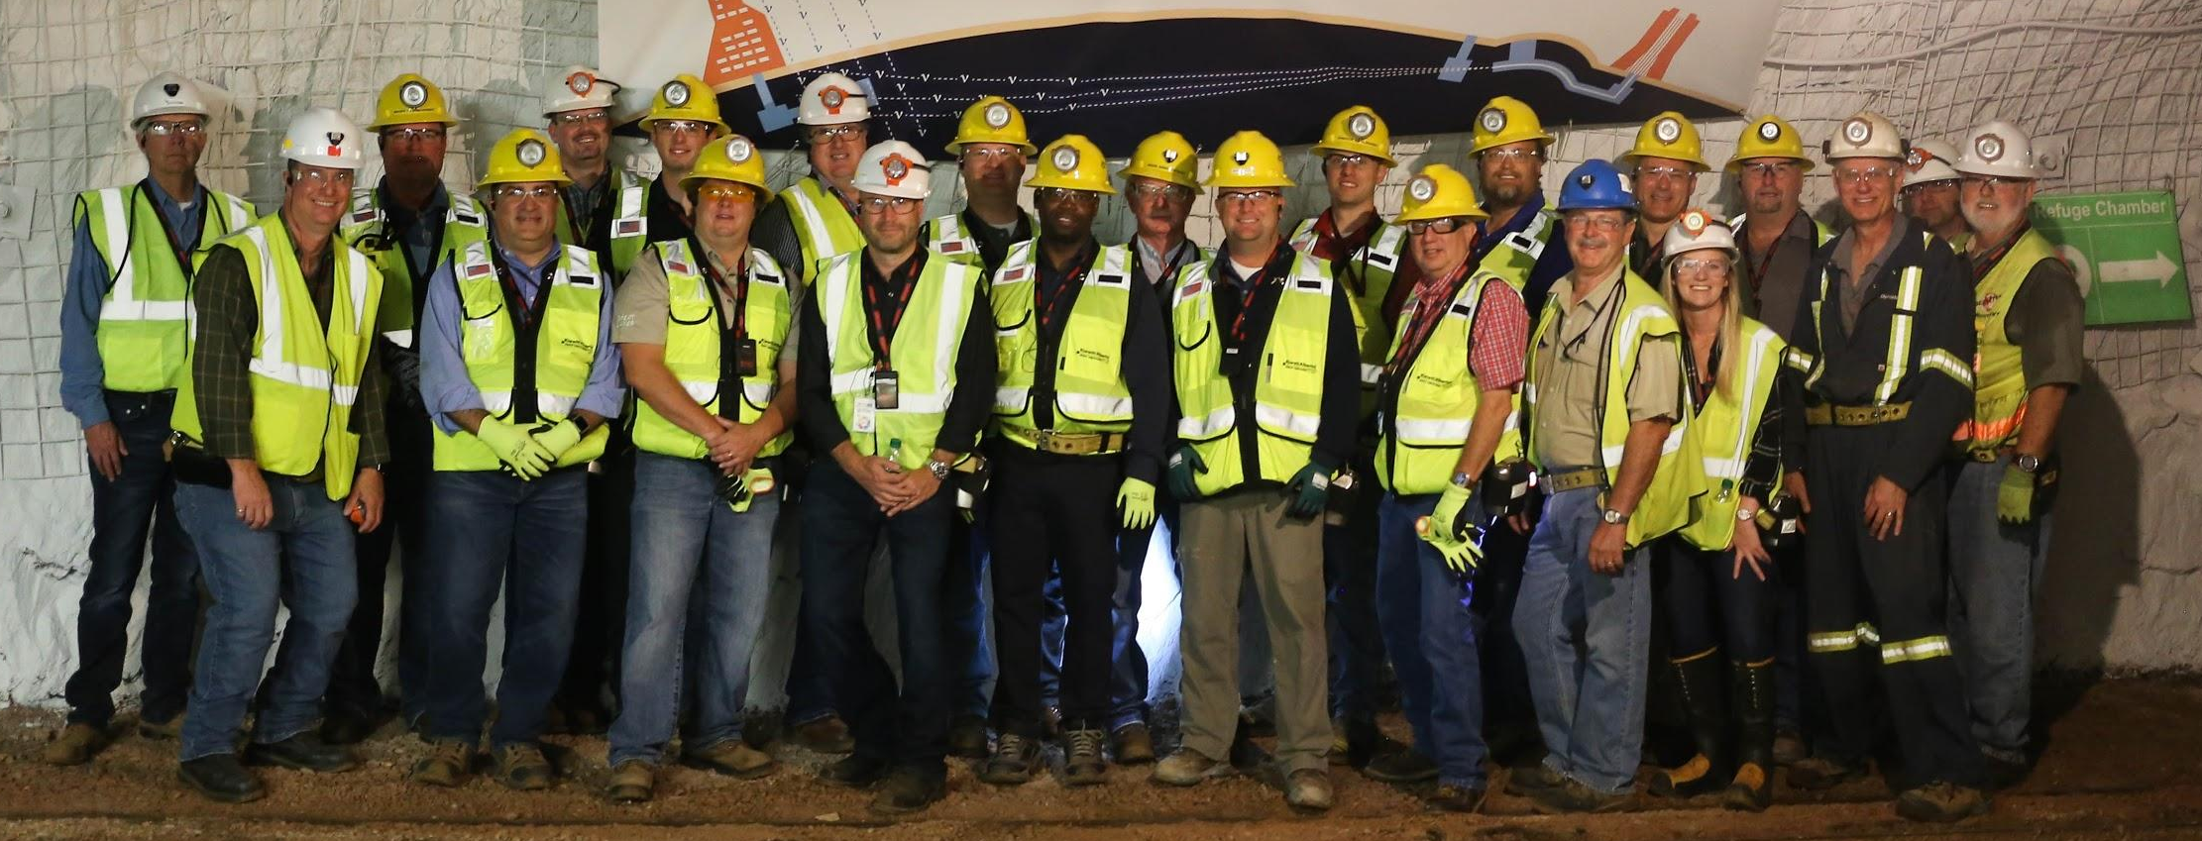
LBNF achievements: CM/GC Contract – Awarded and Authorized to Proceed
9 August – CM/GC contract award to Kiewit/Alberici JV
29/30 August – Kick-off planning meeting held at Sanford Lab
20 September - Notice to Proceed issued

Slide 7
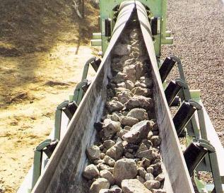
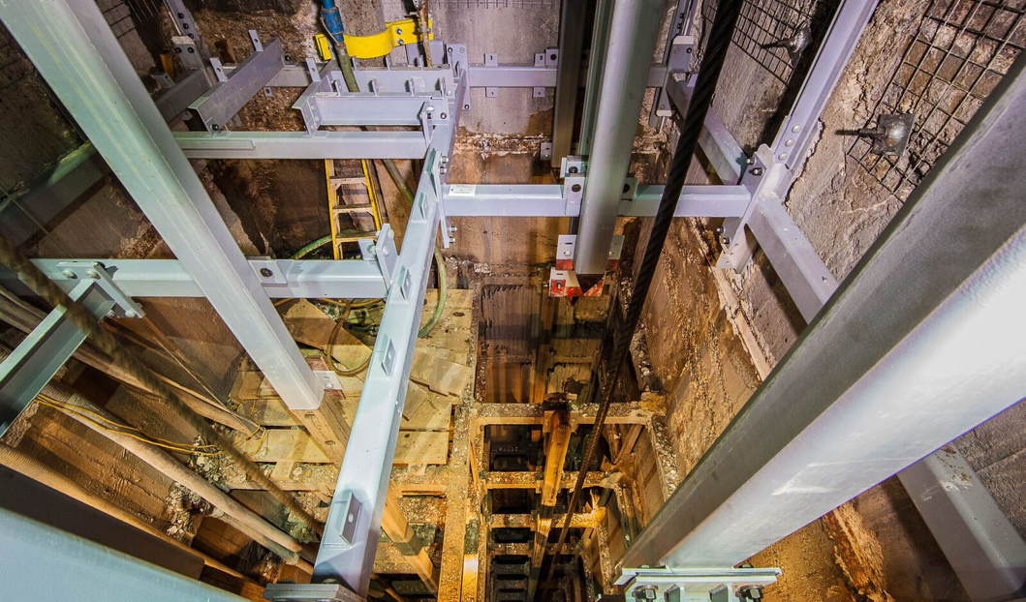
Other LBNF Contracts Progress
Far Site
  16 Jun – Design/Fabricate contract for 1125 meter Rock Conveyor system awarded; on 20 Oct the 50% design was received
  12 Oct - Ross Shaft Renovation: completed to 4850 Level
  24 Oct – LAr “Industry Day” held at Sanford Lab
  Developing acquisition plan for LN2 refrigeration system “design-fabricate-install” contract
  Developing contracts for “reliability” projects for Sanford Lab support systems (see backup for descriptions)
Near Site
  Developing acquisition plan for CM/GC contract to accomplish conventional facilities construction work
Rock Conveyor System
New steel in Ross Shaft

Slide 8
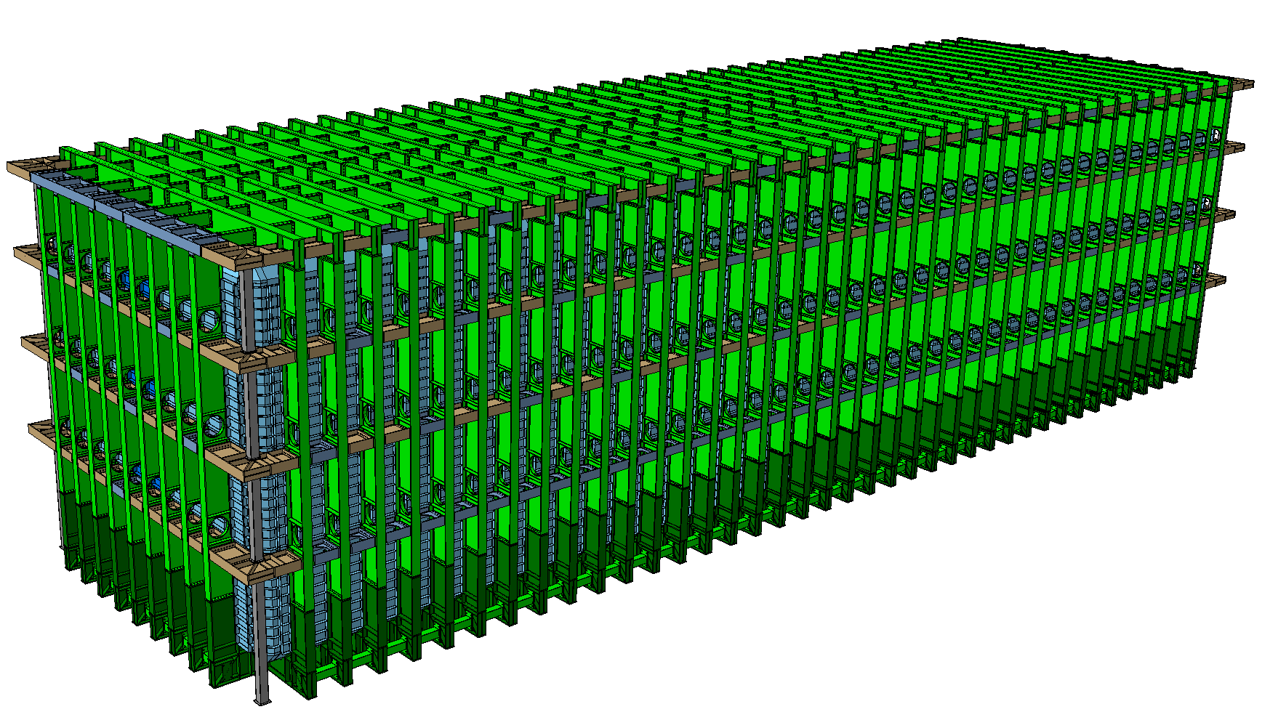
Cryostat Progress
Very successful external review of CERN’s v3 design of steel support structure held on 21-22 August at Sanford Lab
  Improved design simplifies transport of components to 4850L, simplifies and speeds construction, and supports DP and SP LAr TPCs
  LBNF & DUNE have worked to better define penetrations needed for FD and cryogenics
  CERN initiating start of GTT membrane design this fall

Slide 9
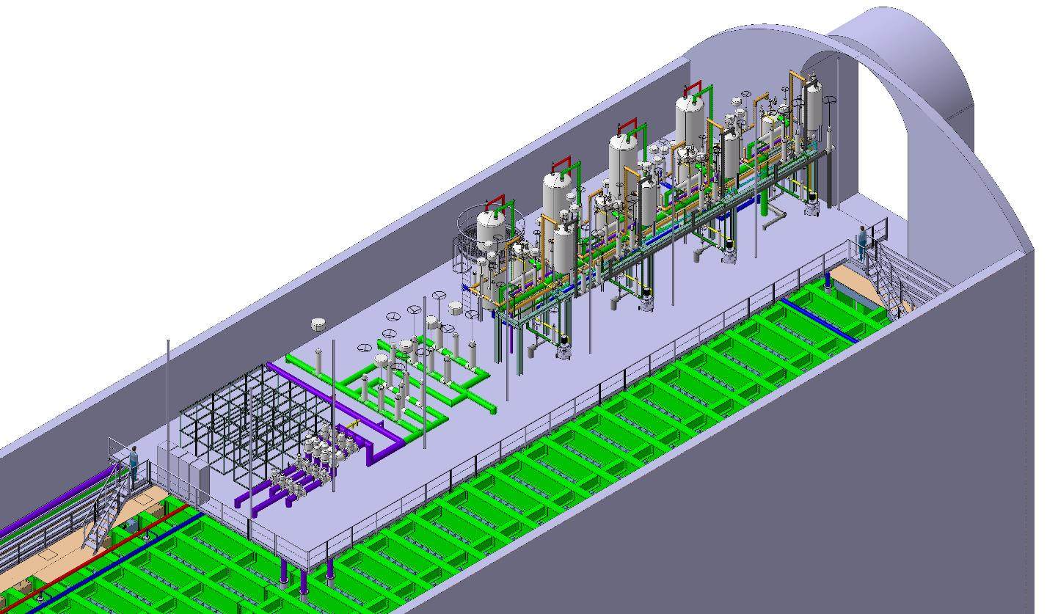
Cryogenic Infrastructure Design Progress
Proximity Cryo on Mezzanine:
  Refining the design to define the size and
  location of the cryostat penetrations
  to inform the cryostat design
  Working with Far Detector and
  CERN on location of penetrations
Central Utility Cavern (location of LAr/GAr Purification skids, LN2 dewars, piping, LN2 cold boxes, etc.):
  Working to prepare a documentation package for LAr Purification #1
  Reviewing the logistics of the largest components (LN2 dewars)
  Identified ways to protect the cryo space/equipment during construction and ops (e.g., bollards)
Internal Cryogenics:
  Verified pipe sizes and started modeling the components. Important to define the vertical location of the detector

Slide 10
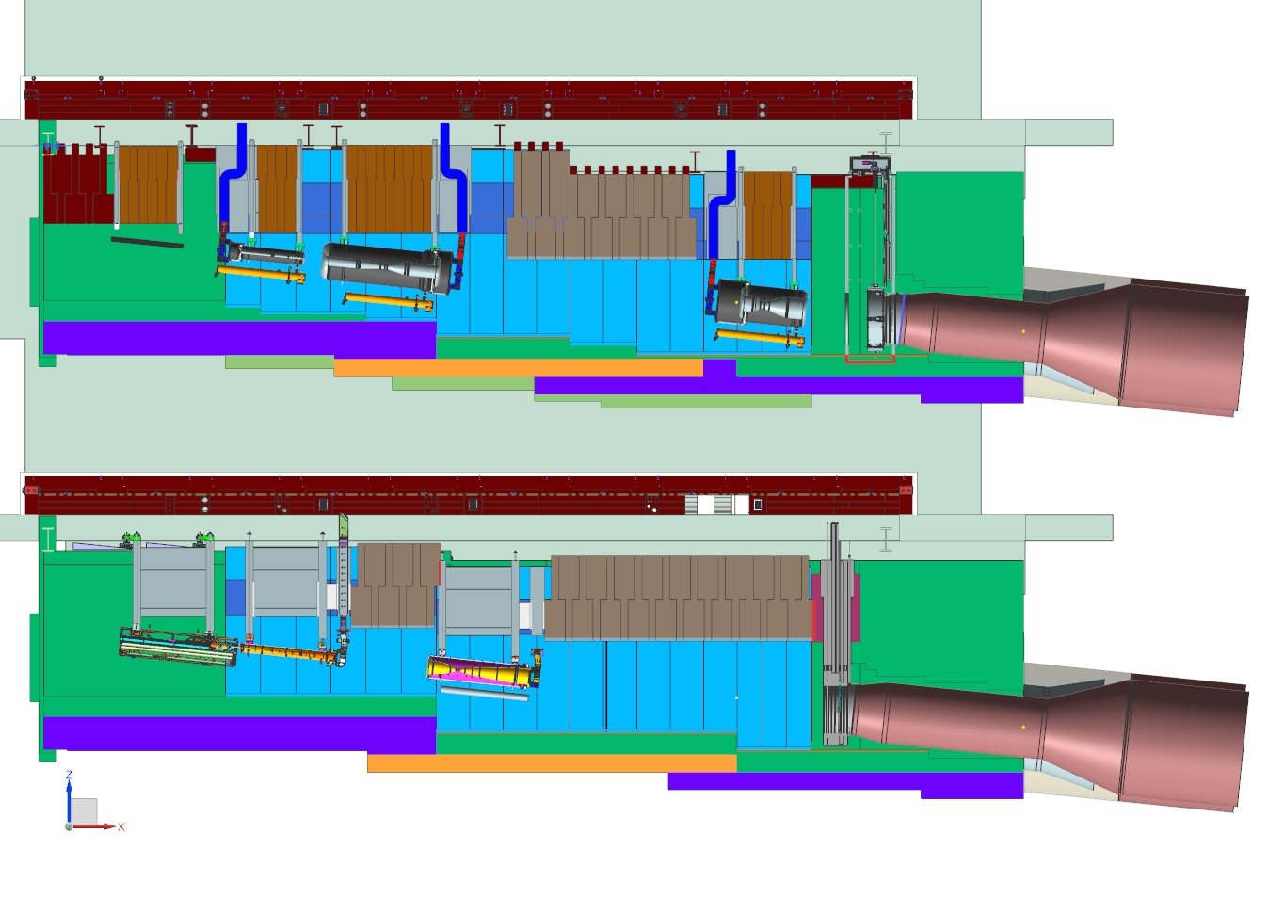
Beamline Optimization Status
Horn A
(w/ Target)
Horn B
Horn C
Upstream Decay Pipe Window
Baffle
Optimized beamline review held 5- 6 October
EFIG review conducted on
1 Nov with recommendation to implement
the optimized design
Beam
Optimized Design
Target
Carriage
Upstream Decay Pipe Window
Horn 1
Horn 2
Reference Design

Slide 11
LBNF Summary
Major contract award achieved – CM/GC – positions project to proceed with >$300M in conventional facilities construction at far site; official ground breaking ceremony held
On track to initiate pre-excavation work in 2018 and major cavern excavation work in 2019
Strong administration, congressional, and DOE support
Project actively managing risk, organizational staffing, and project control systems
Continuing outreach for non-DOE participation

Slide 12
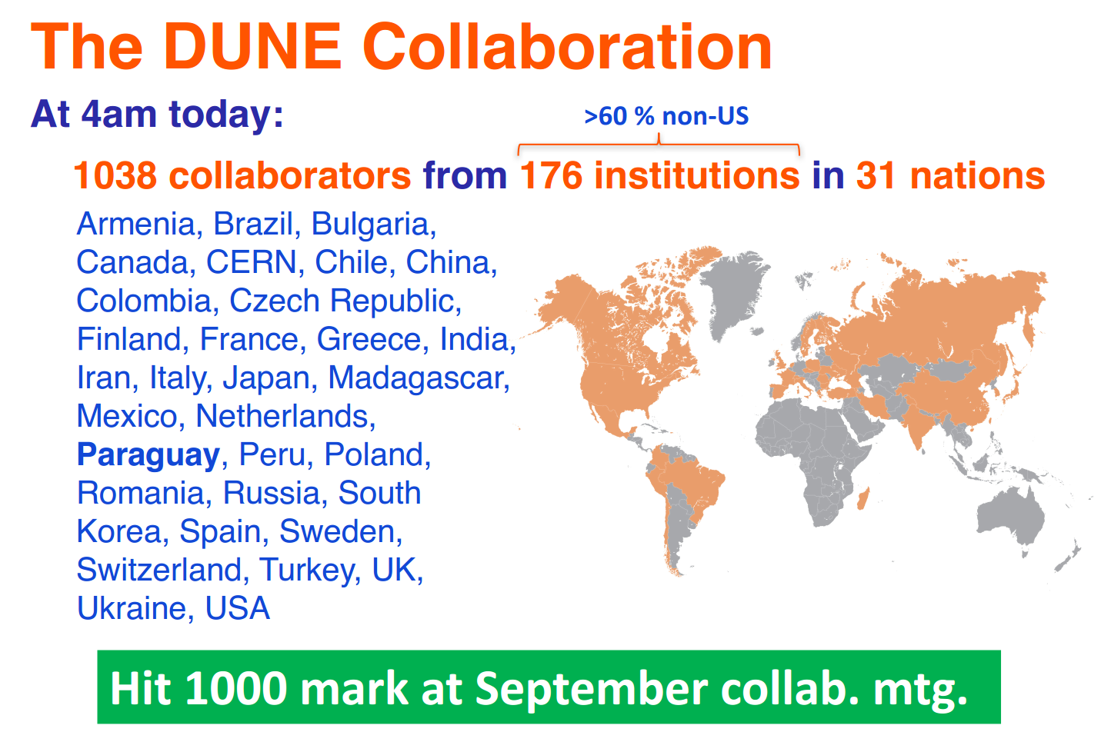
DUNE Achievements

Slide 13
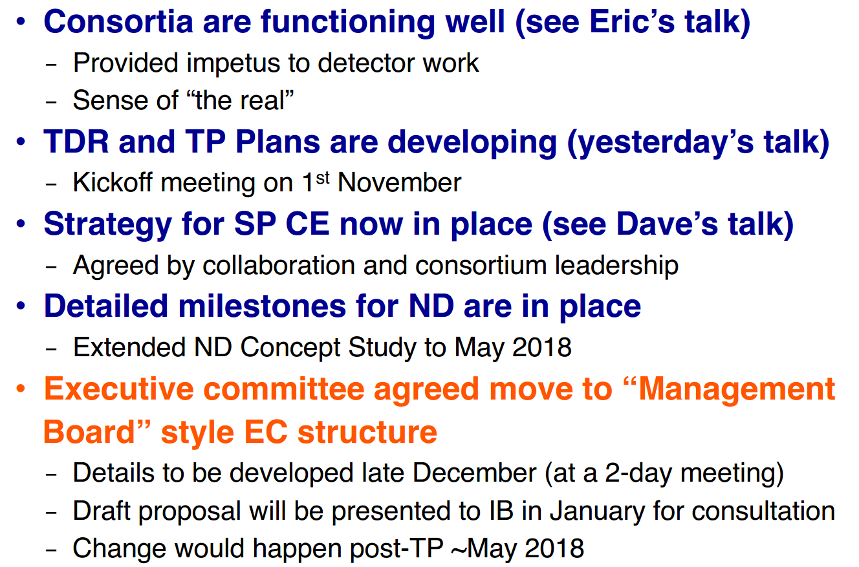
DUNE Achievements

Slide 14
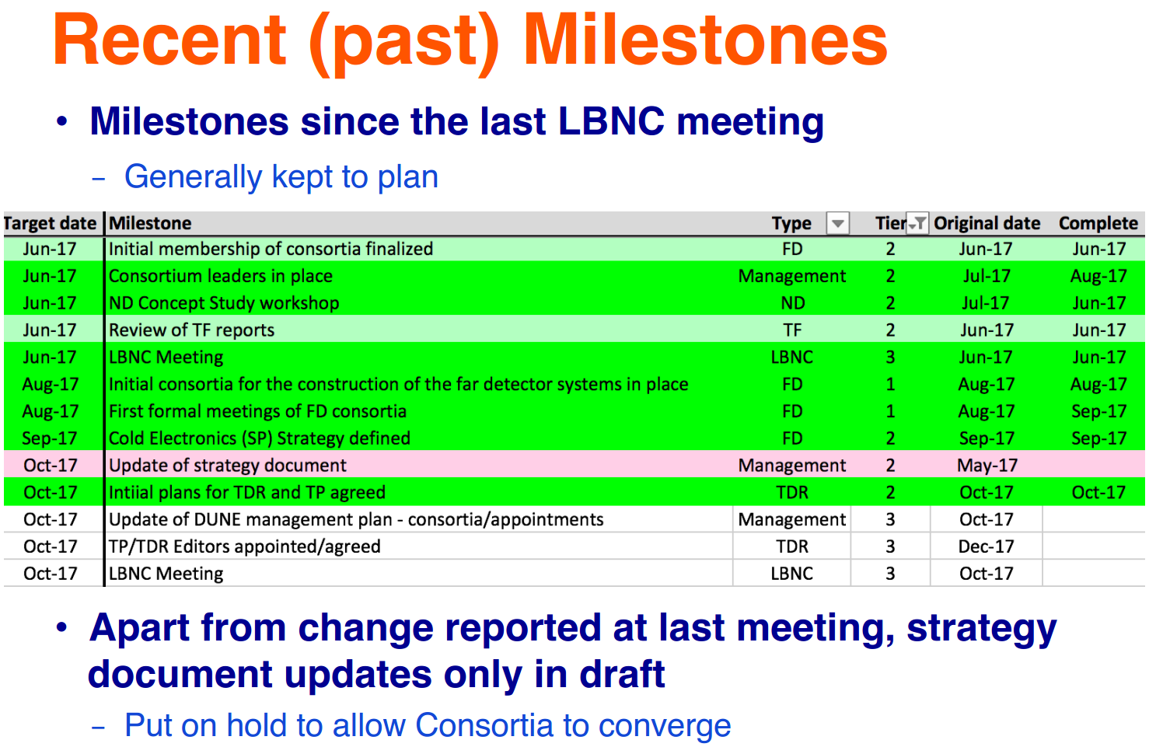
Recent Milestones

Slide 15
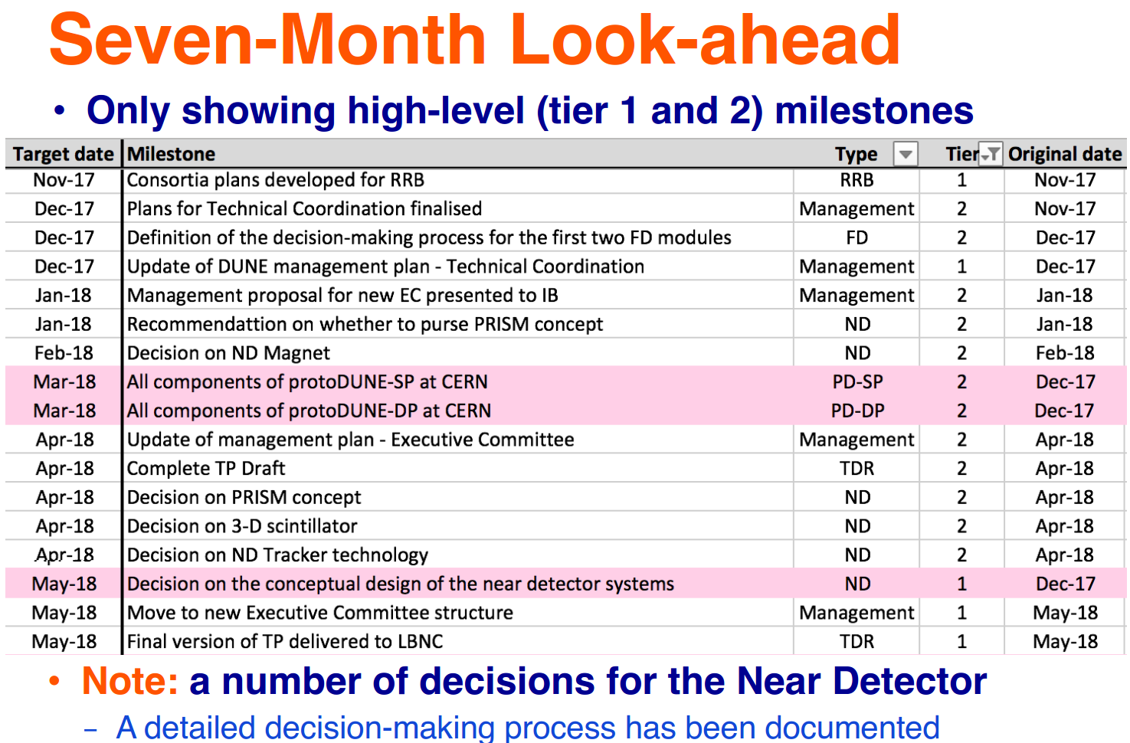
Milestones upcoming

Slide 16
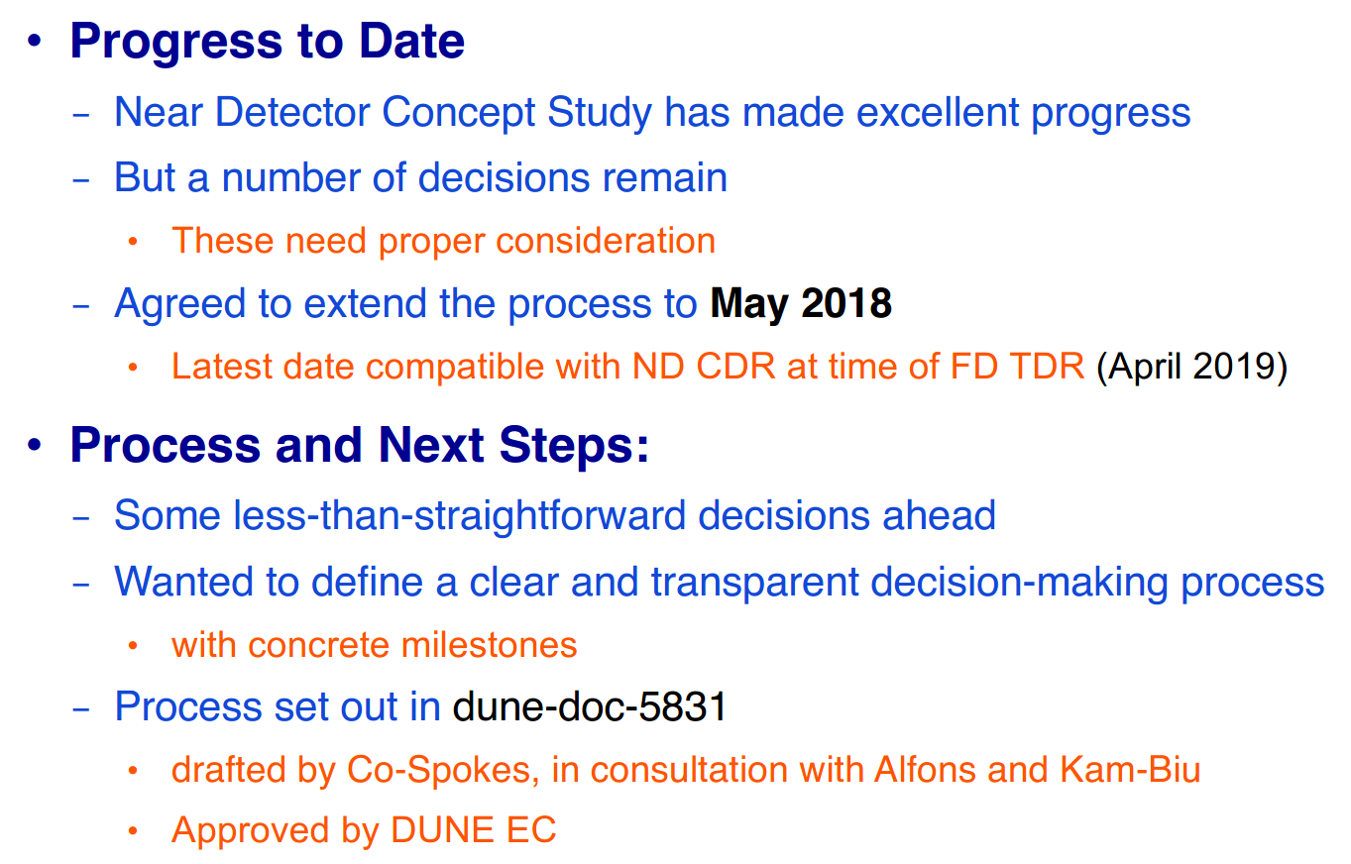
Near detector progress

Slide 17
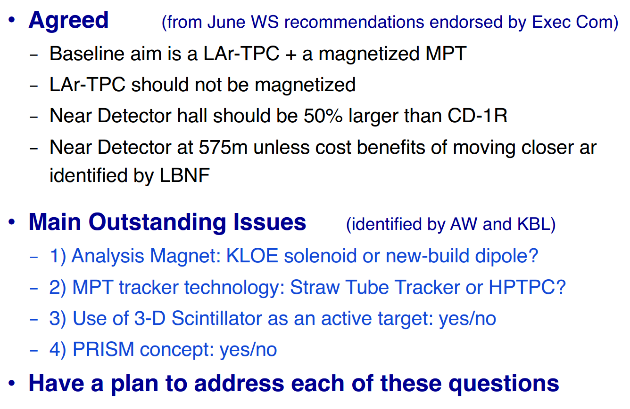
ND: Decision and outstanding issues

Slide 18
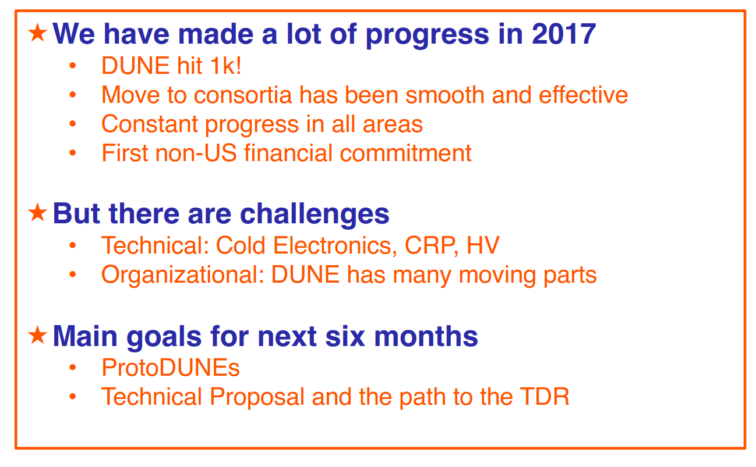
DUNE summary

Slide 19
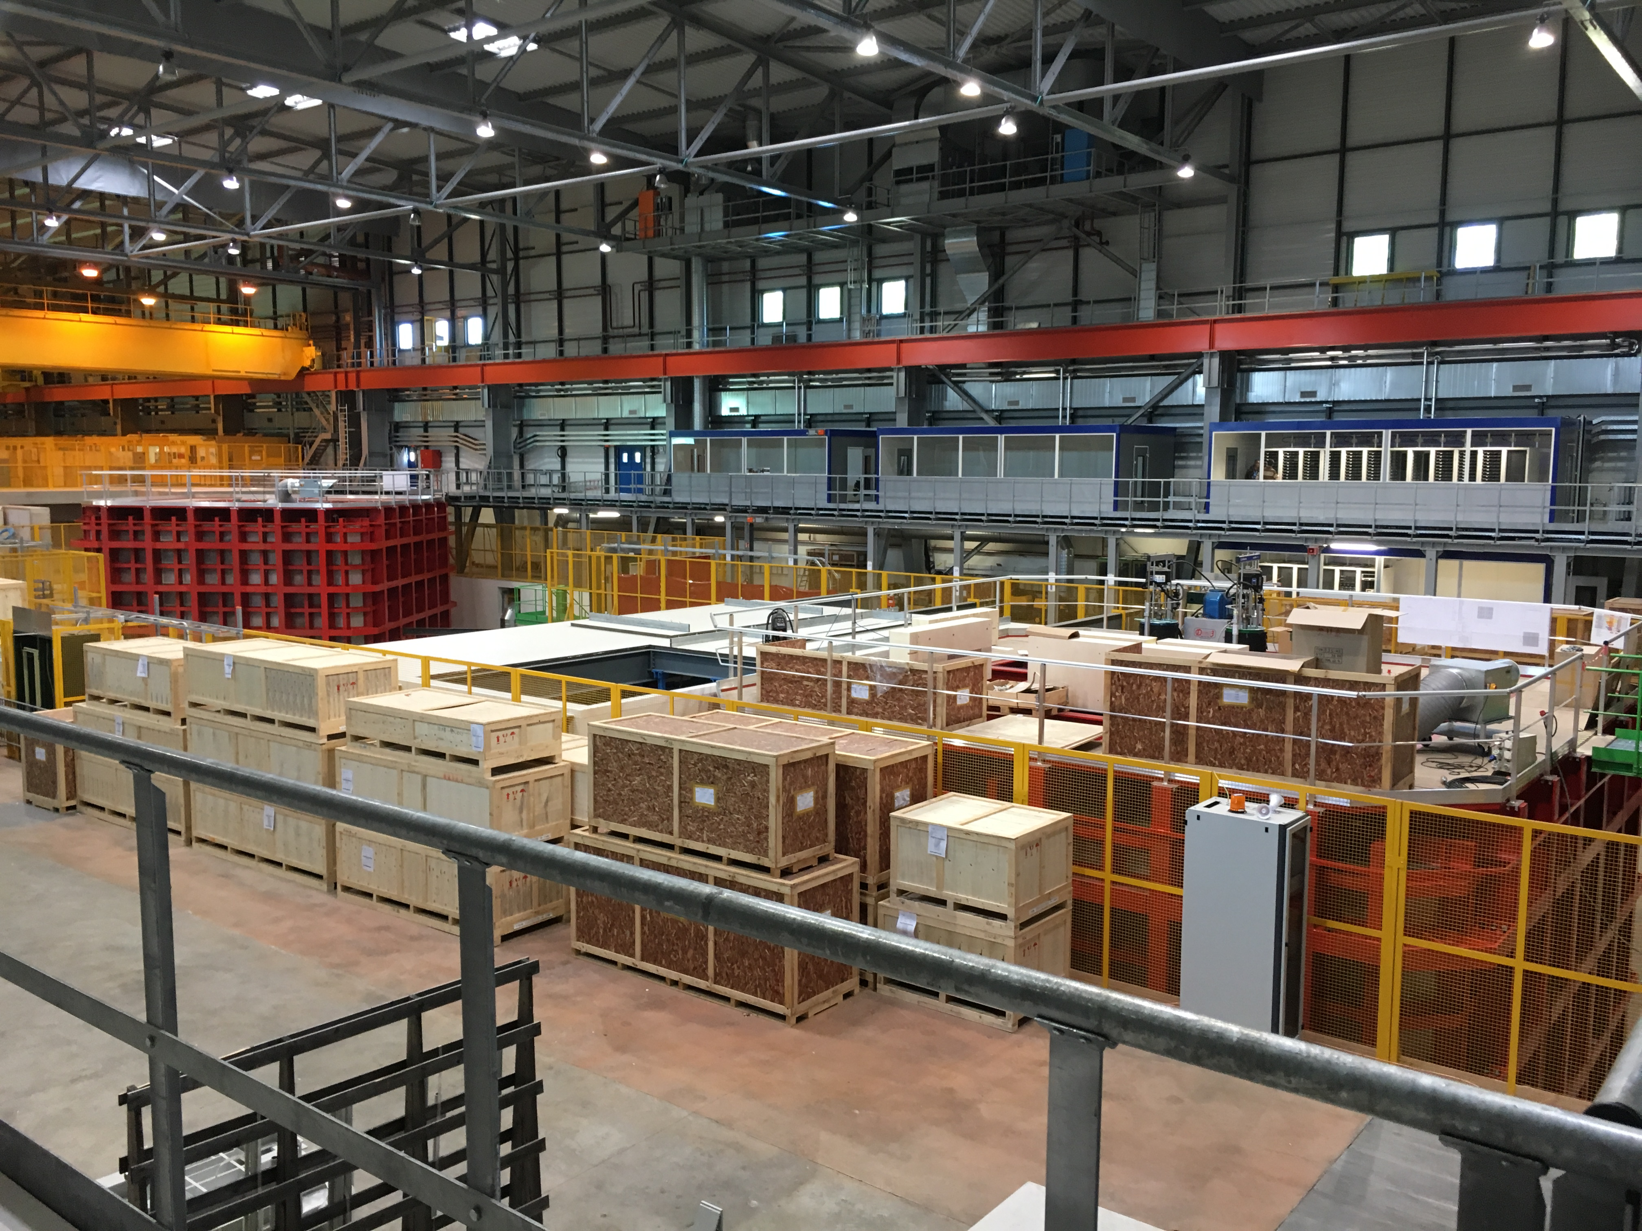
Highlight from June LBNC meeting: Tour of Neutrino Platform
Very impressive progress by CERN, GTT in preparation for protoDUNE:
Cryostat engineering challenges being addressed efficiently and effectively
View of cryostats for protoDUNE-DP (right) and proto-DUNE-SP (left)

Slide 20
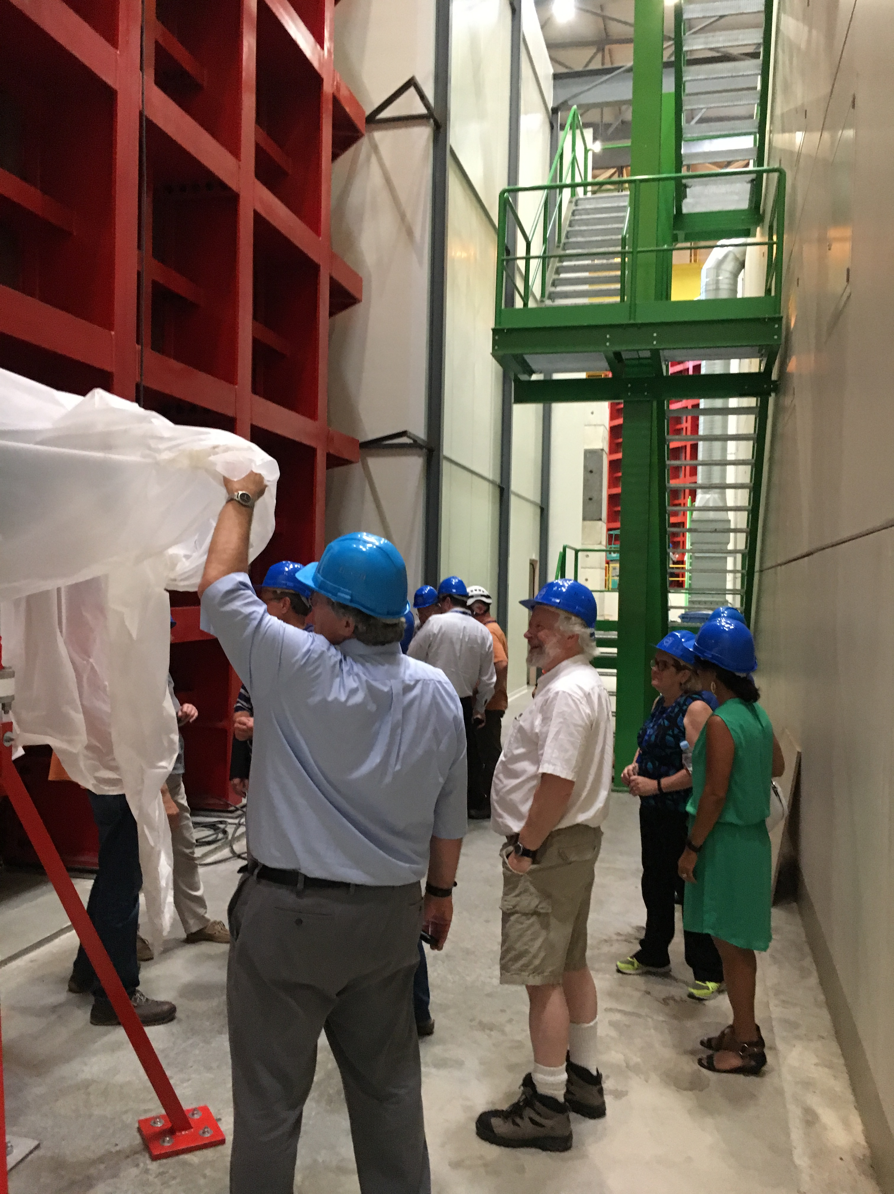
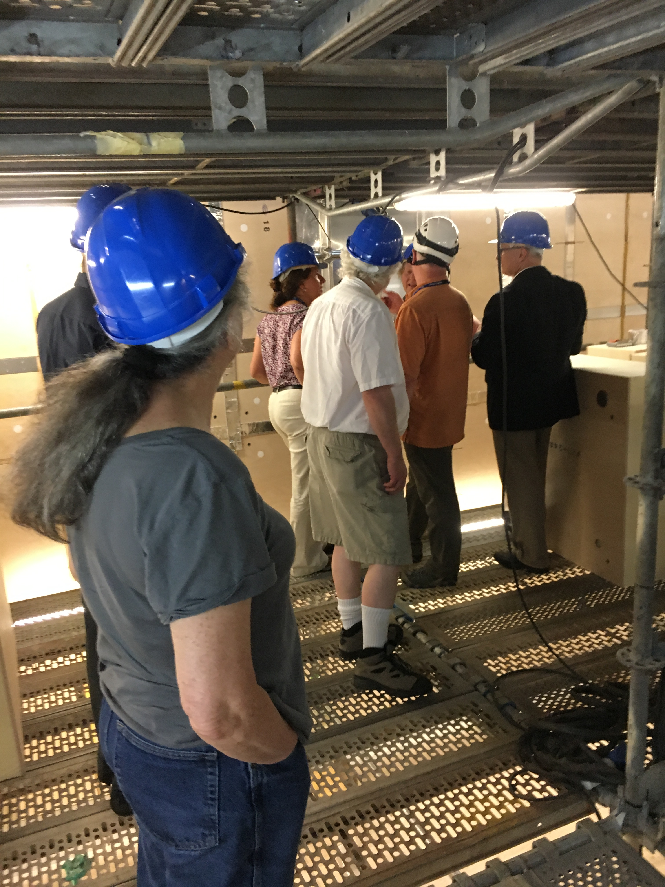
Highlight from June: Tour of Neutrino Platform
Exterior (left) and interior (right) views of proto-DUNE-SP cryostat

Slide 21
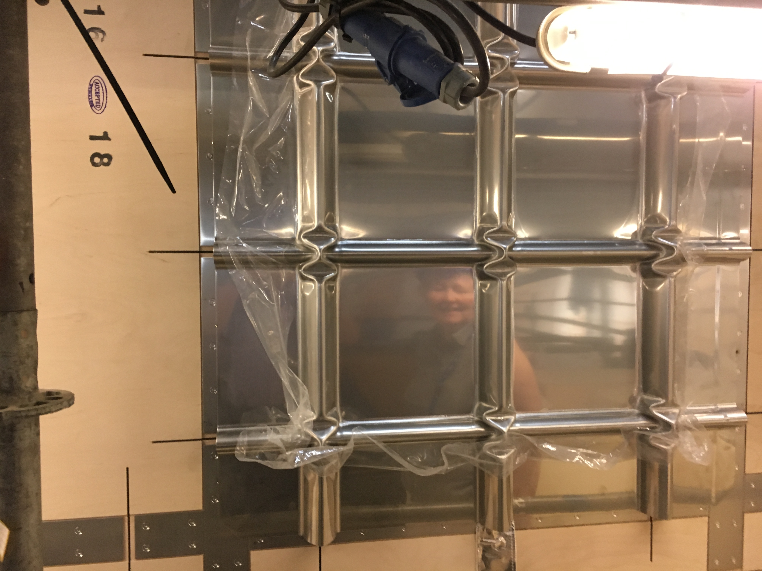
Highlight from June: Tour of Neutrino Platform
Installed portion of membrane on top of insulating panels

Slide 22
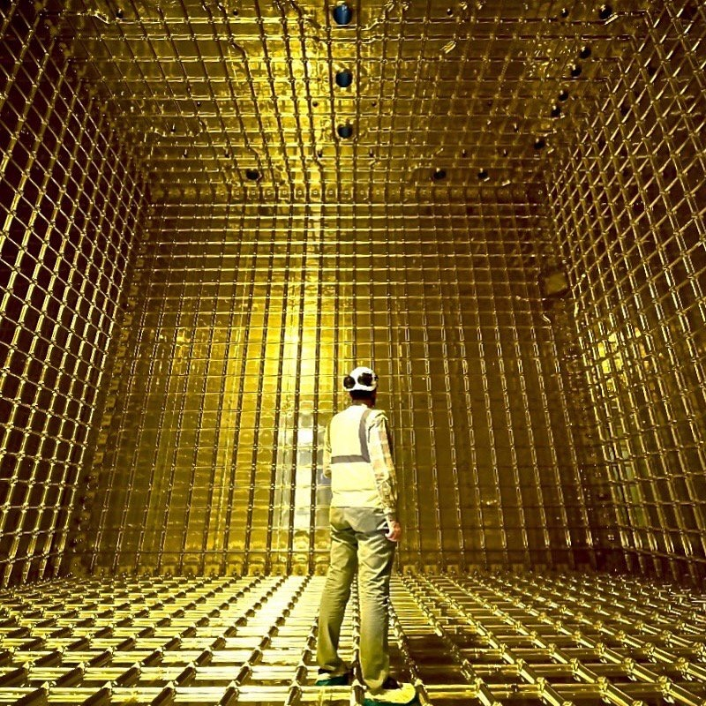
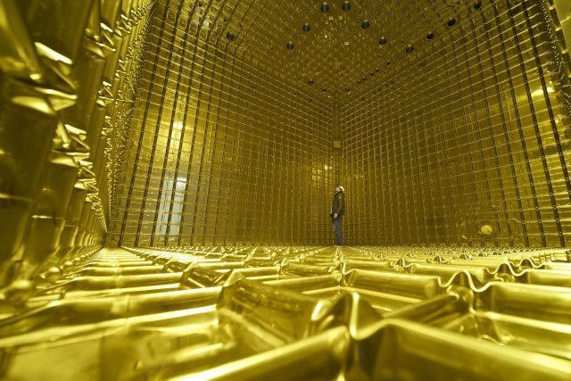
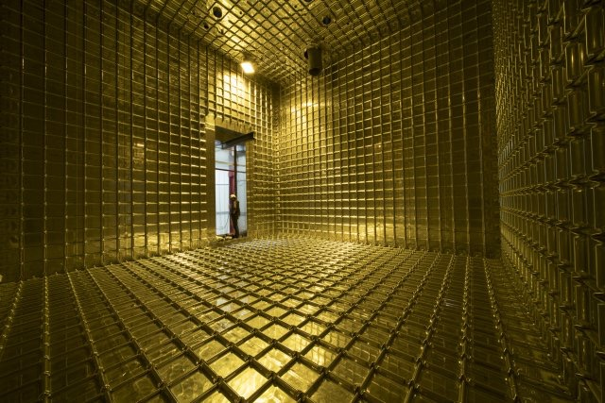
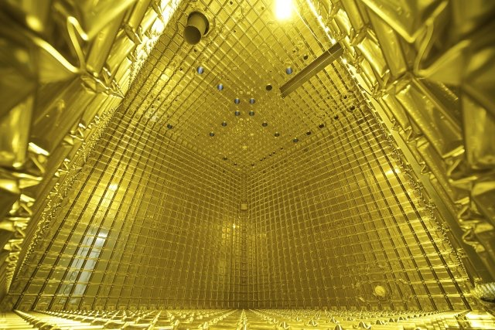
View as of 4 weeks ago

Slide 23
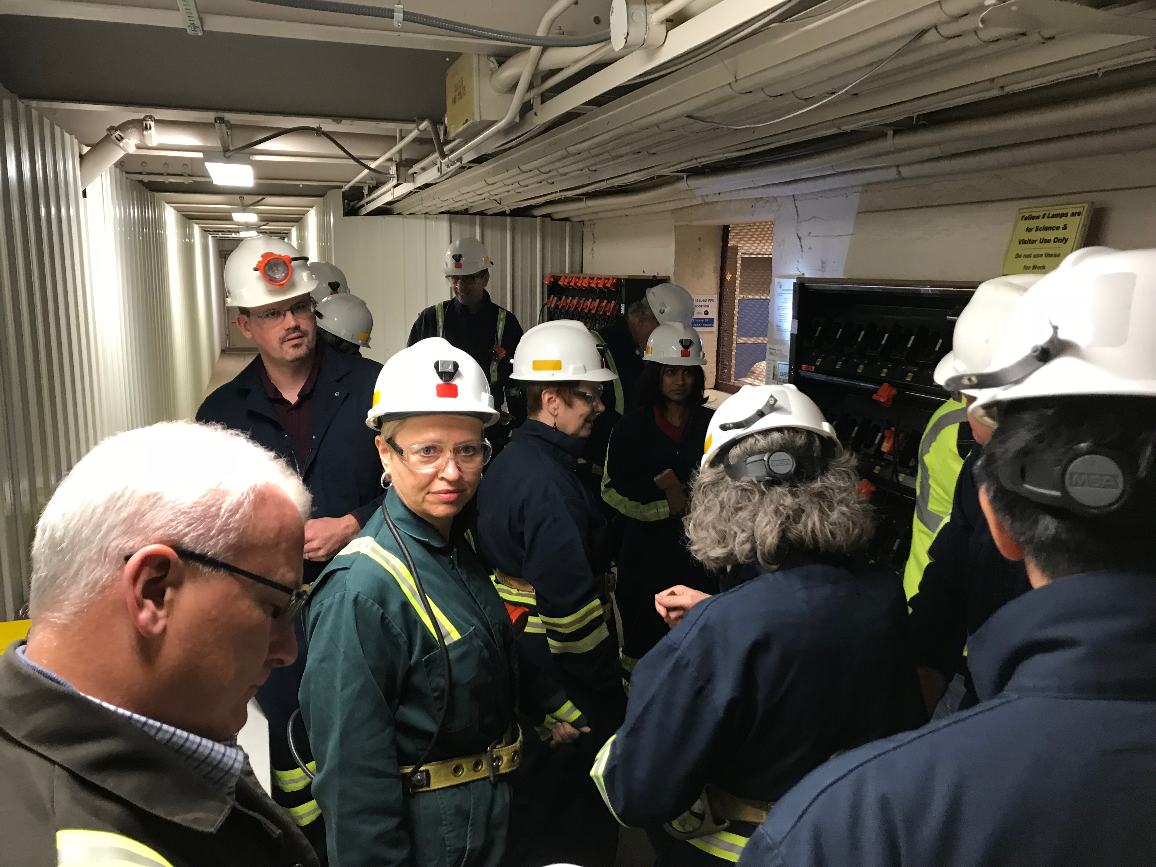
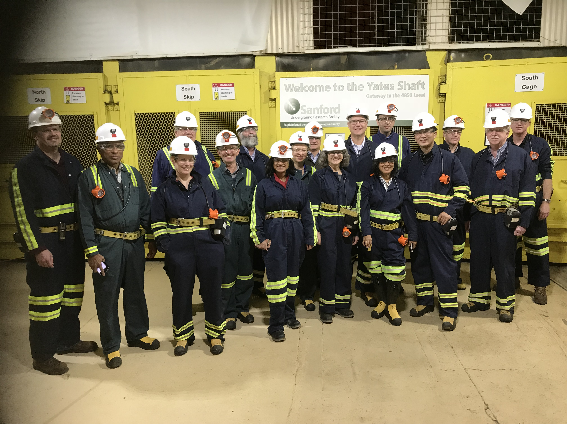
Highlight from October: Tour of 4850L at SURF
Very enlightening tour of SURF facilities: first-hand impressions of building a ship in the bottle down a 1 mile-long straw from the surface
Gearing up with appropriate PPE (left) and ready to enter Yates cage (right)

Slide 24
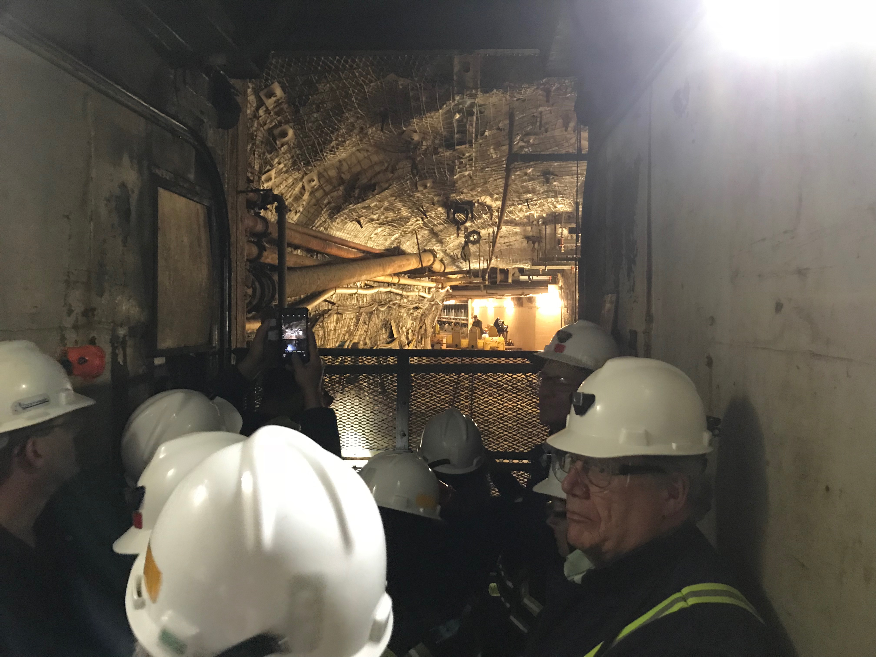
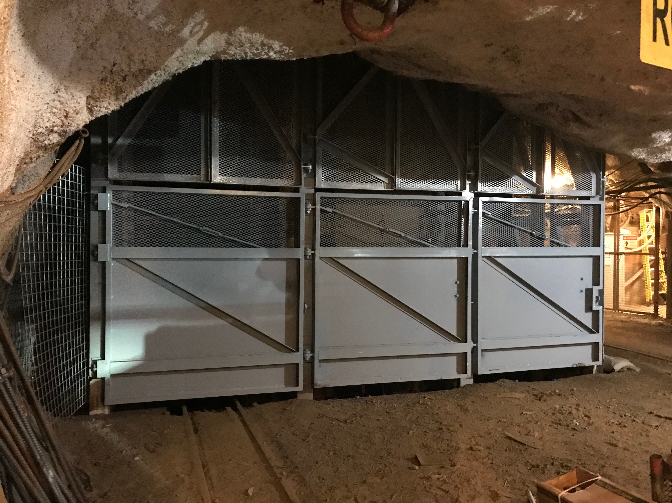
Highlight from October: Tour of Neutrino Platform
Arriving at 4850L (left) and bottom of the refurbished Ross shaft (right)

Slide 25
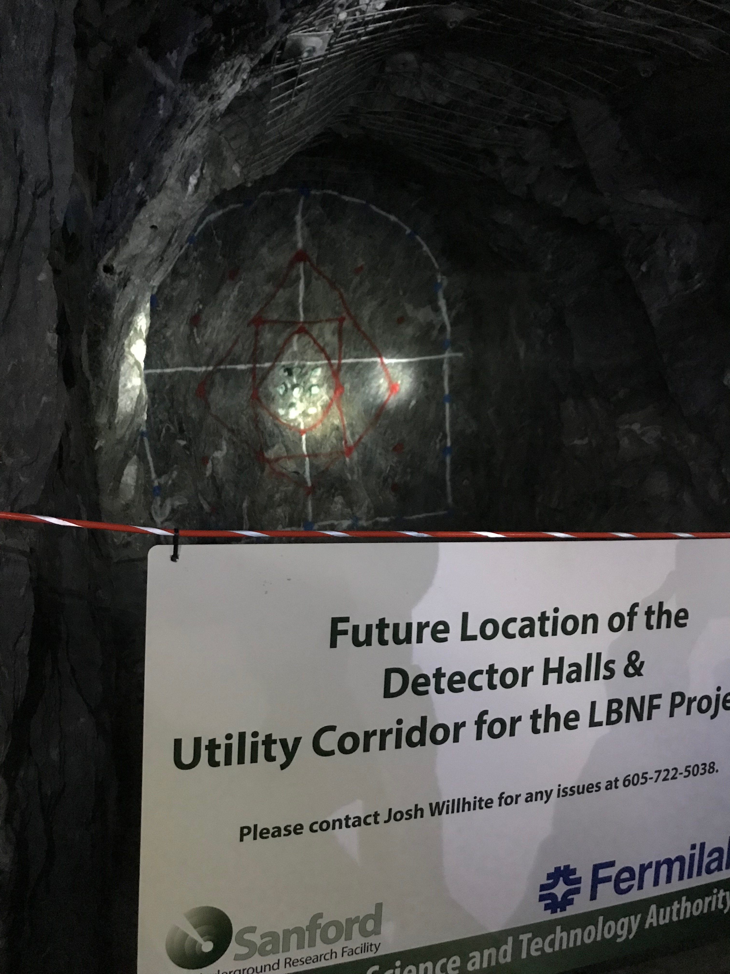
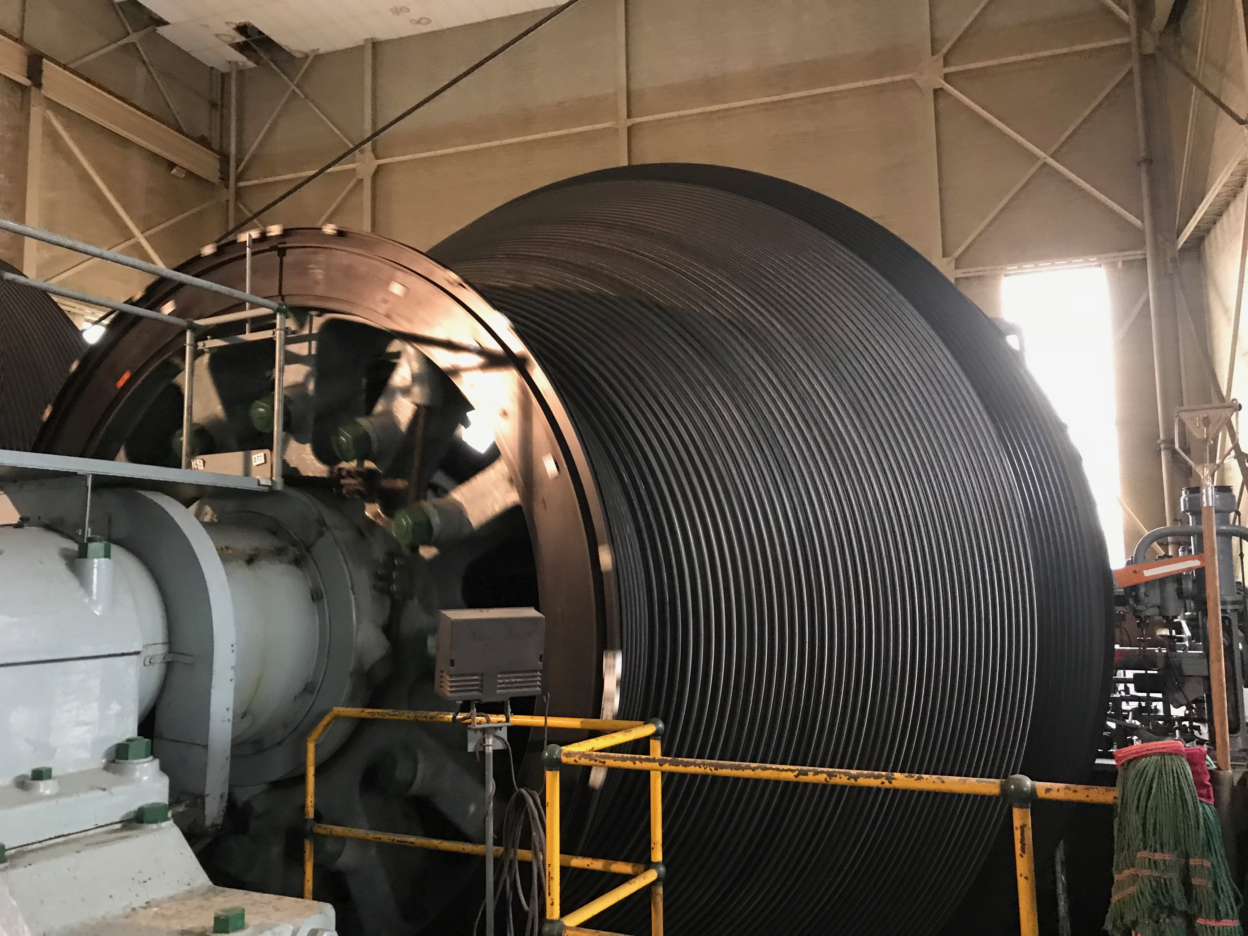
Highlight from October: Test blast site
Blast test site and future home of the DUNE detector hall (left) and inner workings of Yates shaft hoist

Slide 26
Overarching impressions from October: DUNE & LBNF
Very impressed by the significant progress achieved by both LBNF and DUNE since the last LBNC review:
  Conclusion of the Ross shaft steel set refurbishment to the 4850L
  Letting of the CM/GC contract and the imminent start of the conventional facilities final design phase
  Completion of the two protoDUNE cryostats at the Neutrino Platform at CERN
  Delivery of the protoDUNE-SP APA plane #1 (PSL#1) at CERN, installation of photon detectors, testing of the DAQ system with the full assembly installed in the cold box.
  Testing of APA1 at room temperature has shown noise consistent with expectations and testing at cryogenic temperatures is planned to begin the week of Oct 30.

Slide 27
Overarching impressions: DUNE (June to October)
LBNF and DUNE are both making excellent progress
  However, DUNE, as a recently formed major new scientific collaboration, still shows signs of its constituent parts:
    Would benefit from efforts to establish mechanisms to ensure stronger collaboration-wide consensus
    Clearer lines of authority for management and decision making.
Primary recommendations address:
  Need to better understand the overall strategy for the first two far detector modules: Oct: 4 = 2 + 1 + 1 strategy presented
  Enhance coordination between protoDUNE-SP and protoDUNE-DP: Oct: 3 joint consortia between DP & SP
  Launch the DUNE consortia with an eye to the long-term need to maximize efficiency in overlapping areas of detector design

Slide 28
Overarching impressions: DUNE
  Enhance the role of the Executive Committee and Collaboration leadership. Oct: plans to transition to enhanced & empowered EC in May 2018
We also noted that, while it is still early, the demonstration of a working dual phase prototype with WA105, potentially warrants revisiting some aspects of the overall strategy for the DUNE far detector.
  Oct: CERN & WA105 working a planned set of tests to diagnose 1x1x3 HV problems, allowing fixes to be implemented in protoDUNE-DP

Slide 29
Overarching impressions: DUNE
CERN and GTT continue to make progress with demonstrating the membrane cryostat design for DUNE, but experience from the WA105 cryostat points to the protoDUNE cryostats as the critical next engineering step.
  Oct: Completed cryostats with enhanced QC & leak testing during assembly
  Oct: Cryostat commissioning plan being developed
Likewise the electronics system design for the single-phase DUNE design, including the cold electronics components, remains a significant overall concern.
  Oct: Two-pronged development strategy devised, with plans for testing at scale; LBNC requested detailed plan for ADC development, testing & evaluation by Nov 2017

Slide 30
DUNE TP and TDR discussion from October
DUNE presented a plan and detailed outline for TP and TDR.
  LBNC views these plans very ambitious, but agrees that this will allow the Collaboration to maintain full momentum for developing the project in a focused and timely fashion
  Expect detailed construction strategies and schedules for the various components.
  Expect high level risks and mitigation strategies should also be incorporated in these documents.
  Expect clear line of sight between physics and technical requirements

Slide 31
DUNE TP and TDR discussion from October
Recommendations:
  At our next meeting, the LBNC would like to hear a proposed mechanism for documenting the flow down from physics to technical requirements in DUNE, as well as how this will be addressed in the TDR and demonstrated with the protoDUNE test plan.
  There are various algorithms and tools that are being developed for SP and DP. A freeze date for a reference algorithm should be established for producing various physics plots as input for the TDR.
  By February, 2018, develop a list of questions and factors that will influence the computing model, with prioritization of those factors in terms of likely cost and schedule impact.

Slide 32
Overarching impressions: LBNF
LBNF is well placed to execute the far site project once funding becomes available, and are a well organized team with strong risk and project management
  Oct: Accumulating number of procurement, legal, tax, liability and real estate issues may need even more attention than at present
LBNF making good progress on safety code equivalency development for an international project
  Oct: Working to resolve pressure test approach for cryostats

Slide 33
Overarching impressions: LBNF
LBNC strongly encouraged DUNE working with LBNF to re-evaluate whether a common cryostat structure design is possible for both SP and DP detectors
  Oct: Excellent progress on a common design, with reduced number of penetrations for DUNE-DP design, common steel
Need to guard against the schedule pressure impacting key ProtoDUNE technical and quality steps and tests.
  Important to demonstrate performance, reliability, and scientific calibration, but the ProtoDUNEs should be primarily viewed as engineering prototypes.
  Oct: working on a comprehensive commissioning plan for cryostats

Slide 34
Overarching impressions: LBNF
    First time this type of membrane design will be used for a 1/20th scale LAr detector as a prototype for the DUNE cryostat.
Recommendations:
  The LBNC recommends the documentation of a cryogenic testing plan for ProtoDUNE cryogenics including required diagnostics, testing steps and required schedule.
  Oct: The host lab and DOE efforts to resolve numerous legal and procurement challenges at the far site need to further evolve in order to allow timely resolution and achievement of the defined International Project Milestones.

Slide 35
Update on PAC specific actions for LBNC
Incorporating lessons learned, including calibration systems and operational experience, from MicroBooNE into the DUNE TPC design and planning
  [Task force formed, report at next meeting]
Monitor SBN joint analysis development, including identifying milestones and possible agreements between collaborations
  [Upcoming phone report from O.Palamara following joint working meeting]
Test plan and scheduling for cryogenic operations and commissioning of ProtoDUNE-SP and ProtoDUNE-DP cryostats
  [Plenary talk at SURF with follow-up plan]

Slide 36
Update on PAC specific actions for LBNC
Comprehensive strategy for SP electronics system, including an extensive system test program
  [Plenary talk at SURF, follow-up recommendation]
Progress with consortia formation and leadership
  [Plenary talk at SURF]
Update on SBND planning in relation to possible DUNE CE solutions
  [Plenary talk at SURF, SBND adopting COS ADC]
LBNC will closely scrutinize the leadership of consortia, the depth and experience of the partners, and their ability to deal with project risks
  [Monitor through TP/TDR development and guidance]

Slide 37
Update on PAC specific actions for LBNC
Goals for the ProtoDUNE program, including flow-down from physics to specific technical requirements
  [New recommendations for TP]

Slide 38
Summary of planning for TP & TDR related reviews
LBNC is coordinating its review with a new Neutrino Cost Group (NCG) and the Resources Review Board (RRB)
LBNC and NCG will be reviewing the Technical Proposals from the DUNE collaboration in the May-July 2018 timeframe.
The RRB then will be meeting in September 2018 and will hear reports from the LBNC and NCG on their reviews of the DUNE TPs
LNBC and NCG will be reviewing the DUNE Technical Design Reports in the June-early August 2019 timeframe. In early August 2019, both groups will transmit their written recommendations on the TDRs to the Fermilab Directorate
The RRB then will meet in September 2019 to consider and, if appropriate, approve the DUNE TDRs

Slide 39
Intended approach to TP and TDR reviews
Dec 2017: Establish guidelines for TP, TDR, cost and risk documentation
January 2018: Reorganize referee subgroups consortia
Mar 2018: Review progress on TP on intermediate timescale: are the consortia working with demonstrated leadership
May-July 2018: Pair of face-to-face meetings to review written TP, allow for Q&A, and production of synthesized compact report together with NCG
  Reorganized referee subgroups maintain close contact with and focus on relevant technical subsystems before & after TP
  Overlap in membership between NCG & LBNC, to ensure close coordination of review sessions and technical analysis
Similar process, displaced by a year, for TDR review, with now a year of practice for DUNE and LBNC members

Slide 40
Review Plan for 2018
Jan
Feb
Mar
Apr
May
Jun
Jul
Aug
Sep
Oct
Nov
Dec
RRB
RRB
Purpose:
Report on TP from LBNC/NCG
Apr 2018
Sep 2018
LBNC
LBNC & NCG
Q&A
responses
LBNC & NCG
Feb 2018
May 2018
Jul 2018
Purpose:
Review progress on ProtoDUNEs
Progress reports on TP plans from consortia
Purpose:
Initial review of TPs
Purpose:
Final report on TPs for Fermilab & RRB

Slide 41
Review Plan for 2019
Jan
Feb
Mar
Apr
May
Jun
Jul
Aug
Sep
Oct
Nov
Dec
RRB
RRB
Purpose:
Report on TDR from LBNC/NCG
Mar 2019
Sep 2019
LBNC
LBNC & NCG
Q&A
responses
LBNC & NCG
Key US project milestone, linked to IPM
Feb 2019
Jun 2019
Aug 2019
Purpose:
Progress reports on TDR plans from consortia & related R&D
Purpose:
Initial review of TDRs
Purpose:
Final report on TDRs for Fermilab & RRB
Internal DUNE Reviews
Director’s Review CD-2/3b
DOE IPR CD-2/3b
Apr-May 2019
August 2019
October 2019
Internal LBNF Reviews

Slide 42
Summary
LBNC is fully engaged as the main oversight committee to the Fermilab Director on DUNE, and aspects of LBNF & SBN programs
  Working closely with DUNE, and added review of SBN program last summer
Focus is now turning to DUNE Technical Proposal and TDR, including technical and cost reviews
  Enormous progress (Snowmass, P5, LBNF/DUNE) in setting the stage with DOE & the international community for a US-hosted global neutrino facility
  Outstanding performance at CD-1R was a first big test for DUNE/LBNF followed quickly by crucial CD-3a in Dec 2016
Evolving now to in-depth review of TP, TDR focusing on science, technical, project execution & management aspects

