Slide 1
The REDTOP experiment
Rare Eta Decays with a
TPC for Optical Photons
Corrado Gatto
INFN Napoli and NIU
For the REDTOP Collaboration

Slide 2
The Physics Landscape for REDTOP
  SM is showing its age
    SM matter: Dark matter:Dark energy=5%:25%:70%
    Baryon Asymmetry of the Universe
    Expansion of the universe is accelerating (hint to more forces)
    . . . .
  New physics is elusive: probability of processes where new physics is coupled to SM physics is low
  LHC found no hint of new physics at high energy so far
  Newest theoretical models prefer gauge bosons in MeV-GeV mass range as “…many of the more severe astrophysical and cosmological constraints that apply to lighter states are weakened or eliminated, while those from high energy colliders are often inapplicable” (B. Batell , M. Pospelov, A. Ritz – 2009)
  High intensity-low energy experiments are growing in popularity (Fixed target and beam dump)
Notes:
Light sub-GeV dark matter, if assumed to be a thermal relic, requires annihilation channels through light mediators
to avoid over-production in the early universe

Slide 3
REDTOP Key Points
  The experiment will yield 2.5 x 10¹³ η mesons/year and 2 x 10¹¹ η’ mesons/year – Good physics opportunities start at ~10¹¹ η mesons
  That is a consequence of a relatively large η/η’
  hadro-production cross section
  (10-20 mbar in the 2 GeV beam energy region
  and 0.1 mbar at 3 GeV)
  Requires a detector blind to protons and slow pions
  Near-4π detector can be used with beams of different energy and/or particles

Slide 4
Why the η meson is special?
It is a Goldstone boson
It is an eigenstate of the C, P, CP and G operators (very rare in nature): I^{G} J^{PC} =0⁺ 0⁻⁺
All its additive quantum numbers are zero
Q = I = j = S = B = L = 0
All its possible strong decays are forbidden in lowest order by P and CP invariance, G-parity conservation and isospin and charge symmetry invariance.
EM decays are forbidden in lowest order by C invariance and angular momentum conservation
Symmetry constrains its QCD dynamics
It can be used to test C and CP invariance.
Its decays are not influenced by a change of flavor (as in K decays) and violations are “pure”
It is a very narrow state (Γ_{η}=1.3 KeV vs Γ_{ρ}=149 MeV)
Contributions from higher orders are enhanced by a factor of ~100,000
Excellent for testing invariances
η is an excellent laboratory to search for physics Beyond Standard Model

Slide 5
BSM Physics Program (η and η’ factory)
  C, T, CP-violation
  CP Violation via pattern of mirror symmetry breaking asymmetry in the Dalitz plot : η → π^{ο} π⁺π⁻ (New paper from S. Gardner soon on arXiv).
  CP Violation (Type I – P and T odd , C even): η−> 4π^{ο} → 8γ
  CP Violation (Type II - C and T odd , P even): η → π^{ο} l⁺l and η → 3γ
  Test of CP invariance via μ longitudinal polarization: η → μ⁺μ –
  Test of CP invariance via γ∗ polarization studies:η → π⁺π –e⁺e – and η → π⁺π –μ⁺μ –
  Test of CP invariance in angular correlation studies:η → μ⁺μ – e⁺e– and η → l⁺l – l⁺l–
  Test of T invariance via μ transverse polarization: η → πºμ⁺μ – and η → γ μ⁺μ –
  CPT violation: μ polariz. in η → π⁺μ⁻ν vs η → π⁻μ⁺ν and γ polarization in η → γ γ
  Other discrete symmetry violations
  Lepton Flavor Violation: η → μ⁺e – + c.c.
  Double lepton Flavor Violation: η → μ⁺μ⁺e – e – + c.c.
Notes:
We show that
> the
> pattern of CP violation these
> represent (i.e., the particular low-energy constants) can be solved by
> from
> the kinematic pattern of (C and) CP
> odd correlations in the Dalitz plot. Thus an observed pattern of mirror
> symmetry breaking speaks to a particular pattern
> of (C and) CP violating amplitudes, and our new paper analyzes this
> explicitly. This idea is new and even novel within
> the eta \to 3 pi literature, so that REDTOP really does have the chance to
> probe new ground!

Slide 6
BSM Physics Program (η and η’ factory)
  New particles and forces searches
  Scalar meson searches (charged channel): η → π^{ο} Η with H→e⁺e⁻ and H→μ⁺μ⁻
  Dark photon searches: η → γ Α’ with Α’ → l⁺l⁻
  Protophobic fifth force searches : η → γ X₁₇ with X₁₇ → e⁺e⁻
  New leptophobic baryonic force searches : η → γ B with B→ e⁺e⁻ or B→ γ π^{ο}
  Indirect searches for dark photons, new gauge bosons, and leptoquark: η → μ⁺μ⁻ and η → e⁺e⁻
  Search for true muonium: η → γ (μ⁺μ – )|_{2Mμ} → γ e⁺e –
  Other Precision Physics measurements
  Proton radius anomaly: η → γ μ⁺μ – vs η → γ e⁺e⁻
  All unseen leptonic decay mode of η / η ‘ (SM predicts 10⁻⁶ -10⁻⁹)

Slide 7
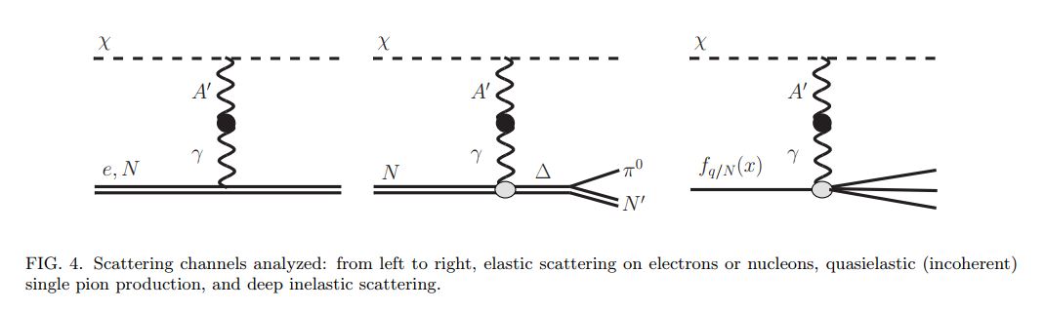
BSM Physics Program (η and η’ factory)
  Non-η/η’ based BSM Physics
  Dark photon and ALP searches in Drell-Yan processes: qqbar → A’/a → l⁺l–
  Dark photon and ALP searches in proton bremsstrahlung processes: p N → p N A’/a with A’/a → l⁺l– (J. Blümlein and J. Brunner)
  ALP’s searches in Primakoff processes: p Z → p Z a → l⁺l– (F. Kahlhoefer)
  Charged pion and kaon decays: π+ → μ⁺ν Α’ → μ⁺ν e⁺e– and Κ+ → μ⁺ν Α’ → μ⁺ν e⁺e–
  Neutral pion decay: πº → γA’ → γe⁺e–

Slide 8
Non-BSM Physics Program
(η and η’ factory)
  High precision studies on low energy physics
  Nuclear models
  Chiral perturbation theory
  Non-perturbative QCD
  Isospin breaking due to the u-d quark mass difference
  Octet-singlet mixing angle
  ππ interactions
  Electromagnetic transition form-factors (important input for g-2)
  Lots of other bread&butter physics

Slide 9
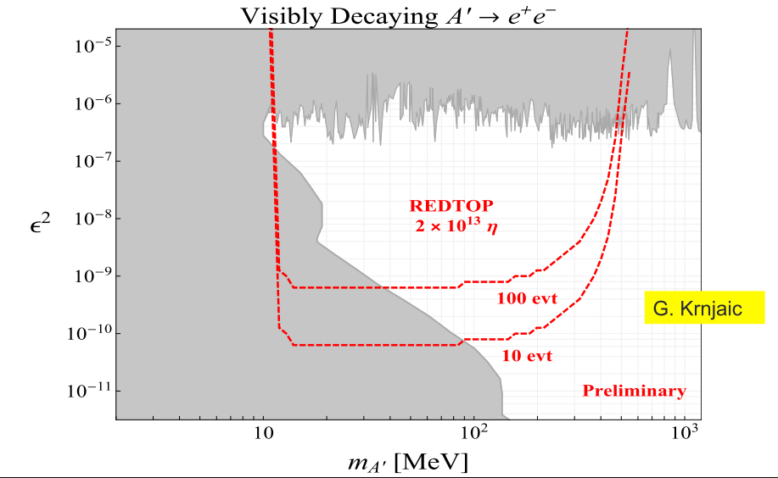
REDTOP – Constraints on Dark photon
  Light sub-GeV dark matter, if assumed to be a thermal relic, requires annihilation channels through light mediators to avoid over-production in the early universe.
  Vector Portal: Dark photon
  η → γ Α’ → γ + l⁺l⁻
Good sensitivity to protophobic vector mediator with M=17 MeV (Feng & Gardner)
Vector Portal
9

Slide 10
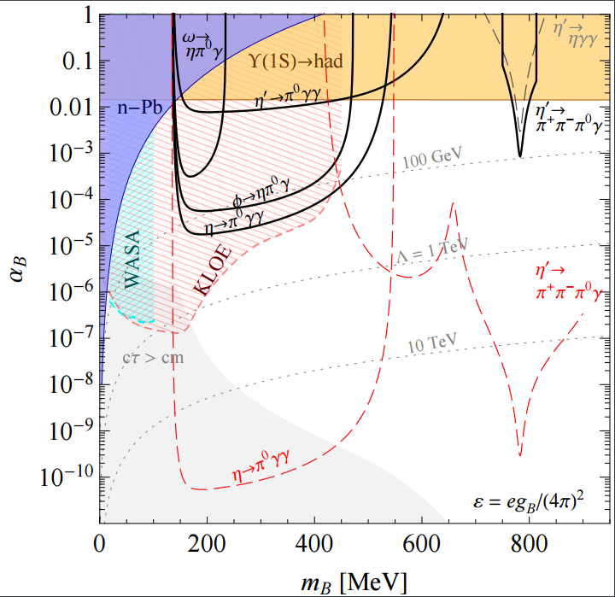
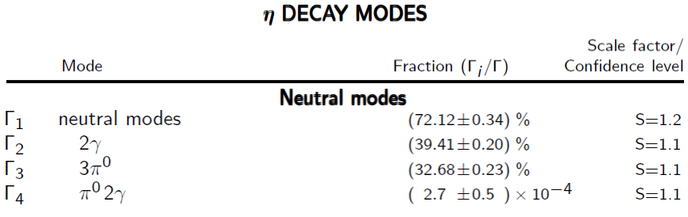
REDTOP Constraints on a new baryonic force (courtesy of S. Tulin – U. York)
REDTOP constraints at the level of BR(η’ → Bγ → π +π −πºγ) < 10⁻⁸
REDTOP constraints at the level of BR(η → Bγ → πºγγ) < 3 × 10⁻⁹
New physics decays as a two 2-body
SM decay as 3-body
Current limit: baryonic force is 2000 times weaker than electromagnetism
Better limits from Dalitz plot analysis of η→π^{ο} γγ. Not been done so far.
REDTOP will collect 10⁹ such event: sensitivity is under study
Baryonic Vector Mediator Portal

Slide 11
Present & Future η Samples
A. Starostin - UCLA
 | Technique |  | η → 3πº | η → e⁺e⁻γ | Total η
CB@AGS | π⁻⁻p→η n |  | 9×10⁵ |  | 10⁷
CB@MAMI-B | γ⁻p→η p |  | 1.8×10⁶ | 5000 | 2×10⁷
CB@MAMI-C | γ⁻p→η p |  | 6×10⁶ |  | 6×10⁷
KLOE | e+e-→Φ→ηγ |  | 6.5×10⁵ |  | 5×10⁷
WASA@COSY | pp→η pp pd→η ³He |  |  |  | >10⁹ (untagged) 3×10⁷ (tagged)
CB@MAMI 10 wk (proposed 2014) | γ⁻p→η p |  | 3×10⁷ | 1.5×10⁵ | 3×10⁸
Phenix | d Au→η X |  |  |  | 5×10⁹
Hades | pp→η pp p Au→η X |  |  |  | 4.5×10⁸
Near future samples
GlueX@JLAB (just started) |  | γ_{12 GeV}p → η X → neutrals |  |  | 5.5×10⁷/yr
JEF@JLAB (recently approved) |  | γ_{12 GeV}p → η X → neutrals |  |  | 3.9×10⁵/day
REDTOP@FNAL (proposing) |  | p_{1.8 GeV}Be → η X |  |  | 2.5×10¹³/yr

Slide 12
Experimental Techniques
  η/η ‘ production
  2.5 x 10⁶ η /sec and 1.5 x 10⁴ η’ /sec hadro-produced from 1.8 and 3 GeV 1x10¹¹ POT/sec – CW
  Use 10 x 0.33mm Be foils targets , spaced 10 cm apart to minimize combinatorics background
  charged tracks detection
  Use Cerenkov effect in an Optical-TPC for tracking charged particles
  Baryons and most pions are below Č threshold
  Electrons and most muons are detected and reconstructed
  Use LHCb-style Fiber tracker vertexing and rejection of γ -conversion
  γ detection
  Use ADRIANO calorimeter for reconstructing EM showers
  σ_{E}/E < 5%/√E
  PID from dual-readout to disentangle showers from γ/μ/hadrons
  96.5% coverage
  Use tiles for high granularity and PFA reconstruction
  200 psec resolution for high rate DAQ

Slide 13
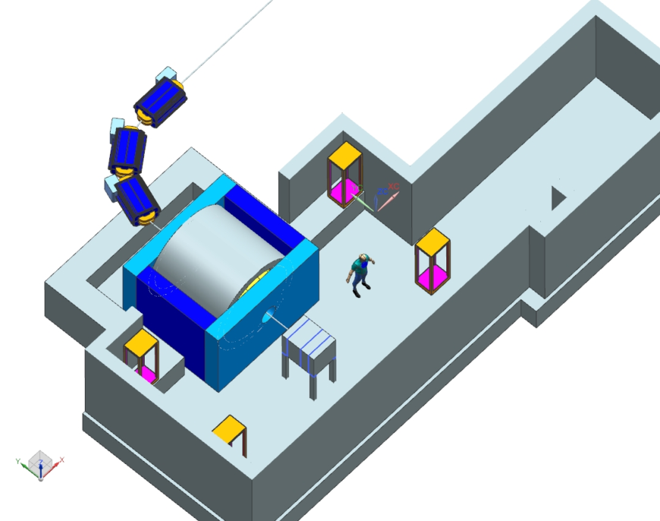
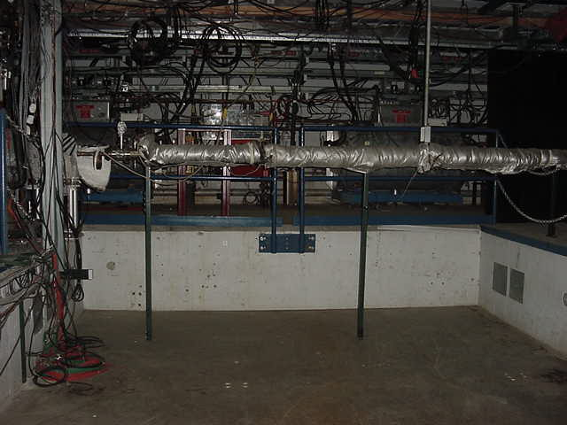
Acceleration Scheme (M. Syphers)
Single p pulse from booster (≤4x10¹² p) injected in the DR (former debuncher in anti-p production at Tevatron) at fixed energy (8 GeV)
Energy is removed by adding 1-2 RF cavities identical to the one already planned (~5 seconds)
Slow extraction to REDTOP over ~40 seconds.
The 270º of betatron phase advance between the Mu2e Electrostatic Septum and REDTOP Lambertson is ideal for AP50 extraction to the inside of the ring.
Total time to decelerate-debunch-extract: 51 sec: duty cycle ~80%
REDTOP

Slide 14
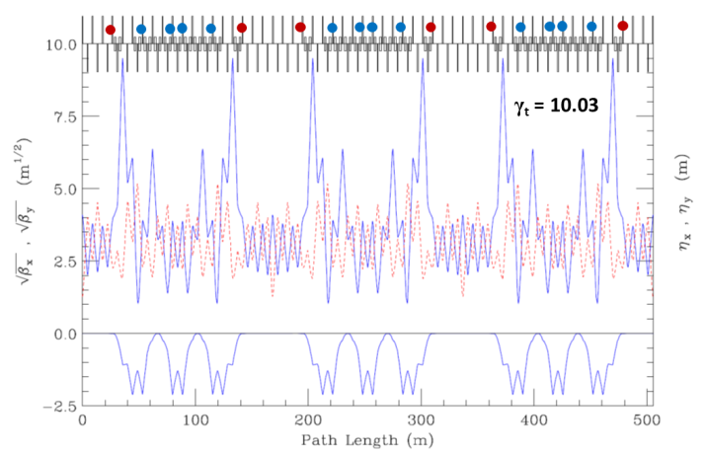
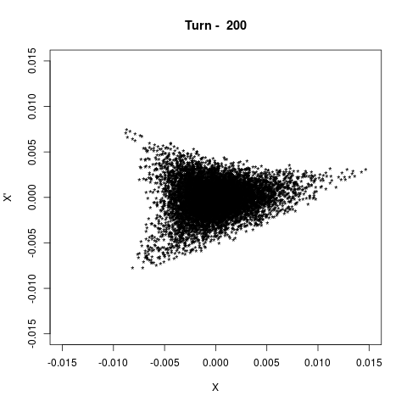
Accelerator Physics Issues
  Transition Energy
    𝛾_{t} is where 𝛥f/f = 1/𝛾2 - <D/𝜌> = 0; synchrotron motion stops momentarily, can often lead to beam loss
    beam decelerates from 𝛾 = 9.5 to 𝛾 = 3.1
    original Delivery Ring 𝛾_{t} = 7.6
    a re-powering of 18 quadrupole magnets can create a 𝛾_{t} = 10, thus avoiding passing through this condition
      Johnstone and Syphers, Proc. NA-PAC 2016, Chicago (2016).
  Resonant Extraction
    Mu2e will use 1/3-integer resonant extraction
    REDTOP can use same system, with use of the spare Mu2e magnetic septum
    initial calculations indicate sufficient phase space, even with the larger beam at the lower energies
  Vacuum
    REDTOP spill time is much longer than for Mu2e
    though beam-gas scattering emittance growth rate 3 times higher at lower energy, still tolerable level

Slide 15
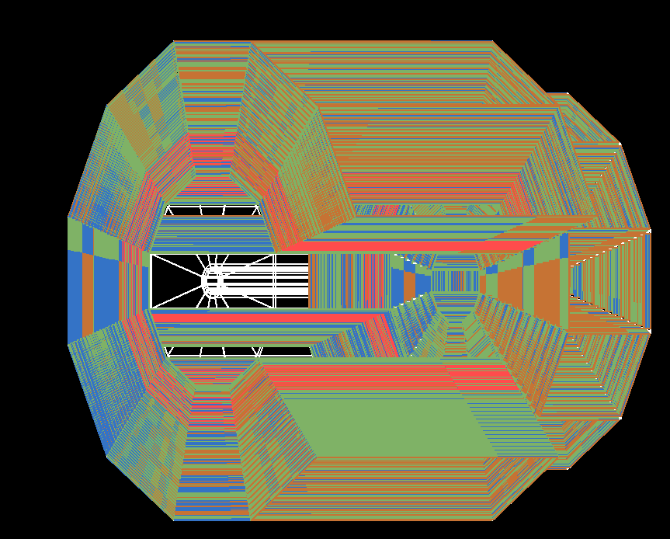
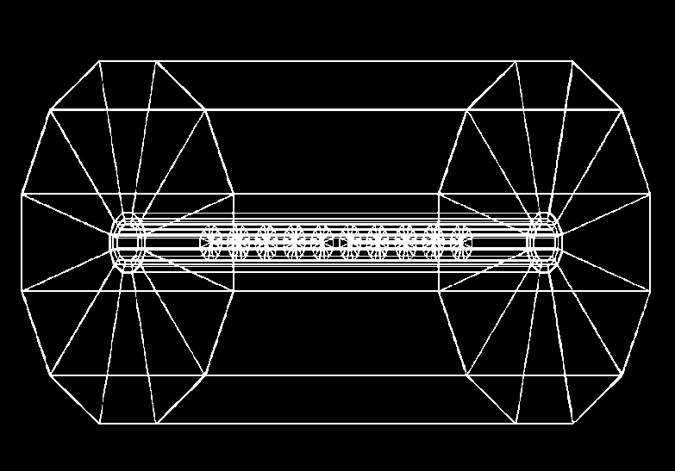
REDTOP detector
Optical TPC
~ 1m x 1.5 m
CH₄ @ 1 Atm
5x10⁵ Sipm/Lappd
98% coverage
ADRIANO2 Calorimeter (tiles)
Scint. + heavy glass sandwich
20 X ₀ ( ~ 64 cm deep)
Triple-readout +PFA
96% coverage
μ-polarizer
Active version (from TREK exp.)
2.4 m
10x Be targets
0.33 mm thin
Spaced 10 cm
1.5 m
2.7 m
1 m
Fiber tracker being investigated (for rejection of γ-conversion and vertexing )
Aerogel
Dual refractive
index system
OTPC

Slide 16
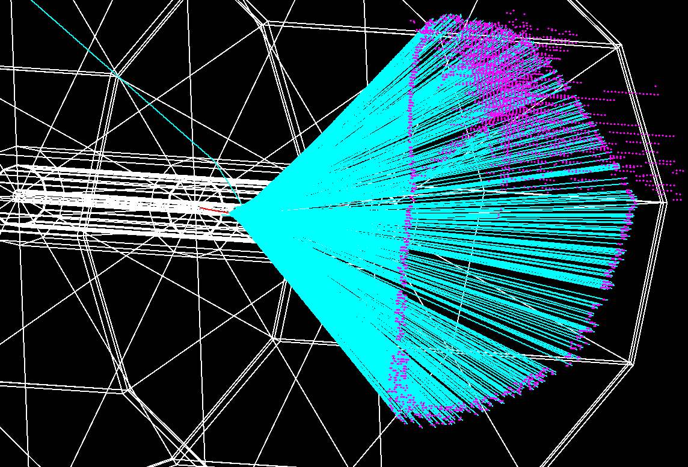
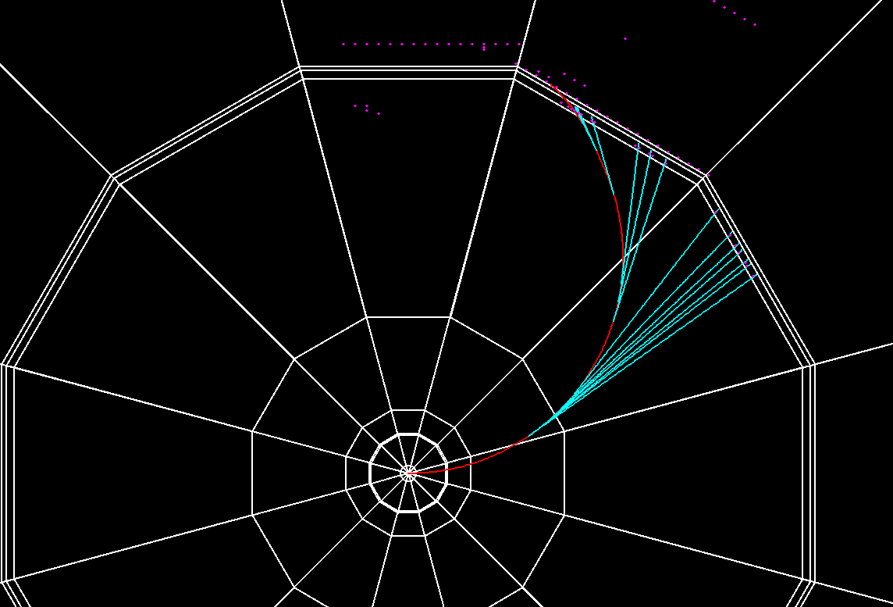
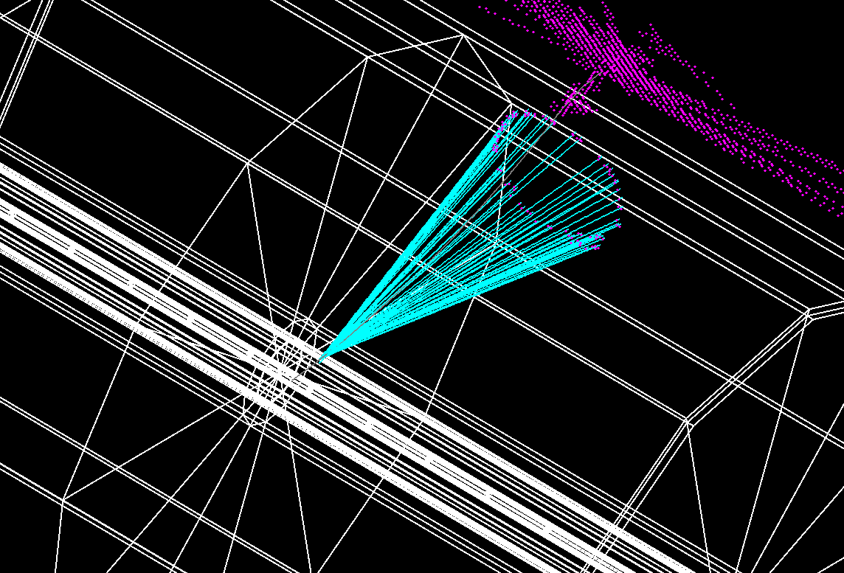
Charged Tracks Detection
Slic/lcsim simulation
100 MeV electron
Cerenkov light in the OTPC
95 MeV muon

Slide 17
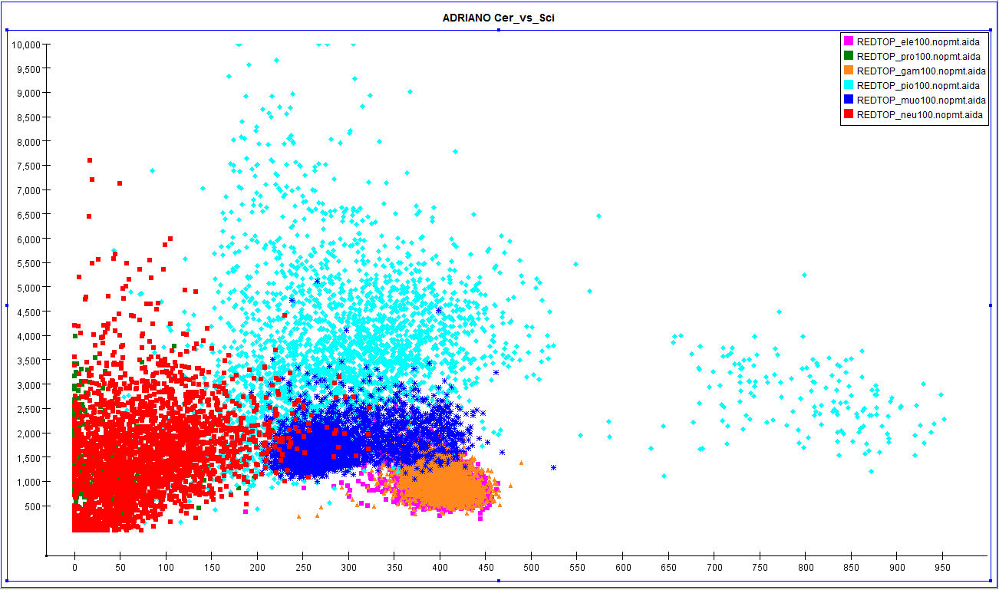
PID with ADRIANO @ 100MeV
Scint
pions
p/n
muon
e/γ
Ceren
Ilcroot simulation

Slide 18
Trigger & DAQ
  Input parameters
  2-5 × 10⁸ p-Be inelastic collisions per second
  1-2.5 × 10⁶ (10⁴ )produced η (η’) per second
  Trigger requirements (L. Ristori)
Level | Algo | Detectors | Hardware | Rejection factor
L0 | Σ OTPC & ADRIANO-Cer | OTPC, ADRIANO | Fast sum | 100
L1 | identification of a pair of leptons, γ-conversion rejection | OTPC, ADRIANO, Fiber Tracker | FPGA | 100
L2 | Reco | All | 2000 CPU-cores | >1
  Expected data rates
  <200 MB/sec from L2
  <2 PB/year to tape (assume 100 kb event size)

Slide 19
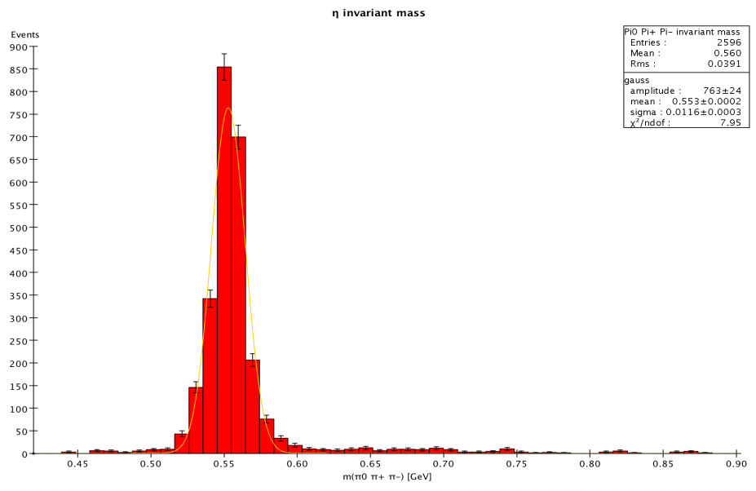
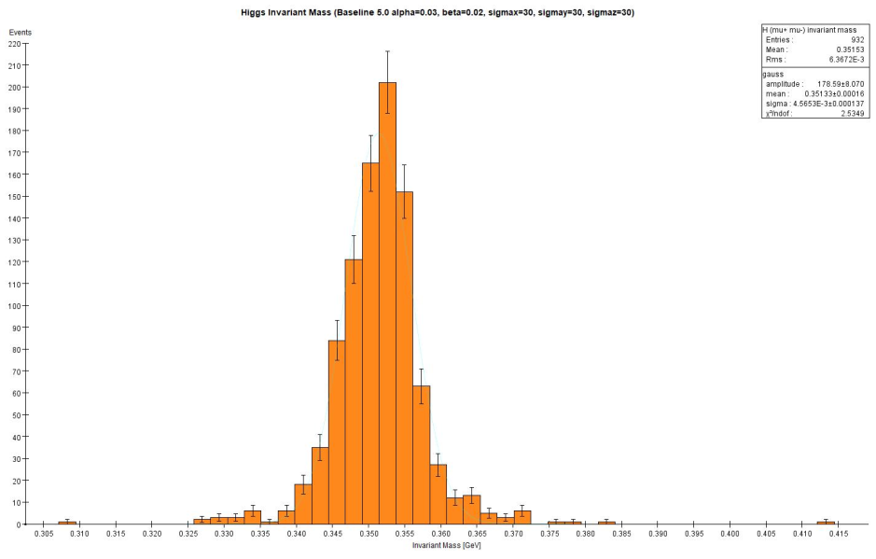
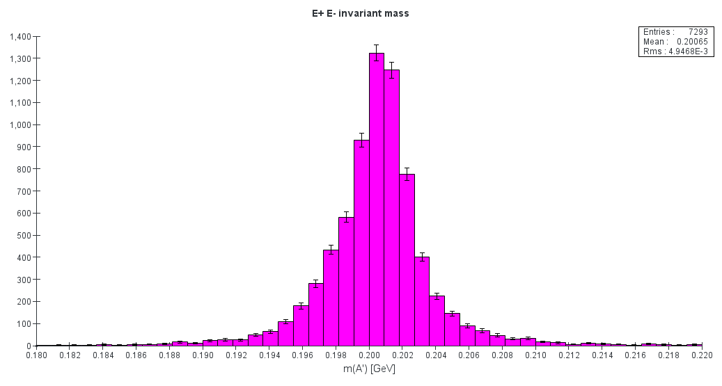
Some plots of invariant masses
π^{ο} π⁺π⁻
Invariant mass
μ⁺μ⁻
Invariant mass
η → π^{ο} π⁺π⁻
σ (π^{ο} π⁺π⁻)= 11 MeV
η → π^{ο} Η with H→μ⁺μ⁻
σ (μ⁺μ⁻)= 4 MeV
e ⁺e⁻ Invariant mass
η → γ Α’ with Α’ →e ⁺e⁻⁻
σ (e ⁺e⁻)= 3 MeV
Slic-lcsim simulation

Slide 20
Physics/Detector Challanges– R&D required
  Physics
Background
  Rejection of multi-pion events
  Mass resolution of di-leptons for bump hunting
  η-tagging
  Apparatus
ADRIANO -> ADRIANO2 (new)
  Add tiles directly coupled to SIPM
  DOE proposal submitted
Sensors for OTPC
  Need to sustain >10 ¹¹ n/cm ² (NEQ)
  LAPPD as possible choice (INCOM is the key)
Fiber tracker - LHCb style (new)
  Radiation damage
Trigger
  Need to recognize Cerenkov rings at L1
  L0/L1 from topological analysis of showers (PFA)
Accelerator Physics Issues
  Transition Energy
  Resonant Extraction
  Vacuum

Slide 21
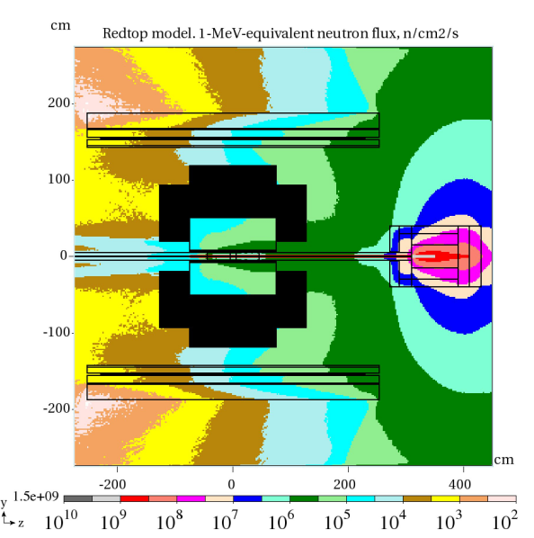
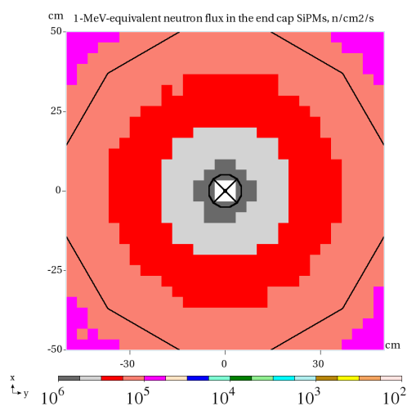
Radiation loads on electronics and detector components
N. Mokhov
V. Pronskikh
Full detector
Fwd Endcap

Slide 22
Prospects
Nov. 2017: EOI to PAC (now)
CY 2018 : LOI
CY 2019 : full proposal to PAC
CY 2018-2020: Detector R&D (could be shorter)
CY 2021: Detector construction + engineering run
CY 2022: Start physics run for Phase-I
Successive phases depends from results of phase I, occupancy of the experimental hall and beam request from experiments
More details: http://redtop.fnal.gov
We have devised a flexible schedule tuned to DOE and P5 needs.
An exciting phase of detector R&D ahead

Slide 23
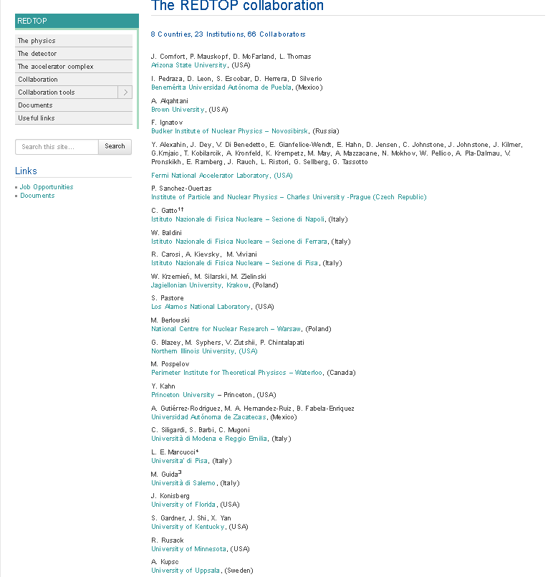
More details at: http://redtop.fnal.gov

Slide 24
Summary
The η /η’ meson is an excellent laboratory for studying rare processes
Existing world sample not sufficient for breaching into decays violating conservation laws or searching for new particles
REDTOP goal is to produce >2 x 10¹³ η mesons/yr in phase I and (~ 2x10 ¹¹ η’ /year) in phase II
Advantages to the scientific community:
  Reach physics BSM
  New generation, super-fast, detector techniques
  Variable energy, CW beam at Fermilab
  Lots of Ph.D. thesis
Currently the collaboration is forming and working at a full proposal
PAC endorsement needed to get funding for physics studies and R&D
Total cost: < 40 M$ (depending on re-use of existing infra-structure)

Slide 25
Backup slides

Slide 26
REDTOP Running Phases
Phase I: η-factory. Goal is 2.5 x 10¹³ η /yr
  T_{beam}: 1.8-2.1 GeV
  Power: 30 W
  Target: 10 x 0.33 mm Be
Phase II: η ’-factory. Goal is ~ 10¹¹ η’ /yr
  T_{beam}: 3.5-4.5 GeV (to be optimized)
  Power: 60 W
  Target: 10 x 0.33 mm Be
Phase III: Dark photons radiating form muons. Goal is > 1.0 ×10¹³ μ/yr
  (G. Krnjaic and Y. Kahn)
  T_{beam}: 1< <3 GeV (to be optimized)
  Target: H₂ gas
Phase IV: Muon Scattering Experiment. Goal is > 2.0 ×10¹² μ/yr
  T_{beam}: 0.2< <0.8 GeV (to be optimized)
  Muon yield: >1.6 ×10⁻⁸ μ/p
  Target: 1 x 100 mm graphite
Phase V: tagged REDTOP. Goal is > 2.0 ×10¹³ η/yr
  T_{beam}: 1.2 GeV at PIP-II
  Muon muon yield: >1.6 ×10⁻⁸ μ/p
  Target: ³H
Phase VI: Rare Kaon Decays: K⁺ → π ⁺ ν ν Goal is > 1×10¹⁴ ΚΟΤ/yr
  T_{beam}: K⁺ from 8 GeV protons
  K⁺/π yield: 1 /13 (neglecting very soft pions – factor 1.8 better than p@92 GeV)
  Target: primary (PT: for K production) + secondary (active: scintillating plastics)
It could be made unnecessary by NA62+ and JPARC

Slide 27
Possible Intermediate Phases
Pre-REDTOP with OTPC only
p ⁷Li → ⁸Be* → e⁺ e⁻ X
  At 2.5 MeV IOTA proton source (Fermilab)
  Confirm 17 MeV bump found in Prague experiment
p D → ³He e⁺ e⁻ (M. Viviani ,L. E. Marcucci and A. Kievsky)
  At 40 MeV Fermilab p linac (Fermilab) or ATLAS facility (ANL)
p ⁹Be → ⁸Be* + X → e⁺ e⁻ X
  At MCenter 2 GeV p beam (Fermilab)
μ ⁺ Nucleus scattering in fixed target mode
  1.5-3 GeV muon campus – Fermilab
μ⁺ Nucleus in beam dump mode
e⁻ Nucleus in fixed target mode
  250-500 MeV, 50 mA IOTA facility – Fermilab
e⁻ Nucleus in beam dump mode
OTPC test with 2 GeV protons dumped by g-2 - Fermilab

Slide 28
Beam Rquirements
  Assume: 1x10¹¹ POT/sec – CW
    Beam power for η factory: @ 1.9 GeV: 10¹¹ p/sec × 1.9 GeV × 1.6 × 10⁻¹⁰ J/GeV = 30 Watts
    Beam power for η’ factory: @ 3 GeV: 10¹¹ p/sec × 3GeV × 1.6 × 10⁻¹⁰ J/GeV = 48Watts
  Target system : 10 x 0.33mm Be foils, spaced 10 cm apart
    Prob(p + target → X) = 0.5%
  Power dissipated from target:
    Heat produced for η factory: 150 mW total - 15 mW per target foil
    Heat produced for η’ factory: 240mW total - 24 mW per target foil
  p-inelastic interaction: 5 x 10⁸ evt/sec (1 interaction/2 nsec in the targets)
  η production: 2.5 x 10⁶ η /sec or 2.5 x 10¹³ η /yr
  η’ production: 1.5 x 10⁴ η’ /sec or 1.5 x 10¹¹ η’/yr

Slide 29

Ring Optics through Deceleration
(J. Johnstone)
Transition is avoided by using select quad triplets to boost γt above beam γ by 0.5 units throughout deceleration until γ_{t} = 7.64 and beam γ = 7.14 (5.76 GeV kinetic).
Below 5.76 GeV the DR lattice reverts to the nominal design configuration
8 GeV injection energy (top) and <5.8 GeV (bottom)
Blue & red circles indicate sites of the γ_{t} quad triplets.
Variation of $γ_{t}$, β_{max}, and the 15π 99% beam envelope through deceleration
"J.Johnstone, M.Syphers, NA-PAC, Chicago (2016)"

Slide 30
The REDTOP Detector (baseline)
Optical TPC
~ 1m x 1.5 m
CH₄ @ 1 Atm
5x10⁵ Sipm/Lappd
98% coverage
  Beam & Target
Aerogel
Dual refractive
index system
Solenoid
0.6-0.8 T
10x Be targets
0.33 mm thin
Spaced 10 cm
μ-polarizer
Active version (from TREK exp.)
ADRIANO2 Calorimeter (tiles)
Scint. + heavy glass sandwich
20 X ₀ ( ~ 64 cm deep)
Triple-readout +PFA
96% coverage
Fiber tracker being investigated (for rejection of γ-conversion and vertexing )

Slide 31
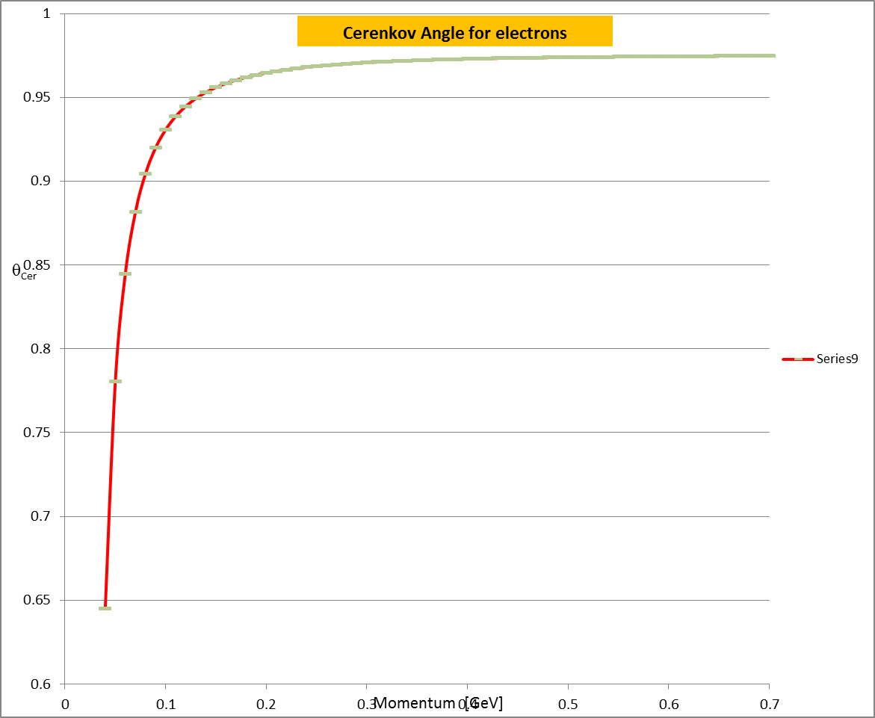
Electron Detection
100 MeV electron
n_{D}(N₂@2.7psi)=1.000145
Č threshold for e- in N₂: P=40 mev
n_{D}(aerogel1)=1.12
n_{D}(aerogel2)=1.22
Slic/lcsim simulation

Slide 32
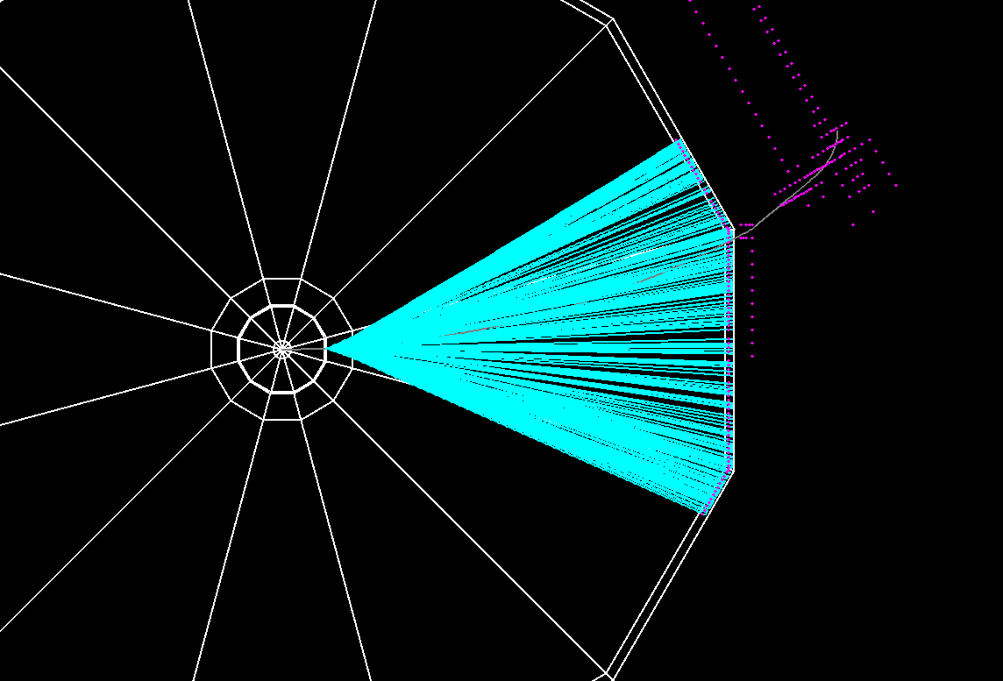
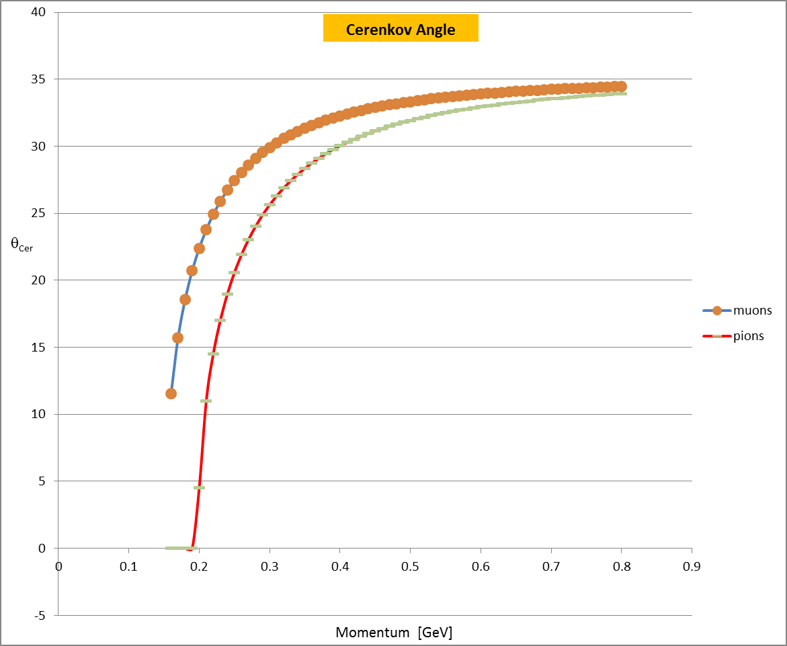
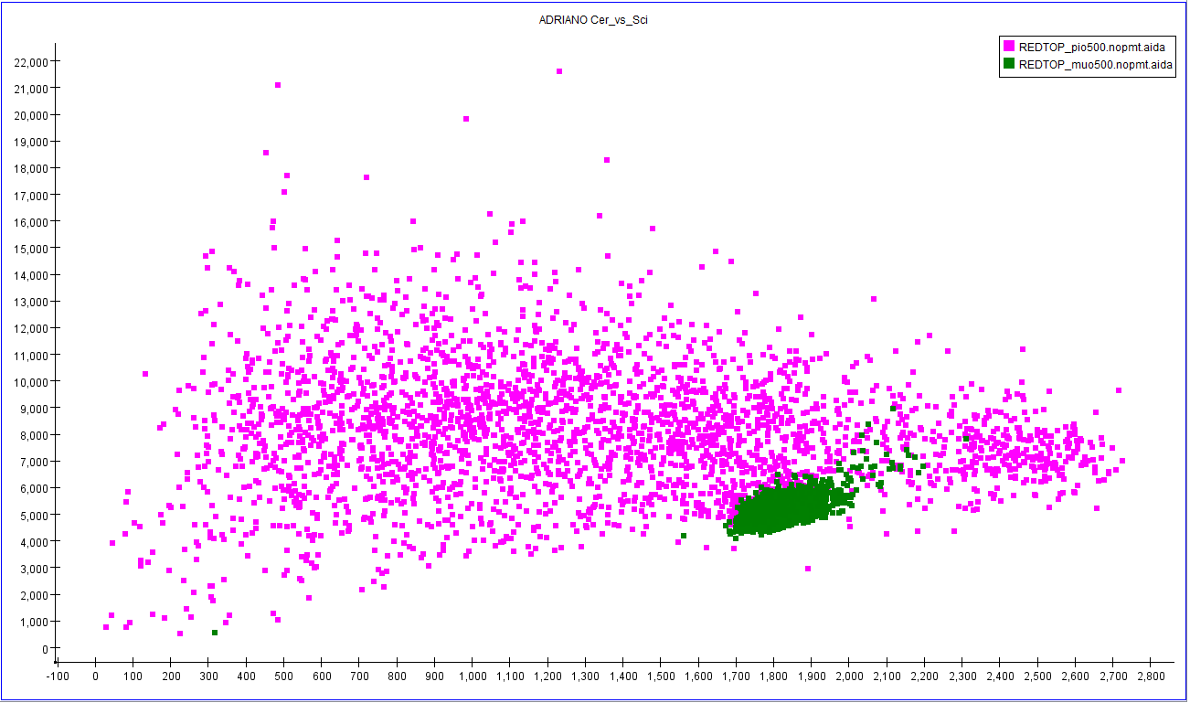
Muon/pion Detection
Slic/lcsim simulation
n_{D}(aerogel)=1.22/1.12
Č threshold for muons: P=160 mev
Č threshold for pions: P=200 mev
95 MeV muon
120 MeV muon
Dual-readout: Č vs S for μ and π with P=500 MeV

Slide 33
Software Frameworks
  Event generation: GenieHad (fortran+ and C++)
    Interface to Genie framework and existing nuclear scattering models
    Developed by REDTOP Collaboration
  Incl++
  Urqmd
  PHSD
  Gibuu*
  Exclusive η decays (via Gibuu LUT)
  Geant4 Electromagnetic models
  Abla++
  Abla7
  Gemini
  KAW
  Detector prototyping: Slic (C++) , lcsim (java)
    Geant4 particle propagation + detector response
    Developed at SLAC for SID and HPS
  Full simulations: ilcroot
    Geant4 particle propagation + detector response
    Developed by INFN for 4th Concept and ORKA

Slide 34
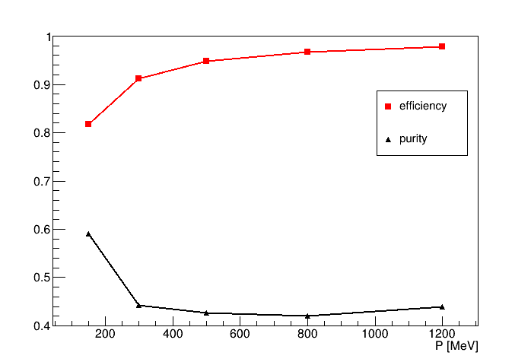
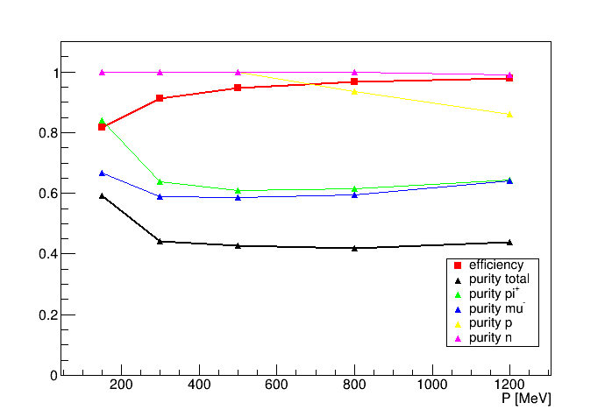
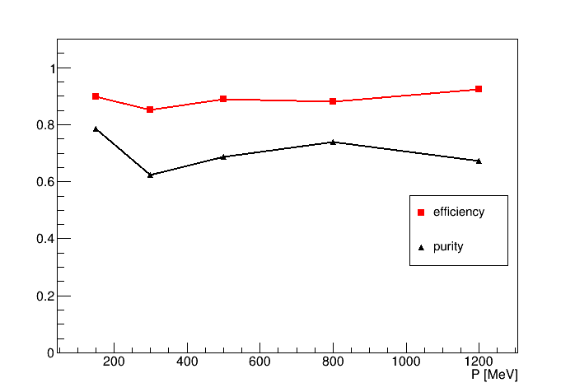
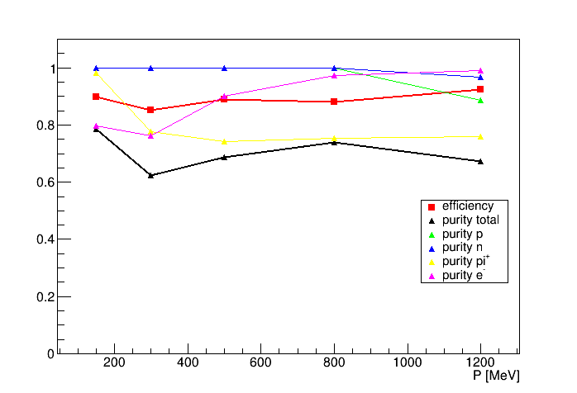
Electrons and muons PID in ADRIANO
(with shape analisys)
electrons
muons

Slide 35
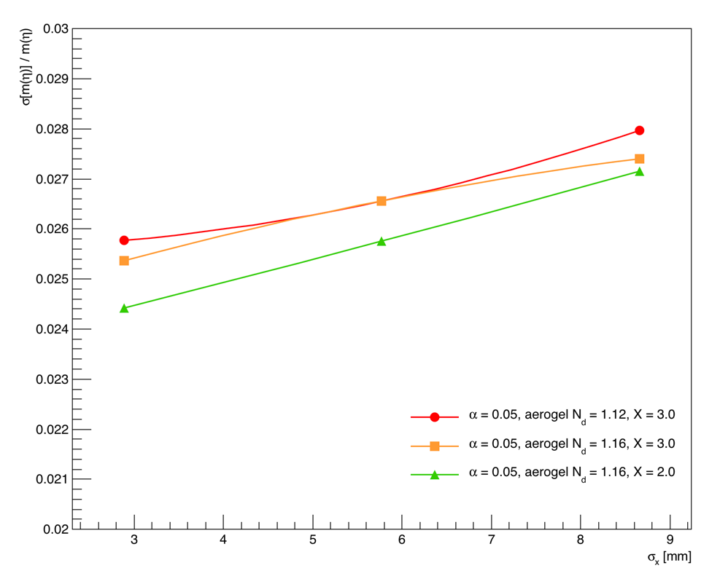
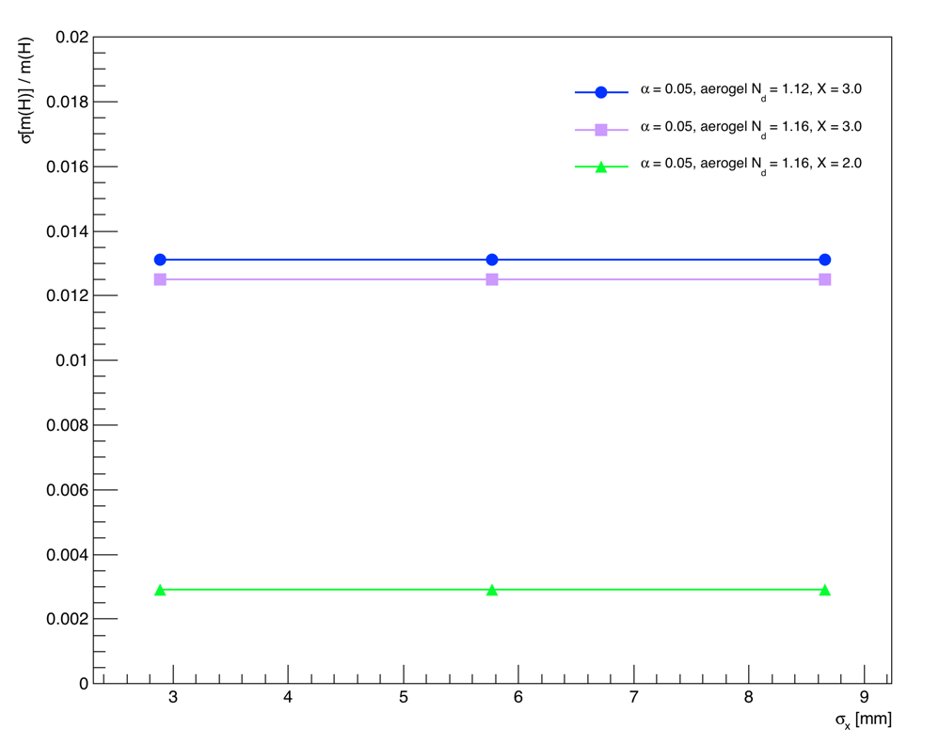
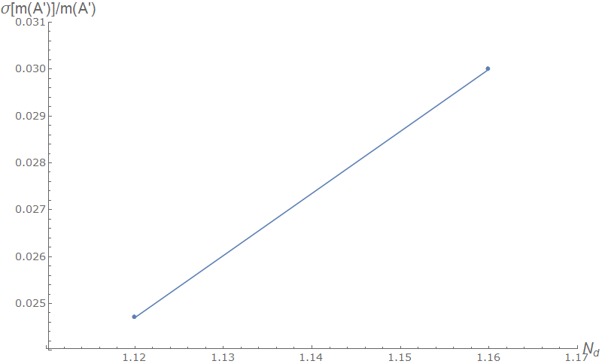
Preliminary Detector Optimization
η → π^{ο} π⁺π⁻
η → π^{ο} Η with H→μ⁺μ⁻
η → γ Α’ with Α’ → l⁺l⁻
Slic-lcsim simulation

Slide 36
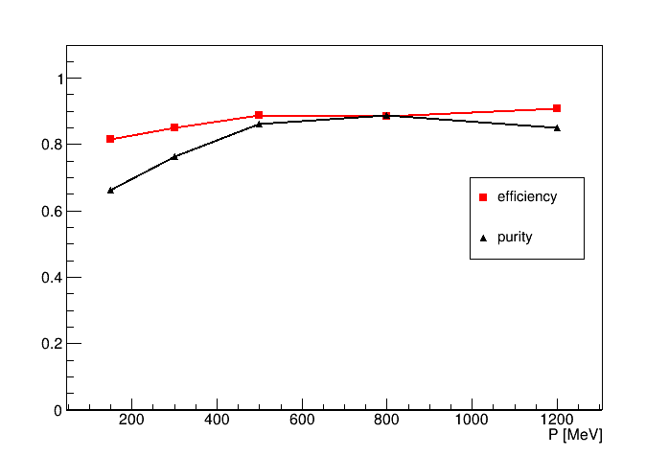
Fast PID from ADRIANO2 for L1 trigger
electron efficiency / purity using ADRIANO shape analysis
Muon efficiency / purity using ADRIANO Cer shape analysis + range
ADRIANO S vs C for 100 MeV particles
Scint
pions
p/n
Ilcroot simulation
Slic-lcsim simulation
muon
Ceren
e/γ

Slide 37
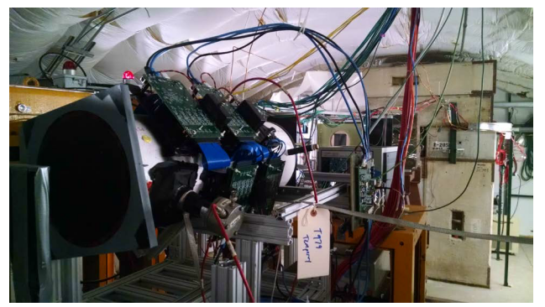
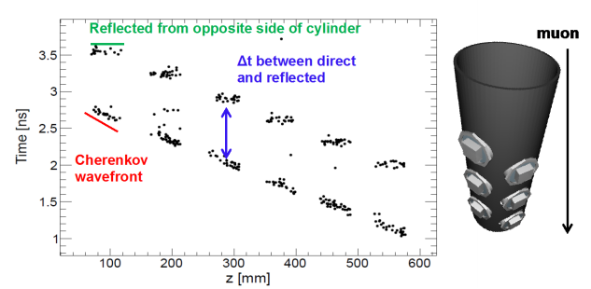
Detector R&D: OTPC
  Fnal –T1059 (H. Frisch, E. Oberla)
  Successful proof of principle in 2015 at FTBF
  Instrumented with an MCP photo-detector, three boards each with thirty channels of 10 GSPS waveform digitizing readout
  http://ppd.fnal.gov/ftbf/TSW/PDF/T1059_tsw.pdf
It requires a robust and dedicated R&D

Slide 38
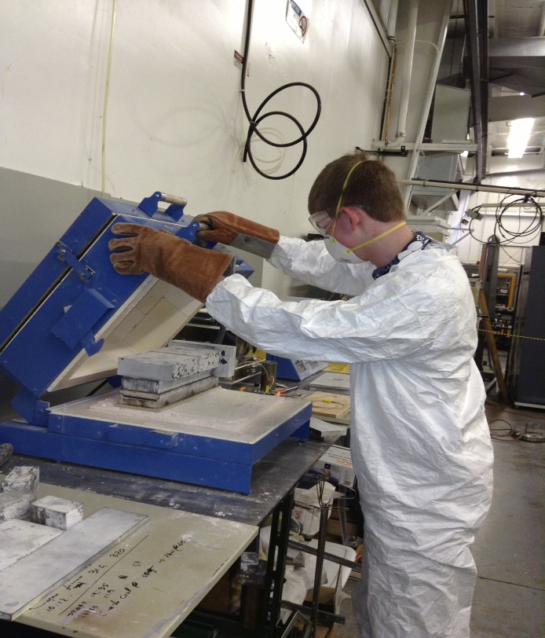
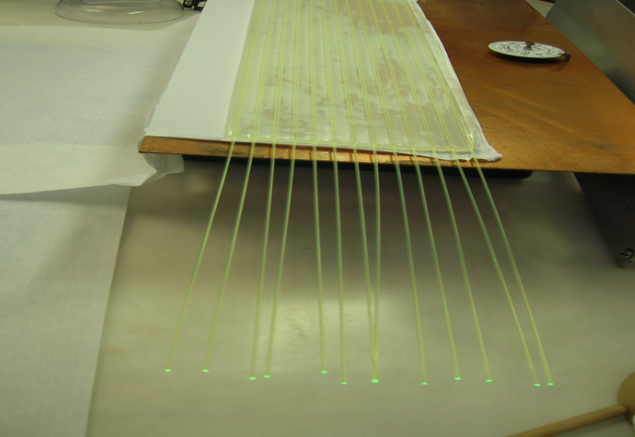
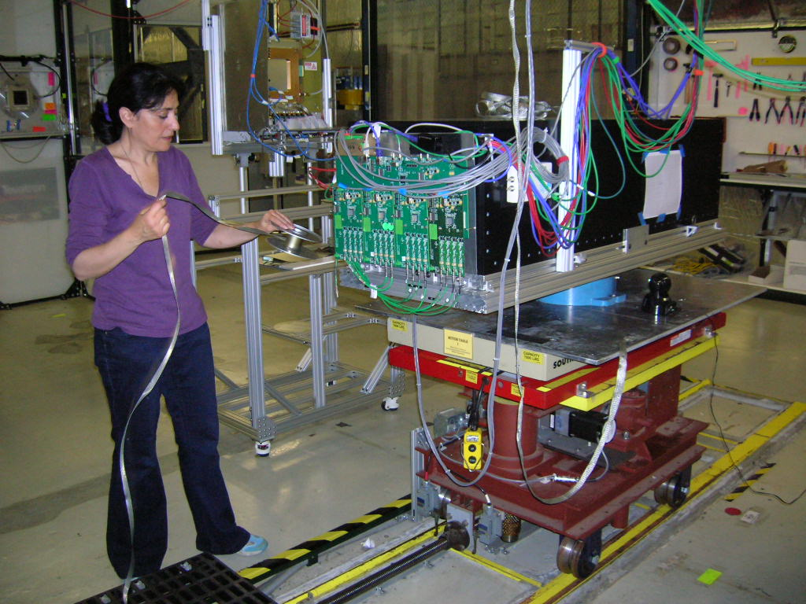
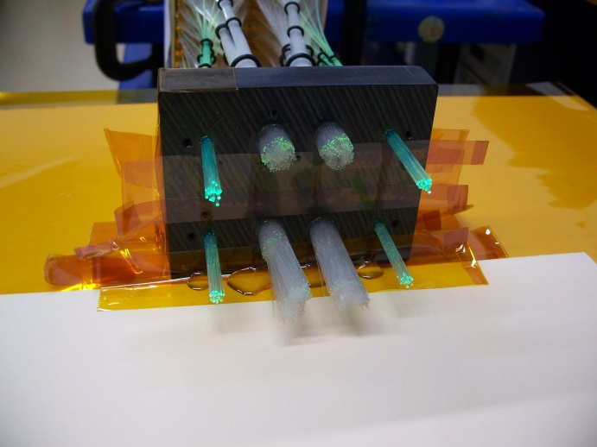
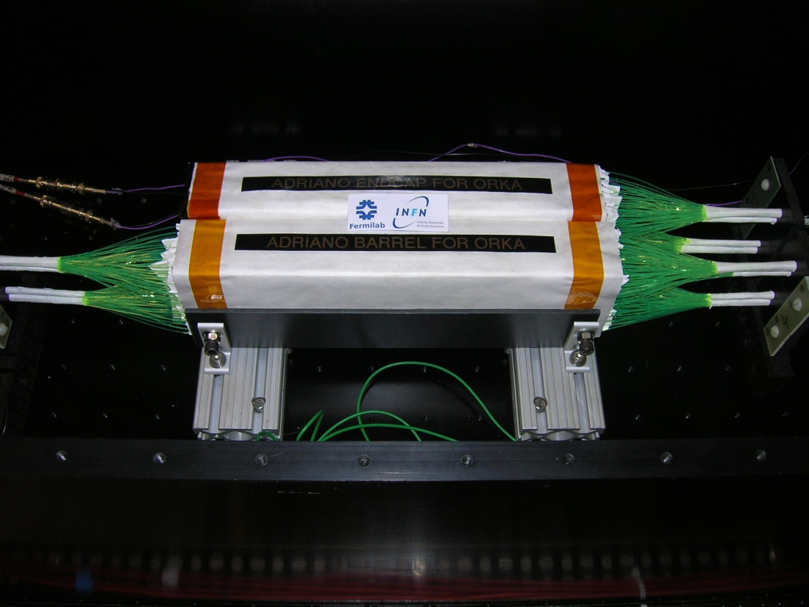
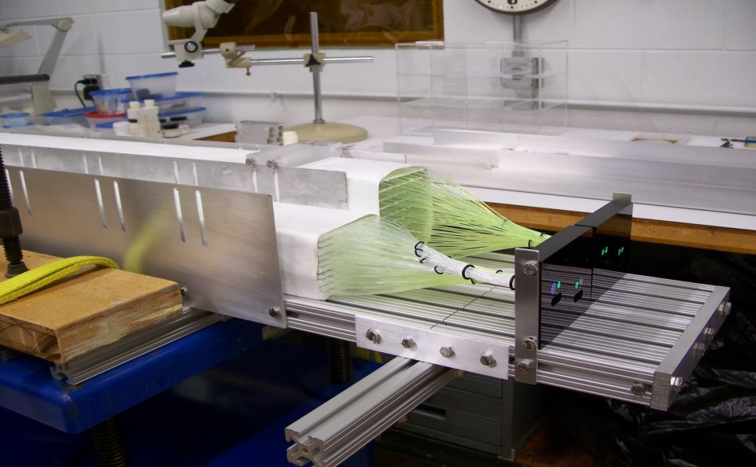
Detector R&D: ADRIANO in T1015
Moving R&D from FNAL to NIU

