Slide 1
WBS 121.5 – Conventional Facilities
Management
Steve Dixon
PIP-II DOE Independent Project Review
12-14 December 2017

Slide 2
Charge Questions

Slide 3
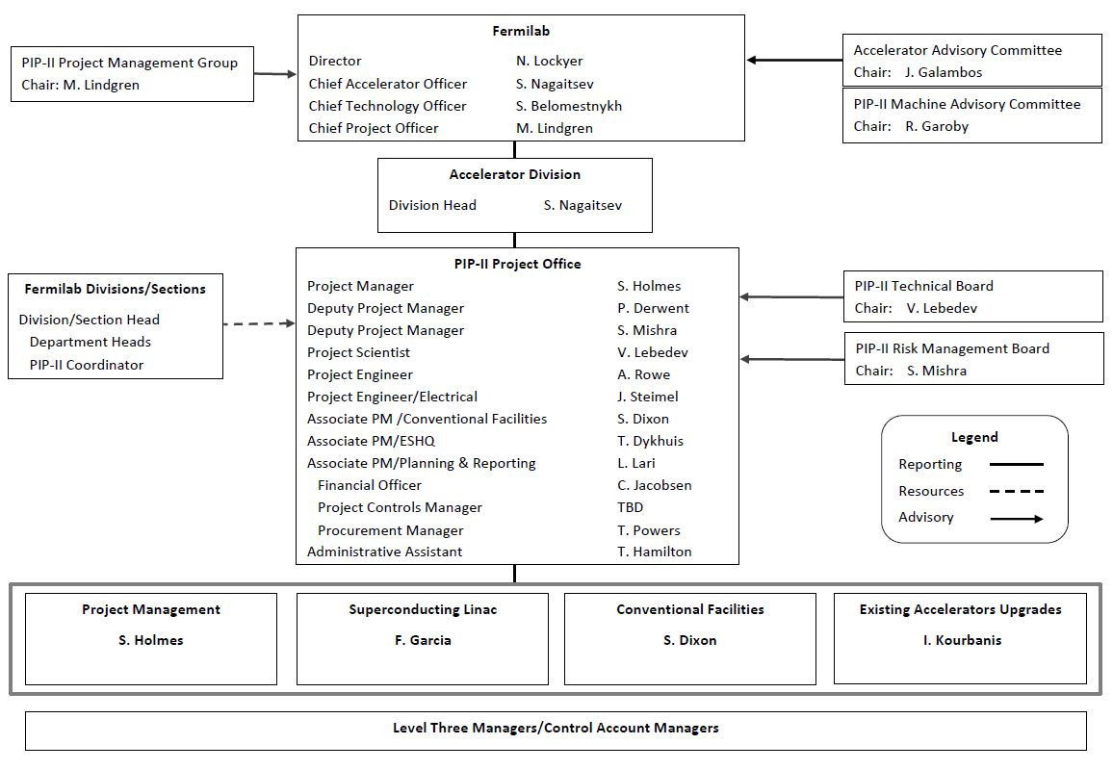
Conventional Facilities Management Structure
Level 2
Chart from PIP-II-doc-118, PIP-II Management Roles, Responsibilities, Authorities, and Accountabilities

Slide 4
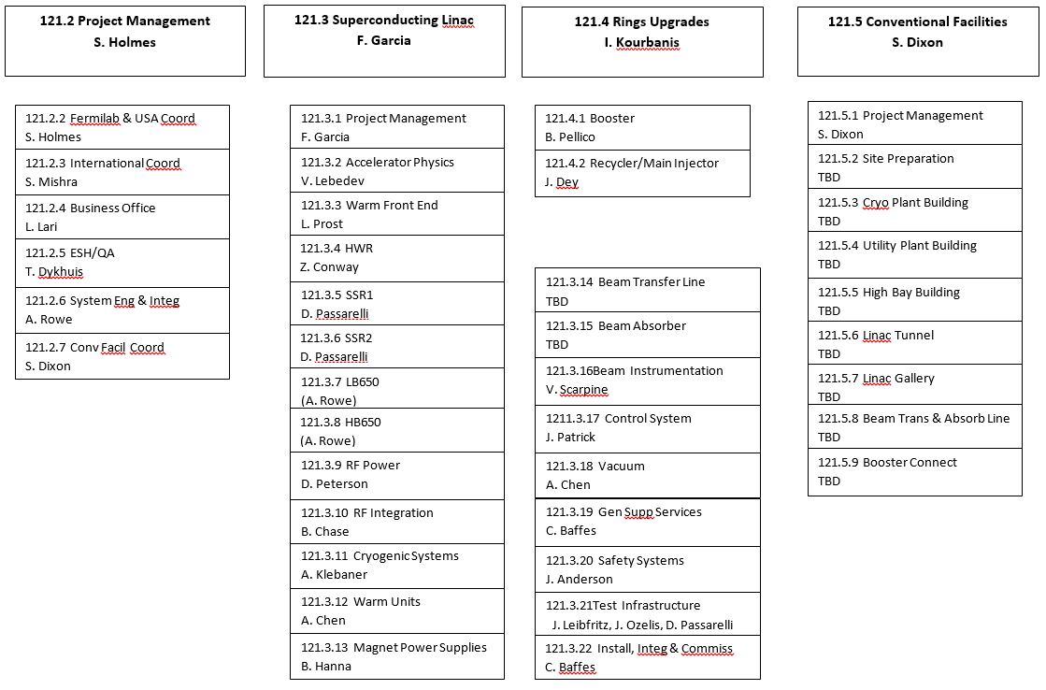
Conventional Facilities Management Structure
Level 2
Level 3

Slide 5
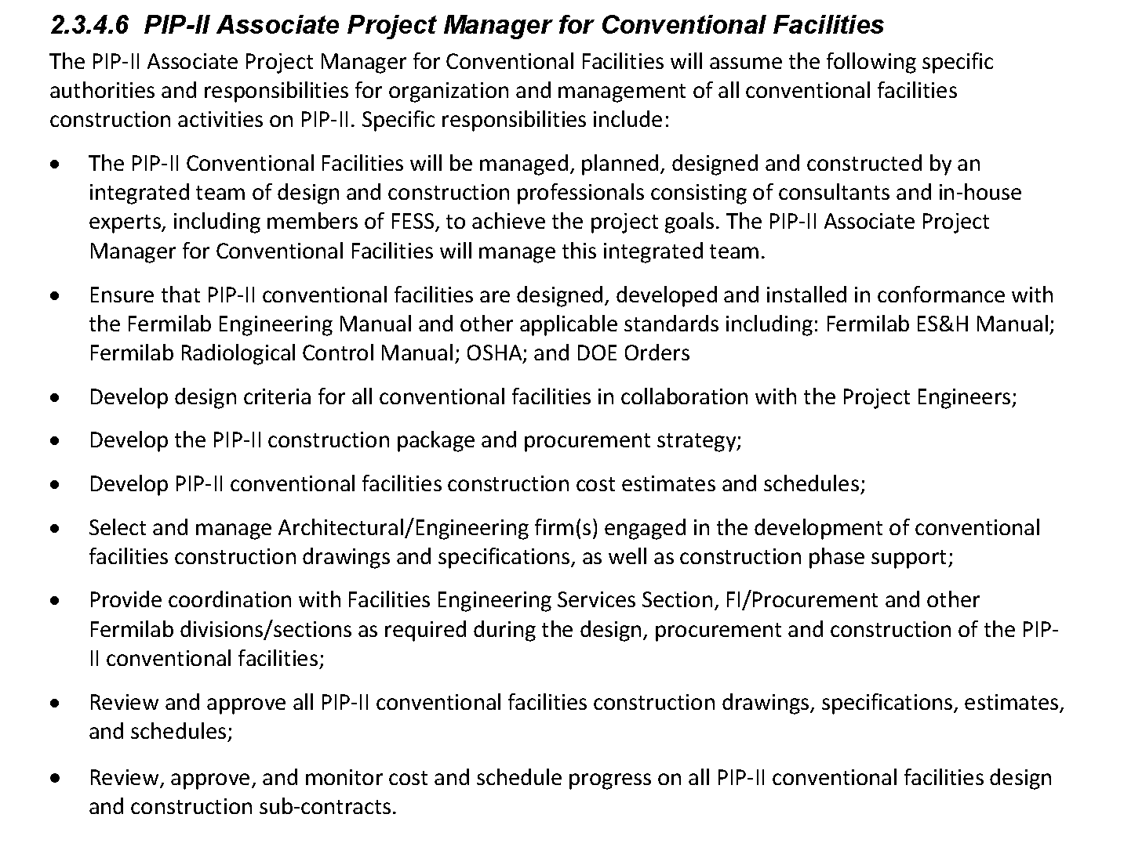
Conventional Facilities Management Structure
From PIP-II-doc-172, Project Management Plan for PIP-II Project

Slide 6
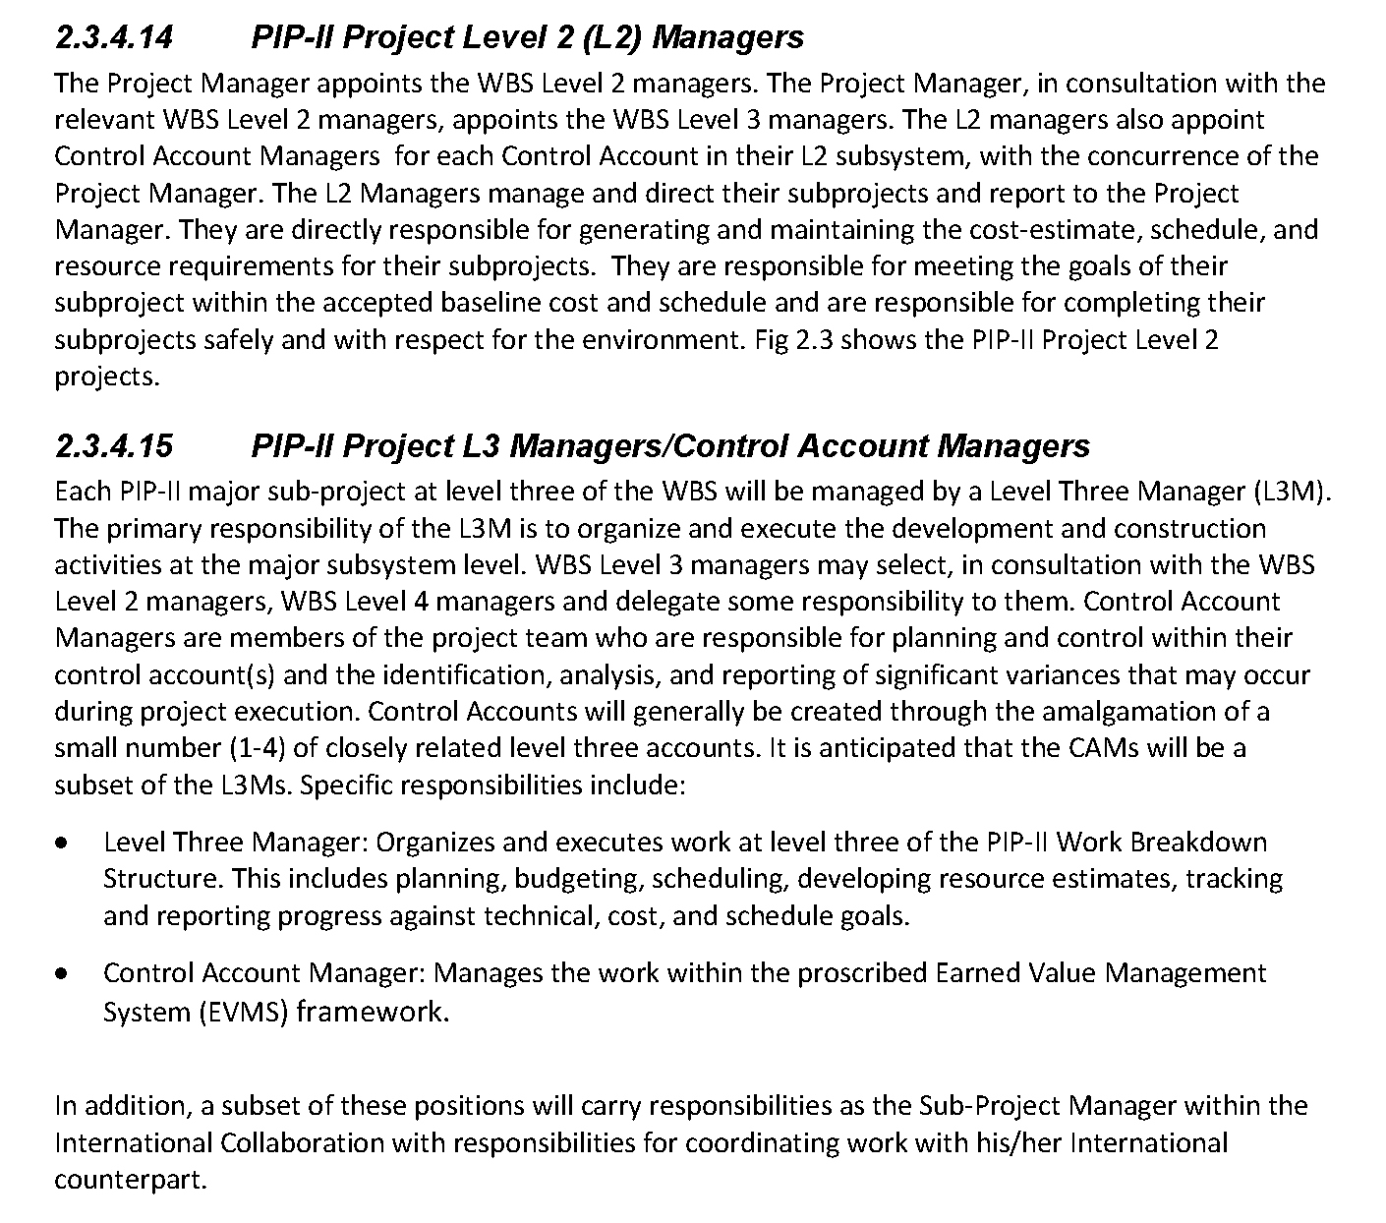
Conventional Facilities Management Structure
From PIP-II-doc-172, Project Management Plan for PIP-II Project

Slide 7
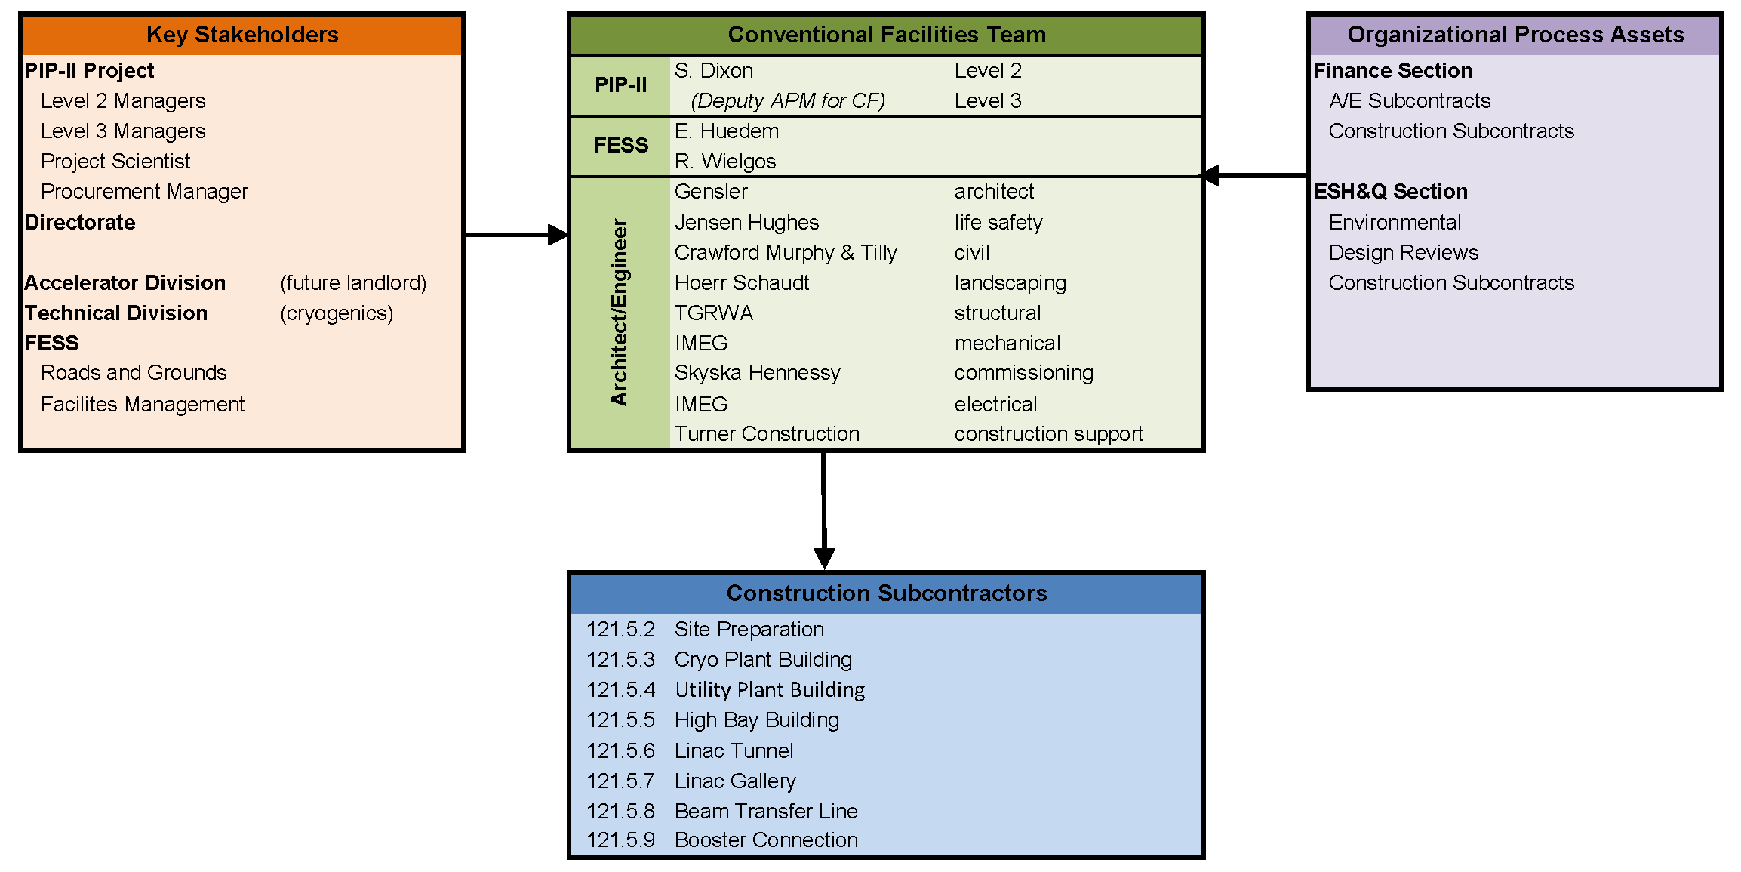
Conventional Facilities Team

Slide 8
Conventional Facilities Team
A/E team selected in February 2017;
Utilized standard Finance/Procurement procedures;
Selection Panel included PIP-II, Procurement, FESS/Engineering and ESH&Q representatives;
Selected for Preliminary Design, Final Design and Construction Phase support;

Slide 9
Conventional Facilities Team
Previous experience at Fermilab shown in red
Consultants with previous experience make up ~85% of project scope

Slide 10
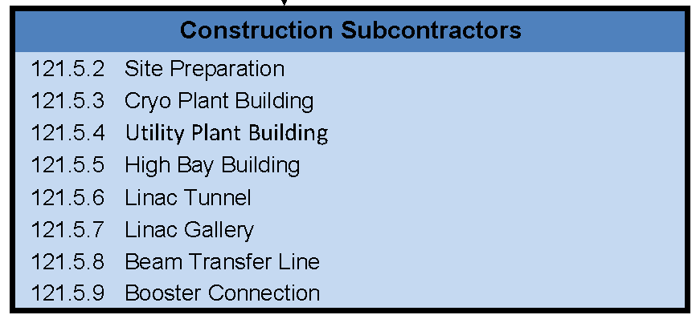
Approach
Broken the work into reasonable work packages;
Assumes funding will be available over a number of FYs;
Construction packages can be combined if funding changes;
Logical construction sequence;

Slide 11
Approach
“Design-bid-build” for construction packages;
Standard Fermilab procurement methods and requirements;
“Conventional Facilities construction will primarily be accomplished through a number of competitively solicited, fixed price construction packages in order to achieve best value procurements.” [1]
[1] – from Section 6 of PIP-II Assumptions Document in PIP-II-doc-144

Slide 12
Summary
Experienced team with knowledge of Fermilab processes and procedures;
Work packages are assembled in a logical manner to provide a reasonable construction sequence with flexibility built in;
Design and Construction approach is based on standard Fermilab procedures;
Management team is ready for CD-1 approval.

Slide 13
Questions

