Slide 1
131.3.17 – Linac Controls
RF Systems
Jim Patrick
PIP-II Independent Project Review
12-14 December 2017

Slide 2
Outline
Requirements
Conceptual Design, Maturity
Scope/Deliverables
Interfaces
Technical Progress to Date
ESH&Q
Risk
Cost
Schedule
Summary

Slide 3
About Me:
Role:
  Level 3 Manager for PIP-II Linac Controls
Relevant Experience:
  Head of Accelerator Controls Department since 2001
  Previously head of CDF experiment data acquisition group
  Scientist at Fermilab

Slide 4
Scope
121.3.17 Linac – Controls (C) | This WBS entry covers design, procurement, fabrications and testing of the control system for the linac, transfer line to the booster, and improvements in the rest of the complex necessary to meet the beam delivery goals. This includes the control system infrastructure, timing system, machine protection system, water and vacuum front-end systems, and associated software.

Slide 5
WBS L3 System Requirements
Charge #2
Control and monitor equipment for PIP-II linac
  With very high availability
  Data acquisition, alarms, logging, save/restore, control and status user interfaces
Support 20 Hz pulsed operation
  Implications for timing and machine protection
Interface to existing complex
  Timing
  Machine Protection
  Data acquisition, alarms, logging, etc.
Scale is a moderate expansion to current complex

Slide 6
Machine Protection Requirements
Charge #2
Manage beam intensity and permit limits of MPS devices
Provide a comprehensive overview of the machine state and readiness status to subsystems and the broader complex
Provide a global synchronization trigger on faults
Save data on trips and provide to control system on request
Provide high availability and fail-safe operation
FRS - Teamcenter ED0004250

Slide 7
Conceptual Design – General Controls
Charge #2
Incorporate the PIP-II Linac in the existing control system
Enhance and modernize as needed
  Both hardware and software
Unified system for the entire complex
Supports diverse simultaneous modes of operation
Should easily adapt to additional scale
Large investment and long experience
Very modular
  Long history of adapting to new accelerators and beam lines
  And upgrading components without disrupting operations

Slide 8
Conceptual Design – General Controls
Charge #2
Console
Applications
Java
Applications
Web
Applications
Database
Central
Services
Servlets
Open Access
Clients
Consolidators
MOOC
Front-Ends
Erlang
Front-Ends
HRM/IRM
Front-Ends
Field Hardware
Ethernet, CAMAC, VME, PMC, IP, CIA, GPIB, …

Slide 9
Conceptual Design - Timing
Charge #2
New global accelerator clock ACLK
Event + data payload
1 GHz link
Support 20 Hz pulsed operation
  Current complex based on 15 Hz
Generates TCLK to service existing complex
8 bit event only
Generates LCLK to service PIP-II linac
Synchronized with RF
Accelerator Clock
(ACLK)
Linac RF
TCLK
Linac Clock
(LCLK)
Existing
Accelerator
Complex
PIP-II Linac

Slide 10
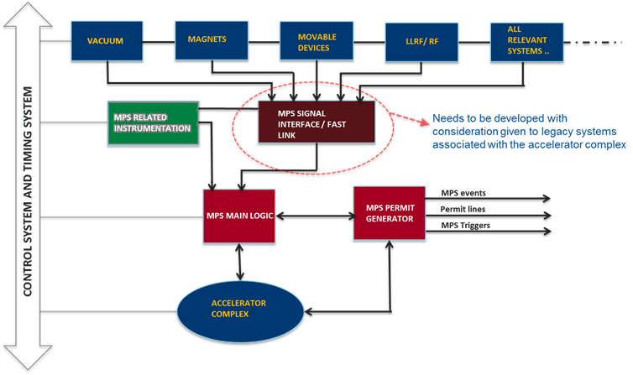
Conceptual Design – Machine Protection
Charge #2
Interfaces with the accelerator control system and machine timing system for configuration management, timing, and post mortem analysis.

Slide 11
Scope and Deliverables
Charge #2
Network Infrastructure
  Central switch plus remote switches for field equipment
Computing Infrastructure
  Consoles for linac area
  Addition servers for central processes
Console and Server software
  Updated application framework, data logging, and other infrastructure software
Application Software
  High level software for control and monitoring
  Drag and drop framework for basic things
  Application framework for more complicated things
  List in BOE document

Slide 12
Scope and Deliverables
Charge #2
Front-End Systems
  Both hardware and software
  List in BOE document
PLC Based Controls
  Vacuum, LCW, RAW controls matched to accelerator design
General Purpose DAQ
  General purposed digitization/digital I/O for basic control, monitoring. Updated version of current Hotlink Rack Monitor
  Dedicated power supply control for higher density systems
Motion Control
  For collimators, scrapers, cavity tuners

Slide 13
Scope and Deliverables
Charge #2
Timing
  New central timing system (ACLK)
  New linac timing system (LCLK) with distribution network to local hardware that needs it
Machine Protection
  Dedicated instrumentation, interfaces to other instrumentation distributed through the linac
  Central system to process inputs and generate permit signal

Slide 14
Controls Interfaces
Charge #2
Top 4 systems this WBS interfaces to:
Top 4 interface within this WBS:
WBS 121.3.17
Linac Controls
WBS 121.3.9/10
RF Integration/Power
Technical & Schedule
WBS 121.3.16
Beam Instrumentation
Technical & Schedule
WBS 121.3.19
General Support Services
Schedule
WBS 121.3.18
Vacuum
Technical & Schedule
WBS 121.3.17
Linac Controls
WBS 121.3.17.4.6
Timing System
Technical & Schedule
WBS 121.3.17.4.7
MPS
Technical & Schedule
WBS 121.3.17.4.1
Network
Infrastructure
Schedule
WBS 121.3.17.4.10
Console & Server Software
Schedule
    Rack & Cable Infrastructure needed for controls installation
    Timing specifications needed for RF, instrumentation, other things
    Machine Protection needs input/specs from subsystems. And MPS needed for beam commissioning
    Commissioning requires both subsystems and control system to be ready
    Network infrastructure needed for controls installation
    Timing specifications needed for design of RF, instrumentation, other things
    MPS specs may drive internal design
    Software infrastructure needed for general controls development
12/13/2017

Slide 15
Progress to date
Charge #2,3
Primary effort has been PIP2IT
Routine beam operation through MEBT
Part of general complex control system
  Newly developed machine protection system
  Adaptation of current timing system
    Parallel to/independent of main complex
Dedicated applications written
  Basic status and control displays
  Dedicated scan and measurement applications
Machine Protection System functional
  Monitoring LEBT chopper and beam coming out
  Monitoring beam transmission to the dump w/ring pickups

Slide 16
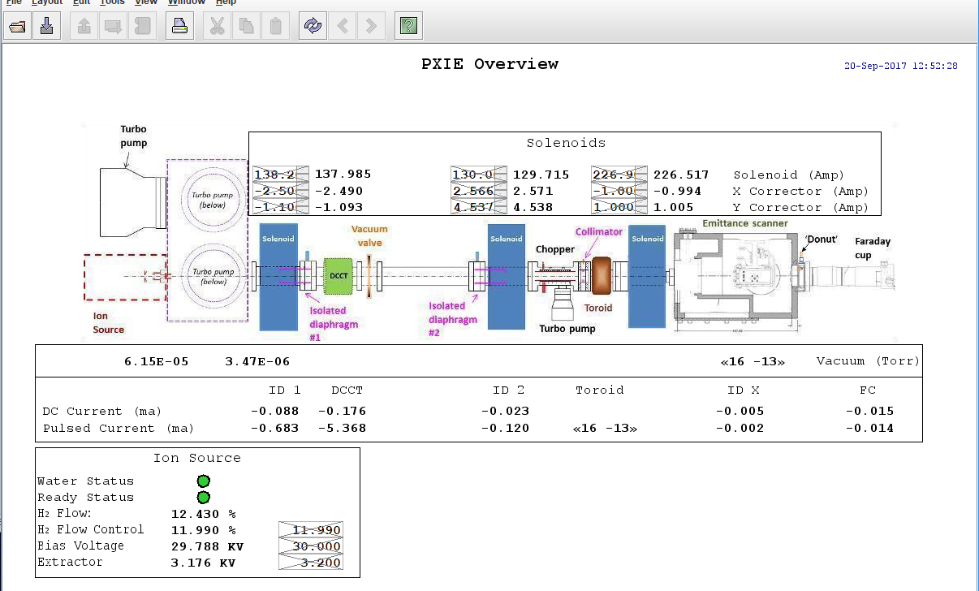
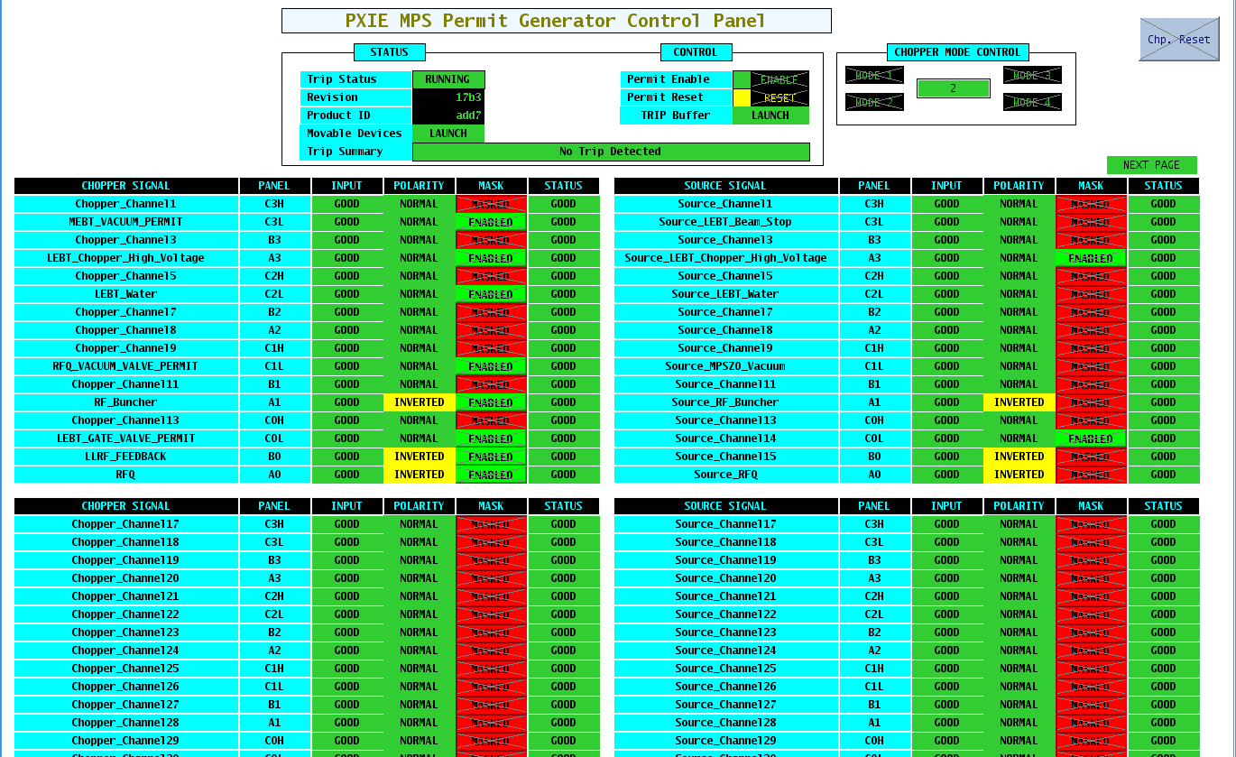
PIP2IT Displays

Slide 17
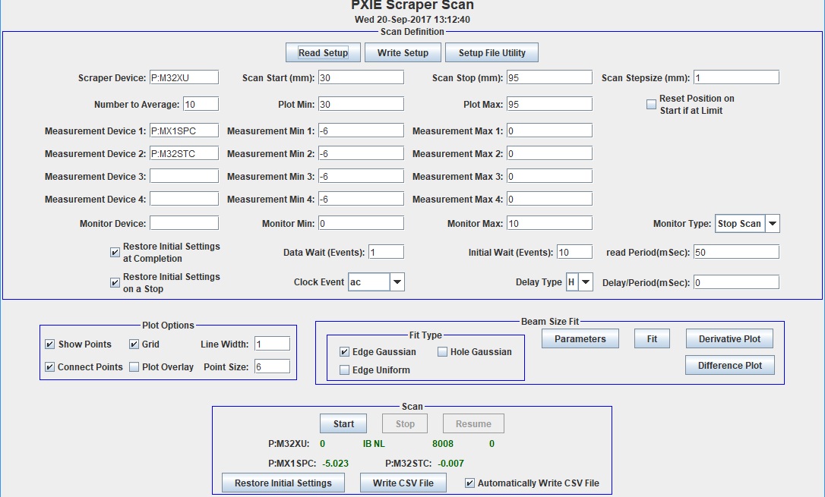
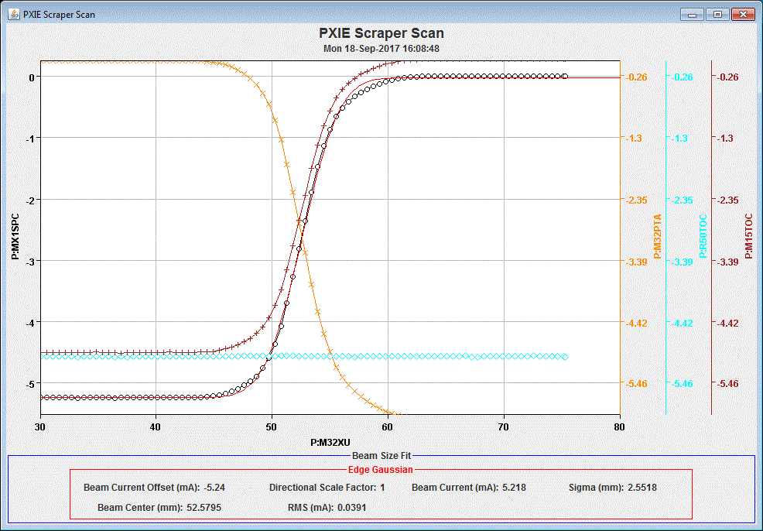
PIP2IT Scraper Scan Application

Slide 18
ESH&Q
Charge #5
Quality Assurance and Control
  Follow Project Quality Assurance Plan (docdb #142)
  Communicate and work with vendors and collaborators
Primary issue is electrical safety
Electrical hazards associated with these systems are covered under the codes below:
  National Electrical Code, NFPA 70
  OSHA 29 CFR, Part 1910, Subpart S, Electrical
  Fermilab ESH&Q Manual, Fermilab Electrical Safety Program

Slide 19
Risk: Controls
Charge #3
Machine Protection System Fails (Allows Beam Event)
Controls interface to existing complex
Internal interfaces to control system

Slide 20
Risk Mitigation: Machine Protection System Fails (Allows Beam Event)
Charge #3
Mitigated by testing at PIP2IT
Currently being commissioned and debugged on warm front-end, where damage probability and cost is very low.
Will be verified with HWR and SSR1 cryomodule systems and interlocks with low duty, pulsed beam.
All aspects of the system will be tested at PIP2IT except for scaling to PIP-II device quantities and the interface to the rings complex.

Slide 21
BOE Summary
Charge #3
WBS Number | Title | Docdb #
121.3.17.3.1 | PIP2IT General Controls | 743
121.3.17.3.2 | PIP2IT Timing | 749
121.3.17.3.3 | PIP2IT Machine Protection | 752
121.3.17.3.4 | PIP2IT Application Software | 755
121.3.17.4.1 | Network Infrastructure | 758
121.3.17.4.2 | Computing Infrastructure | 761
121.3.17.4.3 | PLC Based Controls | 764
121.3.17.4.4 | General Purpose Data Acquisition | 767
121.3.17.4.5 | Motion Controls Infrastructure | 770
121.3.17.4.6 | Timing System | 771
121.3.17.4.7 | Machine Protection System | 776
121.3.17.4.8 | Front-end Systems | 779
121.3.17.4.9 | Application Software | 782
121.3.17.4.10 | Console and Server Software | 785

Slide 22
Cost Summary
Charge #3
Full Burden + Esc = BOE + Escalation + Overhead

Slide 23
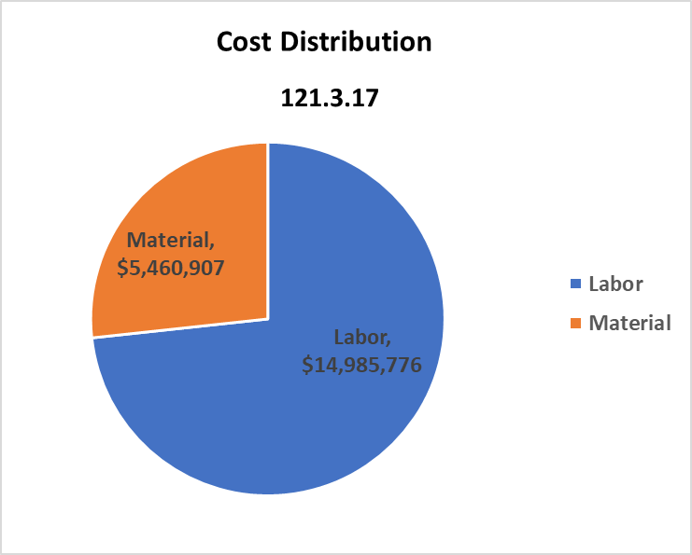
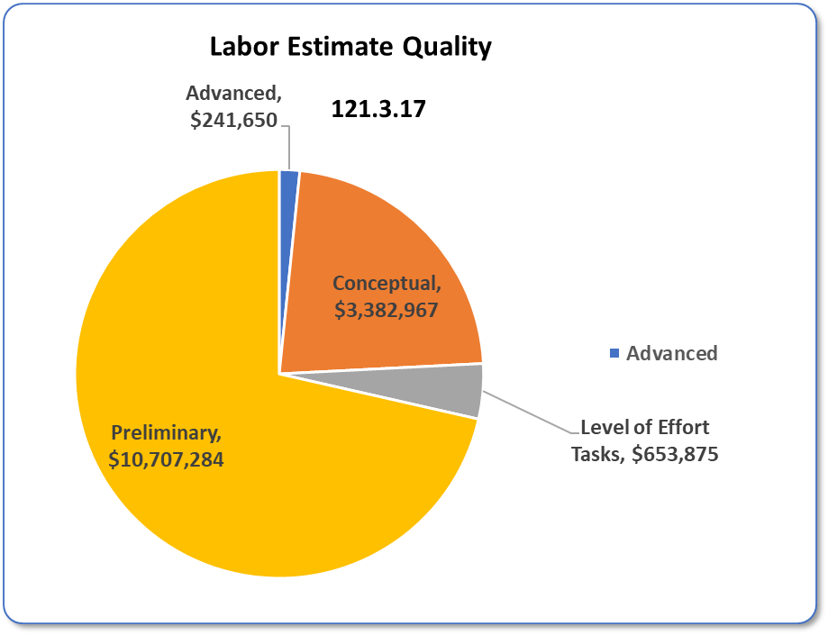
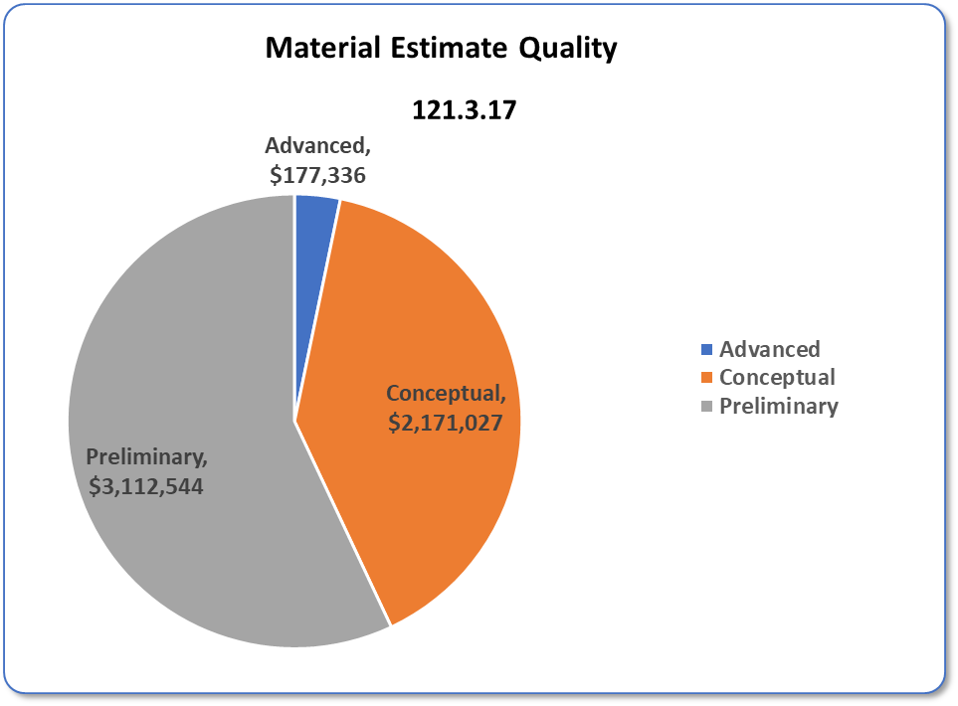
Cost Distribution and Estimate Quality
Charge #3

Slide 24
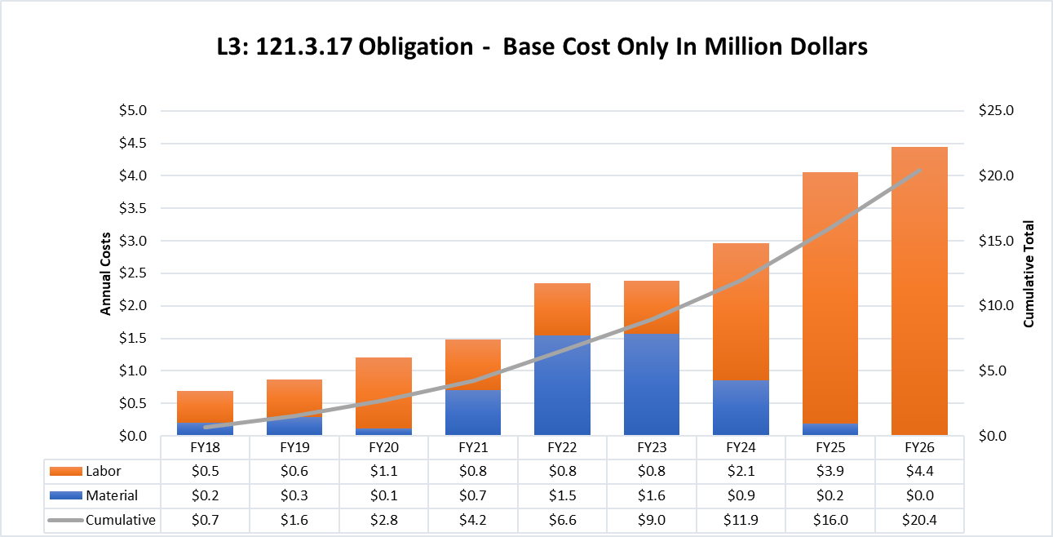
Obligation Profile – P6 Base Cost Only
Charge #3
P6 Base Costs = BOE + Overheads + Escalation
Labor dominates in later years – installation + software development
Detailed schedule has not yet been made – currently planning package
Resource leveling not done

Slide 25
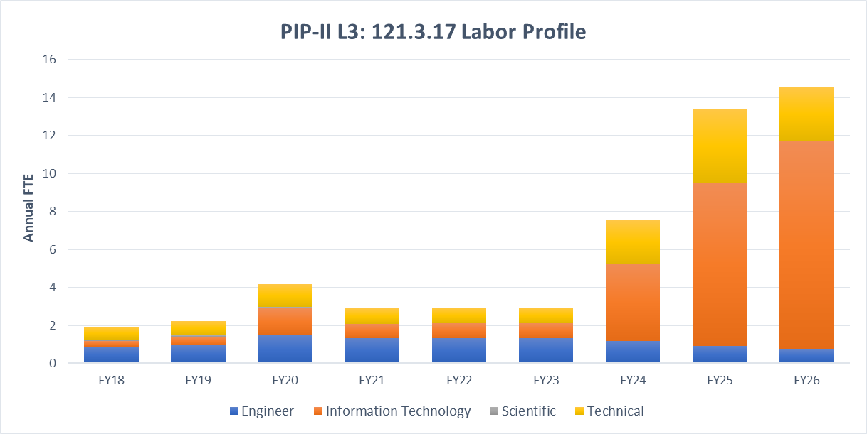
Labor Profile – P6 Hours/FTE
Charge #3
Later years dominated by software development

Slide 26
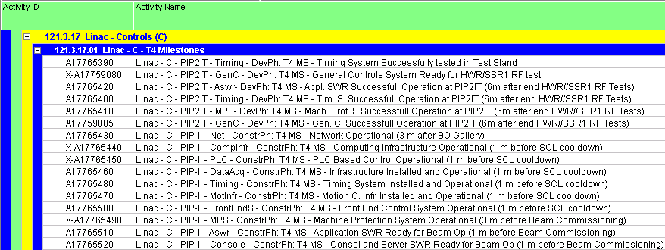
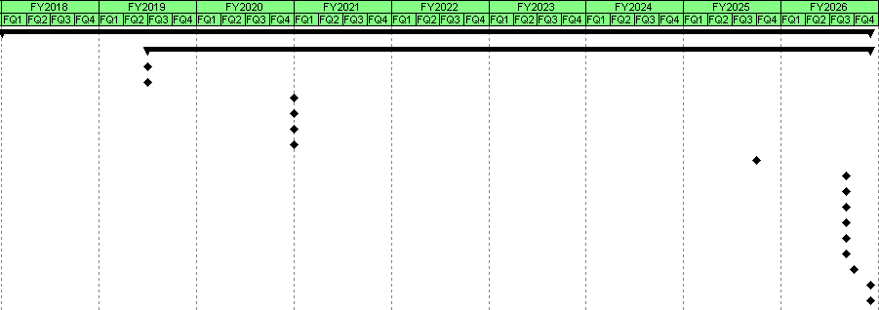
Schedule – Controls
12/13/2017

Slide 27
Summary
Plan is to incorporate PIP-II into the existing accelerator control system
Update and modernize components as needed
PIP2IT is operational using this model
Experience there will influence the final designs
Timing and Machine protection will be new systems
We are ready for CD-1 and look forward to your feedback
Thank you for your attention

Slide 28
END

