Slide 1
121.3.16 Linac - Beam Instrumentation
Breakout Session: RF Systems, Controls, and Instrumentation
Vic Scarpine / Elliott McCrory
PIP-II Independent Project Review
12-14 December 2017

Slide 2
Outline
Requirements
Conceptual Design, Maturity
Scope/Deliverables
Interfaces
Technical Progress to Date
ESH&Q
Risk
Cost
Schedule
Summary

Slide 3
About Dr. Scarpine
Victor Scarpine, PIP-II Beam Instrumentation, Level 3
  L3 Manager for PIP-II Linac beam instrumentation
Relevant experience
  Accelerator Division Application Physicist III
  15 years experience in development and operation of beam instrumentation
    Development of HINS front-end beam instrumentation
    Development of Fermilab RFQ commissioning beam instrumentation
    Development of PIP2IT beam instrumentation

Slide 4
About Me
Elliott McCrory, PIP-II Beam Instrumentation, Level 3
  Backup L3 Manager to Scarpine for Beam Instrumentation
Relevant experience
  Accelerator Division Senior Scientist
  Experience
    Developed all Beam Diagnostics for 1993 Linac Upgrade project
    LHC instrumentation commissioning and operation, 2007-2010
      BPMs and Schottky
    6 years in AD/Instrumentation Department
      Linac and Recycler BPM systems, 2013-present
      Front end software engineer

Slide 5
Scope: WBS Dictionary
WBS Dictionary: pip2-docdb #599
121.3.16 Linac – Beam Instrumentation | This WBS entry covers design, procurement, fabrication, and testing of the Beam Instrumentation Systems.

Slide 6
WBS L3 System Requirements (1/2)
Charge #2
Linac Beam Instrumentation shall measure, process, and record Linac beam parameters required to verify, and to diagnose changes in, beam quality and losses during commissioning and during normal operation
Sub-systems:
  Beam current monitors (BCM):
    Measure current and intensity of the beam transported from the source thru the LEBT, MEBT, SC Linac, and transport sections.
    Integration of beam current measurements into MPS
    Measurement of MEBT chopper bunch-by-bunch extinction efficiency
Unique

Slide 7
WBS L3 System Requirements (2/2)
Charge #2
Sub-systems (cont’d)
  Beam position monitors (BPM):
    Measurements of transverse position, phase and intensity via warm and cold BPMs
      FRS ED0003675 – MEBT BPM
      TRS ED0005680 – SSR1 BPM
  Beam loss monitors (BLM):
    Measure of ionizing particles and neutrons
  Beam profile measurements:
    Transverse and longitudinal profiles
      FRS ED0004340 – MEBT wire scanner
    Transverse emittance
      FRS ED0004080 – MEBT emittance scanner

Slide 8
Conceptual Design
Charge #2
Summary
Beam current
  Based on systems currently operating at Fermilab
Beam position & phase and beam loss
  Based on systems currently operating at Fermilab
Beam profiles (2 slides)
Total: 4 slides
All designs are very mature
  But see risk register

Slide 9
Conceptual Design – Beam current
Charge #2
Three types of Beam Current Monitor (BCM) systems
  Toroids,
  DC (Direct Current) Current Transformer (DCCT)
  Wall current monitors
Based on systems currently operating at Fermilab
  Raw signals are conditioned in a “transition board,” digitized and processed by a digitizer, and interfaces to the control system through a front-end
  Resources will be applied to the design, programming, and testing of alternatives to the current front end standard during the R&D phase
Very Mature

Slide 10
Conceptual Design – BPM & BLM
Charge #2
Beam Position Monitors
  4-button BPM vacuum pickup
    Separate designs for warm and cold BPMs
  Electronics
    Analog transition boards
    FPGA-controlled digitizers for signal analysis
  Bunch-by-bunch position measurement for four of the MEBT BPMs
    Utilize oscilloscopes for signal acquisition
Beam Loss Monitors
  Pickups
    Ionization beam loss monitors
    Fast PMT-based beam loss monitors
    Neutron detectors
  Electronics
    Analog transition boards
    VME-based FPGA-controlled digitizers for signal analysis
    Supported with software
      FPGA firmware
      Front-end controller interfaces to the ACNET control system
        Accelerator Controls NETwork
Very Mature

Slide 11
Conceptual Design – Beam profiles (1/2)
Charge #2
Transverse beam profiles
  Wire-based transverse profile monitor
    Two-wire secondary emission monitors
    Linear motion actuators and FPGA-based signal processing electronics
    Installed into warm MEBT and transfer beamline
  Laser-based transverse beam profile monitor
    Installed in cold section of SC Linac
    Single laser source located in a laser room, outside of the beam enclosure and near the ion source.
    Enclosed line transports laser light from the laser room via fiber optics or free-space to each laser transverse profile monitor locations
    Laser monitor will include a light-tight optics box with required optics and motion to provide the required laser scanning across the beam, as well as electron collection to measure the profile
Very Mature

Slide 12
Conceptual Design – Beam profiles (2/2)
Charge #2
Transverse emittance monitor systems
  LEBT and MEBT - Allison-style emittance scanners
    PC-based data acquisition and controls
    Very mature
  Transfer line - laser-based emittance scanner
    Similar to existing system at Spallation Neutron Source (SNS)

Slide 13
Scope and Deliverables
Charge #2
Summary
Beam position
Beam loss
Beam profiles
Total: 3 slides
We believe there is an excellent opportunity for DAE to supply several of the BI deliverables
  Agreement finalized before CD-2

Slide 14
Scope and Deliverables – Beam position
Charge #2
Deliverables:
  Beam position monitor pickups
    89 warm 4-button pickups
    37 cold 4-plate pickups in HWR, SSR1 and SSR2
  Signal processing electronics, crates and cables
  Fermilab provides
    All cold BPMs
    12 MEBT 4-button BPMs
  We plan to have DAE provide
    R&D prototype signal processing electronics
    78 4-button warm BPM for construction
    512 channels of analog and digital electronics for construction

Slide 15
Scope and Deliverables – Beam loss
Charge #2
Deliverables:
  Beam loss monitor pickups
    115 ionization chamber pickups
    115 PMT-based scintillator pickups
    25 neutron detectors
  Signal processing electronics, crates and cables
  We plan to have DAE provide
    115 assembled and tested ionization loss monitor detectors
    115 assembled and tested PMT-based fast loss monitor detectors
    25 assembled and tested neutron detectors
    Analog and digital DAQ electronics, electronic crates and software to support basic operation of above loss monitor detectors
    HV power supplies to operate above list of loss monitor detectors

Slide 16
Scope and Deliverables – Beam profiles
Charge #2
Deliverables:
  Beam profile monitors
    16 laser-wire transverse profile monitors
    4 wire scanner transverse profile monitors
    4 transverse emittance scanners
  Signal processing electronics, crates and cables
  Fermilab
    Provides all beam profile monitors
    Tests Allison emittance scanners (LEBT and MEBT) at PIP2IT
    Prototypes wire profile monitor and laser wire profile monitor at PIP2IT
    Prototype MEBT laser-based longitudinal profile monitor at PIP2IT

Slide 17
Interfaces
Charge #2
WBS 121.3.16
Beam Instrumentation
WBS 121.3.17
Linac - Controls
If the control system is not complete we will not be able to fully test the instrumentation
WBS 121.3.18
Linac - Vacuum System
Without a viable vacuum system, beam instrumentation cannot operate
WBS 121.3.5,6
Linac- SSR1,SSR2
Delays in delivery of cryo modules will delay final installation and commissioning of beam instrumentation
WBS 121.3.16 Beam Instrumentation
WBS 121.3.10 – RF Integration
WBS 121.3.4 – Half-wave resonator
WBS 121.3.3 – Warm front end
Many systems will rely on proper beam instrumentation for commissioning and operations.

Slide 18
Technical Progress to date
Charge #2,3
Summary
Significant BI work has been completed for the PIP2IT project. This work is directly applicable to PIP-II
Systems covered here:
  Beam current
  BPM
  Transverse emittance
  Total: 3 slides
Our team is already functioning well at this early stage
Our design is on track

Slide 19
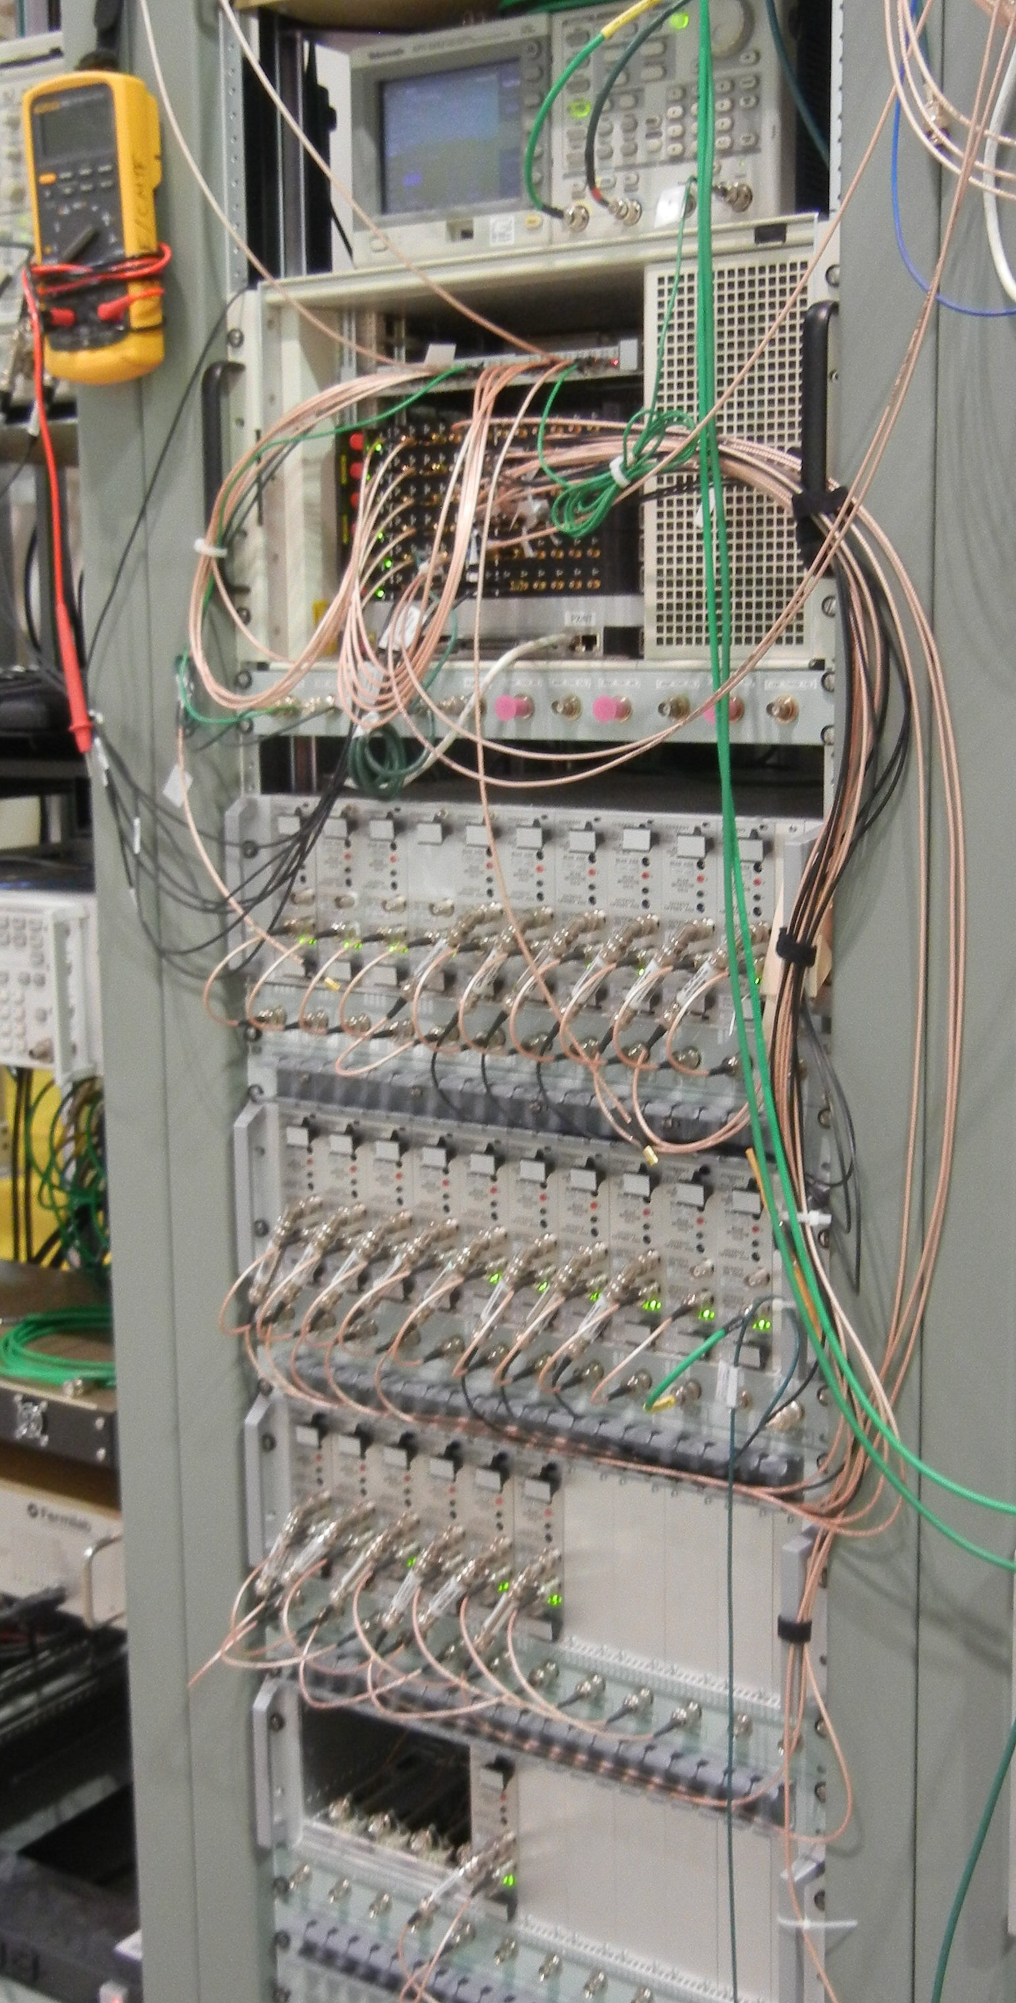
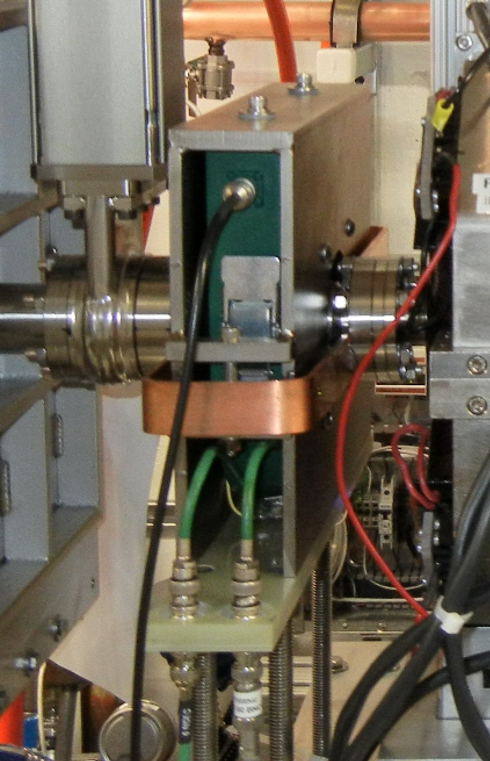
Tech. Prog. to date – Beam current
Charge #2,3
Installation and testing of current measurements at PIP2IT
  PIP2IT LEBT – DCCT and Toroid
  PIP2IT MEBT – Toroids, Faraday cup dump, ring pickups, wall current monitor and EIP (scrapers)
Utilize FPGA-based 8-channel, 125 MHz, 14 bit digitizer cards
  Integrates with MPS
Analog transition/bias cards
  Bias up to +100 volts

Slide 20
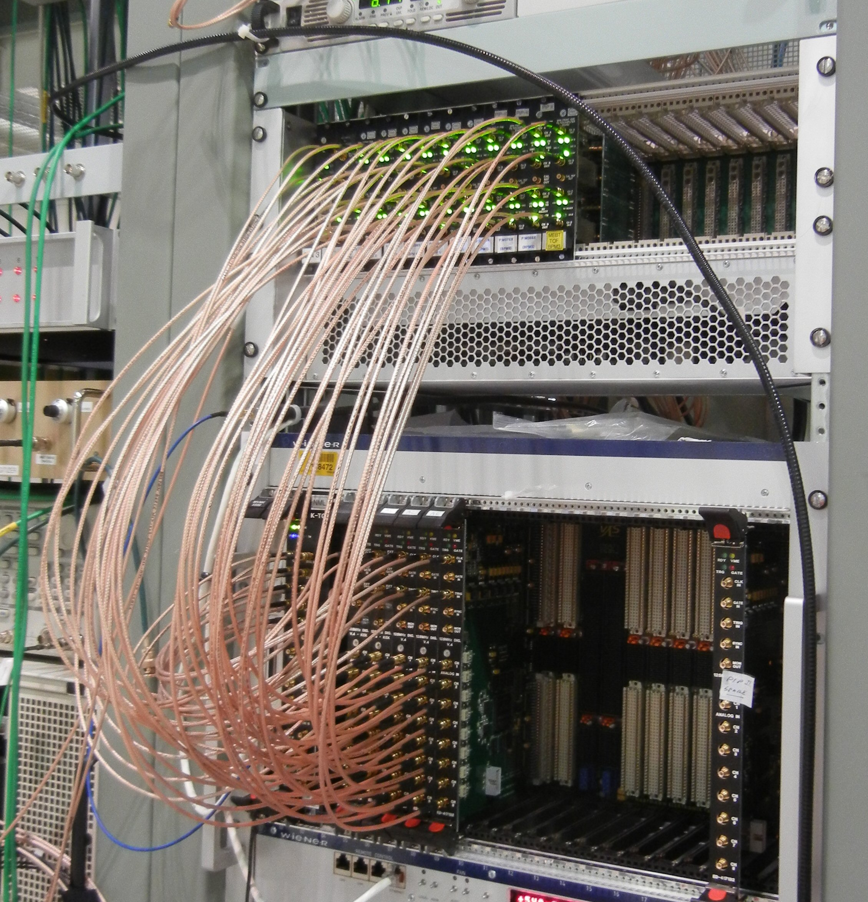
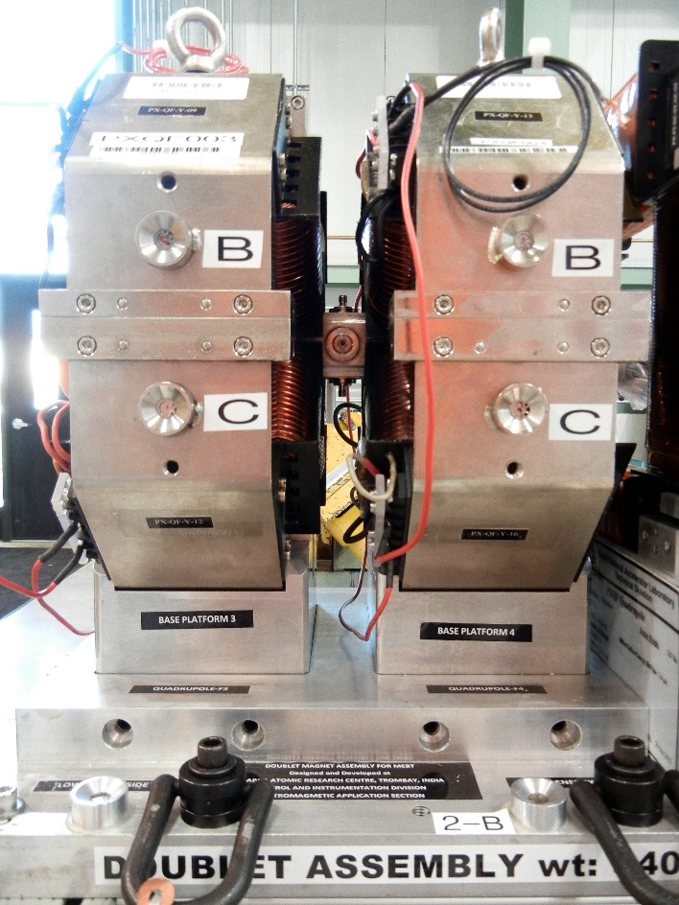
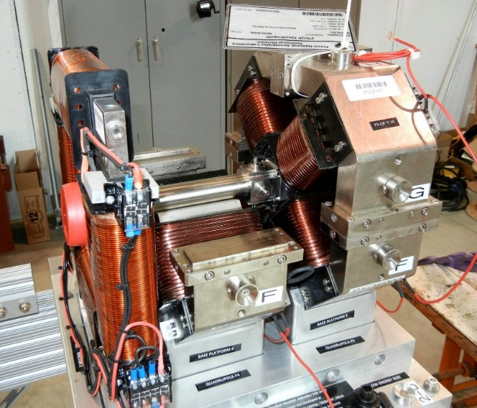
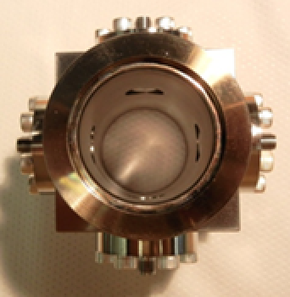
Tech. Prog. to date – Beam position
Charge #2,3
Installation and testing of BPMs in PIP2IT MEBT
  4-button BPMs attached to quad magnet
  DAQ with FPGA-based electronics for CW and pulsed beam
  Analog filter & amp boards
  8 channel, 14 bit, 125 MSPS boards
4-buttom BPM

Slide 21
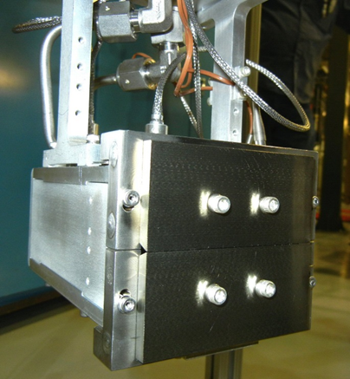
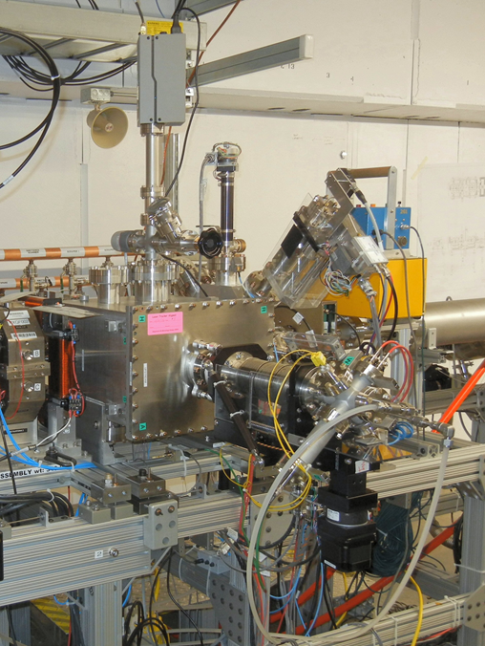
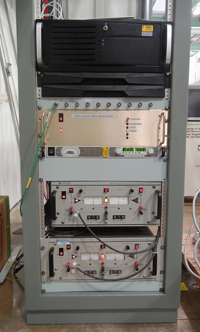
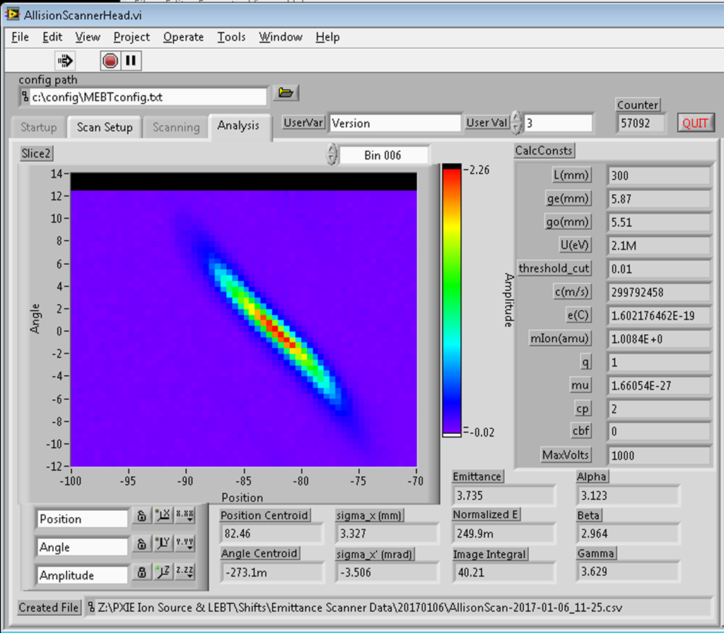
Tech. Prog. to date – Transverse emittance
Charge #2,3
Installation and testing of emittance scanners in PIP2IT LEBT and MEBT
  Water-cooled Allison-style scanners
  PC-based DAQ and motion control

Slide 22
ESH&Q
Charge #5
Project team is committed to construct PIP-II in a safe, environmentally respectful, and cost efficient manner that meets our stakeholders’ needs
Safety is an essential element in all work we do
  Project Integrated Safety Management Plan (docdb #141)
  Laboratory and DOE standards and practices
    Fermi Radiological Control Manual
    Fermi ES&H Manual
Quality Assurance and Control
  Project Quality Assurance Plan (docdb #142)
Lasers present a unique hazard
  Covered under safety documents:
    Fermilab FESHM 4260 – Lasers
    ANSI Z136.1 – Safe Use of Lasers

Slide 23
Preparing for CD-2
Charge #3,4
Finalize all agreements for international deliverables.
Finalize functional interfaces between other subsystems
  For example, Controls and MPS
Complete the development of a work package from the current planning package

Slide 24
Risk: Instrumentation
Charge #3
Choice of laser profiling technology (Transverse Profile)
Integration of instrumentation into MPS

Slide 25
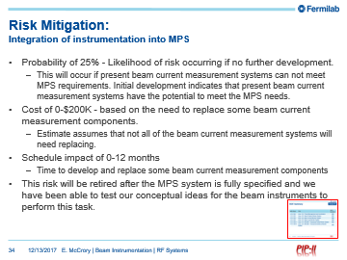
Risk Mitigation:
Choice of laser profiling technology (Transverse Profile)
Charge #3
Two options for laser profiling:
  Low-power lasers
    Preferred choice
    But needs beam measurements as proof of operation
  High-power lasers
    Has been demonstrated at SNS
    But …
      More complicated
      Possible damage from laser
Plan to test low-power option with beam at PIP2IT
  If unsuccessful then fall back to high-power option for PIP-II
Laser profiling PIP-II infrastructure allows for possibility of either laser option as final choice

Slide 26
BOE Summary
Charge #3
WBS Num | Title | PIP2 DocDb #
121.3.16.2 | Linac - BI - Project Management and Coordination | 650
121.3.16.3 | Linac - BI - Beam Position Monitor System | 653
121.3.16.4 | Linac - BI - Beam Current Monitor System | 656
121.3.16.5 | Linac - BI - Beam Loss Monitor System | 659
121.3.16.6.1 | Linac - BI - BProMS - Transverse Profile Monitor System | 662
121.3.16.6.2 | Linac - BI - BProMS - Transverse Emittance Monitor System | 668
Content

Slide 27
Cost Summary
Charge #3
Full Burden + Esc = BOE + Escalation + Overhead

Slide 28
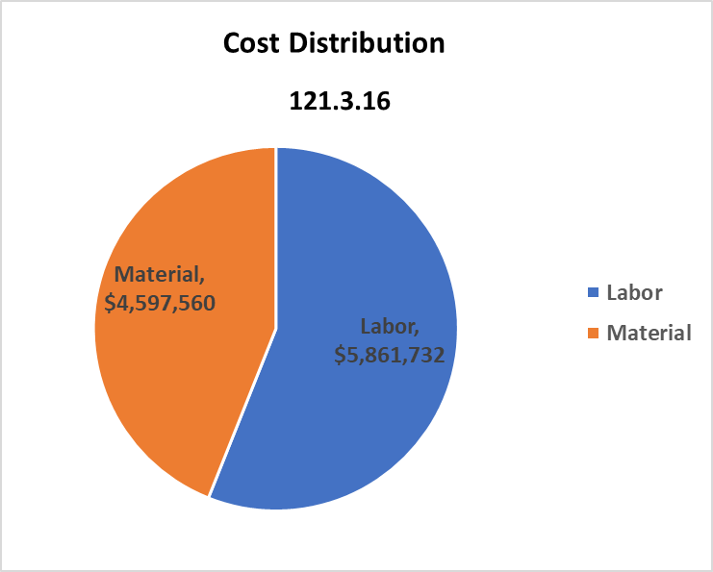
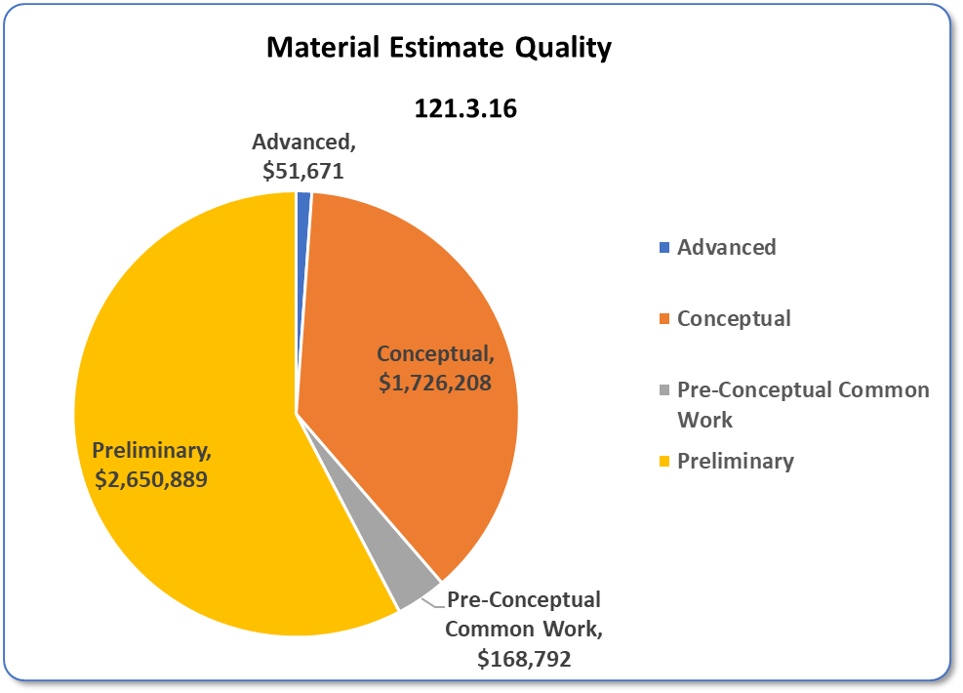
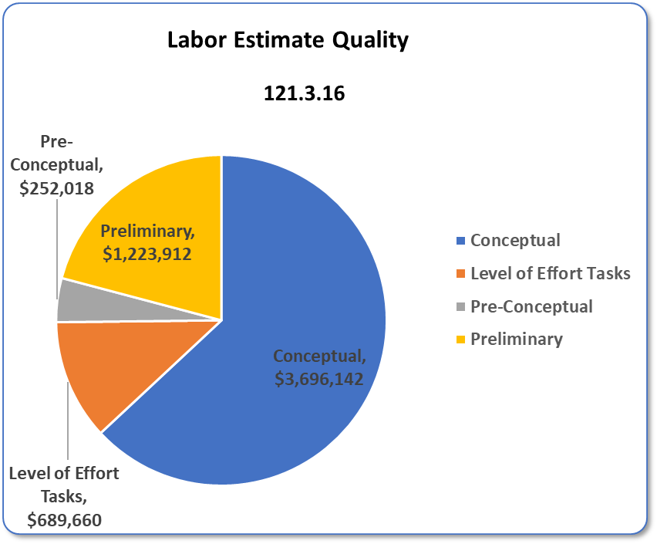
Cost Drivers and Estimate Maturity
Charge #3
Material,
$4,597,560
Labor,
$5,861,732
Conceptual,
$3,696,142

Slide 29
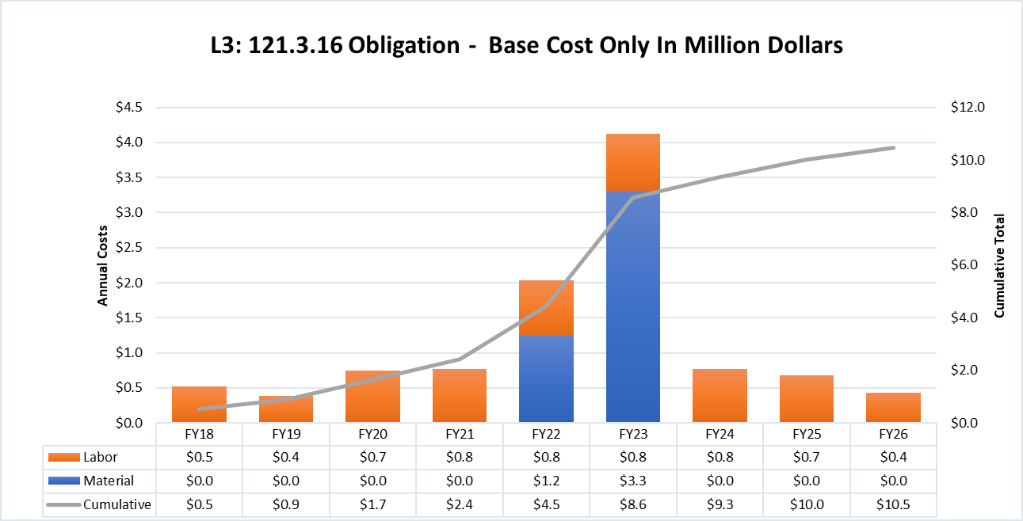
Obligation Profile – P6 Base Cost Only
Charge #3
Costs = BOE + Overheads + Escalation
FY22 jump is when we have the authority to purchase the materials we need.

Slide 30
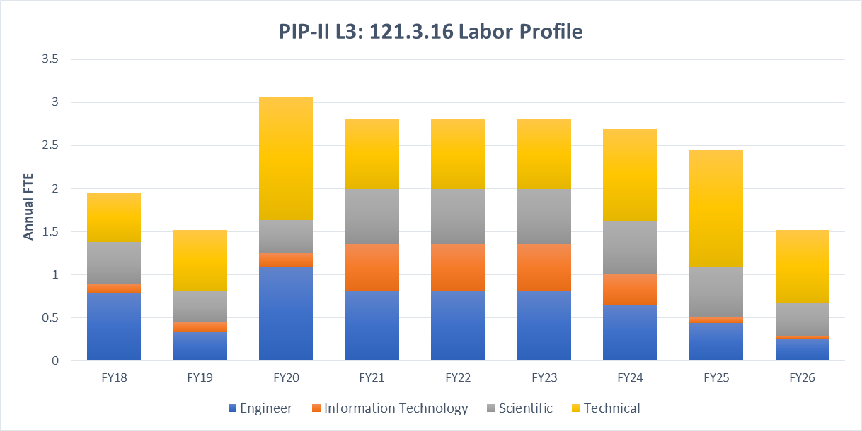
Labor Profile – P6 Hours/FTE
Charge #3

Slide 31
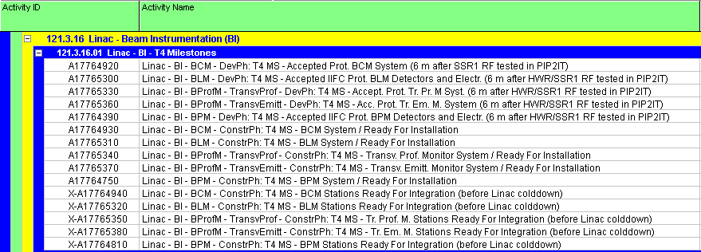
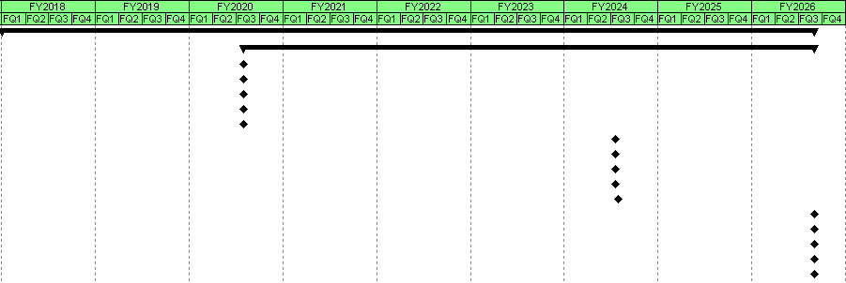
Schedule – Beam Instrumentation
Activity ID
Activity Name

Slide 32
Summary
Instrumentation plan for PIP-II proceeding
Most systems are fully-prototyped
All conceptual designs based on well tested technology
Conceptual design to final design appears fairly straight forward
Many instrumentation systems being tested at PIP2IT
  Testing at PIP2IT invaluable to instrumentation development
  Risk items being addressed at PIP2IT
We are ready for CD-1 and look forward to your feedback

Slide 33
END
Thank you for your attention and comments.

Slide 34
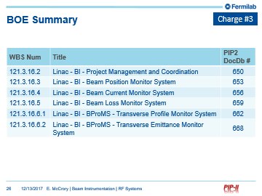
Risk Mitigation:
Integration of instrumentation into MPS
Probability of 25% - Likelihood of risk occurring if no further development.
  This will occur if present beam current measurement systems can not meet MPS requirements. Initial development indicates that present beam current measurement systems have the potential to meet the MPS needs.
Cost of 0-$200K - based on the need to replace some beam current measurement components.
  Estimate assumes that not all of the beam current measurement systems will need replacing.
Schedule impact of 0-12 months
  Time to develop and replace some beam current measurement components
This risk will be retired after the MPS system is fully specified and we have been able to test our conceptual ideas for the beam instruments to perform this task.

