Slide 1
WBS 121.5 – Conventional Facilities
Conventional Facilities Procurements
Steve Dixon
PIP-II DOE Independent Project Review
12-14 December 2017

Slide 2
Agenda
Architect/Engineer Subcontracts
Construction Subcontracts

Slide 3
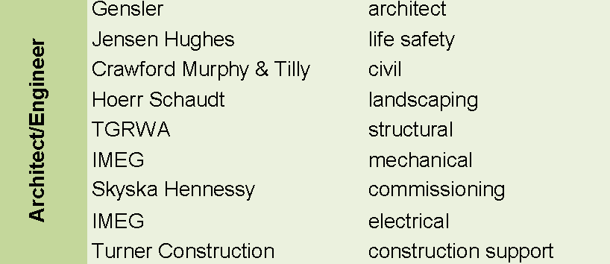
Architect/Engineer (A/E) Subcontract
A/E team selected in February 2017;
Utilized standard Finance/Procurement procedures;
Selection Panel included PIP-II, Procurement, FESS/Engineering and ESH&Q representatives;
Selected for Preliminary Design, Final Design and Construction Phase support;

Slide 4
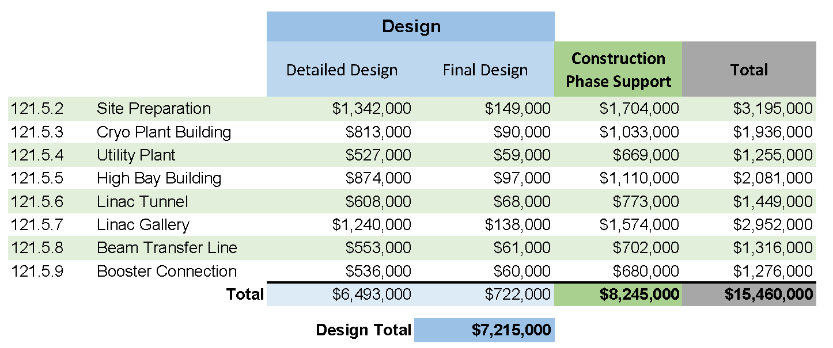
Architect/Engineer (A/E) Subcontract
Base costs only (no escalation or contingency)
Support costs from Basis of Estimate forms;
In FY16 dollars;

Slide 5
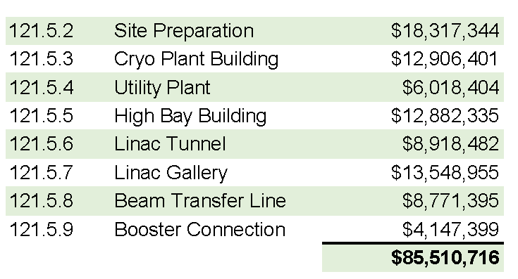
Construction Package Subcontracts
Base costs only (no escalation or contingency)
In FY16 dollars

Slide 6
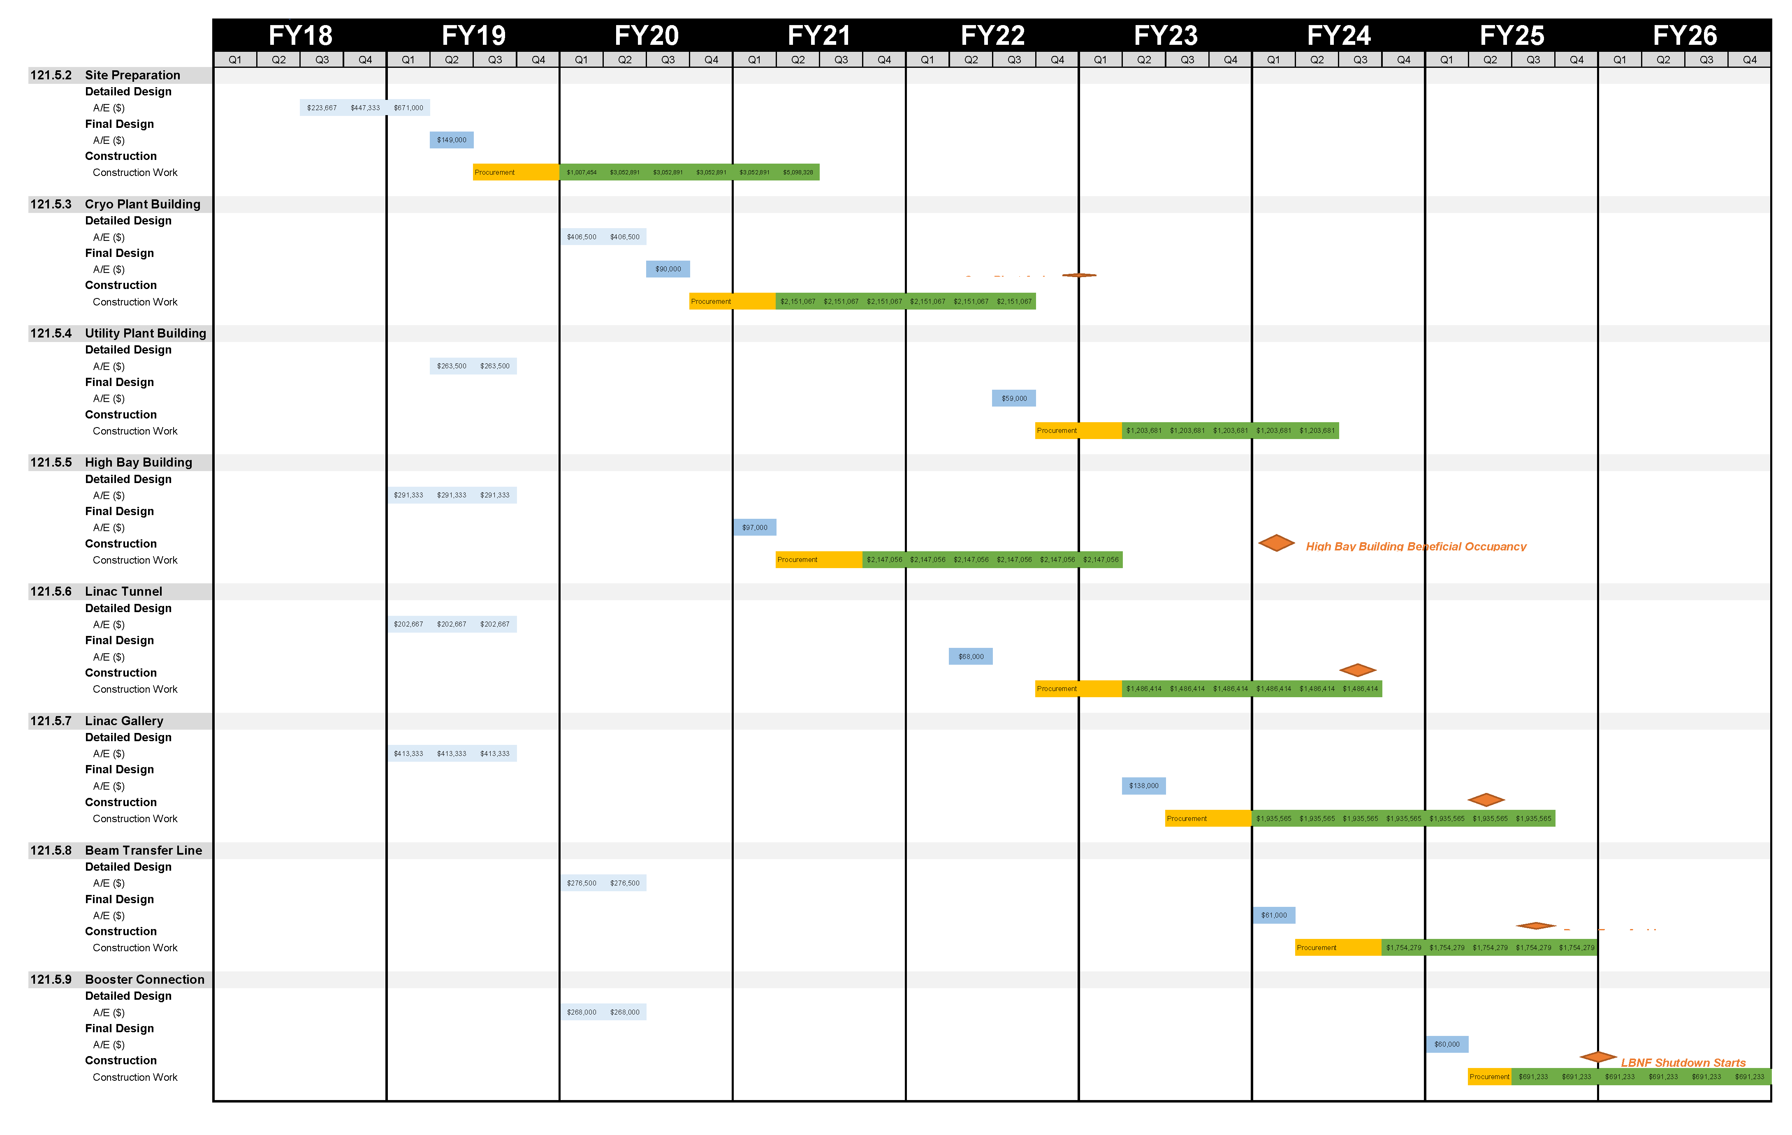
Construction Package Subcontracts

Slide 7
Construction Package Subcontracts
Booster Connection
Utility Plant, Linac Tunnel, Beam Transfer Line
Site Prep, Cryo Plant, High Bay Building, Linac Gallery
From “Fermilab Projects Procurement Support” presentation, dated 15JUL2015

Slide 8
Construction Package Subcontracts
Construction subcontract procurement duration incorporate this requirement (see PIP-II-doc-321)
From “Fermilab Projects Procurement Support” presentation, dated 15JUL2015

Slide 9
Construction Package Approach
“Design-bid-build” for construction packages;
Standard Fermilab procurement methods and requirements;
“Conventional Facilities construction will primarily be accomplished through a number of competitively solicited, fixed price construction packages in order to achieve best value procurements.” [1]
[1] – from Section 6 of PIP-II Assumptions Document in PIP-II-doc-144

Slide 10
Next Steps
Construction Packages:
Prepare Advanced Procurement Plans (APP);
Prepare Acquisition Plans (AP)

Slide 11
Summary
The major subcontracts have been identified;
The A/E subcontract is in place;
The subcontracts are aligned with the resource loaded schedule;
Following standard Fermilab procedures and guidelines;

Slide 12
Questions

