Slide 1
International Collaboration
Project Management Breakout Session
Steve Holmes
PIP-II CD-1 Independent Project Review
12-14 December 2017

Slide 2
Outline
Context
Goals
IIFC Organization
Strategy
Challenges
Summary
Meeting participants:
  India/DAE: K.N. Vyas, S.C. Joshi, S. Krishnagopal
  Italy/INFN: C. Pagani
  UK/STFC: P. McIntosh, A. Wheelhouse
  France/CEA: O. Napoly
  France/IN2P3: J-L. Biarrotte

Slide 3
Context/India
India Institutions and Fermilab Collaboration (IIFC) formed in 2009 to pursue R&D on technologies for high intensity superconducting proton accelerators:
  BARC
  IUAC
  RRCAT
  VECC
Governed by US-India agreements:
  DAE authorized to commit up to $200M
  (in-kind) for R&D + construction deliverables
R&D phase
  Deliverables described in the “Joint Project Document for the R&D Phase of the IIFC under the Framework of Project Annex-I to the Implementing Agreement between DAE and DOE”
  Involved in nearly all linac systems
U.S.-India S&T Agreement
Implementing Agreement
Annex I
Joint Project Documents

Slide 4
Context/Europe
Italy/INFN
  INFN/Milano fabricate two LB650 dressed cavities prototypes
  Integrated with Fermilab and VECC to develop common design
  Construction phase scope (LB650 cavities) has been proposed to INFN
UK/STFC
  Announced in October, $88M (£65M) proposed contribution to LBNF/DUNE/PIP-II
    $28M earmarked for PIP-II
  Developing a plan for contributing three (of four required) HB650 cavities & cryomodules
  Plan to be reviewed by UK government
France/CEA
  Discussions on assembling LB650 cryomodules based on cavities from INFN and/or VECC
  Management recently engaged in discussion
France/IN2P3
  Discussion of collaboration with CEA on LB650 CMs, or direct collaboration with Fermilab on SSR2
  Management recently engaged in discussion

Slide 5
Context
PIP-II Cost Estimate is based on the following assumptions with respect to international deliverables:
Component | Component Fraction Provided
 | India/DAE | Other Int’l
Dressed Cavities
SSR2 | 50%
LB650 | 50% | 50%
HB650 | 50%
Cryomodules
LB650 |  | 100%
HB650 |  | 75%
Linac Warm Magnets | 100%
RF Amplifiers
325 MHz | 100%
650 MHz | 100%
Controls Hardware | 50%
LLRF, RFPI Hardware | 100%
Instrumentation | 50%
Cryoplant | 100%
From Assumptions Document: PIP-II-doc-144

Slide 6
Context/Integration into P6
International deliverables are represented by delivery milestones in P6
  Labelled I3 and I4 milestones
  The cost of international deliverables is not captured
Delivery milestones are preceded by milestones for our standard engineering review process (FRS/TRS → PDR→FDR →PRR)
P6 captures effort and other resources (e.g. travel) required to provide coordination with international partners

Slide 7
International Partner Goals
Development Phase
  Develop capabilities, infrastructure, and working relationships between Fermilab, international partner labs, allied vendors to support construction of the PIP-II linac
Construction Phase
  Construct and commission PIP-II with a significant international in-kind contributions, and significant engagement of international staff
Challenges
  Success requires consistent attention and guidance from management
  Continuous constructive interaction at the technical level is essential in making this work

Slide 8
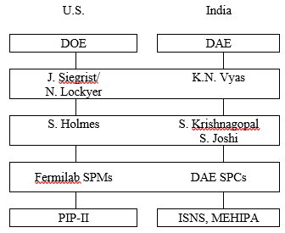
IIFC Organization
Scope and deliverables schedule for R&D phase are governed by the Joint R&D document
  Signed by S. Basu and J. Siegrist
High level management via two Principal Coordinators, supported by three Technical Coordinators
  TC weekly teleconference
Technical integration of work via Fermilab SPMs and Indian SPCs
  SPM/SPC bi-weekly teleconferences
Semi-annual meetings
  January/July 2016/January 2017 (BARC)
  December 2017 (Fermilab)

Slide 9
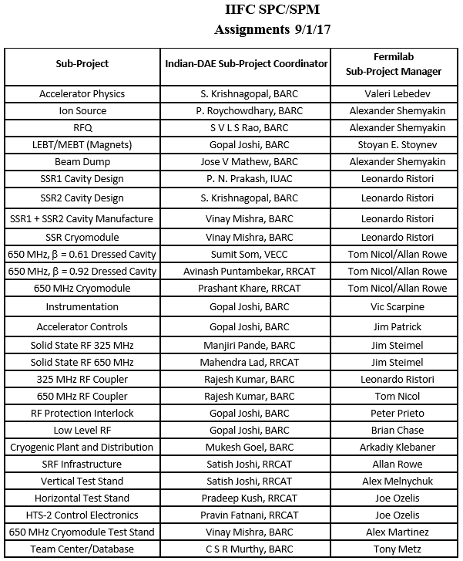
SPC/SPM Assignments
Within Fermilab SPMs are typically Level 3 managers within PIP-II Project

Slide 10
Mapping PIP-II onto Institutional Interests
DAE interests
  Acquiring and developing capabilities, intellectual and physical, to construct high power proton accelerators domestically
  Result: DAE is engaged in all critical systems
INFN, STFC, CEA, and IN2P3 interests
  Contributing to early realization of full capabilities of PIP-II to support MW+ neutrino program
  Building/enhancing domestic capabilities in SRF technologies
Development phase scopes of work based on consideration of:
  Institutional technology interests
  PIP-II risk mitigation strategies
  Vision of construction phase deliverables

Slide 11

PIP-II International Areas of Interest
INFN/CEA/IN2P3
IN2P3
STFC
DAE

Slide 12
Major IIFC R&D Deliverables
System/Component | DAE R&D Deliverable
SSR1 | 2 dressed cavities
SSR2 | 2 bare cavities
LB650 | 2 dressed cavities
HB650 | 4 dressed cavities
SC solenoids | 4 magnets (SSR2)
Warm magnets | All PIP2IT/MEBT magnets 2 focusing magnets (650)
RF Power Sources/325 | 9 sources (SSR1)
RF Power Sources/650 | 7 sources (HB650)
LLRF/RFPI | 4 systems (SSR1,2xHTS-2, CMTF)
HTS-2 | 2 test stands (FNAL & RRCAT)

Slide 13
Integration into the PIP-II Development Phase
Development phase deliverables generally include
  Development and testing of prototypes
  Development of infrastructure
  Engineering documentation
DAE is strongly integrated into the Development Phase
  SSR1 cryomodule to be constructed of 6-7 (Fermilab) + 1-2 (IUAC/BARC) cavities
  HB650 cavity to be constructed of 4-5 (Fermilab) + 1-2 (RRCAT) cavities
  325 MHz 7 kW SSRF amplifiers from BARC to power the SSR1 CM at PIP2IT
  650 MHz 40 kW SSRF amplifiers from RRCAT to power the HB650 CM at CMTS
INFN
  Have completed LB650 cavity electromagnetic design
    In close coordination with VECC and Fermilab
  Approved by Fermilab and proceeding to mechanical design
STFC, CEA, IN2P3
  Initial discussions on incorporating into development phase, once have common vision of construction phase deliverables
  LB650 and HB650 cryomodules

Slide 14
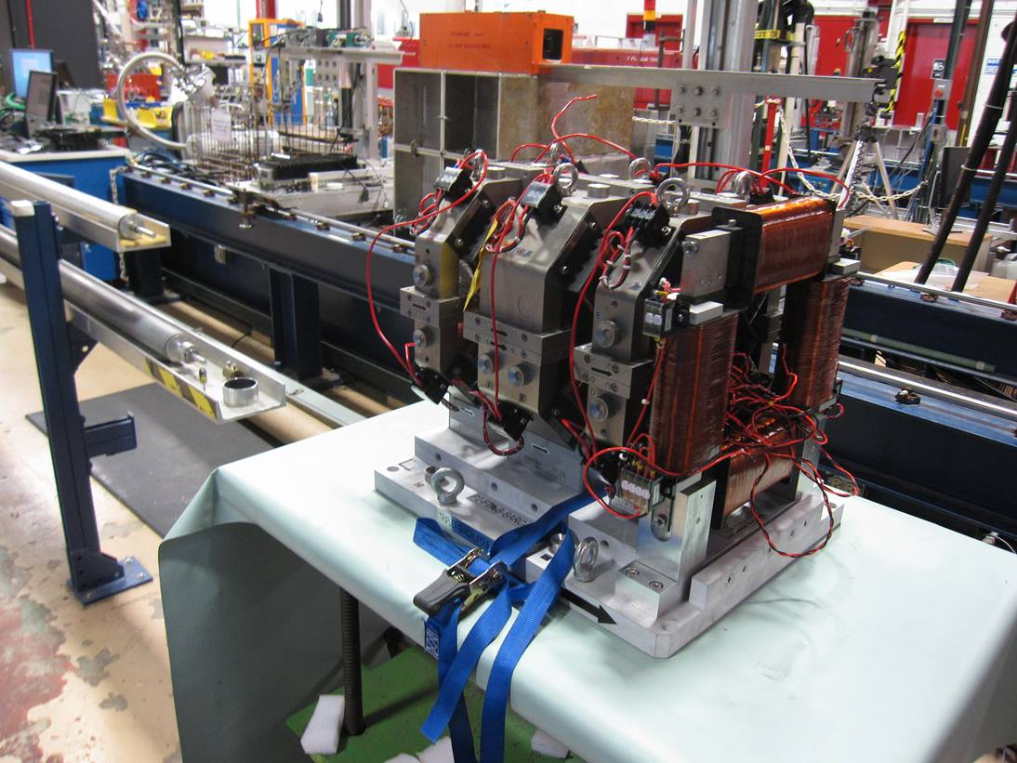
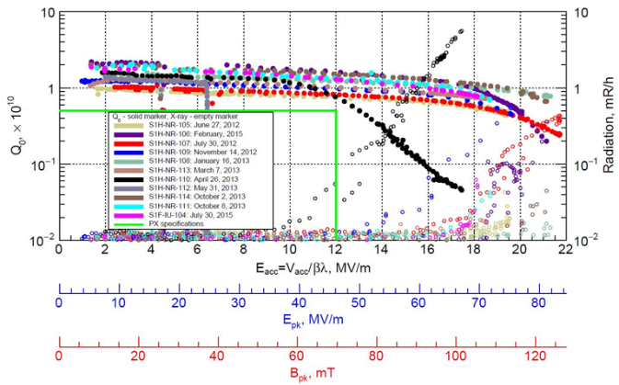
Progress to Date
DAE has delivered:
  Complete set of focusing quadrupoles and correction dipoles required for the PIP2IT MEBT
  Two SSR1 bare cavities
  3 kW SSRF amplifier
  RFPI board
DAE in process:
  Prototype 5-cell HB650 cavity
  325 MHz 7 kW SSRF amplifiers
  650 MHz 40 kW SSRF amplifiers
  SSR2 cavity design
  LB650 5-cell cavity design and fabrication
  LB650 cryomodule design
INFN in process:
  LB650 cavity design and fabrication

Slide 15
Construction Phase
Formal agreements with international partners for construction phase deliverables are not in place at this time.
However, DAE is authorized under Annex I to provide deliverables worth up to $200M (in-kind) for PIP-II
  R&D + Construction phases
  Cryogenic Plant procurement by BARC is currently underway
    Bidding two plants, with intention of one coming to Fermilab
    Capable of supporting CW operations
Plan is to complete and formalize agreements covering all international construction phase deliverables in advance of CD-2

Slide 16
International Risks
Two entries in the risk register related to international contributions are categorized as External Risk, i.e. belong to DOE/HEP & Fermilab; not included in risk analysis:
  RT-121-01-01-001: Failure to reach agreement on international in-kind contributions
  RT-121-01-01-002: Delay in formalizing international in-kind contributions
International risks belonging to the project:

Slide 17
Risk Mitigation
On the other hand, international partners also mitigate significant PIP-II risks:
  International design, development, and fabrication activities reduce competition for Fermilab resources in areas of SC acceleration modules, cryogenics, HLRF, and LLRF
  Leverages infrastructure at partners to allow more timely completion of SC acceleration modules, through parallel fabrication activities
  Makes the project more affordable to DOE
Documented risk mitigation strategy for international deliverables
  Outlines approach to maximizing probably that international deliverables meet PIP-II performance requirements, and can be placed into service and maintained in conformance with Fermilab policies and procedures
  Impossible to eliminate all risk: Goal is to limit cost and schedule impacts
  Shared with international partners
  PIP-II-doc-1201

Slide 18
Risk Mitigation
Strategy elements
  Jointly agreed upon requirements and specifications for international deliverables
  Demonstration of international partners’ capabilities through the project development phase
  Validation of designs through formalized review processes
  Integration of international partners within the Project Quality Assurance Program
  Active coordination by technical managers:
  Maximum possible advanced warning on delivery delays during the construction phase
  Multiple contributors and/or maintenance of redundant capabilities on critical systems
  Backup plans in the event of receipt of non-conforming equipment at Fermilab

Slide 19
Challenges
PIP-II is the first instance of DOE constructing a domestic accelerator incorporating international in-kind contributions
  Creates a set of generic challenges in how to organize and manage
  Has been managed (successfully) in other direction and we are incorporating lessons learned
  Also learning from experimenters, who have done this for decades
India also creates a number of specific challenges…
  Conducting a collaboration between institutions separated by 11 time zones and 8000 miles
    Communications/information flow
    Visits
  Export regulations
    Recognized issue in Annex I
    BARC on the Department of Commerce “entities list”
  Differences in engineering and management cultures also need to be recognized
    Fermilab processes codified in Fermilab Engineering Manual

Slide 20
Moving Forward
Most important: Have established confidence among the partners
Several things have been particularly successful with DAE, and provide a foundation to build upon:
  Deliverables put into service at Fermilab
  FRS/TRS
    Establish basic requirements, including interfaces to other systems
    Generally involve significant discussion and iteration
    Signed off by both Fermilab and partner lab
  Guest engineers/scientists
  Weekly teleconferences
    SPM/SPC
      Integration of INFN into the LB650 teleconference
    Technical Coordination
Post-CD-1 organizational structure to strengthen international connections through Project Director focused on external interactions.

Slide 21
Visitor Program
We hosted six DAE engineers/scientist over the last two years
Our goal for these visits was to provide an experience that was both professionally and personally fulfilling
Assignments
  PIP2IT
  SRF
  LLRF (2)
  Cryogenics (2)
Provided direct support to efforts at Fermilab
Provided interface to home laboratories
Upon return they are well positioned to facilitate interactions between Fermilab and DAE labs, as well as to carry home knowledge & experience
In process of identifying second cohort, to arrive early 2018

Slide 22
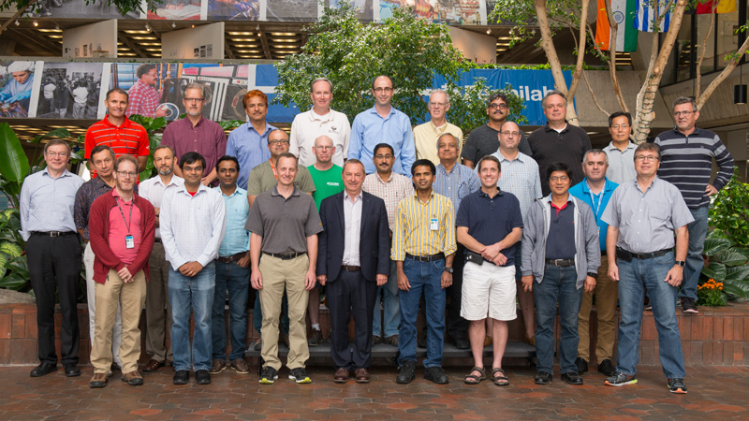
Visitor Program

Slide 23
Summary
Anticipate significant international contributions to PIP-II
Engagement on multiple fronts
  IIFC has been going for eight years
  INFN has joined in the last year, STFC has announced intention, and discussions with CEA & IN2P3 are in process
DAE deliverables are starting to arrive at Fermilab
  MEBT magnets, SSR1 cavities, RFPI boards
DAE staff at Fermilab for extended visits have had significant positive impact
Challenges remain, but all partners are committed to making this work

Slide 24
END

