Slide 1
RLS and BOE Development
Project Management
Luisella Lari
PIP-II Independent Project Review
12-14 December 2017

Slide 2
Outline
Resource Loaded Schedule (RLS) Overview
Multi-Phases RLS
Multi-Levels RLS
  High Level Master Schedule
Deliverable Oriented RLS
Technically & Funding Constrained RLS
  PIP-II Critical Path
  PIP-II Obligation Profile
Basis of Estimate (BOE) data integrated in the RLS
  PIP-II Cost Book
RLS Process Summary
Next Steps
Summary

Slide 3
About Me:
Role in PIP-II:
  PIP-II Associated Project Manager for Planning and Reporting
  Business Office leader
Relevant Experience:
  16 years working experience in scientific (PhD in Physics) and Project Management (PMP certified) fields:
    Project Planning Manager leader for ESS Linac, Sweden.
    Project Planning Engineer for the LHC Main Ring Installation, CERN, Switzerland.

Slide 4


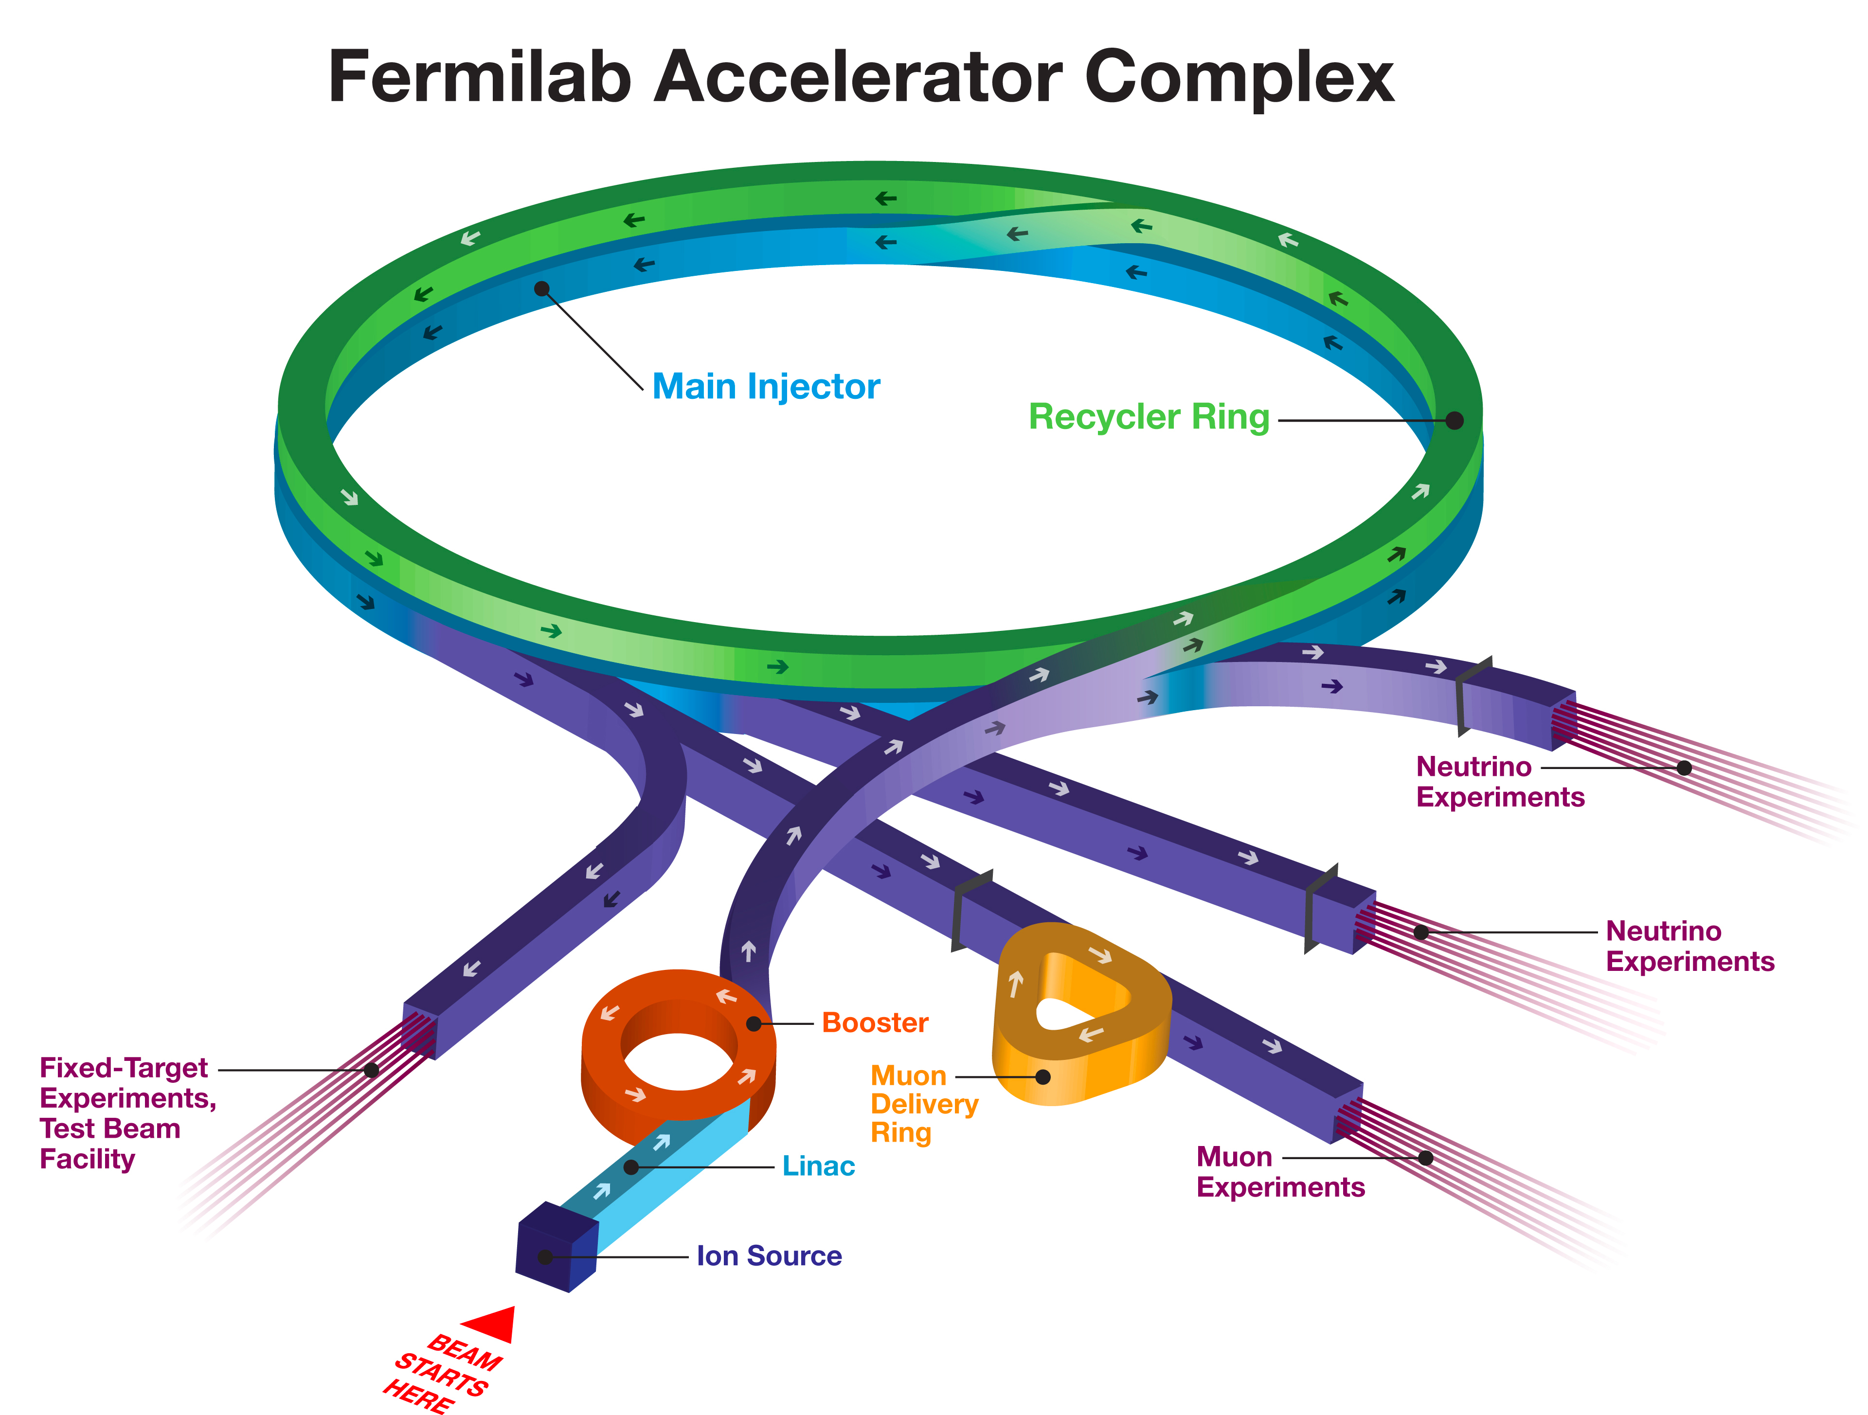

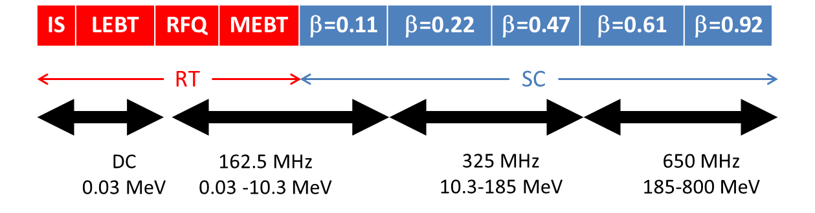
The complex RLS for PIP-II Project
*FONSI= Funding of No Significant Impact
External Milestones
LBNF Shutdown
CMTS
Available
Deliverables from USA laboratories
FONSI*
Civil Engineering
Rings Upgrade
In-kind Contributions
A new 800 MeV Linac
4

Slide 5
The complex RLS for PIP-II Project
The RLS timeframe is from Oct 1st, 2017 to April 1st, 2027
(i.e. early CD-4 date)
RLS, BOEs, Cost Book cover this timeframe.
Actual costs are recorded from CD-0 to Oct 1st, 2017
The RLS does not include the UK contribution for HB650.
Cost impact of Potential UK Deliverable (docdb n. 1212).

Slide 6
The complex RLS for PIP-II Project
The PIP-II RLS is a
Multi-Phases,
Multi-Levels,
Deliverable Oriented and
Technically & Funding Constrained
plan developed with the scope of reporting to DOE the progress with respect to the DOE/HEP given budget.

Slide 7
The complex RLS for PIP-II Project
Multi-Phases
Development and Construction phases
Milestones with Different Levels and Different Levels of Responsibilities for the PIP-II Managers
Multi-Levels
Working schedule @ Level 4 that includes all the major technical deliverables from Fermilab (T4 Milestones (MS)) and from International Partners (I4 MS)
Deliverable Oriented
Technically & Funding Constrained
by ending in Q2 FY27 aligned with Fermilab program and RLS satisfies the given DOE/HEP funding profile.

Slide 8
Development Phase [FY18 – FY23]
Major Milestones:
    HWR/SSR1(CM1) RF tested in PIP2IT [FY20]
    WFE commissioned to meet CDR Parameters [FY22]
    HB650 (CM1) RF tested in CMTS [FY23]
Z. Conway, D. Passarelli
L. Prost
A. Rowe

Slide 9
    Construction Phase [FY19 – FY27]
Major Milestones:
    Meet the 4 KPPs Parameters [Early CD-4 date FY27]
S. Holmes - Plenary
The Construction Phase starts @ CD-3a [Q3 FY19]:
Niobium purchase contracts
Civil Engineer Site Preparation construction contract

Slide 10
Multi-Levels RLS
The PIP-II RLS is built in P6 by WBS scope.
RLS is coupled with the present Organization Structure, but flexible to be readapted with the future new ones.
L2 Managers @ L2 in P6

Slide 11
Multi-Levels RLS
L3 Managers @ L3 in P6

Slide 12
Multi-Levels RLS – Milestones
T MS = Project MS
I MS = International MS
Ex = External Constraints
T MS have float
I MS have 0 float
Ex MS have 0 float
T4
3 m
T3
Working schedule
ends
April 1st, 2027
6 m
T2
1 y
T1
DOE direction / 2.5y
T0

Slide 13
Multi-Levels RLS - Milestones
External Milestones | 4
I4 Milestones | 90
I3 Milestones | 6
T4 Milestones | 371
T3 Milestones | 112
T2 Milestones | 40
T1 Milestones | 5
T0 Milestones | 1
I3 (Fermilab Director)
I4 (L2 Managers)

Slide 14
High Level Master Schedule

Slide 15
Deliverable Oriented RLS – T4 MS
Each T4 Milestone represents a goal for each L2/L3 Manager in the PIP-II Project:
  Performance achieved MS
  Ready For Installation MS
Intermediate Milestones to reach these major goals are identified in the RLS as T5 Milestones in P6, including:
  Design Reviews MS
  Purchase Order Awarded MS

Slide 16
Deliverable Oriented RLS – I4 MS
Each I4 Milestones represent a major delivery from our International Partners:
  I4 MS are linked in the RLS so any possible delays in delivery can produce a cascade effect on the RLS
6 I4 MS with major impact on the Project are tiered to I3 level.
  No Float was added between I3 and I4 MS.
  I3 and I4 have Different Ownership
RLS includes resources for oversight, coordination, QA/QC acceptance testing of International Deliverables
PIP-II Assumptions Doc
(docdb n. 144)

Slide 17
Technically & Funding constrained RLS
RLS contains 5643 activities of which 4510 are in the Linac (L2) WBS. RLS is aligned with Fermilab’s program by ending on Q2 FY27 (LBNF/DUNE plan), and satisfies the given DOE/HEP funding profile.
$513M is the Estimate to Complete from P6 including Escalation and Overhead
P6 Obligations Profile includes a $3M carryover in FY18 not in the DOE/HEP Funding Profile

Slide 18
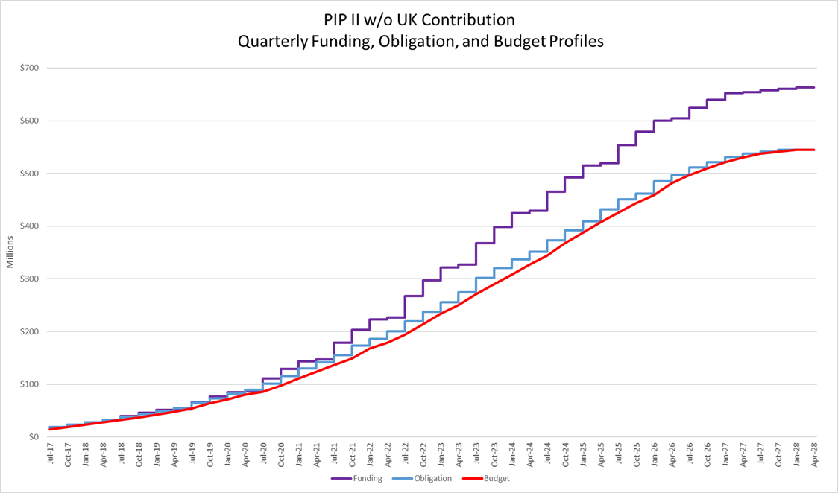
Resulting Cumulative Obligation Profile
Estimate at Completion $545M
= $513M (P6)+ $32M (AC)
AC from CD-0
P6
$700
$600
$500
$400
$300
$200
$100
$0
Millions
Q1 FY17
Q2 FY17
Q3 FY17
Q4 FY17
Q1 FY18
Q2 FY18
Q3 FY18
Q4 FY18
Q1 FY19
Q2 FY19
Q3 FY19
Q4 FY19
Q1 FY20
Q2 FY20
Q3 FY20
Q4 FY20
Q1 FY21
Q2 FY21
Q3 FY21
Q4 FY21
Q1 FY22
Q2 FY22
Q3 FY22
Q4 FY22
Q1 FY23
Q2 FY23
Q3 FY23
Q4 FY23
Q1 FY24
Q2 FY24
Q3 FY24
Q4 FY24
Q1 FY25
Q2 FY25
Q3 FY25
Q4 FY25
Q1 FY26
Q2 FY26
Q3 FY26
Q4 FY26
Q1 FY27
Q2 FY27
Q3 FY27
75 Major/Significant/Critical procurements identified
T. Powers
Planned Value / Budgeted Cost of Work Scheduled (BCWS)
Obligations
DOE/HEP Funding Profile

Slide 19
Critical Path
The Critical Path assumes that each International Partner during the Construction Phase is delivering on time.
Late delay from International Partners is included in the Risk Register.

Slide 20
Critical Path
SSR2 L3M, D. Passarelli
Inst. L3M, C. Baffes
The Critical Path goes through the construction & installation of SSR2 CMs
Several paths close to the SSR2 Critical Path

Slide 21
BOE Development
Follows DOE Cost Estimating Guide (DOE-G-413.3-21)
S. Holmes - Plenary
BOEs are the basis for developing the RLS
RLS and BOEs contain the same
  Direct M&S costs
  Direct labor hours & P6 Resources

Slide 22
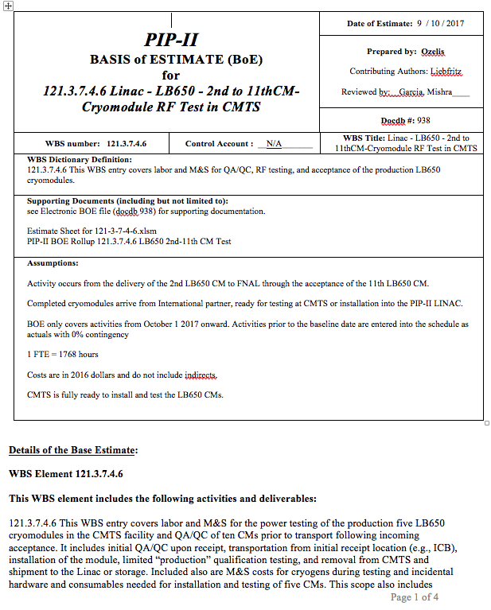
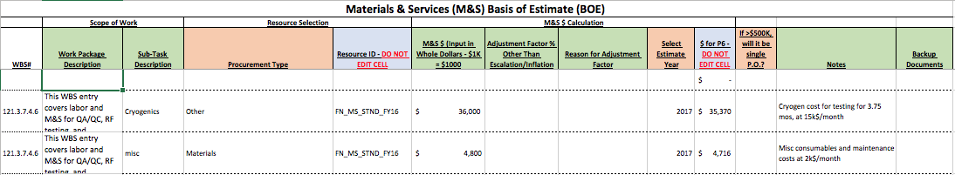
BOE Development details
136 Basis of Estimate documents
Each BOE consists of:
  Word document:
    WBS Dictionary definition
    Assumptions
    Explanation behind the estimate
  Excel document:
    Labor and M&S estimates at Level 5
    Estimate Uncertainty
Base year FY16
Each BOE was reviewed for consistency / understanding
  Checklist for validation of the BOE
P. Derwent

Slide 23

BOEs for RLS Development
Following the standard EVMS procedure, each BOE data were integrated in P6, through an iterative process in order to meet the PIP-II Development and Construction phases goals, respecting the limitation of DOE/HEP Funding Profile.
At the end of this process the PIP-II Cost Book was produced

Slide 24
Cost Book
BOE Trace folder with:
Direct Hours,
Direct M&S
Cost Book folder with:
P6 Escalation
P6 Overhead
P6 Labor Rates
Estimate Uncertainty

Slide 25
BOE data integrated in P6 per WBS
136 BOEs integrated in P6
BOE Numbers distribution
BOE Costs distribution

Slide 26
BOE data integrated in P6 per WBS
LoE is 14% of total costs
% in costs

Slide 27
RLS Process Summary
The PIP-II RLS is developed and aligned with:
  PIP-II Alternative Selection
  PIP-II Assumptions Document
  PIP-II CDR
  PIP-II Procurement Management Plan
  Project Annex 1 for IIFC deliverables
  DOE Cost Estimating Guide (DOE-G-413.3-21)
  Fermilab Guidelines 12.PM-004.DT-01; 12.PM-004.DT-03;

Slide 28
Next Steps
Before CD-2
Align the RLS and WBS with the new organizational structure.
Incorporate formalized International Deliverables into RLS.
Implement EVMS:
  EVMS reporting active at least 6 months before CD-2
  CAM training planned for Q2 FY18
Implement usage of standard FNAL tools (P6, Cobra, PRA)
  P6, PRA already used
  Cobra Cost Processor to be implemented
Staffing Business Office to grow by ~ 3 FTE at CD-2
  Project Controls Manager + Project Control Specialist
  Assistant to APM Planning & Reporting
  Potential: More Procurement and Financial support

Slide 29
Summary
The PIP-II Resource Loaded Schedule has been developed in P6, consistent with the DOE/HEP Funding Profile and with Fermilab’s plan for for LBNF/DUNE, and identifying the project critical path.
  RLS starts on Q1 FY18 and it is constrained by ending on Q2 FY27, including a complete network logic.
RLS Estimate to Complete costs is $513M, including escalation and overhead. $545M including Actual Costs.
RLS is not yet including the UK contribution (docdb n. 1212).
RLS integrated the major deliverables from International Partners.
RLS is aligned with the present organization chart and it fully integrates the BOEs data, as reported in the PIP-II Cost Book.
We believe the cost and schedule estimates are comprehensive, well documented, accurate and credible.
We are ready for CD-1 and look forward to your feedback.

Slide 30
Additional Slides

Slide 31
Technically & Funding constrained RLS
Obligations Profile plot without and with UK contribution vs. DOE/HEP Funding Profile

