Slide 1
PIP2IT Plans and Accomplishments
Accelerator Support Systems
Alexander “Sasha” Shemyakin
PIP-II DOE Independent Project Review
12-14 December 2017

Slide 2
Outline
Introduction to PIP2IT
PIP2IT warm front end
Achievements
Plans
Summary

Slide 3
About Me:
Role in PIP-II: PIP2IT group leader
  With PIP-II project since 2011, working with the Warm Front End
Relevant Experience
  Worked with accelerators for 35 years
  20 years at Fermilab. Development and operation of 4 MeV Electron Cooler

Slide 4
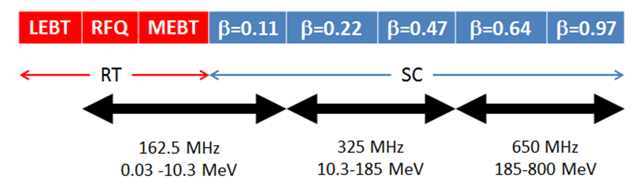
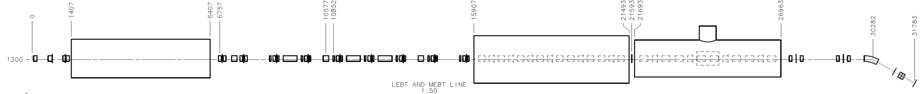
PIP-II and PIP-II Injector Test (PIP2IT)
PIP2IT: a test accelerator representing the PIP-II front end
Warm Front End (WFE) has been assembled and tested
PIP-II Linac scheme
30 keV
2.1 MeV
10 MeV
25 MeV
LEBT
RFQ
MEBT
HWR
SSR1
HEBT
PIP2IT scheme
To be installed and tested in FY19/20
LEBT = Low Energy Beam Transport; RFQ= Radio Frequency Quadrupole; MEBT= Medium Energy Beam Transport;
HWR = Half-Wave Resonator; SSR1=Single Spoke Resonator; HEBT = High Energy Beam Transport

Slide 5
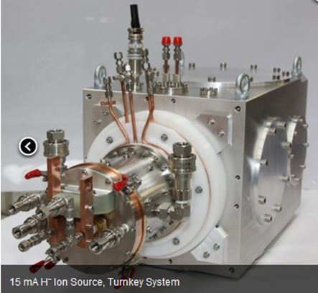
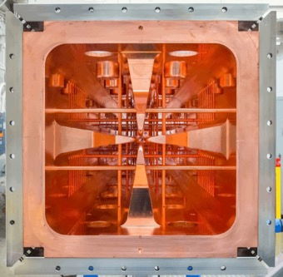
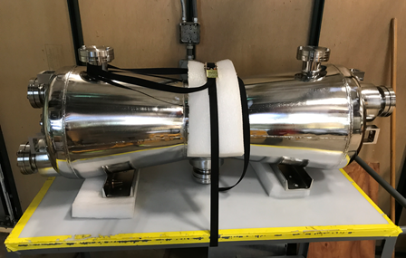
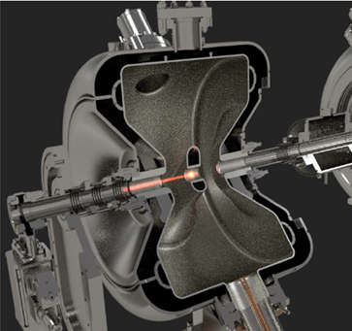
PIP2IT: Testing one-of-a-kind elements of PIP-II
Variety of different accelerator structures
  Ion source (30 keV),
  RFQ (2.1 MeV),
  HWR (10 MeV),
  SSR1 (25 MeV)
Bunch-by-bunch selection scheme (next slide)
Mission Statement (see P. Derwent’s presentation):
The PIP-II Injector Test (PIP2IT) facility replicates the front end of the PIP-II linac through the first SSR1 cryomodule. PIP2IT is intended to serve as a complete systems test that will reduce technical risks associated with the PIP-II linac in both pulsed and CW operating modes.
PIP2IT FRS - ED0001223

Slide 6
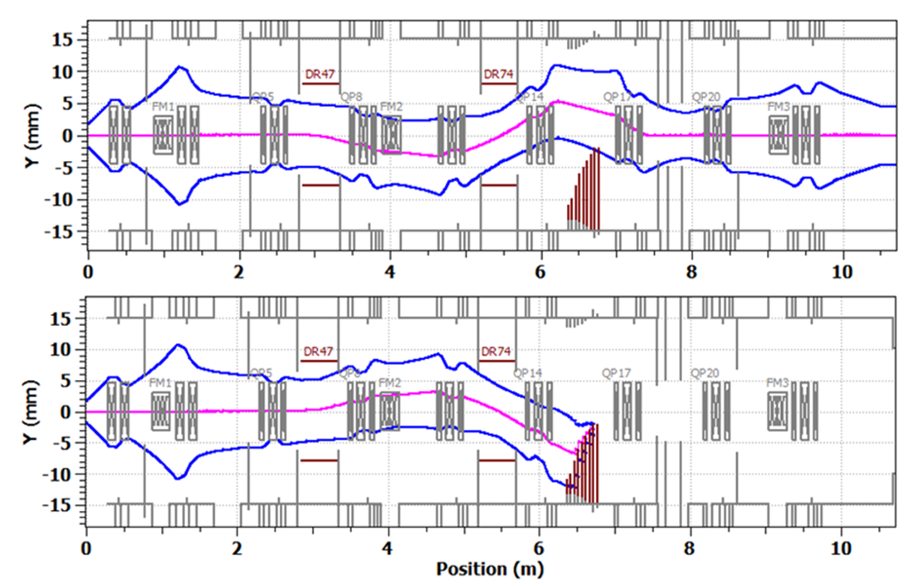
Unique feature of PIP-II: flexible bunch structure
“Bunch-by-bunch selection” in MEBT allows removing un-needed bunches
  Effective injection into the Booster
  With an RF separator at the end of the linac, possibility to deliver quasi-simultaneously to different users the beam with very different time structure
The selection scheme is being tested at PIP2IT
  Chopping system: Two kickers working in sync and absorber.
  6σ separation at absorber
Simulated 3σ envelopes of passed (top) and removed (bottom) bunches.

Slide 7
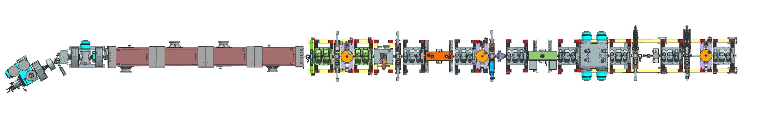
Presently assembled: PIP2IT WFE
IS + LEBT
RFQ
MEBT
Beam to dump or HWR cryomodule
30 keV, 15 mA H⁻ Ion Source (from 5 µs to DC)
LEBT (3 – solenoids; 30º bend to accommodate 2 ion sources in PIP-II)
  Chopper to form macro-pulses
CW-compatible 2.1 MeV RFQ (produced by LBNL)
10-m long MEBT with fast chopper
  2 quadrupole doublets and 7 triplets (produced by BARC, India)
  3 bunching cavities
  Collimation system (4 sets x 4 scraper plates)
  Differential pumping system

Slide 8
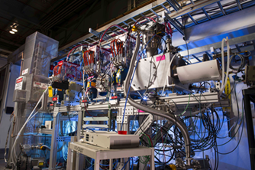
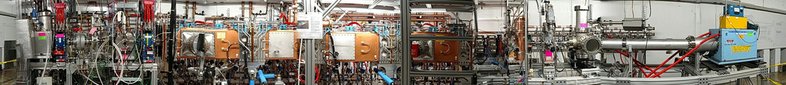
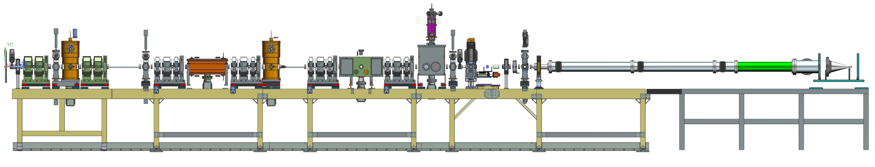
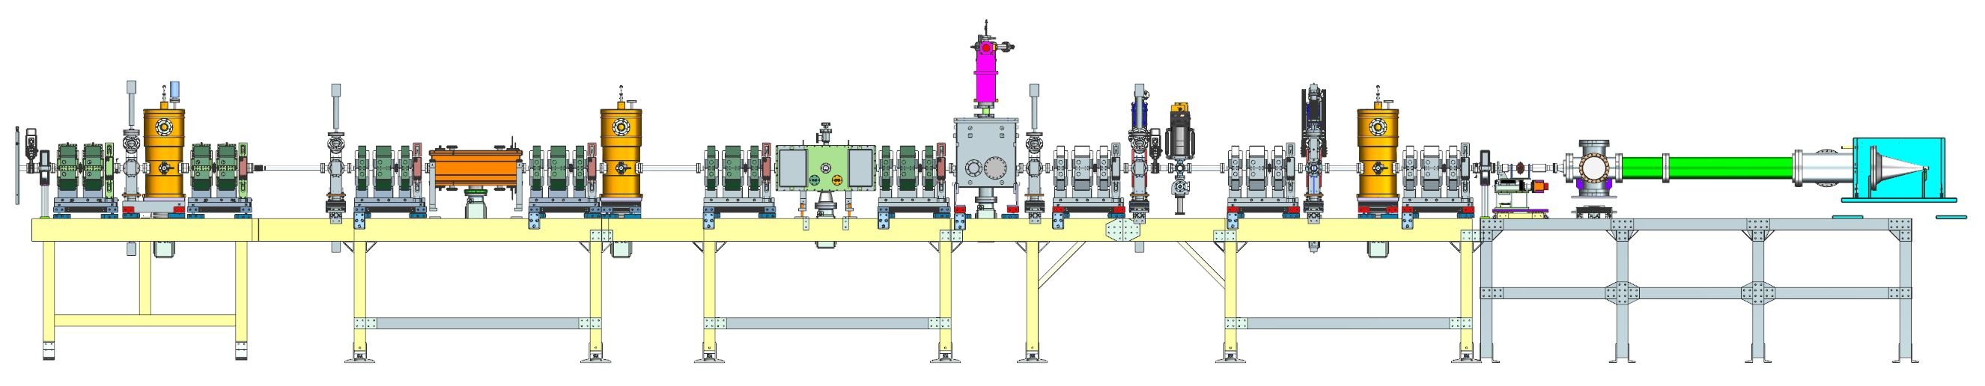
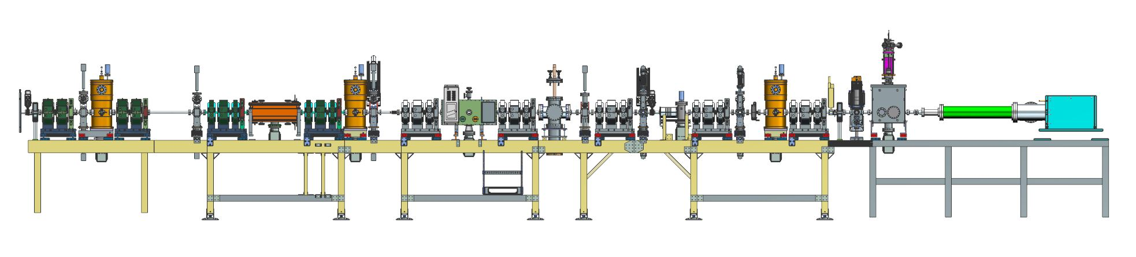
Several stages
Adding equipment in pace with delivery and budget
  Ion Source + LEBT in several versions
  Addition of RFQ + two-doublets MEBT
  +4 triplets and kickers
  + 3 triplets and both kickers
  + differential pumping insert (present assembly)

Slide 9
“CDR parameters” and high duty factor operation
PIP-II: “CW-compatible linac working initially in a pulse mode”
Philosophy for PIP2IT
  Design all elements intended to be used at PIP-II as CW-compatible but focus on operation at “CDR parameters”
    “CDR parameters” = parameters required for future injection into the Booster: 0.54 ms x 20 Hz at 5 mA from the RFQ with about half of all bunches removed in MEBT to create a non-periodic pattern optimized for filling the Booster RF buckets
  Test at higher duty factors, up to CW, when it is compatible with pursuing the main goal
    address discovered issues

Slide 10
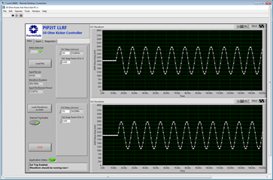
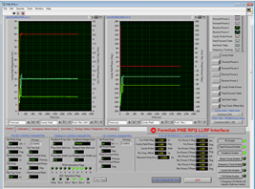
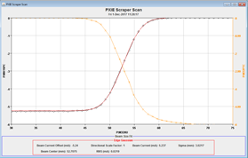
Achievements
Beam at “CDR parameters” through a full-length MEBT
LEBT with un-neutralized section
RFQ reliably operating at CDR parameters
CW – compatible MEBT
Prototype elements of the fast chopping system
CW-compatible Machine Protection System
Diagnostics
And other development that will not be presented here, e.g.
  LLRF, control programs, 20 Hz operation …

Slide 11
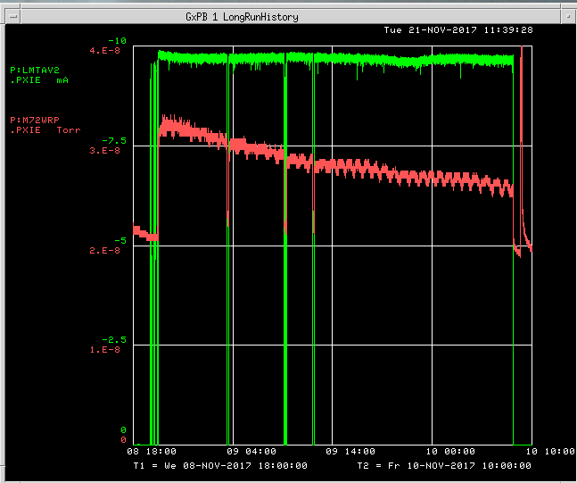
Beam through a full-length MEBT
Operation of most WFE components at CDR parameters have been demonstrated
  Beam was passed through the full-length MEBT with one kicker producing a required deflection pattern
    0.54 ms x 20 Hz x 5 mA; about half of all bunches are deflected
    24 hours continuous run with both passed and deflected bunches transported to the beam dump
  Beam with a higher duty factor was passed through the full-length MEBT and deposited to the absorber prototype for 35 hours
    1.75 ms x 20 Hz x 10 mA; with kickers off
Current,
2.5 mA/div
Pressure,
1.E-8 Torr/div
Beam current and MEBT pressure during the 35-hrs long run of the beam to the absorber prototype.
40 hrs

Slide 12
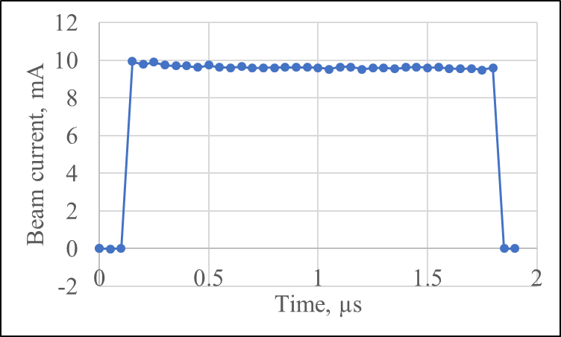
LEBT with un-neutralized section
Downstream portion of the LEBT is not neutralized
  With scraping near the ion source and proper focusing, the beam emittance remains low, and beam parameters at the RFQ entrance are optimal
  Vacuum at the RFQ entrance stays below 2∙10⁻⁷ Torr with beam
Since the LEBT chopper is located in this section, beam parameters stays constant through the MEBT pulse
  Tuning made with 10 µs pulses work for long-pulse operation
50
Beam current measured in MEBT through 1.8 ms pulse
Phase portrait measured at the end of the LEBT at 5 mA. Emittance =0.105 µm (rms, n).
Y’, mm
0
-50
-10
0
10
y, mm

Slide 13
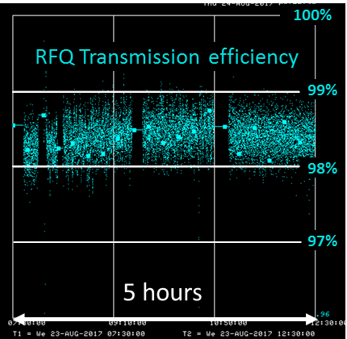
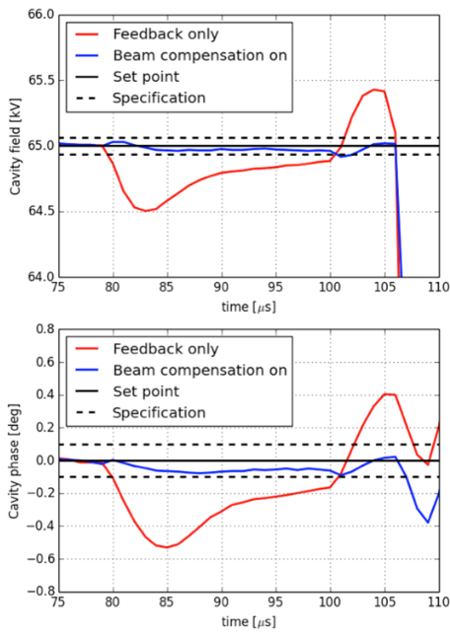
RFQ
RFQ works reliably at CDR parameters
  Includes amplifiers, LLRF, and cooling system
  > 95% transmission
  transverse emittance ≤0.2 µm (n rms)
  Energy is as specified, 2.11±0.5% MeV
Some of remaining issues
  Frequency offset (fixed tuners need to be re-machined)
  Couplers are not compatible with CW
Measured RFQ voltage waveforms with 20 µs, 5 mA beam.
With LLRF feed-forward, feedback, and beam compensation loops on, regulation is at 0.1% amplitude and 0.1º level.

Slide 14
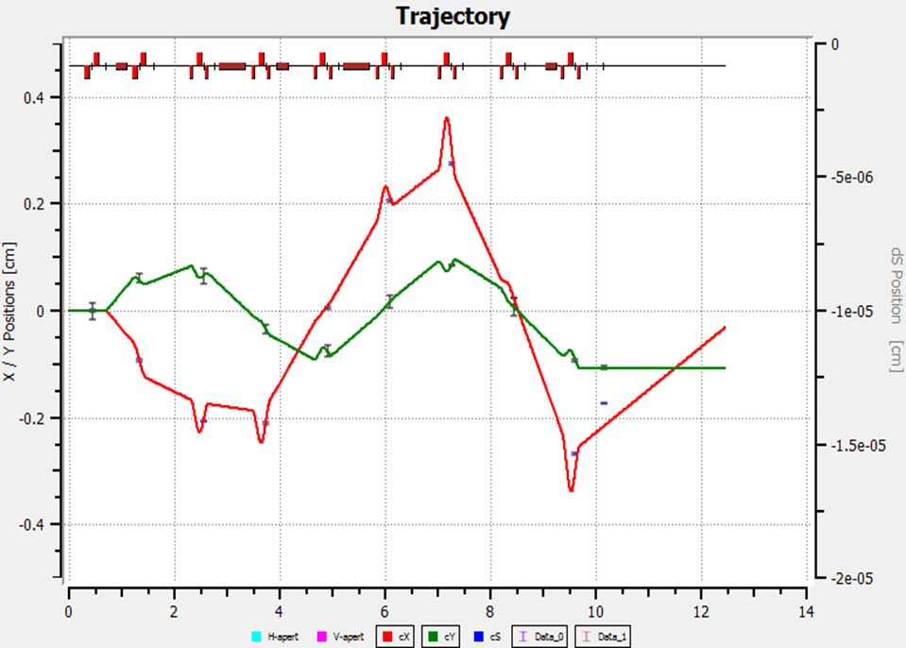
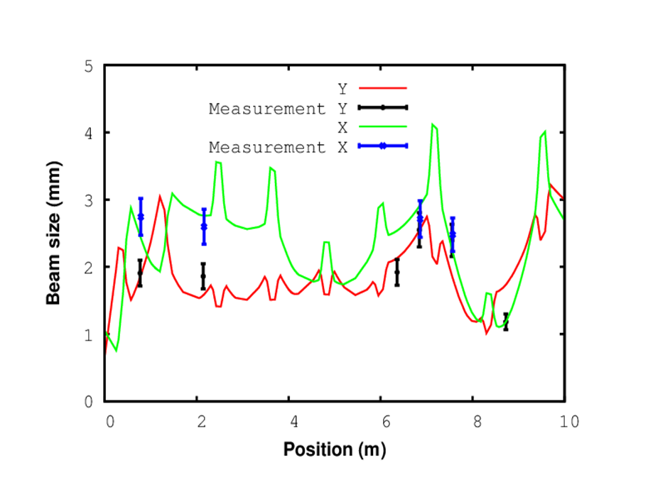
MEBT optics
Transverse optics is measured and in reasonable agreement with simulations
  Can predict the beam envelope at ~10% level
x
y
Comparison of simulated and measured beam trajectory responses to deflection with the first dipole corrector.
Comparison of simulated and measured beam envelopes. Beam current is 5 mA.

Slide 15
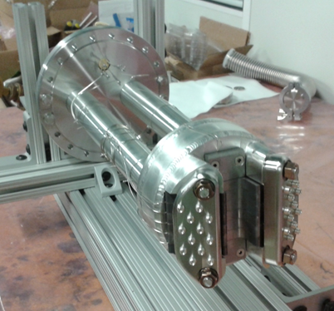
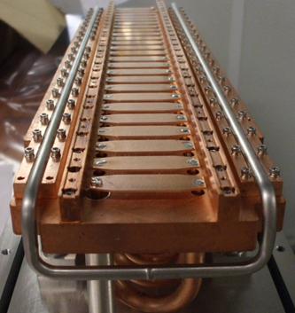
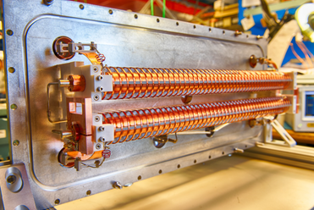
Chopping system
Two kickers working in sync and absorber
Since a CW-compatible kicker capable of providing an arbitrary pattern was beyond state-of-the-art, two kicker versions were developed, “200 Ohm” and “50 Ohm”
  Both are installed; 200 Ohm kicker is fully characterized with beam
Absorber prototype has been developed and tested at full power density with an electron beam and at 7x CDR parameters at PIP2IT
50 Ohm kicker
¼ length absorber prototype
200 Ohm kicker

Slide 16
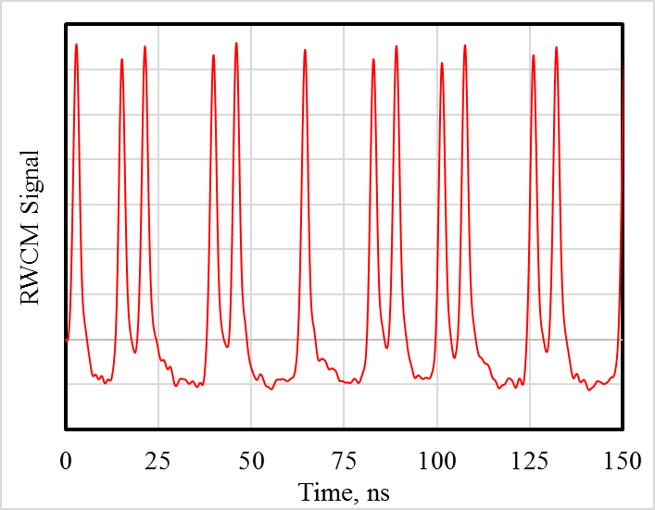
200 Ohm kicker performance
Completely satisfies CDR requirements
  500 V per plate generates 7 mrad deflection
  Generates non-periodic pattern required for Booster injection
  Tested with beam in 24-hr run at 0.54 ms x 20 Hz, with switching frequency equal to Booster injection frequency, 44.7 MHz
The choice for the final kickers
Example of bunch pattern formed by the MEBT chopping system and recorded with Resistive Wall Current Monitor (portion of 10 µs pulse).
The 5 mA beam is collimated to 1.5 mA and deflected by 200 Ohm kicker to a scraper. Population left of removed bunches is < 2%.
Non-zero signal between neighboring passed bunches is determined by properties of RWCM.

Slide 17
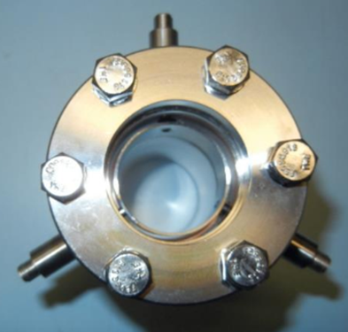
Machine protection system development
The beam is interrupted when MPS detects unfavorable conditions
  Controls pulse width
  Vacuum, position of valves and insertable devices
  Beam loss between current detectors
    MPS employs dedicated capacitive pickups
    Presently can protect from 3% unexpected beam loss
Capacitive pickup for MPS

Slide 18
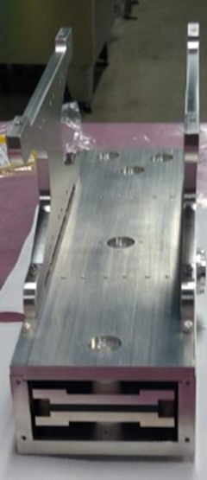
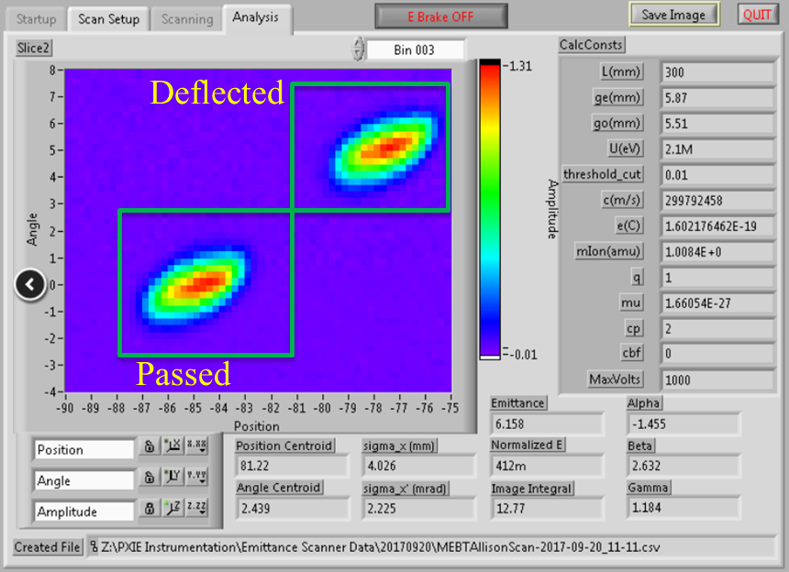
Diagnostics
Beam current
  Toroids (ACCT) measure with 2% accuracy
  Currents to dump, scrapers, protection electrodes are measurable in 1 µs steps
  RWCM to measure removal of bunches
BPMs for position and phase
Scrapers are used for envelope measurements
MEBT Allison scanner under assembly
Allison emittance scanners in LEBT and MEBT
  Successful implementation at 2.1 MeV is unique
Example of MEBT Allison scanner measurement.
3 µs slice of 10 µs pulse. The 5 mA beam is collimated to 1.5 mA and deflected by 200 Ohm kicker.

Slide 19
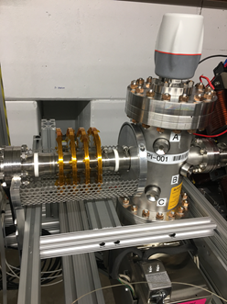
Main items remaining for PIP2IT WFE
Test the Differential Pumping System with beam
  Recently installed
Manufacture and test the chopping system
  final kickers and absorber
Address RFQ issues
  adjust resonance frequency
  Address coupler issues
Assemble and test the vacuum protection system
Assemble UHV, particle – free portion of the MEBT adjacent to HWR
Differential Pumping Insert installed in MEBT

Slide 20
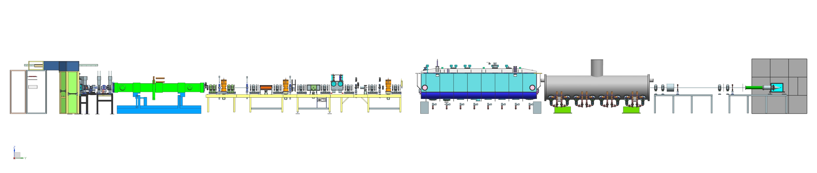
Plans
FY18- finish the beam run in WFE–only configuration
  Start installation of the cryo distribution system in Q3 FY18
Q3FY19 – start installation of HWR, followed by SSR1
  Cool down and test all cavities at full gradient – finish in Q1FY20. HWR in CW; SSR1 in both CW and pulse
FY21/22 – pass the “CDR-parameters” beam through SRF
  Test all remining items in the Warm Front End
FY24 WFE is moved to PIP-II
  Cave is used for testing of SSR1 and SSR2 through FY26
PIP2IT in its final configuration

Slide 21
Summary
PIP2IT is an important and fruitful test bed for PIP-II front end
  Solutions for most of WFE components are found and tested
    Some of them are novel and unique
Most of CDR WFE parameters are demonstrated
Plans for the front end to be ready for installation into PIP-II are developed
Thank you for your attention

Slide 22
END

