Slide 1
121.3.19 – Linac – General Support Services (GSS)
121.3.22 – Linac – Installation, Integration and Commissioning (II&C)
Breakout Session: Accelerator Support Systems
Curt Baffes
PIP-II Independent Project Review
12-14 December 2017

Slide 2
Outline
Scope/Deliverables
Requirements
Conceptual Design, Maturity
Interfaces
Technical Progress to Date
ESH&Q
Risk
Cost
Schedule
Summary

Slide 3
About Me:
PIP2 Roles
  L3 Manager for General Support Services
  L3 Manager for Installation, Integration and Commissioning
  Installation lead for PIP2IT
Other Fermilab experience
  Participated in build-out of FAST, PIP2IT, and CMTS1 machines
  Led design and installation of FAST 50 and 300MeV beamlines
  Led installation of 1.3GHz CC1 and CM2 cryomodules at FAST
  Led installation of first LCLS2 cryomodule in CMTS1 test stand

Slide 4
Scope: WBS Dictionary
WBS Dictionary: pip2-docdb #599
121.3.19 Linac - General Support Services (GSS) | This WBS entry covers the design, procurement, fabrication, assembly, and pre-installation test and QA of utilities (LCW, RAW, compressed air, compressed N2, and electrical distribution) in the linac, transfer line, and associated galleries. Installation of these systems, including post-installation testing such as pressure testing, is covered by the installation WBS 121.3.22.
121.3.22 Linac - Installation, Integration & Commissioning (II&C) | This WBS entry covers the reception of parts, components and sub-assemblies from either a post-processing & testing or rack integration activity. Installation begins at beneficial occupancy of the new accelerator enclosure and utility buildings. These activities include, but are not limited to, mechanical installation of beamline components, installation of vacuum components, alignment, vacuum pump down, vacuum leak checking and functional testing of the components and all of their respective control systems. Management of project installation activities are not covered in this section. Those activities are covered under WBS 121.3.1 . This WBS section also covers the removal and/or relocation of existing PIP-II beamline components, for example, PIP2IT elements from the CMTF area to the new linac enclosure.

Slide 5
Scope and Deliverables for GSS WBS
Charge #2
GSS Project Management and Coordination (LOE) (121.3.19.2)
GSS Fluids Systems Scope (121.3.19.3)
  LCW and RAW water systems
  Compressed air and N₂ systems for Linac and BTL/BAL
  Special cooling systems for Ion Source and RFQ
GSS Electrical Systems Scope (121.3.19.4)
  Electrical distribution from CF-provided panels to racks, tray infrastructure
  Cable database administration

Slide 6
Scope and Deliverables for II&C WBS
Charge #2
II&C Project Management and Coordination (LOE) (121.3.22.2)
II&C Installation planning (121.3.22.3)
  Creation of the installation plan
  PIP2 3D CAD model
  CM and magnet stands, in-tunnel cryomodule mover
II&C Linac Installation (121.3.22.4-5)
  Removal and relocation of PIP2IT
  Installation of all hardware in the tunnel and gallery
  Primary deliverable is a fully-installed accelerator
II&C Linac Commissioning (121.3.22.6)
  Begins with ORC for power in a given subsystem
  Primary deliverable is an accelerator that achieves project KPPs

Slide 7
GSS L3 System Requirements
Charge #2
Fluids Systems Requirements (121.3.22.3)
  FRS ED0006218 Rev- (LCW)
  Conventional performance for LCW systems: ±1º C
  All permanent fluids infrastructure sized for CW
  Challenging requirements of RFQ cooling system (e.g.±0.1º C stability) demonstrated at PIP2IT.
  All fluids systems requirements can be met with conventional systems with direct analogue at CMTF
Electrical Infrastructure Requirements (121.3.22.4)
  At a high level, this is a conventional, connective system
  Requirements to be defined at rack level in subsystem ICDs

Slide 8
II&C L3 System Requirements
Charge #2
Functional
  Execute installation scope as defined in L3-L3 ICDs
  Execute commissioning (at super-system and machine levels)
  Achieve KPPs #3 (cryo), #1 (beam delivery to booster), #2 (beam extracted from booster)
Performance
  Perform value engineering to minimize cost, schedule, risk
  In collaboration with Systems Engineering and ESH&Q, ensure all documentation is delivered and in place

Slide 9
KPPs in the II&C Phase
Charge #2
# | Description of Scope | Threshold KPP | Objective KPP | II&C Phase Comments
1 | SRF linac | 700 MeV beam delivered to the Booster Injection Region | 800 MeV beam delivered to Booster Injection Region | Linac II&C phase ends when KPP is achieved
2 | Booster/RR/MI upgrades | L11 Booster injection region, Recycler RF upgrades, and MI RF upgrades, hardware installed. Linac beam injected and circulated in the Booster. | 8 GeV beam transmitted through Recycler and Main Injector, delivered to the MI dump. | Beam commissioning is in II&C scope. Commissioning activities before beam are not.
3 | Cryogenic Infrastructure | Cryogenic plant and distribution lines ready to support pulsed RF operation, and operated to 2 K. | Cryogenic plant and distribution lines ready to support CW RF operation, and operated to 2 K. | Threshold KPP achieved when SCL achieves 2K. Cryo operations off-project thereafter
4 | Civil Construction |  |  | Not in II&C scope

Slide 10
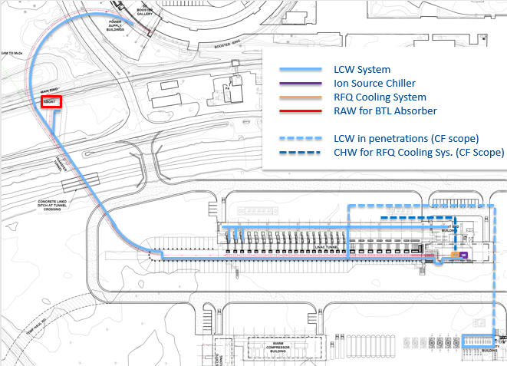
GSS Conceptual Design and Design Maturity
Charge #2
Configuration evolving in collaboration with CF team
Example:
Cooling water configuration

Slide 11
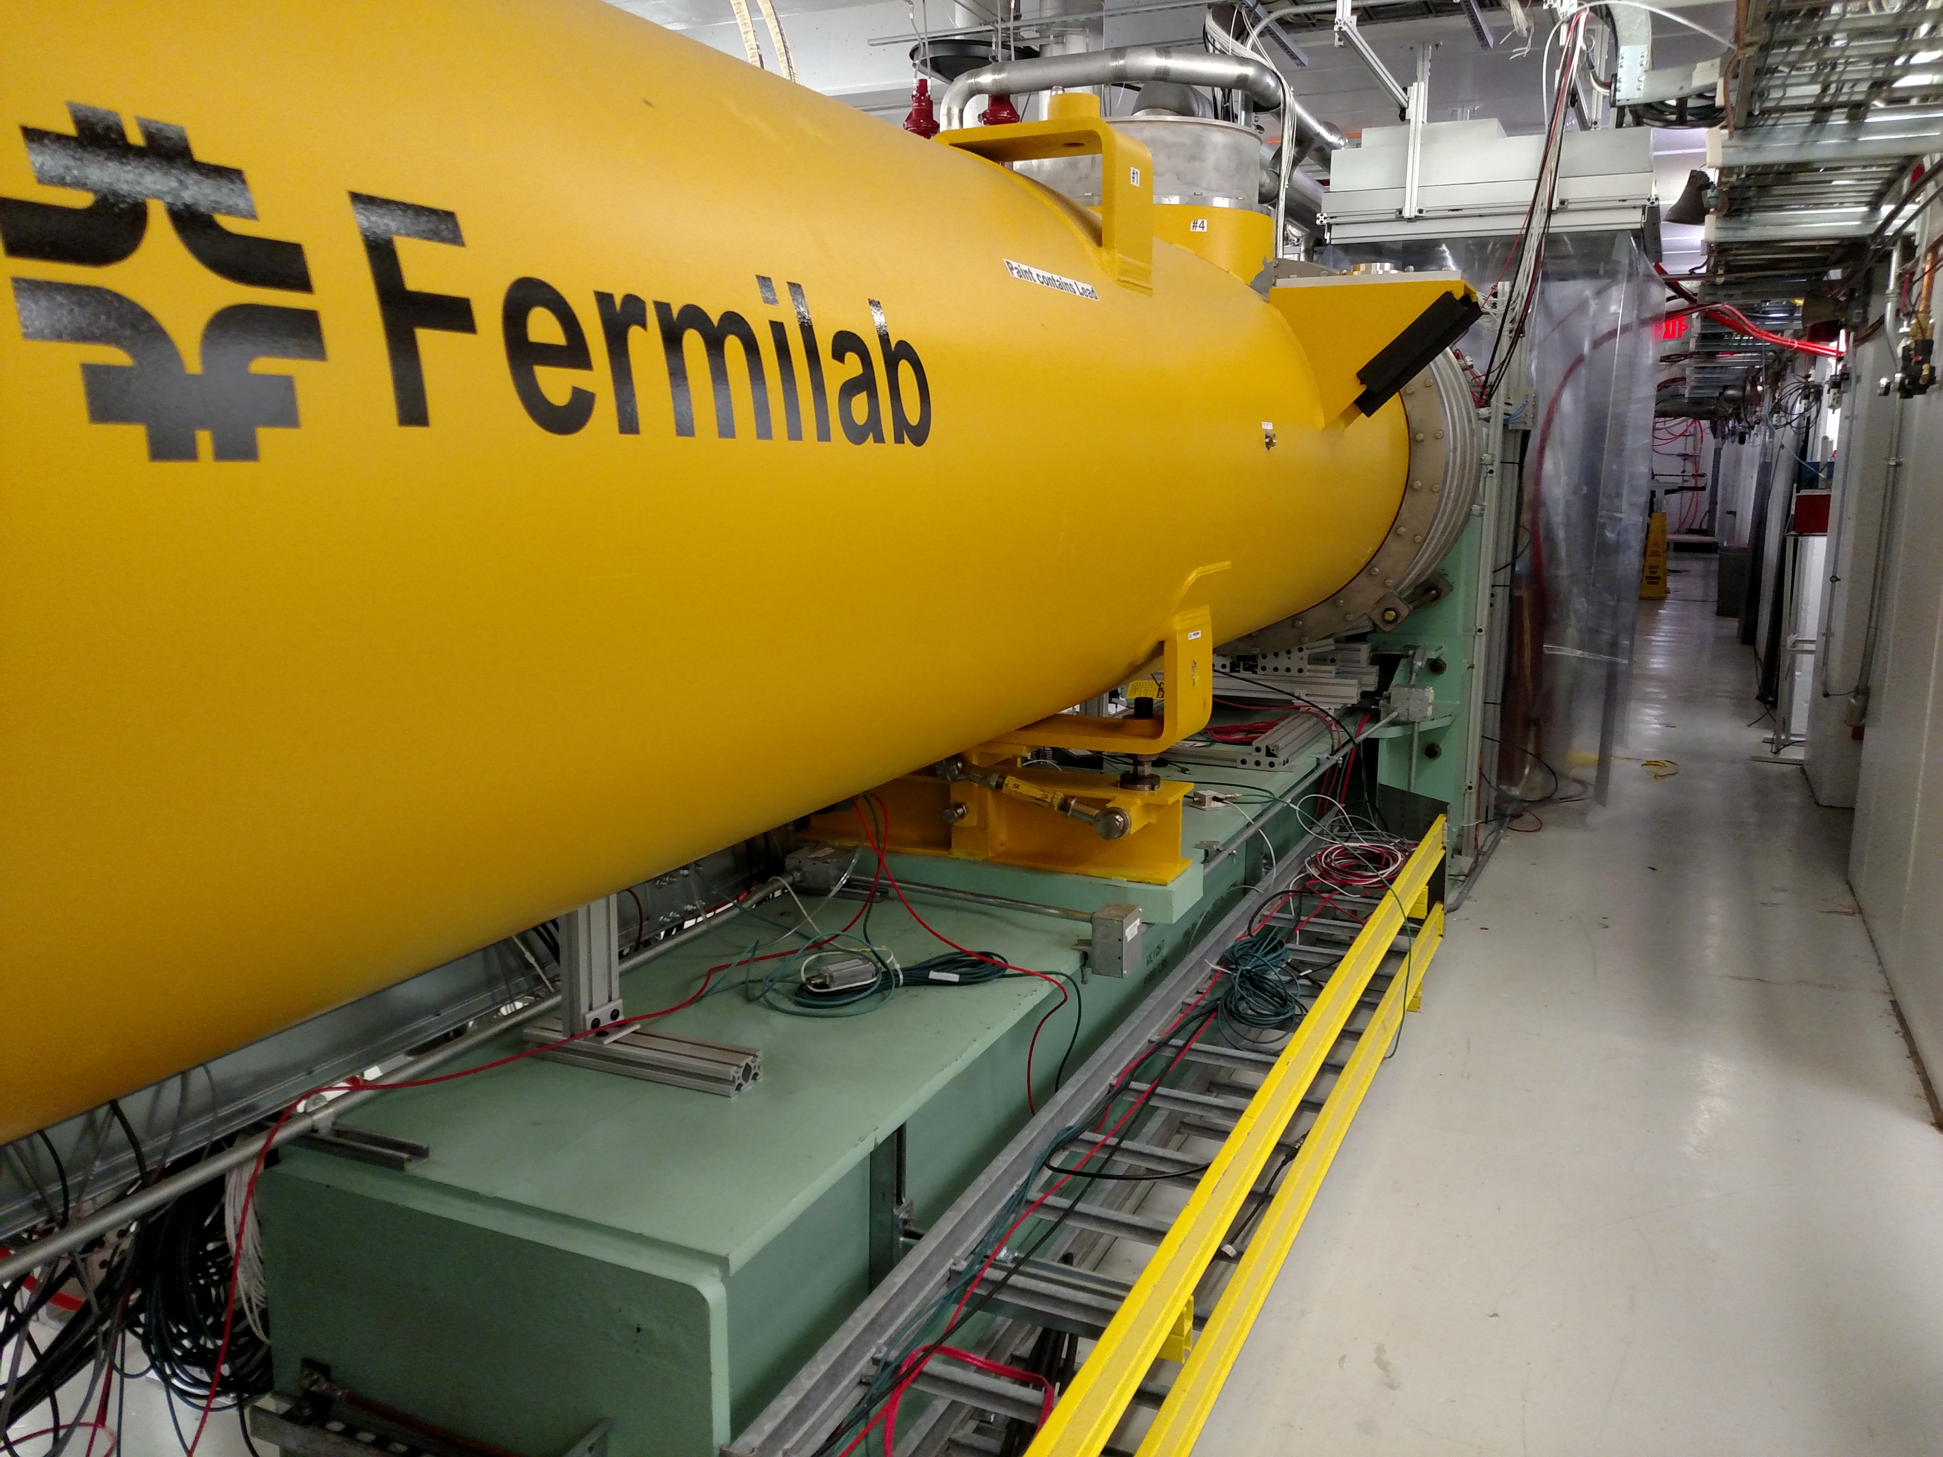
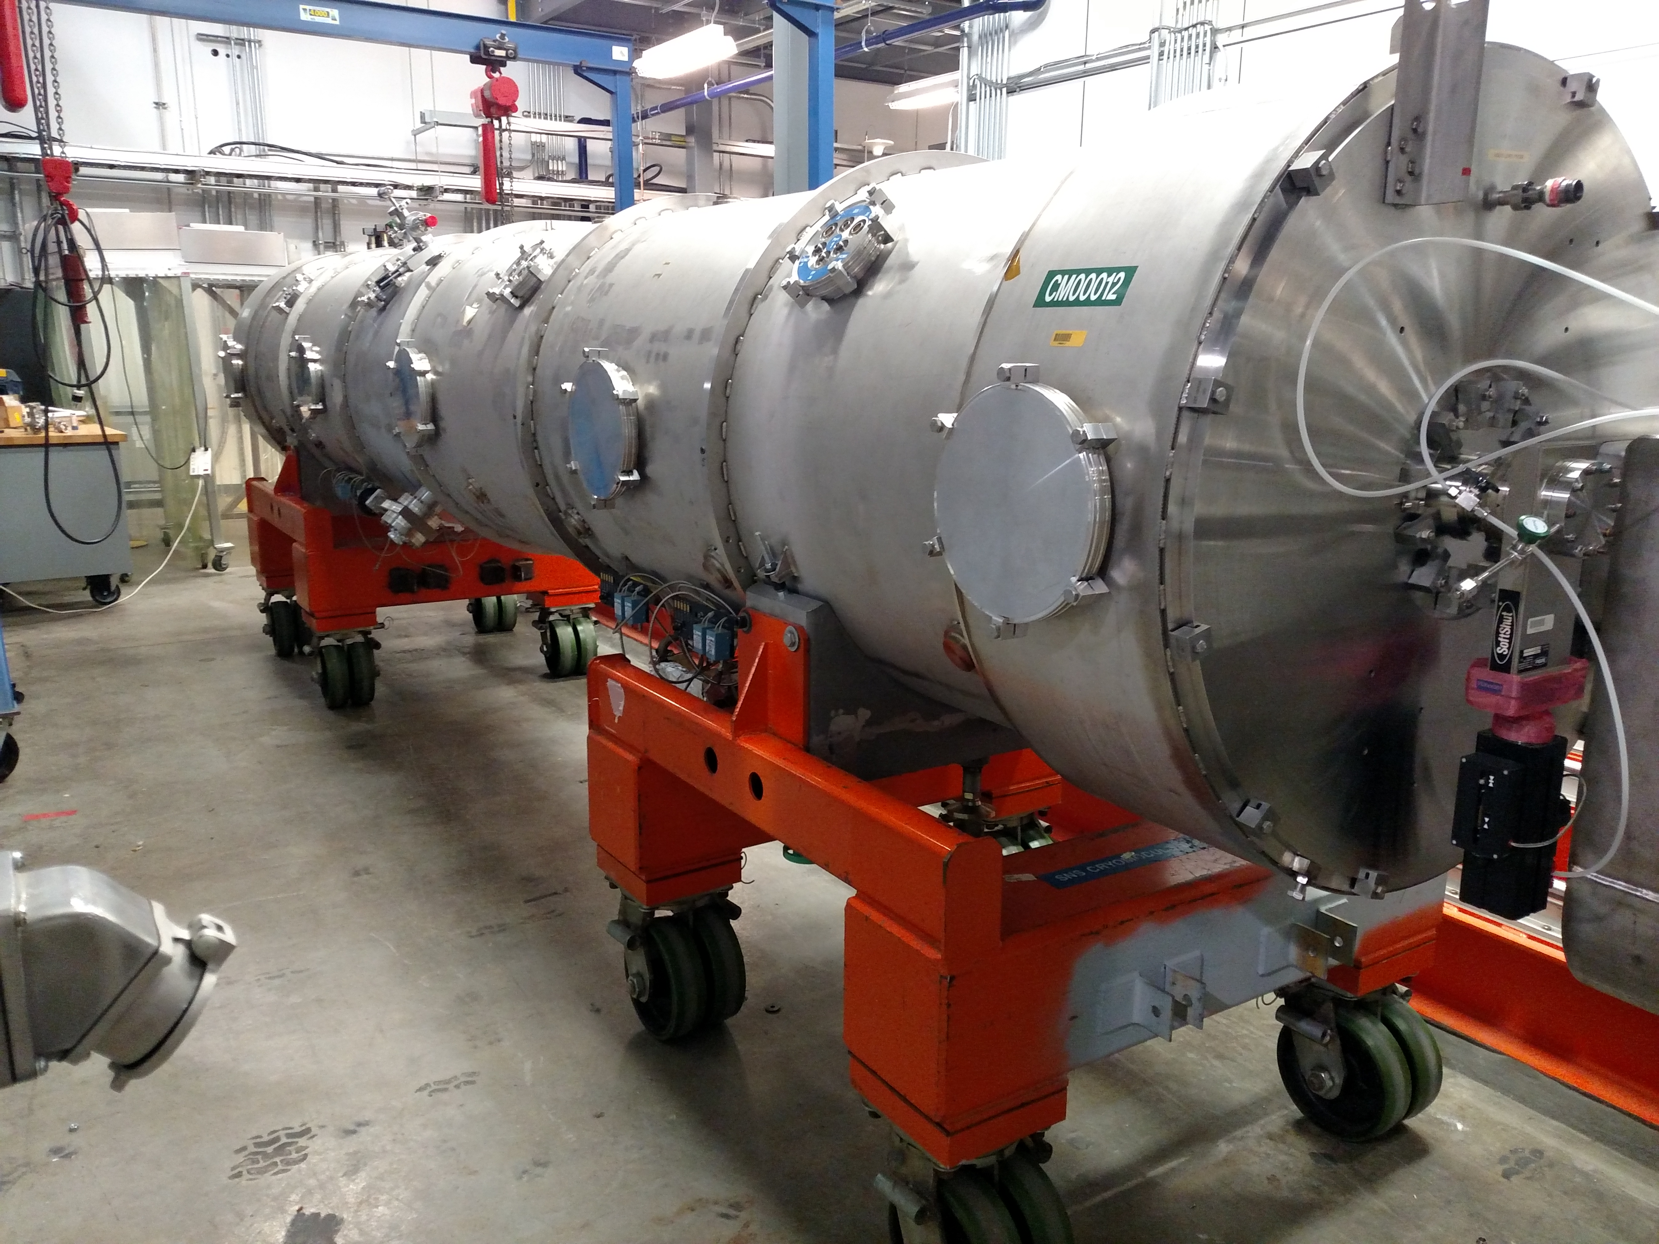
II&C Conceptual Design and Design Maturity
Charge #2
II&C WBS element is responsible for some traditional “design” scope
  System-level 3D CAD model
  Cryomodule Stands
  Magnet Stands
  Cryomodule Mover
Will rely on existing tools, methods and designs as much as possible
FAST cryomodule stand
SNS cryomodule mover

Slide 12
II&C Conceptual Design and Design Maturity
Charge #2
II&C campaign must be strategically designed for flexibility and tight integration with CF work and hardware delivery schedule
After receiving BO of each area, begin a support services installation phase
  Alignment network creation
  Installation of electrical infrastructure
  Installation of fluids infrastructure
  Installation of cryo transfer line (assumed to be subcontracted)
  Installation of (empty) stands
Then begin installing accelerator components in sections
  WFE campaign
  SCL campaign (several chunks)
  BTL/BAL campaign

Slide 13
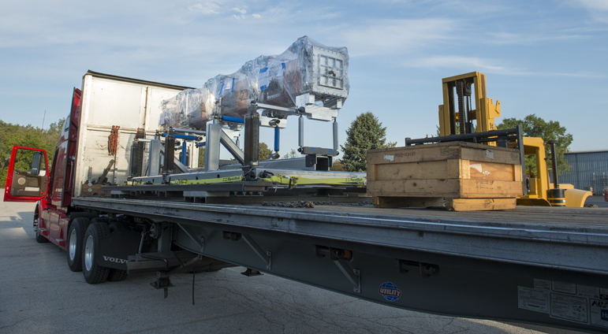
Warm Front End Installation
Charge #2
Removal from CMTF is part of II&C WBS
Philosophy: do disassembly and reassembly in one campaign as soon as highbay readiness allows, to minimize “memory loss” in PIP2IT team
Disassembly scheme
  Confirm labeling and documentation
  Disassemble to movable chunks (RFQ, HWR require dedicated transport fixtures, MEBT girders can be left largely intact)
Reassembly Scheme
  Reinstall major components
  Interleave addition of (new) utilities in highbay building
  Cable pull campaign
RFQ transport fixture

Slide 14
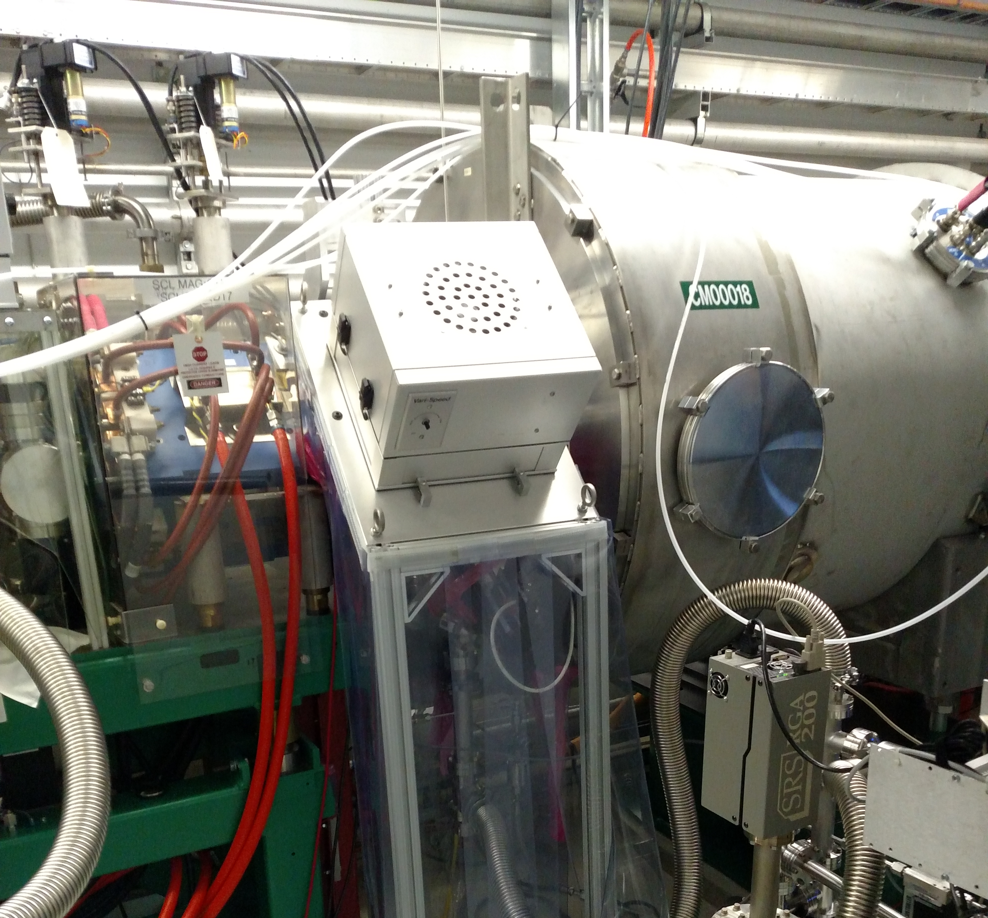
SCL Installation
Charge #2
Philosophy:
  After support services phase, do other heavy and “scissors lift” work
  Perform cryomodule + warm unit installation in chunks of similar cryomodules, at a pace dictated by cryomodule delivery
  Penetration work driven by gallery readiness
Notional chunking (non-chronological)
  HWR (1 cryomodule)
  SSR1 (2 cryomodules)
  SSR2 1-3 (3 cryomodules)
  SSR2 4-7 (4 cryomodules)
  LB650 1-5 (5 cryomodules)
  LB650 6-11 (6 cryomodules)
  HB650 1-4 (4 cryomodules)
CM/Warm Unit interface setup at SNS

Slide 15
BTL/BAL Installation
Charge #2
Philosophy:
  Magnet installation requires magnet mover access through main linac aisle
  Due to phasing of beneficial occupancy, magnet moves can occur after most cryomodules are already in position
  BTL/BAL vacuum installation non-particle-free after first bend dipole: more conventional installation

Slide 16
Commissioning
Charge #2
System commissioning (without beam) will be ongoing as systems are installed and connected
2.1MeV beam commissioning campaign
  Warm front end can be commissioned to the MEBT absorber
  Executed ahead of linac cooldown and off the critical path
800MeV beam commissioning campaign
  Linac cooldown
  Cold RF conditioning
  Initial beam at low intensity to straight-line temporary absorber
  Transport to through BTL to beam absorber
  Deliver to booster and inject
Rings commissioning campaign
  Significant advantage from previous commissioning experiences

Slide 17
General Support Services Interfaces
Charge #2
Top 4 systems Interfaces to GSS:
WBS 121.3.19
GSS
WBS 121.3.9
RF Power
Impact on schedule, cost and risk
Biggest fluids customer
WBS 121.3.17 Controls
Impact on schedule, cost and risk
Large customer for electrical GSS, controls provider for fluids
WBS 121.5 Conventional Facilities
Impact on schedule and cost.
Host for GSS systems
WBS 121.3.3 Warm Front End
Impact on schedule and cost
Technically demanding requirements on fluids
    GSS systems have customer-driven external interfaces
    Physical interfaces (e.g. fittings)
    Heat loads
    Electrical power requirements

Slide 18
II&C Interfaces
Charge #2
Top 4 systems Interfaces to II&C:
II&C Internal Interfaces
WBS 121.3.22
II&C
WBS 121.3.5-6
SSR1, SSR2
Impact on schedule, cost and risk
WBS 121.3.7-8 LB650, HB650
Impact on schedule, cost and risk
WBS 121.3.9-10 RF Power and integration
Impact on schedule, cost and risk
WBS 121.5 Conventional Facilities
Impact on schedule and cost
121.3.22.4
Tunnel Installation
People, sequences, penetration access, enclosure access
Hardware and documentation
121.3.22.3
Planning,
Stands
documentation
121.3.22.4
Gallery Installation
documentation
121.3.22.6
Commissioning
People, sequences
Systems,
Enclosure access, ORCs
    II&C interfaces to nearly every other L3 WBS. Interfaces include:
    Physical deliverables
    Volumes (static and dynamic)
    Schedule commitments and constraints
    Personnel commitments and constraints
    II&C-internal interfaces include:
    Documentation (e.g. procedures)
    ORCs
    Logistics (access, people)

Slide 19
Progress to date
Charge #2,3
GSS
  Close interface with CF team during conceptual design phase
  Collection and compilation of requirements
  Design of fluids systems for PIP2IT
    Complete LCW and compressed air systems
    Ion source chiller procurement and operation
    RFQ cooling system design, assembly, and operation
II&C
  Focus has been scoping, cost estimation, and development of initial RLS
  Begin ramp-up in FY20 to develop installation plan
  Team has been involved in II&C of PIP2IT, lessons learned there will be carried forward

Slide 20
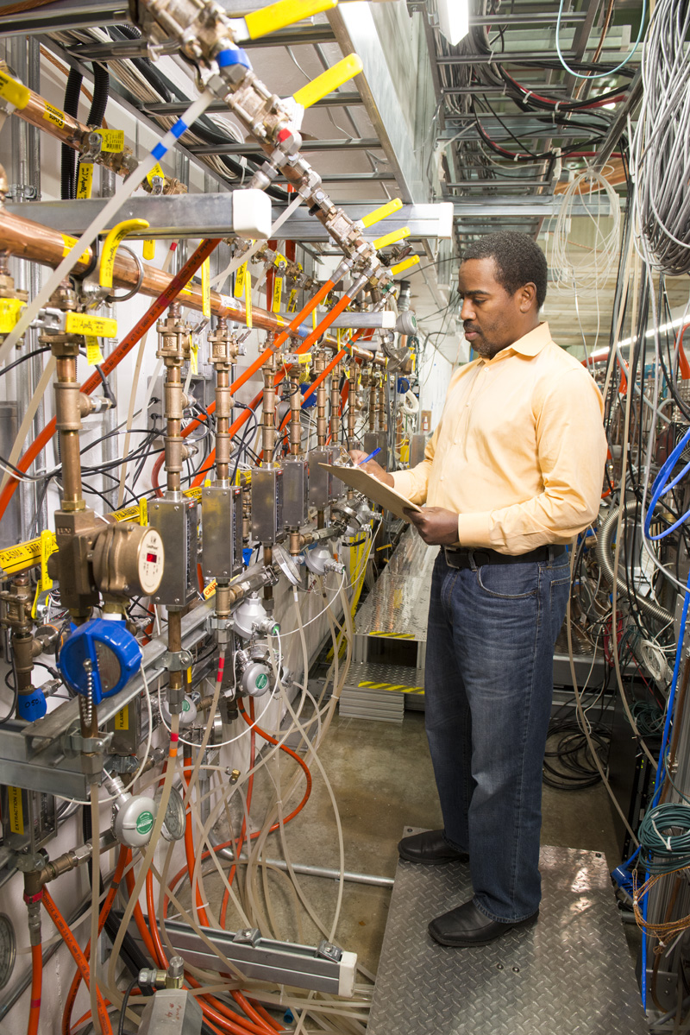
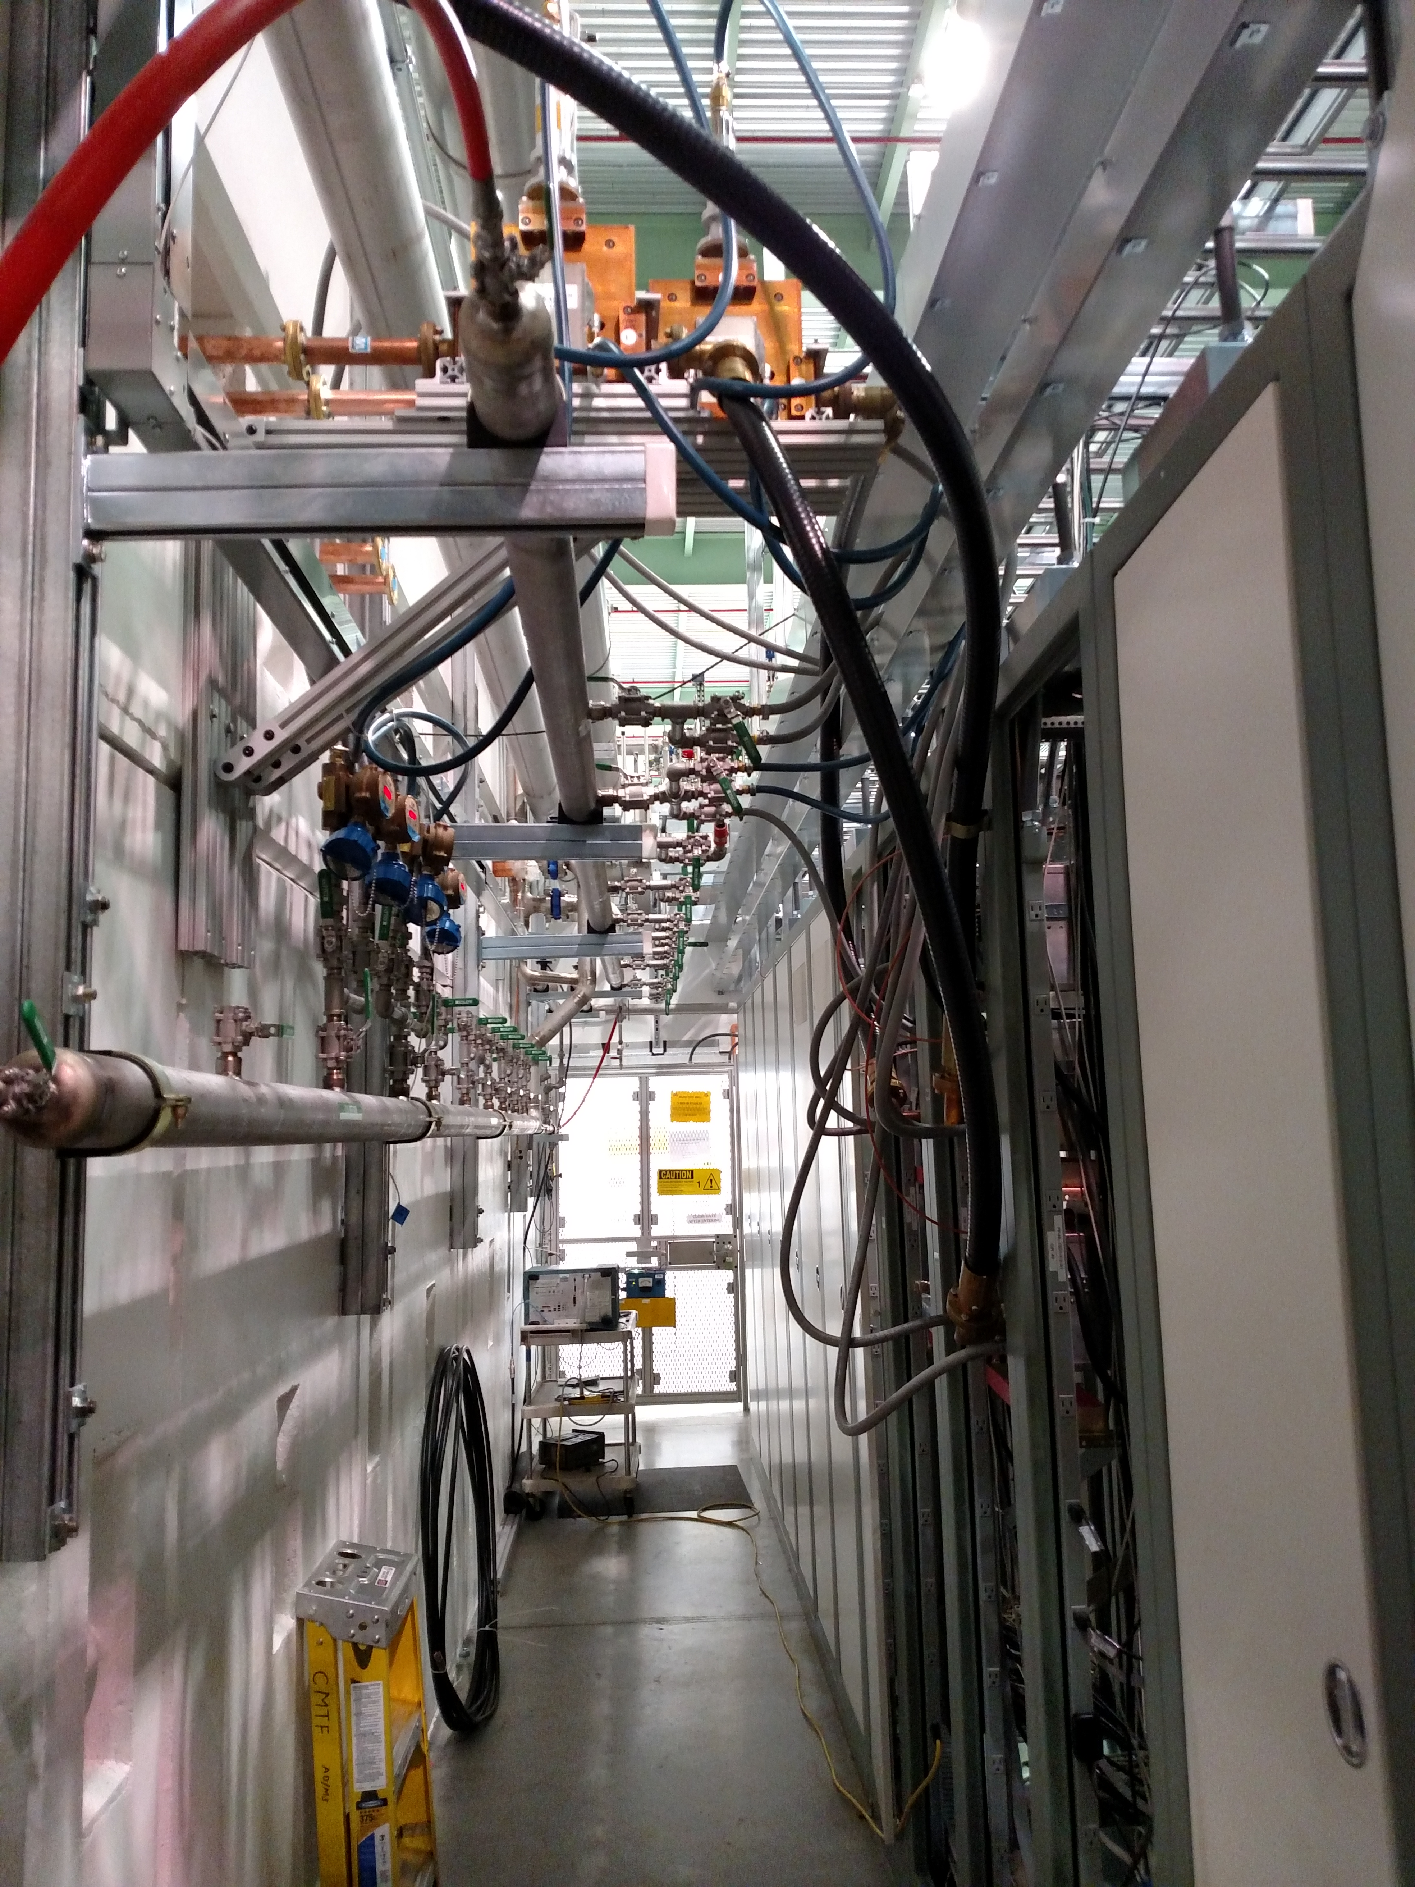
Progress to date – PIP2IT Fluids
Charge #2,3
PIP2IT LEBT LCW Manifold
PIP2IT RF Gallery

Slide 21
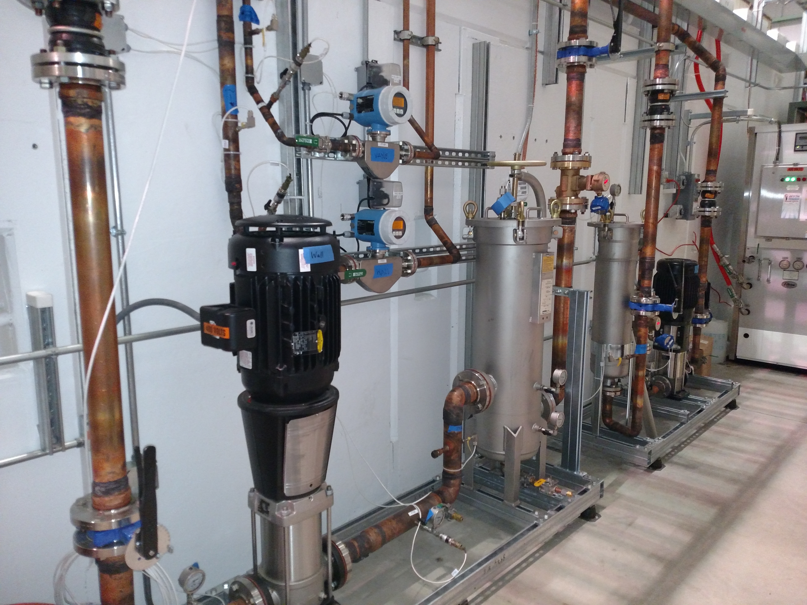
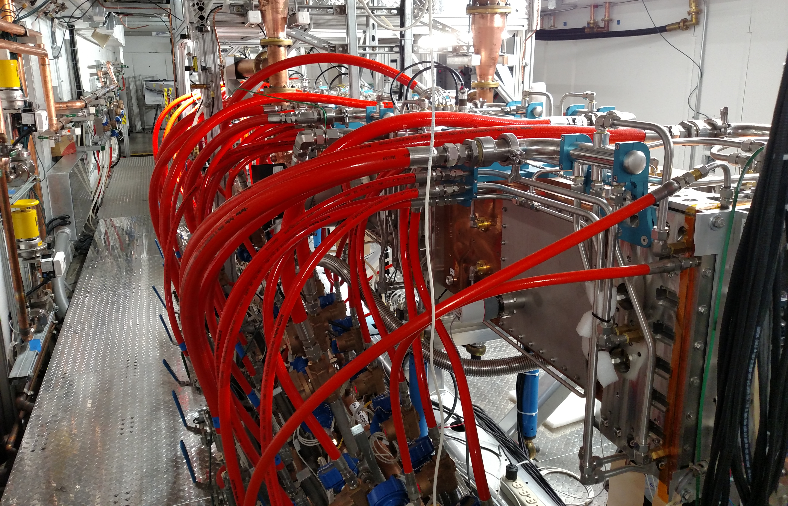
Progress to date – RFQ Cooling System
Charge #2,3
Manifolding inside cave
Vane and wall skids outside cave

Slide 22
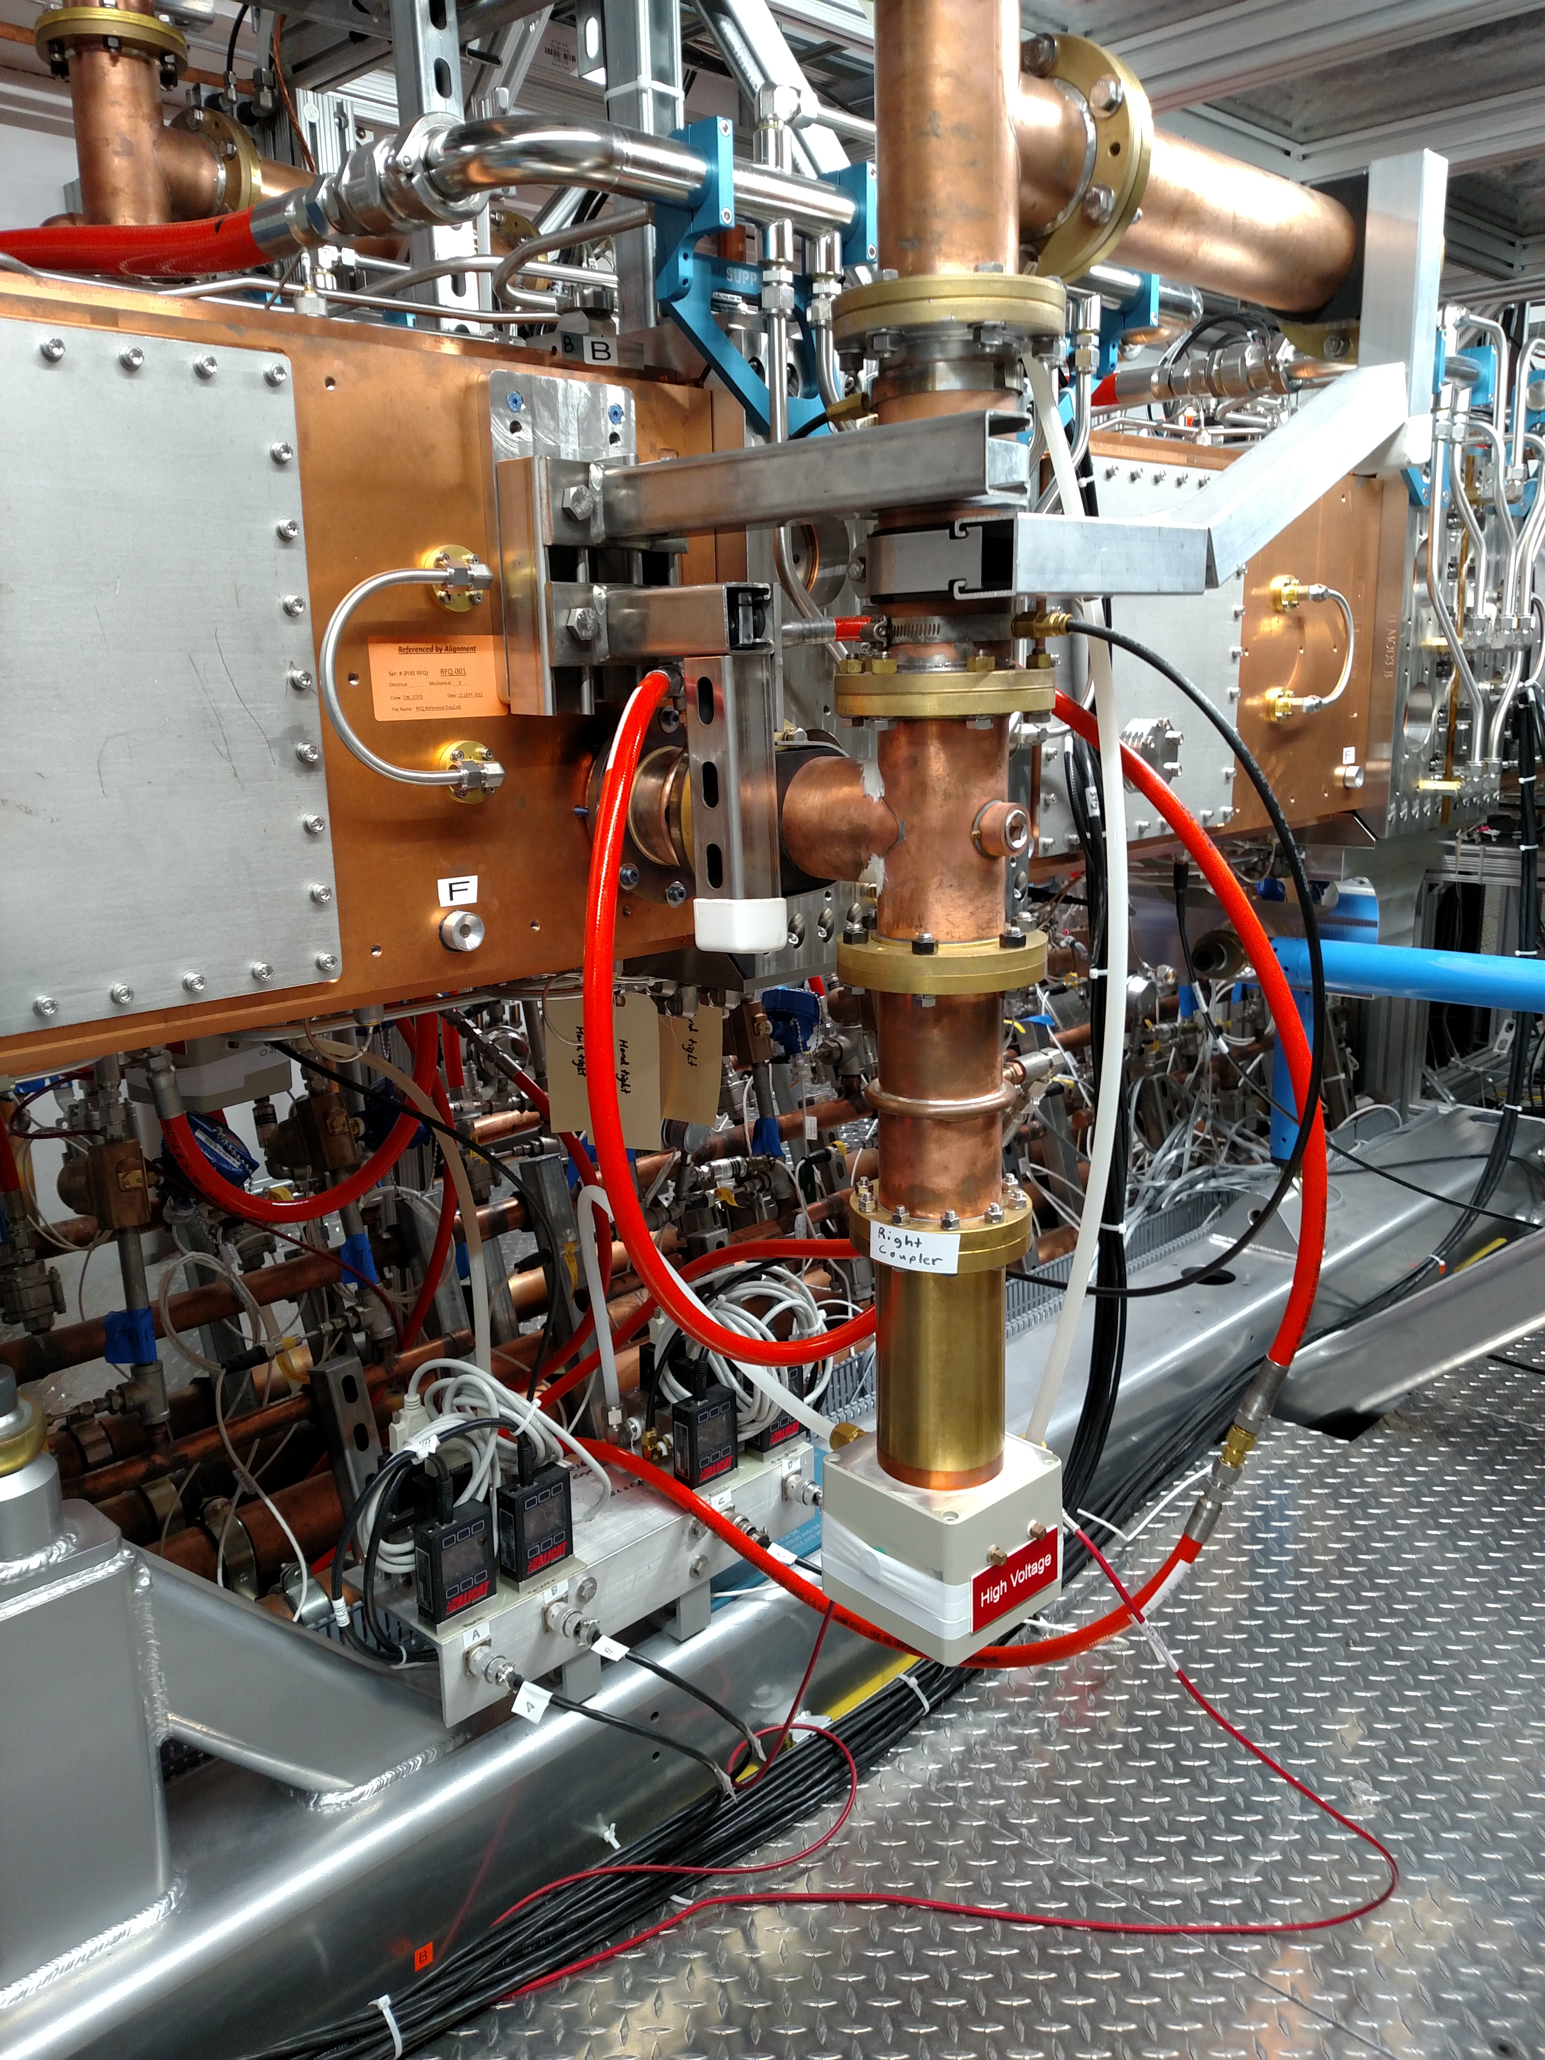
Progress to date – RFQ coupler cooling
Charge #2,3
Supply
Return air flow measurements for interlocks

Slide 23
PIP2IT II&C Lessons Learned
Charge #2,3
Maintenance of complete volume envelopes in the CAD model is critical, especially for “non-mechanical” systems
Make sure the subsystems folks can populate the cable database, properly and consistently
Re-verify hardware documentation at the moment of delivery (EPDM, survey referencing, drawings, procedures are all complete and stored in the appropriate database)
Re-verify system pressure specifications prior to fluids connection and keep track of discrepancies
Confirm that machine protection features are fully implemented and tested at the subsystem level prior to responsible engineers handing off to operations

Slide 24
Design Review Plan
Charge #3,4
Completed: RFQ Cooling System (ED0002899)
Planned:
  Division/Department review procedures apply throughout
  GSS
    Preliminary and final design reviews for each system
    Procurement Readiness Reviews for fixed-price contracts
  Installation
    Preliminary and final installation plan reviews
    Installation readiness reviews for each area (phased with BO)
  Commissioning
    Commissioning plan reviews
    Operation Readiness Clearance (ORCs) at subsystem levels
    Accelerator Readiness Review (ARR) at system level

Slide 25
ESH&Q
Charge #5
Project team is committed to construct PIP-II in a safe, environmentally respectful, and cost efficient manner that meets our stakeholder’s needs
Safety is an essential element in all work we do
  Project Integrated Safety Management Plan (docdb #141)
  Laboratory and DOE standards and practices
    Fermi Radiological Control Manual
    Fermi ES&H Manual
  Apply ”Lessons Learned” from internal and external project work
    Nearly every identified risk/hazard is in play in the IIC phase
    LOTO schemes to be given explicit consideration in ICDs
    Cable management and documentation is a high priority
  Partner deliverables are required to meet Laboratory Safety Standards

Slide 26
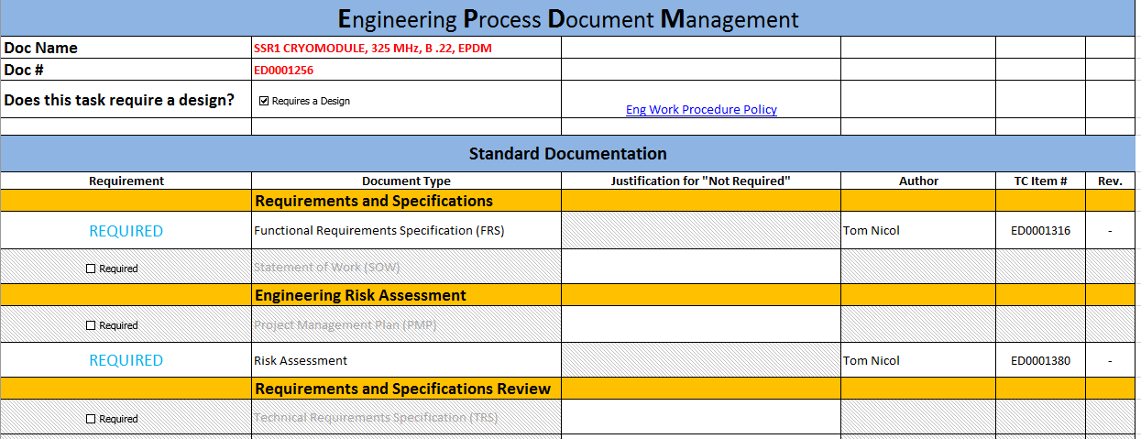
ESH&Q
Charge #5
Quality Assurance and Control
  Project Quality Assurance Plan (docdb #142)
  Communicate and work with vendors and collaborators
  Particular focus on hardware acceptance
    The last, best chance to make sure documentation is complete
    One model - Hardware Acceptance Review with complete walk-through of EPDM documentation index

Slide 27
Risk: General Support Services
Charge #3
Low-Conductivity Water System does not achieve temperature stability requirements
Requirements or interface definition for Low-Conductivity Water System Less Than Adequate

Slide 28
Risk Mitigation: LCW system does not achieve temperature stability requirements
Charge #3
Interface documentation to be created and reviewed to ensure system capabilities match customer needs
Requirements review
  Draft FRS ED0006218 Rev-, in review currently
PIP2IT/CMTF/CMTS1 experience
  “Modern” LCW system with similar architecture installed in CMTF, servicing PIP2IT and CMTS1
    Currently meets all requirements for PIP2 LCW system
  Most critical customer systems (e.g. RF amps) must be operated at PIP2IT or CMTS1 prior to PIP2, allowing for early detection of component-specific problems with cooling
    Unexpectedly-stringent cooling needs have already been identified in one RF component at PIP2IT – this drove the selection of a more robust component for PIP2

Slide 29
Risk: Installation and Commissioning
Charge #3
Machine performance problems during commissioning
Subsystem or component problem discovered after installation
Late subsystem delivery makes installation less efficient
Mismatch between subsystem delivery and installation schedule creates need for storage

Slide 30
Risk Mitigation: Subsystem or component problem discovered after installation
Charge #3
PIP-II development plan includes testing of all subsystems before delivery for installation.
  Minimizing this risk
Primary mitigations
  Test critical systems at PIP2IT/CMTS1
    Entire Warm Front End
    Cryomodules and RF
Communication and team continuity
    We are creating experts with PIP2IT and CMTS1 testing
    Same experts to commission PIP2
Adhere to the project QA plan

Slide 31
BOE Summary
Charge #3
WBS Number | Title | Docdb #
121.3.19.2 | Linac General Support Services PM and Coordination | 791
121.3.19.3 | Linac General Support Services Fluids Systems | 794
121.3.19.4 | Linac General Support Services Electrical Infrastructure | 800
121.3.22.2 | Linac Installation, Integration and Commissioning PM and Coordination | 806
121.3.22.3 | Linac Installation Planning | 809
121.3.22.4 | Linac Accelerator Installation | 812
121.3.22.5 | Linac Gallery Installation | 815
121.3.22.6 | Linac Commissioning | 818

Slide 32
Cost Summary - GSS
Charge #3
Uncertainties chosen attempt to strike a balance between systems that are not yet designed, but fully conventional

Slide 33
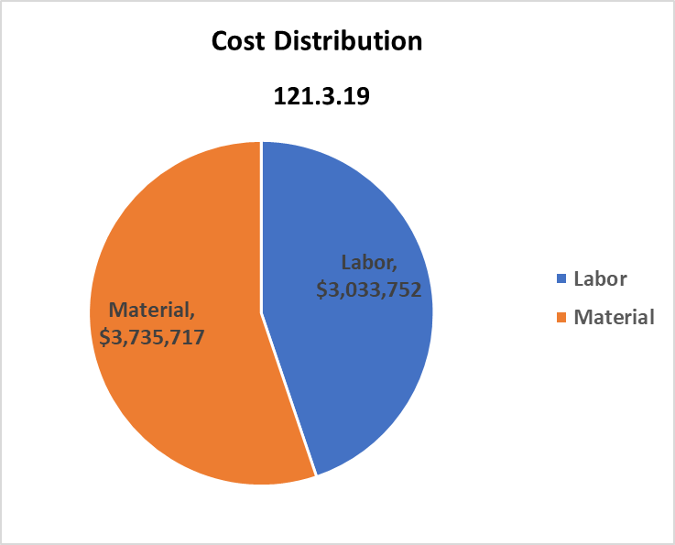
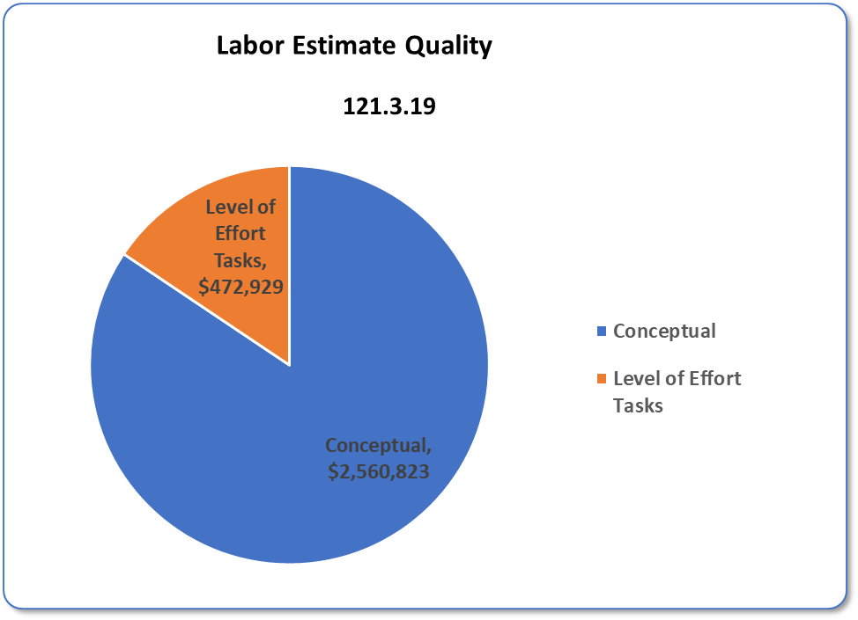
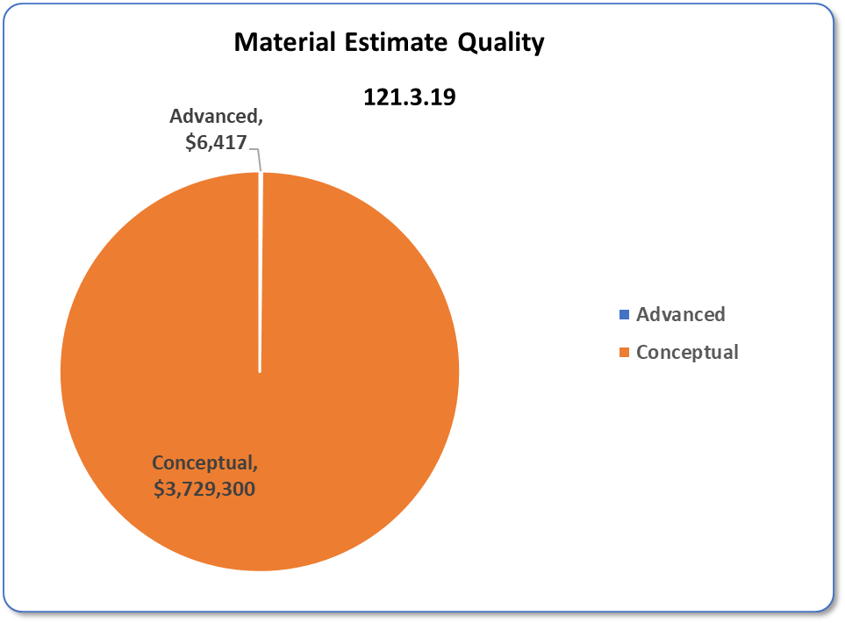
Cost Distribution and Estimate Quality - GSS
Charge #3
Labor is driven by design and documentation efforts
M&S is primarily material and equipment purchases
Installation labor not included (captured on 121.3.22)

Slide 34
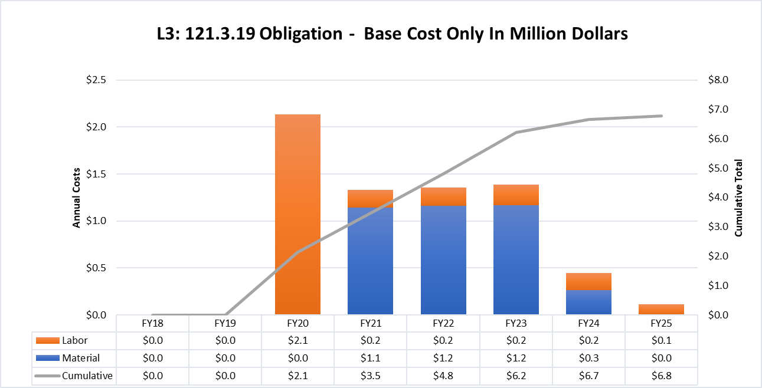
Obligation Profile – P6 Base Cost Only - GSS
Charge #3
Costs = BOE + Overheads + Escalation

Slide 35
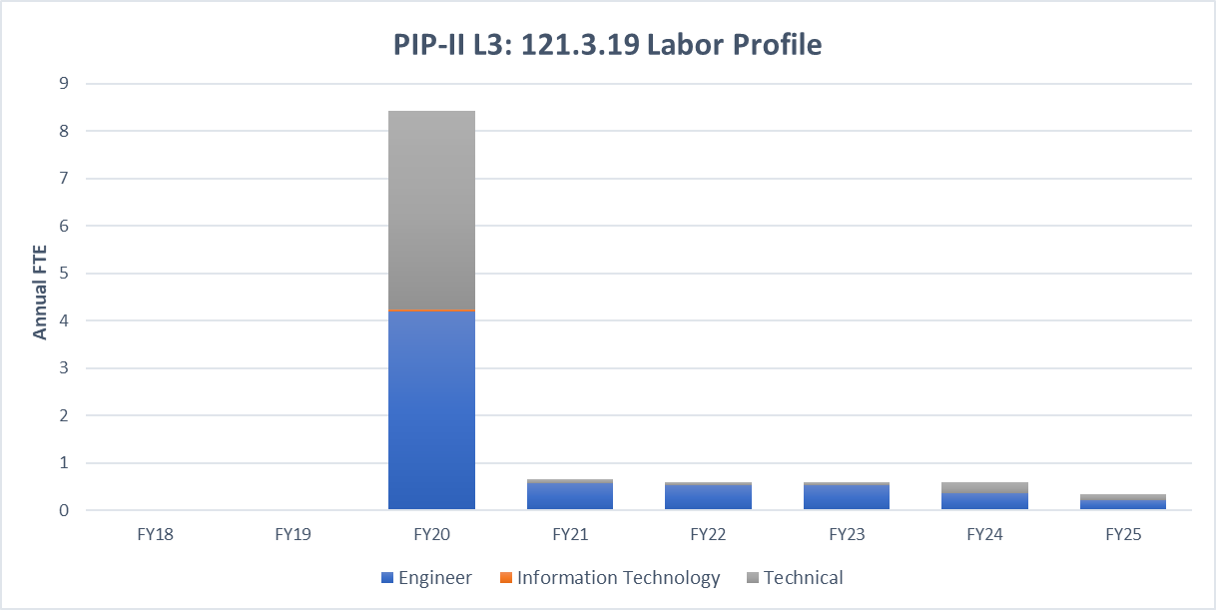
Labor Profile – P6 Hours/FTE - GSS
Charge #3
Labor effort driven by design
Note that designers are categorized as “technical” on this plot

Slide 36
Cost Summary – II&C
Charge #3
Full Burden + Esc = BOE + Escalation + Overhead
Installation itself is ~65% of total cost
Commissioning is ~24% of total cost
Remaining ~11% is LOE, planning, stands, etc.

Slide 37
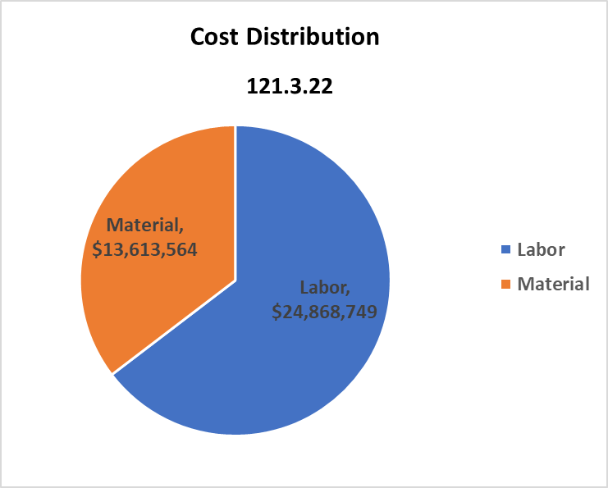
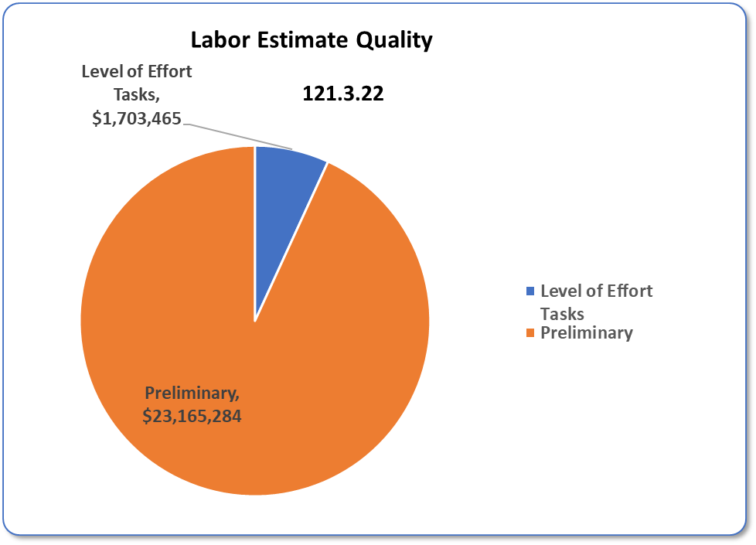

Cost Distribution and Estimate Quality – II&C
Charge #3
Labor cost is the driver
M&S costs are driven by T&M and subcontracted installation tasks, e.g. Cryo Distribution System installation

Slide 38
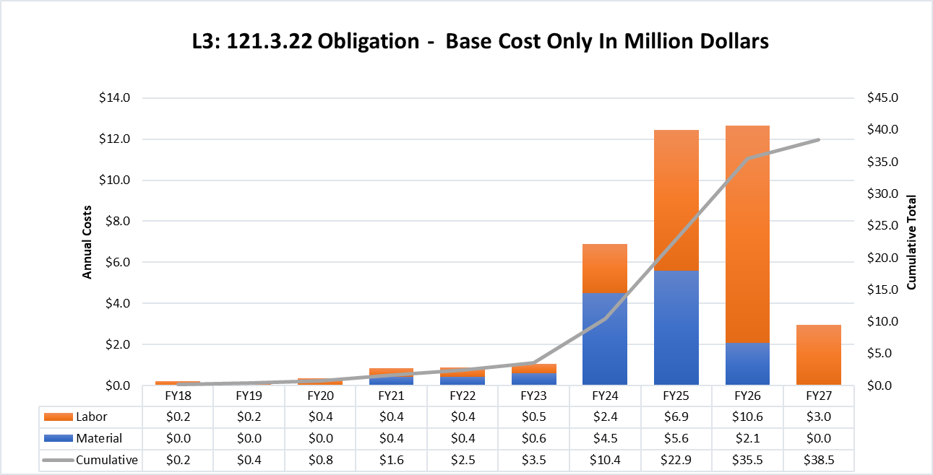
Obligation Profile – P6 Base Cost Only – II&C
Charge #3
II&C Window is Jan FY24 - Apr FY27
Obligation profile peaks during the middle of the II&C window

Slide 39
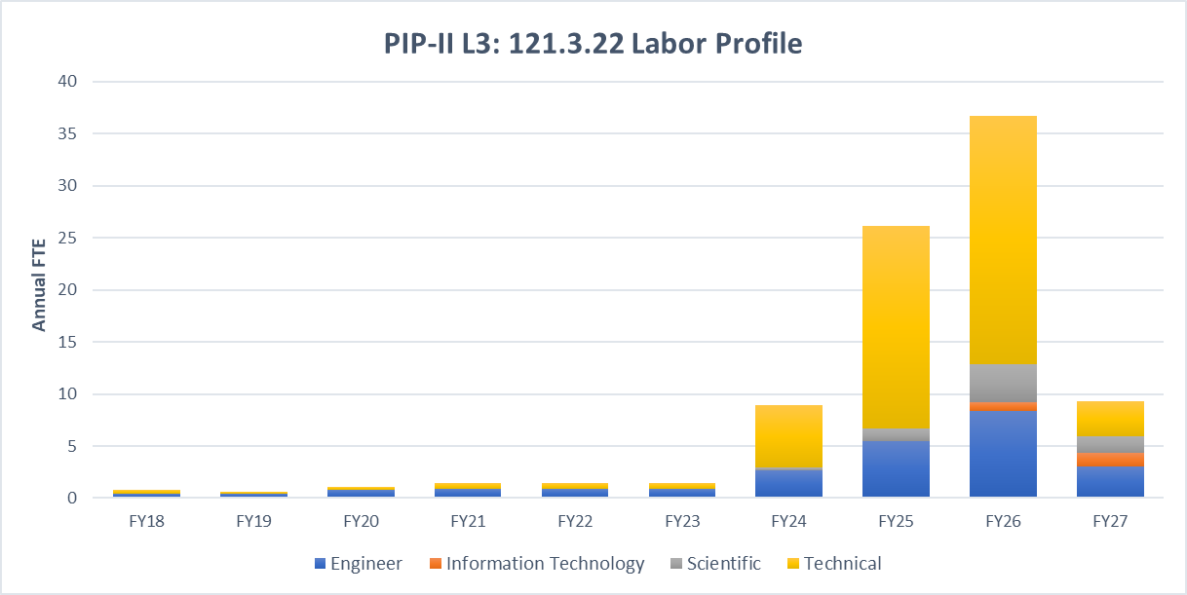
Labor Profile – P6 Hours/FTE – II&C
Charge #3
II&C Window is Jan FY24 - Apr FY27
Labor peaks in FY26, driven by final cryomodule deliverables and BTL work

Slide 40
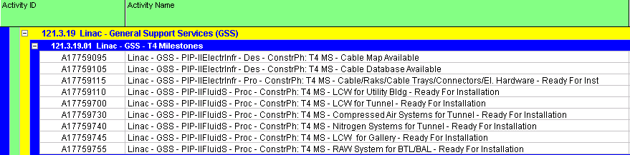
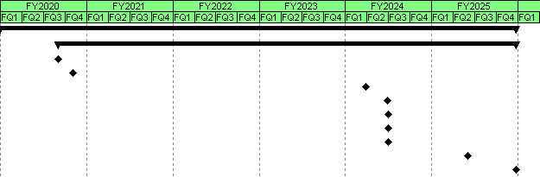
Schedule – General Support Services

Slide 41
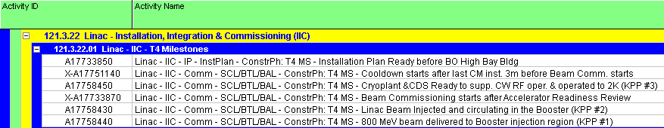
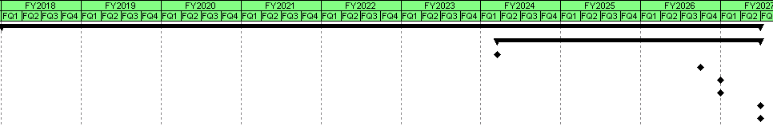
Schedule – Installation, Integration & Commissioning

Slide 42
Summary
GSS Systems are conventional, and have good precedent at PIP2IT/CMTF.
Installation concepts will evolve in parallel with CF design and RLS development
Focus of the team in the near term will be interface documentation
The team’s past (and future) efforts at PIP2IT provide guidance and training for PIP2
We look forward to your feedback, thank you for your attention

Slide 43
END

