Slide 1
121.3.3 Linac – Warm Front End
Linear Accelerator Support Systems, Installation and Commissioning
Lionel PROST
PIP-II Independent Project Review
12-14 December 2017

Slide 2
Outline
Requirements
Conceptual Design, Maturity
Scope/Deliverables
Interfaces
Technical Progress to Date
ESH&Q
Risk
Cost
Schedule
Summary

Slide 3
About Me:
Level 3 Manager for the Linac Warm Front End
  Senior Scientist (>15 years experience with accelerator systems)
  Contributed to the Recycler Electron Cooler project at Fermilab
    Highest energy electron cooler in the world
    Beam power ~4MW
IS/LEBT Design
WFE commissioning at PIP2IT

Slide 4
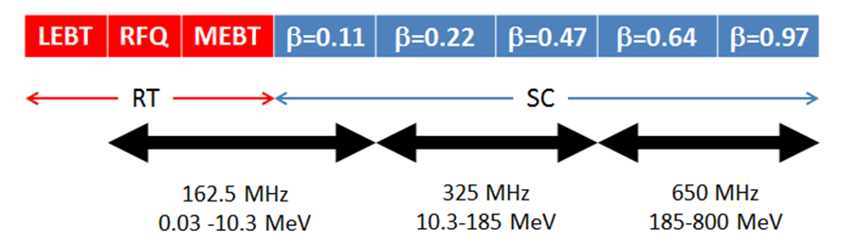
Warm Front End
The Warm Front End (WFE) prepares a H⁻ beam optimized for injection into the Booster and provides capabilities for future CW operation
  A low emittance beam is required to minimize beam loss in the SRF linac and at injection into the Booster (KPP #1)
Warm Front End
PIP-II Linac technology map

Slide 5
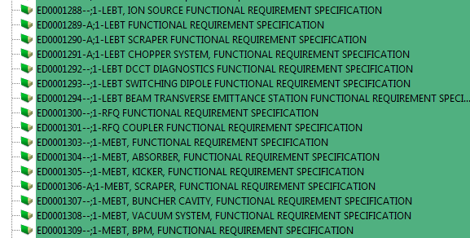
WFE Requirements Documentation
Charge #2
Requirements are captured in a set of Functional Requirement Specifications (FRS) within our Project Document Database (Teamcenter)
  ED0001288 (IS)
  ED0001289 (LEBT)
  ED0001300 (RFQ)
  ED0001303 (MEBT)
    Many more FRSs have been written for the various subsystems that make up the WFE (e.g.: choppers, absorber…)
Partial list from Teamcenter

Slide 6
WFE Main Requirements
Charge #2
Parameter | Requirement | Units
Particle species | H⁻
Output beam energy (kinetic) | 2.1 | MeV
Bunch repetition rate | 162.5 | MHz
Nominal output beam current (average) | 2 | mA
Nominal charge per bunch (RFQ current) | 30 | pC
Sequence of bunches | Programmable
Beam pulse duration* | 0.55 | ms
Beam pulse repetition rate* | 20 | Hz
Normalized rms beam emittance - Transverse | ≤ 0.23 | mm mrad
Normalized rms beam emittance - Longitudinal | ≤ 0.31 | mm mrad
* For injection into the Booster
Emittance requirements are specified for an ion source beam current (DC) in the range of 2-5 mA

Slide 7
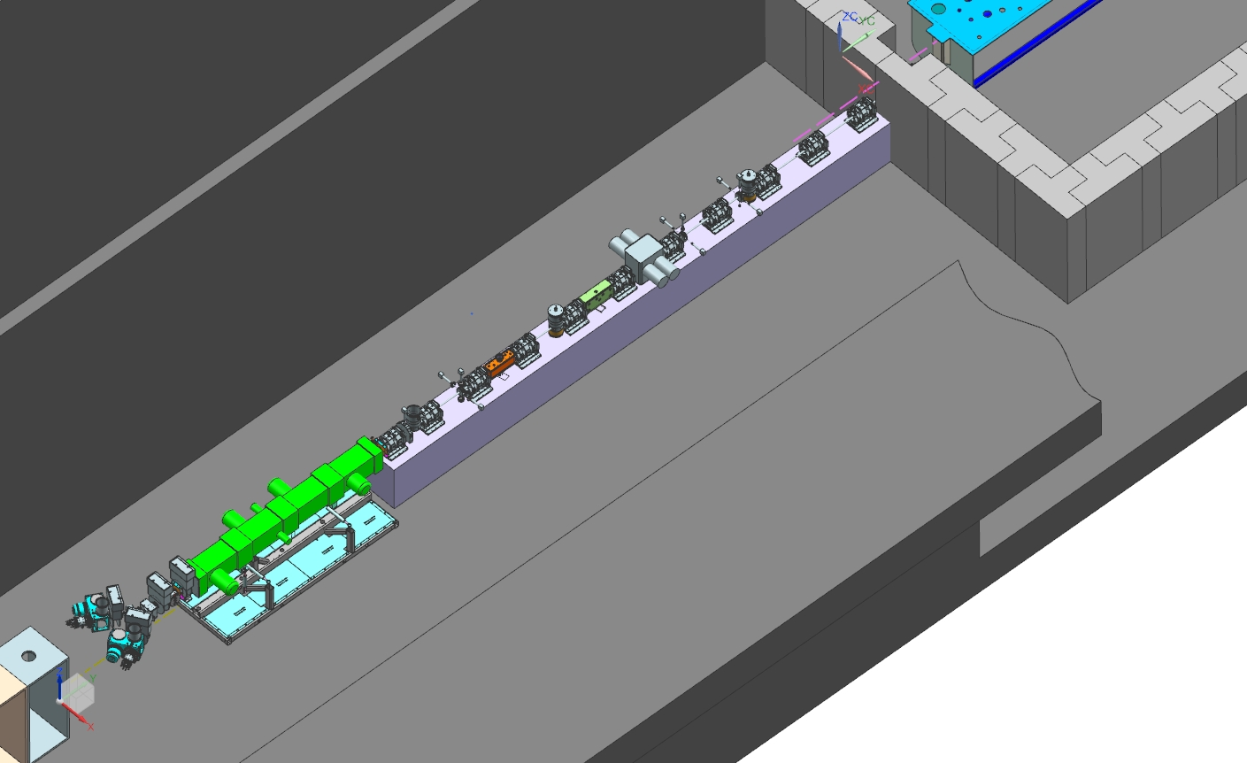
Conceptual Design
Charge #2
Mature and stable design with focus on factors that may determine reliability and uptime
  Two ion sources with switching magnet (30 keV, 15 mA DC)
  2-m long LEBT with partial neutralization transport scheme
    Chopper for creating “macro” pulses
  4.4-m long, 4-vane RFQ, 2.1 MeV, 162.5 MHz CW
  14-m long MEBT with:
    Bunch-by-bunch
    chopping system
    Radiation protection
    wall
    Scraping system
    Differential pumping
    section after absorber
HWR
MEBT
121.3.3.4
121.3.3.6
LEBT
RFQ
121.3.3.5
Two ion sources
121.3.3.3

Slide 8
Critical design issues
Charge #2
LEBT with low emittance growth compatible with chopping ✓
  Vacuum management in the LEBT/RFQ region ✓
Reliable CW RFQ, including couplers (partially ✓)
Bunch-by-bunch selection in MEBT (kickers) (partially ✓)
  Bunch extinction, effective emittance growth
Compatibility of high-power deposition in MEBT absorber with SRF downstream
  Absorber reliability & lifetime
All are being addressed at the PIP-II Injector Test (PIP2IT) being constructed at the Cryo-Module Test Facility (CMTF)
[A. Shemyakin presentation, PIP2IT Plans and Accomplishments]

Slide 9
Scope: WBS Dictionary
Charge #2
WBS Dictionary: PIP-II DocDB #599
121.3.3 Warm front End | This WBS entry covers development of the PIP-II 2.1 MeV normal conducting front-end. This system includes ion sources, solenoids and other magnets, accelerator sections, diagnostics sections. Included is the High Energy Beam Transport downstream of the HWR and SSR1 cryomodules in the PIP-II Integration Test at CMTF.
  Decommissioning of PIP2IT, transport to and installation of the WFE in the PIP-II building high-bay are not part of this WBS

Slide 10
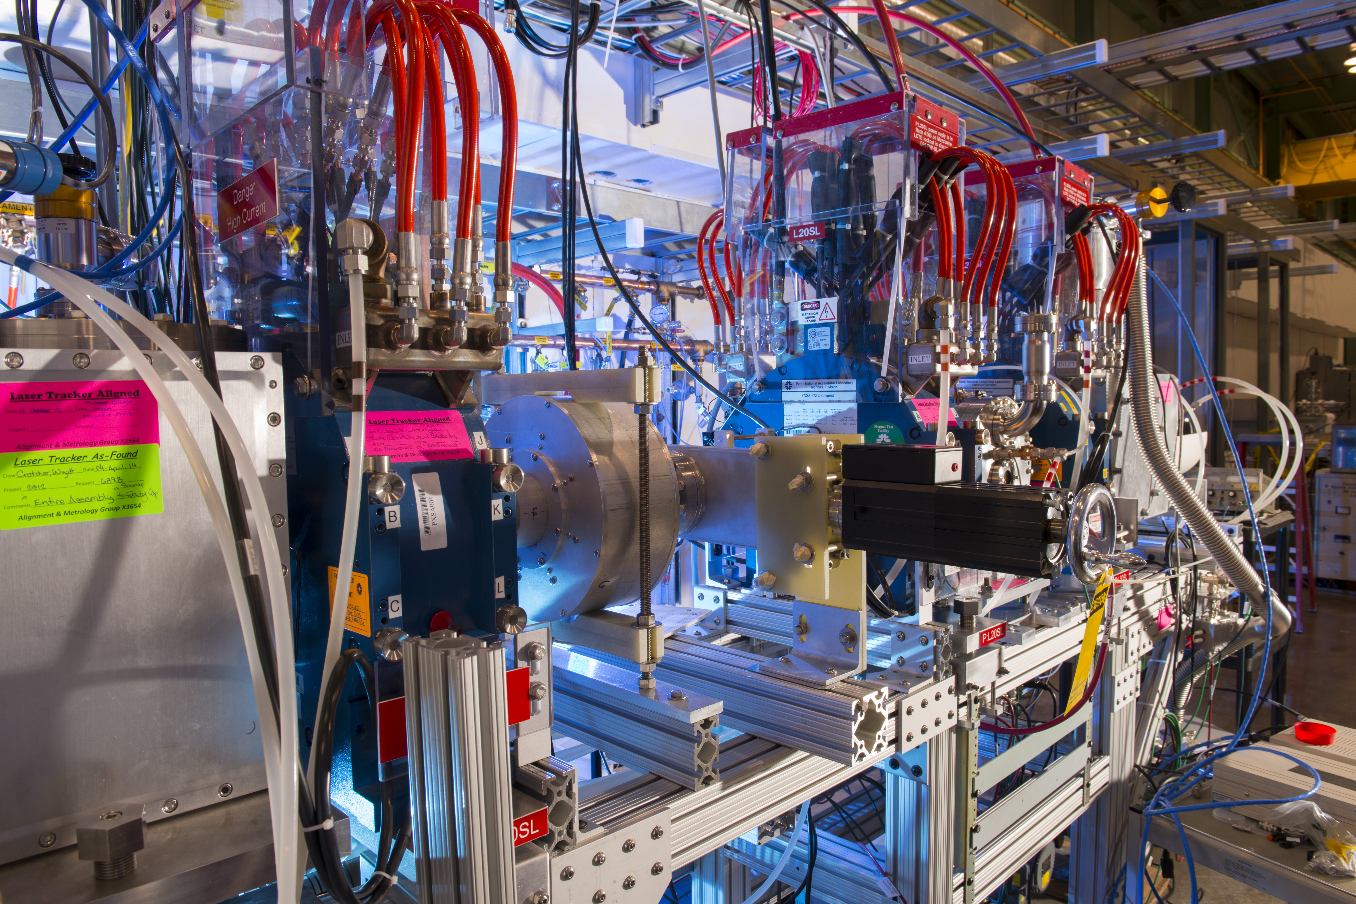
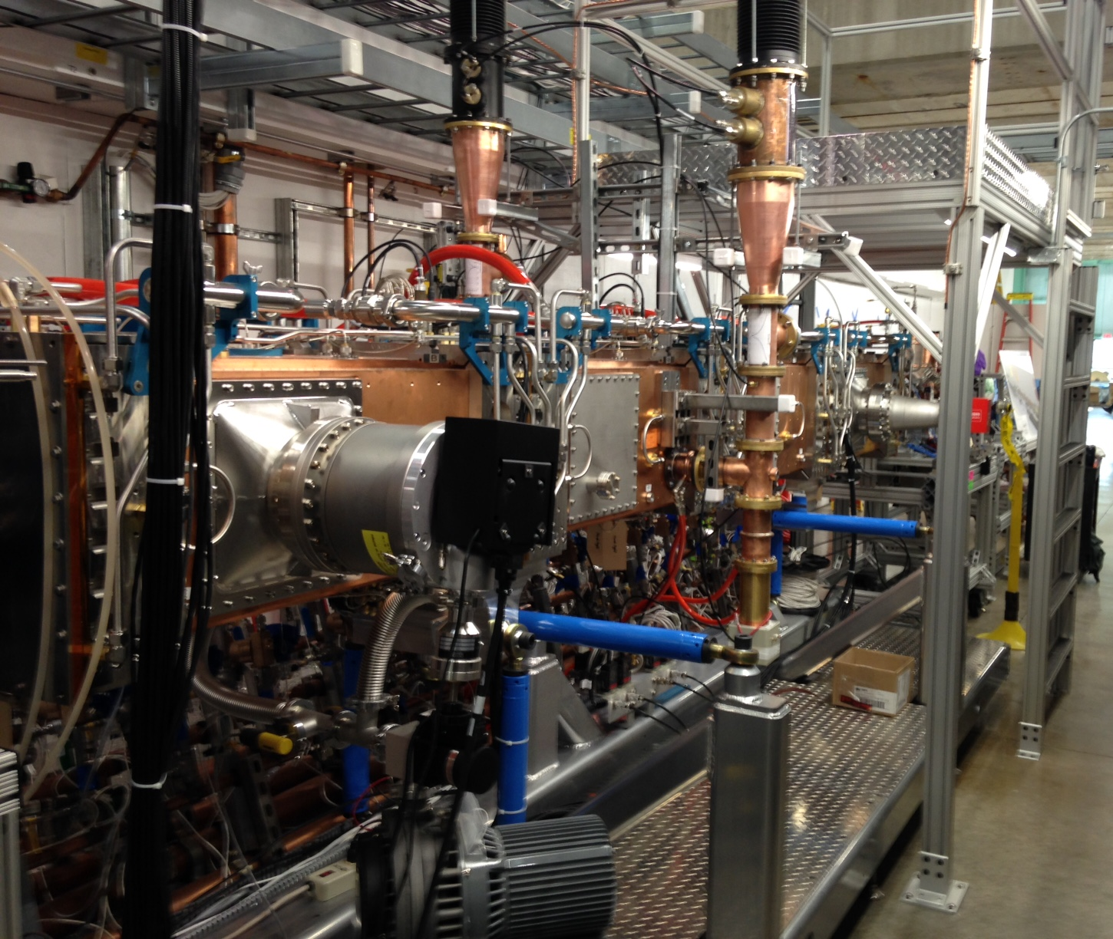
List of deliverables
Charge #2
Most of the PIP2IT hardware will be used for PIP-II
  Significant fraction already acquired and not explicitly in WBS
    Ion source assembly (1) including an emittance scanner
    Solenoids (4), chopping system (1) and scraping electrodes (4) (LEBT)
    RFQ including PAs and water cooling skids for resonance control
IS & LEBT
RFQ

Slide 11
List of deliverables (cont’)
Charge #2
Ion Source assembly (1) including power supplies (WBS #121.3.3.3)
  IS and its vacuum chamber will be procured
Components to complete the 2nd leg of the LEBT (WBS #121.3.3.4)
  Includes a scraping electrode and a vacuum valve
New RFQ power couplers (2 + 2 spares) and new tuner slugs (80) to bring the RFQ to the proper resonant frequency (WBS #121.3.3.5)
MEBT (WBS #121.3.3.6)
  Focusing and steering elements (14 + 3 spares long quadrupoles, 20 + 2 spares short quadrupoles, 12 + 2 spares 2—plane dipole correctors), kickers (2), absorber (1), scraping systems (16 scraper paddles and associated drive mechanisms), bunching cavities (4 + 1 spare), differential pumping section (DPI)
    Does not cover vacuum equipment and supporting infrastructures (e.g.: water distribution, electrical power, alignment)
  In addition, this WBS covers the High Energy Beam Transport at PIP2IT
    Focusing elements (4 long quadrupoles)
    Radiation shield for the beam dump

Slide 12
International partners contribution
Charge #7
Bhabha Atomic Research Centre (BARC) has designed the MEBT focusing and steering elements (quadrupole and dipole magnets)
  Fabricated and delivered most of them for PIP2IT already
    Last shipment (expected FY18): 11 long quadrupoles and two short quadrupoles
      Includes quadrupoles for HEBT
  Built to specs, as verified by magnetic measurements both at BARC and Fermilab (upon reception)
  In addition, it is assumed that BARC will provide 3 long quadrupoles and 6 short quadrupoles for the PIP-II MEBT
    The details concerning deliverables and schedule will be finalized by CD-2

Slide 13
Interfaces
Charge #2
Top 4 systems this WBS interfaces to (upstream):
Top 3 systems this WBS interfaces to (downstream):
WBS 121.3.3
WFE
WBS 121.3.5
SSR1
Delivery and installation of the SSR1 cryomodule will determine the WFE operation schedule
WBS 121.3.4
HWR
Delivery and installation of the HWR cryomodule will determine the WFE operation schedule
WBS 121.3.17
Controls
The control system impacts all commissioning activities, from simple operation to data taking
WBS 121.3.20
Safety Systems
If safe operation of the PIP2IT WFE is not possible, it will delay commissioning activities
WBS 121.3.3
WFE
WBS 121.3.22
II&C
Impact on Cost and Schedule
WBS 121.5.5
CF-High Bay
Impact on Schedule
WBS 121.3.4
HWR
Impact on Technical
    Cryomodules delivery schedule impacts the activities being carried out at PIP2IT WFE
    Safety Systems need to be in place to operate beam
    Developing the controls system (in particular MPS) is an important part of retiring risks with PIP2IT activities
Findings at PIP2IT WFE may influence the design of the PIP-II building High Bay and, subsequently of its installation
In order to carry out beam tests with the HWR cryomodule, the WFE must be operating at the right frequency and the appropriate level safeguards

Slide 14
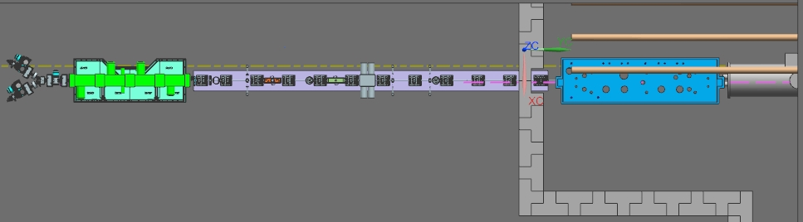
PIP-II WFE Development
Charge #2,3
PIP-II Injector Test (PIP2IT)
  Nearly full-length WFE to be installed at CMTF
PIP-II MEBT longer by ~3.5 m
  3 more focusing triplets and one more bunching cavity
    Protection of SRF from absorber vacuum failure (increased distance)
  Free space to accommodate shielding wall from high energy part
    Public viewing (no residual radiation at 2.1 MeV but minimum safety distance when in operation)
PIP-II High Bay
PIP-II Linac Tunnel
PIP2IT
(11/2017)

Slide 15
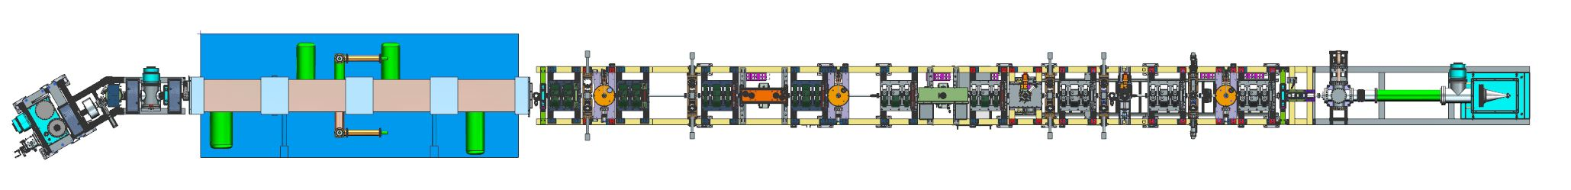
PIP-II Injector Test (PIP2IT)
Charge #2,3
Ion Source, complete LEBT (including switching dipole magnet), RFQ, MEBT with all focusing elements (transverse and longitudinal)
Prototype scraping systems, prototype kickers
(2 different designs), prototype absorber (¼ length)
Diagnostics girder (Fast Faraday Cup, Time-Of-Flight
Beam Position Monitor, Resistive Wall Current Monitor)
Production version of the prototypes will be installed and tested with beam at PIP2IT before being moved to the PIP-II High Bay
Ion Source
LEBT
RFQ
MEBT
Dump
Diagnostics girder

Slide 16
Design Reviews
Charge #3,4
Yearly overall design reviews via the Machine Advisory Committee
  2017 PIP-II Machine Advisory Committee serves as the Independent Design Review for the purpose of CD-1
Follow Division/Department Design Review procedures
  Critical components (complexity and/or cost) go through formal design reviews
    LEBT switching dipole magnet Final Design Review (ED#0003548)
    RFQ main body Final Design Review (ED#0001657)
    RFQ RF couplers Final Design Review (ED#0005909)
    MEBT scrapers Final Design Review (ED#0005913)
    Differential Pumping Insert (ED#0006709)

Slide 17
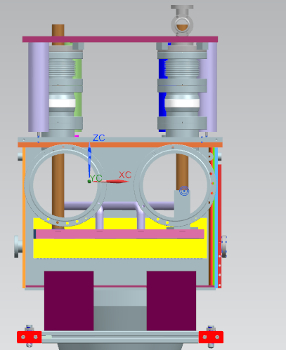
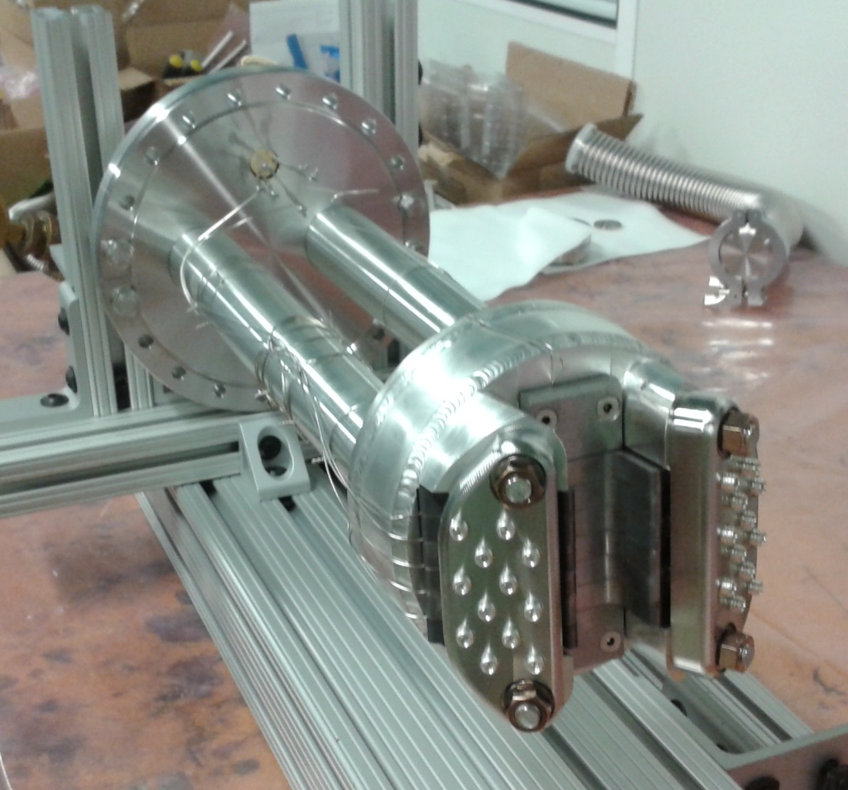
Upcoming and foreseen design reviews
Charge #3,4
MEBT absorber Final Design
Review in FY18
Additionally, because the PIP-II MEBT is slightly different from the PIP2IT MEBT, there is provision for a limited-in-scope review of the MEBT as a whole
  Following the completion of the PIP2IT program
CAD model
¼ length prototype

Slide 18
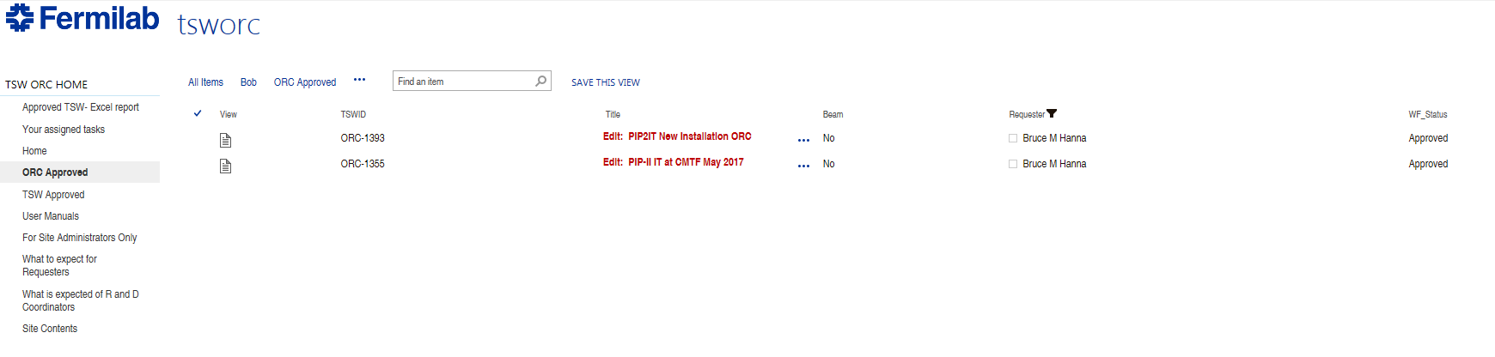
ESH&Q
Charge #5
Project team is committed to construct PIP-II in a safe, environmentally respectful, and cost efficient manner that meets our stakeholder’s needs
  Project Integrated Safety Management Plan (DocDB #141)
  Laboratory and DOE standards and practices
    Fermi Radiological Control Manual, Fermi ES&H Manual
    AD Operation Readiness Clearance (ORC)
      Conducted at PIP2IT for each new configuration
    Radiation surveys are conducted as the beam power increases
ESH&Q Fermipoint screenshot
https://fermipoint.fnal.gov/service/tsworc/Lists/tsworc/ORC%20Approved.aspx

Slide 19
ESH&Q (cont’)
Charge #5
Preliminary Hazard Analysis for PIP2IT (DocDB #40)
  Up to 2.1 MeV
Apply ”Lessons Learned” from internal and external project work
Partner deliverables are required to meet Laboratory Safety Standards
Quality Assurance and Control
  Project Quality Assurance Plan (DocDB #142)
  Communicate and work with vendors and collaborators
    MEBT Bunching cavities from vendor
    MEBT Magnets from BARC, India

Slide 20
Relatively low impact risks
Charge #3
MEBT kickers performance is unsatisfactory
Unable to maintain proper vacuum between MEBT absorber and SRF
MEBT Absorber does not meet performance requirement
It is the purpose of the PIP2IT program to retire risks associated with the WFE
  E.g.: Risk “ LEBT bending magnet deteriorates the beam emittance” has been retired

Slide 21
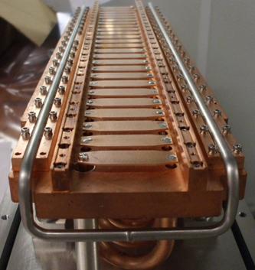
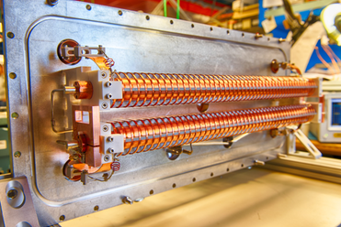
Risk Mitigation
Charge #3
“MEBT kickers performance is unsatisfactory”
  Developed 2 concepts for the MEBT kickers
    “50-Ohm” and “200-Ohm”
  One prototype of each kind has been fabricated and installed at PIP2IT
    Tests with beam have started
“50-Ohm” kicker electrode
“200-Ohm” kicker helical structure
Beam
Beam

Slide 22
BOE Summary
Charge #3
Basis of Estimates are located in the PIP-II Document Database (a.k.a. Docdb)
  Electronic signoffs for revision control
  Convenient way to gather BoEs and all relevant supporting documentation in a single place
WBS Number | Title | Docdb #
121.3.3.2 | Linac – WFE Project Management and Coordination | 563
121.3.3.3 | Linac – WFE – Ion Sources | 569
121.3.3.4 | Linac – WFE – Low Energy Beam Transport (LEBT) | 569
121.3.3.5 | Linac – WFE – Radio Frequency Quadrupole (RFQ) | 572
121.3.3.6 | Linac – WFE – Medium Energy Beam Transport (MEBT) | 575
Note: Combined BoE document for 121.3.3.3 & 121.3.3.4

Slide 23
Cost Summary
Charge #3
Costs generated from resource loaded schedule
  Fairly detailed given the status of this part of the project
Estimate Uncertainty follows project guidelines

Slide 24
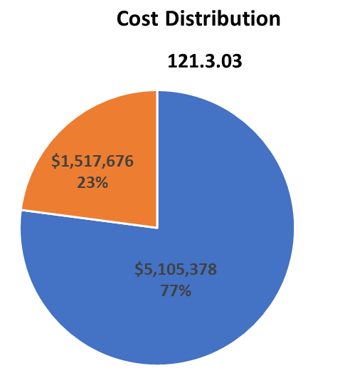

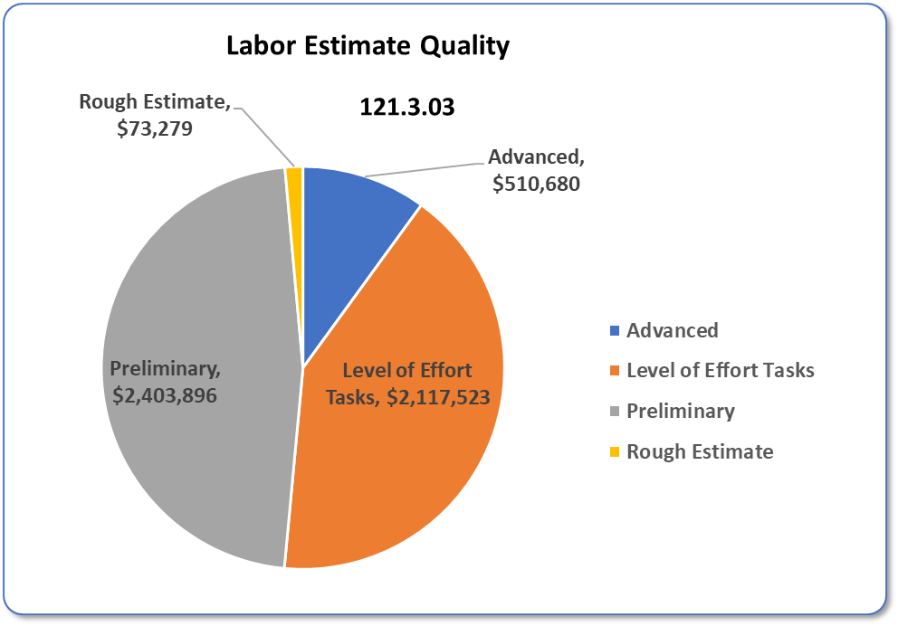
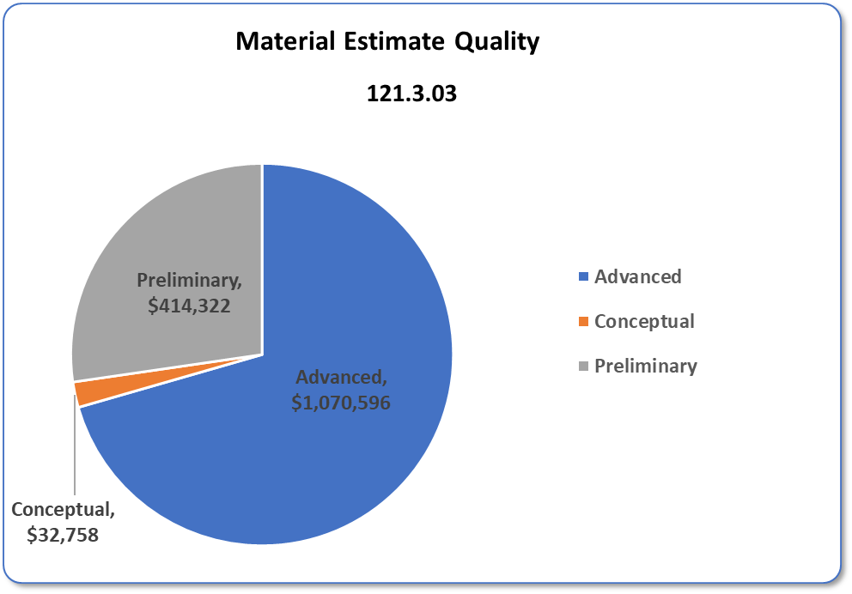
Cost Distribution and Estimate Quality
Charge #3
Costs = BOE + Overheads + Escalation
Estimate Quality Categories are per Fermilab Standards and descriptions can be found in DocDB #345
Cost driven by Labor
  Major M&S expenses (e.g.: RFQ) have already occurred
    2nd ion source and bunching cavities only large procurements remaining

Slide 25
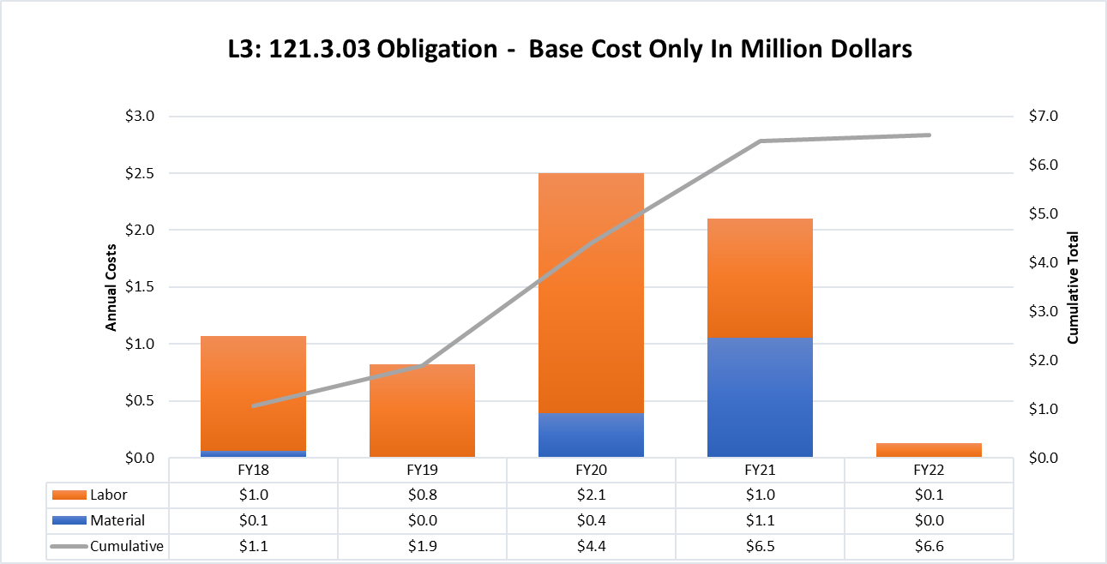
Obligation Profile – P6 Base Cost Only
Charge #3
P6 Base Costs = BOE + Overheads + Escalation
Labor-dominated early during PIP2IT activities
Kickers, absorber fabrication FY20 into FY21
Bunching cavities procurement and fabrication of the 2nd ion source assembly in FY21

Slide 26
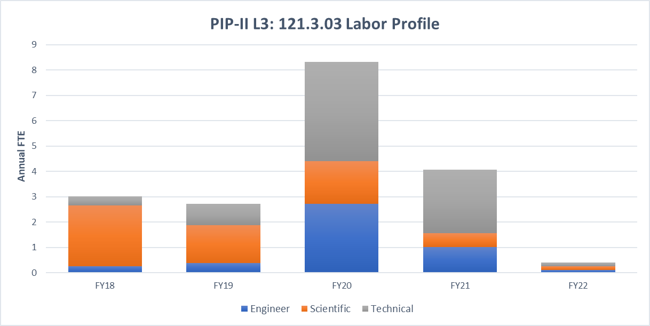
Labor Profile – P6 Hours/FTE
Charge #3
Fabrication of MEBT (production) components in FY20/21 → Technicians and Engineers

Slide 27
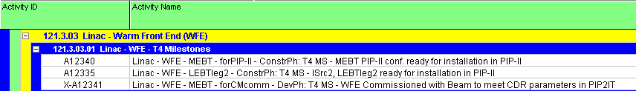
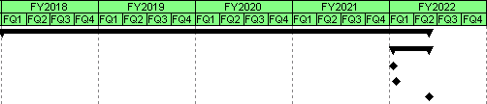
Schedule Overview
Charge #3
This WBS is not on the critical path but tied to external factors
  Delivery of HWR and SSR1 cryomodules
  Critical Decisions
  Beneficial Occupancy of the PIP-II High-Bay

Slide 28
Summary
The PIP-II Warm Front End design is complete and an integrated system is being constructed and tested (i.e. PIP-II Injector Test at the Cryo-Module Test facility)
  Most sub-systems have been fabricated (at least at the prototype level) and assembled
    Several design requirements have been met
Cost, schedule, and risks/opportunities for the PIP-II WFE are well defined
  Most of PIP2IT is destined for installation in the PIP-II building ⇒ cost scope is limited (and so are risks)

Slide 29
Thank you for your attention

