Slide 1
Cavity and Cryomodule Testing Plan
SC Acceleration Modules and Cryogenics
Joe Ozelis
PIP-II DOE Independent Project Review
12-14 December 2017

Slide 2
Outline
Scope of Design and Development
SRF Test Program Goals
SSR1/SSR2
  CM-Specific Components
  Testing CM-Specific Components
  Testing CM-Specific Sub-Systems
HB650/LB650
  CM-Specific Components
  Testing CM-Specific Components
  Testing CM-Specific Sub-Systems
General CM Risks
Addressing General CM Risks
Summary

Slide 3
About Me:
PIP-II Manager for Test Infrastructure at Meson Detector Building (STC@MDB)
  WBS 121.3.21.1
Sr. Engineering Physicist, joined FNAL in 1989, involved in SRF since 2000
    Horizontal Test Facility Manager (HTS, STC, HTS-2) (current)
      Testing, operations, maintenance, upgrades
    VTS Area Leader (2006-2012)
      Facility design and construction, operations, maintenance, upgrades, actively conducted 200+ cavity tests
    Test Facility Coordinator, QA Group Leader (SNS Project @ JLab, 2000-2006)
      Coordinating VTA and CMTF operations/upgrades, SNS production cavity testing, established SRF QA program for SNS
    LHC/SSC Magnet Programs (1989-2000)
      SSC & LHC Magnet performance measurements (quench & mechanical), test system design and implementation, short-sample test facility design/implementation

Slide 4
Scope Of Design And Development
PIP-II entails developing and assembling 5 cryomodule types (HWR, SSR1, SSR2, LB650, HB650)
  HWR is a basic extension of current technology at ANL
    Limited development program at ANL
    CM Testing at PIP2IT
  SSR1/2 and HB/LB650 are new, unique CM designs
  Require development and verification of new designs for
    Cavities (incl Helium vessel and magnetic shields)
    Couplers
    Tuners
    Focusing elements (SSR1/2)
    Cryomodule support, cryogenics, and thermal management systems
Component, sub-system, and overall CM performance will need to be rigorously verified

Slide 5
SRF Linac Risks
Through a comprehensive Risk Analysis exercise, we have identified the top-level (highest) risks associated with the 4 cryomodule types:
  Pulsed and CW cryomodule operating modes cause cryogenic or mechanical instabilities
  SSR1/SSR2/LB650/HB650 CM(1) Performance at PIP2IT/CMTF does not meet technical requirements
  SRF Pre-Production Input Coupler Failure
  Q₀ performance of installed cavities
  Resonance control

Slide 6
SRF Test Program Goals
Within the WBSs for the 4 CM types are numerous activities associated with design verification of components and sub-systems, and qualification of production components.
  These activities are integrated in the P6 schedule, with resources assigned.
  Except for production qualification, they typically precede final design activities and production procurements.
Each WBS also includes comprehensive testing of “1st CMs” for all CM types, followed by production testing of all cryomodules.
  These activities are also integrated into P6, with resources assigned.
  This is the final activity that addresses “global” CM performance risks.
The Test Program addresses performance risks from the component to sub-system to final integrated CM level.

Slide 7
Testing Hierarchy
Components
Sub-Systems
Integrated System
Cavity
Dressed Cavity
Coupler
Tuner
Cavity
Dressed Cavity
Cryomodule
Coupler
Tuner
The Test Program addresses performance risks from the component to sub-system to final integrated CM level.
Cavity
Dressed Cavity
Coupler
etc.

Slide 8
CM-Specific Components – SSR1/SSR2
Cavities
  SSR1 bare & jacketed/dressed cavity design verified (VTS/STC), but minor design upgrade underway for CM#2
  SSR2 cavity new design, will require complete testing/verification of bare and jacketed cavities in the VTS (and then STC)
  MP and FE are of concern for all SSR1/SSR2 cavities
Couplers
  Prototype and pre-Production couplers tested in RT test stand and in STC w/ cavity
    Design meets performance goals for SSR1
  Still need to test production couplers
    Verify vendor manufacturing processes, reliability
    Verify meets performance requirements for SSR2

Slide 9
CM-Specific Components – SSR1/SSR2
Tuner/Resonance control
  Prototype and production tuner design bench tested and tested on dressed SSR1 cavity in STC.
    Prototype used for extended resonance control studies
    Production tuner now being used in STC testing for additional further resonance control studies on SSR1 cavities.
  Resonance control pushes state-of-the-art
Focusing Elements (solenoids)
  Prototype solenoids for SSR1 #1 tested in SC Magnet Test Facility (IB1)
    LHe bath
  Current leads need to be tested (current capacity, heat load)
    Using HWR CM style leads
      Established technology

Slide 10
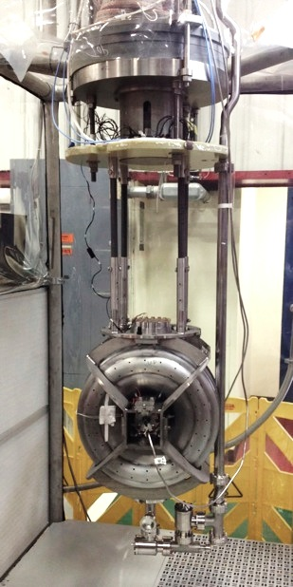
Testing CM-Specific Components – SSR1/SSR2
Bare Cavities
  Updated SSR1 cavity design for CM#2 will be tested bare in VTS
    All 9 cavities to be tested bare in VTS
    All 9 cavities to be tested jacketed (w/He vessels) in VTS
  SSR2 cavity new design
    2 prototype cavities built for FNAL, 2 prototype cavities built by DAE
      All (4) prototypes tested bare at FNAL VTS
        3 process/test cycles/cavity for FNAL cavities in schedule
      All (4) prototypes tested jacketed at FNAL VTS
    4 pre-production cavities built for FNAL
      All (4) pre-production cavities tested bare at FNAL VTS
      All (4) pre-production cavities tested jacketed at FNAL VTS
  SSR2 production cavities
    All jacketed production cavities tested in VTS (FNAL and DAE supplied)
      A 40% re-process/re-test fraction is included in P6 planning
SSR1 cavity – VTS test

Slide 11
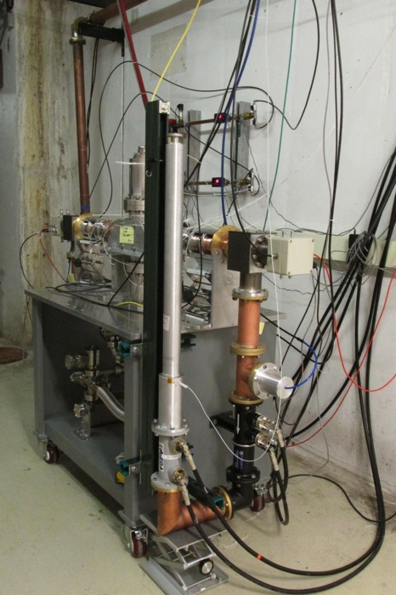
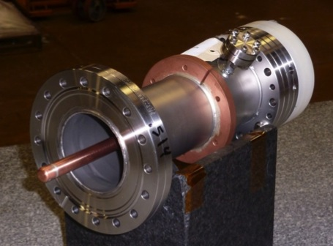
Testing CM-Specific Components – SSR1/SSR2
Couplers
  Couplers for SSR1 CM#1/CM#2
    All CM#1 couplers tested on room-temperature test stand after initial QA/QC
    Testing sub-set for CM#1 on dressed cavities in STC (cavity qualification for SSR1 CM$#1)
      Couplers for CM#2 ordered after these tests (and any design updates)
    All CM#2 couplers tested on room-temperature test stand after initial QA/QC
    Testing 2 couplers for CM#2 on dressed cavities in STC
  A set of SSR1 Couplers have been tested on test stand to SSR2 spec (30kW)
    One tested to failure at 47kW (50% above spec)
RT Test Stand
  2 Prototype SSR2 couplers to be procured
    Tested on room-temperature test stand after initial QA/QC
    Tested on (2) prototype cavities in STC
    6 Pre-production couplers to be procured
    After tests pf prototypes in STC
    All tested on room-temperature test stand after initial QA/QC
  Testing of 2 pre-production couplers with pre-production dressed cavities in STC
325MHz Coupler – cold end

Slide 12
Testing CM-Specific Components – SSR1/SSR2
Tuner/Resonance control
  SSR1 CM#2 tuners ordered after testing of SSR1 CM#1 tuners in STC
  Continued testing of SSR1 CM#1 cavities with tuners allow for additional resonance controls studies
  Pre-production tuners for SSR2 (based on SSR1) design ordered after tests in STC of SSR1 production tuners
  Production tuners for SSR2 ordered after tests of SSR2 prototype cavities and pre-production tuners in STC
SSR1 Cavity with Tuner in STC
Focusing Elements (solenoids)
  4 Solenoids for SSR1 #2 will be tested in SC Magnet Test Facility (IB1) in like manner as those for SSR1 CM#1
  Current leads undergo QA/QC upon receipt
  SSR2 solenoids undergo incoming QA/QC followed by testing in SC Magnet Test Facility

Slide 13
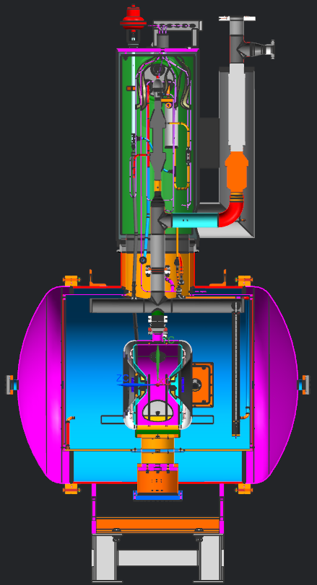
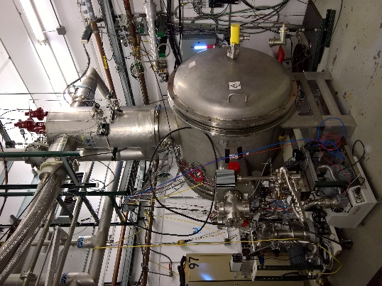
Testing CM-Specific Sub-Systems – SSR1/SSR2
Sub-System tests with dressed cavities (cavity/HeV/tuner/
coupler) are also planned, as part of system and extended component design verification.
    Incorporated into P6 schedule with adequate durations
    Using prototype or “first-article”/pre-production components
    Serve as “gatekeeper” to FDR or PRR
Uses existing STC facility & ancillaries

Slide 14
Testing CM-Specific Sub-Systems – SSR1/SSR2
STC test program:
  SSR1 CM#1 Dressed cavities and prod couplers/tuners (4)
    Qualification testing – 2 weeks cold testing (1 week RC studies)
  SSR1 CM#1 Dressed cavities and prod couplers/tuners (2)
    Qualification/vendor production testing – 5 weeks cold testing
  SSR2 Prototype dressed cavities and prot tuner/coupler (2 FNAL, 2 DAE)
    Design verification testing – 7-8 weeks cold testing
  SSR2 Pre-production dressed cavities and pre-prod tuner/coupler (2)
    Design verification/vendor qualification testing – 4-7 weeks cold testing
  SSR2 Production dressed cavities and prod tuner/coupler (3 DAE, 2 FNAL)
    Qualification/vendor production testing – up to 4 weeks cold testing
A total of 15 STC test cycles for ~80 “cold weeks” for SSR1/SSR2

Slide 15
CM-Specific Components – HB650 (LB650)
The SRF Test Program for elliptical cavities is focused on the requirements of the HB650 CM. The LB650 CM development (where not identical to HB650) is the responsibility of International Partners (with close FNAL involvement).
Bare Cavities
  HB650 cavity design (β=0.92) is new
    2 prototype cavities to be fabricated by vendor
    Cavity Q₀ (r_{s}) specification requires N-doping recipe similar to LCLS-II
      Flux expulsion (fast cooldown) & magnetic shielding will be critical
      Recipe being developed using existing β=0.90 cavities for CM#1
  LB650 cavity design (β=0.61) is new
    Prototypes will be fabricated by partner labs
    Similar stringent requirements on Q₀ (r_{s}) : N-doping, flux expulsion, magnetic shielding
      Adopt HB650 processing recipe for LB650
      Utilize similar (identical) magnetic shielding and flux-expulsion techniques
  FE-free performance requires optimization of HPR tools
  Tight tolerance on microphonics and LFD bandwidth requires advanced resonance control techniques.

Slide 16
CM-Specific Components – HB650 (LB650)
Couplers
  New coupler design : coaxial, 650MHz, 120kW (suitable for both HB/LB CMs)
    Two cold end designs being prototyped
    Prototypes to be evaluated on RT test stand and also in STC tests with β=0.90 cavities
  Verification of RF (power), thermal, and vacuum performance required before pre-production/production procurement
Tuner/Resonance control
  Tuner design based on LCLS-II tuner, suitable for both HB/LB cryomodules (with slight adaptation); prototype received and bench tested.
    Design being refined
    Cryogenic operation to be evaluated during STC tests with β=0.90 cavities
  Resonance control to be studied during all STC testing, no experience yet in achieving required specifications

Slide 17
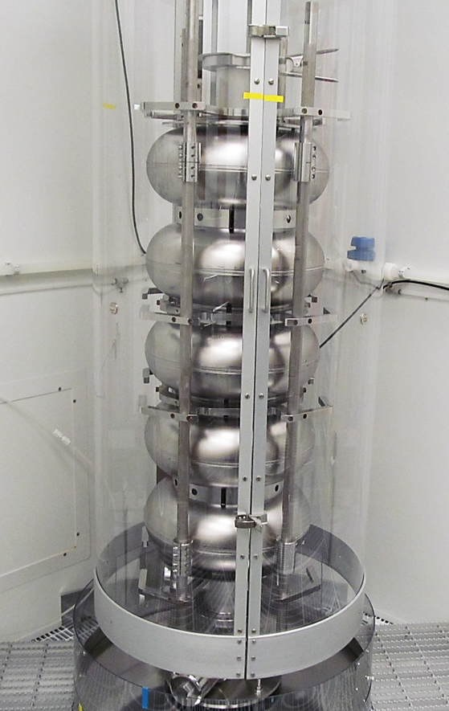
Testing CM-Specific Components – HB650
Bare Cavities
  HB650 cavity new design (β=0.92)
    2 prototype cavities built for FNAL
      Tested bare at FNAL VTS
        3 process/test cycles/cavity in schedule
        Use N-doping/processing recipe developed
        for β=0.90 cavities as baseline
        HPR tooling to be optimized
      Tested jacketed at FNAL VTS
    4 prototype cavities being fabricated and jacketed by DAE
      Tested jacketed at FNAL VTS (tested bare (VTS) & dressed (HTS) by DAE)
  HB650 production cavities (10)
    Production cavities supplied by FNAL tested bare in VTS
    Production cavities supplied by FNAL tested jacketed in VTS
      A 40% re-process/re-test fraction is included in P6 planning in both cases
  HB650 cavity old design (β=0.90)
    1 more bare cavity to be tested in VTS
    4 jacketed cavities to be tested in the VTS
650MHz β=0.90 Cavity in HPR Tool

Slide 18
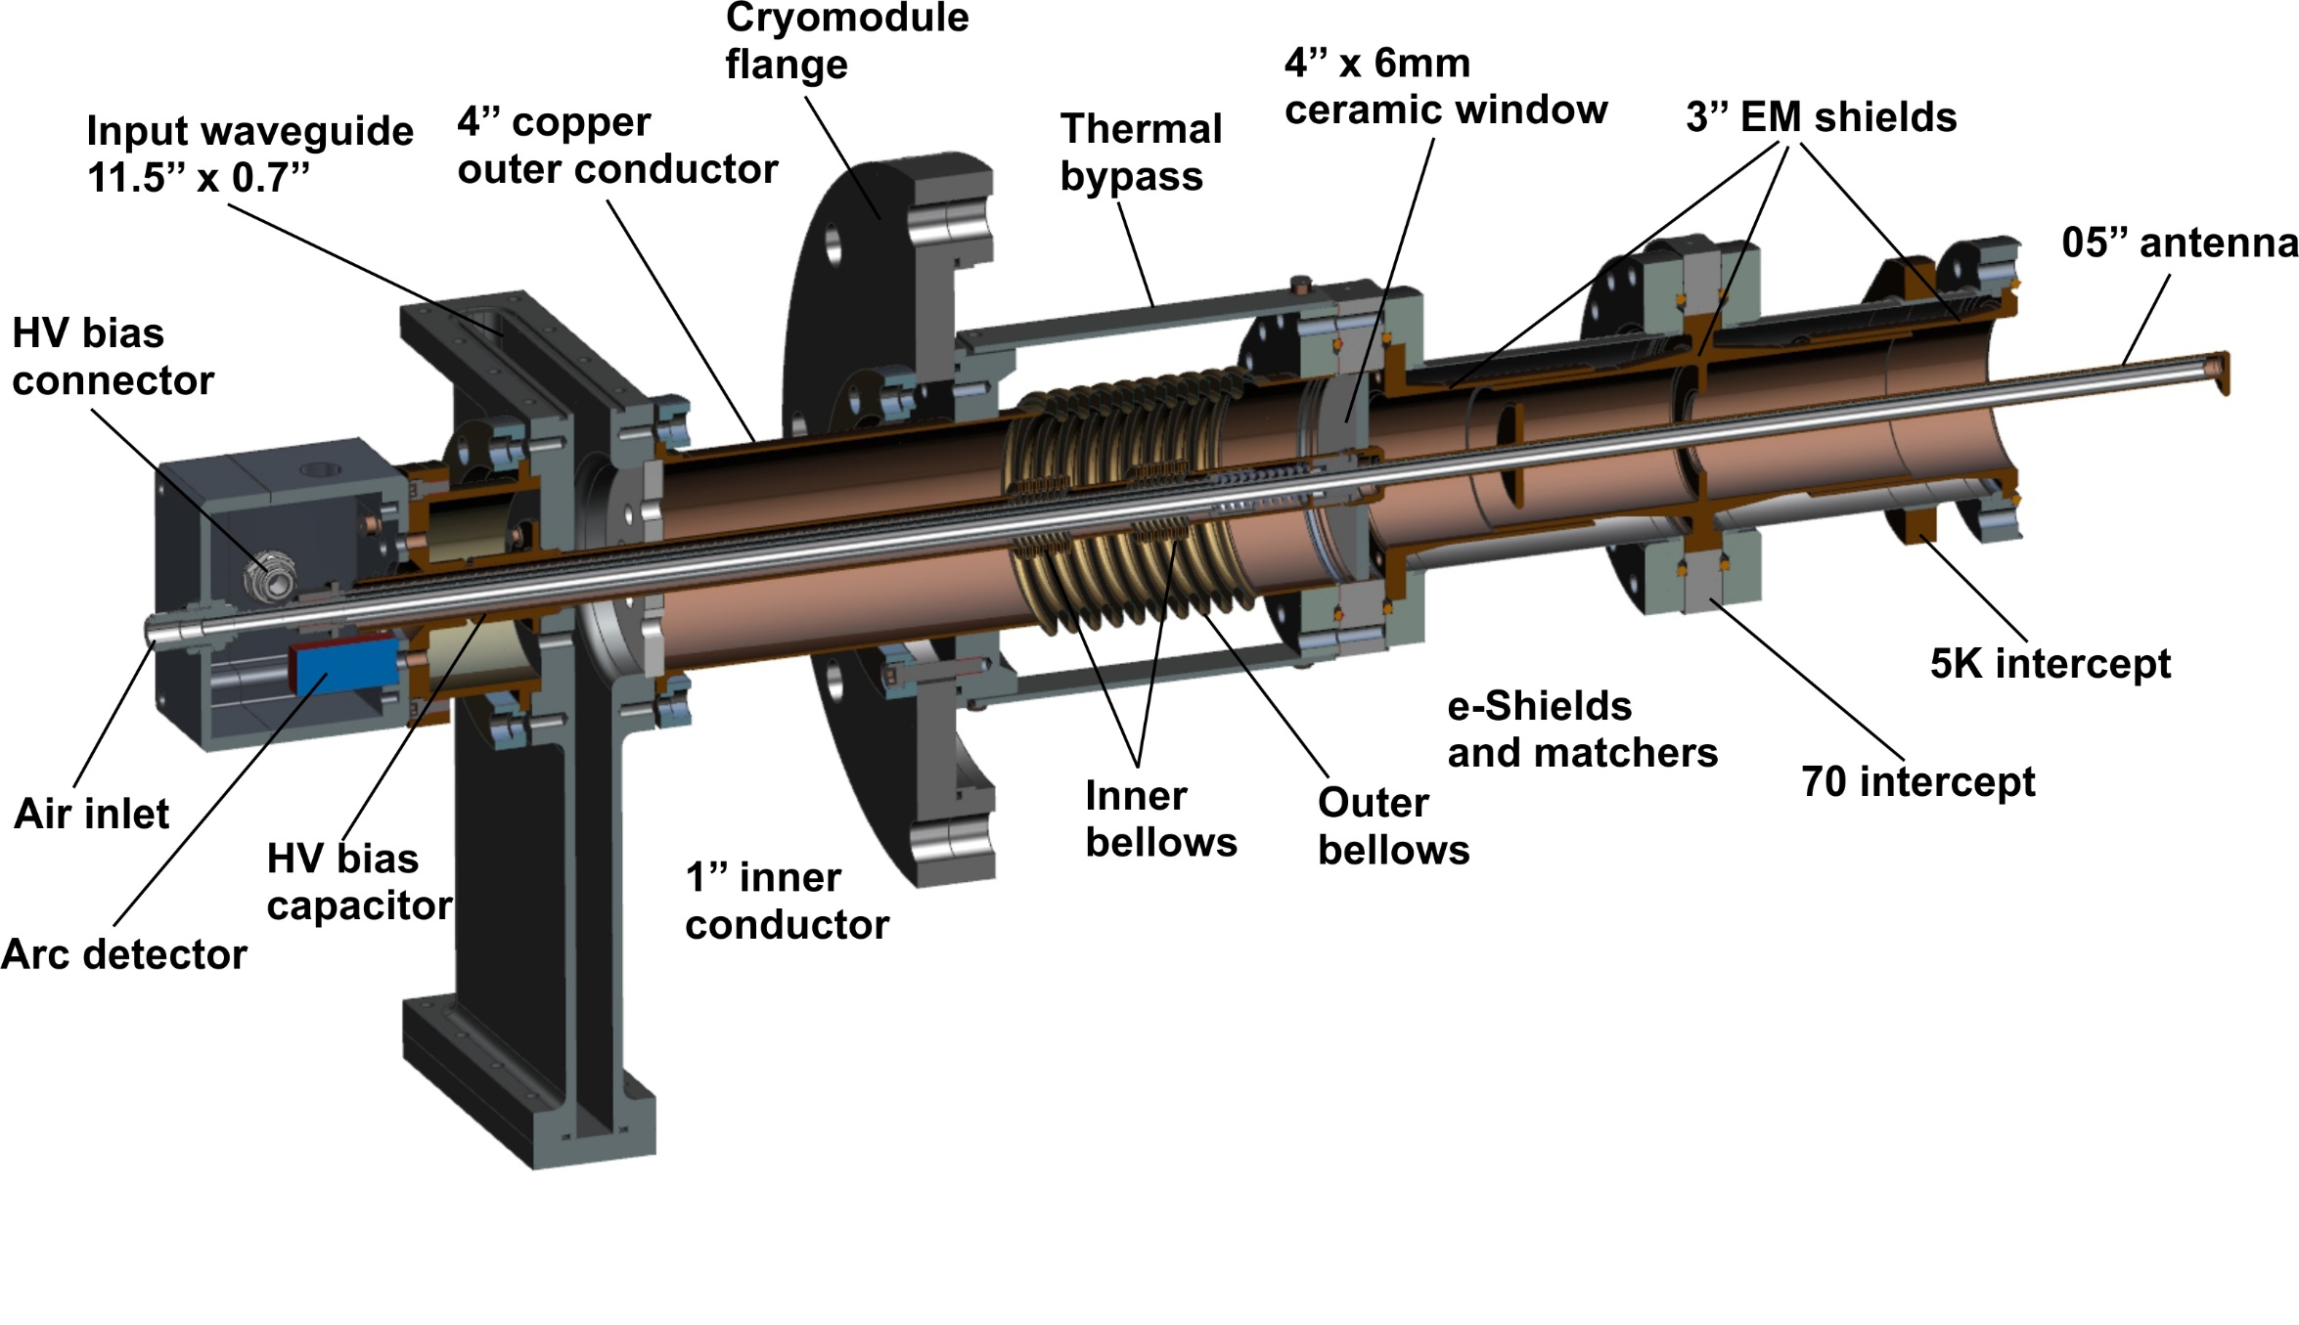
Testing CM-Specific Components – HB650 (LB650)
Couplers
  4 Prototype HB650 coupler cold-ends have been procured
    Two of each (cold end) design, two “universal” warm ends
    Tested on room-temperature test stand after initial QA/QC
    Tested on first 2 β=0.90 cavities in STC
      One of each kind, unless RT testing indicates otherwise
  8 Pre-production couplers to be procured
    After initial tests of prototypes in STC
    All tested on room-temperature test stand after initial QA/QC
    Tested on two remaining β=0.90 cavities in STC
    Tested on two prototype β=0.92 cavities in STC
650 MHz Coupler

Slide 19
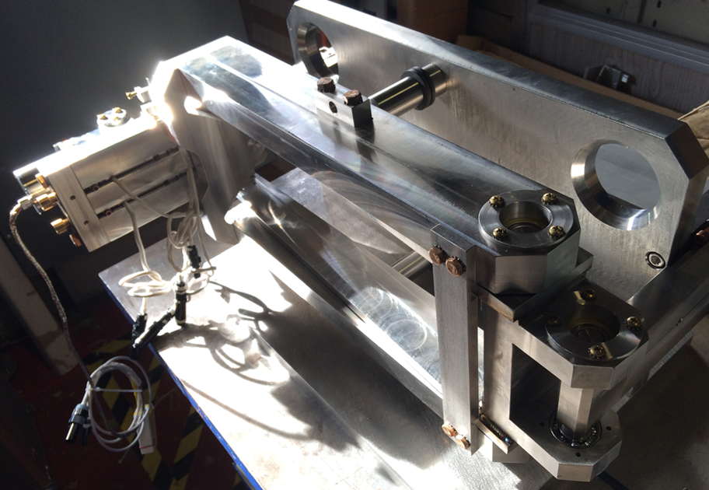
Testing CM-Specific Components – HB650 (LB650)
Tuner/Resonance control
  1st (upgraded) prototype to be tested in STC using β=0.90 cavities
  4 “production” tuners for β=0.90 cavities and 3 “production” tuners for β=0.92 cavities ordered after prototype tested in STC
    tested with β=0.90 and β=0.92 cavities in STC
      β=0.90 cavities used on CM#1
  10 production tuners for CMs 2-4 ordered after prototypes and early “production” tuners tested and CM#1 tested at CMTF.
  Resonance control studies part of all extended (design verification) STC testing with β=0.90 and β=0.92 cavities
  Tuner motor and piezo lifetime tests planned as part of “bench-testing”
650 MHz Prototype Tuner V. 1

Slide 20
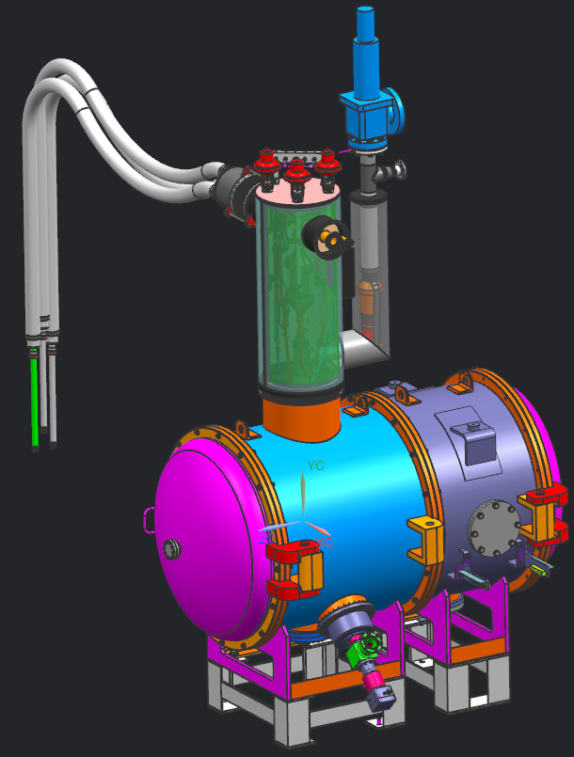
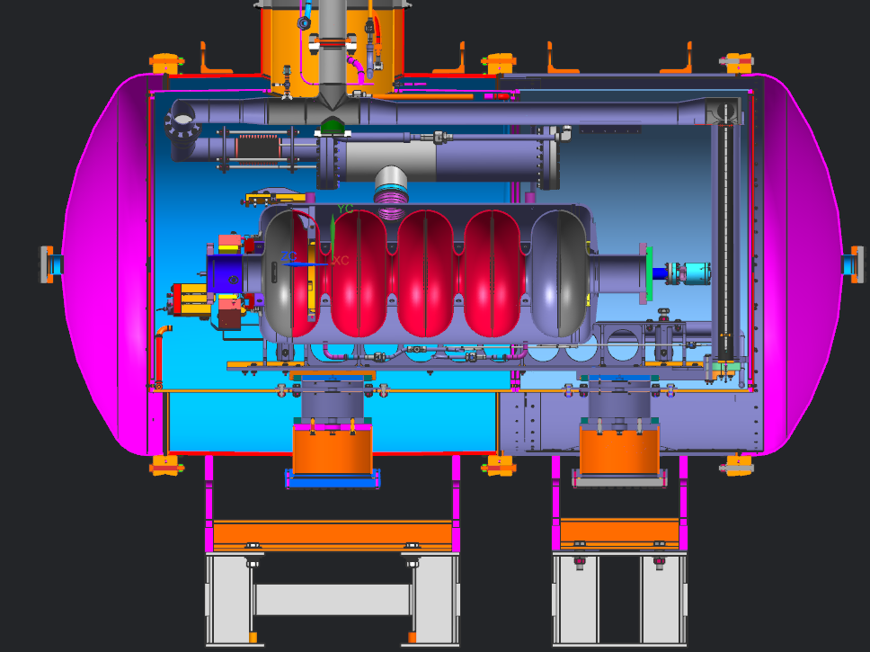
Testing CM-Specific Sub-Systems – HB650
Sub-System tests with dressed cavities (cavity + HeV + tuner + coupler) are also planned, as part of system design verification.
    Incorporated into P6 schedule with adequate durations
    Multiple iterations
    Using prototype or “first-article”/pre-production components
    Serve as “gatekeeper” to FDR or PRR
Use modified (extended) STC facility & ancillaries

Slide 21
Testing CM-Specific Sub-Systems – HB650
STC test program:
  HB650 CM#1 β=0.90 cavities (4) tested in STC with prototype and pre-production couplers/tuners
    Design verification testing – 8 weeks cold testing cavities 1,2; 5 weeks cold testing cavities 3, 4
      This allows multiple (fast) cooldowns, coupler thermal studies, extended resonance control studies
  HB650 prototype β=0.92 cavities (2) with pre-production couplers/tuners
    Design verification testing – 8 weeks cold testing
      This allows multiple (fast) cooldowns, coupler thermal studies, extended resonance control studies
  HB650 production dressed cavities and prod tuner/coupler (2, supplied by FNAL)
    Qualification/vendor production testing – up to 4 weeks cold testing
A total of 8 STC test cycles for ~50 “cold weeks”, for HB650

Slide 22
General CM Risks – SSR1/SSR2/LB650/HB650
In addition to the specific challenges related to cryomodule components, there remain the overall cryomodule performance risks :
  Pulsed and CW cryomodule operating modes may lead to cryogenic or mechanical instabilities
    Increases difficulty of resonance control due to enhanced microphonics
  CM(1) Performance at PIP2IT/CMTS may not meet technical requirements
    CM might not achieve performance necessary to operate in the Linac
  Q₀ performance of installed cavities
    Increased CM heat load, especially in CW operating
  Resonance control
    Greater difficulty in operating cavities in phase/on frequency, more difficult to compensate LFD in pulsed mode

Slide 23
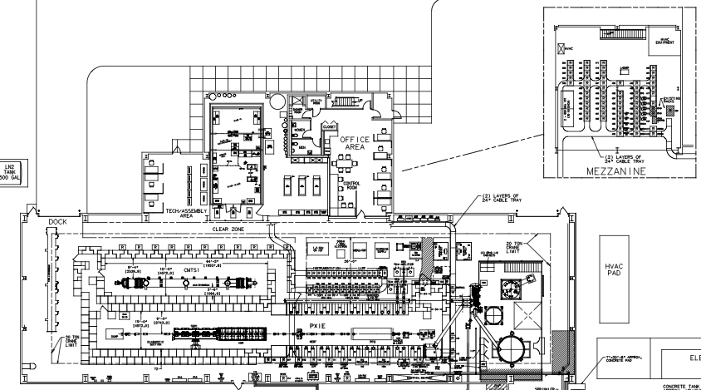
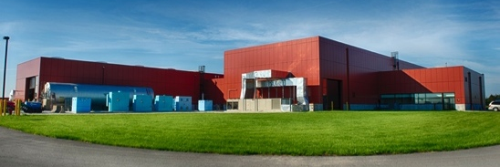
Addressing General CM Risks
Comprehensive testing of cryomodules addresses global CM performance risks documented in the Risk Register, and also provides design verification of CM support, thermal, and cryogenic structures, that can not be otherwise evaluated.
HB650/LB650/SSR1/SSR2 CM#1s are extensively tested in the CMTS or PIP2IT facilities.
CMTS1
650MHz Test Cave
PIP2IT 325MHz Test Cave
Cryogenic Plant

Slide 24
Addressing General CM Risks
HB650/LB650/SSR1/SSR2 CM#1s are extensively tested in the CMTS or PIP2IT facilities.
  A test plan using lessons-learned from LCLS-II pCM testing will be developed for CM#1s
    Two months (60 calendar days) of cold testing is planned in P6 for each 1st CM type.
      Additional time for installation, checkout, preparation, and cooldown are included, based on experience with LCLS-II pCM
      Multiple cooldown cycles (“fast cooldowns”, where appropriate)
      Extensive diagnostics
      Performance feedback to inform Final Design efforts, precursor to FDR/PRR
Production cryomodules (SSR12 #2, SSR2 #2-7, HB650 CM#2-4, LB650 CM#2-11) are also fully tested in CMTS.
  Test durations from 16-8 days (decreasing with later production)

Slide 25
Summary
A comprehensive “Test Program” designed to
    evaluate prototype designs
      provide feedback to production design
    qualify production components
      provide feedback to vendors
    validate sub-system performance
      provide feedback to design and assembly teams
    qualify overall cryomodule design/performance
      provide feedback to assembly and commissioning teams
has been fully integrated into the WBS structure for the SRF Linac in the P6 schedule
  Labor efforts and M&S for these activities are included in our project planning
The successful pursuit of these activities is the responsibility off the respective L3 managers
These activities are designed to retire the risks associated with cryomodule performance in the Linac.

Slide 26
END

Slide 27
BACKUP SLIDES

