Slide 1
PIP-II CD-1 Overview
Steve Holmes
PIP-II Independent Project Review
12-14 December 2017

Slide 2
Outline
Review Context and Overview
Project Overview
Alternative Selection
Project Organization
Cost and Schedule Range
Risk Management
ESH&Q
CD-1 Documentation Status
Next Steps to CD-2
Prior Review Recommendations
Summary

Slide 3
About Me
Role in PIP-II: Project Director
Relevant Experience
  34 years at Fermilab
  Fermilab Associate Lab Director for Accelerators
  Fermilab Accelerator Division Head
  Main Injector Project Manager

Slide 4
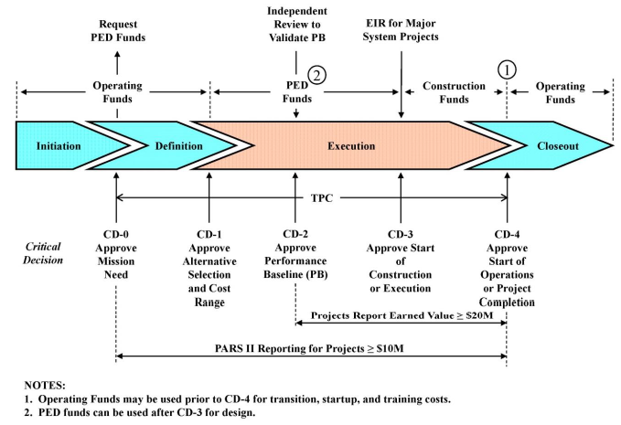
Review Context
FY19
FY20
FY27
We are here
Alternative selected
CDR released
Cost Range developed
End of Project Definition phase

Slide 5
Review Overview
Over the next two days we will present:
A Conceptual Design that meets the requirements outlined in the P5 plan and the Mission Need Statement
A TPC Cost Range of $652M - $859M, documented through a complete set of Bases of Estimate (BOEs)*
  Cost to DOE, after significant offset from international partners
A Resource Loaded Schedule that aligns with the BOEs and with the CD-1 funding profile provided by DOE/HEP
A complete set of documentation as required by DOE 413.3b for CD-1
International partnerships forming to support development and construction

Slide 6
Review Overview
*TPC incorporates late input on a substantial in-kind contribution from UK/STFC.
Scope: HB650 cavities and cryomodules
BOEs and P6 do not incorporate this adjustment
We have agreed with DOE to incorporate as a “below the line” TPC subtraction
  Basis of subtraction documented in PIP-II-doc-1212

Slide 7
Charge Questions
Charge #X
Speaker
Has the project team documented a carefully considered analysis of alternatives that supports the preferred alternative?
Does the conceptual design satisfy the performance requirements?
Does the conceptual design report and supporting documentation adequately justify the stated cost range and project duration?
Does the proposed project team have adequate management experience, design skills, and laboratory support to manage all aspects of this project and produce a credible technical, cost, and schedule baseline?
Are the ES&H aspects of the project being properly addressed and is the ES&H planning currently sufficient for this stage of the project?
Is the documentation required by DOE 0 413.b for CD-I approval complete and in good order?
Is the allocation of the technical scope that will be contributed by international partners sufficiently understood and documented such that the conceptual design and cost range can be relied on?
Has the project satisfactorily responded to the recommendations from previous reviews?
Bottom Line: Is the project ready for CD-1?

Slide 8
Review Agenda
Plenary Session
  Overview
  Description of the Conceptual Design
  Level 2 presentations covering all systems
Breakout Sessions
  Project Management
  SC Acceleration Modules and Cryogenics
  RF Systems
  Accelerator Support Systems
  Conventional Facilities
Tour
  PIP2IT
  ICB/LCLS-II CM assembly

Slide 9
Project Overview
Mission Need
  PIP-II concept is responsive to the requirements for sustained U.S. leadership in accelerator-based neutrino physics as outlined in the P5 report and the PIP-II Mission Need Statement.
Goals
  Deliver >1 MW of proton beam power from the Main Injector over the energy range 60 – 120 GeV, at the start of LBNF operations;
  Support the ongoing 8 GeV program including Mu2e and short-baseline neutrinos;
  Provide an upgrade path for Mu2e;
  Provide a platform for extension of beam power to LBNF to >2 MW;
  Provide a platform for extension of capability to high duty factor/higher beam power operations.

Slide 10
Key Performance Parameters
# | Description of Scope | Threshold KPP | Objective KPP
1 | SRF linac | 700 MeV beam delivered to the Booster Injection Region | 800 MeV beam delivered to Booster Injection Region
2 | Booster/RR/MI upgrades | L11 Booster injection region, Recycler RF upgrades, and MI RF upgrades, hardware installed in respective machines. Linac beam injected and circulated in the Booster. | 8 GeV beam transmitted through Recycler and Main Injector, delivered to MI dump.
3 | Cryogenic Infrastructure | Cryogenic plant and distribution lines ready to support pulsed RF operation, and operated to 2 K. | Cryogenic plant and distribution lines ready to support CW RF operation, and operated to 2 K.
4 | Civil Construction | Tunnel enclosures and service buildings ready to support 700 MeV SRF linac and transfer line to the Booster | Tunnel enclosures to support 1 GeV SRF linac and transfer line to the Booster. Service buildings to support 800 MeV SRF linac and transfer line to Booster.
TPC estimate based on Objective KPPs

Slide 11
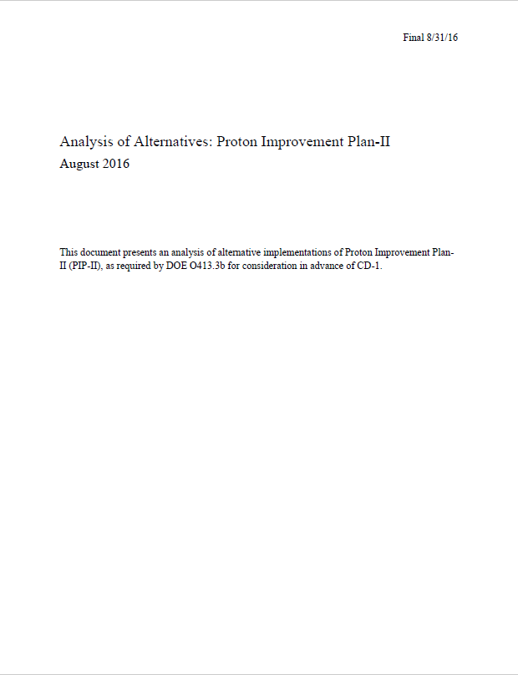
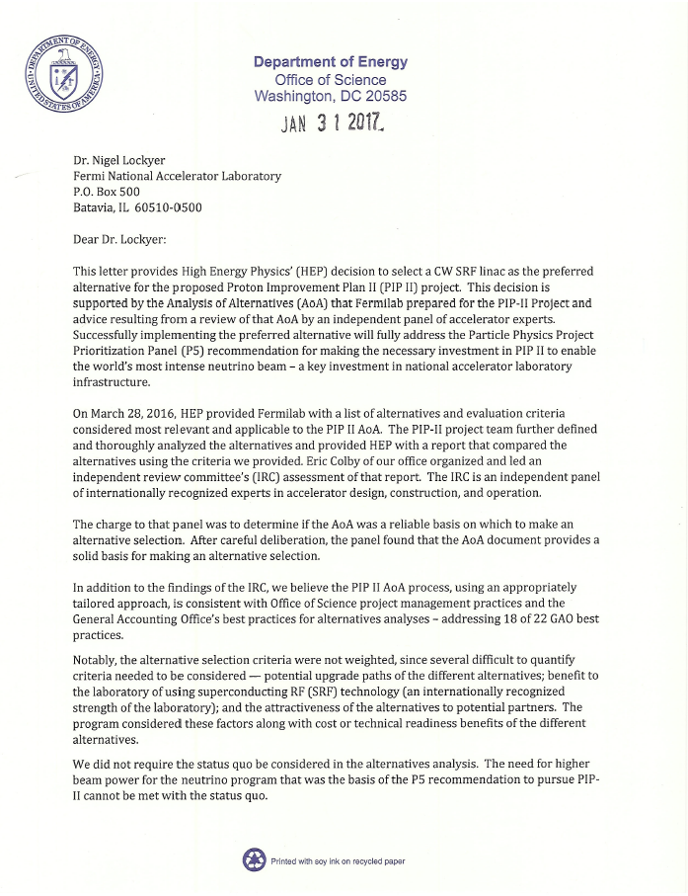
Alternative Selection
Charge #1
PIP-II-doc-107

Slide 12
Alternative Selection
Charge #1
Four alternatives specified by DOE/HEP
  800-MeV SC Linac, CW-compatible; Reference Design
  800-MeV SC Linac, pulsed, higher current
  Hybrid: Relocated 400-MeV NC Linac + 400-MeV SC Linac
  Relocated 400-MeV NC Linac + 400-MeV NC Linac
Ten evaluation criteria provided by DOE/HEP (backup)
Fermilab performed analysis; no recommendation
DOE/HEP Review Committee validated the report as being an accurate analysis; no recommendation
  Author/referee model; process involved several iterations
DOE Associate Director for HEP selected preferred option
  “HEP has selected option 1 for a CW SRF linac as the preferred option”

Slide 13
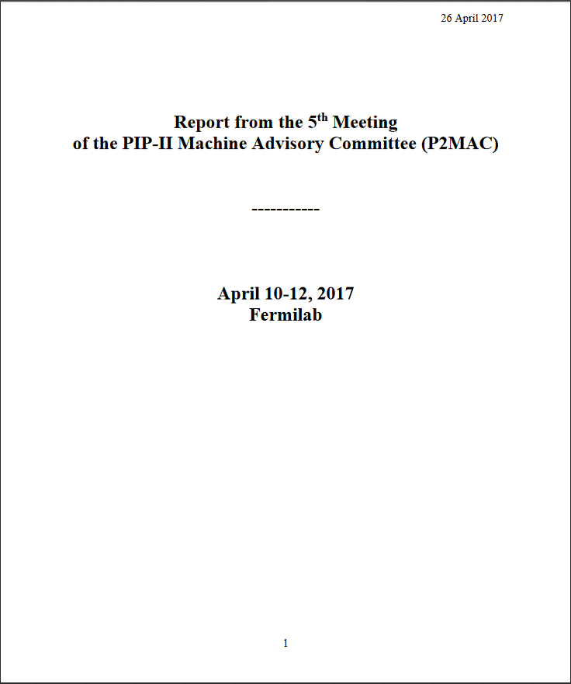
Scope Overview
Charge #2
Derwent
PIP-II Functional Requirements Specification defines performance requirements from lab perspective
  Signed by Fermilab CRO and CAO
  PIP-II-doc-1166 (aka TC ED0001222)
Conceptual Design Report
  800-MeV superconducting linac, constructed of CW-capable components, operated initially in pulsed mode
  Accompanied by modifications to Booster, Recycler, Main Injector to accommodate higher injection energy and higher beam intensities
  Increase Booster repetition rate to 20 Hz
  PIP-II-doc-113
CDR reviewed & validated by PIP-II Machine Advisory Committee, April, 2017
  “As it stands, the conceptual design is supported by convincing results of studies and experimental tests that provide a sound technical basis for CD-1.”
  PIP-II-doc-605

Slide 14
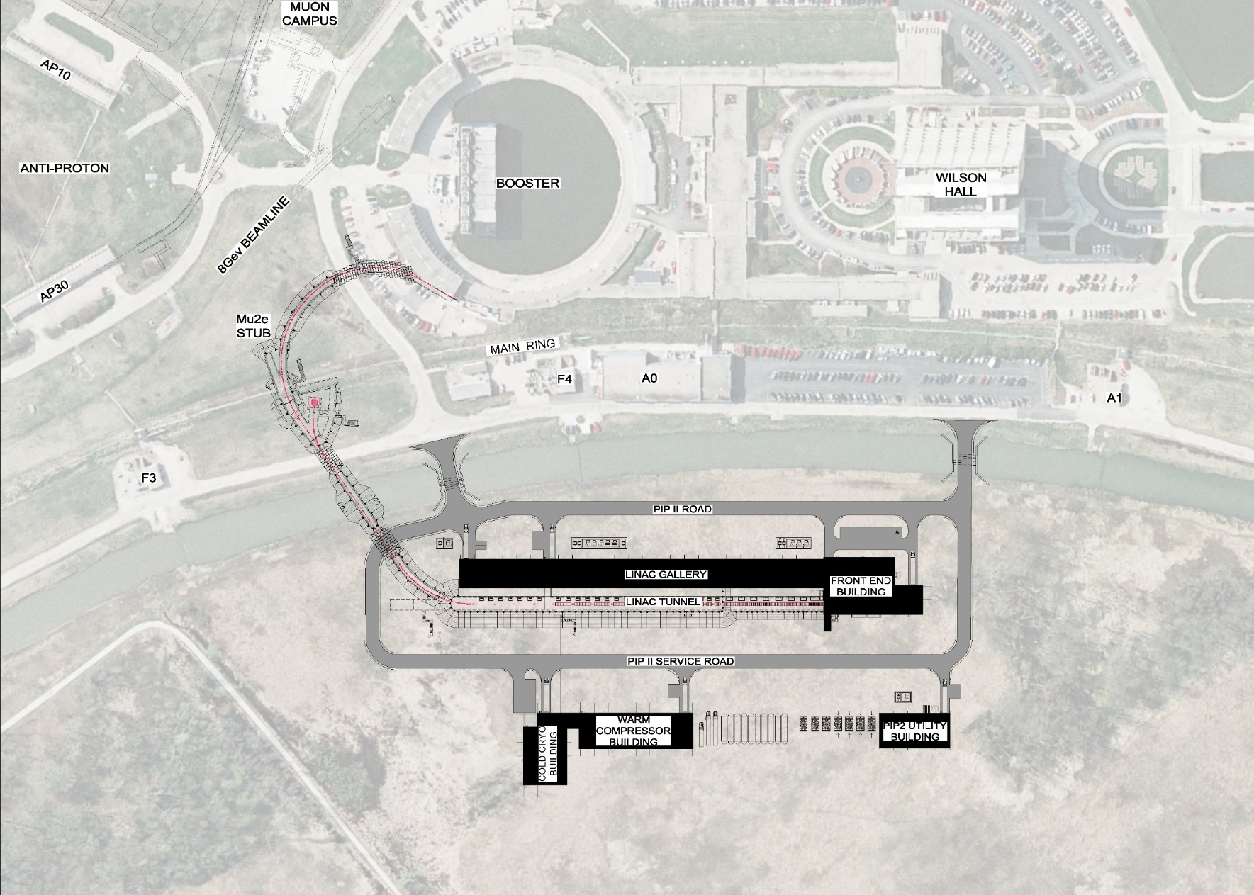
Scope Overview
Charge #2
Derwent
Rings Upgrades: WBS 121.4
BTL: WBS 121.3.
Linac: WBS 121.3
Conv Fac: WBS 121.5

Slide 15
Partner Laboratories
Charge #7
Holmes
National
  ANL: HWR cryomodule design/fabrication
  LBNL: RFQ design/fabrication; expect participation in LLRF
International: Widespread interest at various stages of fruition
  India/DAE: SRF cavities, RF sources, cryo systems, etc.
    Long-standing collaboration with four laboratories
    R&D and construction contributions authorized in formal agreements
  Italy/INFN: LB650 accelerating cavities – draft agreement under discussion
  UK/STFC: HB650 cavities/cryomodules – proposal under review at government level
  France/CEA, IN2P3: LB650 cryomodules – under discussion
Partner deliverables to be formalized in advance of CD-2

Slide 16
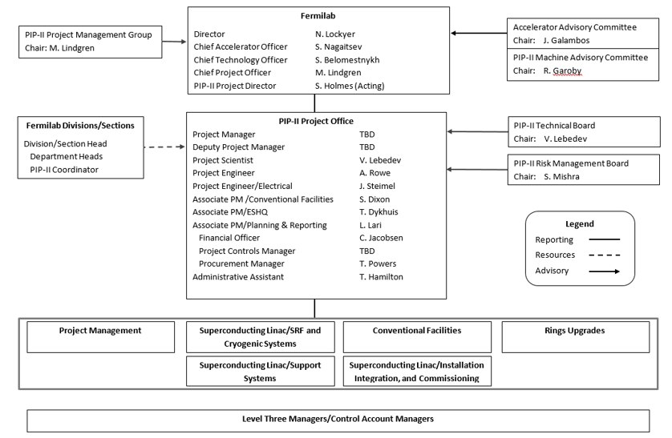
Project Organization/post-CD-1
Charge #4
Holmes
Post-CD-1 organization modified to provide more effective structure for managing a construction project
  Project Director/Project Manager
  Split Superconducting Linac into (3) pieces

Slide 17
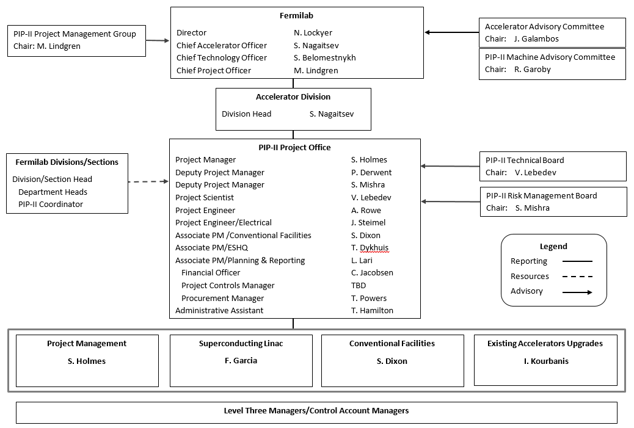
Project Organization/Current
Charge #4
Holmes
Project Team with many years experience in accelerator development, construction, and operations:
  Main Injector, NOvA, US LHC Accelerator, PIP, SBN, and LCLS-II projects
  LHC and ESS projects
  Tevatron, CEBAF, NOvA operations
This organization is the basis of the CD-1 estimate
  (Note: for purposes of this review CAM=L3M)

Slide 18
Resource Loaded Schedule
Charge #3
Lari
P6 Schedule
  Provides time-phased resource requirements
  Work Breakdown Structure
    WBS dictionary: PIP-II-doc-599
  Total of 5643 tasks and milestones
    Combination of work and planning packages
  Critical path identified
  Provides a good head start on EVMS
CD Dates (early dates)
  CD-1 March 2018
  CD-2/3a April 2019
  CD-3 August 2020
  CD-4 April 2027
International in-kind contributions
  Scope outlined in Assumptions Document
  RLS includes resources for oversight, coordination, acceptance testing of international deliverables.

Slide 19
High Level Master Schedule
Charge #3
Lari

Slide 20

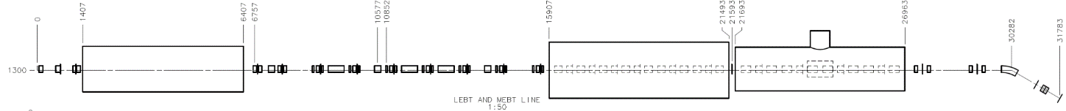
Progress to Date/Technical
Charge Item: #2
PIP-II Injector Test (PIP2IT)
Now
2019
30 keV
2.1 MeV
10 MeV
25 MeV
RFQ
MEBT
HWR
SSR1
HEBT
LEBT
40 m, ~25 MeV

Slide 21
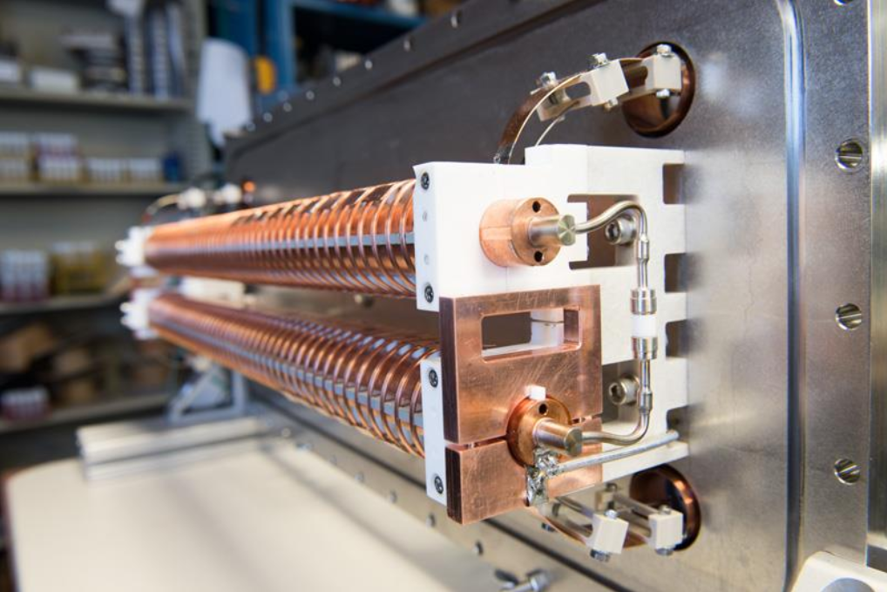
Progress to date/Technical
Charge #2
Breakouts
PIP-II Injector Test (PIP2IT) facility complete through MEBT and commissioned with (pulsed) beam
  Beam characteristics
  meet PIP-II requirements
  at 2.1 MeV
  Includes demonstration
  of fast chopping
  Successful integration of
  magnets from DAE/BARC
HWR cryomodule in
fabrication at ANL
SSR1 cryomodule being
prepared for string
assembly at Fermilab

Slide 22
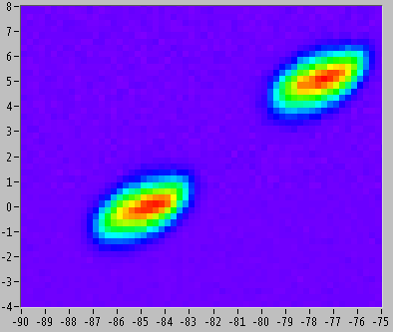
Progress to date/Technical
Charge #2
Shemyakin
Observed removal of individual (162.5 MHz) bunches with 200 Ω chopper:
Emittance Scanner
‘Missing’ bunches

Slide 23
Progress to date/Int’l Partners
Charge #7
Holmes
India/DAE
  PIP2IT MEBT magnets delivered and in service
  SSR1 cavities in final dressing prior to integration into SSR1 CM
  325 and 650 MHz prototype amplifiers successfully tested at DAE labs
  HB650 prototype cavity fabricated and in processing
  LB650 cavity mechanical design in process
  RFPI board tested at Fermilab; LLRF board ready to ship
  Cryoplant procurement in process
  Successful long-term visitors program
Italy/INFN
  LB650 cavity e-m design complete, mechanical design initiated
UK/STFC
  Developing detailed estimate for HB650 deliverable
France/CEA, IN2P3
  Technical discussions underway; agency discussions initiated

Slide 24
Funding Profile
Charge #3
Lari
Funding profile from DOE/HEP ($ amounts in millions)
  (Funding = obligation + contingency)
P6 schedule constructed to meet this profile.
Point estimate is $721M
  Adjustments to be implemented in latter years
 | FY16 | FY17 | FY18 | FY19 | FY20 | FY21 | FY22 | FY23 | FY24 | FY25 | FY26 | FY27 | TOTAL
Annual | $19 | $15 | $20 | $35 | $60 | $80 | $100 | $102 | $90 | $85 | $50 | $9 | $665
Cum | $19 | $34 | $54 | $89 | $149 | $229 | $329 | $431 | $521 | $606 | $656 | $665

Slide 25
Cost/Schedule Development Process
Charge #3
Lari, Derwent
Follows DOE Cost Estimating Guide (DOE-G-413.3-21)
Employs standard Fermilab tools (P6, Cobra, PRA)
Basis of Estimates
Existing P.O.
Prior Experience
Catalog Listing
Expert Opinion
Budgetary Estimate
Pre-conceptual Design
Engineering Estimate.
Estimate Uncertainty
WBS and High Level Milestones
WBS & Dictionary (with full project scope)
Tiered Milestones
Off Project milestones
Primavera P6 Schedule
Initial activity based resource loading of budget to determine spending profile.
Resources: Labor Hours
Materials FY16$
Schedule: Activities
Durations
Predecessors
Risk Register
Total Project Cost (TPC)
Burdened, escalated cost (budget) with Estimate Uncertainty (EU)

Slide 26
Estimate Uncertainty Rules
Charge #3
Lari, Derwent
Estimate uncertainties are defined by the L3 Managers and are documented in BOEs
  Rules: PIP-II-doc-345
Total estimate uncertainty: 22.1% (dollar weighted)
 | M&S | Labor
Existing Purchase Order | 0% | NA
LOE/Oversight Work | 0%-20% | 0%-20%
Advanced | 10%-20% | 10%-25%
Preliminary | 20%-40% | 25%-40%
Conceptual | 40%-60% | 40%-60%
Pre-Conceptual (Common Work) | 60%-80% | 60%-80%
Pre-Conceptual (Un-Common Work) | 80%-100% | 80%-100%
Beyond State of the Art | >100% | >100%

Slide 27
Risk: PIP-II Project Risk
Charge #3
Risk Register contains 125 approved entries
  Developed by L3Ms and entered into Fermilab risk register
  Reviewed & edited in day-long workshop, including participation from other Fermilab projects
Top-ten project risks
  Ranked by Technical – Cost – Schedule impact
Risk contingency derived from risk register via Primavera Risk Analysis
International Deliverable Risk Strategy described in PIP-II-doc-1201
Mishra

Slide 28
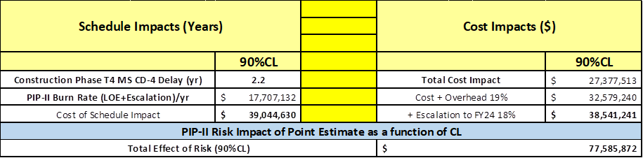
Risk Analysis
Charge #3
Mishra
Cost Risk = $39.0M (90% CL)
Schedule Risk estimated at 2.2 years (90% CL)
  Standing Army: ~30 FTE ≈ $7.75M/year
  Escalation/delay: ≈ $9.95M/year
Total Risk Contingency = $78M

Slide 29
Cost Summary/TPC
Charge #3
Lari, Derwent
BOEs document direct M&S costs (unloaded, FY16$), labor hours, and estimate uncertainties
  BOEs start Oct 1, 2017
Costs generated by P6
  Translate hours to $, add overhead, and escalation
Actual costs FY16-17 $32M
P6 Budget to Complete $513M
  BOEs + overheads + escalation
Estimate Uncertainty $113M
Risk Contingency $78M
TPC offset from UK -$15M
TPC Point Estimate $721M

Slide 30
Cost Summary – Level 2
Charge #3
Full Burden + Esc = BOE + Escalation + Overhead
Estimate to Complete comes from P6
  BOE + Overhead + Escalation = Budget to complete
  Estimate Uncertainty
  P6 Estimate to Complete

Slide 31
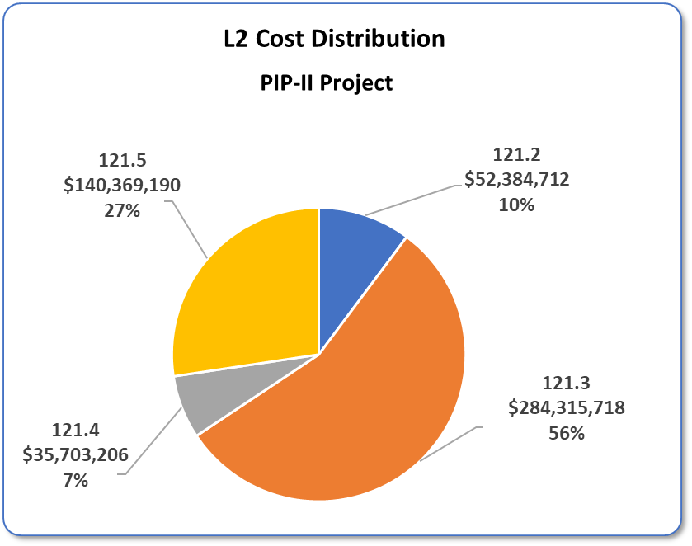
Cost Distribution – Level 2
Charge #3
Costs = BOE + Overheads + Escalation

Slide 32
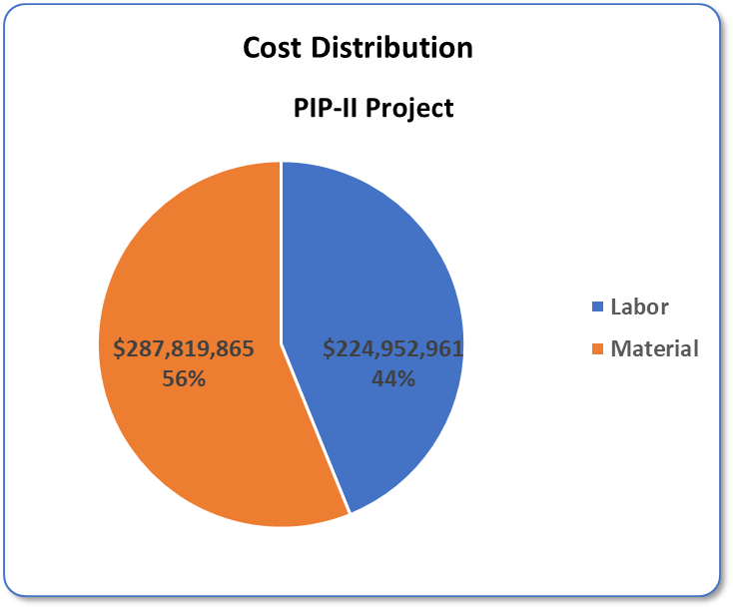
Cost Distribution – Labor vs M&S
Charge #3
Costs = BOE + Overheads + Escalation

Slide 33
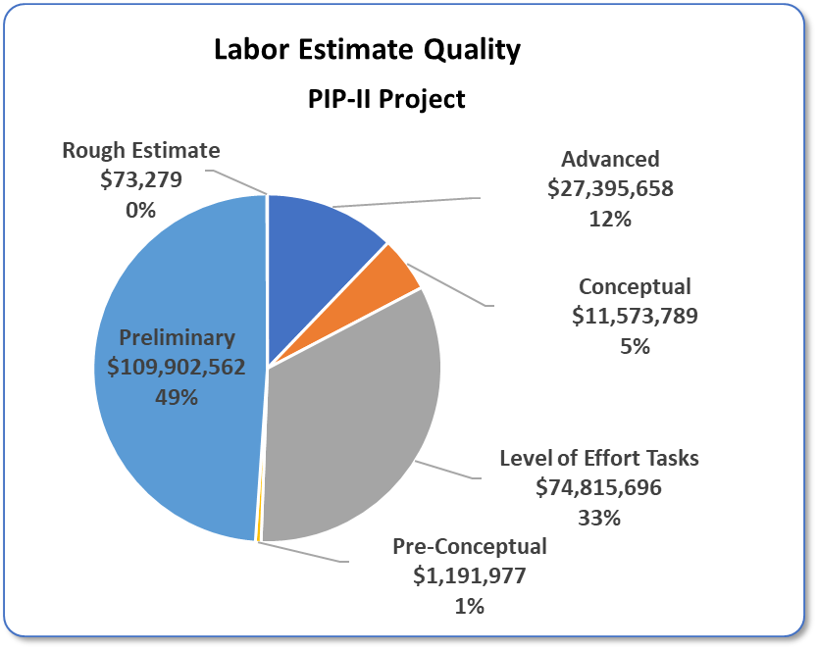
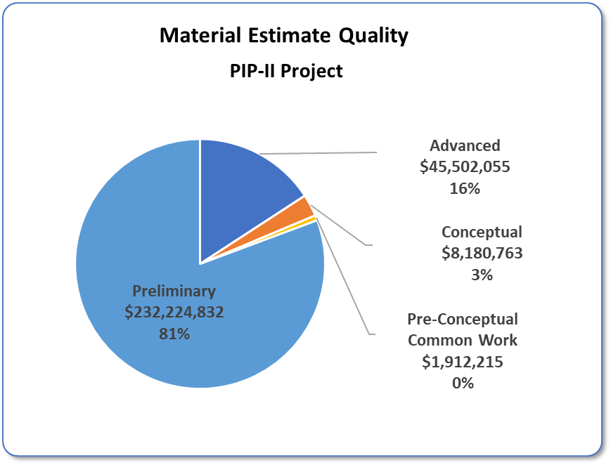
Cost Distribution – Estimate Quality
Charge #3
Costs = BOE + Overheads + Escalation
Estimate Quality Categories are per Fermilab Standards: PIP-II-doc- 345

Slide 34
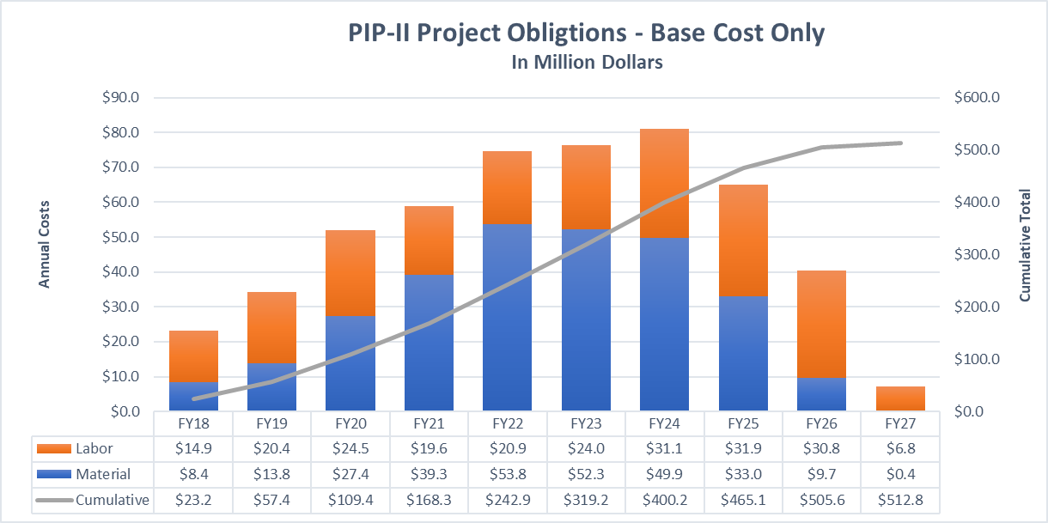
Obligation Profile – P6 Base Cost Only
Charge #3
P6 Base Costs = BOE + Overheads + Escalation

Slide 35
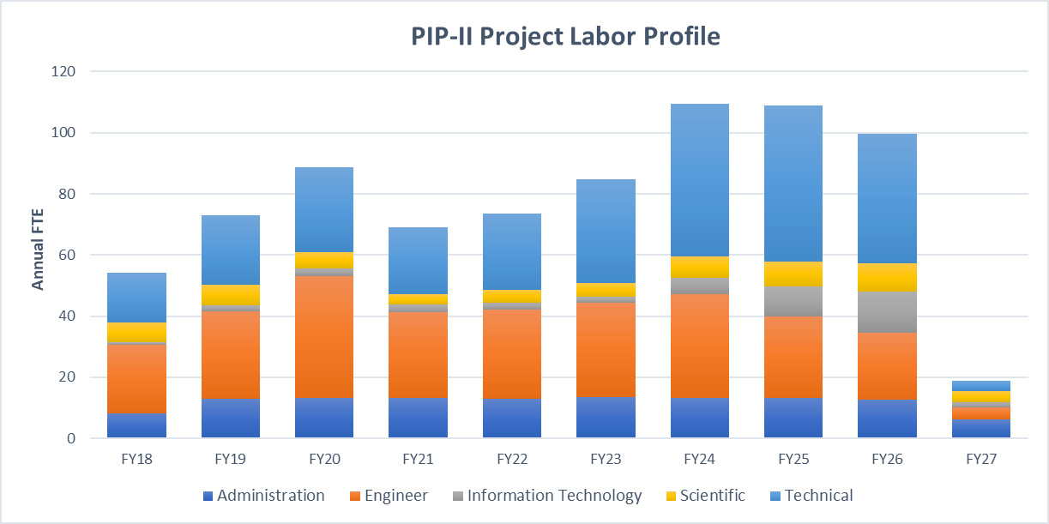
Labor Profile from P6/FTE
Charge #3

Slide 36
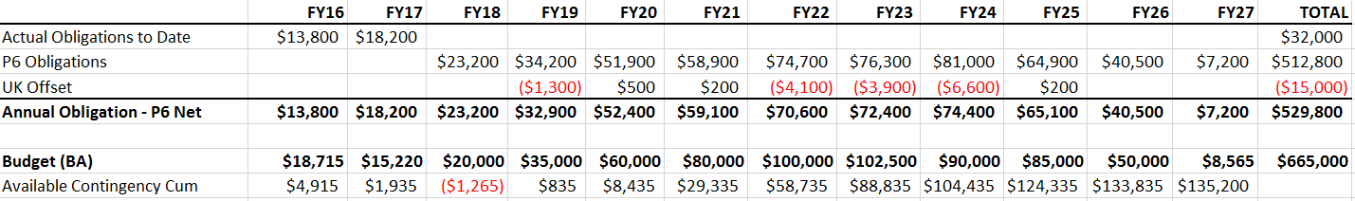
Obligation Profile
Charge #3
Lari
Obligation Profile derived from P6
  Excluding estimate uncertainly and risk contingency
RLS identifies 75 individual procurements, totaling $152M
  All procurements >$0.5M
  Critical procurements of <$0.5M
  Represents 53% of total project M&S
All other M&S and Labor (SWF) are assumed obligated and costed simultaneously
Profile ($ amounts in thousands):

Slide 37
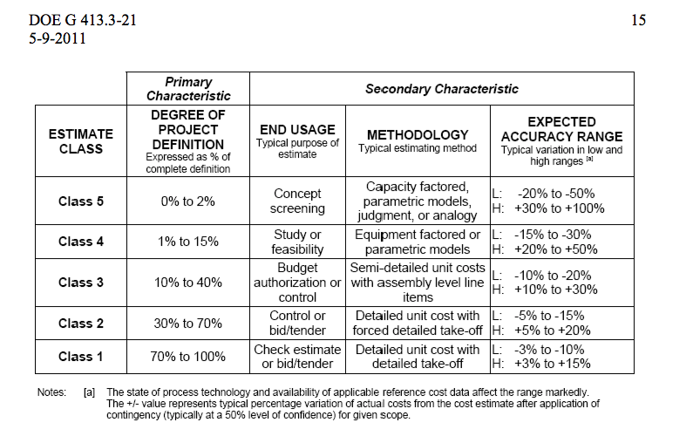
Cost Range
Charge #3
Derwent
Project definition based on Technology Readiness Level and Project Definition Rating Index
We judge PIP-II to be at Project Definition 25-40% (Class 2-3)

Slide 38
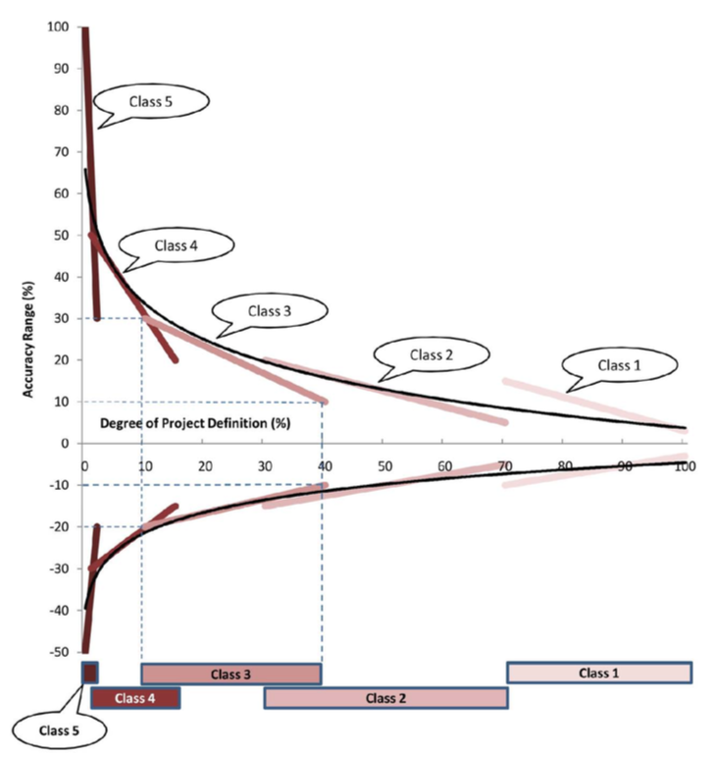
Cost Range
Charge #2
Derwent
Project Definition 25-40%
  Lower range
    - (10 – 18%)
  Upper range
    + (20 – 25%)
  Suggest -10%, +20%
Point Estimate $721M
Cost Range
$652M - $859M

Slide 39
ESH&Q
Charge #5
Dykhuis
Project team is committed to construct PIP-II in a safe, environmentally respectful, and cost efficient manner that meets our stakeholder’s needs
PIP2IT operations are governed by project and laboratory safety policies and procedures
  All installed equipment complies with FESHM
  Operations authorized by Operational Readiness Clearance (ORC)
CD-1 ESH&Q documentation requirements have been met
  Integrated Safety Management Plan
  Preliminary Hazard Assessment Report
  Preliminary Quality Assurance Plan
    Reflects international aspects, incorporating input from LBNF
    International Risk Mitigation Strategy – PIP-II-doc-1201
  NEPA Determination
Environmental Assessment contract awarded

Slide 40
CD-1 Documentation Deliverables
Charge #6
Document | PIP-II-doc# | Status
Acquisition Strategy | 138 | Draft for Review
Alternatives Analysis | 107 | Approved
Preliminary Project Execution Plan | 115 | Draft for Review
CDR | 113 | Approved
CDR Review (P2MAC Report) | 605 | Complete
Preliminary Hazard Analysis Report | 140 | Approved
Integrated ESH Management Plan | 141 | Approved
Preliminary Quality Assurance Plan | 142 | Final Review
Risk Management Plan | 163 | Approved
Preliminary Security Vulnerability Assessment Report | 143 | Approved
NEPA Determination | 1151 | Approved
Sustainable Federal Building Requirements | 184 | Approved
Project Management Plan | 172 | Ready for Approval

Slide 41
Additional Review Documentation
Charge #6
Document | PIP-II-doc# | Status
Assumptions Document | 144 | Approved
PIP-II – Fermilab Interface Document | 528 | Approved
Procurement Management Plan | 522 | Ready for Approval
International Risk Mitigation Strategy | 1201 | Approved
TPC Offset from Potential UK Contribution | 1212 | Complete
1-for-1 Replacement Requirements | 1064 | Approved

Slide 42
Next Steps to CD-2 (1)
Complete Preliminary Design
  Prepare a Technical Design Report
  Complete Site Preparation detailed design
Continue development activities in support of the Preliminary Design
  Coordinate with International Partners
  Retire risks
Develop the Performance Baseline
  Transition to new organizational structure and align WBS
  Assign new L2 Managers
  Assign Project Controls Manager
  Optimize P6 schedule and prepare for EVMS
Prepare for EVMS implementation
  Formally assign and train CAMs
  Initiate EVMS reporting 6 months prior to CD-2

Slide 43
Next Steps to CD-2 (2)
Complete Environmental Assessment and (presumably) receive FONSI
Formalize construction deliverables from international partners and incorporate into P6
Prepare for CD-3a coincident with CD-2
  Site Prep
  Nb procurement
Grow staff to meet post-CD-2 requirements
  53 FTE (current) to ~75 at time of CD-2
  Staffing needs are defined in P6
  Reassess requirements for SRF, procurement, QA, PM staff

Slide 44
Response to Prior Recommendations
Charge #8
Summary of recommendations from prior review are posted on the review website:
  DOE IPR – November 2016
  P2MAC – March 2017
  CD-1 Director’s Review – October 2017
All recommendations are either closed or have associated action plans

Slide 45
Summary (1)
Alternative selected
Conceptual Design is complete and defines project scope
  Independent review by P2MAC
Development activities aligned with technical and cost risks
  Coordinated with international partners
P6 provides time-phased budget and defines critical path
Complete set of BOEs exist and are aligned with P6
Point estimate: $721M
Cost Range: $652M - $859M
  Based on design maturity (25-40%)

Slide 46
Summary (2)
International partners engaged
ESH&Q program underway
  Environmental Assessment contract awarded
CD-1 deliverables complete
  Cost Range
  Resource Loaded Schedule
  BOEs
  Risk Register
  Supporting Documentation
Experienced management team is in place that can be expected to successfully execute the PIP-II project
We are ready for CD-1 and look forward to proceeding to CD-2

Slide 47
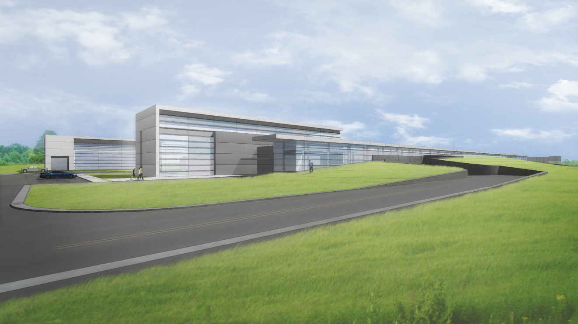
Thank you for your attention

Slide 48
Plenary Wrap Up
Thank you for your attention and provocative questions.
Breakouts begin at 3:15 and will end tomorrow at 11:00
  Project Management Comitium (WH2SE)
  SC Accel Mod + Cryo One East (WH1E)
  RF Systems Racetrack (WH7X)
  Accelerator Support Systems Curia II (WH2SW)
  Conventional Facilities Black Hole (WH2NW)
  Drill downs Snake Pit (WH2NE)
Dinner tonight at 6:00 Second floor crossover
Tour tomorrow at 11:00 Meet at Wilson Hall entrance

Slide 49
Backups

Slide 50
Alternative Selection
Charge #1
Ten evaluation criteria provided by DOE/HEP
  >1 MW of proton beam power over the range 60 GeV to 120 GeV, at the start of LBNF operations;
  Sustain high reliability operations of the accelerator complex;
  Support the current 8-GeV program;
  Upgrade path for a second generation Mu2e;
  Platform for >2 MW to LBNF;
  Platform for high beam-power, high duty-factor operations.
  Extent of interruption to ongoing accelerator operations during construction;
  Technical risk;
  Potential for international contributions;
  Cost to DOE including operation of the accelerator.

Slide 51
Cost Summary – Level 3 – Linac
Charge #3

Slide 52
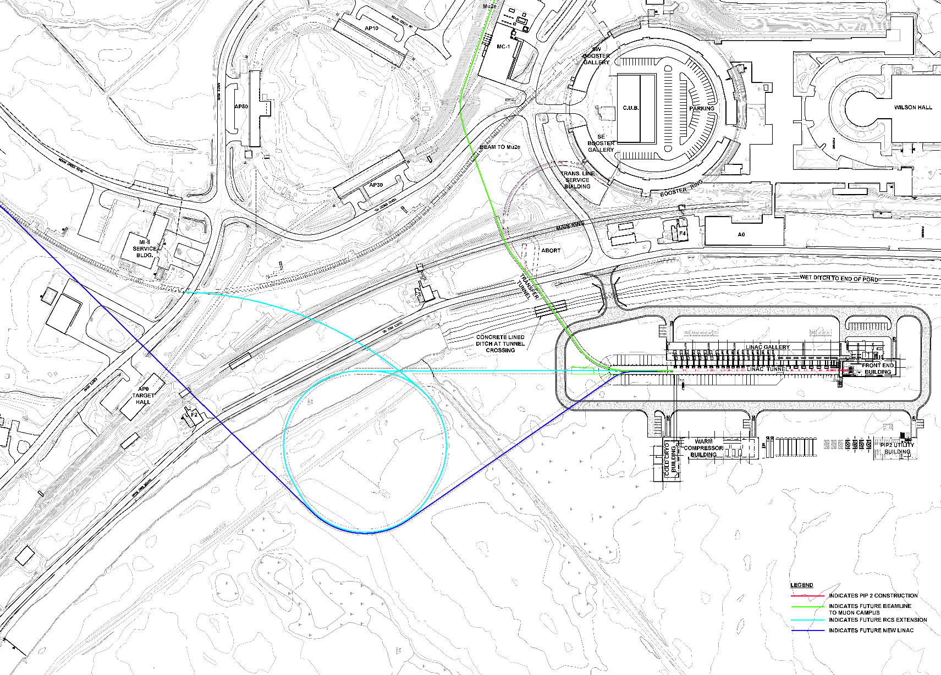
Siting – Future Expansion

