Slide 1
121.2, 121.3.2: Project Management, Accelerator Physics
Project Management Breakout
Steve Holmes
PIP-II Independent Project Review
12-14 December 2017

Slide 2
Outline
Scope & Requirements
Deliverables
Organization/Interfaces
Progress to Date
Risk
Cost
Schedule
Summary
Project Management Plan: PIP-II-doc-172

Slide 3
Scope and Requirements
Charge #4
Project Management (WBS 121.2)
  Responsible for executing and managing the PIP-II Project to the approved scope, cost, and schedule
    Conform with requirements of DOE413.3b
    Provide a safe working environment for all project participants and minimize environmental impacts
    Coordinate with external stakeholders
Accelerator Physics (WBS 121.3.2)
  Establish and control the configuration of the PIP-II accelerators
L2, L3 Management (WBS 121.3.X.2)
  Note: All L3 activities have a management and coordination task assigned at L4 (Not covered in this talk)

Slide 4
Project Management Deliverables
Charge #4
Project Management (WBS 121.2)
  KPPs
  Project Office
    Coordination of L2, L3, and CAMs
    Resource planning
    Configuration control
    Systems engineering/integration
    ESH and QA coordination
    Risk Management
    Monthly Reporting
    Primary interface to DOE/HEP and Fermilab management
    Coordination with external collaborators
Accelerator Physics (WBS 121.3.2)
  Design Reports (conceptual, technical)
  Complete set of Functional Requirements Specifications
  Accelerator configuration management
    Technical Board
  Support for accelerator commissioning

Slide 5
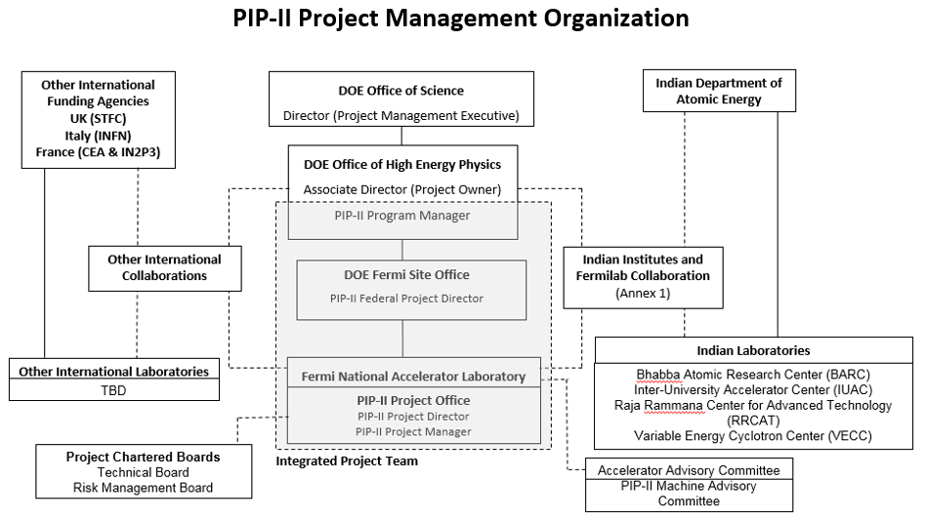
Organization and Interfaces
Charge #4
PIP-II: DOE/SC Project
HEP responsible for funding and oversight
Fermilab responsible for execution
IPT responsible for coordination

Slide 6
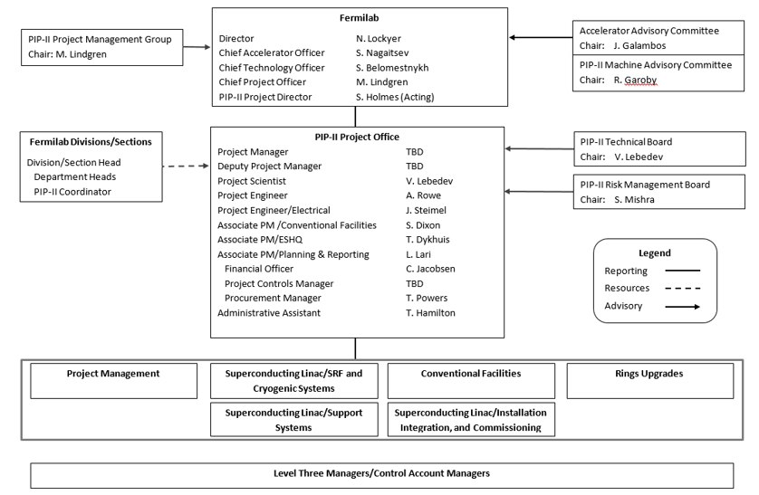
Organization/post-CD-1
Charge #4
PIP-II-doc-172

Slide 7
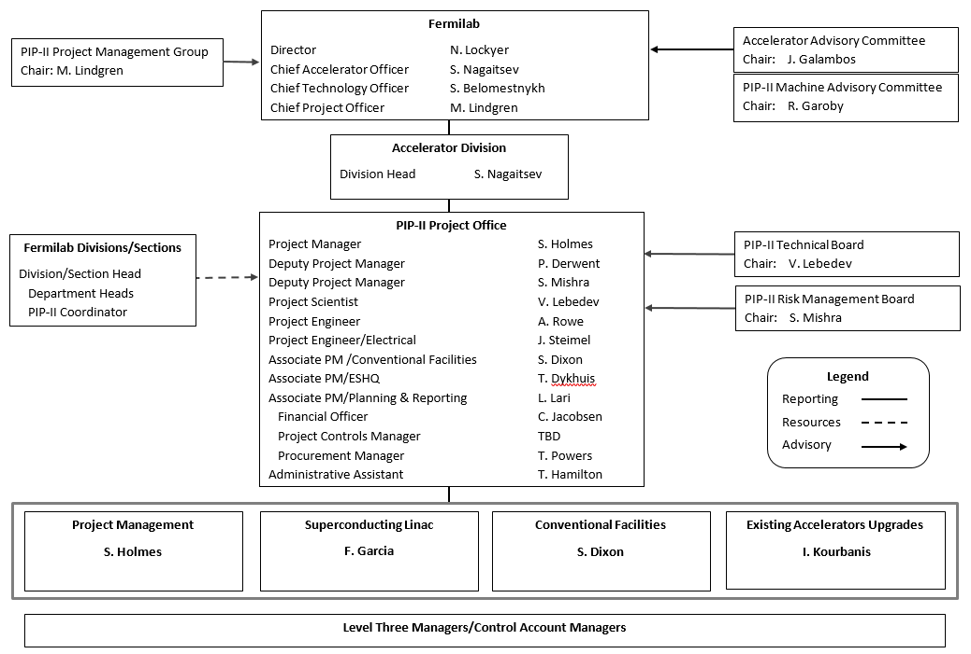
Organization/pre-CD-1
Charge #4

Slide 8
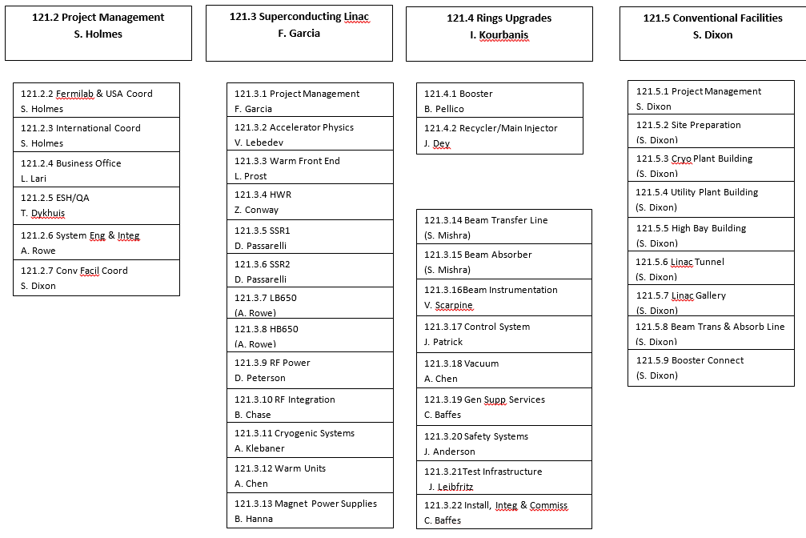
Organization/pre-CD-1
For this review CAM=L3M

Slide 9
Progress to date
Charge #4
Organization provides high-level oversight of all key project aspects:
  Project Scientist
  Project Engineer(s)
  Associate PMs for
    Conventional Facilities
    ESH&Q
    Planning and Reporting
High level positions filled with the exception of Project Controls Manager
Team has successfully:
  Transitioned from R&D to development + project activities
  Completed the Analysis of Alternatives report and developed a Conceptual Design Report based on the preferred alternative
  Organized and developed CD-1 deliverables
  Managed the India Institutions and Fermilab Collaboration (IIFC)
  Engaged INFN, STFC, CEA, and IN2P3
  Coordinated interactions with national partner institutions
CD-1 cost estimate based on the current organization chart
  Will modify the organization post-CD-1 to provide more effective alignment with project goals
  Expect all L3s to remain but grouped into three L2s

Slide 10
Design Validations
Charge #4
PIP-II Machine Advisory Committee (P2MAC)
  Chartered to provide advice to the Directorate on PIP-II technical design and development activities
  Meets annually and reports to the Fermilab Director through the Chief Accelerator Officer
    CAO provides the charge for each meeting
    Project Scientist develops the meeting agenda
    Closeout followed by written report
  April 2017 meeting reviewed the Conceptual Design suitability for CD-1:
  “As it stands, the conceptual design is supported by convincing results of studies and experimental tests that provide a sound technical basis for CD-1.”
  Full report at PIP-II-doc-605
Engineering reviews
  Engineering design reviews are the responsibility of the Project Engineer(s)
  The requirements are outlined in the Fermilab Engineering Manual
  FRS/TRS → PDR → FDR → PRR → ORC
  Requirements are applied to international partners

Slide 11
ESH&Q
Charge #4
Dykhuis
Responsibility of the Associate Project Manager for ESH&Q
  ESH&Q professional with 17 years experience at Fermilab
    Expertise in NEPA
All CD-1 requirements met
  NEPA strategy in place
Integration of international deliverables within QA Plan
  Also see Int’l Risk Mitigation Strategy (PIP-II-doc-1212)

Slide 12
Risk: PIP-II External Risks
Failure of SRF cavity processing equipment
SRF Test Infrastructure Cryogenic Plant Failure
Delay in access to SRF testing and fabrication infrastructure
Delay in formalizing international in-kind contributions
Major Accident/Incident on Fermilab Site

Slide 13
Risk: PIP-II Project Level Risks
Technical Issues with International Deliverables
Insufficient Scientific, engineering and technical human resources including Contractor
  Inability to assign qualified individuals to key Project positions
Insufficient International Deliverable Documentation
Assumed R&D funding profile not achieved
Non-jurisdictional Wetlands application denied
Project Assumption of Operating fund with laboratory not implemented

Slide 14
BOE Summary
Charge #3
WBS Number | Title | Docdb #
121.2 | Project Management | 229
121.3.2.2 | AP PM & Coord | 887
121.3.2.3-7 | AP Support for PIP-II | 890

Slide 15
Cost Summary
Charge #3
Cost estimate based on pre-CD-1 org chart
Labor activity is all level-of-effort (LOE)
  Covers period Q1FY18 to Q3FY27 (9.5 years)
    Project Management (121.2): 141 FTE-years
    Accelerator Physics (121.3.2): 12 FTE-years
M&S is dominated by travel and import duties
  Conference travel $0.5M
    10 domestic and 6 foreign conferences/year
  International collaboration travel $0.4M
    5 trips/year up to CD-2, 8 trips/year after
  International short-term visitor support $0.5M
    2 short term visitors continuously over project duration
  Import duties on international contributions $2.2M
    2.6% x $86M (estimated value of int’l deliverables)
  Environmental Assessment $0.1M

Slide 16
Cost Summary/Project Management
Charge #3
Full Burden + Esc = BOE + Escalation + Overhead
Costs generated from resource loaded schedule
Overall contingency is low (9%) because this activity is dominated by LOE and can be managed to a nearly fixed budget.

Slide 17
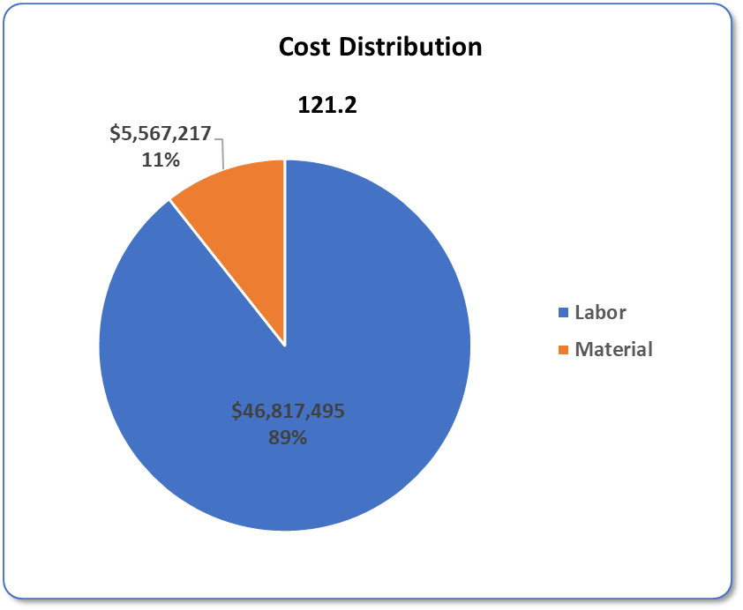
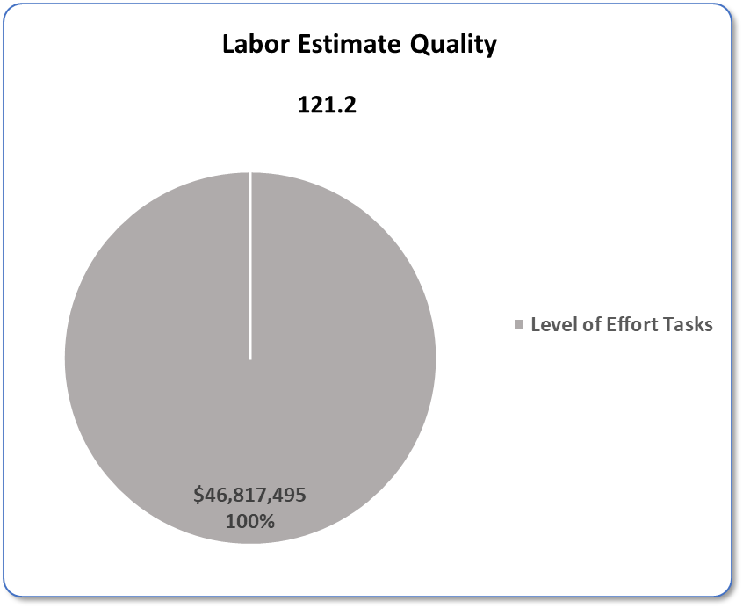
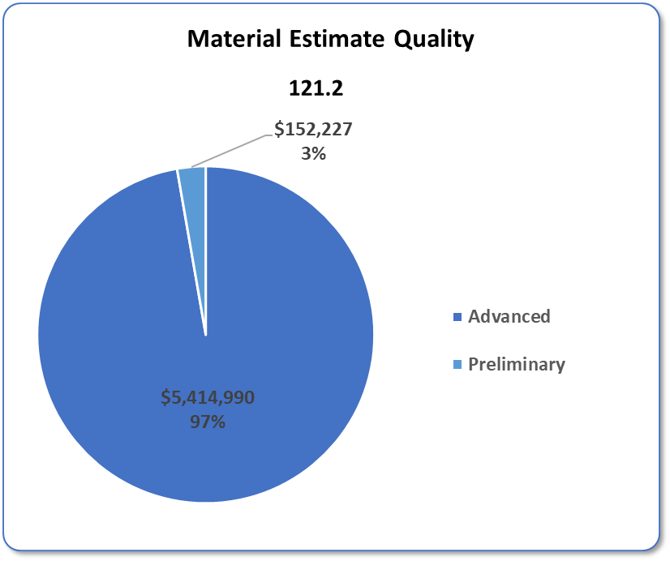
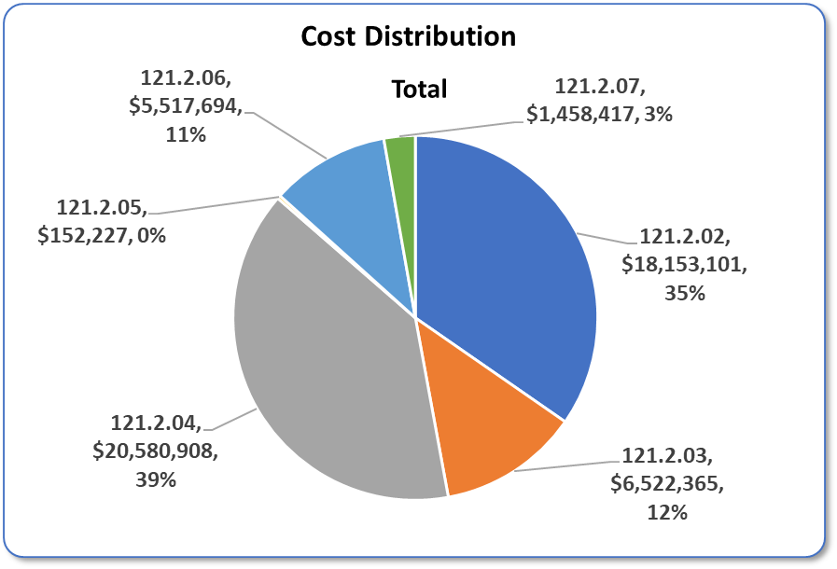
Cost Distribution and Estimate Quality
Charge #3
Dominated by Labor (LOE)
M&S dominated by import duties and travel
  20% estimate uncertainty assigned to import duties
  10% estimate uncertainty assigned to travel

Slide 18
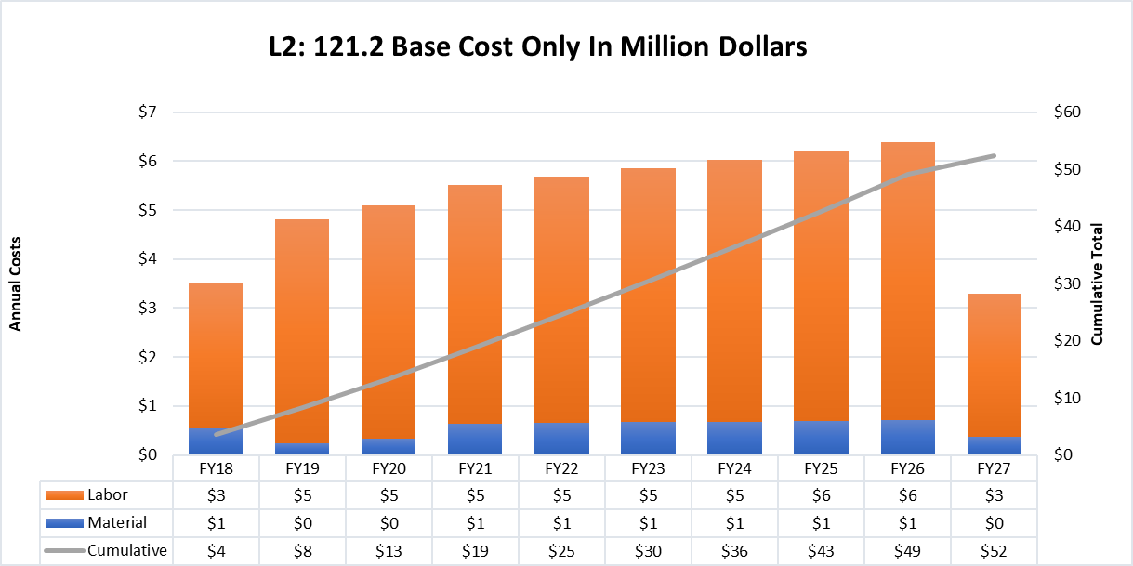
Obligation Profile – P6 Base Cost Only
Charge #3
P6 Base Costs = BOE + Overheads + Escalation
Note: Assumes project completion in Q3FY27
  Standing army associated with Project Management is ~15 FTE

Slide 19
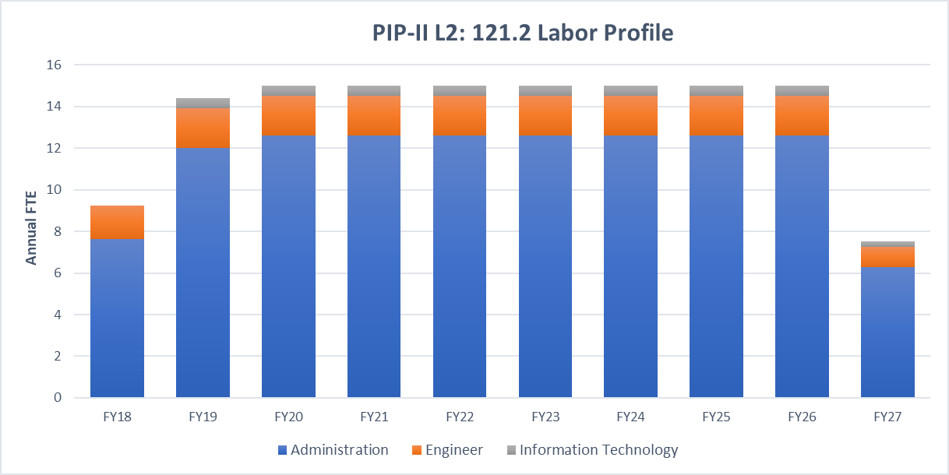
Labor Profile – P6 Hours/FTE
Charge #3
Essentially all required labor for FY18 is currently on-board
Modest build-up required in FY19-20
  Primarily project controls staff

Slide 20
Cost Summary/Accelerator Physics
Charge #3
Full Burden + Esc = BOE + Escalation + Overhead

Slide 21
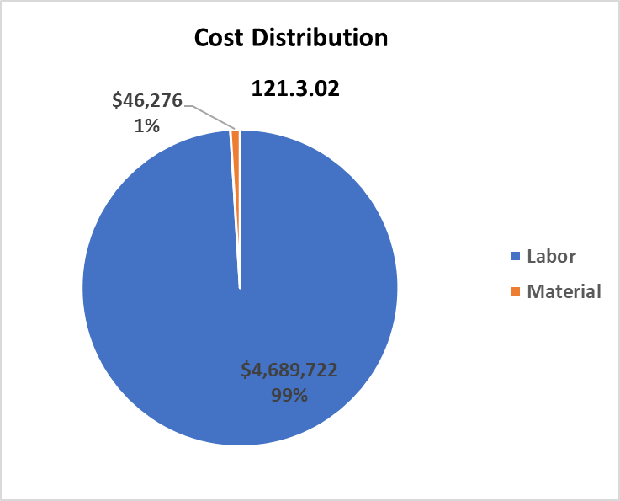
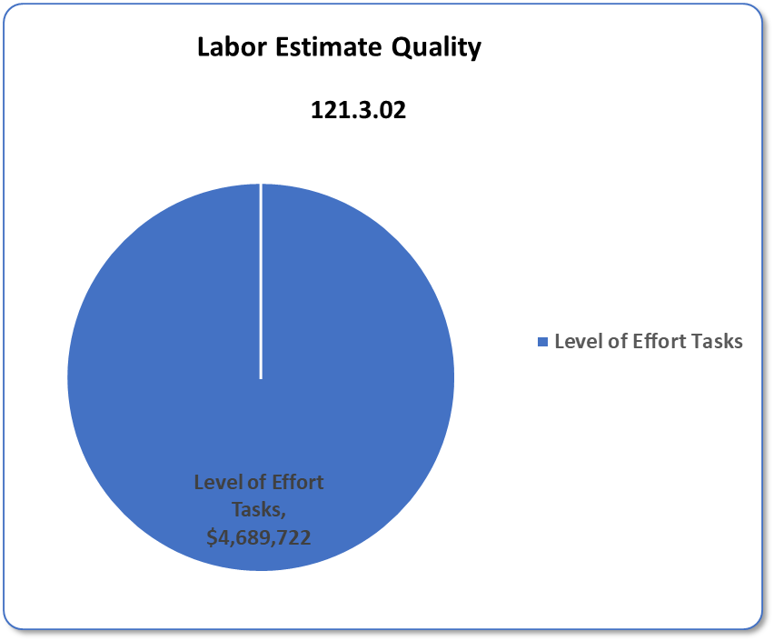
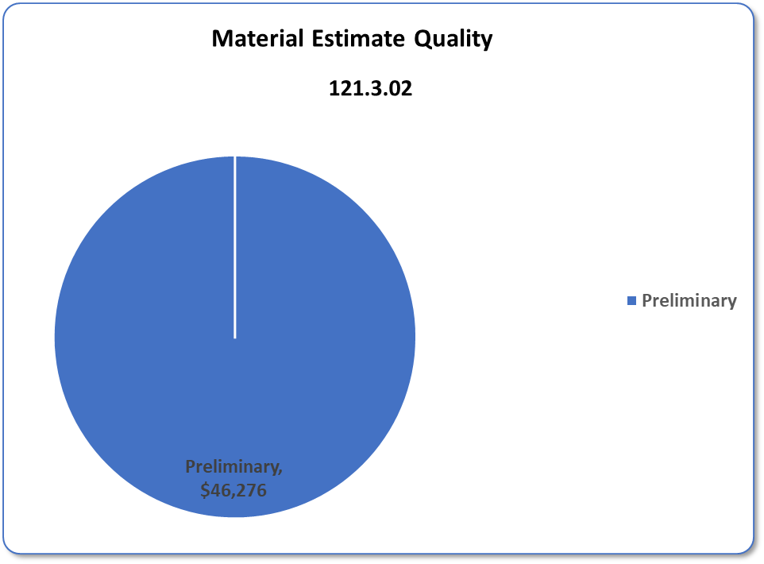
Cost Distribution and Estimate Quality
Charge #3

Slide 22
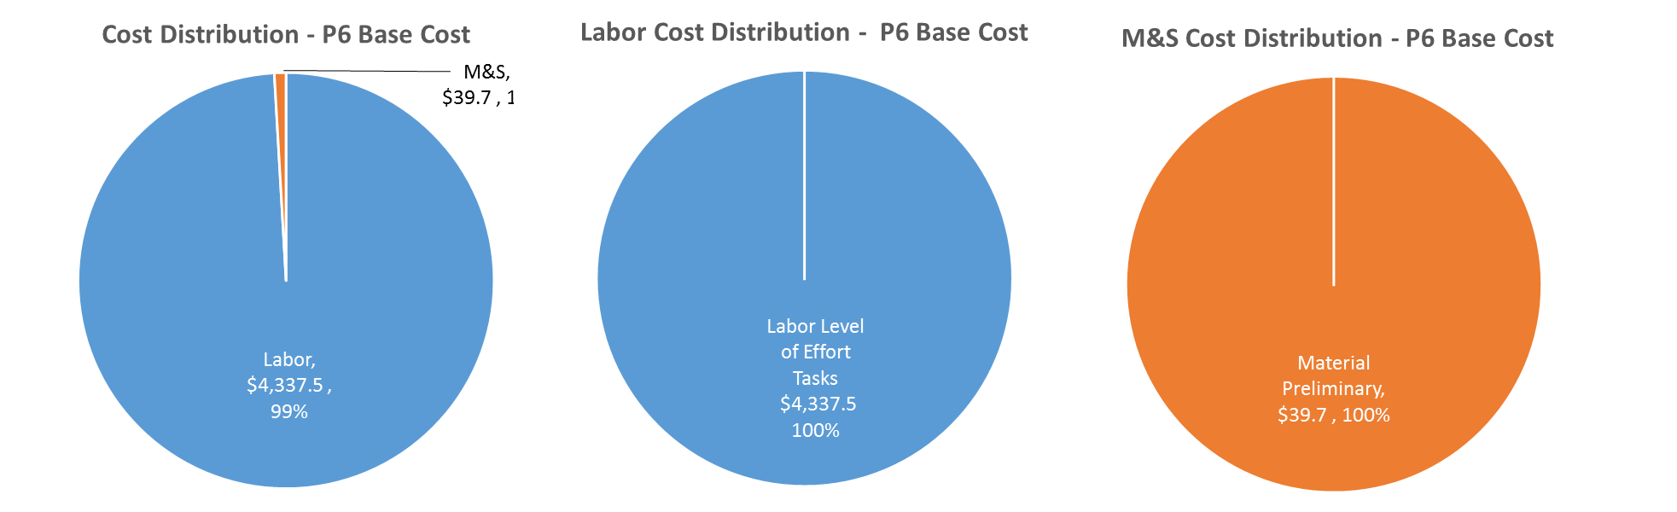
Cost Drivers and Estimate Maturity
Charge #3
P6 Base Costs = BOE + Overheads + Escalation

Slide 23
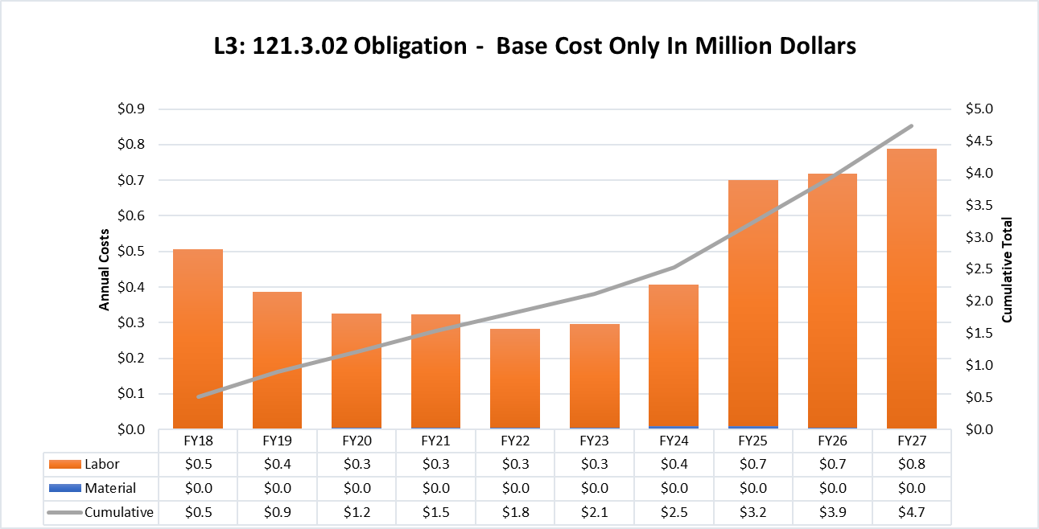
Obligation Profile – P6 Base Cost Only
Charge #3
P6 Base Costs = BOE + Overheads + Escalation

Slide 24
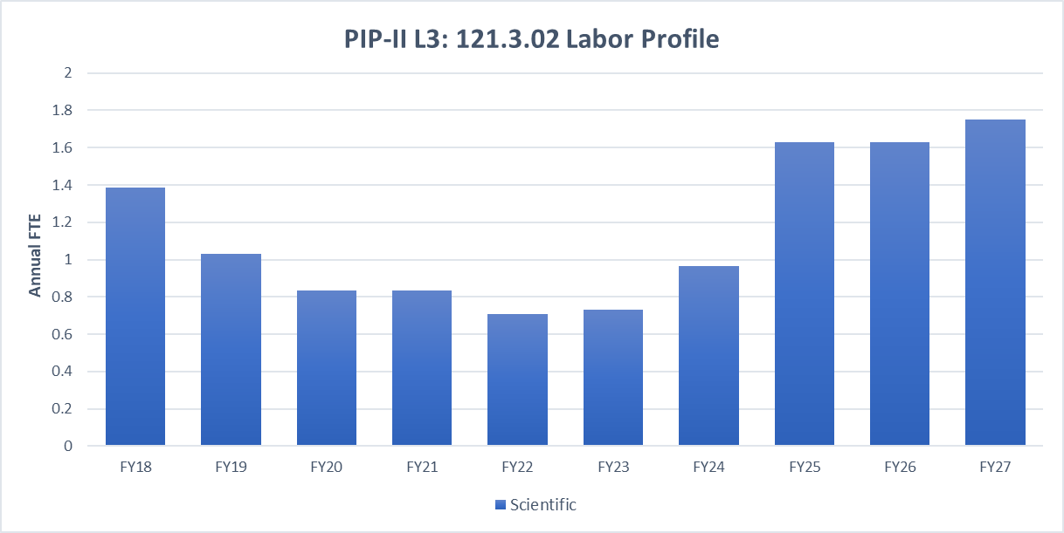
Labor Profile – P6 Hours/FTE
Charge #3
Labor roll-off following development phase, then buildup in preparation for, and participation in, commissioning

Slide 25
Schedule – T3 Milestones
Charge #3
PM T3 milestones come in three flavors:
  T3 milestones corresponding to T2s
  Reviews prior to CD’s
  Ready for installation

Slide 26
Schedule – T3 Ready For Installation MS
Charge #3

Slide 27

Schedule – Accelerator Physics
Charge #3

Slide 28
Next Steps to CD-2
Develop the Performance Baseline
  Transition to new organizational structure and align WBS
  Assign new L2 Managers
  Assign Project Controls Manager
  Optimize P6 schedule and prepare for EVMS
Prepare for EVMS implementation
  Formally assign and train CAMs
  Initiate EVMS reporting 6 months prior to CD-2
Project Management Team needs to grow by ~3 FTE at CD-2
  Project Controls Manager + PC specialist
  Assistant to APM_Planning & Reporting
  Financial Officer support
  Review need for: More procurement support, dedicated QA manager

Slide 29
Summary
Substantial progress over prior year in transitioning from R&D to project activities
Project Management tasks are well-defined
  BOEs and P6 based on current organization chart
  Nearly all positions filled
  Adjustments to org chart & WBS anticipated after CD-
    Moving to Project Director/Project Manager model
Project Team is well-qualified to deliver this project
  Many years experience in accelerator development, operations, and projects
Groundwork is being laid for CD-2 and we are ready to move forward following CD-1

Slide 30
Thank you for your attention

