Slide 1
131.3.10 RF Integration
RF Systems
Brian Chase
PIP-II Independent Project Review
12-14 December 2017

Slide 2
Outline
Requirements
Conceptual Design, Maturity
Scope/Deliverables
Interfaces
Technical Progress to Date
ESH&Q
Risk
Cost
Schedule
Summary

Slide 3
About Me:
Brian Chase:
  L3 Manager for RF Integration
Relevant experience
  30+ years in accelerator technology development
  400 MeV Linac, Main Injector, Tevatron, Recycler, SRF(A0, NML, ILC, LCLS-II)
  Low Level RF group leader - with an experienced team

Slide 4
Scope: WBS Dictionary
WBS Dictionary: pip2-docdb #599
Copy this directly from the excel spreadsheet
121.3.10 Linac - RF power INTegration (RF-INT) | This WBS entry covers design, procurement, fabrications and testing of the RF Power integration tasks, which includes Low Level RF, RF Protection interlocks, and system integration. It includes development of systems at 162.5 MHz, 325 MHz, and 650 MHz, for both test infrastructure and linac systems.

Slide 5
WBS L3 System Requirements
Charge #1
LLRF: Maintain proper amplitude and phase control of cavities in order to meet requirements for phase-space painting into the booster WBS #121.3.10.1
  Provide system to deliver amplitude stability to 0.01% and phase stability to 0.01°
  Provide for resonance control for RFQ and SRF cavities
  Provide system that supports pulsed or CW modes
  Chopper Driver: Beam pattern generator control
    Provide signals necessary for beam transfer to Booster
    Define chopper pattern, drive and regulate beam chopper waveforms
RFPI: Provide RF protection and interlocks WBS #121.3.10.5
  Provide protection to cavities, and RF systems from RF related issues
  RF Phase Reference line: WBS #121.3.10.5
  Provide distributed phase-locked reference signals at 1300 MHz (for instrumentation), 650 MHz, 325 MHz, and 162.5 MHz.
LLRF for Test Infrastructure WBS #121.3.10.2
  Provide complete LLRF systems for PIP2IT and CMTS
  Provide operational support
  Testbed to develop resonance control

Slide 6
Conceptual Design and Design Maturity
Charge #1
 | Frequency [MHz] | Number of RF cavities | Amplifiers per Cavity | Pulsed / CW | Amplifier power [kW] | Number of 4-cavity stations
RFQ | 162.5 | 1 | 2 | CW | 75 | 1 (special)
Bunching Cavities | 162.5 | 4 | 1 | CW | 3 | 1
HWRs | 162.5 | 8 | 1 | CW | 3,7 | 2
SSR1s | 325 | 16 | 1 | Pulsed | 7 | 4
SSR2s | 325 | 35 | 1 | Pulsed | 20 | 9
LB650s | 650 | 33 | 1 | Pulsed | 40 | 9
HB650s | 650 | 24 | 1 | Pulsed | 70 | 6
LLRF hardware is compatible for all frequencies and is repeated in racks controlling four cavities
Each cavity frequency has its own Phase Reference Line and Local Oscillator
RFPI supports all cavity types
FRS and TRS

Slide 7
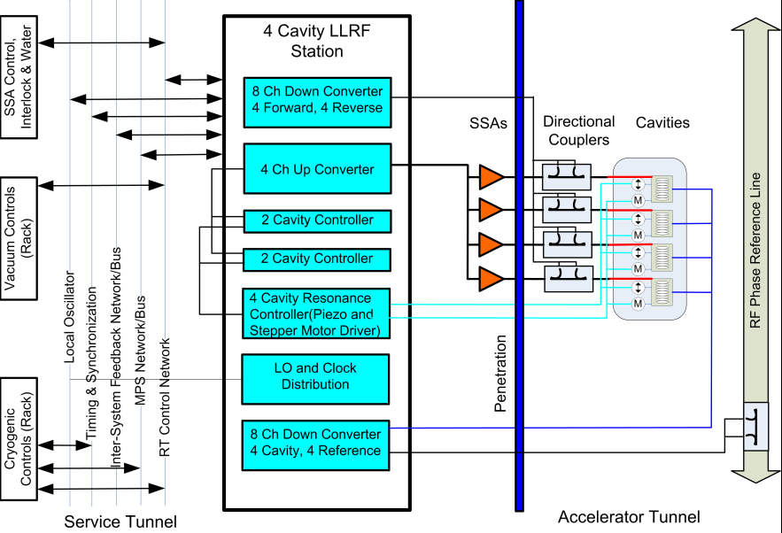
Conceptual Design and Design Maturity: LLRF
Charge #1

Slide 8
Conceptual Design and Design Maturity: RFPI
Charge #1
Protects coupler and cavity from damage by cutting RF drive (sparks, field emission, quenches)
LLRFDrive
Fast RF Switch
SSA
Coupler/Cavity
RF_INH
SSA Inhibit
Operational systems at PIP2IT
Reset
VideoPLS
Reset
VideoPLS
Reset
VideoPLS
Reset
VideoPLS
System Control
PMT
RF_INH
MODINH
FEP
FWR/REFL
RF_INH
MODINH
RF_INH
MODINH

Slide 9
Scope and Deliverables
Charge #1
Provide hardware, software, and firmware to satisfy system requirements.

Slide 10
Scope and Deliverables
Charge #1
Provide hardware, software, and firmware to satisfy system requirements.
PIP2-IT/CMTS LLRF:
  Low level RF for all cavities in each test stand
    Systems for 162.5 MHz cavities is initially supplied by FNAL: DAE hardware will be integrated
    All other hardware supplied by DAE/BARC
  Resonance control for the RFQ and half wave resonators
  Resonance control support for SSR and elliptical cavities

Slide 11
Scope and Deliverables
Charge #1
Provide hardware, software, and firmware to satisfy system requirements.
PIP2-IT/CMTS LLRF:
  Low level RF for all cavities in each test stand
    Systems for 162.5 MHz cavities - FNAL
    Systems for 325 MHz cavities (DAE deliverable)
PIP-II LLRF Hardware Deliverables:
  8 Channel down-converter (DAE deliverable)
  4 Channel up-converter (DAE deliverable)
  Rack power supplies (DAE deliverable)
  Resonance control chassis (DAE deliverable)
  Field control chassis (DAE deliverable)
  Reference line system(DAE/FNAL)
  Chopper pattern generator and interface to Booster (FNAL)

Slide 12
Scope and Deliverables
Charge #1
PIP-II LLRF Software/Firmware Deliverables:
  Data acquisition firmware (DAE Deliverable)
  Field control firmware (DAE Deliverable)
  Resonance control integration
  Software (DAE Deliverable)
  Global LLRF system control
  Chopper Waveform Generator (FNAL)
  Beam-based energy stabilization (FNAL)

Slide 13
Scope and Deliverables
Charge #1
PIP-II LLRF Software/Firmware Deliverables:
  Data acquisition firmware (DAE Deliverable)
  Field control firmware (DAE Deliverable)
  Resonance control integration
  Software (DAE Deliverable)
  Global system control
  Chopper Waveform Generator
  Beam-based energy stabilization
RFPI Deliverables
  PIP2-IT systems
  CMTS(DAE Deliverable)
  PIP-II all SRF cavities Hardware/Software/Firmware(FNAL and DAE Deliverable)

Slide 14
Progress to date
Charge #1
Complete FNAL systems operating on the RFQ and two bunching cavities supporting CW and pulsed mode validating many design decisions
Collaborations
  Two DAE engineers on site for two years
  Weekly meetings with DAE team
  Partnership agreement with Berkeley in progress
System studies including:
  Noise and feedback analysis
  Longitudinal sensitivity analysis
  Performance analysis
  RFQ resonance control

Slide 15
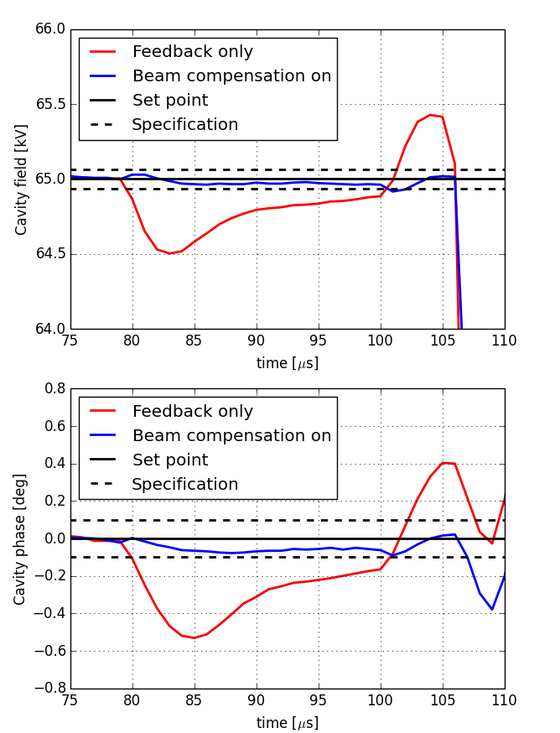
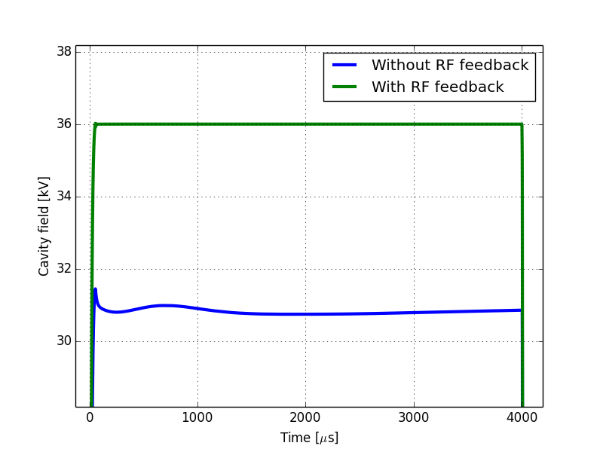
Progress to date – PIP2IT results
- bunching cavity
Charge #1
System meets regulation requirements
  With feed-forward beam compensation, the LLRF system achieves the regulation requirements for a short beam pulse
  Right: Demonstration of feed-forward beam loading compensation for a 20 microsecond beam pulse at 5mA
  Bottom: Illustration of amplifier transients mitigated by LLRF feedback

Slide 16
Progress to date: LLRF Systems and Chassis
Charge #1
Resonance Control Chassis
Operational LLRF at PIP2 IT(FNAL)
Seven joint FRSs Approved (two more near approval)
  TRS in process (DAE/FNAL)
8-Channel Down-Converters
  DAE version is in test
4-Channel Up-Converters
  DAE version in test
FPGA Board
  In layout
ADC-DAC FMC Module
  In Layout
Resonance Control Chassis
  Leverage from FNAL LCLS-II design and is in progress
Master Oscillator and Reference line in design
Digitizer Chassis

Slide 17
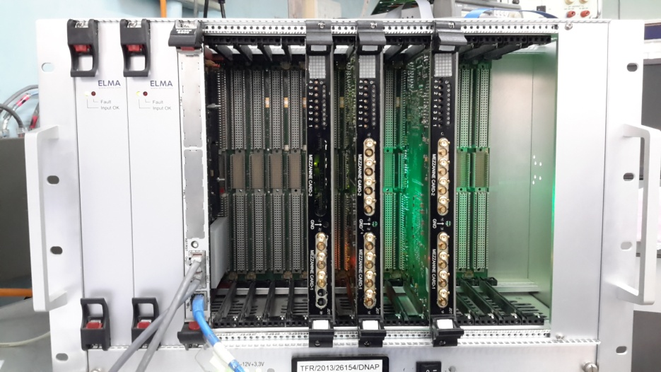
Progress to date: RFPI
Charge #1
RFPI Hardware Prototype Delivered by DAE

Slide 18
ESH&Q
Charge #4
Almost all of the hazards associated with these systems are electrical in nature and are covered under the codes below listed in the PHAR (docdb# 140):
  National Electrical Code, NFPA 70
  OSHA 29 CFR, Part 1910, Subpart S, Electrical
  Fermilab ESH&Q Manual, Fermilab Electrical Safety Program
Domestically procured electrical equipment will be National Recognized Testing Lab (NRTL) certified.
No exposed energy sources above 50V
QC of DAE deliverables - PIP2 QC docdb 141, 142
  100% verification of modules meeting pre-established specifications

Slide 19
Risk: RF Integration
Charge #3
Resonance control and field regulation
DAE LLRF/RFPI hardware/software does not meet acceptance criteria
RF interlocks fail to protect SSA-Coupler-Cavity

Slide 20
Risk Mitigation: Resonance control and field regulation
Charge #3
Is a Risk in the pulse mode of PIP-II operation due to microphonics and Lorentz force detuning
  Which is the default operating mode for the LBNF DUNE
Is a much smaller Risk in the CW mode of PIP-II operation as Lorentz force detuning does not come into play
  PIP-II is being built as a CW capable SRF Linac
  Additional operating cost in CW mode will be ~850k/year
  Workable solutions may fall between pure pulsed and CW
Planned Development (FY18-FY23) is to mitigate these Risks
  Risk Mitigation Plan (DocDB 1272)

Slide 21
BOE Summary
Charge #2
WBS Number | Title | Docdb #
121.3.10.2 | Linac – RF-INT Project Management and Coordination | 986
121.3.10.3.1 | Linac – RF-INT – LLRF PIP2IT | 999
121.3.10.3.2 | Linac – RF-INT – LLRF Test Infrastructure | 992
121.3.10.3.3 | Linac – RF-INT – LLRF PIP-II | 995
121.3.10.4 | Linac – RF-INT Reference Line (RL) | 998
121.3.10.5 | Linac – RF-INT – RF Protection/Interlocks | 1001

Slide 22
LLRF Interfaces and key dependencies to other systems
Charge #2
121.3.10.3
Linac - RF-INT : Low Level Radio Frequency (LLRF)
LLRF, RFPI, Reference line
121.3.21
Linac - Test Infrastructures
Impacts LLRF development schedule and risk mitigation
121.3.5.1
Linac (SSR1)
Impacts 325 MHz Field and Resonance Control, development schedule
All other cavities types are important to LLRF too
121.3.17
Linac – Controls
Precision timing and machine protection interface, High data rate DAQ, System level control
121.3.9
Linac - Radio Frequency power
Impacts schedule and system performance
DAE supplying most of LLRF and RFPI Components

Slide 23
Cost Summary
Charge #3
Full Burden + Esc = BOE + Escalation + Overhead

Slide 24
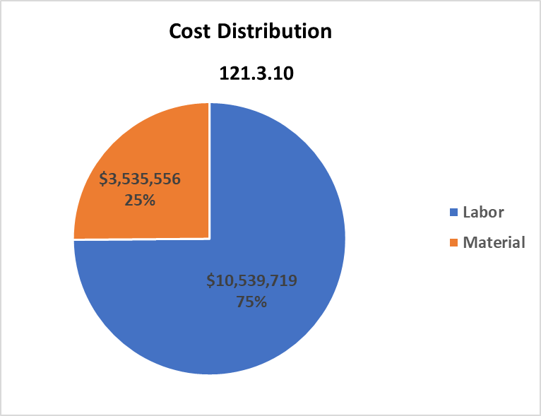
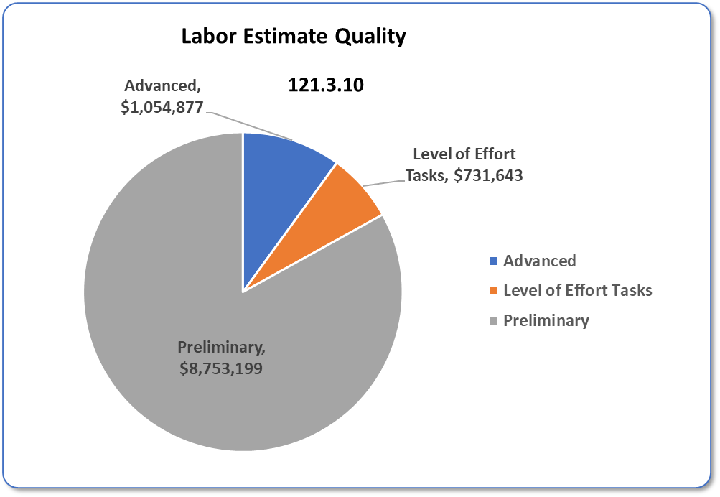
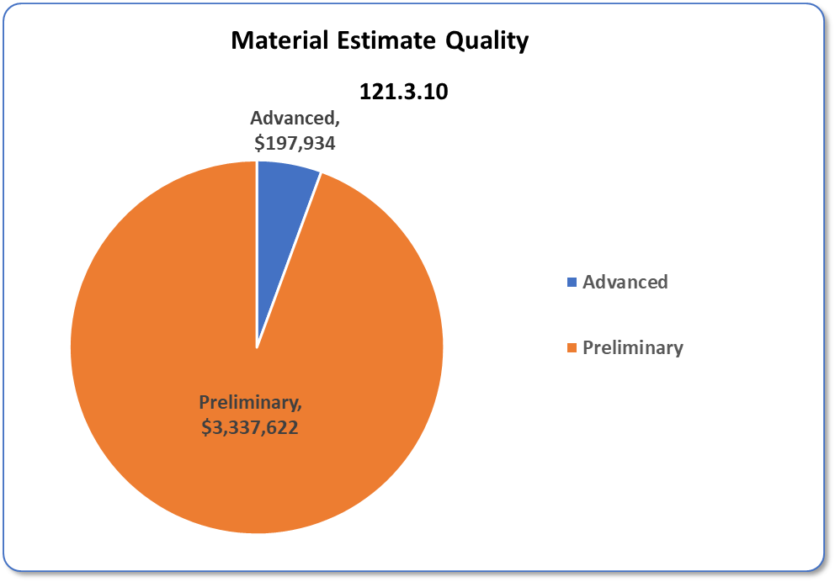
Cost Distribution and Estimate Quality
Charge #3

Slide 25
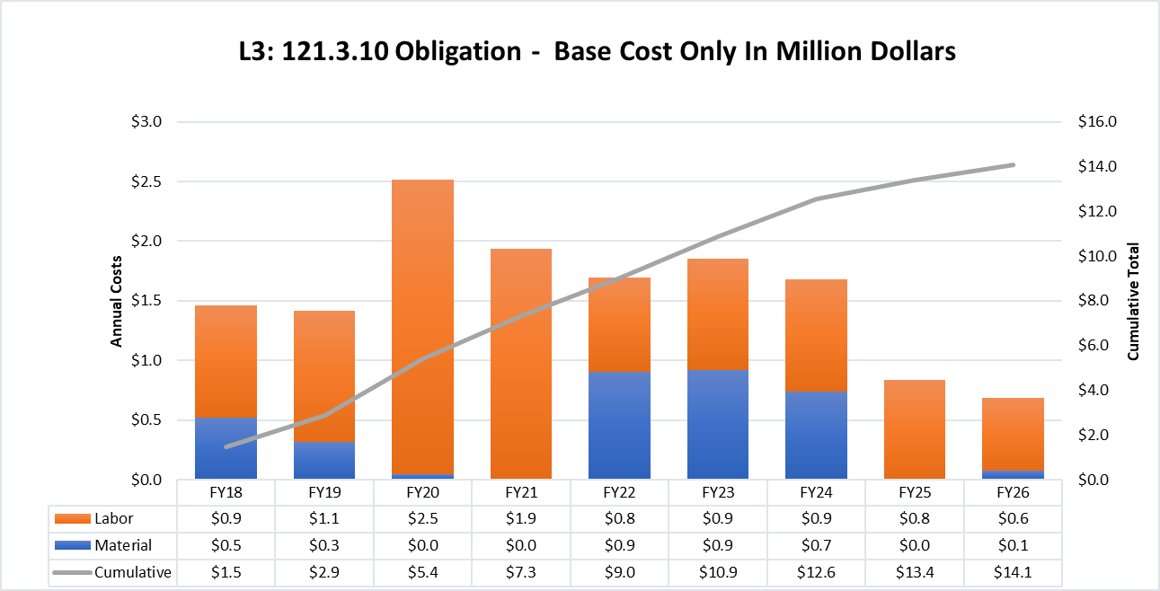
Obligation Profile – P6 Base Cost Only
Charge #3
P6 Base Costs = BOE + Overheads + Escalation

Slide 26
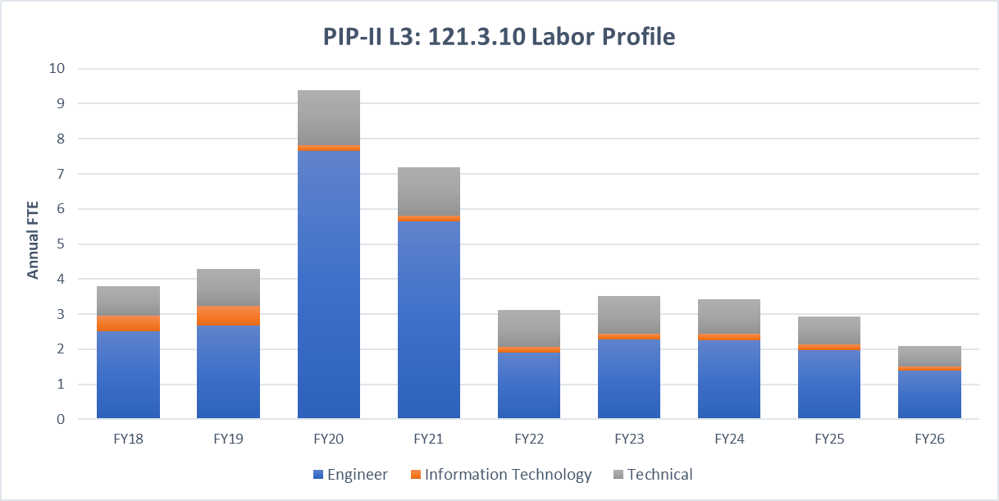
Labor Profile – P6 Hours/FTE
Charge #3

Slide 27
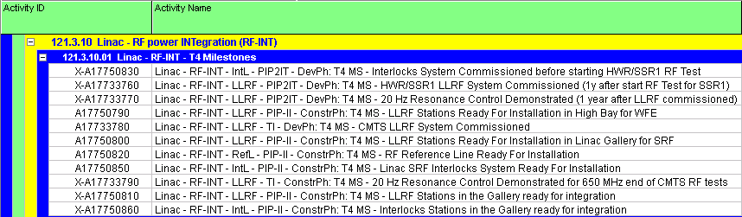
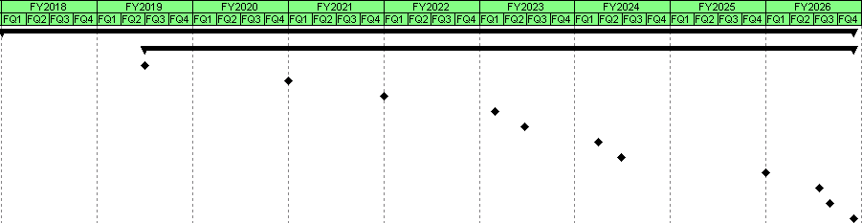
Schedule – RF Power Integration
Charge #3

Slide 28
Summary
The Low Level RF and RF protection and interlock are leveraged from FNAL and LCLS-II designs and are well understood
The beam energy stability requirements are very tight for a pulsed machine, however, full machine simulations and testing at PIP2-IT show them to be attainable
There is ongoing work and a plan forward to cover pulsed Lorentz force detuning (resonance control)
We have a good working relationship with our DAE collaborators
Cost, schedule and risks are understood
  We are ready for CD-1 and look forward to your feedback

Slide 29
END

Slide 30
PIP-II High Level Master Schedule

