Slide 1
Linac Accelerator Support Systems
Installation and Commissioning
(WBS 121.3.3,12-15,18-22)
Fernanda G. Garcia
PIP-II Independent Project Review
12-14 December 2017

Slide 2
Outline
Requirements
Conceptual Design, Maturity
Scope/Deliverables
Organization
Interfaces
Technical Progress to Date
Plan for CD-2/Preliminary Design
ESH&Q
Risk
Cost
Schedule
Breakout Session topics
Summary

Slide 3
Fernanda G. Garcia
Role:
  L2 manager for PIP-II SRF Linac
Relevant Experience:
  Scientist – 17 years of experience at the lab
  13 years in Accelerator Division
    Linac Group Leader (2008-present)
    PIP Deputy Project Manager (2012-present)
      L2 manager for Linac Upgrade
      L3 manager for Linac 200 MHz RF Power Systems
    L2 manager for SBN-FD (ICARUS) Inst. and Integ. (2015-present)
    Head of 400 MeV Transfer Line (2004-2008)
      Designed new injection scheme lattice into Booster
      Leadership role during installation and commissioning phase
    Head of MuCool beamline installation and integration (2007)

Slide 4
WBS L3 System Requirements
Charge #2
121.3.3 Warm Front End (WFE)
  Prepare and deliver 2.1 MeV beam to SC Linac
    Bunch pattern to match Booster injection
    Emittance for efficient transfer
    Pulse mode at 20 Hz, 2 mA, 0.55 msec
121.3.12 Warm Units (WarmU)
  Focusing elements between LB650 and HB650 cryomodules
121.3.13 Magnet Power Supplies
  Regulation and control of cold (including quench protection) and warm magnet power supplies
121.3.14 & 121.3.15 Beam Transfer Line (BTL) & Beam Absorber Line (BAL)
  Transfer H⁻ beam from the exit of the SRF linac to the injection girder of the Booster
  Transport PIP-II beam to a 50kW beam absorber
121.3.18 Vacuum (V)
  Ultra High Vacuum (UHV) and low particulate practice for SC Linac;
  UHV and low particulate practice for the transition regions up/down stream of the SC Linac;
  High Vacuum for the regions from ion source (IS) to the medium energy transport line (MEBT) absorber and the beam transfer line to Booster, beam absorber line

Slide 5
WBS L3 System Requirements
Charge #2
121.3.19 General Support Services (GSS)
  Fluids (LCW, RAW) Infrastructure
    WFE, magnets, gallery racks
  Electrical Infrastructure in Gallery
    racks, power distribution
121.3.20 Safety Systems (SS)
  Radiation, ODH, and Electrical Safety Interlocks for linac tunnel and cryo buildings
121.3.21 Test Infrastructure (TI)
  Support for cavities & cryomodules test areas
    Spoke Test Cryostat (STC)
    CryoModule Test Stand (CMTS)
    PIP-II Injector Test (PIP2IT)
121.3.22 Installation, Integration, and Commissioning (IIC)
  Execute installation scope as defined in L3-L3 Interface Control Documents
  Execute commissioning (at super-system and machine levels)
Specific requirements for individual L3 system covered in breakouts

Slide 6
Conceptual Design and Design Maturity
Charge #2
Breakout
121.3.3 - Warm Front End
  Several WFE sub-system designs are mature and stable
    extensive testing of sub-systems has been done to date
    focus on factors that may determine reliability
121.3.12 - 650 Warm Units (between cryomodules)
  Magnets, stands, BPMs, vacuum designs are conceptual
  Engineering analyses done for magnets and documented
121.3.13 - Magnet Power Supplies
  Cryogenic magnet power supplies designs are mature and will substantially be based on similar in-house technology used elsewhere
  Quench Protection Monitor (QPM) advanced design stage
  Warm magnets power supplies for both WU and BTL will count on a mix of mature commercial supplies and similar in-house technology used elsewhere

Slide 7
Conceptual Design and Design Maturity
Charge #2
Breakout
121.3.14&15 - Beam Transfer Line & Beam Absorber Line
  PIP-II transfer lines design have been developed and optimized to address constraints and limitations raised by interferences with existing beamlines and infrastructures
121.3.18 - Vacuum
  PIP-II vacuum system design will be conventional
    turbo molecular pumps for pumping the IS/LEBT/RFQ/MEBT abs.
    sputter ion pumps for MEBT/BTL/BAL with differential pump sections strategically located upstream/downstream cryomodules
    NEG for the warm section between cryomodules
121.3.19 - General Support Services
  PIP-II fluids and electrical system design will be conventional
    Based on the as-built system at PIP2IT
  Communication on space requirements and integration in the Linac tunnel is closely performed in collaboration with task 121.5 (CF)

Slide 8
Conceptual Design and Design Maturity
Charge #2
Breakout
121.3.20 - Safety Systems
  Conceptual design of PIP-II Linac and transfer lines for main safety systems elements (ODH, RSIS) have been complete
    Based on understanding of work CF design and operational experience
121.3.21 - Test Infrastructure
  STC: Design is at advanced stage
  CMTS1 & PIP2IT modifications
    Conceptual design complete
    Based on understanding of work for existing LCLS-II Test Stand
121.3.22 - Installation, Integration & Commissioning
  II&C plan is preliminary and is based on the cryomodule delivery schedule

Slide 9
Scope and Deliverables
Breakout
Charge #2
pip2-docdb#599
Scope | Deliverables
121.3.3 Warm Front End (WFE) This WBS entry covers development of the PIP-II 2.1 MeV normal conducting front-end. This system includes ion sources, solenoids and other magnets, accelerator sections, diagnostics sections. Included is the High Energy Beam Transport downstream of the HWR and SSR1 cryomodules in the PIP-II Integration Test at CMTF. | * IS and power supply * RFQ power couplers/tuner slugs * Quadrupole and dipole mag. * MEBT scrapers, absorbers, kickers, buncher cavities
121.3.12 Linac - LB650 and HB650 Warm Units (WarmU) This WBS entry covers design, procurement, fabrication, and testing of the warm units interspersed between the individual LB650 and HB650 cryomodules in the PIP-II linac. Each warm unit contains focusing and correction magnets, and vacuum equipment. | * 11(9) warm units for LB(HB)650 * WarmU assembled on a girder and vacuum certified prior installation
121.3.13 Linac - cold and warm magnets Power Supply (PS) This WBS entry covers design, procurement, fabrications and testing of the magnet power supplies. It includes supplies for the cold magnets (in the cryomodules), the warm magnets in the linac, and the warm magnets in the beam transfer line. | * All power converters required for all the 5 SRF regions * Power supplies for the beamline magnets and special devices
121.3.14 Linac - Beam Transfer Line to Booster (BTL) This WBS entry covers the design, procurement, fabrication, and testing of Beam Transfer Line magnets and collimators from the end of the Linac to the injection point in the Booster. | * 2 collimators * All magnets deployed in the beam transfer line to Booster

Slide 10
Scope and Deliverables
Breakout
Charge #2
pip2-docdb#599
Scope | Deliverables
121.3.15 Linac - Beam Absorber Line (BAL) This WBS entry covers the design, procurement, fabrication, and testing of Beam Absorber Line magnets and beam dumps. It includes a low power beam dump in line with the Linac and the main beam dump off of the Beam Transfer line. | * 2 beam absorbers * All magnets that compose the transport line to the absorber
121.3.18 Linac - Vacuum (V) This WBS entry covers the design, procurement, testing of all vacuum system to be deployed at the machine | * Deliver every vacuum system used in the PIP-II Linac
121.3.19 Linac - General Support Services (GSS) This WBS entry covers the design, procurement, fabrication, assembly, installation, test and QA of utilities (LCW, compressed air, and electrical distribution) in the linac, transfer line, and associated galleries. In general, this WBS includes "hard" parts of the infrastructure installed before accelerator components. Connection to the accelerator components (e.g. hoses, cables) is covered in the installation WBS 121.3.22. | * Water pumps for cooling distribution in PIP2 tunnel, transfer lines and service building (LCW/RAW) * Compressed Air, N2 lines * AC electrical distribution
121.3.20 Linac - Safety Systems This WBS entry covers design, procurement, fabrications and testing of the Linac Safety Systems. Final scope will be delivery of the beamline enclosure Radiation and Electrical Safety Systems, Enclosure Access Radiological Frisking Stations, Radiological Monitoring Systems, and the Oxygen Monitoring Systems for the Linac and Cryo Building. | * Interlock system gates * Access safety and control system * Audible emergency evacuation * TLM system * ESS system *Critical Devices including logic modules

Slide 11
Scope and Deliverables
Breakout
Charge #2
pip2-docdb#599
Scope | Deliverables
121.3.21 Linac - Test Infrastructures (TI) This WBS entry covers design, procurement, fabrication and testing/commissioning of the test infrastructure necessary for the project. Included are Lab 2 (for Cryomodule string assembly), HTS-2 (a 650 MHz Horizontal Test Stand at Meson Detector Building), CMTS1 (modifications for 650 MHz operation to the CryoModule Test Stand in the CryoModule Test Facility), PIP2IT (the injector Test facility at CMTF), and STC (the spoke test cryostat at Meson Detector building). | * CMTS ready to test 650 cryomodules * PIP2IT ready to test SSR2 cryomodules * STC facility ready for SSR1,SSR2, HB650 cavity qualification
121.3.22 Linac - Installation, Integration & Commissioning (I&I&C) This WBS entry covers the reception of parts, components and sub-assemblies from either a post-processing & testing or rack integration activity. Installation begins at beneficial occupancy of the new accelerator enclosure and utility buildings. These activities include, but are not limited to, mechanical installation of beamline components, installation of vacuum components, alignment, vacuum pump down, vacuum leak checking and functional testing of the components and all of their respective control systems. Management of project installation activities are not covered in this section. Those activities are covered under WBS 121.3.1. This WBS section also covers the removal and/or relocation of existing PIP-II beamline components, for example, PIP2IT elements from the CMTF area to the new linac enclosure | * Installation and (De)-installation of accelerator components and transport to the linac tunnel * Installation of equipment in the galleries * Provide support services * 3D CAD model * Cryomodule / magnet stands and movers * ORC

Slide 12
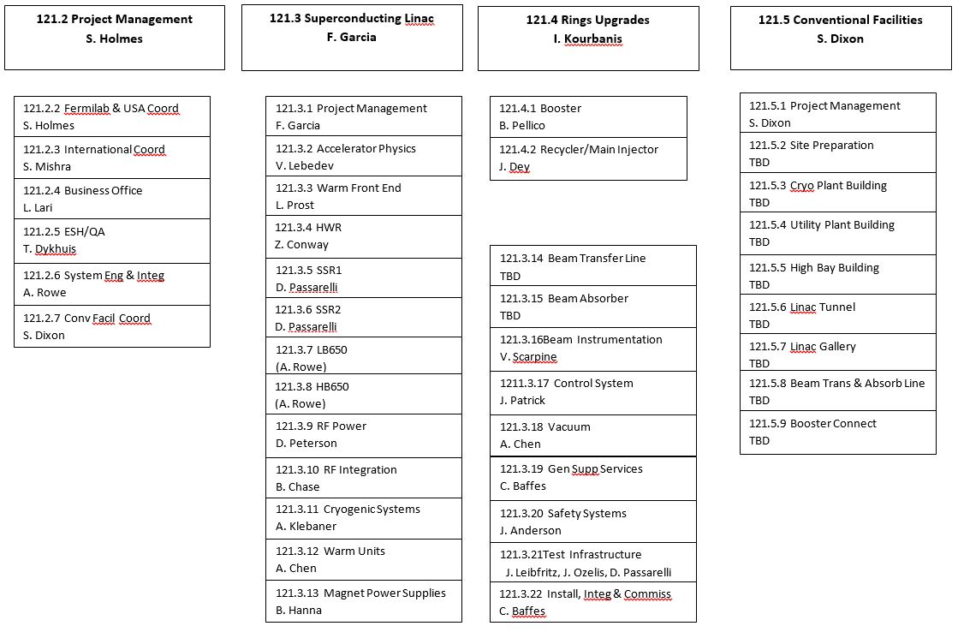
Organization
Charge #4
WBS 121.3 Superconducting Linac
121.3.3
Warm Front End
121.3.14
Magnet Power Supplies
121.3.12
Warm Units
121.3.14
Beam Transfer Line
121.3.15
Beam Absorber Line
121.3.18 Vacuum
121.3.19
Gen. Supt. Services
121.3.20
Safety System
121.3.22
Inst. Integ. Com.
121.3.21
Test Infrastructure
L. Prost
A. Chen
B. Hanna
TBD
TBD
in the interim
S. Mishra
A. Chen
C. Baffes
J. Anderson
C. Worel
J. Leibfritz
J. Ozelis
C. Baffes

Slide 13
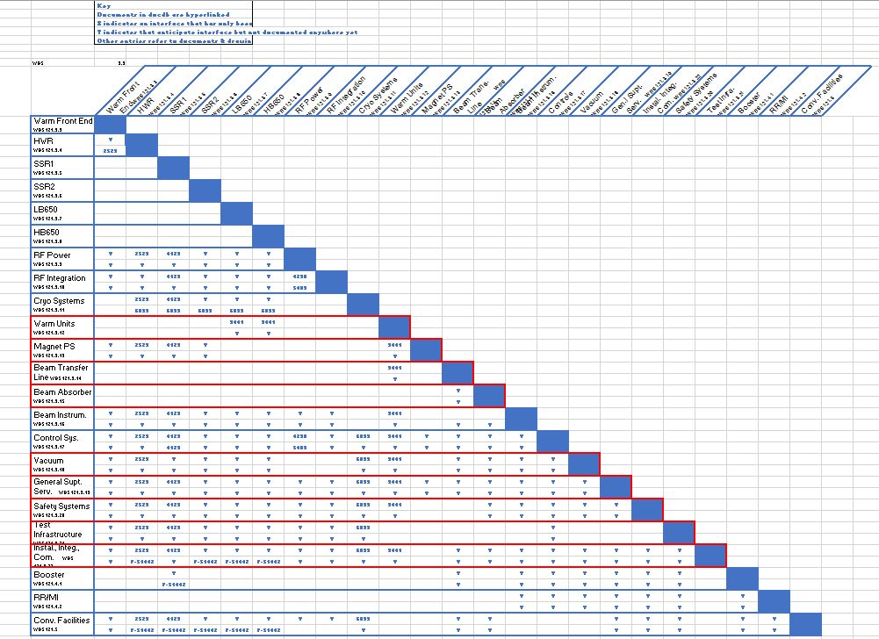
Interfaces
Charge #2
PIP-II Interface Matrix: pip2-docdb#1160
  Interface documents are kept in TeamCenter revision controlled/sign-offs routed
  Besides technical interfaces some WBS also have an international partner interface
Warm Units
Magnets
Beam Trans. Line
Beam Abs. Line
Vacuum
Gen. Supt. Serv.
Safety Systems
Test Infrastructure
Inst. Integ. Com.

Slide 14
Interfaces
Charge #2
PIP-II Interface Matrix: pip2-docdb#1160
  Interface documents are kept in TeamCenter revision controlled/sign-offs routed
  Besides technical interfaces some WBS also have an international partner interface
Breakout talks
will discuss in more details the
top 4 interfaces with a single WBS
Warm Units
Magnets
Beam Trans. Line
Beam Abs. Line
Vacuum
Gen. Supt. Serv.
Safety Systems
Test Infrastructure
Inst. Integ. Com.

Slide 15

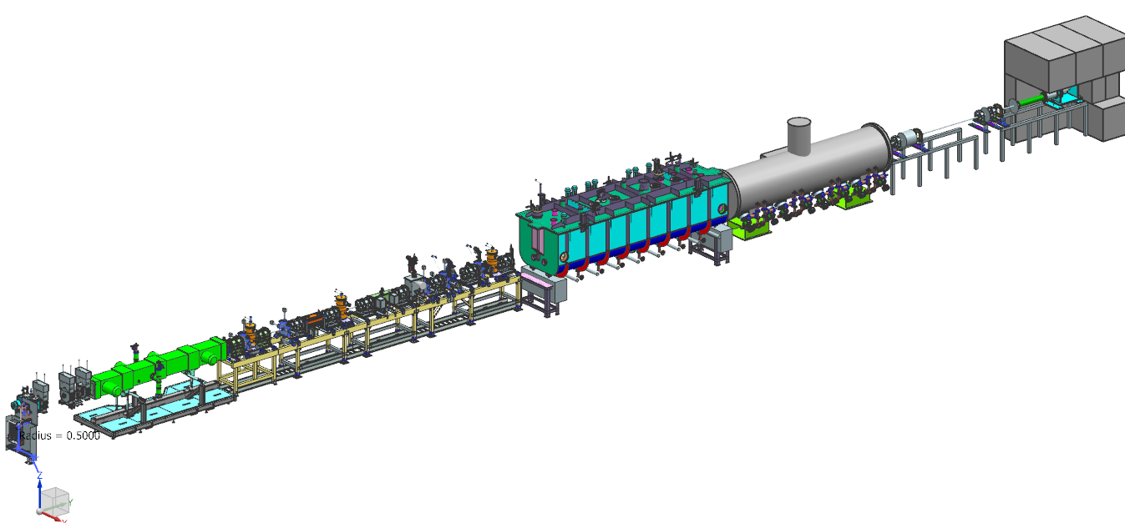


Progress to date: Warm Front End (121.3.3)
Charge #2
Prost
Almost full scale PIP-II 2.1 MeV normal conducting front-end
Support HWR and SSR1 CM commissioning with beam
HEBT
Lots of progress made so far!
SSR1
- understood
|
| See slide
| for risks
HWR
- on-going
- not yet installed
MEBT
25 MeV
Source
LEBT
RFQ
10 MeV
40 m
2.1 MeV
Next several years testing additional
systems: vacuum, ODH, Safety Systems
30 keV
Various key systems verified/tested up to date

Slide 16
Progress to date: Warm Units, Magnet Power Supplies & BTL/BAL, Vacuum (121.3.12-15,18)
Charge #2
Hanna
WarmU, MagPS, BTL, BAL, V
  Warm Units
    Analysis on magnet field and thermal engineering analysis complete
  Magnets Power Supplies
    Preliminary design progressing on various sub-systems with internal reviews being carried out or complete (QPM); tests being performed on power plugs
  BTL & BAL
    Conceptual design developed which identifies magnets specifications and beamline diagnostic insertions
  Vacuum
    Activities mainly on installation of vacuum system at PIP2IT and developing design details of the remaining systems
12/12/17

Slide 17
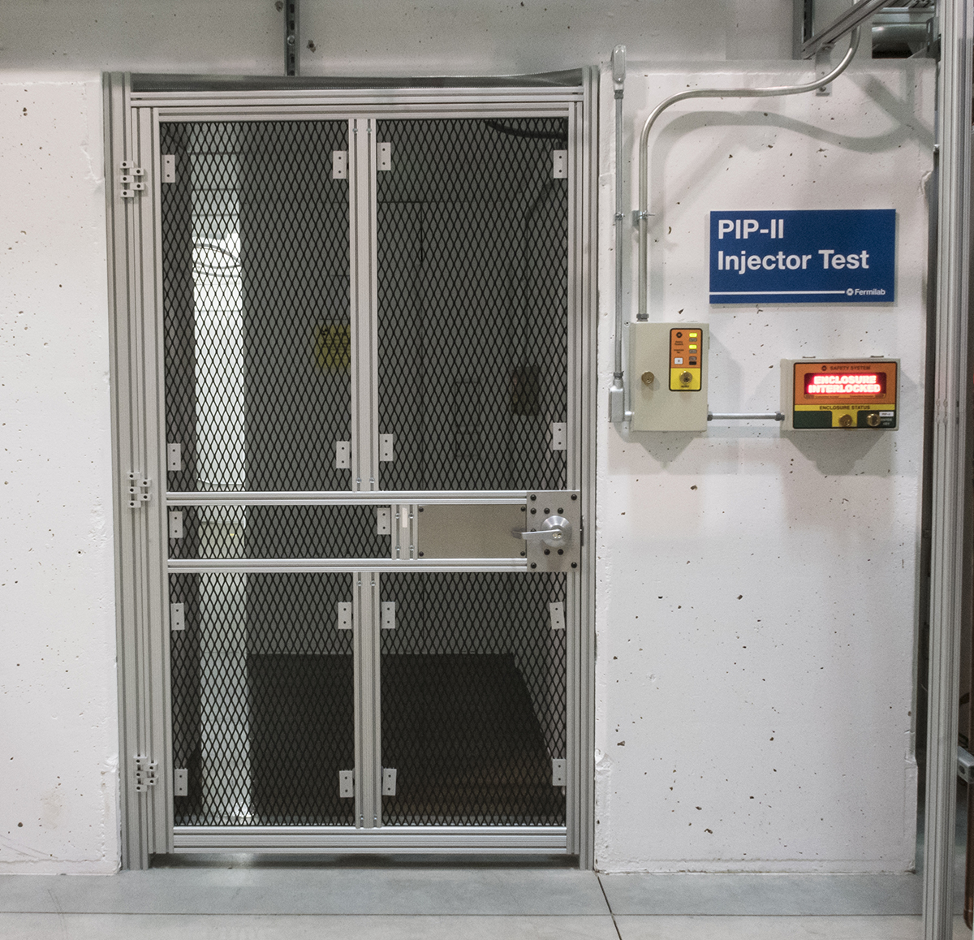
Progress to date: Safety System (121.3.20)
Charge #2
Safety System
  PIP2IT RSIS is in operational mode
  Near future plans are understood to expand
  the system to support PIP2IT schedule – for
  instance expand the ODH monitoring system
  to accommodate cryomodules testing
Breakout
see Worel’s talk
Progress to date: GSS & II&C (121.3.19,22)
GSS & II&C
  Preliminary plan developed for both GSS and II&C including support documentation
    Plans formulated from recent FNAL installation experience with PIP2IT and LCLS-II installation at CMTS
see Baffes’ talk

Slide 18
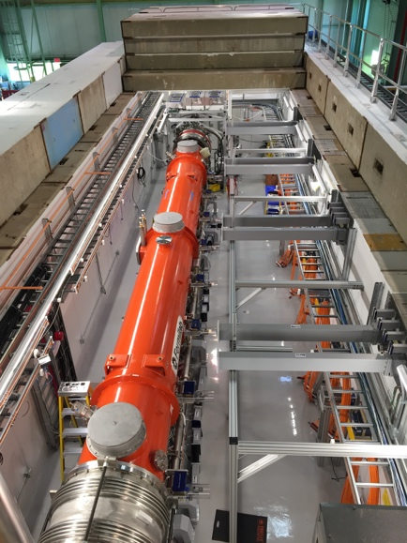
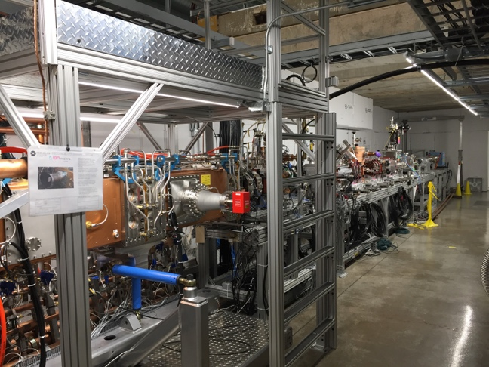
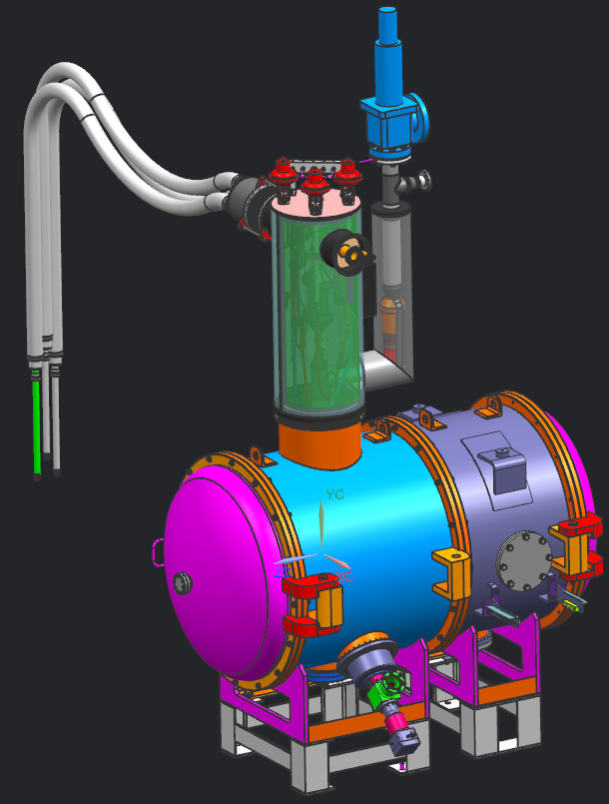
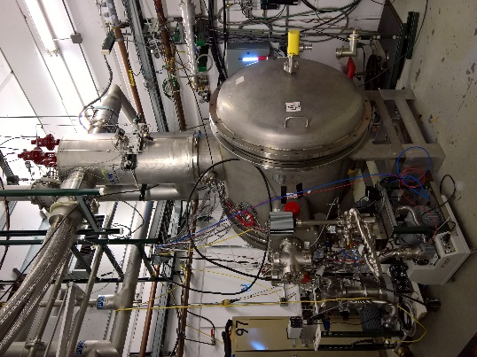
Progress to Date: Test Infrastructure (121.3.21)
Charge #2
Test Infrastructure:
Leibfritz
  CMTS1: CMTF
  (Cryo Module Test Stand #1 @ Cryo Module Test Facility)
  Operational test stand
  RF-cryomodule without beam
  Current used for LCLS-II cm testing
  Future plans: reconfigure facility for 650 MHz CM testing
Operational
  PIP2IT: CMTF
  (PIP2 Injector Test @ Cryo Module Test Facility)
  Nearly full-scale PIP-II front-end test with beam
      2.1 MeV, 10mA, 1.75msec, 20 Hz
  Future plans: HWR and 1st SSR1 CM will be tested with beam ->SSR2 RF-cryomodule test w/o beam
Demonstrated
  STC: MDB
  (Spoke Test Cryostat @ Meson Detector Building)
  Demonstrate dressed cavity performance
  Current used for testing SSR1 cavities for CM1
  Future plans: cavity testing for SSRs and HB650 -> require extension to cryostat to accommodate cav.
Operational

Slide 19
Next Steps toward CD-2
Charge #3
Finalize L3 manager and CAM assignments
Complete remaining design work for the L3 systems
Complete interface specifications between L3 systems
Complete Technical Requirement Specifications as required
Perform design reviews to ensure the subsystems are fully integrated and satisfy the performance requirements
Finalize cost/construction schedule for the individual L3 systems
  Further develop the installation plan in close collaboration with L3 work packages to improve the process and optimize the installation sequence – identify tasks that can be run in parallel

Slide 20
ESH&Q
Charge #5
PIP-II work being executed at many institutions: authority and responsibility for safety is with institutions where work is conducted
Fermilab has the responsibility to assure that all equipment installed and operated at the laboratory complies with Fermi ES&H Manual (FESHM) and pass through Operational Readiness Clearance (ORC) review
PIP-II activities will follow the Project Integrated Safety Management Plan (pip2-docdb#141)
  Partner deliverables are required to meet Laboratory Safety Standards
    Project Engineers work proactively with L3s and collaborating institutions to ensure necessary documentation is prepared
Quality Assurance and Control
  Responsibility with L3s: technical design and construction reviews
  Project Quality Assurance Plan (pip2-docdb #142)
  Communicate and work with vendors and collaborators

Slide 21
Charge #3
Risk: Linac Support System, Installation and Com.
Machine performance problems during commissioning
MEBT kickers performance is unsatisfactory
Unable to maintain proper vacuum between MEBT absorber and SRF
MEBT Absorber does not meet performance requirement
LCW system does not achieve temperature stability requirements

Slide 22
Risk Mitigation: Machine performance problems during commissioning
Charge #3
This is a technical risk with a high impact to schedule & cost
Development plan (FY16-FY22) is planned to minimize the impact
  PIP2IT and CMTS1 will enable a variety of system-level tests to be performed on many critical systems providing opportunity for the majority of the issues to be identified and addressed long before the accelerator components are installed in PIP-II tunnel
  Perform cold RF-cryomodule test on all cryomodules
  Verification of RF power systems before and after installation
  Machine protection system is being developed and tested at PIP2IT
  First two cryomodules (HWR and one SSR1 cryomodule) will be tested with beam at PIP2IT before moving to PIP-II enclosure

Slide 23
Cost Summary – Level 3 – Linac
Charge #3

Slide 24
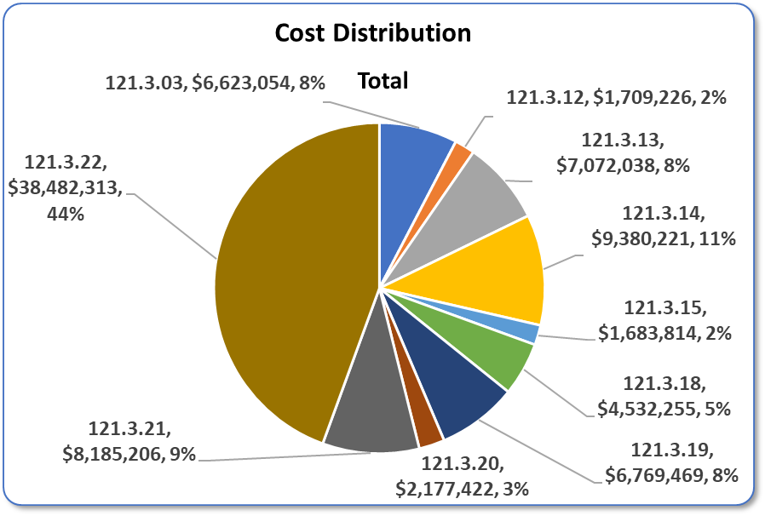
Cost Distribution – Level 3
Charge #3
WFE
WarmU
MagnPS
IIC
BTL
BAL
Vacuum
GSS
TI
SS
P6 Base Costs = BOE + Overheads + Escalation

Slide 25
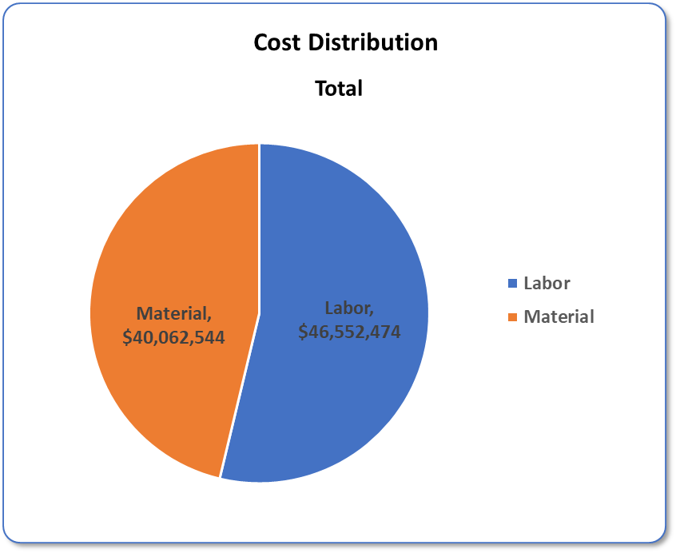
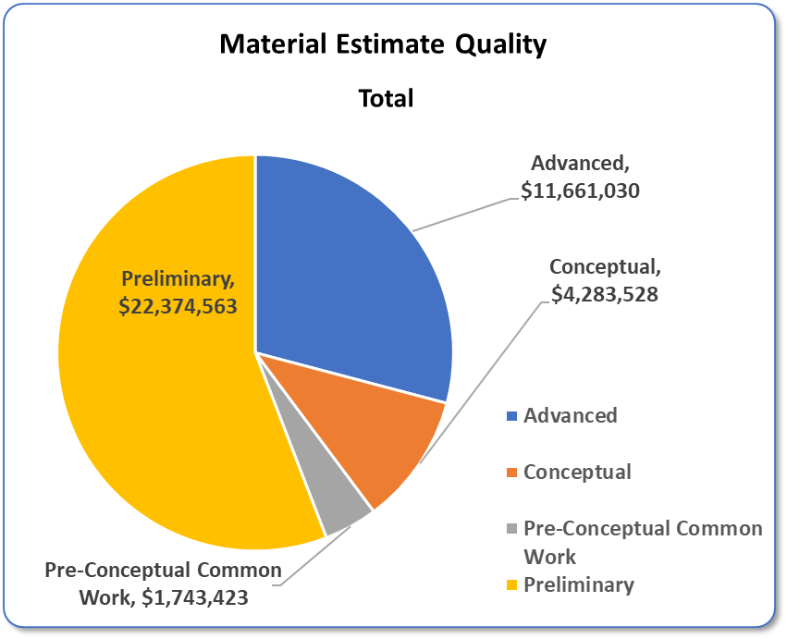
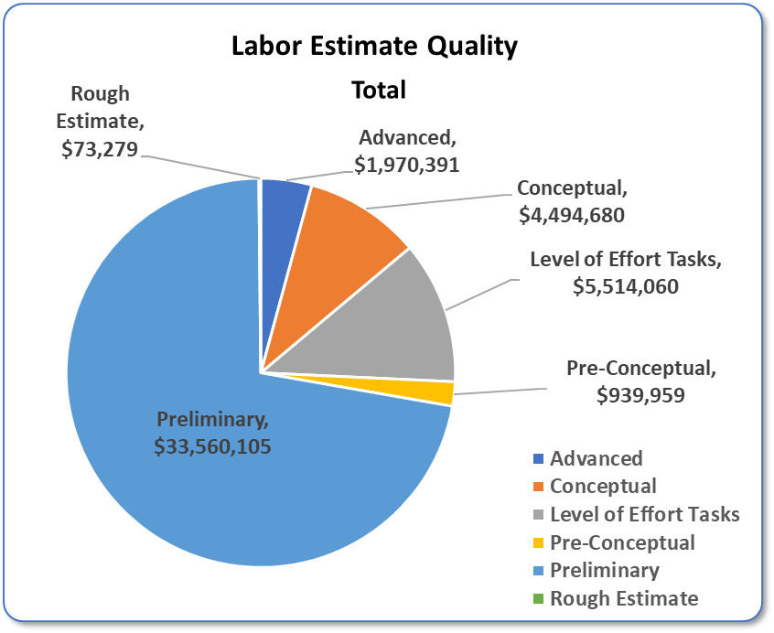
Cost Distribution – Estimate Quality
Charge #3
46% Material
54% Labor
85% Preliminary and Advanced Stage
P6 Base Costs = BOE + Overheads + Escalation
72% Preliminary Stage
Costs = BOE + Overheads + Escalation
Estimate Quality Categories are per Fermilab Standards and descriptions can be found in docdb item number 345

Slide 26
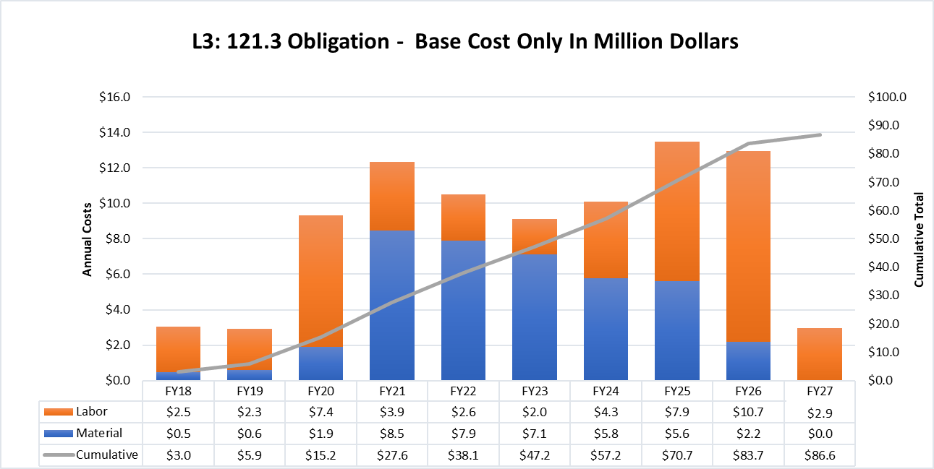
Obligation Profile – P6 Base Cost Only
Charge #3
P6 Base Costs = BOE + Overheads + Escalation
Labor peaks in FY20 to complete final design efforts and also activities related with beam in the WFE session
Procurement peaks after CD-3
Second labor peaks in after FY24 associated with installation & commissioning
Notes:
FY20 – CD-2

Slide 27
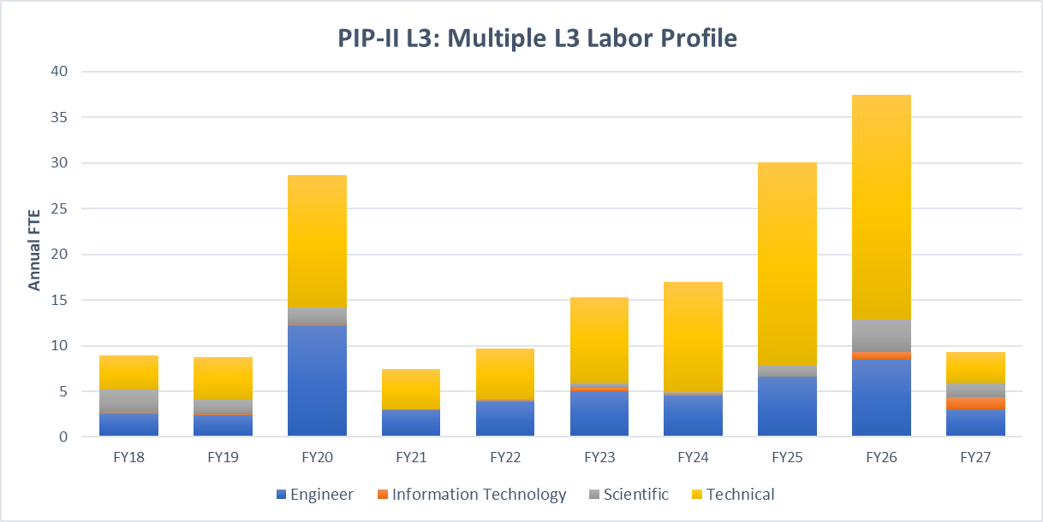
Labor Profile – P6 Hours/FTE
Charge #3
Labor is dominant by engineer and technical skills
Scientists contribution increases during beam commissioning effort

Slide 28
High Level Master Schedule
Activities described are not in the critical path until reach the installation and commissioning

Slide 29
Breakout Sessions
Breakouts
Breakout Session: Accelerator Support Systems
Tuesday, December 12
15:15 | PIP2IT Plans and Accomplishment ………………………………... | A. Shemyakin
15:45 | 121.3.21 Linac – Test Infrastructure…………………...…………… | J. Leibifritz
16:15 | 121.3.19 Linac – General Support Systems………………………. 121.3.22 Linac – Installation and Integration and Commissioning | C. Baffes
Wednesday, December 13
8:00 | 121.3.3. Linac – Warm Front End…………………………………... | L. Prost
8:30 | 121.3.13 Linac – Magnet Power Supplies 121.3.12,18 Linac – 650 Warm Units, Vacuum Systems………... 121.3.14,15 Linac – Beam Transfer Line, Beam Absorber | B. Hanna
9:10 | 121.4.1 Booster………………………………………………………. | W. Pellico
9:40 | 121.3.20 Linac – Safety Systems…………………………………... | C. Worel
10:10 | Available for Drill Downs
in Curia-II
WH 2SW
in Curia-II
WH 2SW

Slide 30
Summary
Requirements are defined and understood for these elements
Conceptual design is sound and meets the requirements
  PIP2IT beam operation
    Demonstrated requirements
    Test bed for continued work
  Many based on similar systems/facilities in operation at Fermilab
    Test Infrastructures, vacuum, cooling systems
Cost, schedule, and risks are understood
  Not on critical path (until beam commissioning)
Safety is the number 1 priority
  ESH&Q has been properly addressed given the project’s current stage
  Continue to maintain constant vigilance
We are ready for CD-1 and look forward to your feedback

Slide 31
Linac Accelerator Support Systems
Installation and Commissioning
(WBS 121.3.3,12-15,18-22)
Fernanda G. Garcia
PIP-II Independent Project Review
12-14 December 2017

