Slide 1
Conventional Facilities (WBS 121.5)
Steve Dixon
PIP-II Independent Project Review
12-14 December 2017

Slide 2
Outline
Requirements
Conceptual Design, Maturity
Scope/Deliverables
Organization
Interfaces
Technical Progress to Date
Design Review Plan
Plan for CD-2/Preliminary Design
ESH&Q
Risk
Cost
Schedule
Breakout Session topics
Summary

Slide 3
About Me:
PIP-II Associate Project Manager for Conventional Facilities
Relevant Experience
  Licensed Architect;
  Project Management Professional (PMP);
  LEED Accredited Professional;
  25+ years at Fermilab;
  NOvA Project L2 Manager for Site and Buildings;
  General Plant Project Manager for 15+ years
    Short Baseline Neutrino (SBN) Near Detector Building;
    Short Baseline Neutrino (SBN) Far Detector Building;
    CDF Refurbishment;
    Experimental Operations Center;

Slide 4
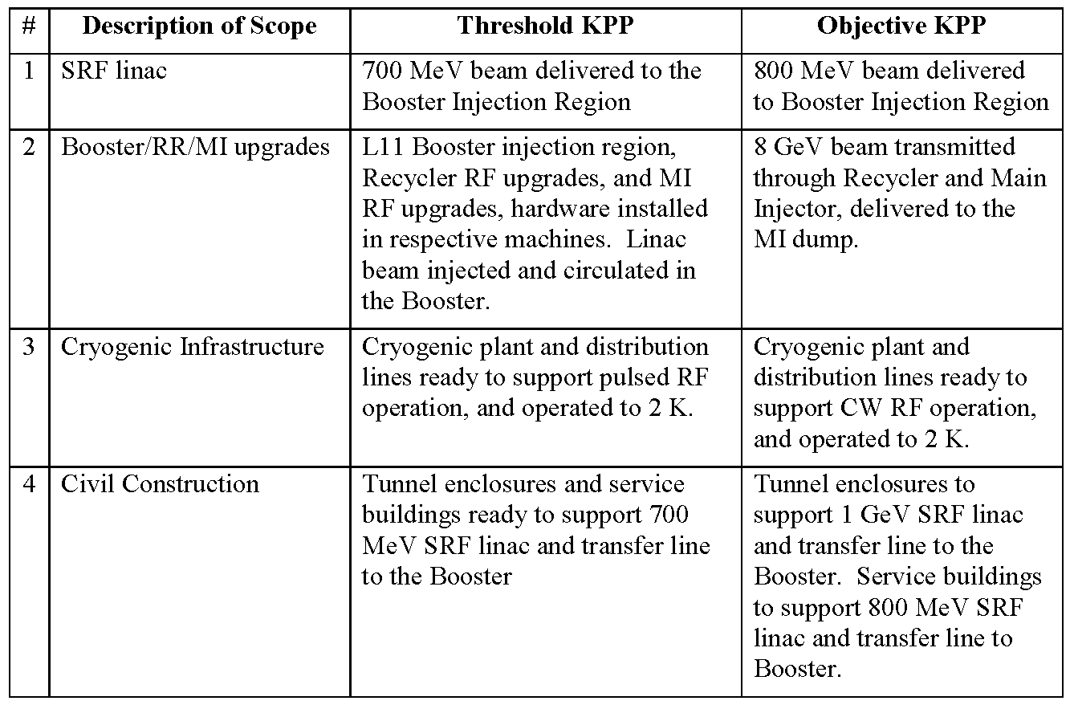
Conventional Facilities Requirements
Charge #2
Key Performance Parameters (KPP):
Threshold and Objective KPP met with Base Design;
  KPP from PIP-II Preliminary Project Execution Plan (PIP-II-doc-115)

Slide 5
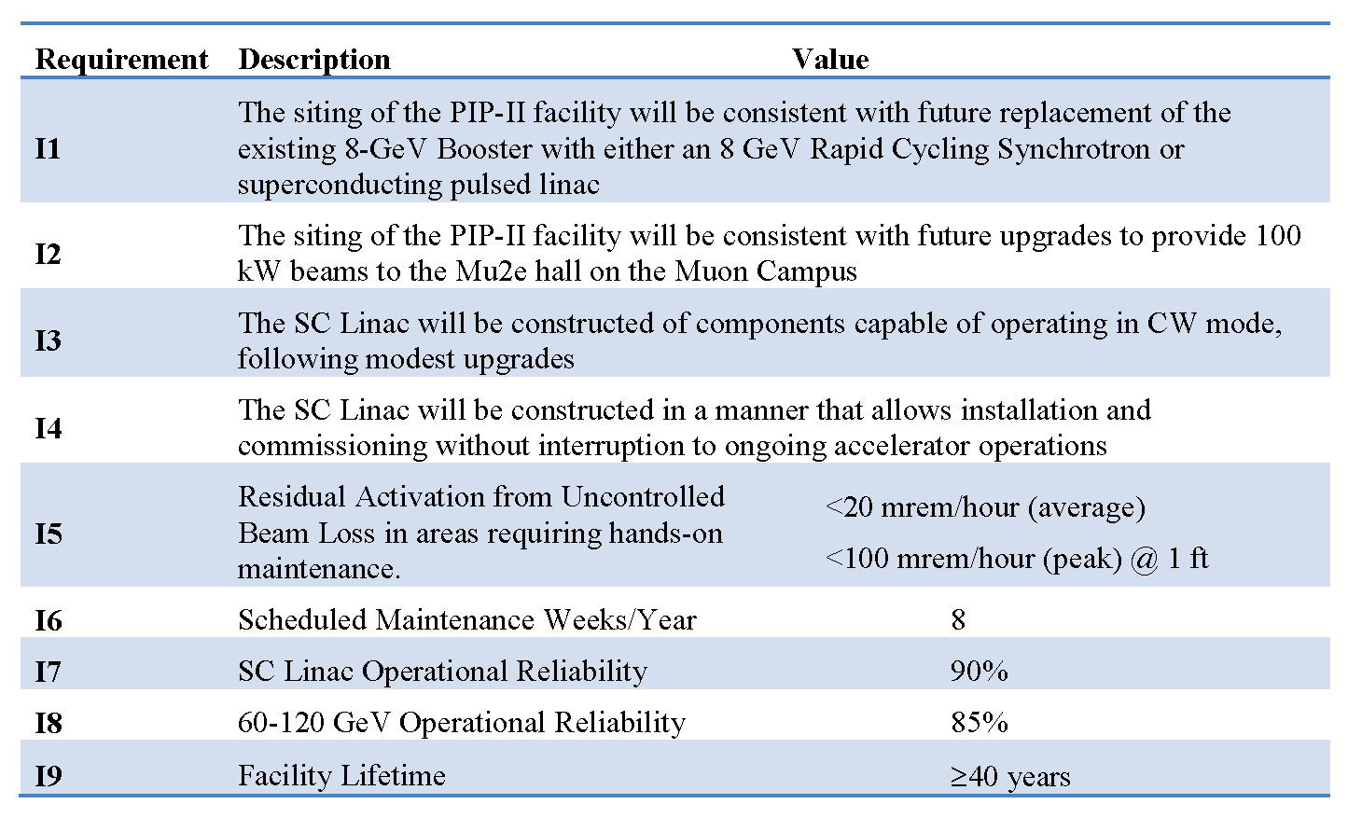
Conventional Facilities Requirements
Charge #2
Functional Requirements Specification: [1]
  Section 5
“Associated conventional facilities including enclosures, equipment galleries, and utilities. The linac enclosure will be constructed with a length to accommodate two HB650 cryomodules beyond the nominal compliment required for 800 MeV.”
  Section 6
Conventional Facilities
Related requirements
  [1] – PIP-II Functional Requirements Specification can be found in PIP-II-doc-1166 ( TeamCenter ED0001222)

Slide 6
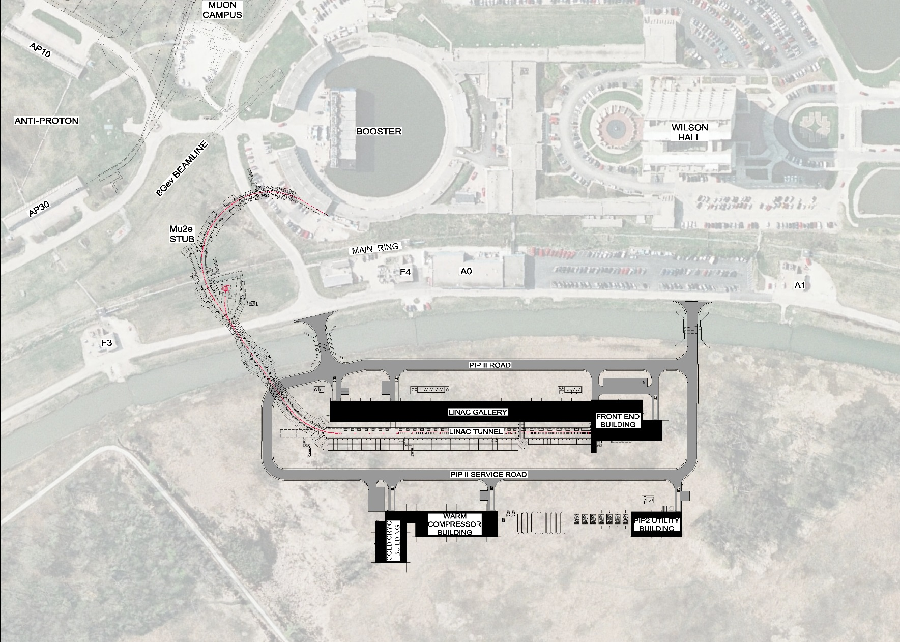
Conventional Facilities Overview
Charge #2
Work Breakdown Structure
121.5.2 Site Preparation
121.5.3 Cryo Plant Building
121.5.4 Utility Plant Building
121.5.5 High Bay Building
121.5.6 Linac Tunnel
121.5.7 Linac Gallery
121.5.8 Beam Transfer Line
121.5.9 Booster Connection
Booster Connection
Beam Transport Line
Linac Gallery
High Bay Building
Linac Tunnel
Cryo Plant Building
Utility Plant Building

Slide 7
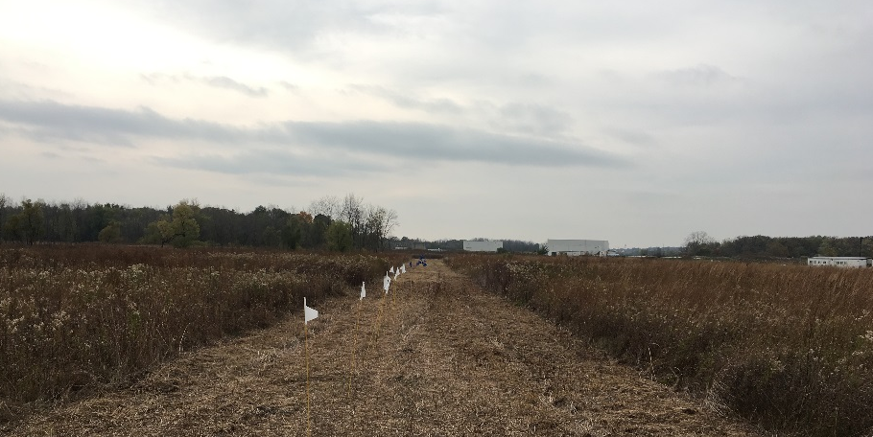
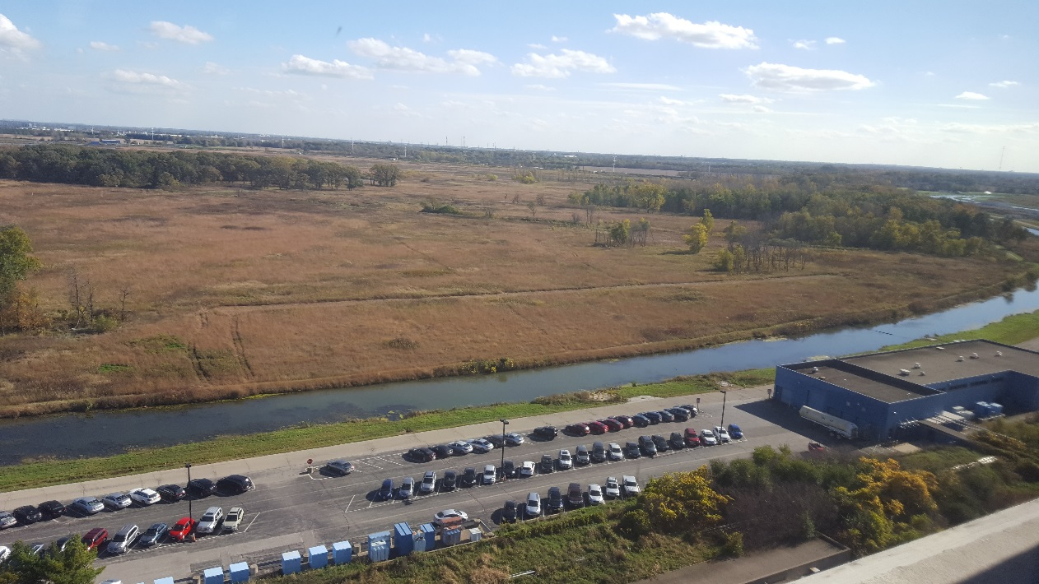
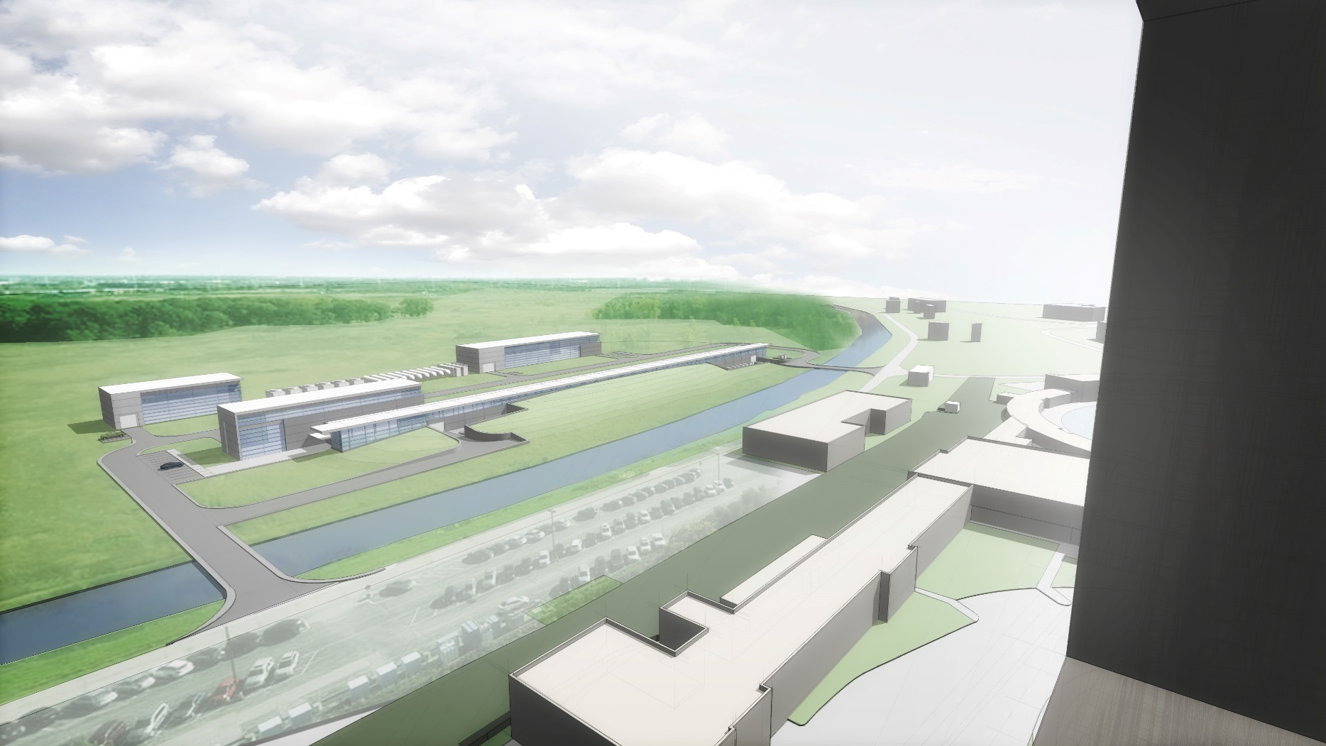
Conventional Facilities Overview
White Flags = Warm Components
Blue Flags = Cold Components
Linac
Looking South Along Beamline
AZero Service Building
Tevatron Enclosure Berm
Looking Southeast From Wilson Hall – Fall 2016
View from Wilson Hall

Slide 8
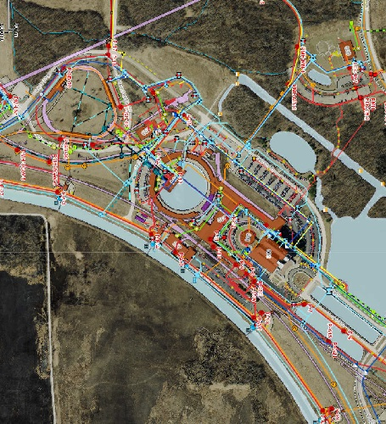
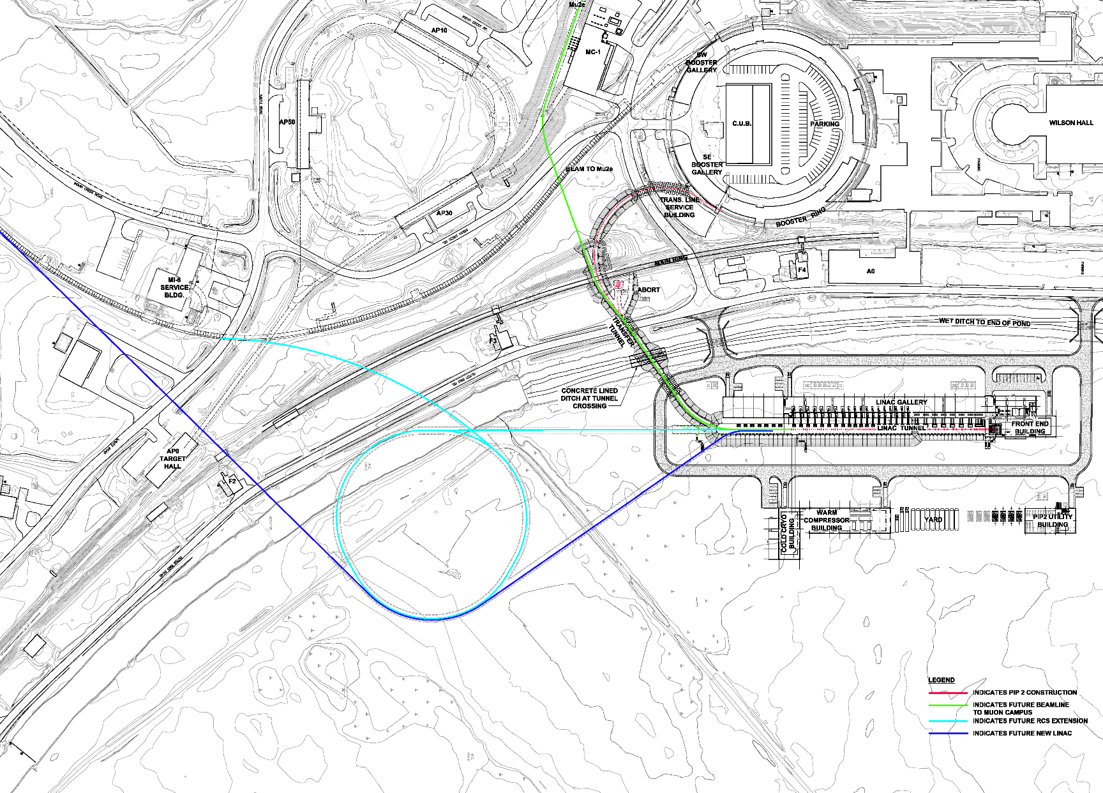
Siting Considerations
Charge #2
Existing Utilities
and Services
I2
I1
5
FRS Integration and Upgradability:
I1: Future RCS or Pulsed Linac
I2: Future 100 kW beam to Mu2e;
I4: Installation/Commissioning during ongoing operations
FRS Section 5 (Facility Scope):
Linac length to accommodate two (2) additional HB650 cryomodules

Slide 9
Conceptual Design and Design Maturity
Charge #2
Breakout Talk
Meetings with Stakeholders:
  Goal: Document the spatial and infrastructure requirements for PIP-II facilities; [2]
  Started in January 2016;
Results:
  Conceptual Design drawings and text that described the sizes/arrangement of spaces and buildings to accommodate the functional requirements; [3]
  Documented Cost Estimate Assumptions; [4]
  Life Safety Analysis; [5]
  Developed cooling strategies for pulsed mode and continuous wave operation that could be implemented in a modular fashion;
  Conventional facilities are similar to typical Fermilab construction;
  [2] – Meeting Minutes can be found in PIP-II-doc-70
  [3] – Conceptual Design Drawings can be found in PIP-II-doc-1155
  [4] – Assumptions can be found at PIP-II-doc-333
  [5] – Final LSA can be found at PIP-II-doc-120

Slide 10
Scope and Deliverables [6]
Charge #2
Breakout Talk
WBS 121.5.2 – Site Preparation Package
  This WBS covers procurement and management for all contracted labor, materials, tools, equipment, and services needed for the construction of the Site Preparation work scope. It describes the labor resources, materials and services necessary for management, organization, planning, oversight and engineering, design, inspection and administration (EDIA)
WBS 121.5.3 – Cryogenic Plant Building – 23,245 square feet
  This WBS covers procurement and management for all contracted labor, materials, tools, equipment, and services needed for the construction of the Cryo Plant Building work scope. It describes the labor resources, materials and services necessary for management, organization, planning, oversight and engineering, design, inspection and administration (EDIA).
WBS 121.5.4 – Utility Plant Building – 7,995 square feet
  This WBS covers procurement and management for all contracted labor, materials, tools, equipment, and services needed for the construction of the Utility Plant work scope. It describes the labor resources, materials and services necessary for management, organization, planning, oversight and engineering, design, inspection and administration (EDIA).
WBS 121.5.5 – High Bay Building – 21,275 square feet.
  This WBS covers procurement and management for all contracted labor, materials, tools, equipment, and services needed for the construction of the High Bay Building work scope. It describes the labor resources, materials and services necessary for management, organization, planning, oversight and engineering, design, inspection and administration (EDIA).
[6] – Descriptions from WBS Dictionary (PIP-II-doc-599)

Slide 11
Scope and Deliverables
WBS 121.5.6 – Linac Tunnel – 19,935 square feet
  This WBS covers procurement and management for all contracted labor, materials, tools, equipment, and services needed for the Linac Tunnel enclosure. It describes the labor resources, materials and services necessary for management, organization, planning, oversight and engineering, design, inspection and administration (EDIA).
WBS 121.5.7 – Linac Gallery – 32,905 square feet
  This WBS covers procurement and management for all contracted labor, materials, tools, equipment, and services needed for the Linac Gallery. It describes the labor resources, materials and services necessary for management, organization, planning, oversight and engineering, design, inspection and administration (EDIA).
WBS 121.5.8 – Beam Transfer Line – 14,435 square feet
  This WBS covers procurement and management for all contracted labor, materials, tools, equipment, and services needed for Beam Transfer Line enclosure. It describes the labor resources, materials and services necessary for management, organization, planning, oversight and engineering, design, inspection and administration (EDIA).
WBS 121.5.9 – Booster Connection – 7,750 square feet
  This WBS covers procurement and management for all contracted labor, materials, tools, equipment, and services needed for Booster Connection. It describes the labor resources, materials and services necessary for management, organization, planning, oversight and engineering, design, inspection and administration (EDIA).

Slide 12
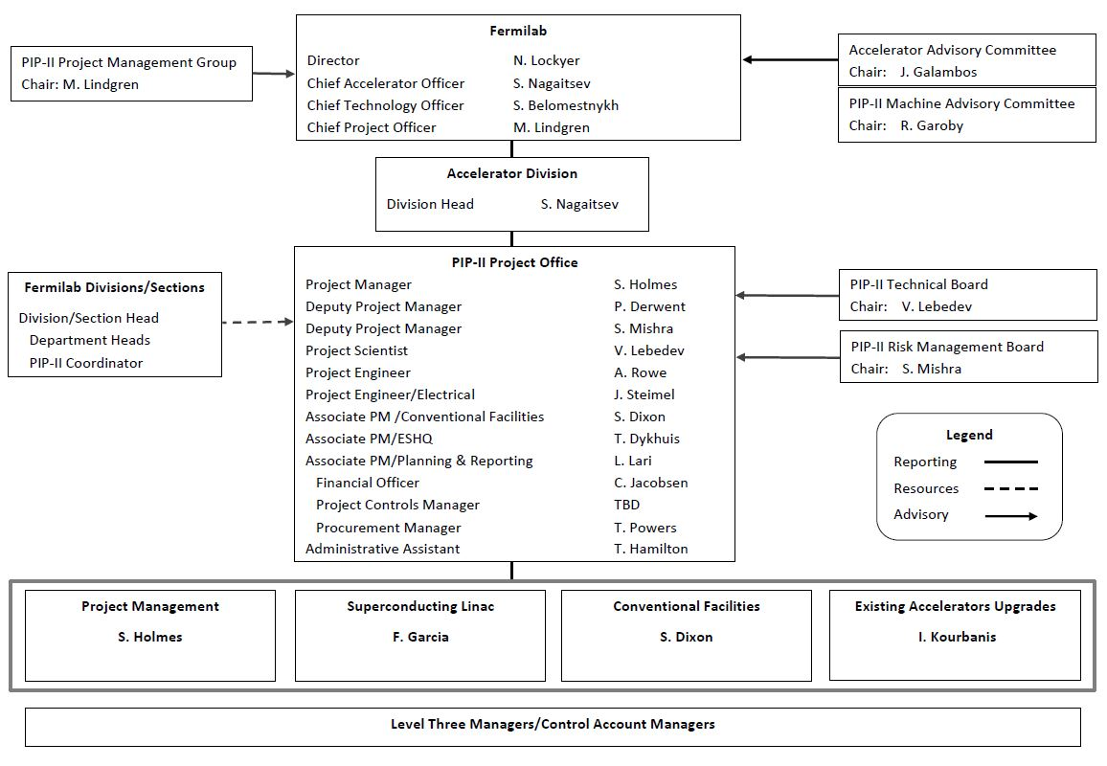
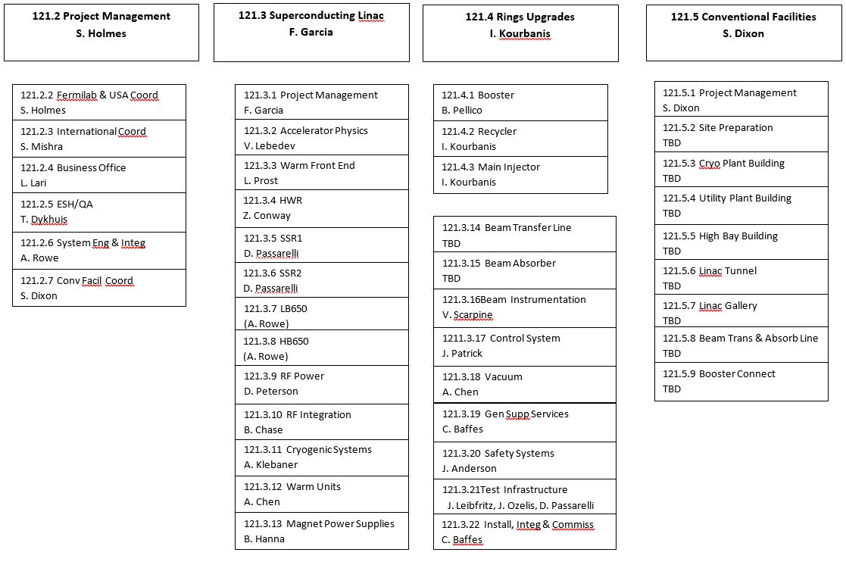
Organization
Charge #4
Breakout Talk

Slide 13
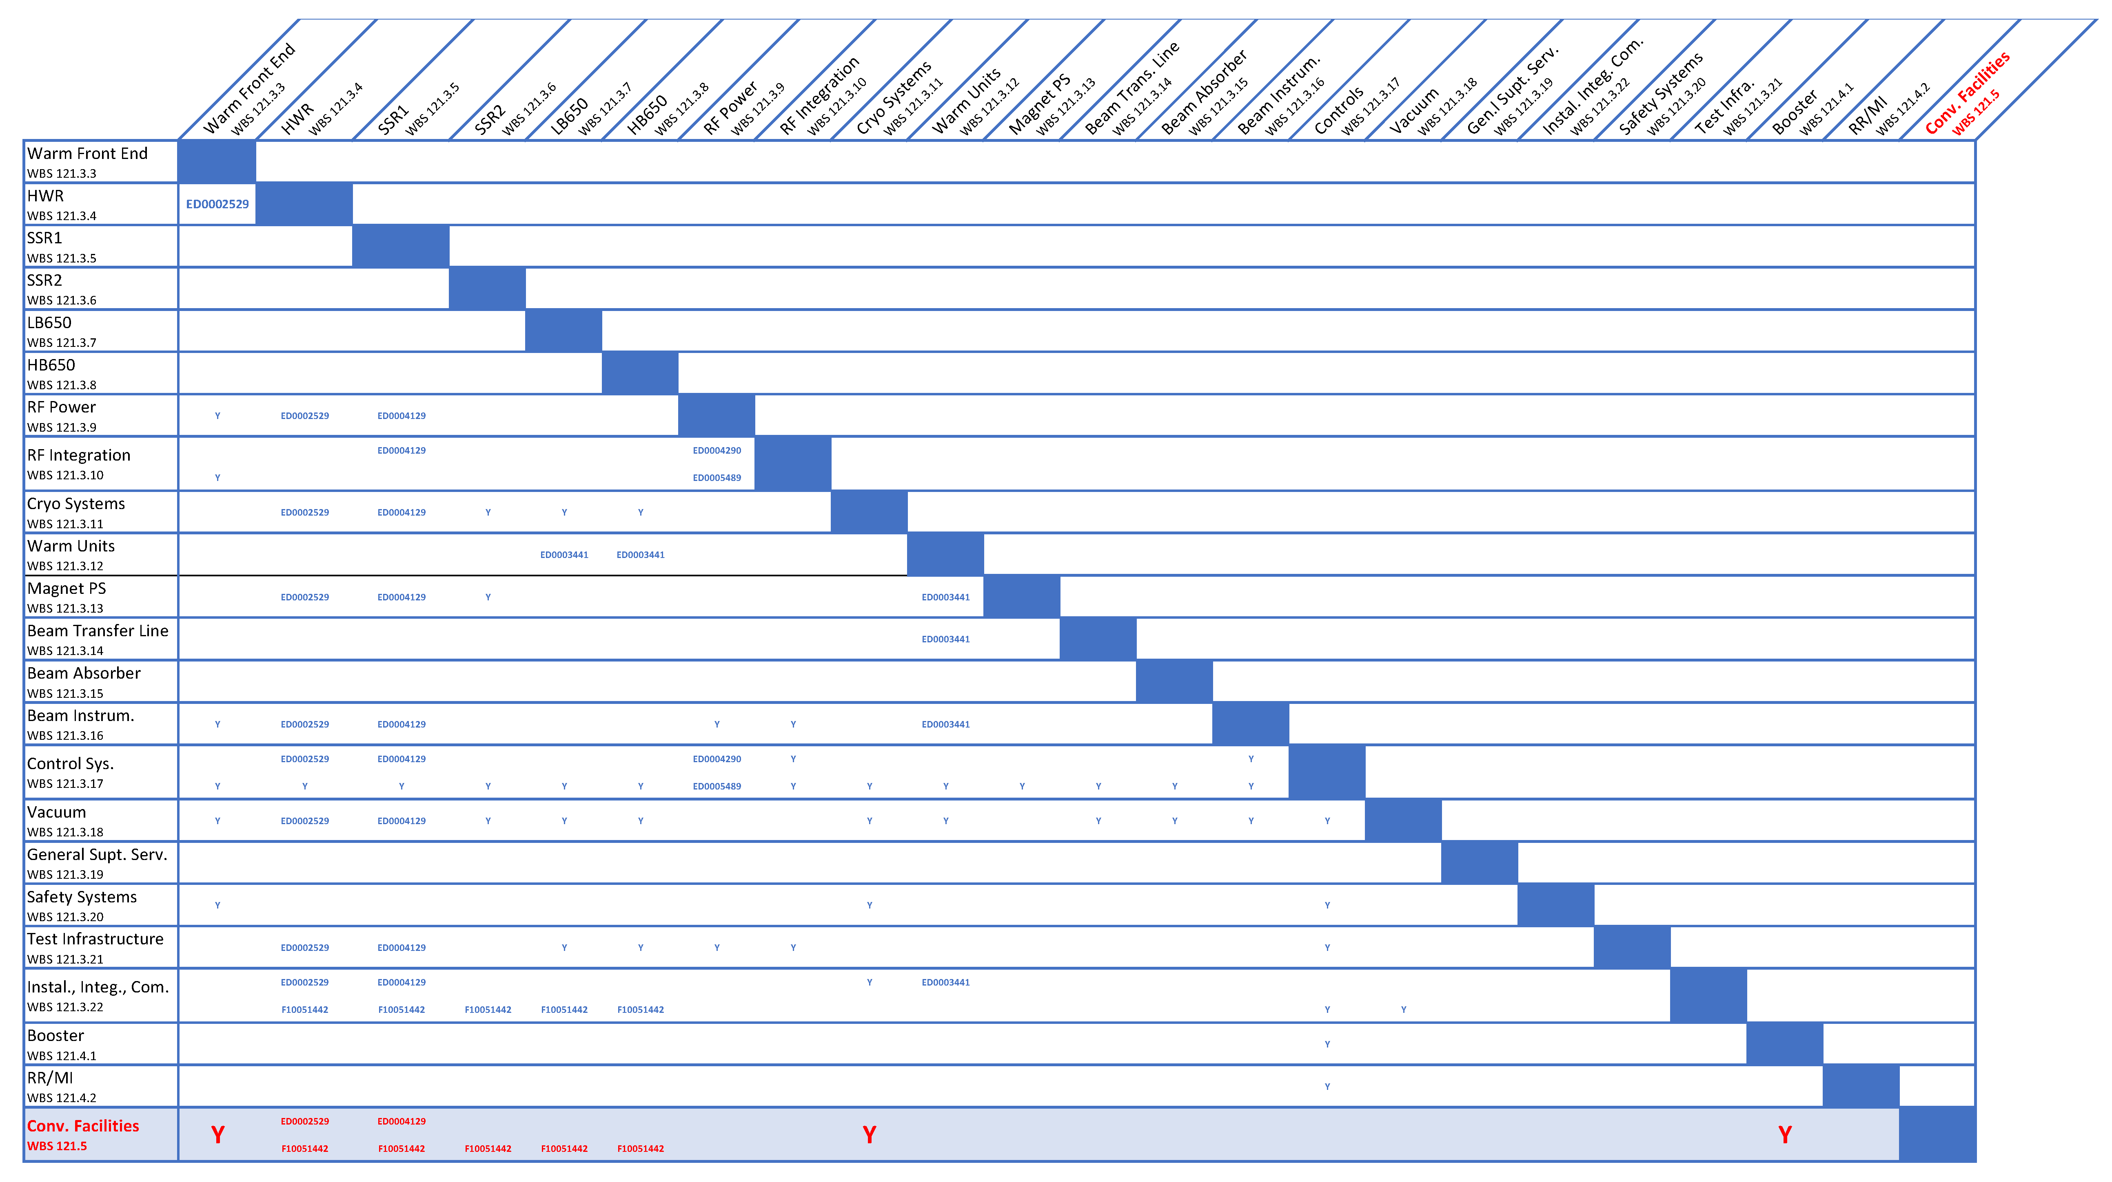
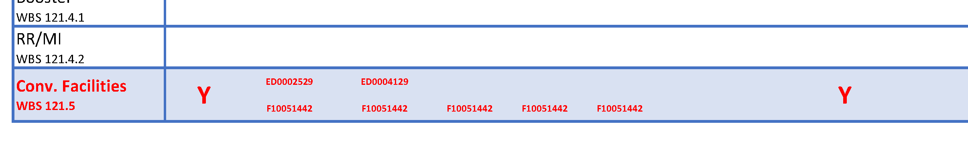
Interfaces – Other Subprojects
Charge #2

Slide 14
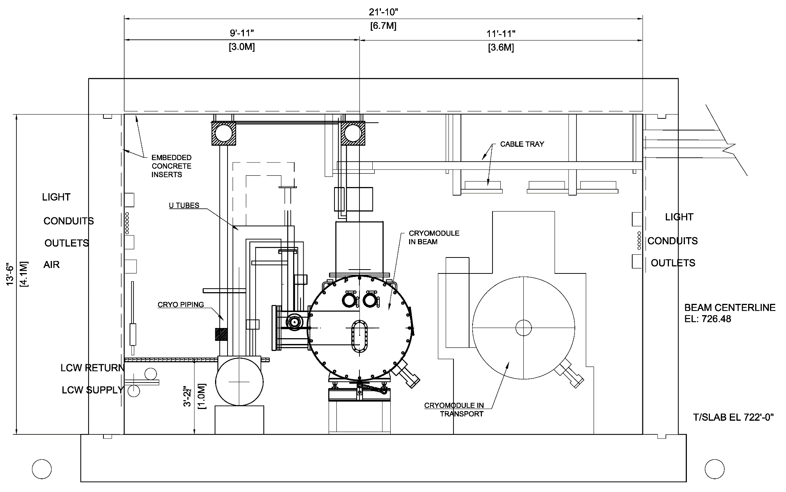
Interfaces – Linac Tunnel Cross Section
1’-10”
Aisle
LCW Zone
1’-10”
Aisle
RF Zone

Slide 15

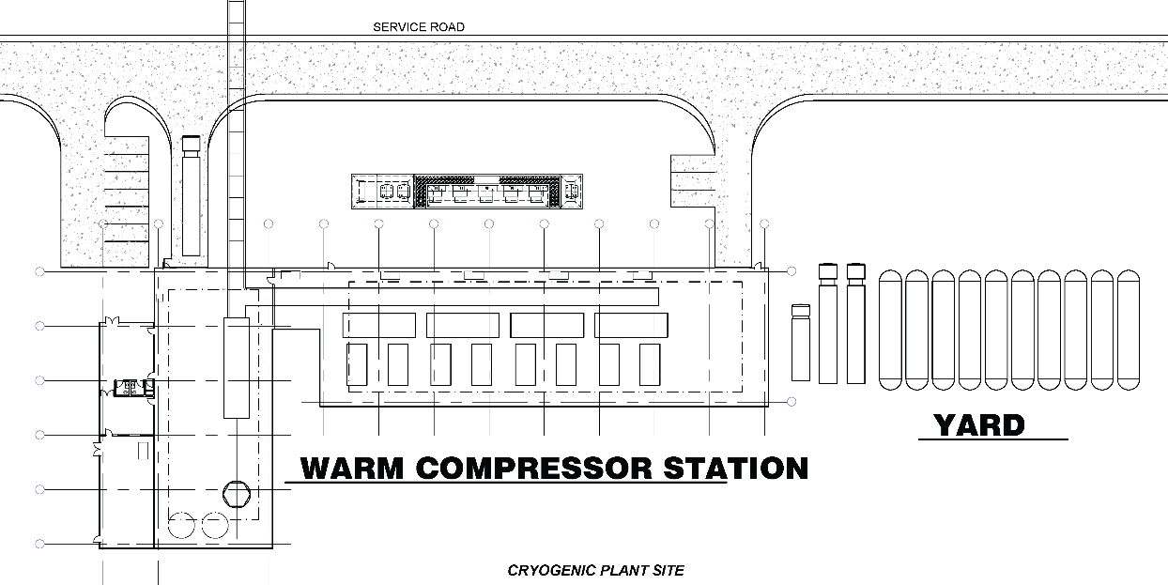
Interfaces – International Partners
Charge #7
Cryoplant equipment is part of the Indian contribution;
Involved in the development of conceptual design;
Interface is through 121.3.11 (Cryogenics subproject);

Slide 16
Progress to Date
Charge #3
Conceptual Design:
  Conceptual Design Report Text;
  Conceptual Design Drawings;
  Life Safety Analysis;
  Construction Cost /Schedule Estimate [7, 8]
  Selected Architect/Engineering firm;
  Supported Analysis of Alternatives; [9]
  Supported NEPA Process;
  Prepare for CD-1
  Resource Loaded Schedule
  Basis of Estimates
  Documentation
  Risk Analysis
Breakout Talk
Breakout Talk
Breakout Talk
  [7] – Construction Cost Estimate can be found in PIP-II-doc-333
  [8] – Construction Schedule Estimates can be found in PIP-II-doc-581
  [9] – Analysis of Alternates can be found at PIP-II-doc-107

Slide 17
Design Review Plan
Charge #3
Completed Reviews/Presentations
  Conceptual Design Drawings (September 2016);
  CD Independent Project Status Review (November 2016);
  PIP-II Machine Advisory Committee (P2MAC) (March 2016, April 2017);
  FESS Presentation (March 2017);*
  ESH&Q Presentation (May 2017);*
  Tritium Task Force Presentation (June 2017);*
  FESS/Roads and Ground Presentation (November 2017);*
  Functional Requirement Specifications/Technical Requirement Specifications;
Planned Reviews
  Independent Cost/Schedule Estimate;
  Constructability Reviews;
  60% and 90% complete reviews of each construction package;
[*] – These presentations can be found in PIP-II-doc-587

Slide 18
Next Steps toward CD-2/3a
2018
  Subsurface Investigation;
  Value Engineering Exercise;
  Finalize Interfaces with other sub projects;
  Detailed Design for WBS 121.5.2 – Site Preparation
Prior to CD-2/3a
  Finalize L3 manager and CAM assignments;
  Independent Cost/Schedule Estimate;
  Constructability Review;

Slide 19
ESH&Q - Overview
Charge #5
Consider and plan for ESH&Q issues throughout the project life cycle;
Conceptual Design Phase
  Provided conventional facilities specific input to ESH&Q documents;
  Life Safety Analysis [10] completed for conceptual design;
  Considered ESH&Q in architect/engineer selection process;
[10] – Final LSA can be found at PIP-II-doc-120

Slide 20
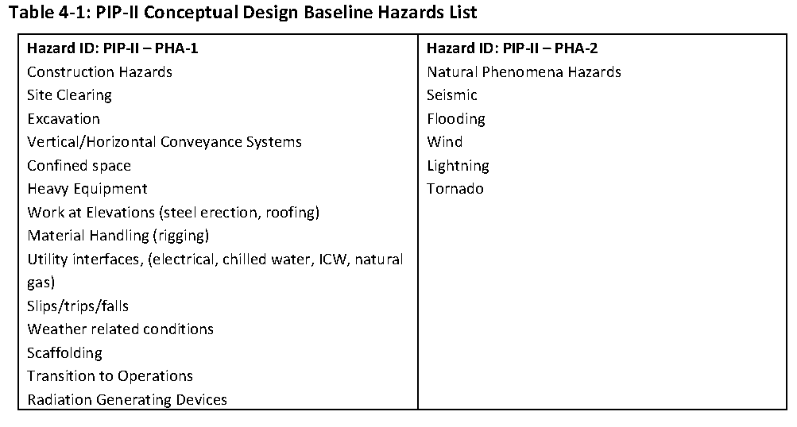
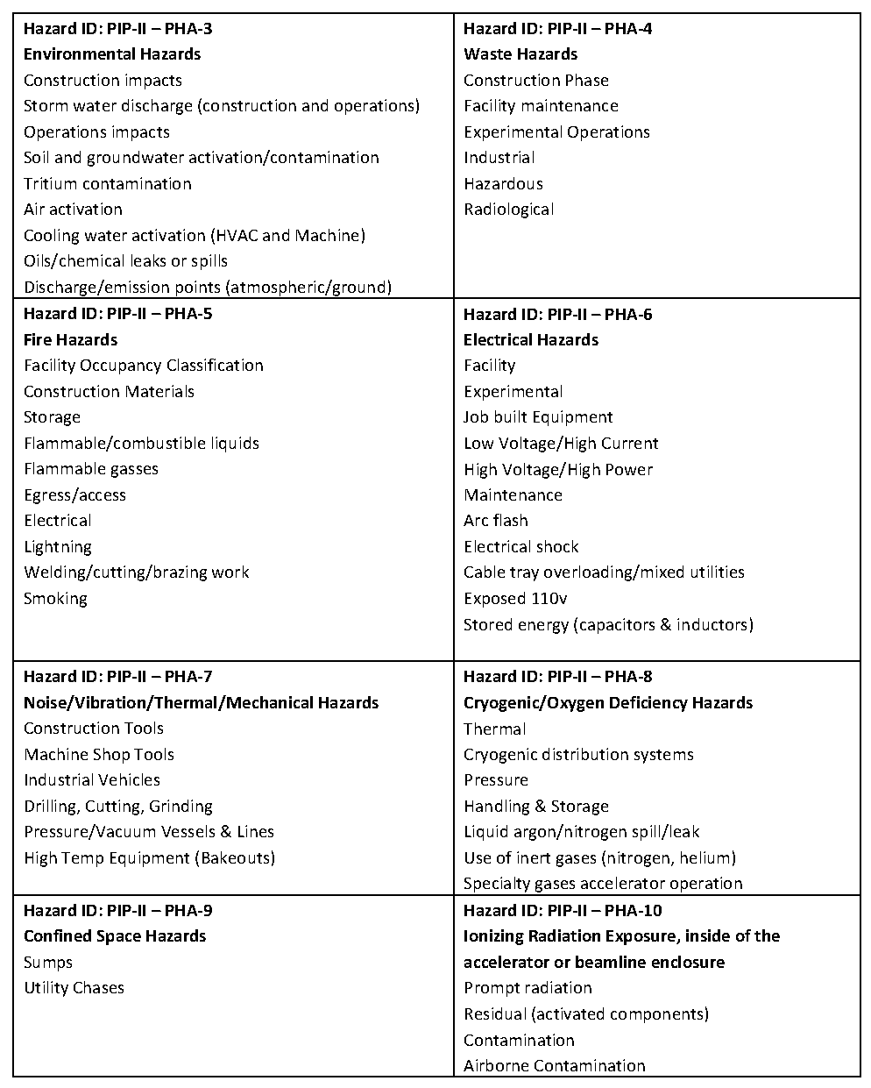
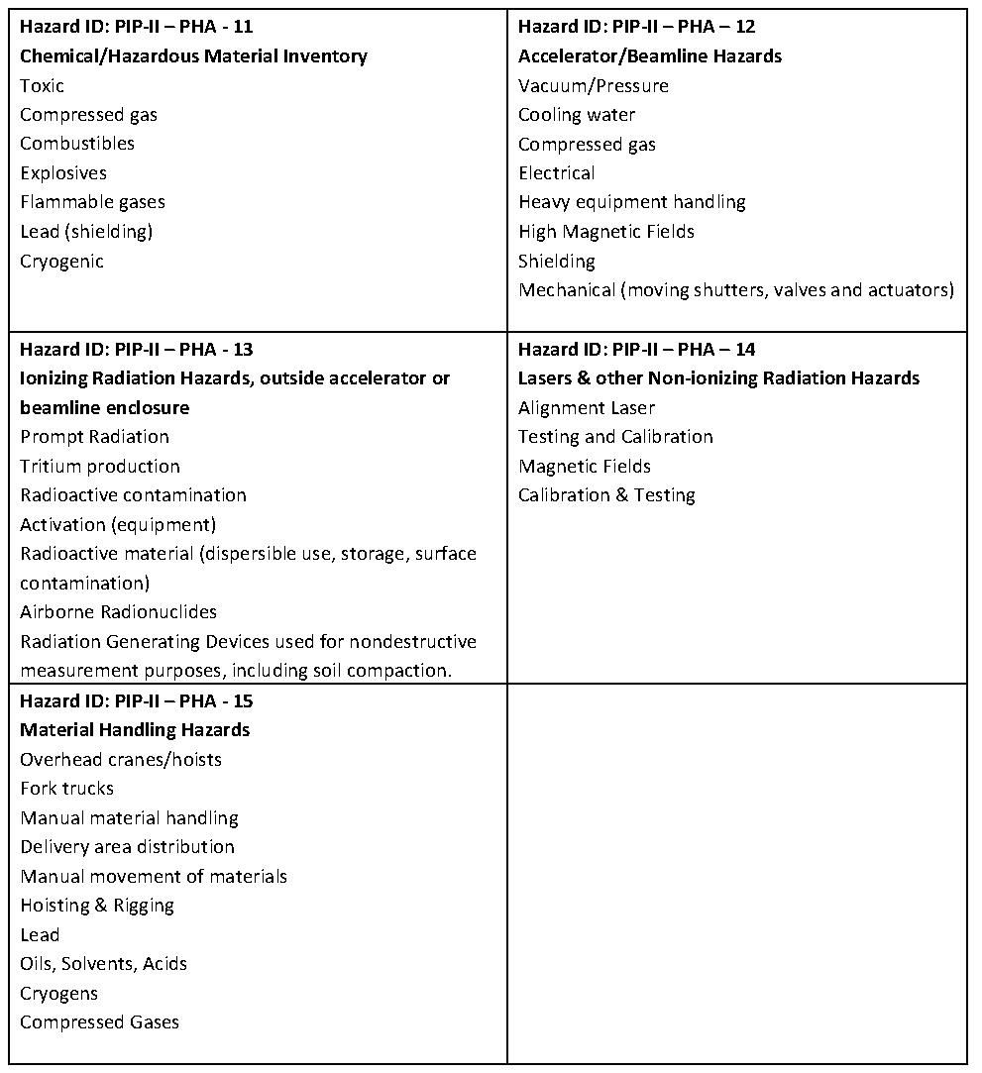
ESH&Q - Hazards
Preliminary Hazard Analysis Report (PHAR) [11]
  s
Design inputs
Conventional construction hazards are “Moderate” risk.
Addressed in design, procurement and construction processes.
[11] – PHAR can be found in PIP-II-doc-140

Slide 21
ESH&Q – Construction Safety
Goal: Zero Accidents/Lost Time Incidents
Incorporate safety during the design process:
  FESHM 7010 (July 2017) requirement for constructability review “including ES&H issues” no later than 60% design completion:
  Component of planned constructability reviews;
Incorporate safety during the procurement process:
  Include safety performance as part of the selection process;
  Experience Modification Rate (EMR) of less than 1 and 3 year safety record for =< 85% of General Construction stats
Safety during the construction process:
  Detail the responsibilities for team members including the Construction Subcontractor and Fermilab Construction Coordinator;
  Independent Oversite by ESH&Q.
Experience Modification Rate (EMR) is used by insurance companies to gauge a company’s dedication to safety, according to Western National Insurance (WNI). This number is based on a company’s past costs because of safety issues and its future risk of safety-related costs.

Slide 22
ESH&Q - Sustainability
Sustainability Goal:
Fermilab is committed to designing, locating, constructing, maintaining and operating its facilities in an energy efficient and sustainable manner that strives to achieve a balance that will realize maximum attainable reuse and recycling of depletable resources, in an economically viable manner and consistent with with Fermilab’s mission and goals.
Implementation
Consider Project Siting during the conceptual design phase;
Design/construct to meet the DOE’s Guiding Principles for High Performance Sustainable Building; [12]
Review the plan throughout the design process;
Implement the plan during construction.
Breakout Talk
  [12] – HPSB implementation strategy can be found in PIP-II-doc-184

Slide 23
ESH&Q - Quality
Architect/Engineer Quality Program:
  Part of A/E selection process;
  Task specific quality requirements included in tasking agreements;
  Constructability Reviews;
External Reviews:
  Independent Design Review;
  Commissioning Agent;
Internal Controls:
  Lab-wide review process at key milestones in the design process;
  ESH&Q included as part of review team;
  Responsibility of Construction Coordinator during construction.

Slide 24
Risk: Conventional Facilities
Charge #3
Breakout Talk
Following the procedures in the PIP-II Risk Management Plan [13];
Managing 42 Threats and 9 Opportunities
Top six (6) Conventional Facilities risks:
[13] – Risk Management Plan can be found in PIP-II-doc-163

Slide 25
Risk Mitigation
Subproject Changes Impact Conventional Facilities
Summary
  If the subproject requirements changes then the design of the conventional facilities will need to be modified jeopardizing the cost and schedule objectives
Cause/Trigger
  Changes to the subproject requirements
Mitigation
  ​Include subproject managers in design meetings;
  Include subproject managers in formal design reviews;
  Management control of changes through a change/configuration control process;

Slide 26
Cost Summary
Charge #3
121.5 Total Managed Amount
Costs generated from resource loaded schedule;
Estimate Uncertainty (EUC) follows project guidelines;

Slide 27
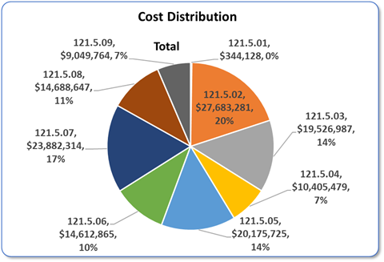
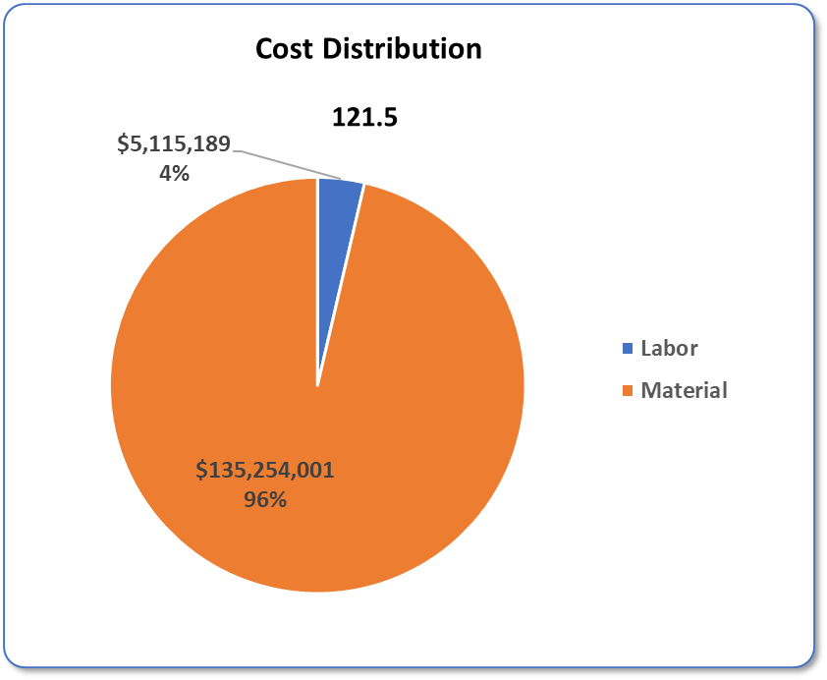
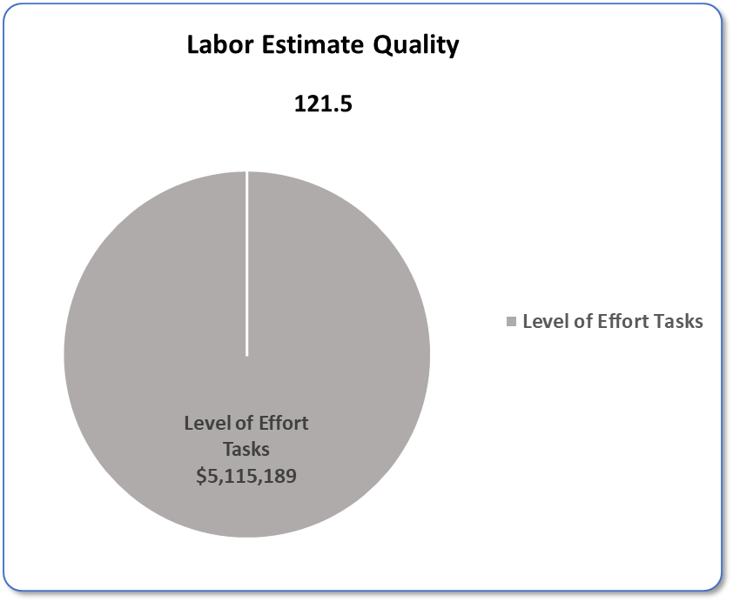
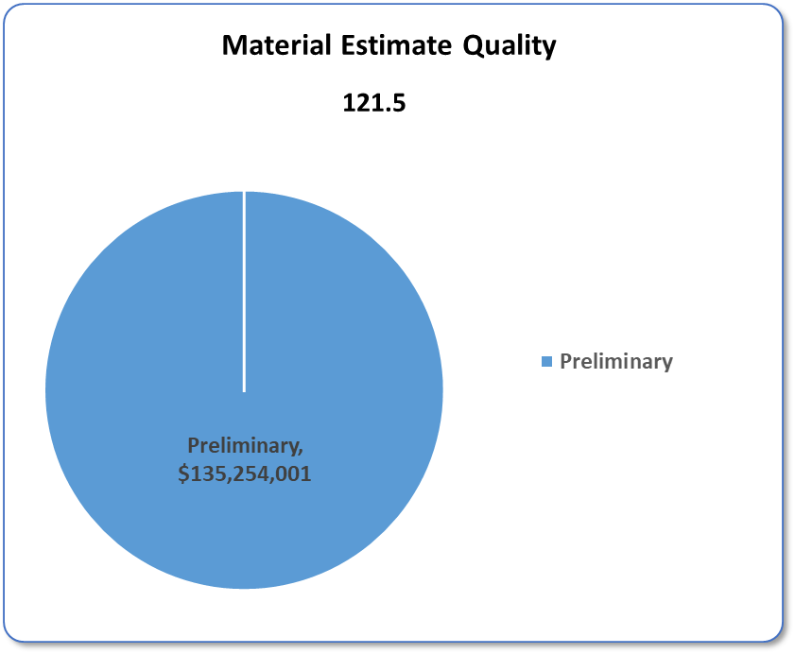
Cost Drivers and Estimate Maturity
Charge #3
P6 Base Costs = BOE + Overheads + Escalation
Estimate Quality Categories follow Fermilab Standards and Descriptions (see PIP-II-doc-345)

Slide 28
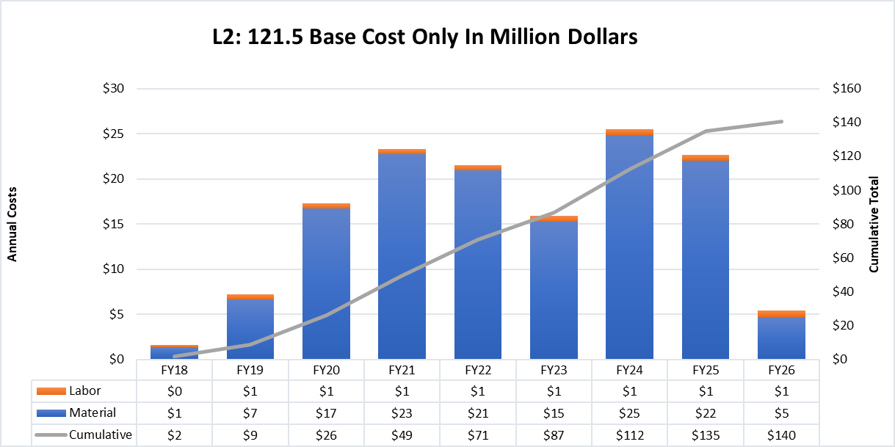
Obligation Profile – P6 Base Cost Only
Charge #3
P6 Base Costs = BOE + Overheads + Escalation

Slide 29
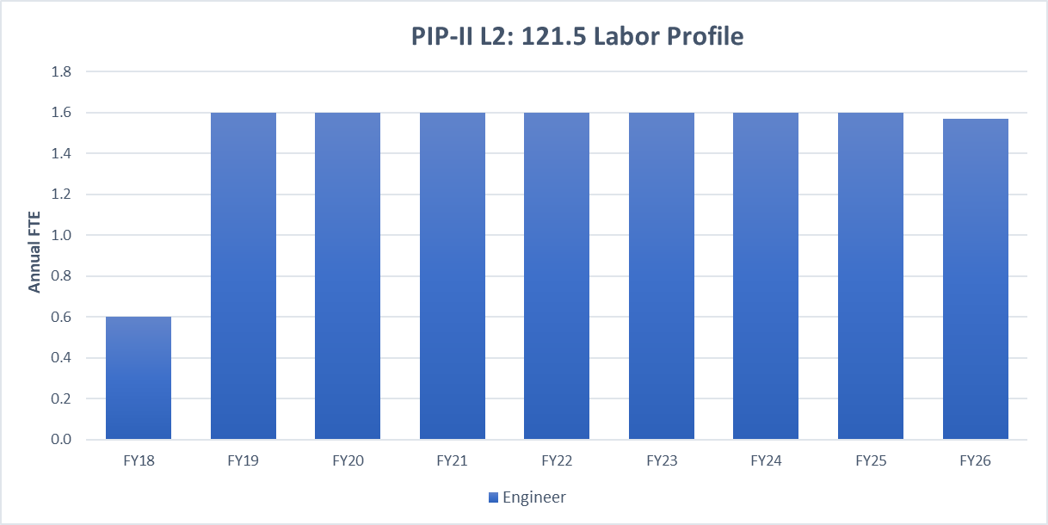
Labor Profile – P6 Hours/FTE
Charge #3

Slide 30
Schedule
Focused on interfaces with other sub-projects;

Slide 31
Previous Review Recommendations
Charge #8
Director’s Review for CD-1 (October 2017)
Secure signoff of the PIP2 Fermilab Interface Document with the Laboratory by the CD-1 review – Complete (PIP-II-doc-528)
Secure signoff of current Technical Requirements Specifications (TRS) and Functional Requirements Specification (FRS) documents in process by the CD-1 OPA Review - Complete

Slide 32
Breakout Sessions
These talks are available:
  Conventional Facilities Management
  Conventional Facilities Design and Scope
  Conventional Facilities Cost and Schedule
  Conventional Facilities CD-1 Documentation
  Conventional Facilities Procurement Planning

Slide 33
Summary
Developed the conceptual design of conventional facilities based on iterative discussions and meetings with stakeholders;
The cost and schedule estimates for conventional facilities are based on a well defined conceptual design and include adequate scope, cost and schedule contingency;
ESH&Q issues have been incorporated in the project processes;
The required DOE Order 413.3B documentation for CD-1 approval is complete;
The interfaces of the other subprojects and international partners is understood and incorporated into the planning process;
Recommendations from previous reviews have been addressed;
We are ready for CD-1 and look forward to your feedback

Slide 34
Questions

