Slide 1
WBS 121.5 – Conventional Facilities
Cost and Schedule
Steve Dixon
PIP-II DOE Independent Project Review
12-14 December 2017

Slide 2
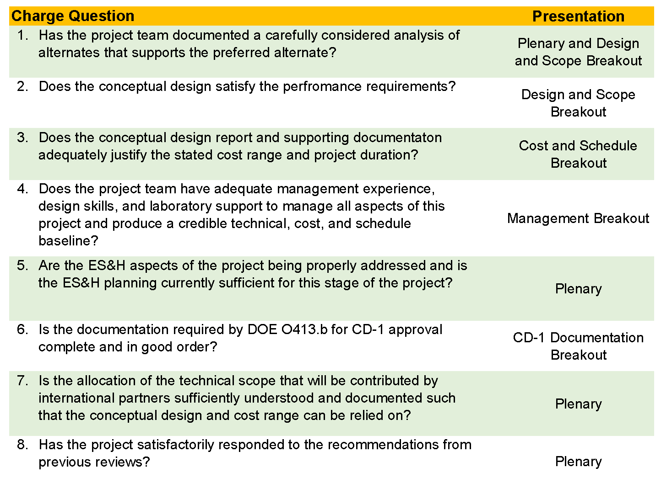
Charge Questions

Slide 3
Outline
Cost Estimate Process
  Construction Base Cost;
  Engineering Design and Inspection;
  Project Management and Coordination;
Schedule Estimate Process
  Construction Durations;
  Procurement Durations;
Contingency
Basis of Estimate Form
Risk Uncertainty

Slide 4
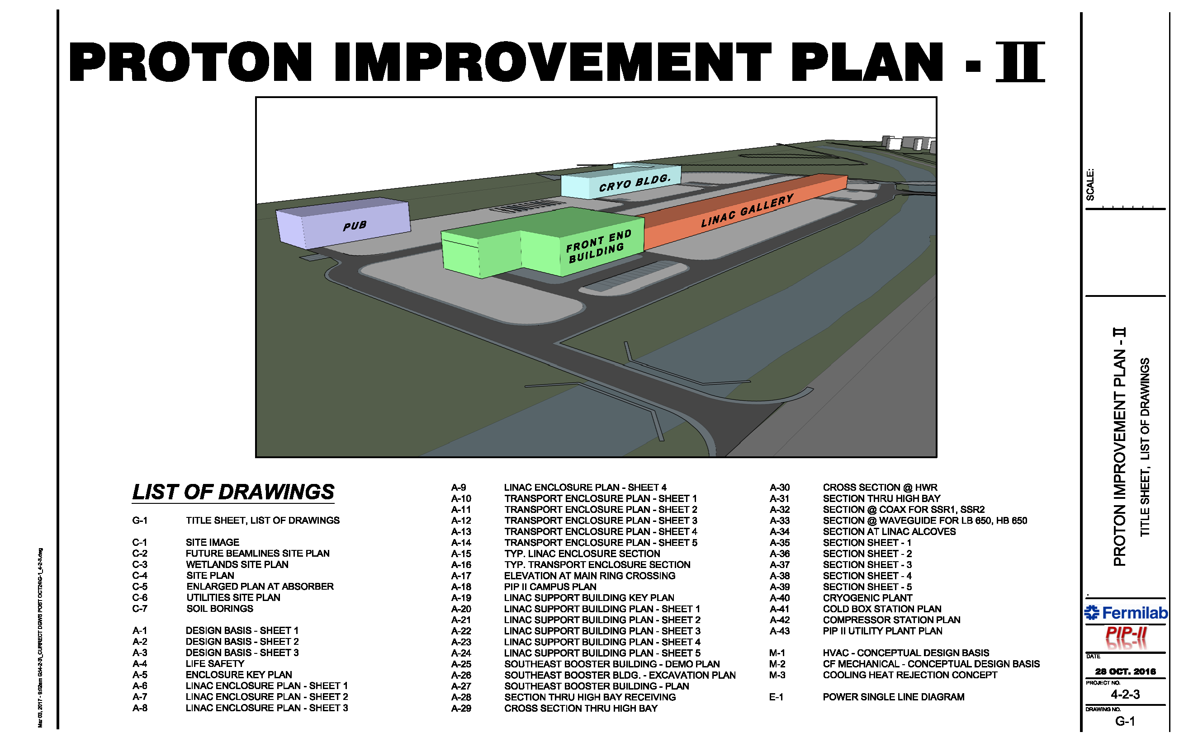
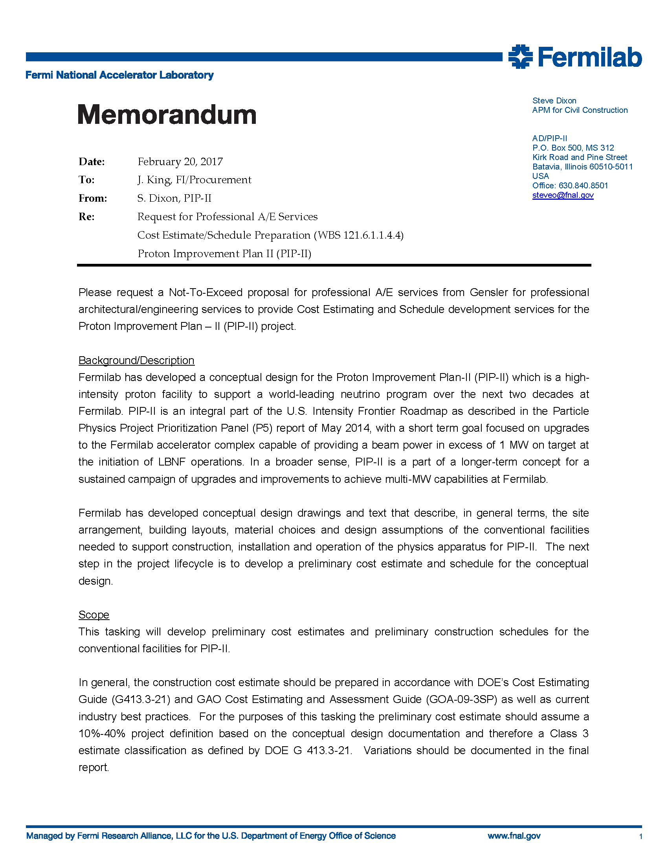
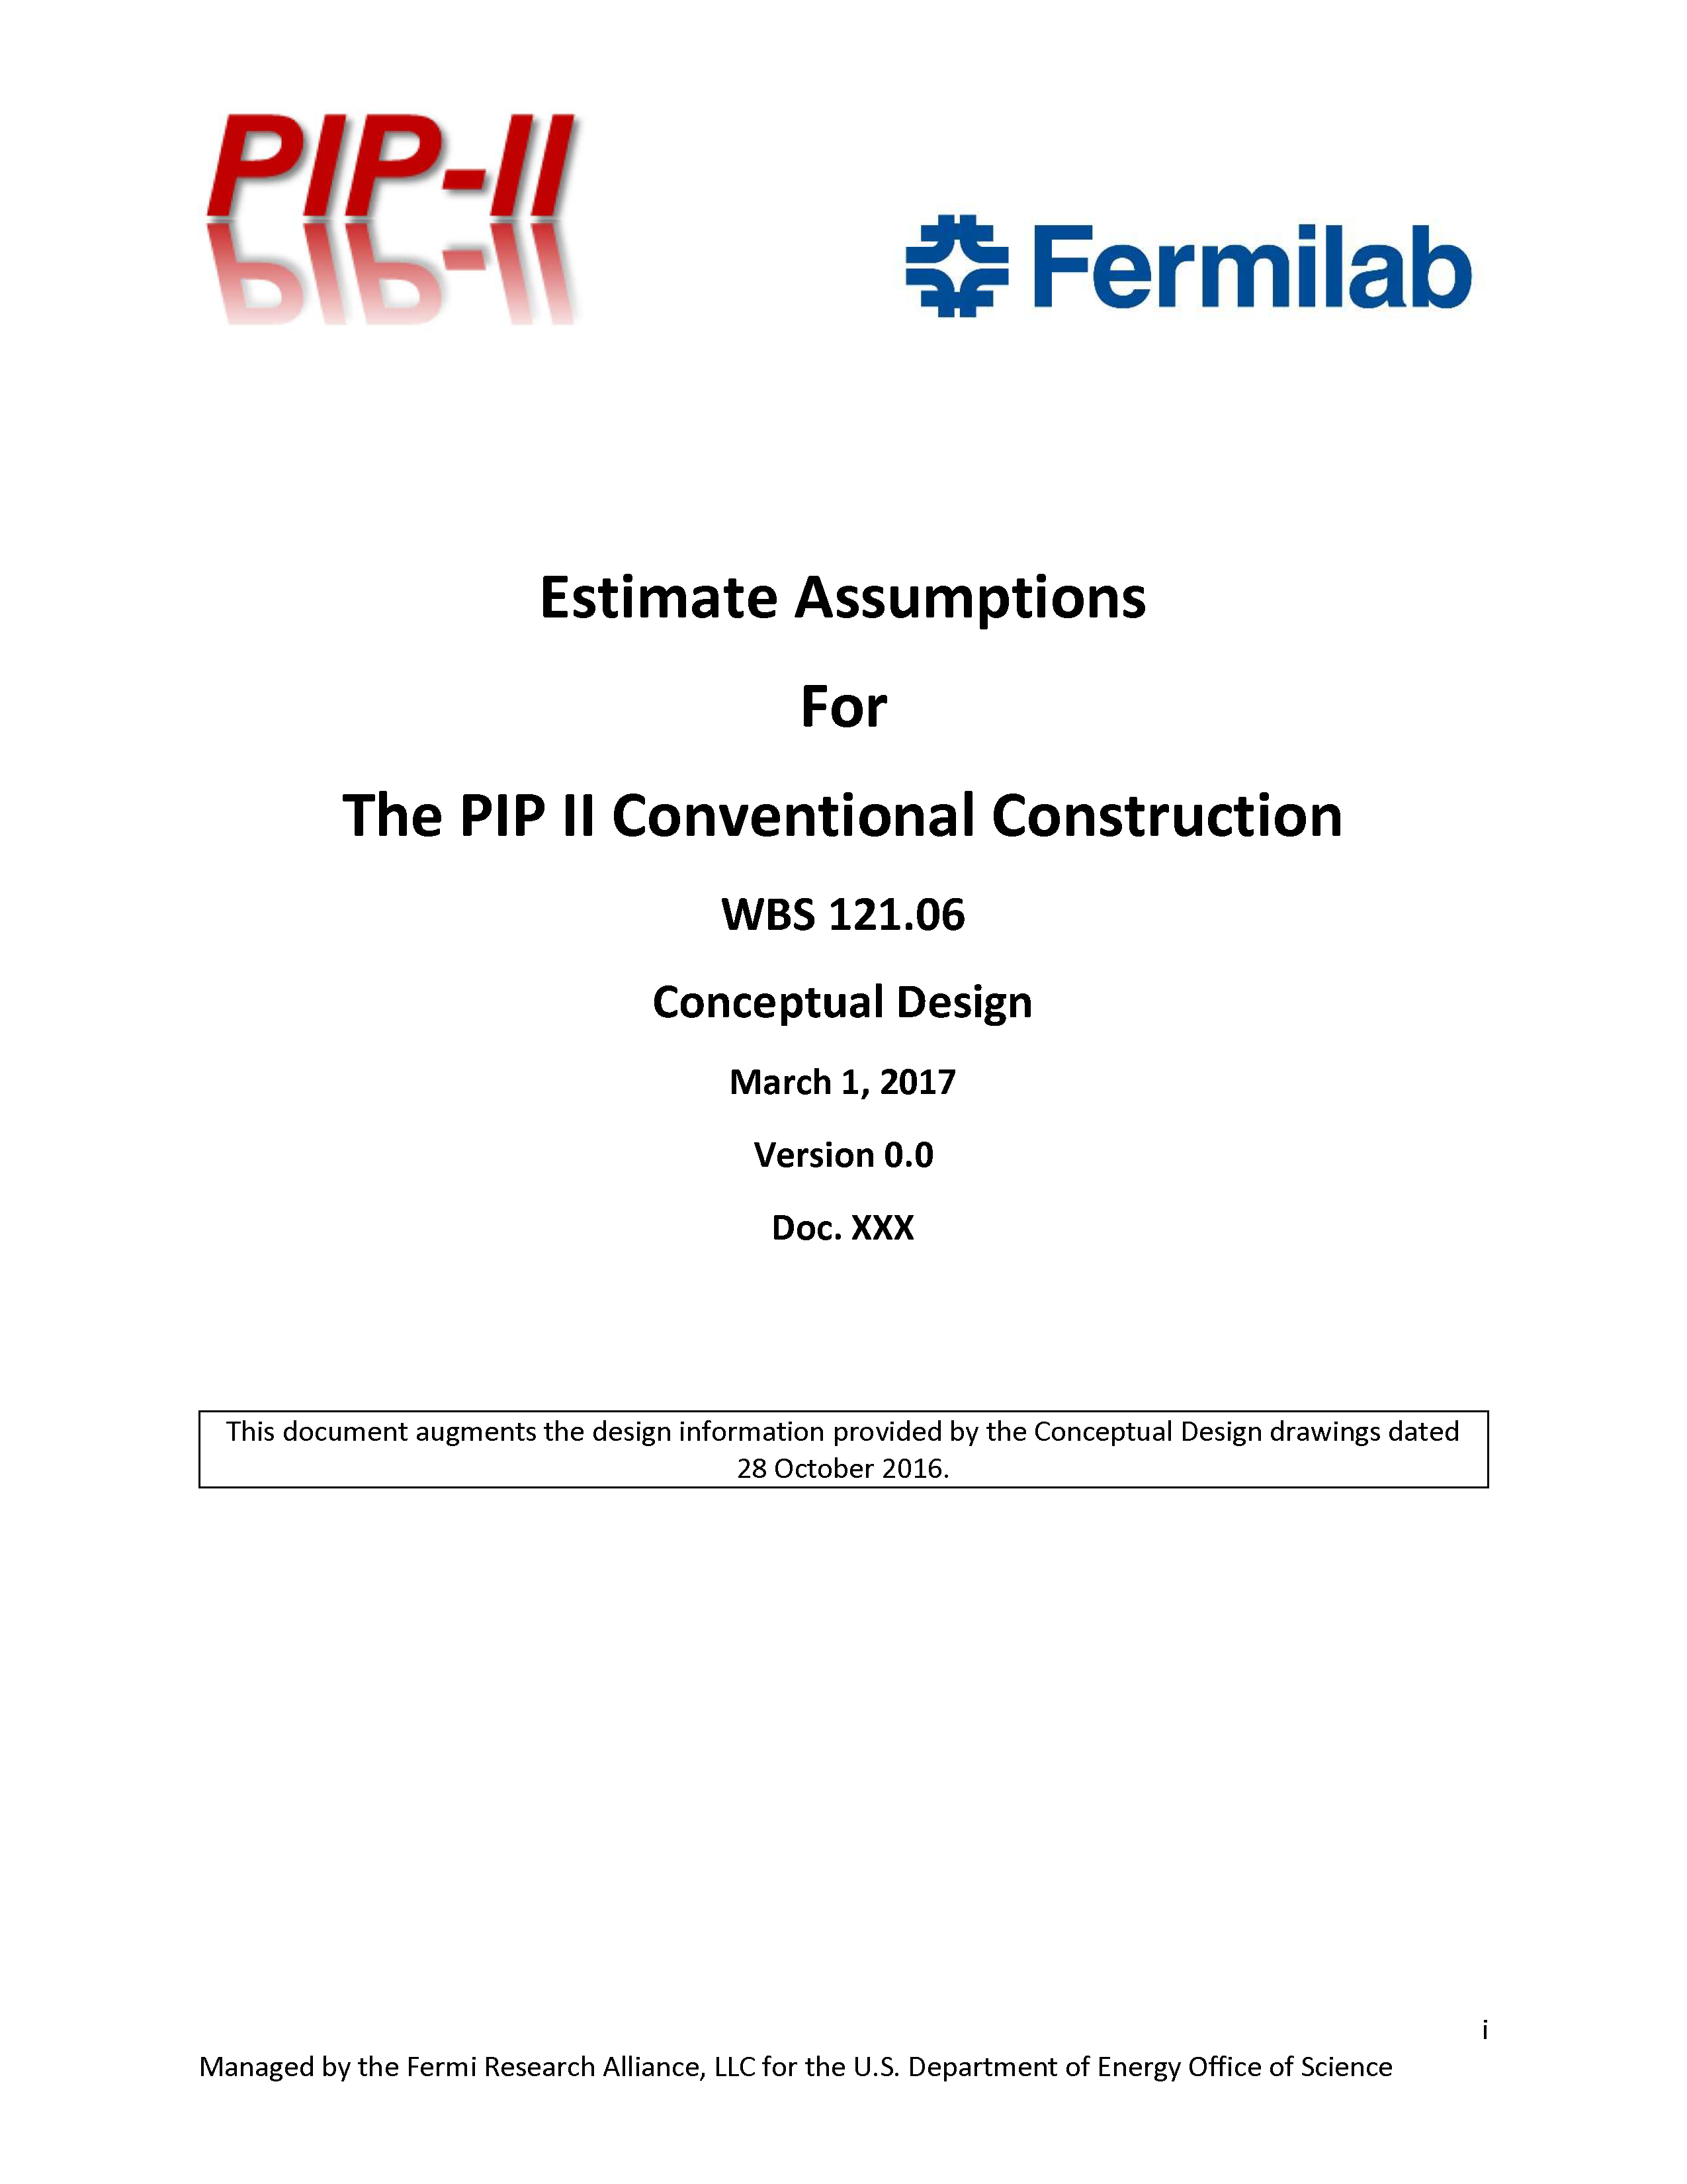
Cost Estimate Process – Construction Base Cost
Drawings from PIP-II-doc-1155
Initial Tasking for A/E Team
Conceptual Design drawings and Estimate Assumptions developed with input from stakeholders
the construction cost estimate should be prepared in accordance with DOE’s Cost Estimating Guide (G413.3-21) and GAO Cost Estimating and Assessment Guide (GOA-09-3SP) as well as current industry best practices. For the purposes of this tasking the preliminary cost estimate should assume a 10%-40% project definition based on the conceptual design documentation and therefore a Class 3 estimate classification as defined by DOE G 413.3-21
Documentation can be found at PIP-II-doc-333

Slide 5
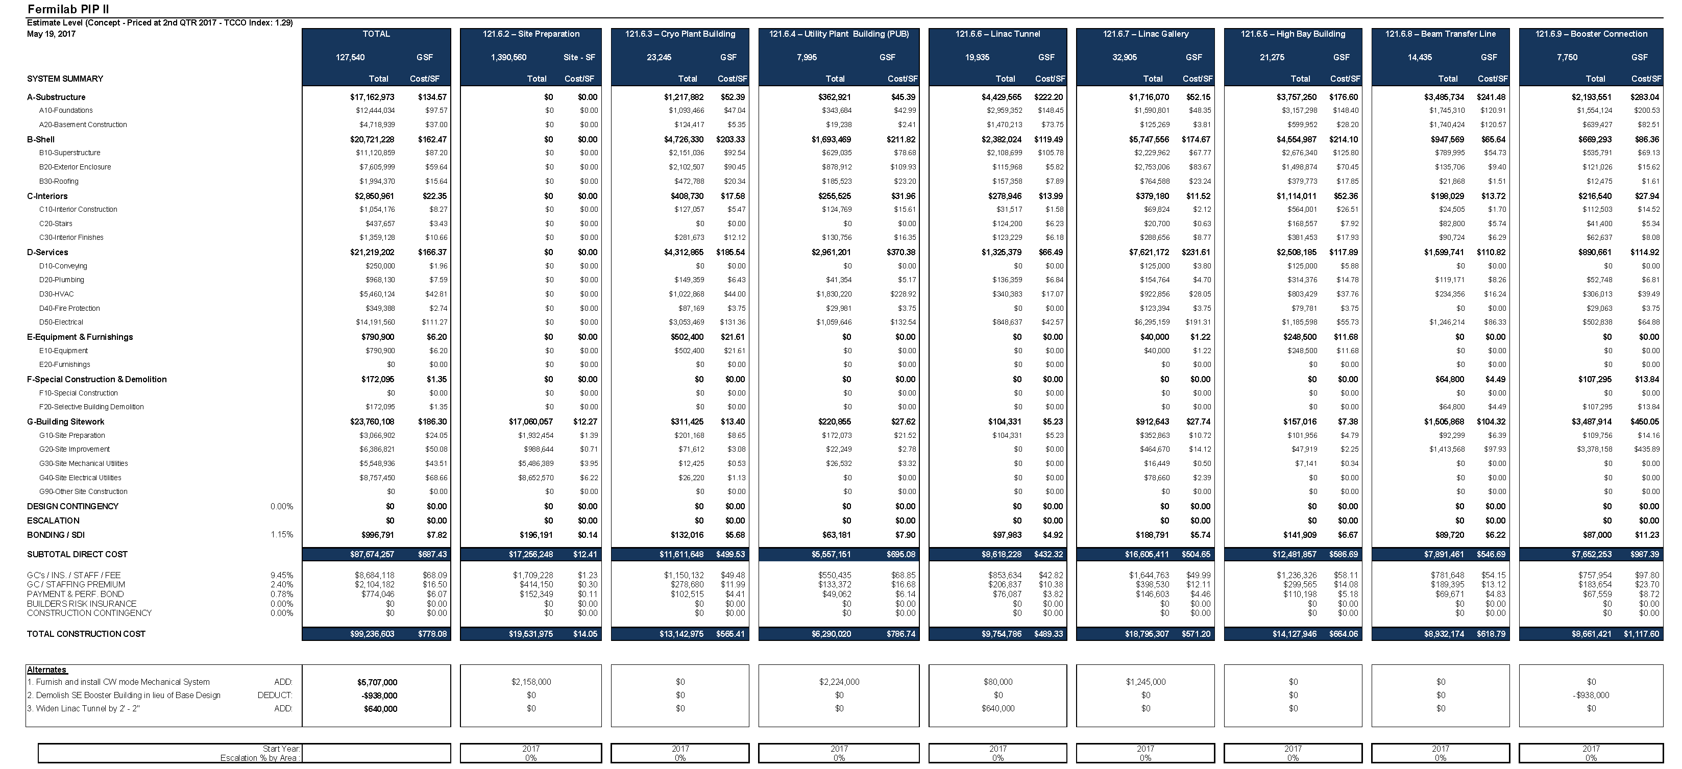
Cost Estimate Process – Base Cost
Estimate completed in May 2017;
Broken down by work package;
Costs in FY17 dollars, de-escalated to FY16 dollars for overall project consistency;
Included several initial scope alternates.
Documentation can be found at PIP-II-doc-333

Slide 6
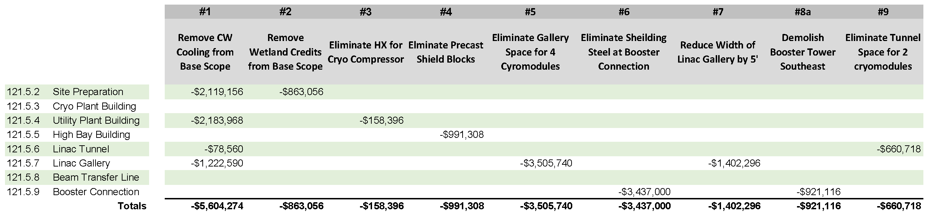
Cost Estimate Process – Early Scope Reductions
Prioritized List of Scope Reduction (high level);
Reductions to Base Cost, broken down by work package;
Costs in FY17 dollars, de-escalated to FY16 dollars;
Discussed and reviewed by PIP-II project;
Documented in Basis of Estimate forms.
Documentation can be found at PIP-II-doc-1025

Slide 7
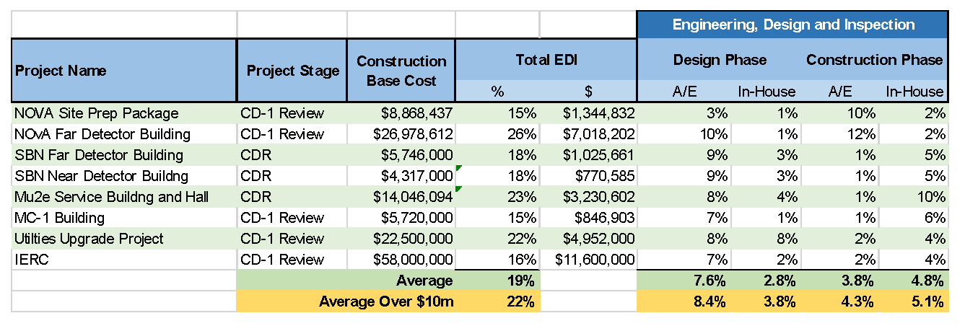
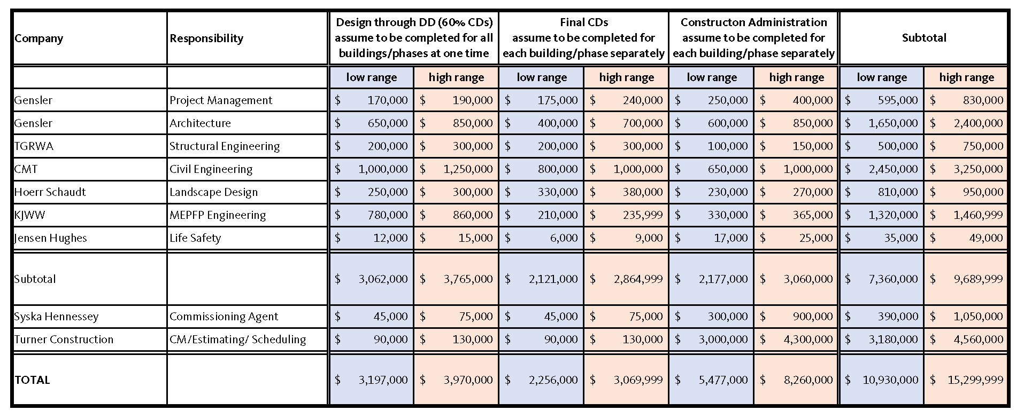
Cost Estimate Process – ED&I
Engineering Design and Inspection (EDI)
  Based on Construction Cost;
  Review of Historic Data from Fermilab projects;
  Initial Range from architect/engineer;
Range: 10.4% to 14.6%
Historic data from previous projects
Documentation can be found at PIP-II-doc-327

Slide 8
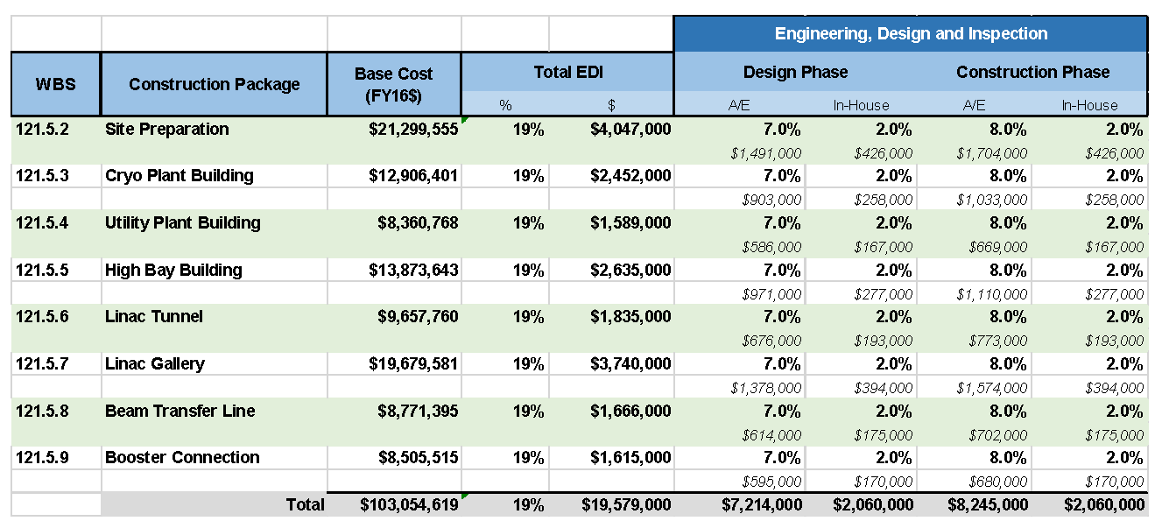
Cost Estimate Process – ED&I
Engineering Design and Inspection (ED&I) – 19% Overall
  In-house: 2% for Design, 2% for Construction Phase
  Architect/Engineer: 7% for Design, 8% for Construction Phase
Documentation can be found at PIP-II-doc-327

Slide 9
Cost Estimate Process - Administration
Project Management and Coordination Costs (PM&C)
“Administration” costs are primarily management and oversite activities during the design and construction phases;
Consist of one (1) full time equivalent (FTE) for the Associate Project Manager for Conventional Facilities (APM-CF) from FY18 until the end of the project;
An additional one (1) FTE for a deputy APM-CF position assumed to begin in ~FY19 coinciding with CD-2/3a and extends until the end of the project;
This PM&C cost is divided between:
  40% - Project Office Support
  10% - Conventional Facilities Management and Coordination
  50% - Individual work packages
Documentation can be found at PIP-II-doc-327
Project Office Support basis of estimate can be found at PIP-II-doc-229
Conventional Facilities Management and Coordination basis of estimate can be found at PIP-II-217

Slide 10
Schedule Estimate Process
Drawings from PIP-II-doc-1155
Initial Tasking for A/E Team
Conceptual Design drawings and Estimate Assumptions developed with input from stakeholders
The preliminary construction schedule should instead focus on the completion of major milestones (eg: excavation complete, foundation complete, building shell complete, beneficial occupancy, etc.) within the overall schedule to provide a reasonable prediction of one possible construction scenario. This schedule information will be included in the PIP-II resource loaded schedule as a planning package that will be updated with further information and details as they become available.
Documentation can be found at PIP-II-doc-581

Slide 11
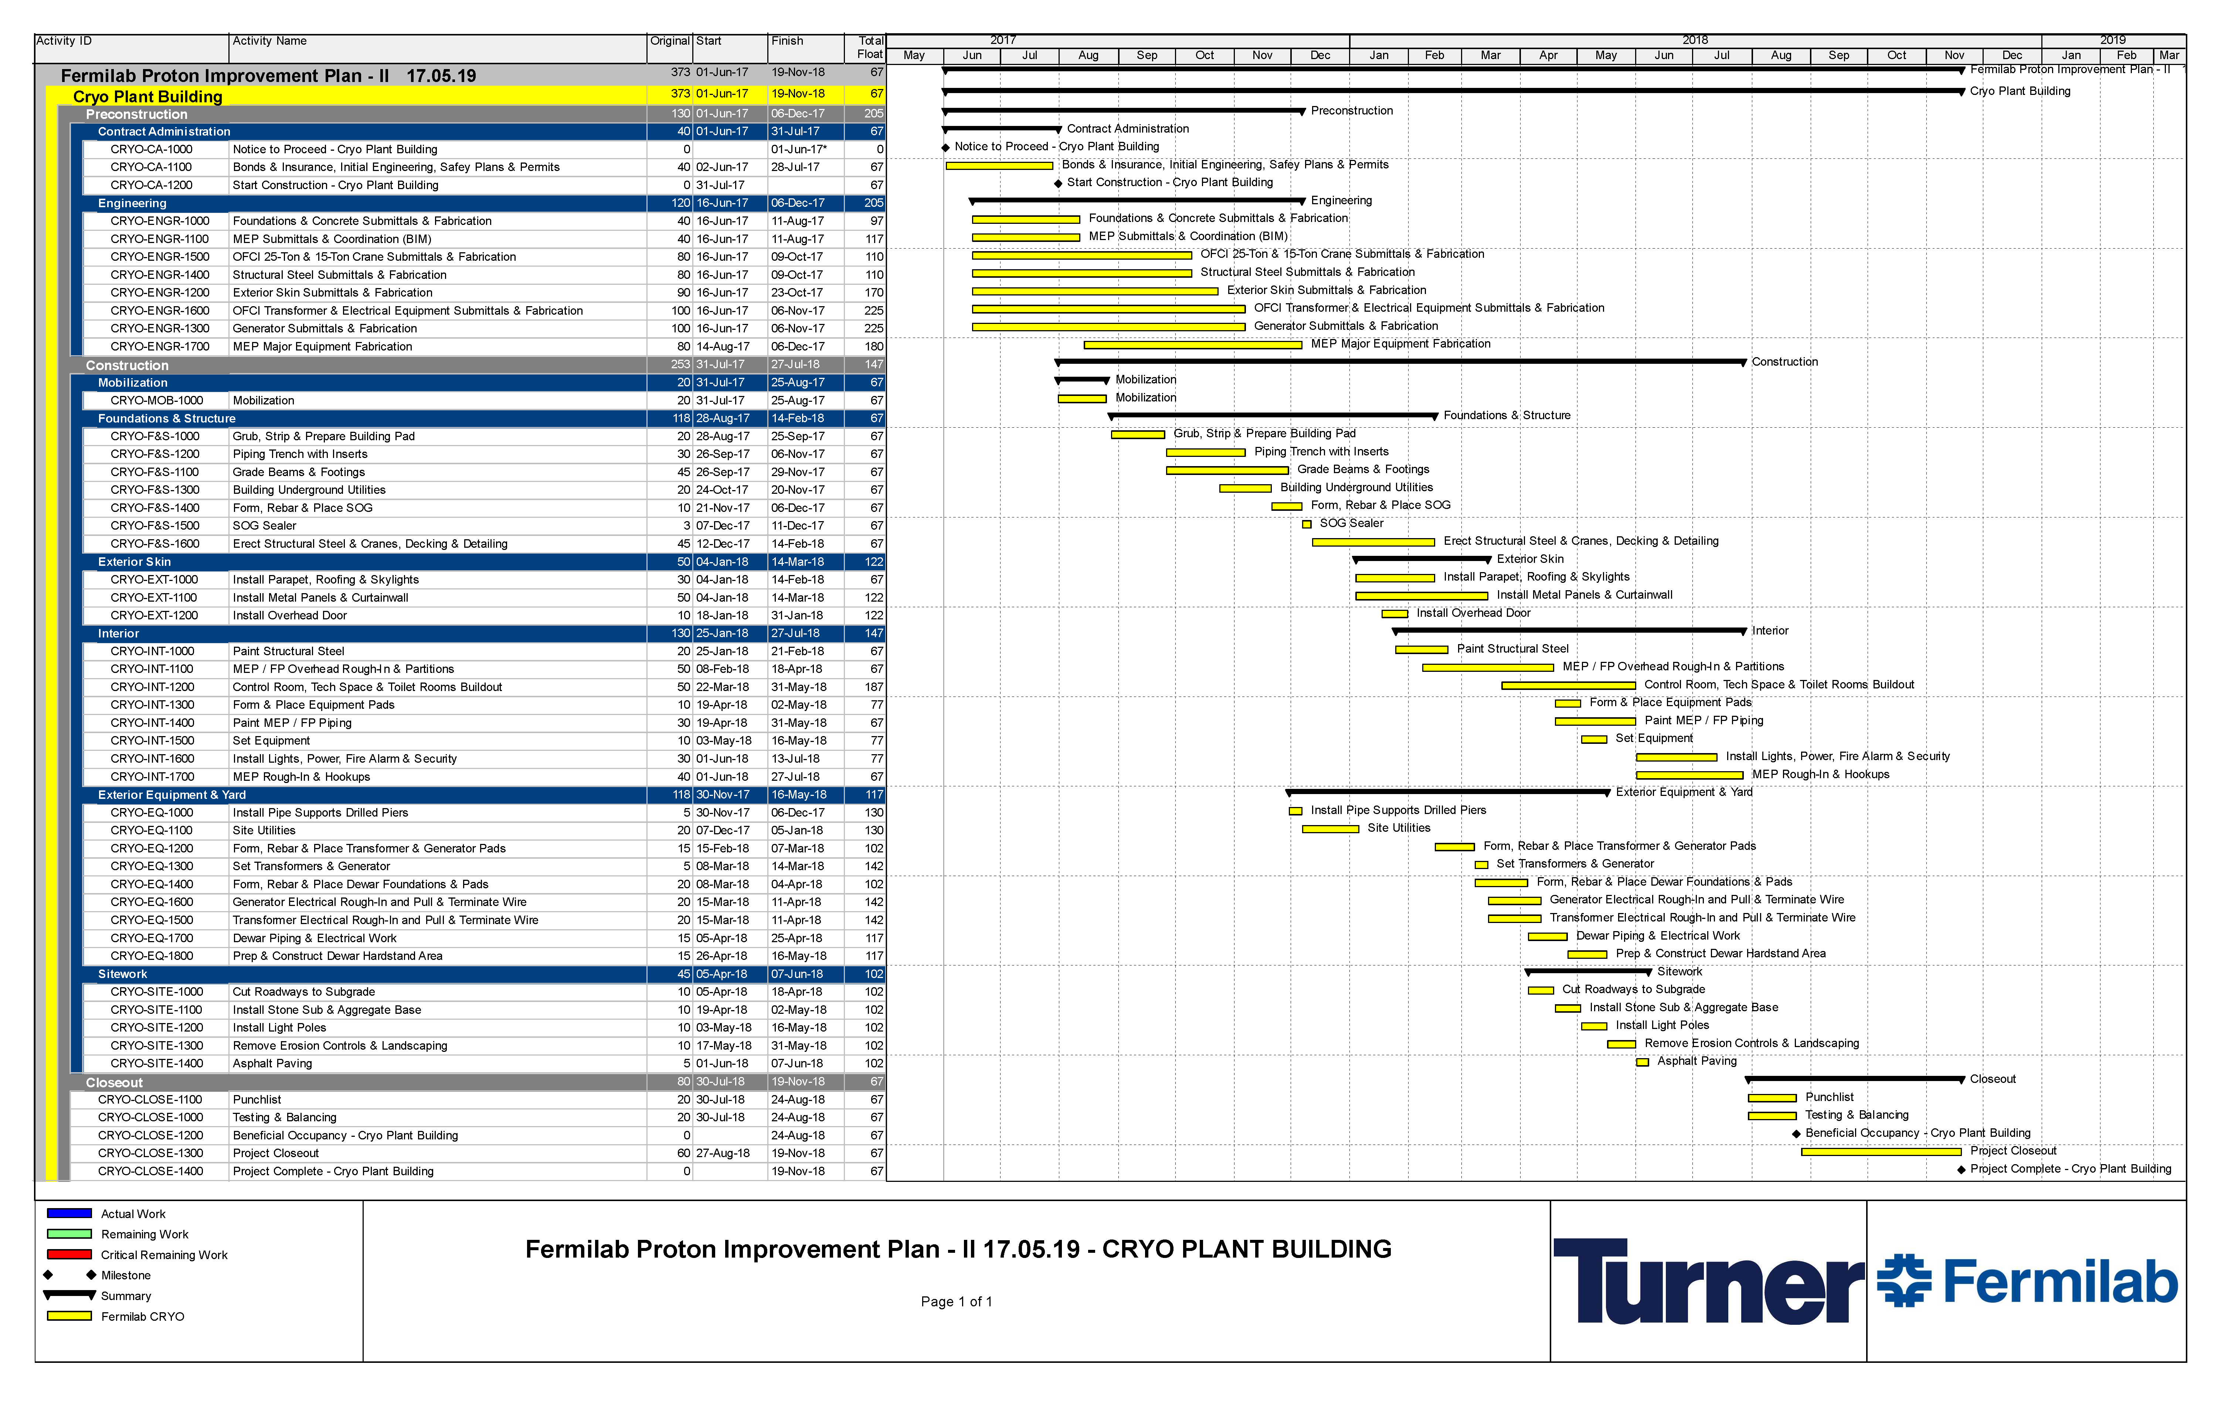
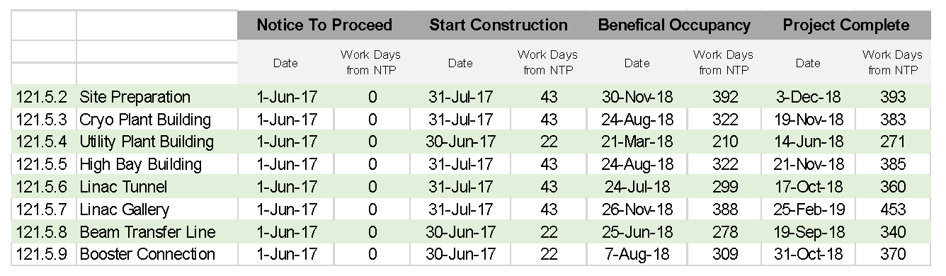
Schedule Estimate Process
Considered Planning Packages;
Technically driven schedules;
Focused on subproject interface milestones.
Documentation can be found at PIP-II-doc-581 and in each Basis of Estimate file

Slide 12
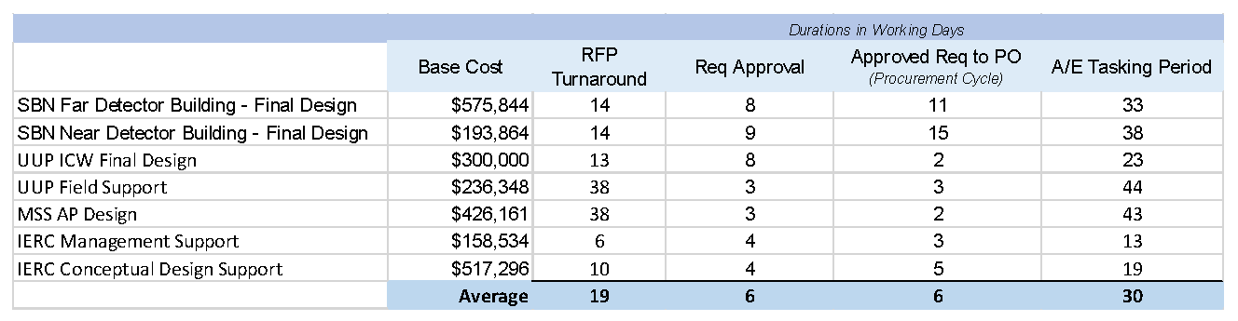
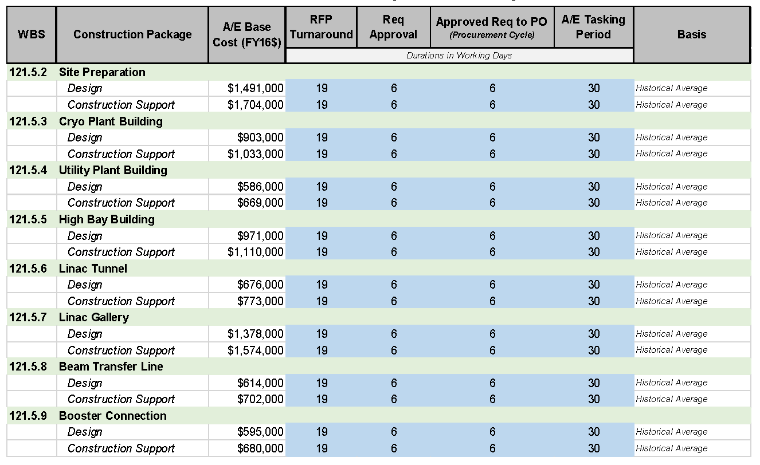
Procurement Durations – A/E Firms
Architect/Engineering Firm;
  Review of Historic Data from Fermilab projects;
  Includes turnaround times for Request for Proposal (RFP), Requisition Approval and Issue PO;
  Average of 30 working days.
30 Working Days
Historic data from previous projects
Documentation can be found at PIP-II-doc-318

Slide 13
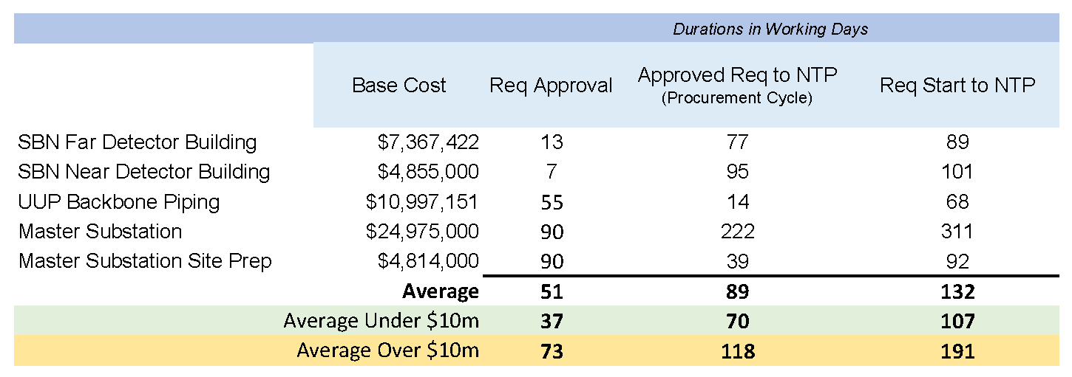
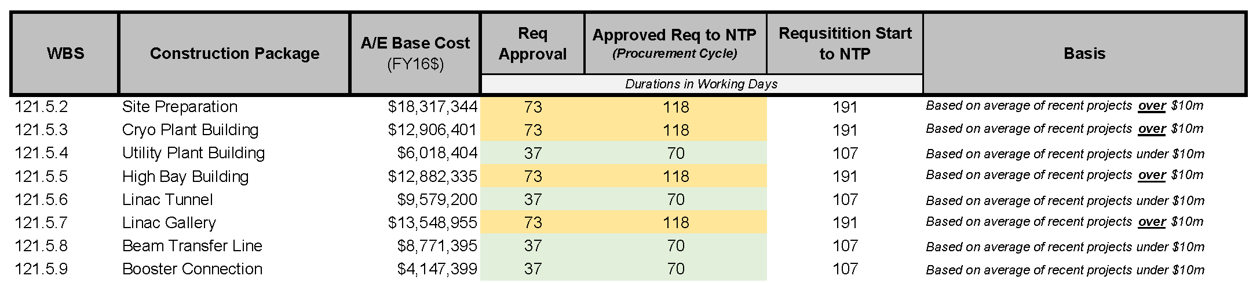
Procurement Durations – Construction
Construction Subcontracts;
  Review of Historic Data from Fermilab projects;
  Includes turnaround times for Requisition Approval, Request for Proposal (RFP) and Issue Notice To Proceed (NTP);
  Average of 107 working days for under $10m;
  Average of 191 working days for over $10m;
Historic data from previous projects
Documentation can be found at PIP-II-doc-321

Slide 14
Contingency
Cost Estimate Uncertainty:
Based on level of definition and design maturity;
A/E team provided input;
20% cost contingency applied to most construction subcontracts;
22% cost contingency for High Bay, Linac Tunnel and Linac Gallery work packages;
20% cost contingency applied to design work;
Schedule Uncertainty:
-10% to +20% schedule contingency provided by A/E team.

Slide 15
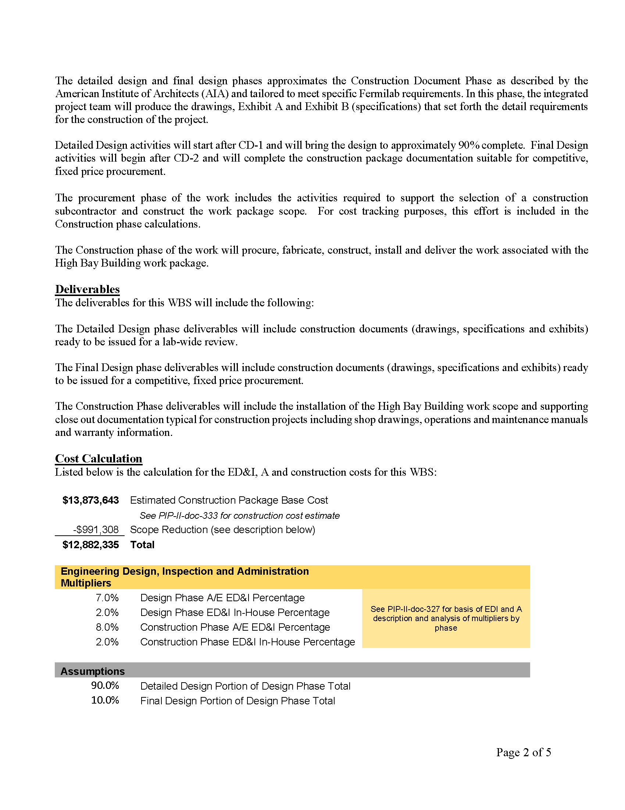
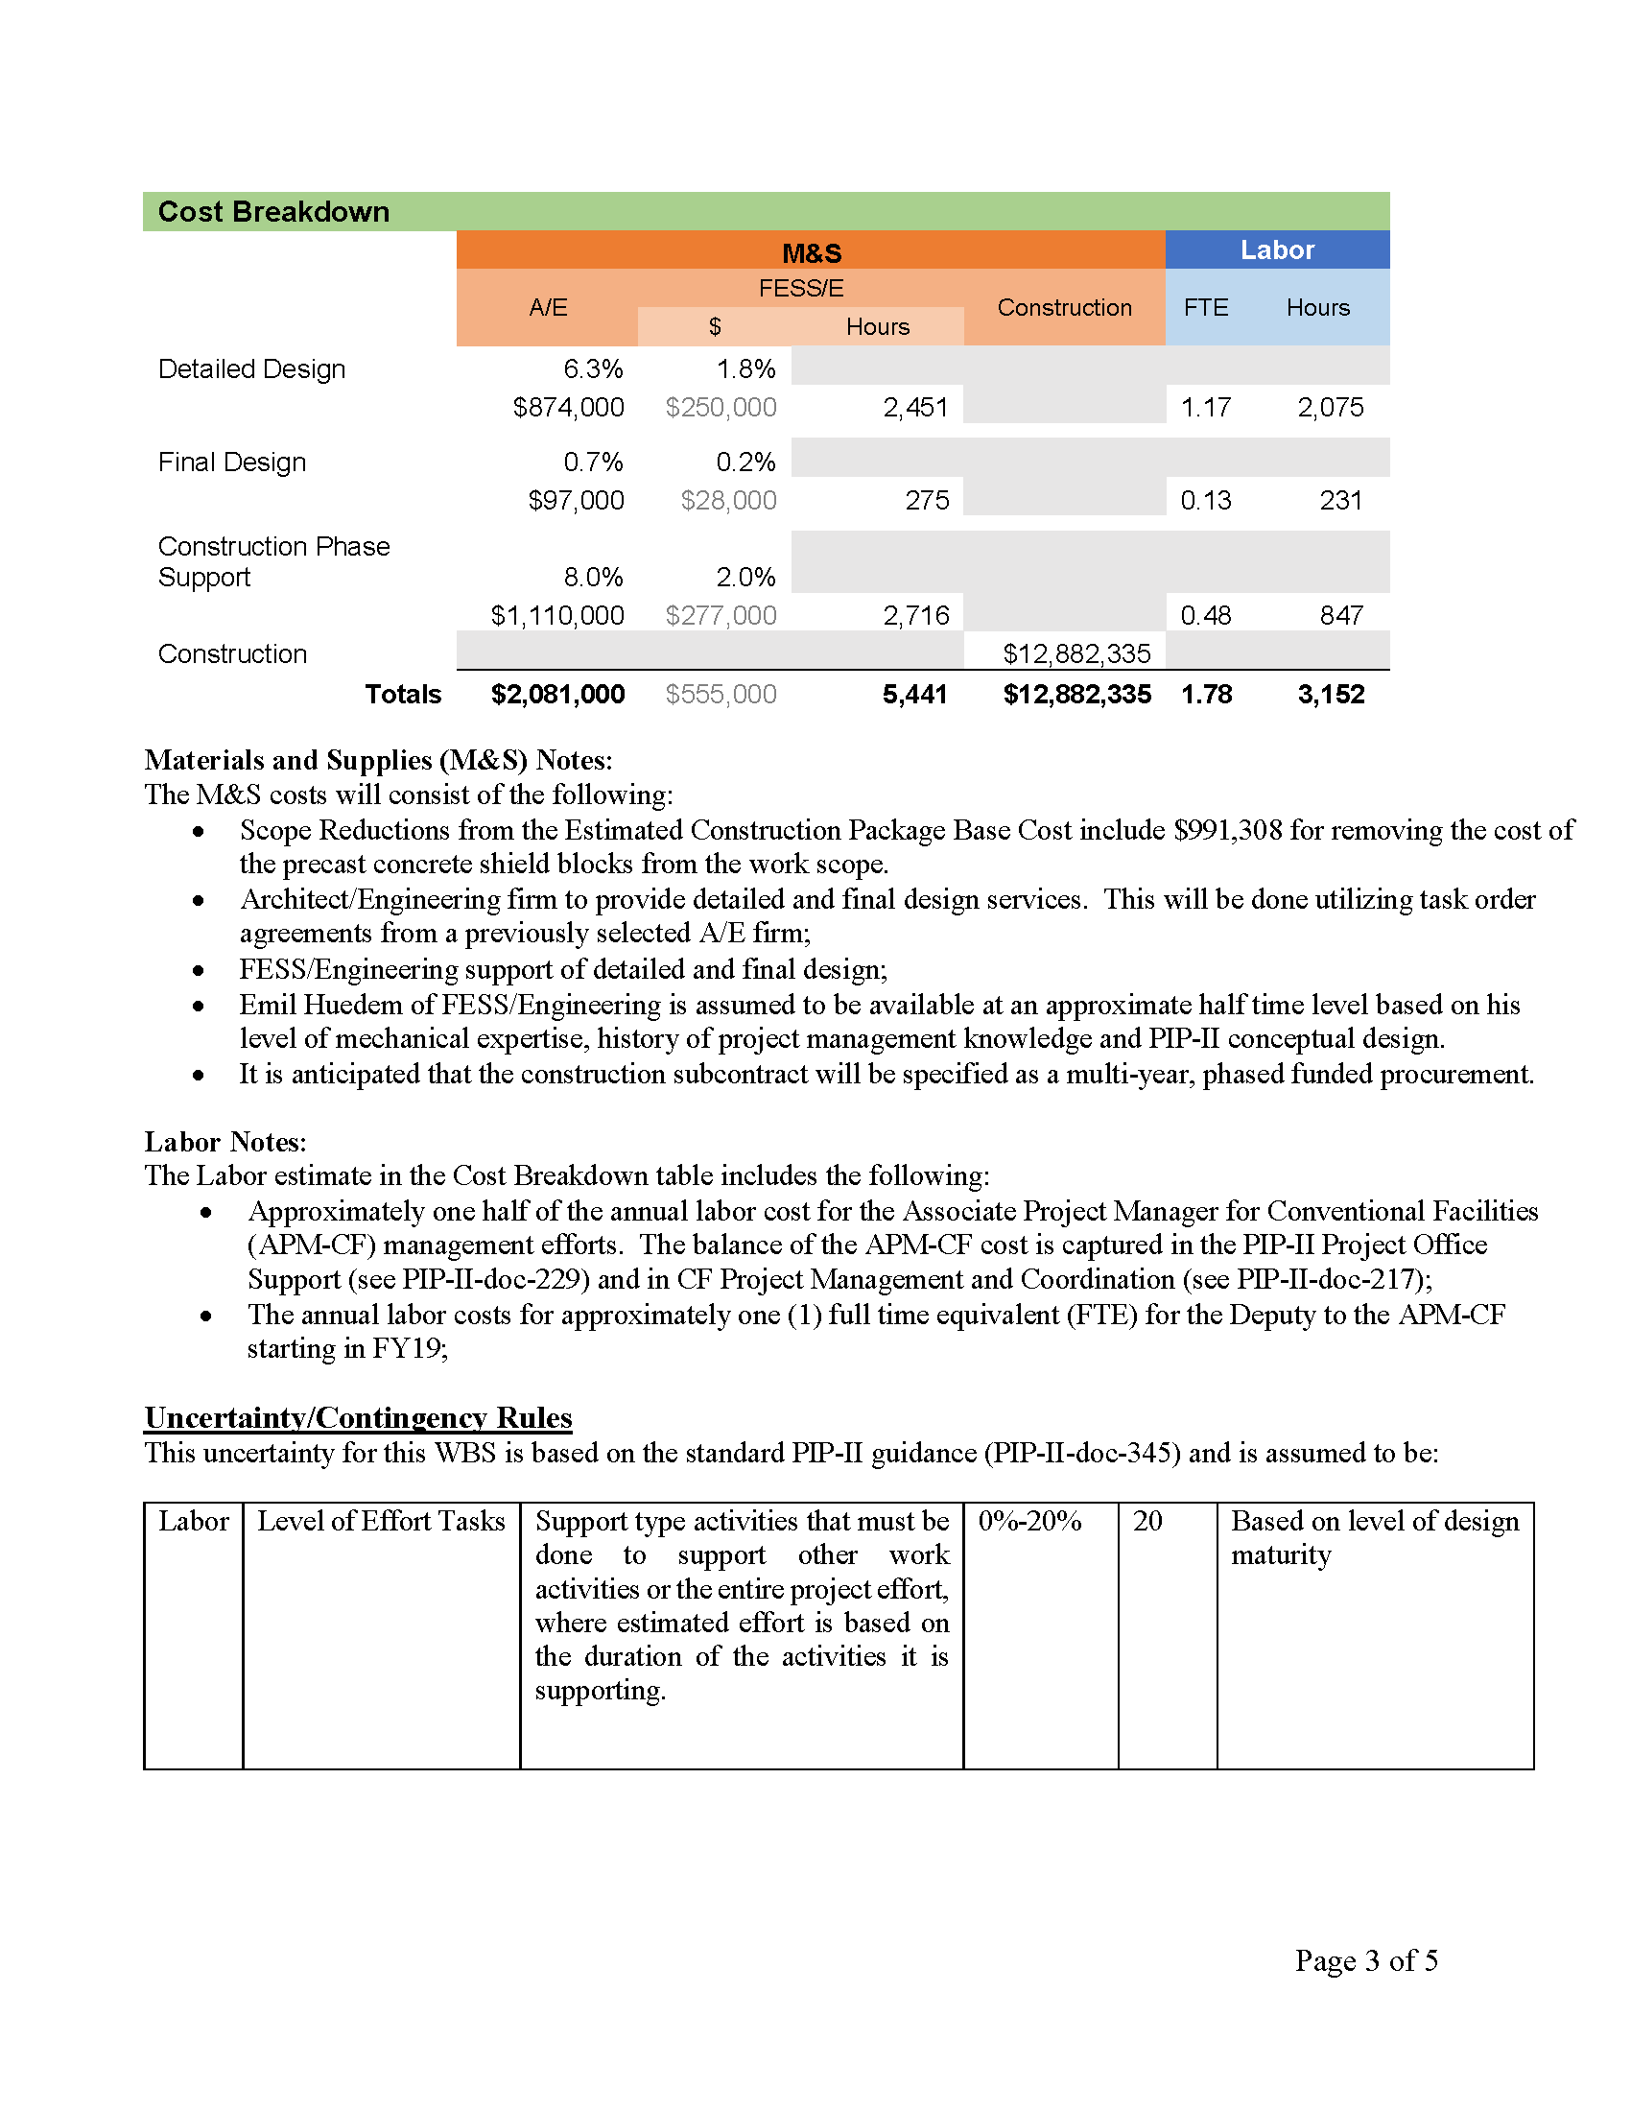
Basis Of Estimate
Project Management and Coordination Costs
(PIP-II-doc-327)
ED&I Costs
(PIP-II-doc-327)
Construction Cost
(PIP-II-doc-333)
including
Scope Reduction Options
(PIP-II-doc-1025)
Typical Basis of Estimate form
Contingency

Slide 16
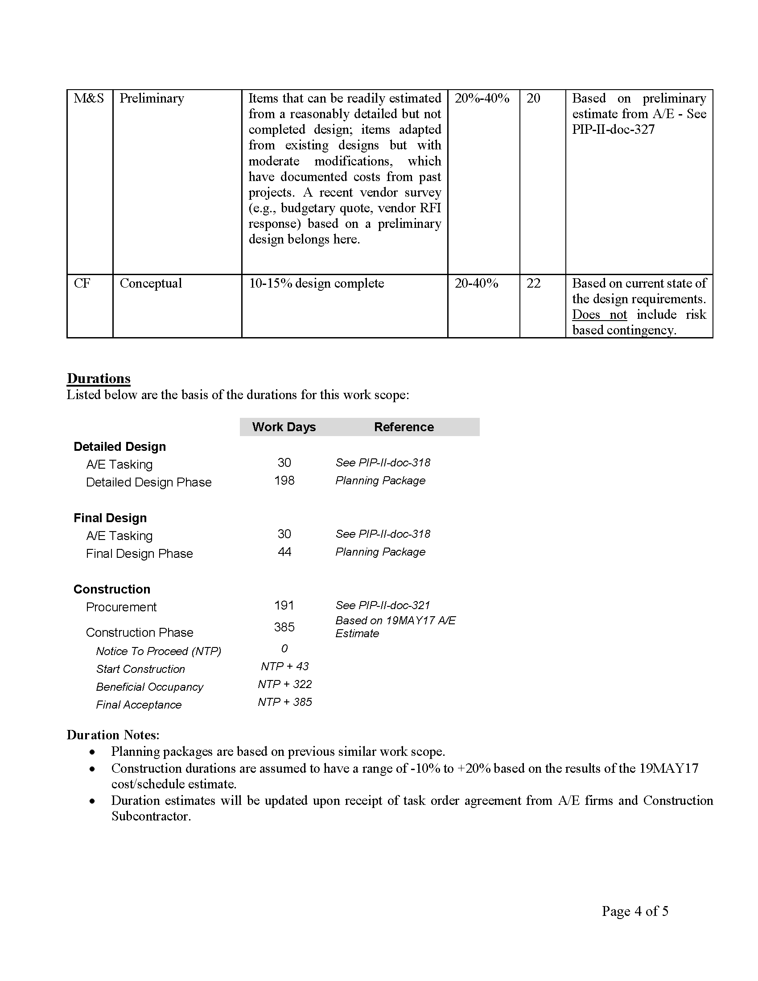
Basis Of Estimate
Contingency
A/E Tasking Durations
(PIP-II-doc-318)
Construction Subcontract Procurement Duration
(PIP-II-doc-321)
Construction Subcontract Duration
(PIP-II-doc-581)
Typical Basis of Estimate form

Slide 17
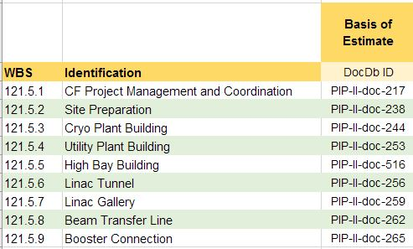
Basis Of Estimate List

Slide 18
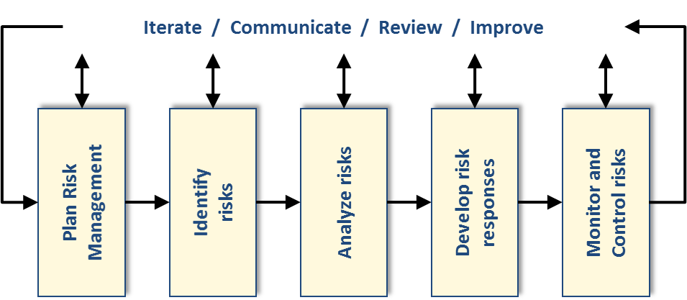
Risk Uncertainty
Follow the PIP-II Risk Management Plan
  (see Management Breakout)
Process:
  Reviewed past projects at Fermilab;
  Reviewed lessons learned from other labs;
  Met with the Conventional Facilities project team including A/E and Procurement (April 2017);
  Formal Risk Management Workshop with outside reviewers;
  Input, tracked and updated in the Fermilab Risk Register;
PIP-II Risk Management Plan can be found at PIP-II-doc-163
Fermilab Risk Register can be found at https://fermipoint.fnal.gov/organization/ocoo/ippm/Lists/Risk%20Register/all-risks.aspx

Slide 19
Risk Uncertainty Results
42 Threats and 9 Opportunities
Top 6 Risks:
5 Closed
Light Fixtures Fail in Radiation Environment (Managed);
Wetland Mitigation Less than Anticipated (Retired);
One-For-One Replacement/Space Bank Uncertainty (Retired);
East Booster Tower Shielding Inadequate (Retired);
Asbestos/Lead in East Booster Tower (Retired)

Slide 20
Risk Opportunities
RO-121-05-02-001: Value Management Opportunities
RO-121-05-002: Renewable Energy Opportunities
RO-121-05-003: Radiation Shielding Opportunities
RO-121-05-004: Construction Bids Below Estimate
RO-121-05-005: Full Funding for Conventional Facilities
RO-121-05-06-001: Increased Linac Enclosure Width
RO-121-05-07-001: Increased Support Space in Linac Gallery
RO-121-05-08-001: Main Ring Enclosure Not Needed

Slide 21
Risk Uncertainty – Interfaces
Top 4 systems this WBS interfaces to:
Top 4 interface within this WBS:
WBS 121.5
Conventional Facilities
WBS 121.2.
SL/SRF and Cryo Systems
Impact on schedule and cost
WBS 121.3.19
SL/Support Systems
Impact on technical and schedule
WBS 121.3.22 SL/Installation, Integration and Commissioning
Impact on Cost and Schedule
WBS 121.4
Existing Rings
Impact on Schedule and Cost
WBS 121.5.2
Site Preparation
WBS 121.5.3
Cryo Plant Building
Existing Fermilab Infrastructure
WBS 121.5.5 Linac Complex
WBS 121.5.4 Utility Plant Building
    Top Risks
    RT-121-05-01-002 – Subproject Changes Impact Conventional Facilities
    RT-121-05-09-005 – Poor Delineation
Interfacing within this WBS including sequencing of work and existing Fermilab infrastructure.

Slide 22
Risk Uncertainty – RT-121-05-01-002
Subproject Changes Impact Conventional Facilities
Summary
  If the subproject requirements changes then the design of the conventional facilities will need to be modified jeopardizing the cost and schedule objectives
Cause/Trigger
  Changes to the subproject requirements
Mitigation
  ​Include subproject managers in design meetings;
  Include subproject managers in formal design reviews;
  Management control of changes through a change/configuration control process;

Slide 23
Risk Uncertainty – RT-121-05-013
Construction Bids Exceed Estimates
Summary
  ​If the construction bid proposals exceed the budgeted estimate then the cost and schedule will be impacted which jeopardizes project goals
Cause/Trigger
  Construction package proposals receive exceed the budget estimate
Mitigation
  Include a reasonable contingency in budget;
  Design to a target estimate;
  Revisit the estimate periodically throughout the design process;
  Include in the design add/deduct alternates to provide flexibility at bid day.

Slide 24
Risk Uncertainty – RT-121-05-07-001
RF LCW Temperature Delta Too Low
Summary
If the temperature delta for the LCW cooling water is less than 10 degrees F then the piping size will need to be increased which jeopardizes the cost budget
Cause/Trigger
  Early discussions with the RF team indicated that temperature differential across the RF equipment was 1 degree F. Upon further discussion, this increased to 10 degrees F since a small temperature differential is inefficient and presents controls difficulties. The conventional facilities was updated with the assumption of a 10 degree temperature differential. Reduction of this value would require increased piping sizes and changes to the equipment selections
Mitigation
  Verify that the 10 degree F value is adequate to meet the RF requirements
  Include RF subprojects on design meetings and formal reviews

Slide 25
Risk Uncertainty – RT-121-05-01-004
Unclear/Incomplete Delineation Between Construction Packages
Summary
  If the coordination and delineation between construction packages is unclear/incomplete then cost/schedule could be impacted.
Cause/Trigger
  ​Unclear delineation between construction packages
Mitigation
  Include coordination/delineation requirements during design reviews
  Include coordination/delineation requirements during constructability reviews

Slide 26
Risk Uncertainty – RT-121-05-01-001
Design Complexity
Summary
  ​​If the final design is overly complex then the cost/schedule could be impacted which jeopardizes the overall project goals.
Cause/Trigger
  Designs that are overly complex and/or utilize untested construction methods have the potential to reduce the pool of potential subcontractors and increase the cost of the work and delay the schedule
Mitigation
  The project team will conduct periodic constructability reviews focused on key components with the goal of developing a design that can be executed in an efficient and cost effective manner.
  The PIP-II conventional facilities team will include architect/engineers and construction contractors that will participate in constructability review.
  If overly complex methods are identified, the project team may consider breaking that work out as a separate construction package and/or pre-qualifying the potential subcontractors.

Slide 27
Risk Uncertainty – RT-121-05-09-005
Poor Interface Definition
Summary
  If the interface between subprojects and conventional construction in inadequate then needed infrastructure could be missing or double counted which jeopardizes the cost and schedule objectives
Cause/Trigger
  Poor interface between subprojects and conventional construction
Mitigation
  Include subproject managers on design meetings and sign-offs on formal reviews;
  Document, track and receive concurrence on the interface between the subprojects and conventional facilities

Slide 28
Summary
Scope
  Conceptual Design is based on stakeholder input which identifies the scope of the conventional facilities required to support the project.
Cost Estimate
  Construction Cost estimate was done by professional contractors independent from the team that developed the conceptual design;
  Engineering, Design and Inspection (ED&I) costs were based on historic Fermilab project data and initial cost ranges provided by the architect/engineer.
Schedule
  Work packages schedules were developed based on historic data and input from professional contractors.
Basis of Estimate
  Contain the information needed as input for the resource loaded schedule.
Risk
  Identified risks based on past project team experience, managed following the project’s Risk Management Plan.

Slide 29
Questions?

