Slide 1
WBS 121.5 – Conventional Facilities
CD-1 Documentation
Steve Dixon
PIP-II DOE Independent Project Review
12-14 December 2017

Slide 2
Charge Questions

Slide 3
Outline
CD-1 Requirements
One-for-One Replacement Strategy
DOE Guiding Principles Strategy
CD-2 Requirements
Project Definition Rating Index (PDRI)

Slide 4
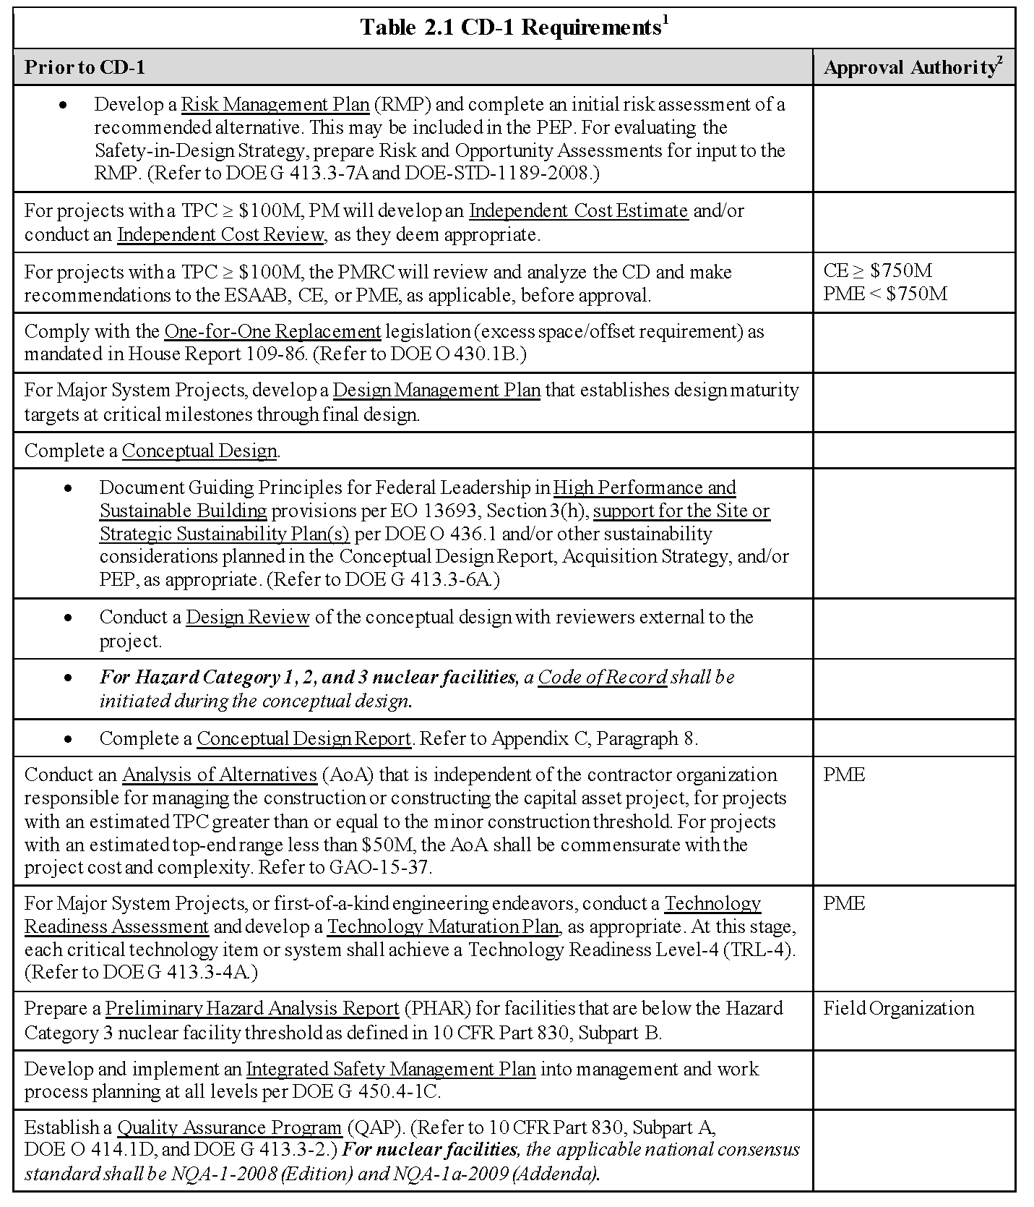
CD-1 Requirements – 413.3B
CF included in Cost and Schedule Breakout Talk
PIP-II-doc-163
This talk
Separate Breakout Talk
This talk
P2MAC – April 2017
PIP-II-doc-113
PIP-II-doc-107
PIP-II-doc-140
PIP-II-doc-141
PIP-II-doc-142

Slide 5
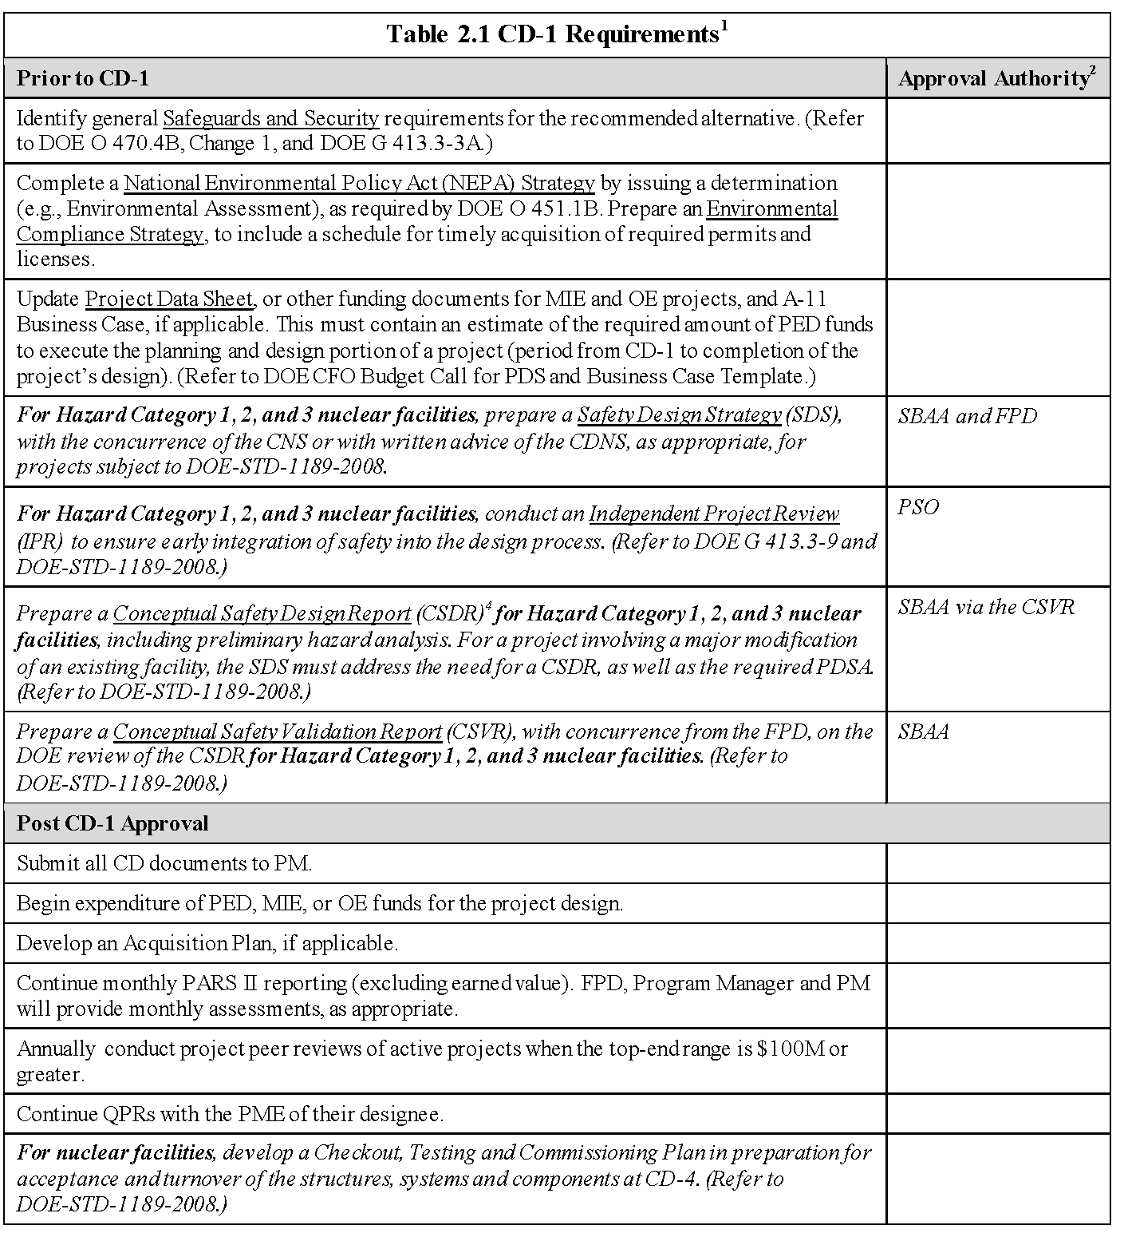
CD-1 Requirements – 413.3B
T. Dykhuis Breakout
T. Dykhuis Breakout

Slide 6
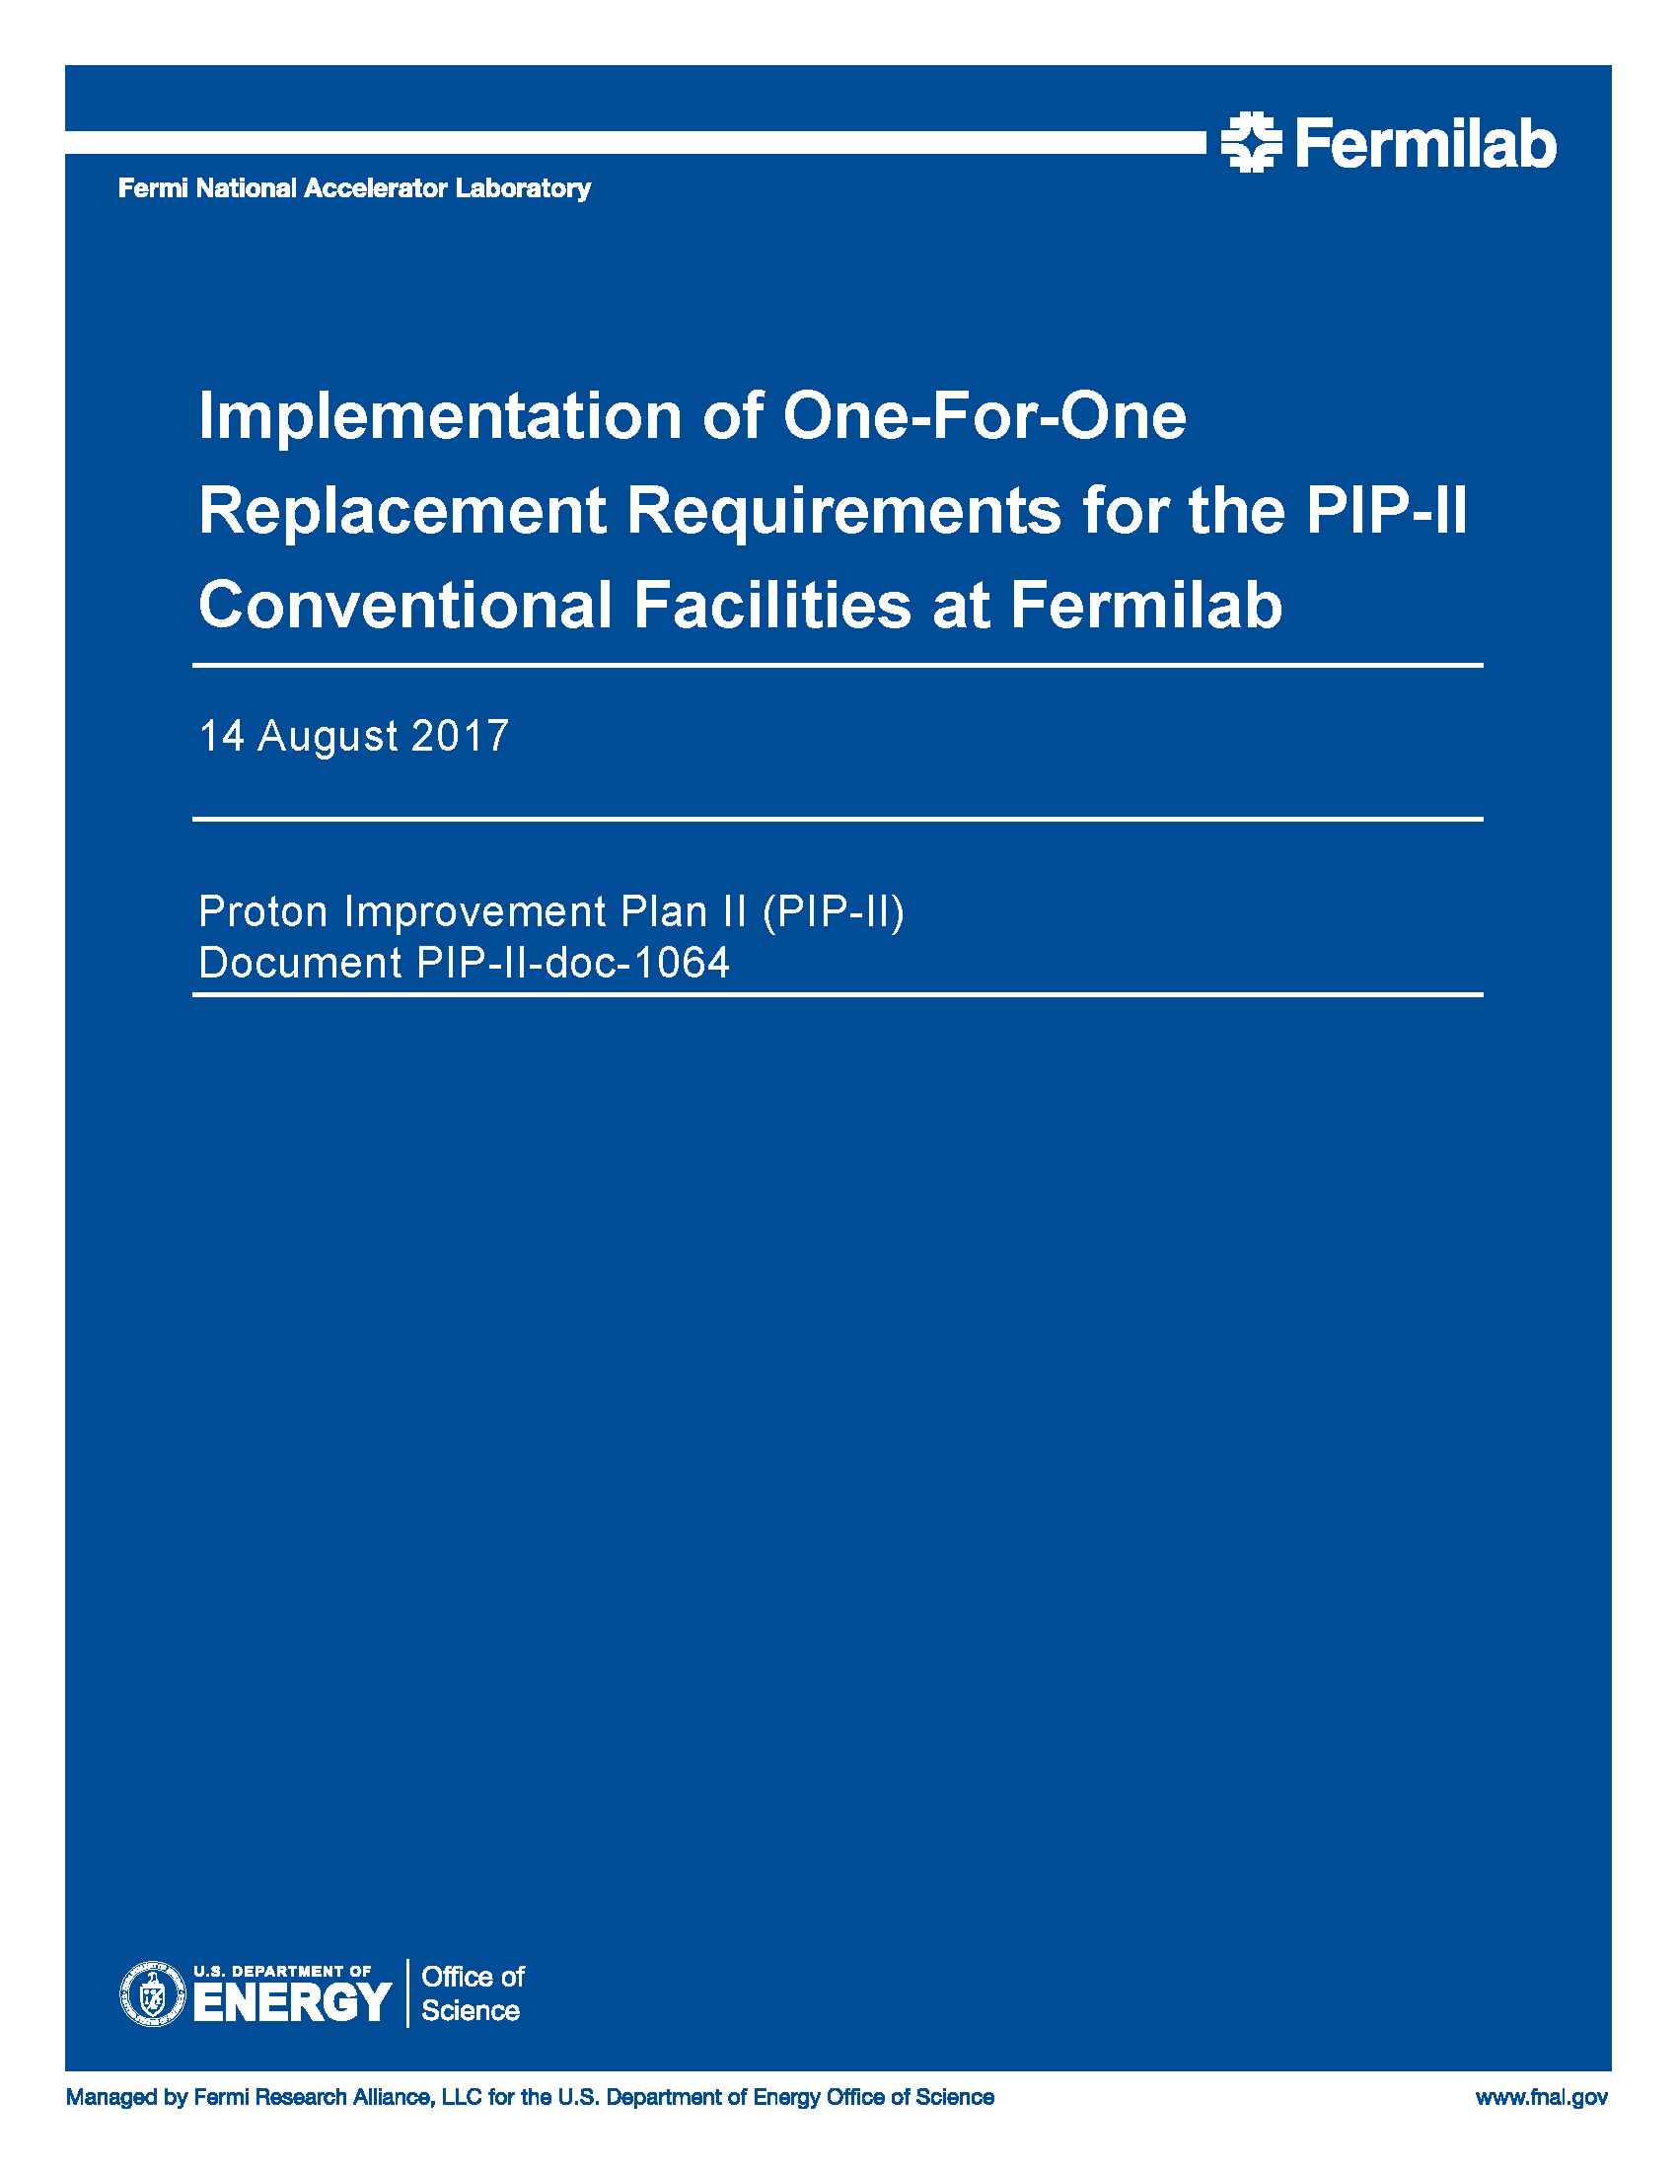
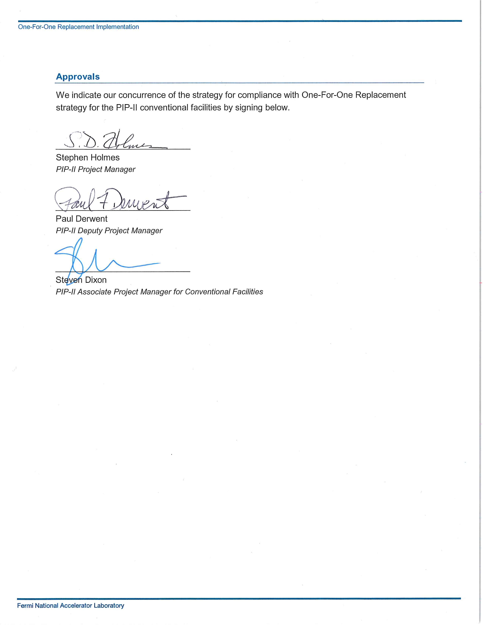
One-For-One Replacement Strategy
2006: House Report 109-06 and DOE Order 430.1;
Requirement that new construction of DOE-owned building area be offset with a declaration of excess or demolition of building area of an equivalent or greater size;
2006-Current: Changes in reporting and the tracking of the space usage/demolition;

Slide 7
One-For-One Replacement Strategy
The design of the PIP-II conventional facilities will follow DOE Order 430.1C, Real Property Asset Management, requirements including:
Ensuring construction or renovation of DOE-owned buildings above 5,000 gross square feet meet federal sustainability principles and building efficiency requirements; (HPSB)
Ensure facilities regardless of ownership comply with applicable federal metering requirements; (HPSB)
Ensure newly constructed, renovated or leased building area designated for office does not exceed the Department’s office space design standard. (180 sf/person maximum)

Slide 8
One-For-One Replacement Strategy
The design of PIP-II conventional facilities will comply with the FY 2017 Real Property Data Related to Operations and Maintenance Guidance by:
Optimizing space for functionality;
Increasing density; (180 sf/person maximum)
Eliminating old, expensive, and difficult to maintain facilities;
Constructing modern, flexible, collaborative and efficient space in accordance with sustainable practices. (HPSB)

Slide 9
One-For-One Replacement Strategy
The PIP-II project will track and report the anticipated and actual square footage of the conventional facilities throughout the project life cycle;
FESS will use existing methods to report totals to DOE (AAIM and FIMS) *;
Approach was approved in November 2017;
PIP-II-doc-1064
* AAIM = Anticipated Asset Information Module
FIMS = Facilities Infrastructure Management System

Slide 10
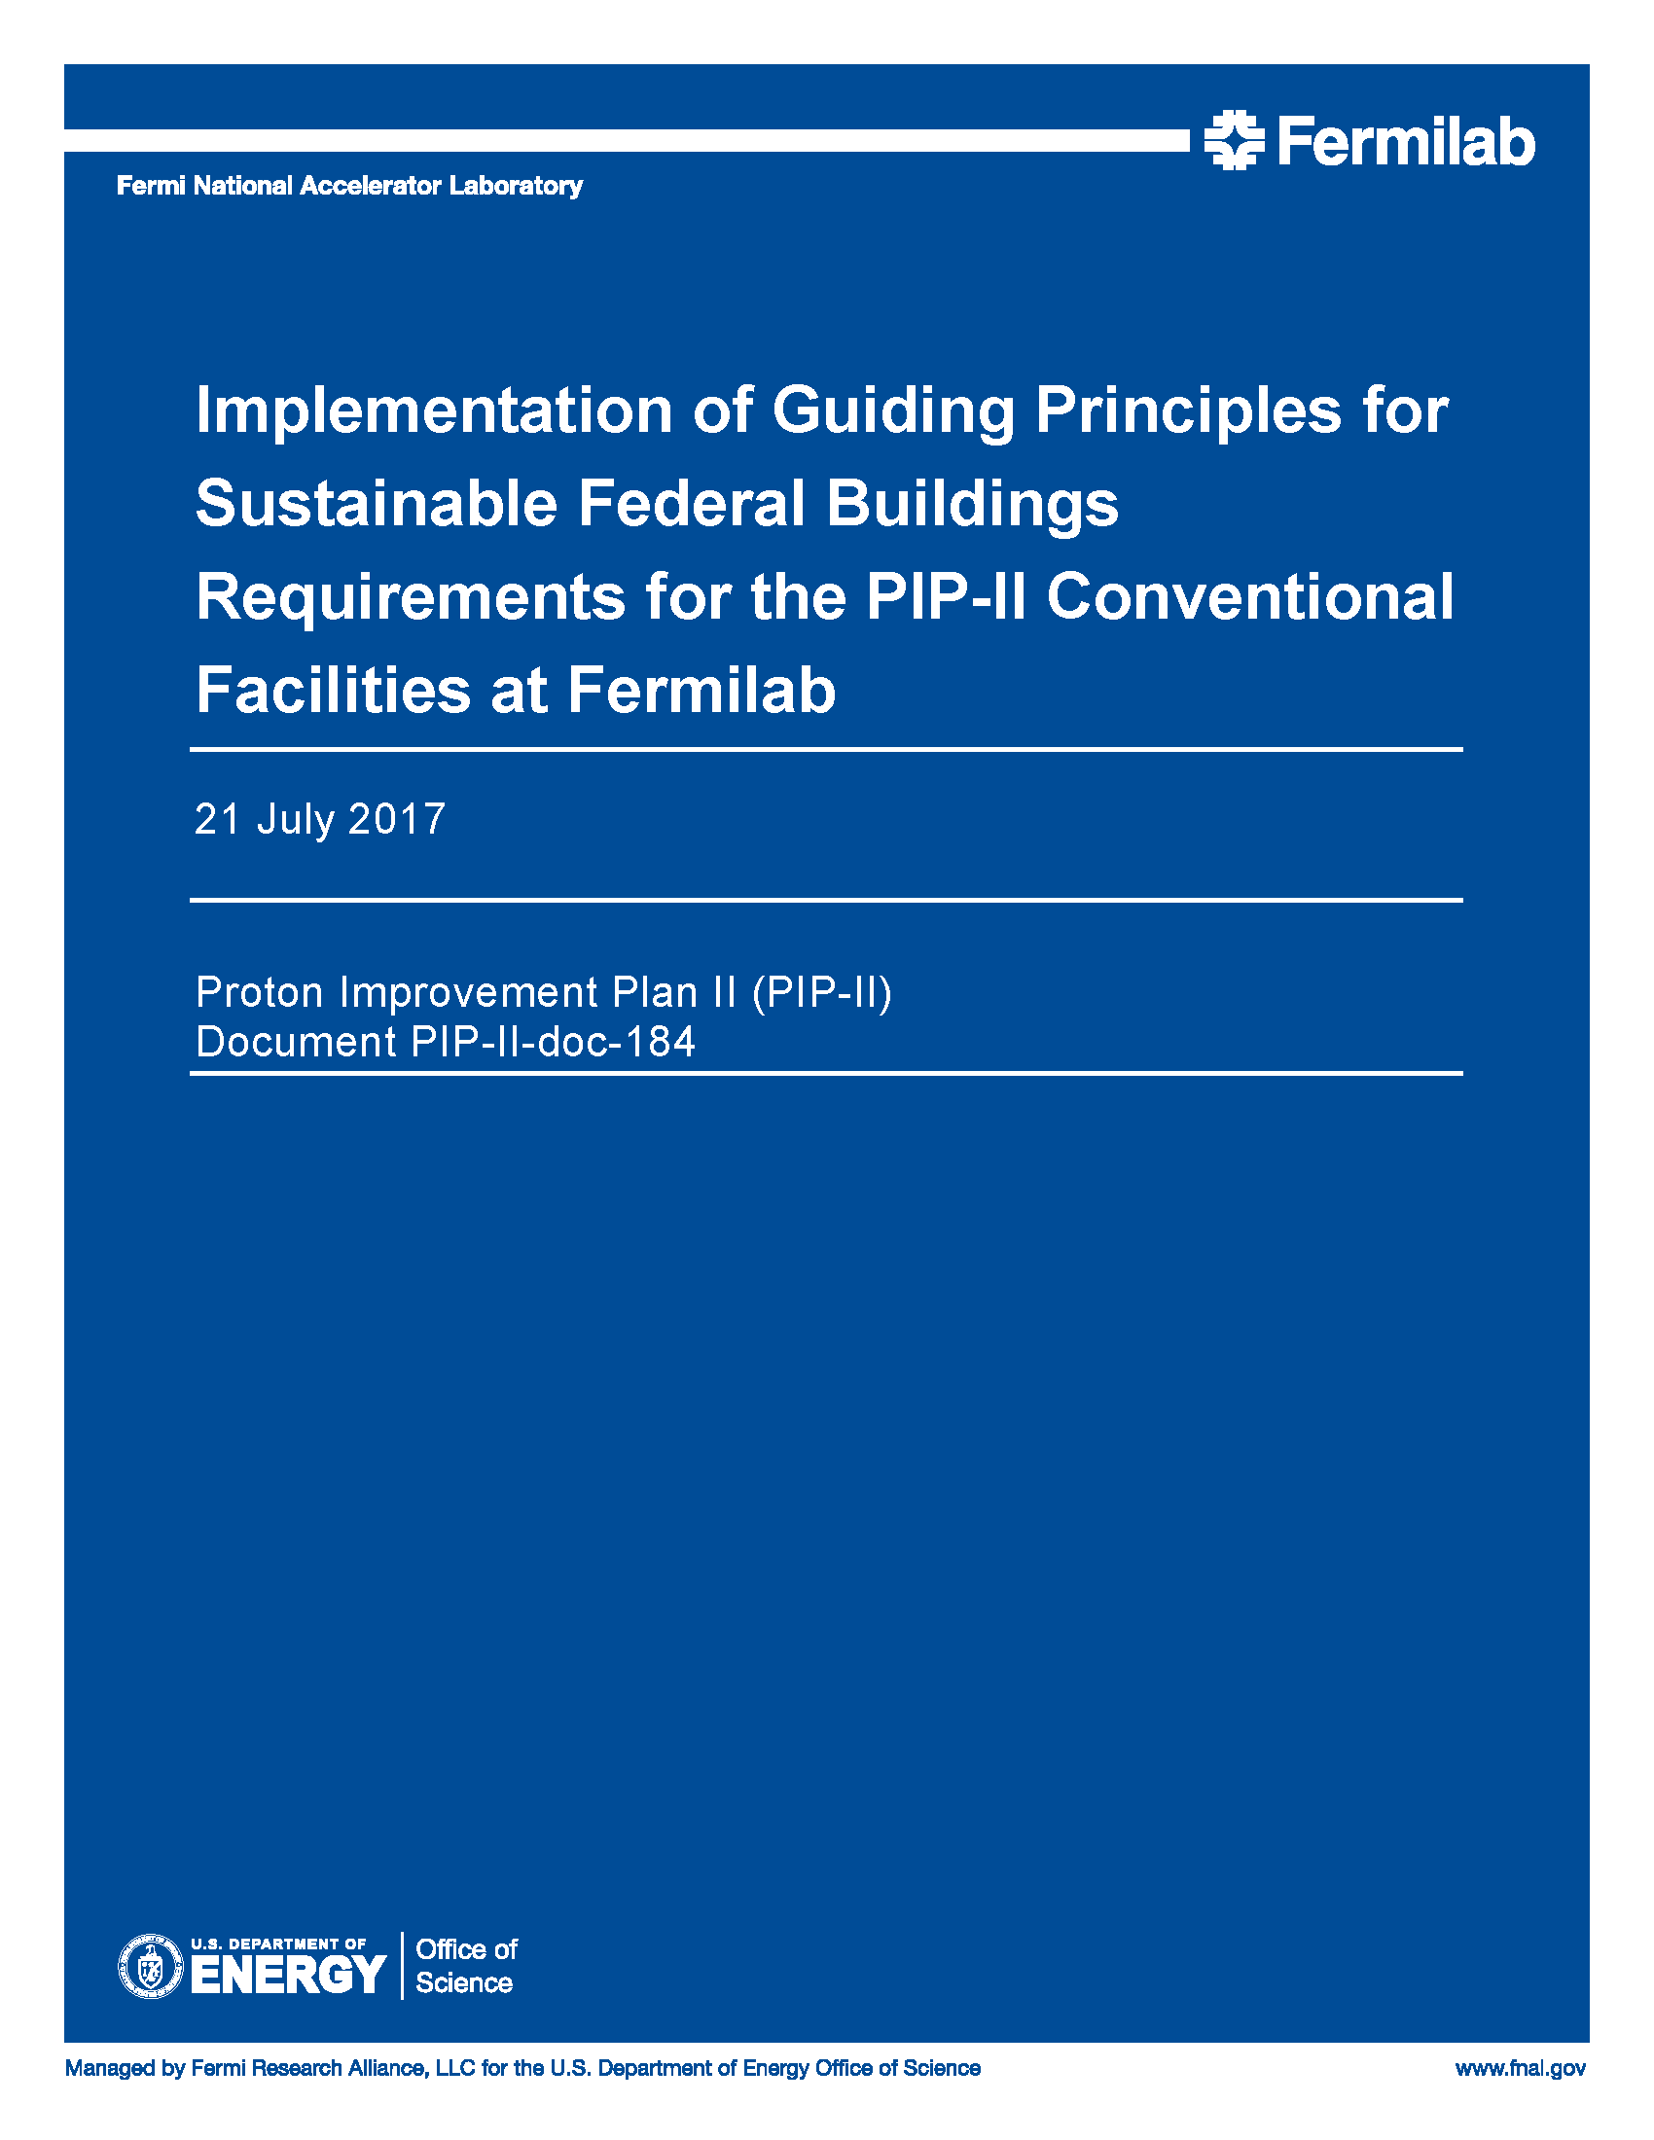
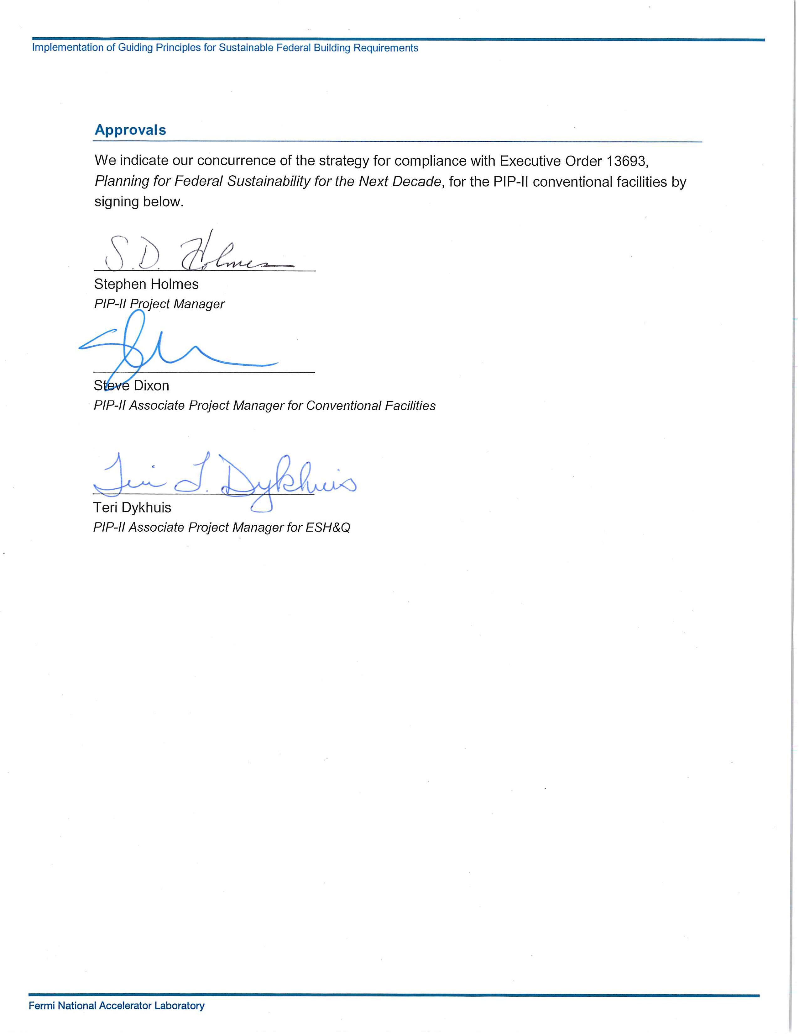
Guiding Principles for Sustainable Federal Buildings
Requirements:
Executive Order 13963
Guiding Principles for Sustainable Federal Buildings;
Compliance with 20 metrics required for new buildings;
Does not include process loads
Implementation process through design and construction;
Strategy document was signed in July 2017;
PIP-II-doc-184

Slide 11
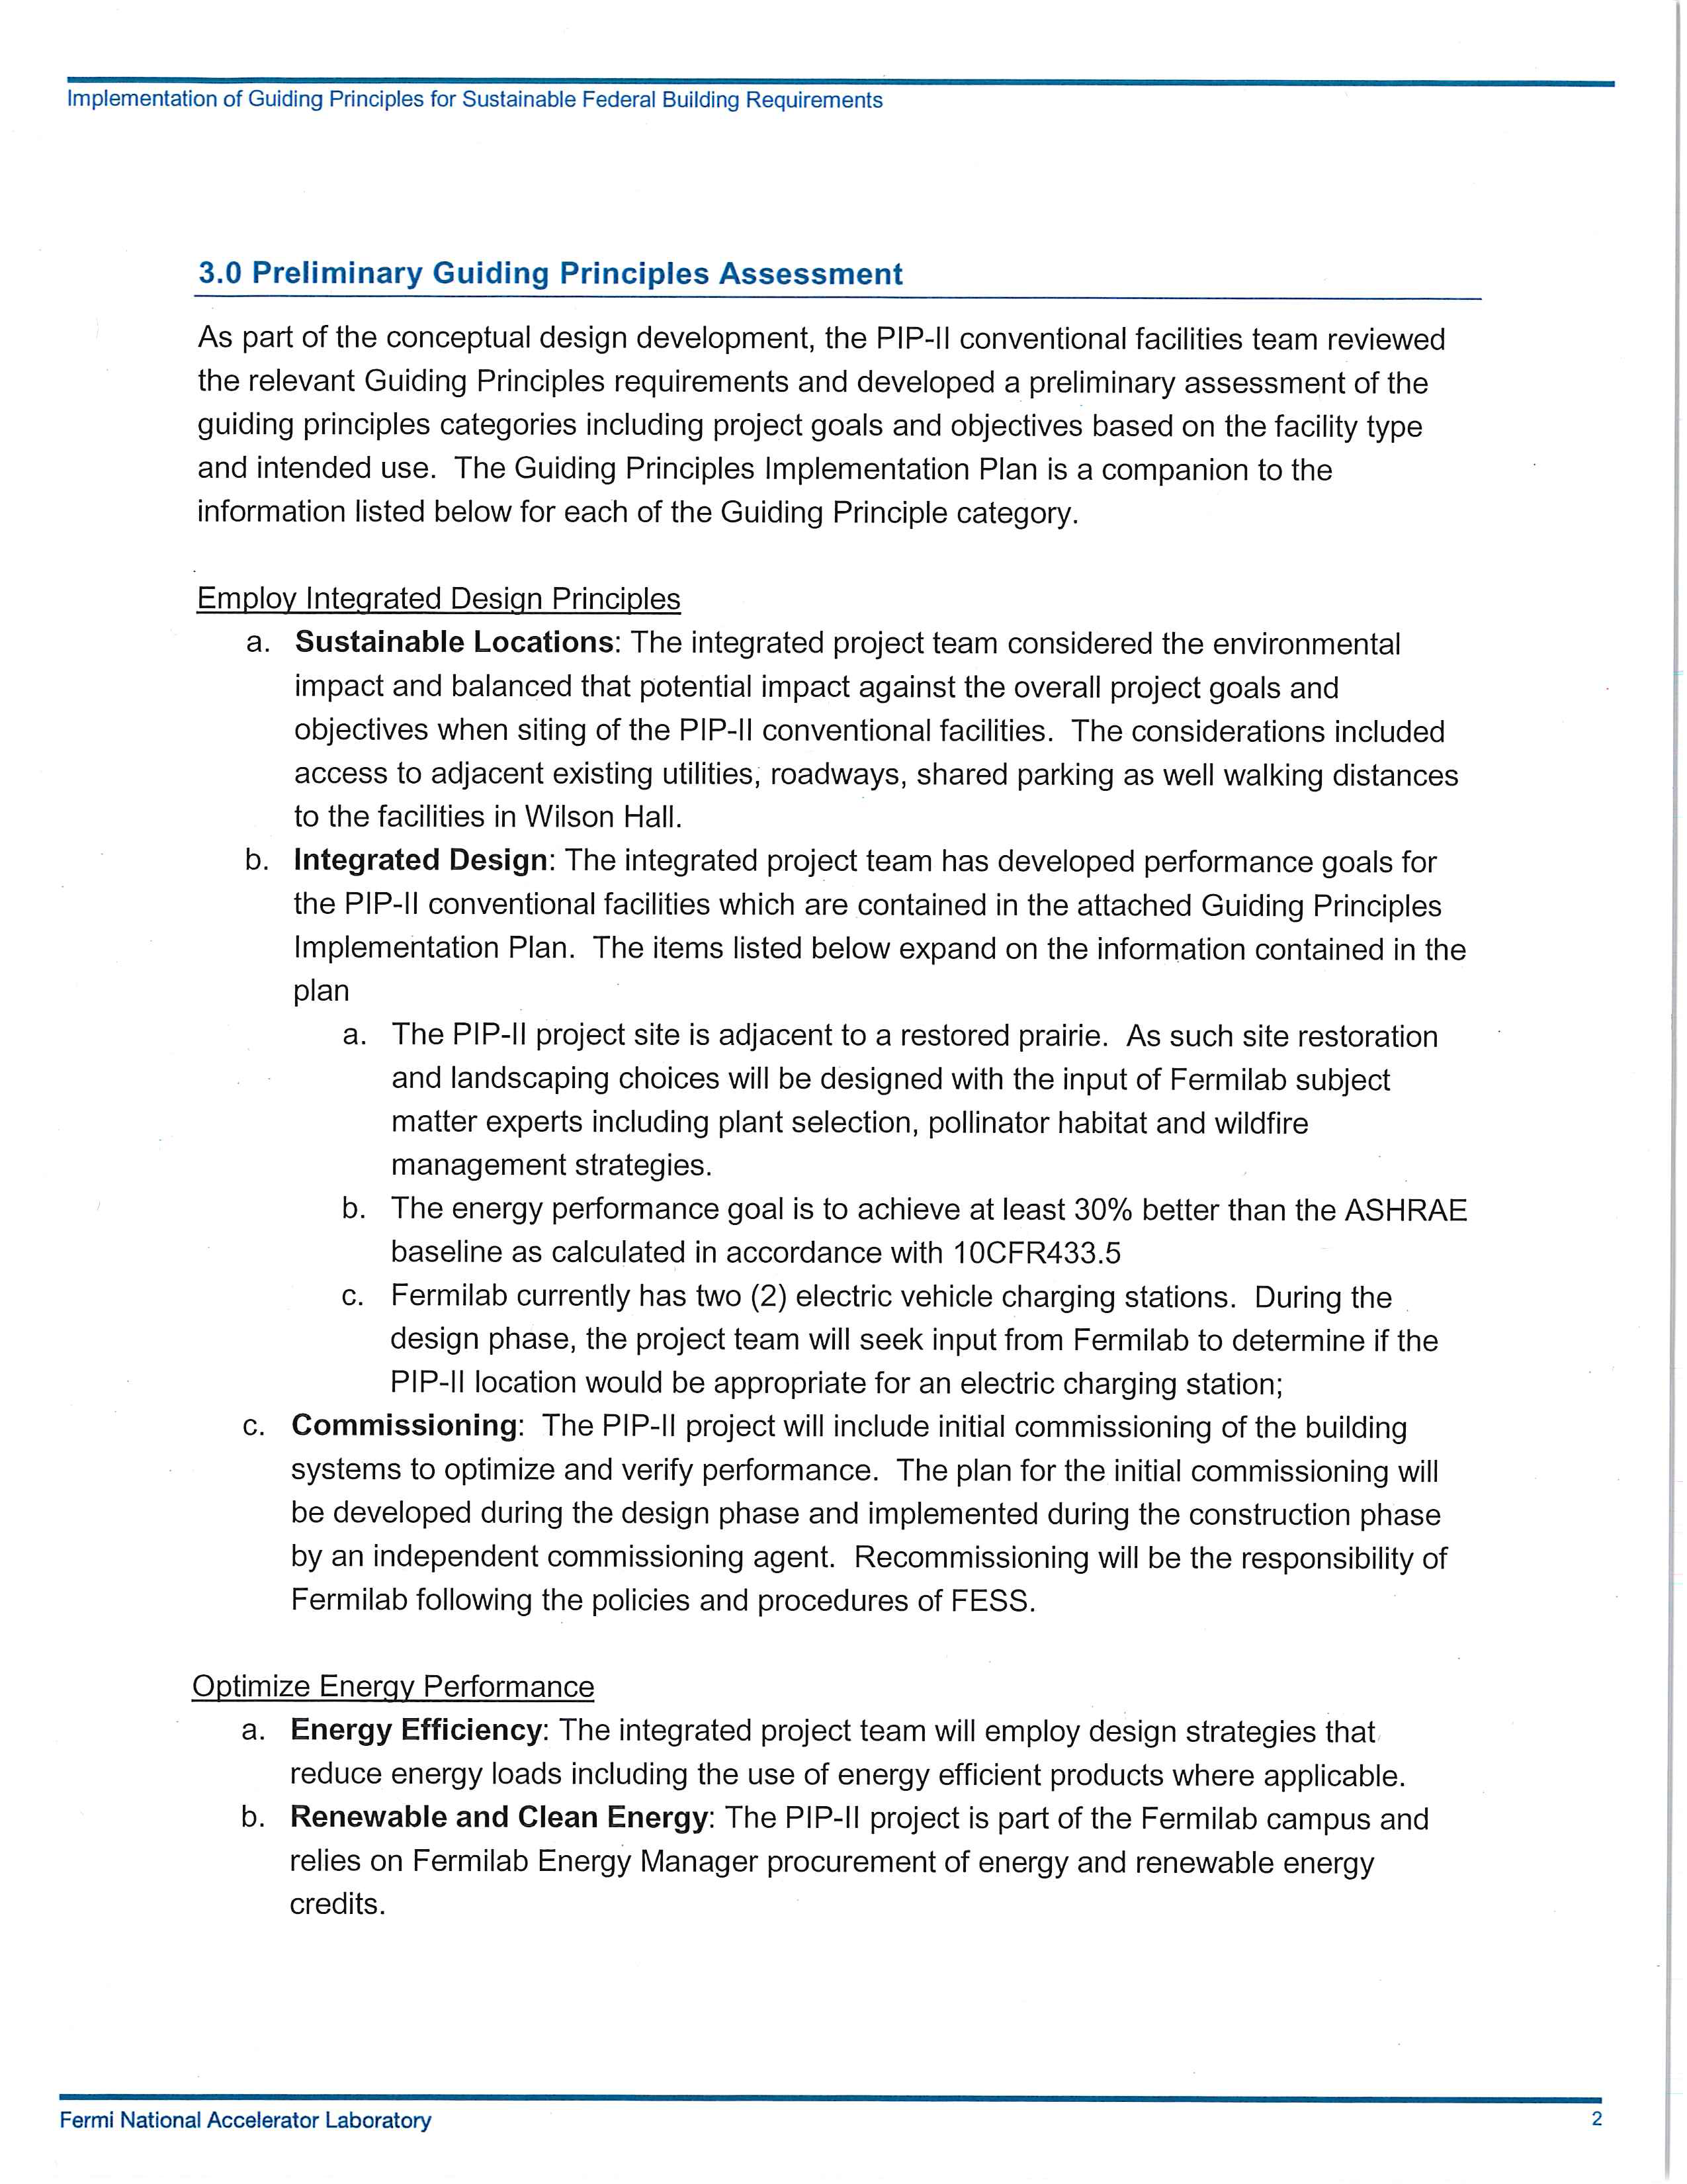
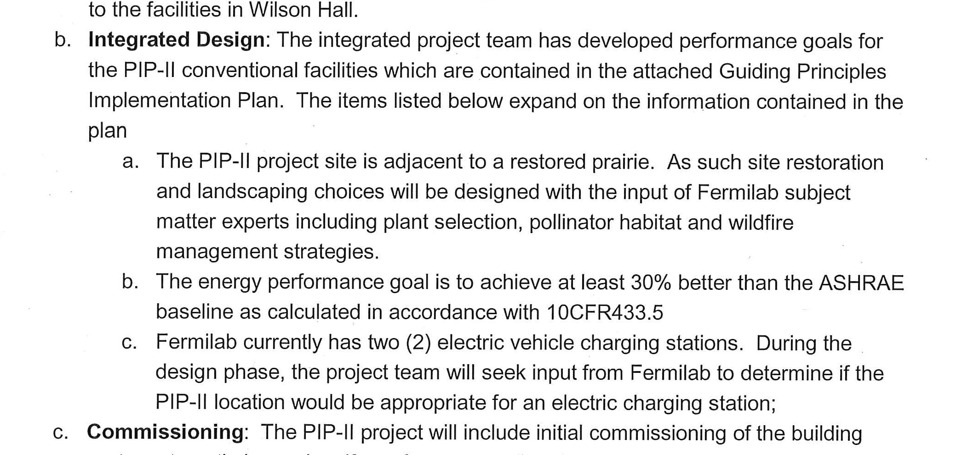
Guiding Principles for Sustainable Federal Buildings
Energy Goal:
Energy performance goal is to achieve at least 30% better than ASHRAE baseline
From the text portion of the Strategy Document

Slide 12
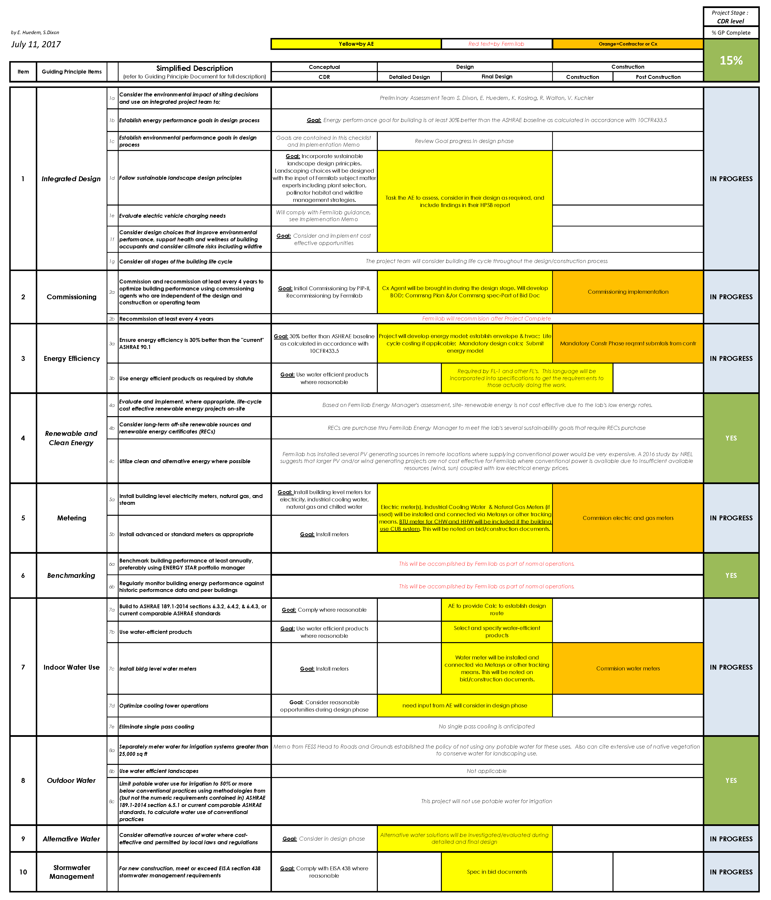
Guiding Principles for Sustainable Federal Buildings
Metering Goal
Install building level meters for electricity, industrial cooling water, natural gas and chilled water.
Goal
A/E firm
responsibilities
Subcontractor
responsibilities
From the Implementation Plan portion of the Strategy Document

Slide 13
Guiding Principles for Sustainable Federal Buildings
Conceptual Phase
Established Goals;
Assigned Responsibilities;
Reviewed and approved strategy;
Currently ~15% complete with compliance;
Next Steps:
Goals and Expectations will be included in both architect/engineer (A/E) and construction subcontracts;
Periodic updates to the implementation plan;

Slide 14
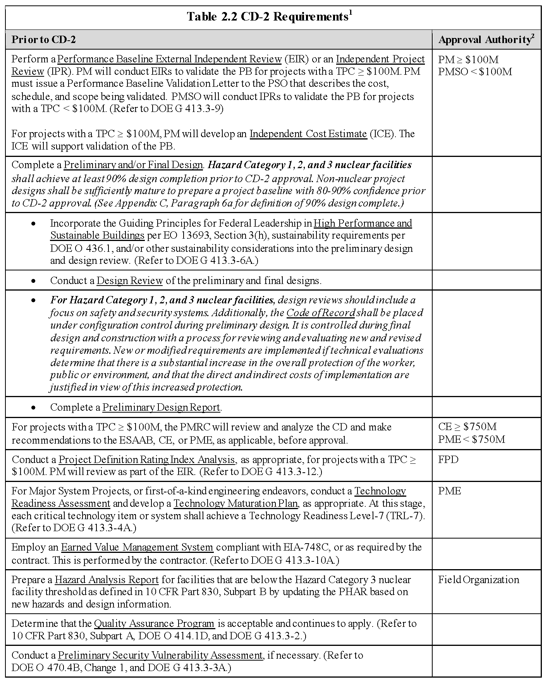
CD-2 Requirements
Plan in place
Implementation Plan in place
Reviews included in plan
Underway
DOE G413.3-12
“a project management tool designed to increase the likelihood of project success by improving project scope definition, specifically by identifying deficiencies in scope definition early during the front-end planning process”

Slide 15
Project Definition Rating Index Analysis
Project Management Tool
DOE Guide 413.3-12 Project Definition Rating Index Guide for Traditional Nuclear and Non-Nuclear Construction Projects;
Based on numerical project management tool developed by Construction Industry Institute;
Measures the degree of scope development for traditional construction projects;
Tool:
5 major elements;
73 scope definition sub-elements;

Slide 16
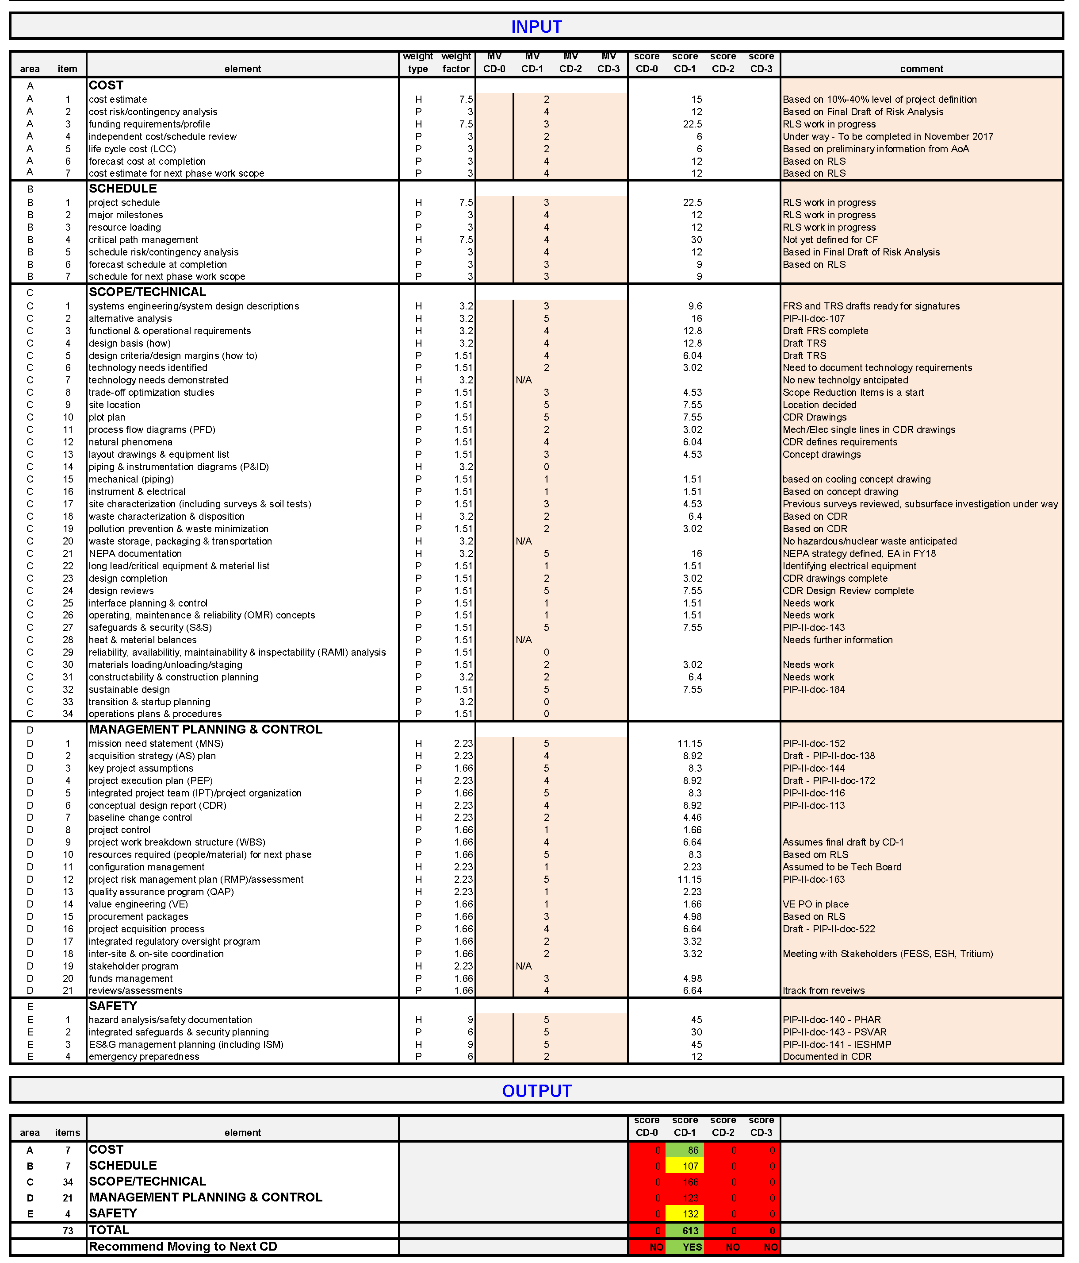
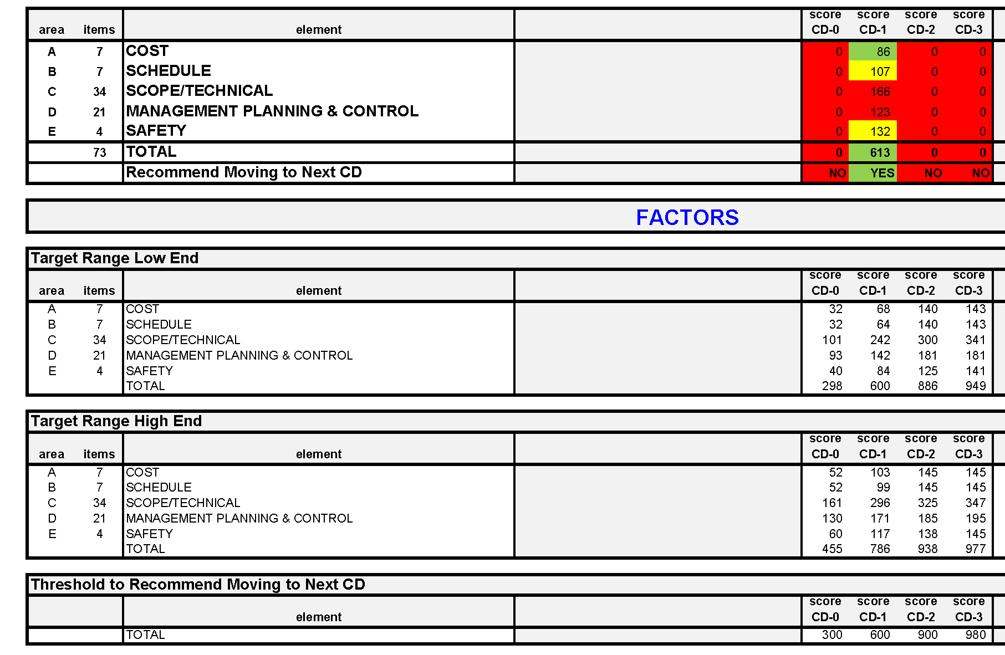
Project Definition Rating Index Analysis

Slide 17
Project Definition Rating Index Analysis
First Pass
PIP-II project office;
Scored 613 at CD-1 level
PIP-II-doc-1230
Next Steps
Review with the A/E project team;
Continue to review throughout project life cycle;

Slide 18
Summary
Path to CD-1
Conceptual Design - Complete;
Conceptual Design Report - Complete;
Design Review - Complete;
One-for-One Replacement Strategy - Complete;
HPSB Documentation - Complete;
CD-2 Requirements
Complete Preliminary and/or Final Design – Plan in place
HPSB Implementation – Executing Plan
Design Reviews – Plan in place
Project Definition Rating Index – 1st pass complete

Slide 19
Questions

