Slide 1
121.4.2 Recycler and Main Injector
RF Systems
Joseph E. Dey
PIP-II Independent Project Review
12-14 December 2017

Slide 2
Outline
Requirements
Conceptual Design, Maturity
Scope
Interfaces
Technical Progress to Date
ESH&Q
Risk
Cost
Schedule
Summary

Slide 3
About Me:
Joseph E. Dey : Senior RF Design Engineer
  NOvA - Main Injector RF Cavities L3 Manager
  Mu2e - Delivery Ring RF L3 Manager
  Recycler RF AIP L2 Manager
  Accelerator Division RF Department

Slide 4
Scope: WBS Dictionary
WBS Dictionary: pip2-docdb #599
121.4.2 PIP-II – Rings Upgrade - Recycler / Main Injector | This WBS entry covers labor, materials, travel, and costs associated with the design, procurement, fabrication, and installation of the upgrades to the Recycler and Main Injector to handle increased intensity and shorter cycle times.

Slide 5
WBS L3 System Requirements
Charge #2
Recycler Requirements
  Slip Stack at 20 Hz
    Slip stacking cavities with higher voltage.
  Support Main Injector operations from 60-120 GeV.
    Slip stacking cavities should be able to work CW.
Main Injector requirements
  Have enough RF power to accelerate up to 7.5E13ppp with a 1.2 sec cycle time.
    Increase the RF power in all 20 MI RF stations.

Slide 6
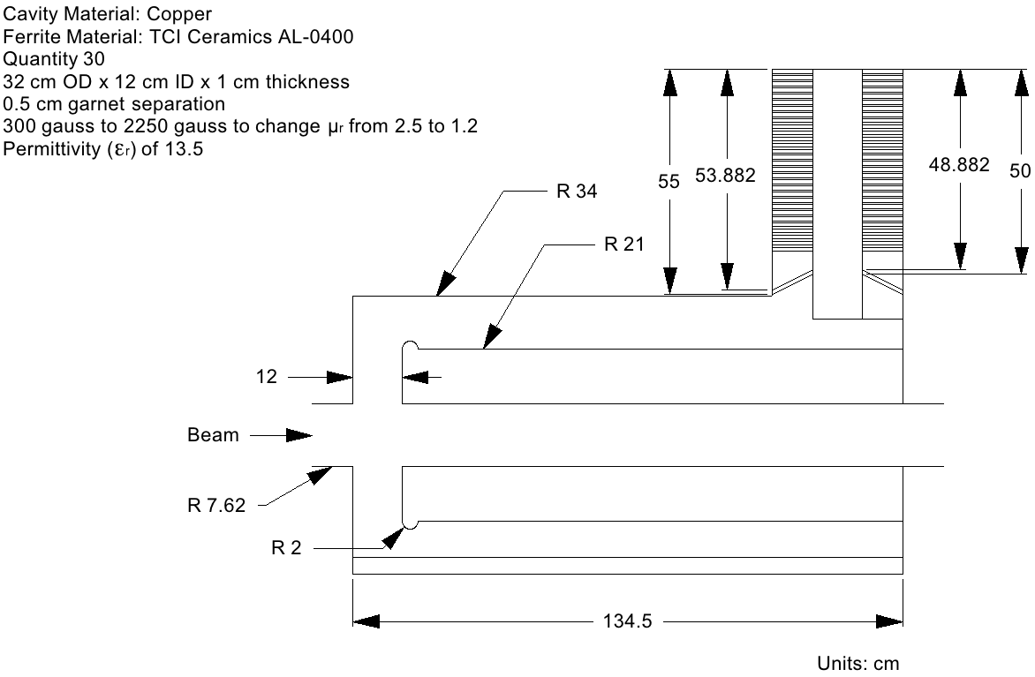
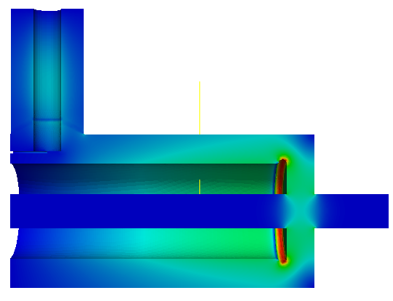
Conceptual Design and Design Maturity
Charge #2
Preliminary Design of
Recycler 53 MHz Cavity
maxEs=7.4MV/m
@ μr=2.5 and μr=1.2
with 20mm gap rounding
Second Harmonic Cavity Design for Project X Main Injector
IPAC 2012, New Orleans, Louisiana
Liling Xiao, Cho-Kuen Ng, SLAC
J. Dey, I. Kourbanis, FNAL

Slide 7
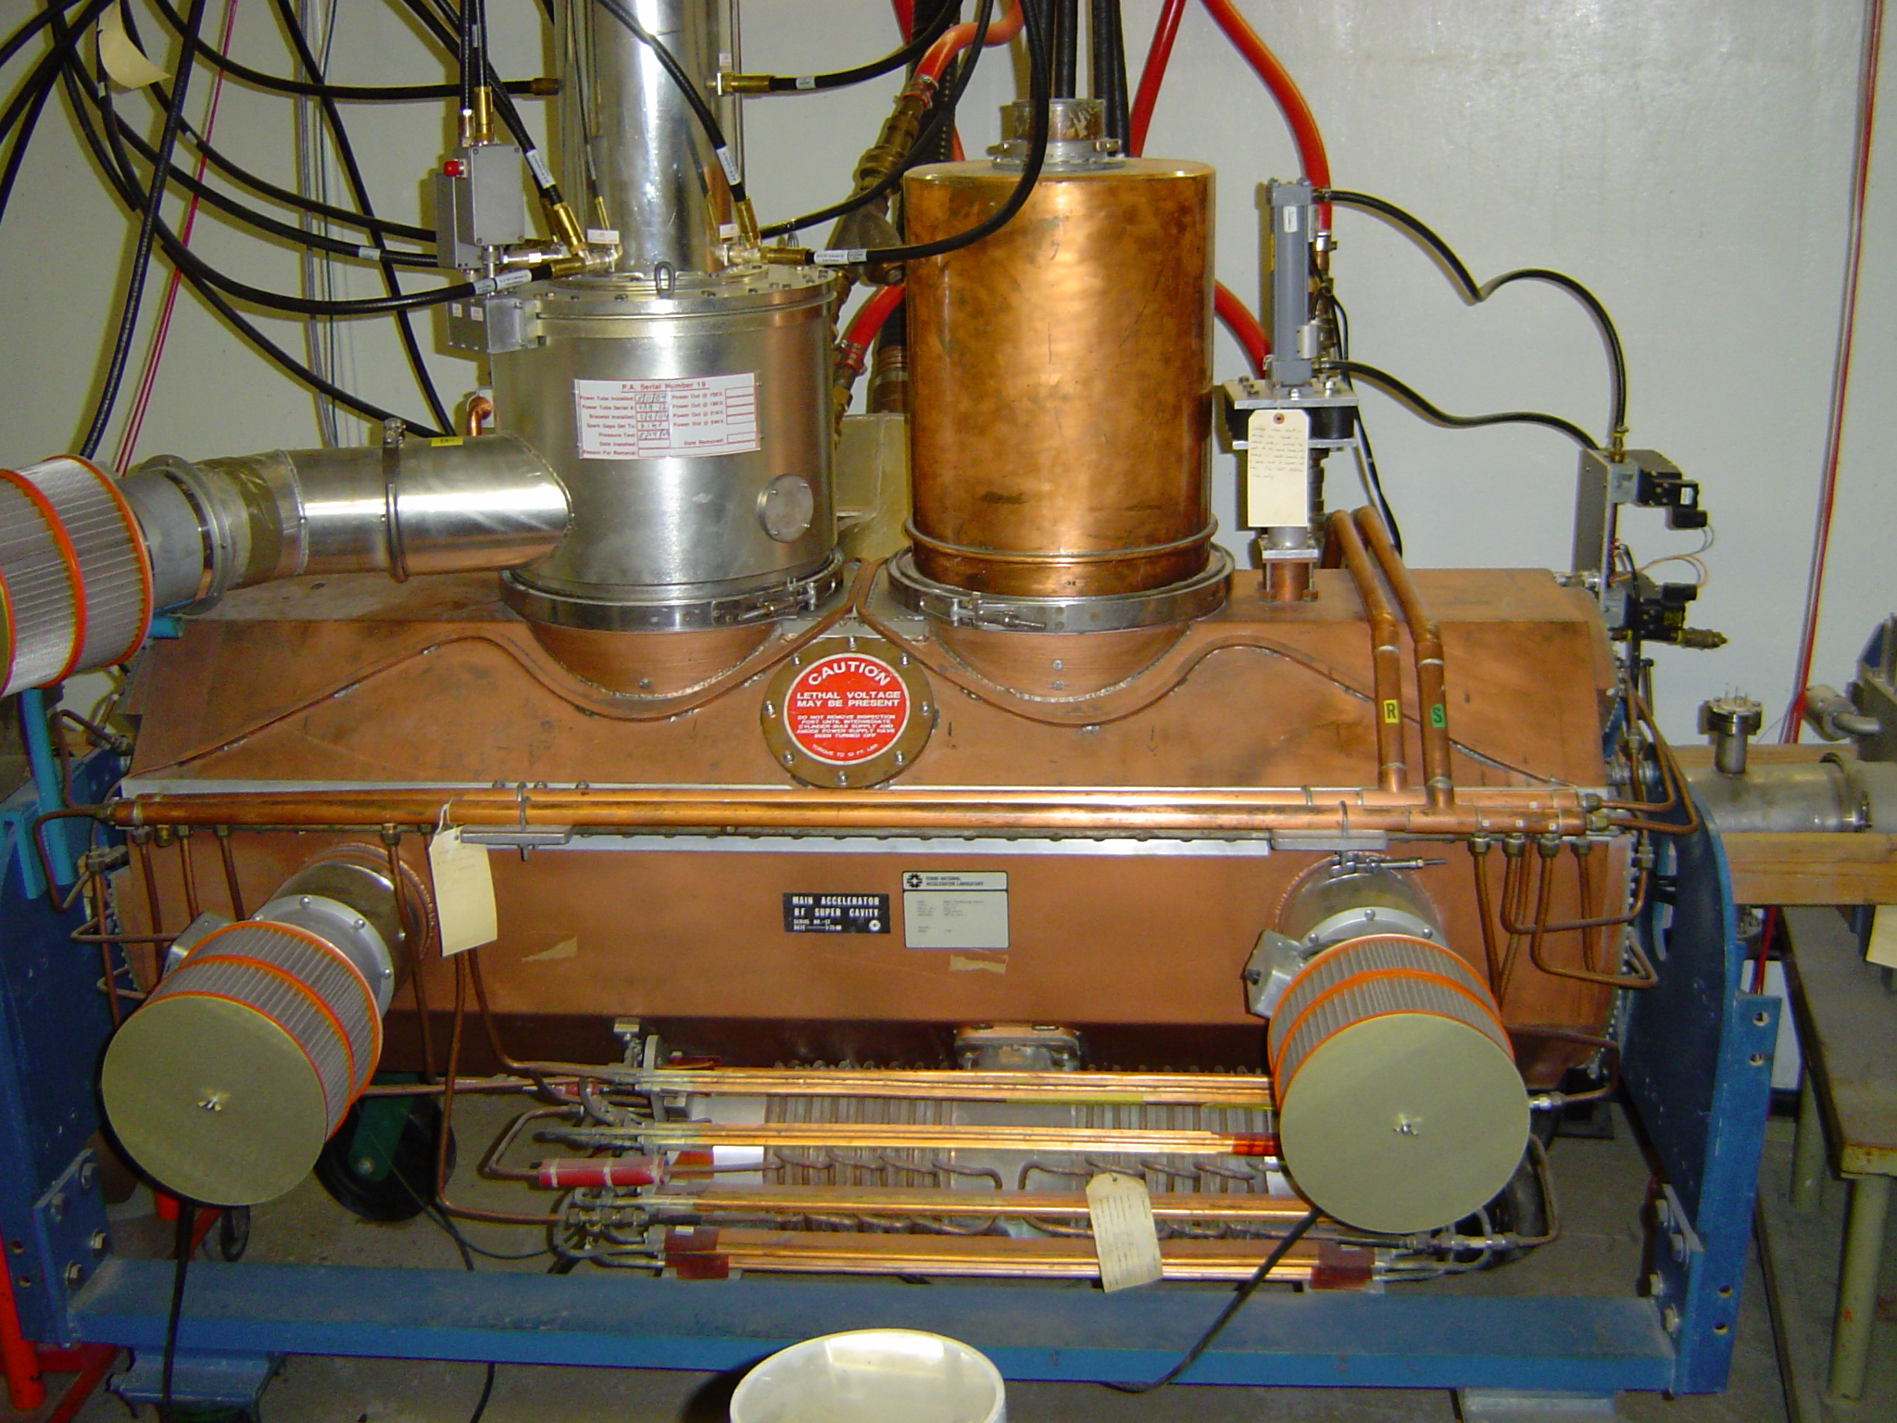
Conceptual Design and Design Maturity
Charge #2
Preliminary Design of
MI-RF Power Upgrade
Two Power Amplifier

Slide 8
Scope and Deliverables
Charge #2
WBS 121.4.2.3 - Deliver 3 new Recycler 53 MHz cavities that meet their design requirements along with their driver amplifiers.
WBS 121.4.2.3 - Remove the old Recycler 53 MHz cavities and install the 3 new cavities in their place.
WBS 121.4.2.4 - Deliver 20 upgraded MI RF stations along with their corresponding modulators and their solid state drivers.

Slide 9
Interfaces
Charge #2
System this WBS interfaces to:
Top 3 Internal Interfaces
within this WBS:
WBS 121.02.03.03 Recycler Cavity System - Fabrication/Delivery Support
WBS 121.02.03.02 Recycler Cavity System - Procurement
WBS 121.02.03.04 Recycler Cavity System - Test/Assembly
WBS 121.4.2
Recycler and Main Injector
WBS 121.3.17
Linac -Controls
If the control system is not complete we will not be able to run Recycler or Main Injector
WBS 121.4.1 Booster

Slide 10
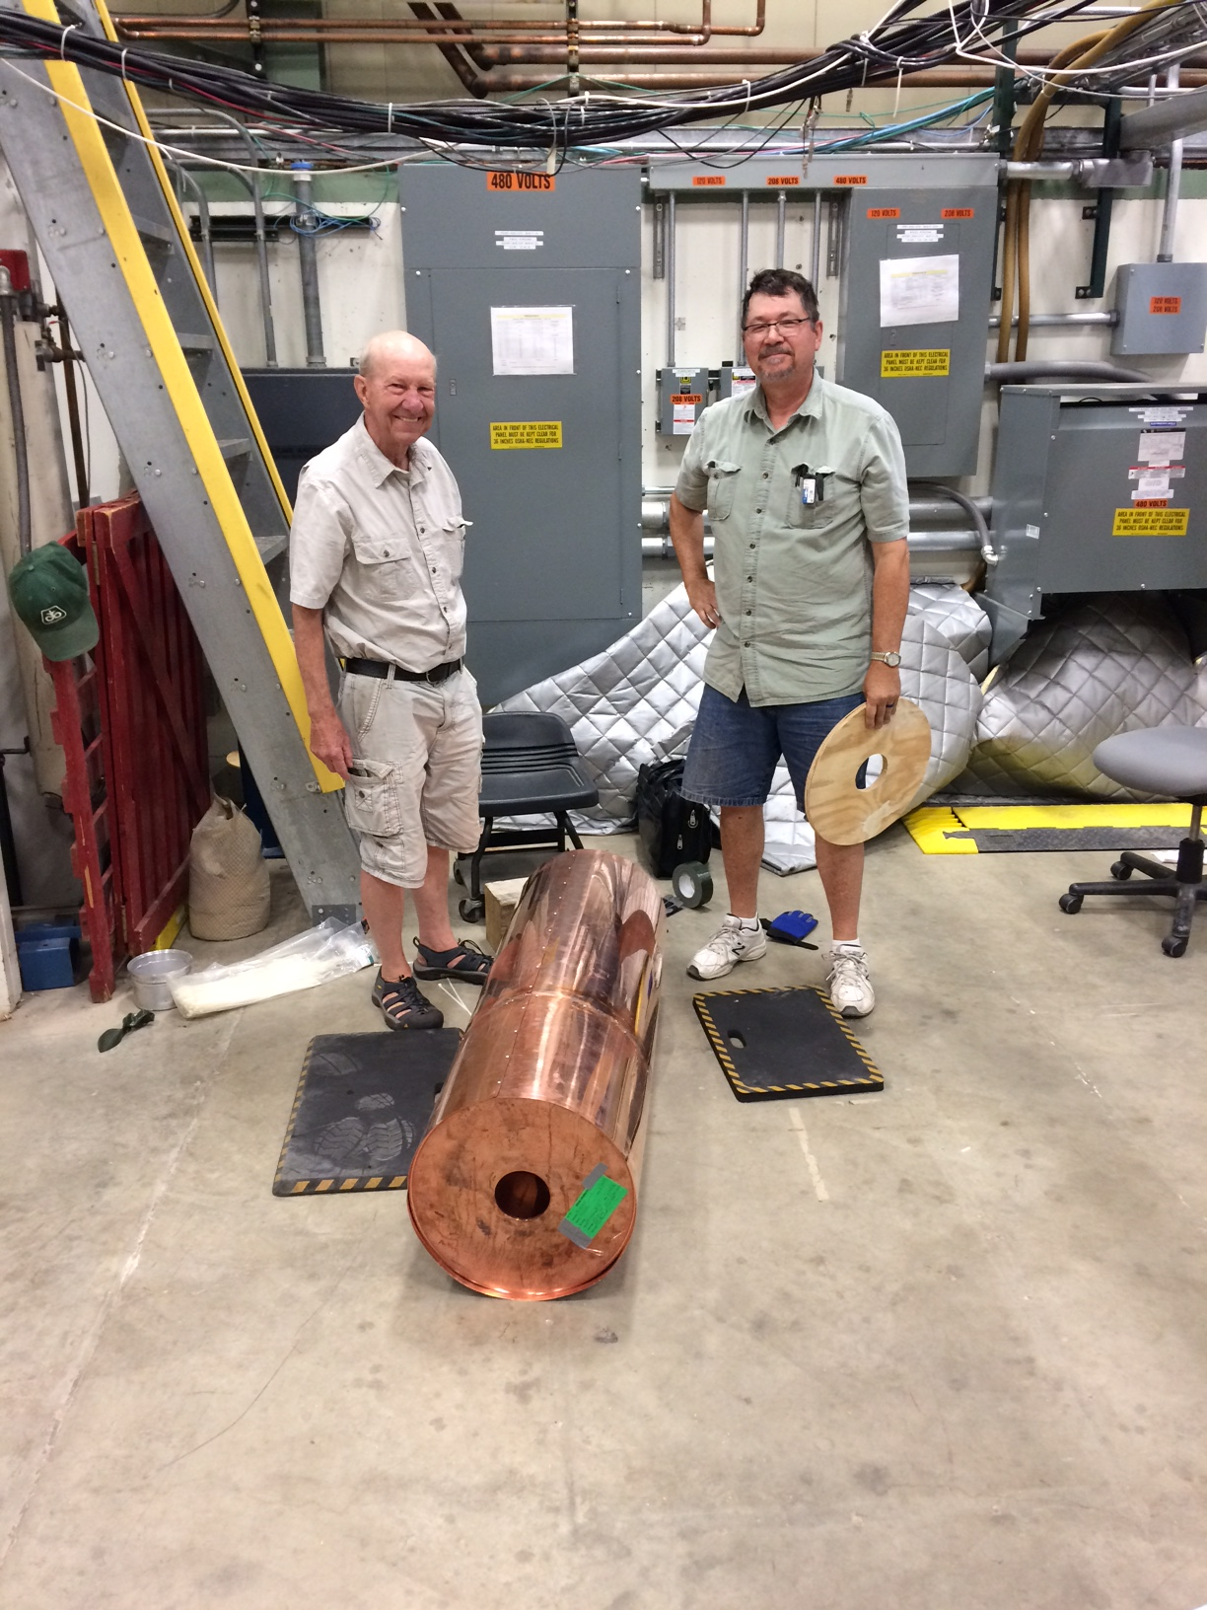
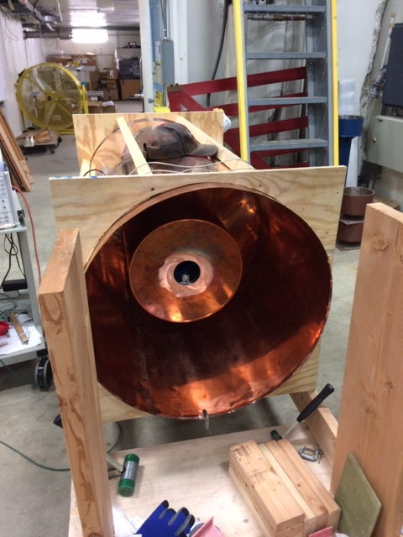
Progress to date
Charge #2,3
Mock-up of Recycler Ring Cavity

Slide 11
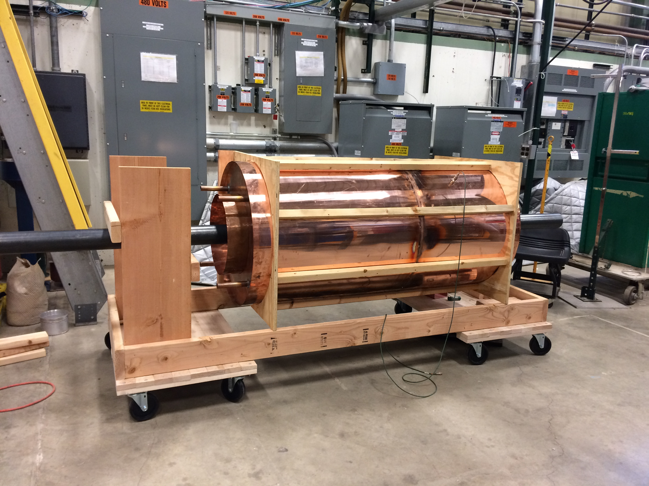
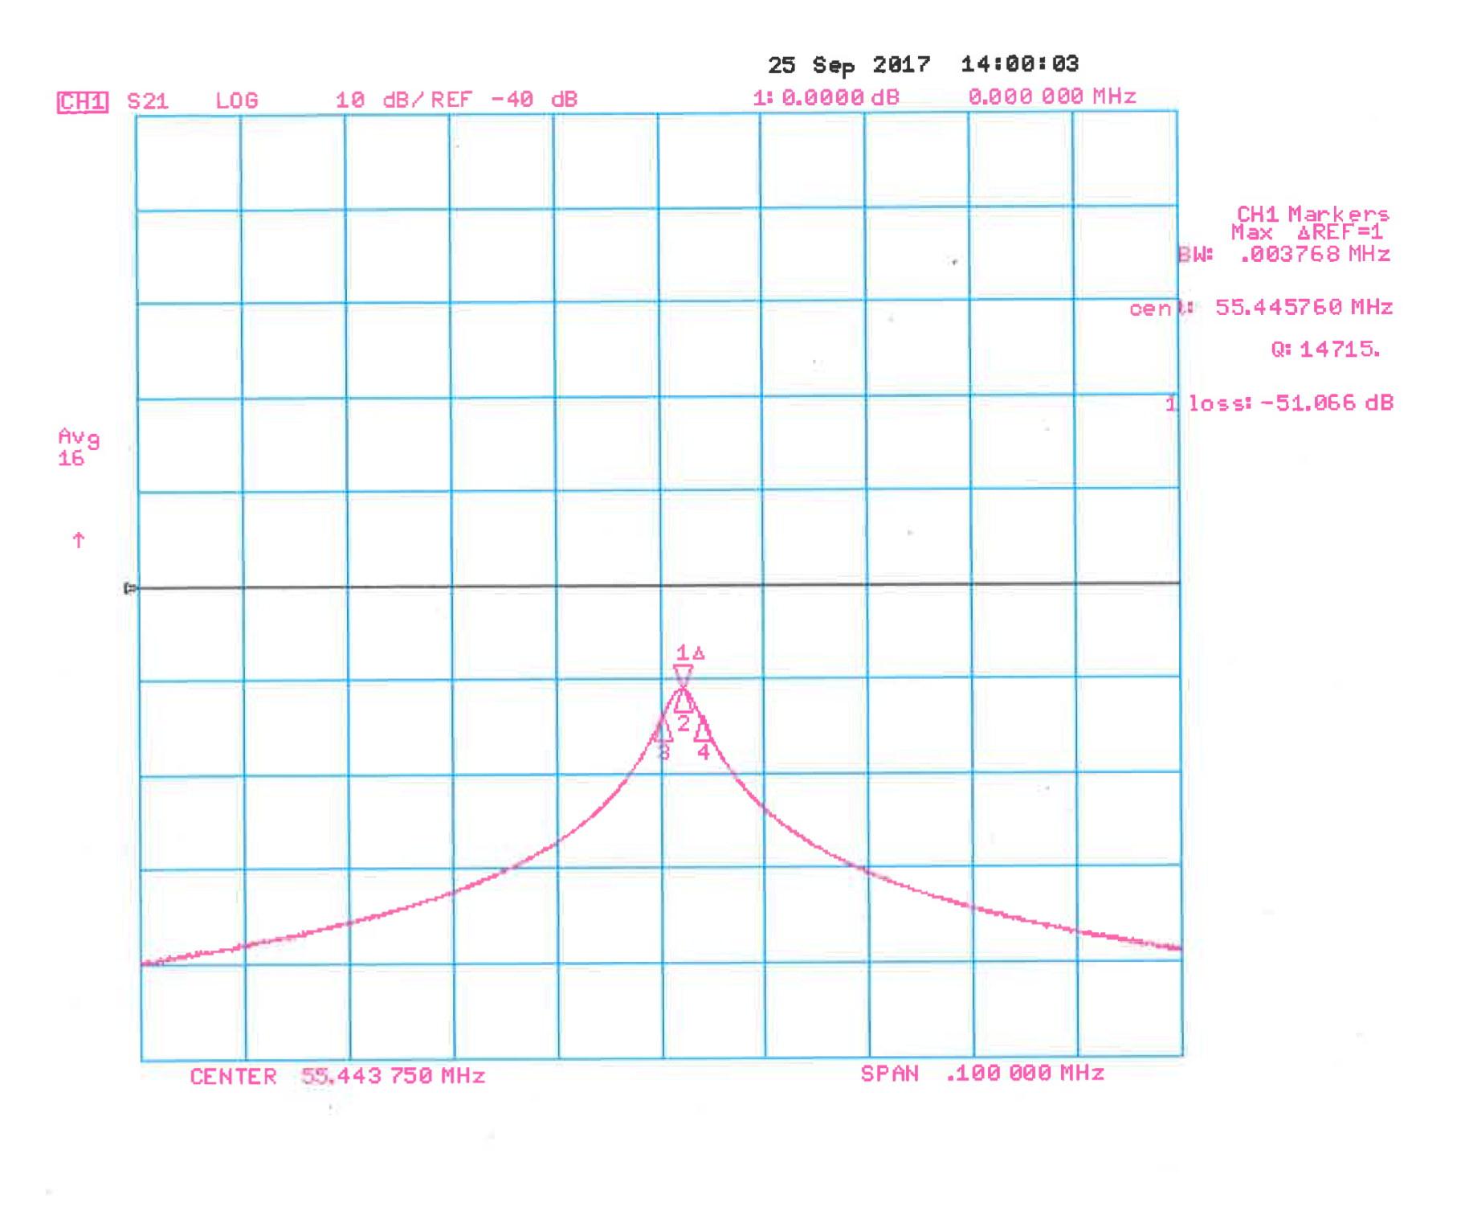
Progress to date
Charge #2,3
Mock-up of Recycler Ring Cavity
Mathematica Transmission Line Model: Q = 16,283
CST Microwave Studio Model: Q = 15,860
Mock Cavity Measurement: Q = 14,715

Slide 12
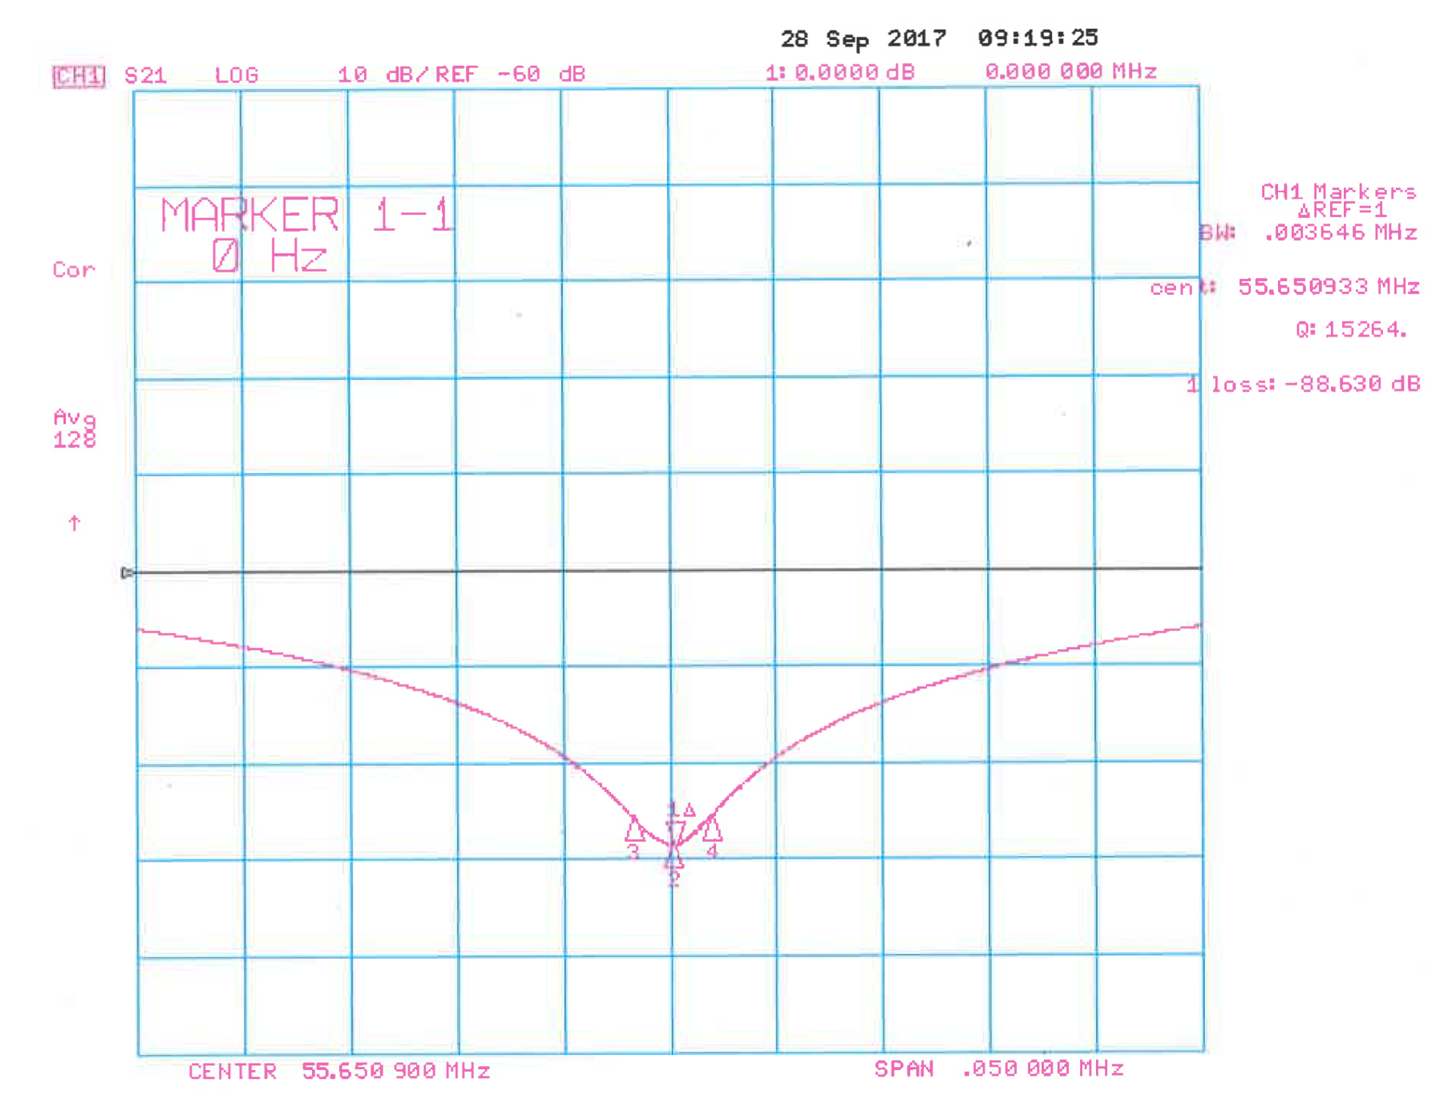
Progress to date
Charge #2,3
Mock-up of Recycler Ring Cavity
Shunt Impedance
Mathematica Transmission Line Model: 700.2 kΩ
CST Microwave Studio Model: 705.8 kΩ
Stretched Wire Method on Mock Cavity: 717.5 kΩ
Stretched Wire Method

Slide 13
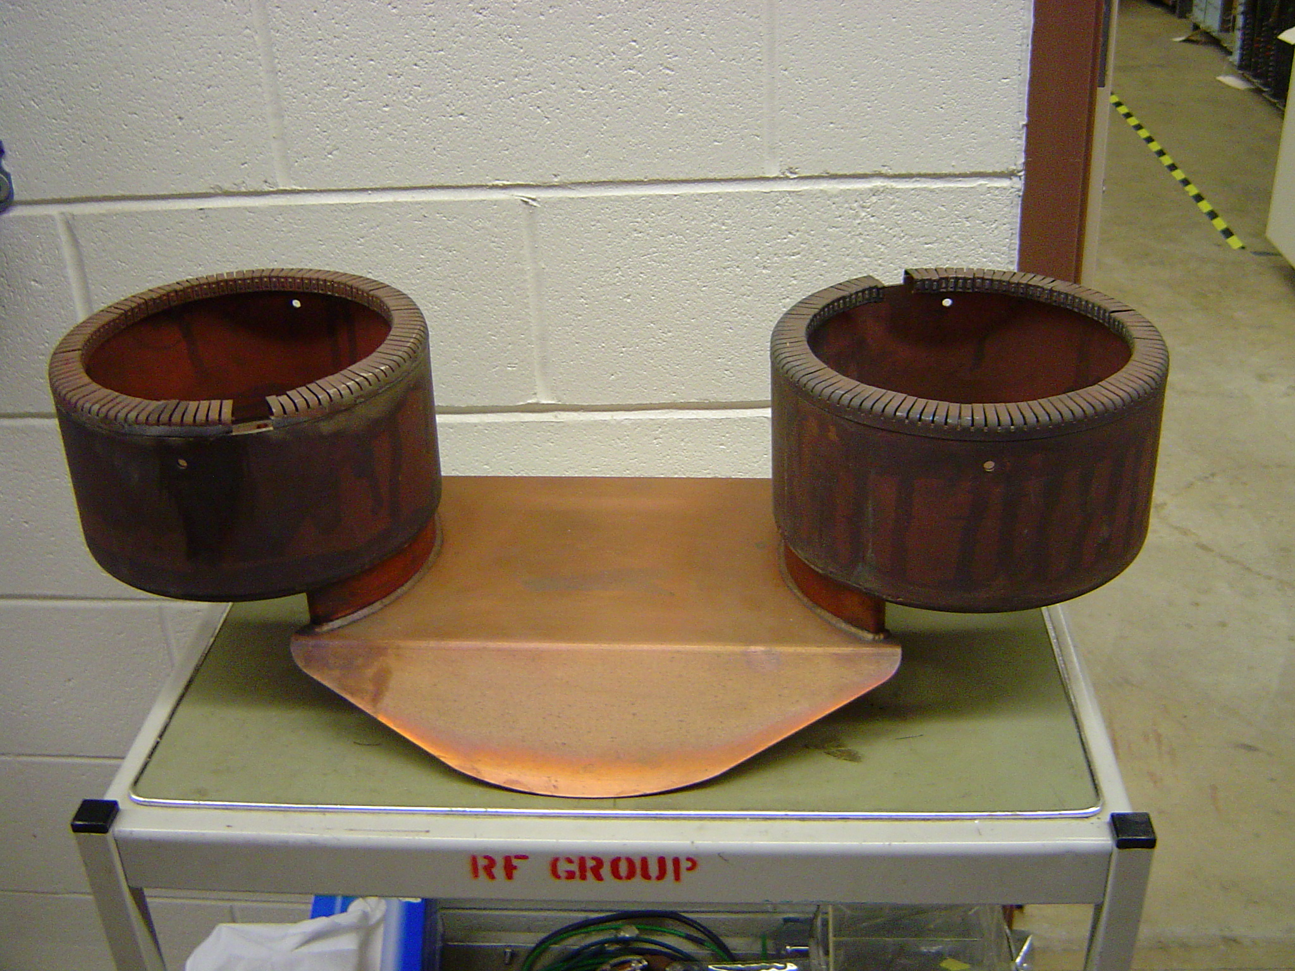
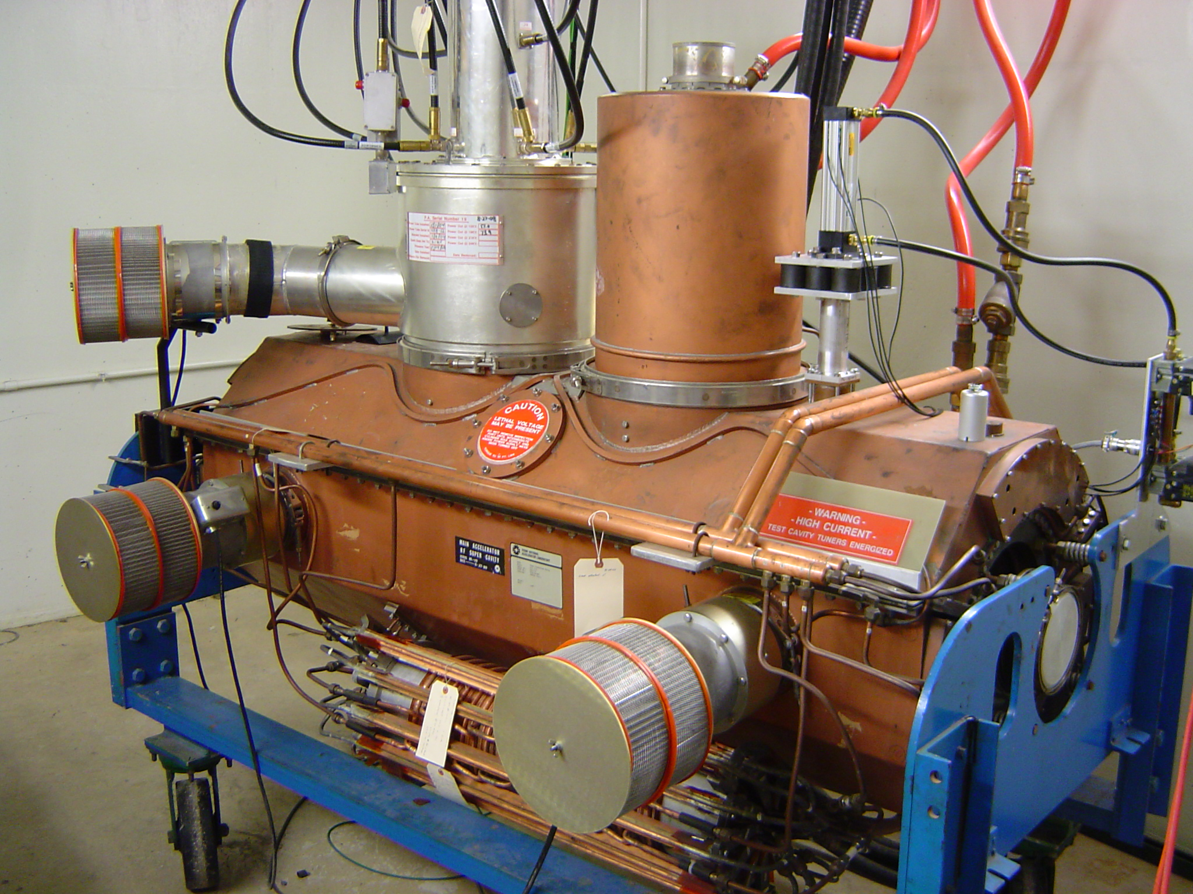
Progress to date
Charge #2,3
MI-RF Power Upgrade
Two Power Amplifier
Two PA Coupling Loop
Main Injector Test Stand
Low-level Test with MI Test Stand Cavity Modified
with Two Power Amplifiers.

Slide 14
ESH&Q
Charge #5
ESH is integrated into all phases of the Project
  Design, Construction, Installation
ESH requirements are clearly defined within the Project
  FESHM, FRCM
  Project Integrated Safety Management Plan (docdb #141)
Design & installation review process includes an ESH component
Utilize Fermilab’s work planning requirements & processes
  Hazard analysis
  Daily work planning meeting
QA/QC activity such as:
  Follow the project quality program
  Flowdown to vendors/collaborators
  Test protocols in development

Slide 15
ESH&Q
Charge #5
ESH in Action -
  Paper was written called “X-ray Exposure Analysis for the Recycler/Delivery Ring 2.5 MHz Ferrite Loaded Cavity” for Recycler RF AIP.
Quality Assurance and Control
  Project Quality Assurance Plan (docdb #142)
  Communicate and work with vendors and collaborator
QA in Action -
  70 half meter in diameter Ferrites were electrically, physically and mechanically tested and characterized after they were received by vendor. This was for the Recycler RF AIP.

Slide 16
Risk
Charge #3

Slide 17
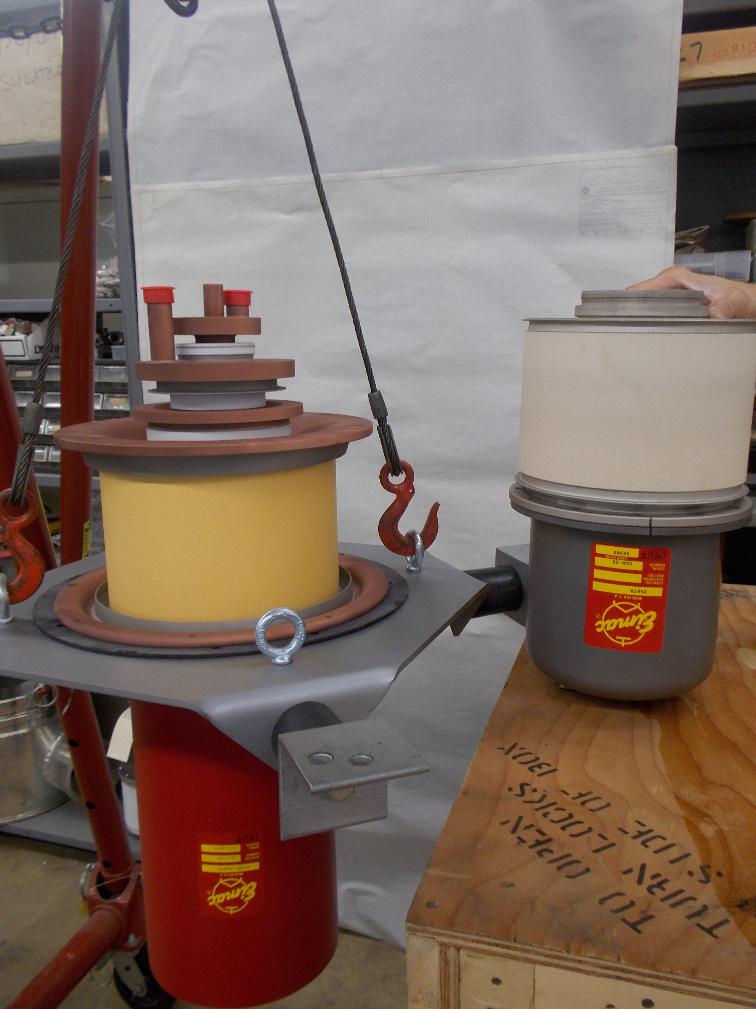
Risk
Charge #3
MR RF System Upgrade Development program is perusing two options using the existing RF cavities
  Two tubes side by side
  Single tube.
The two tubes solution is the default option, it cost less
4CW250,000B next to
presently used Y567B on right.

Slide 18
BOE Summary
WBS Number | Title | Docdb #
121.4.2.2 | BOE Document for 121.4.2.2 Recycler/Main Injector Project Management and Coordination | 620
121.4.2.3 121.4.2.4 | BOE Document for 121.4.2.3 & 121.4.2.4 Recycler/Main Injector RR Cavity and MI RF System Upgrades | 623

Slide 19
Cost Summary – Level 3
Charge #3

Slide 20
Cost Drivers – Labor vs M&S
Charge #3
Costs = BOE + Overheads + Escalation
Materials dominate because of the cost of Three New Recycler Cavities and Modification of 20 Main Injector Cavities.

Slide 21
Cost Drivers – Estimate Quality
Charge #3
Preliminary dominates with Labor because it is based on direct experience with similar work.
Advanced dominates for Material because it is based on an existing design with little or no modifications and for which the costs are documented.
Estimate Quality Categories are per Fermilab Standards and descriptions can be found in Docdb item number 345

Slide 22
Cost Profile – P6 Base Cost Only
Charge #3
Materials Dominate in FY22 because numerous amounts of raw material will be needed to build three Recycler cavities.
P6 Base Costs = BOE + Overheads + Escalation

Slide 23
Labor Profile – P6 Hours/FTE
Charge #3
Labor will gradually escalate after FY22.

Slide 24
Schedule
Charge #3

Slide 25
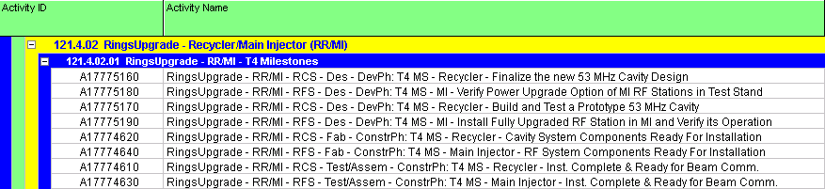
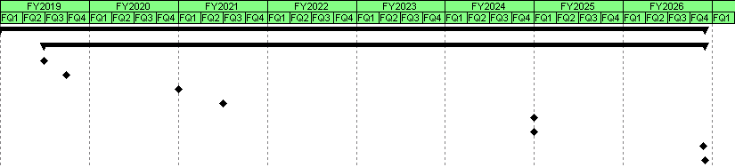
Schedule
Charge #3

Slide 26
Summary
Requirements are well defined.
Plans for Prototypes and Testing in Place.
Teams Organized to Make Progress on Every Front.
Interfaces, Risks, ES&H Issues are Actively Managed.

Slide 27
Amplifier Specifications
Operating Frequency: 53 MHz
Bandwidth: ± 5 MHz minimum

Slide 28
Amplifier Specifications

Slide 29
Amplifier Specifications

