Slide 1
Plan for US-Japan Cooperation Program Development of far-infrared light quantum detector based on superconductors for the cosmic background neutrino decay search
Nov. 21, 2017

Slide 2
Projects we expect in the program
Evaluation of Hf-STJ
The dilution refrigerator at Tsukuba is not in the good condition. The temperature is bottoming out around 120mK. We’d like to measure our Hf-STJ samples below 50mK using dilution refrigerators at Fermilab during our visit.
Front-end system development
Signal from cryogenic amplifiers will proceed to a front-end electronics (flash ADC or peak hold ADC etc.) placed at room temperature.
Fermilab ASIC group has much experience on development SVX chips.
Can this be developed with an existing device or with a programable analog device?
Cryogenic post-amplifier development (optional)
Cryogenic pre-amplifier will be deployed at 2K stage, but we plausibly need a post-amplifier for the signal relay at higher temperature stage (~70K?) using FD-SOI technology?

Slide 3
The plan of our visit in the first year
Visit Fermilab two times in the year.
Two staffs and three (or two) graduated students.
Stay for two weeks to have two refrigerator runs in each visit.
1st visit
Demonstrate our cryogenic SOI amplifiers in development.
3K stage, feedthrough for signal/bias lines
Measure the temperature dependence of Hf-STJ leak current in the range of 30~160mK.
Cold stage, Superconducting coil attached to 3K stage, feedthrough for signal/bias lines

Slide 4
The plan of our visit in the first year
2nd visit
Demonstrate readout of Nb/Al-STJ pulse response via cryogenic SOI amplifiers.
Cold stage, 3K stage, feedthrough for signal/bias lines and optical fiber, Superconducting coil attached to 3K stage
Measure the Hf-STJ response to pulsed light illumination.
Cold stage, Superconducting coil attached to 3K stage, feedthrough for signal/bias lines and optical fiber

Slide 5
The plan of our visit in the second year or later
Combined test of Nb/Al-STJ, cryogenic amplifiers and front-end readout.
Hf-STJ evaluation with pulsed light source
A post-doc or graduated students will stay for a month or longer for these tests.

Slide 6
Budget in the first year
Fermilab visit
$1,000/week x 5 person x 2week = $10,000
Air fare $2,400/person x 5 person = $12,000
3 Rent-a-cars = $3,000
$25,000 /visit x 2visits = $50,000
Expense for refrigerator run ($30,000 for Japan, 20,000 for Fermilab)
Front-end electronics development $50,000
Cryogenic post-amplifier development $50,000
Total: $200,000

Slide 7
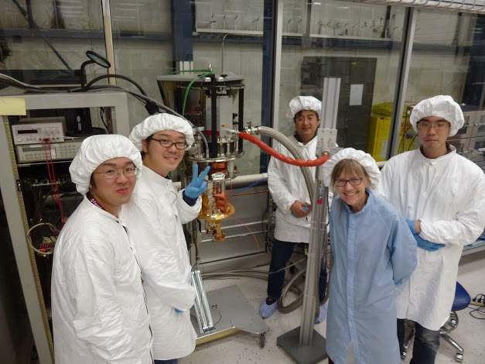
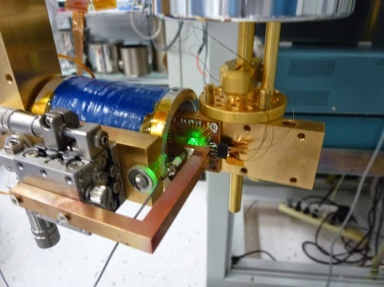
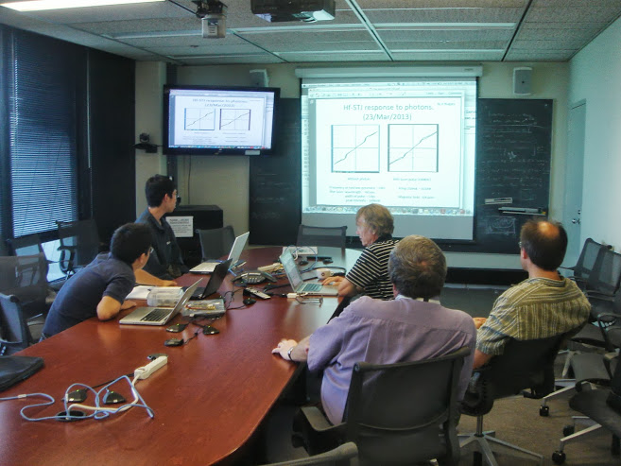
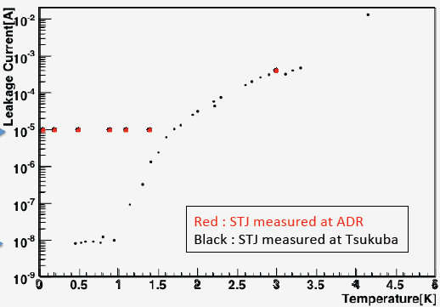
Nb/Al-STJ leak current measurement with ADR at FNAL in 2014
100x100um² Nb/Al-STJ （●） measured with ADR at FNAL in Feb. 2014
← 10μA at T=1.4K

Slide 8
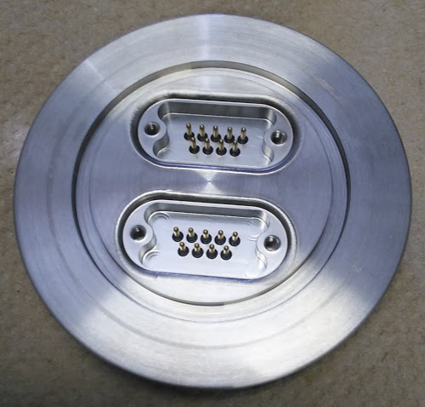
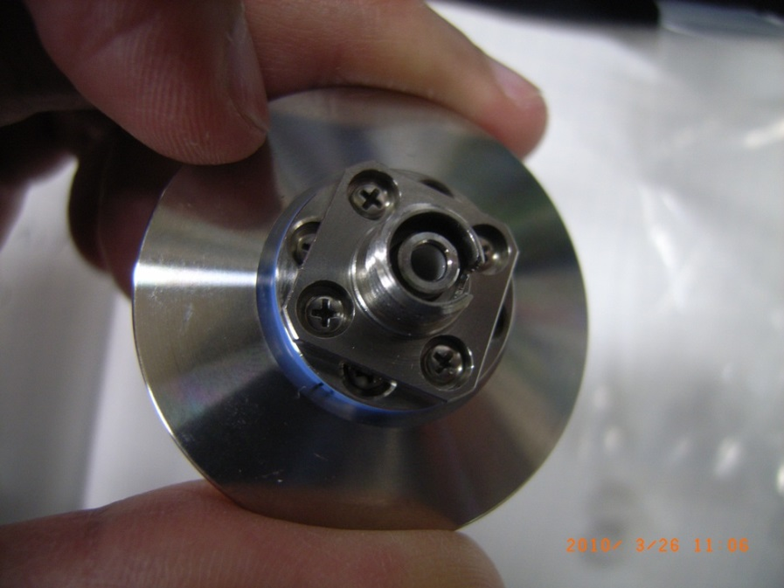
Optical fiber, feedthrough
Optical fiber
quartz, core/clad=62.5/125um, PVC jacket
FC connector feedthrough
NW50 hermetic D-sub connector for signal, power lines
D-sub 9bin x 2

Slide 10
Schematic views of sample chamber with jigs
Sample stage
Magnet
Support rod
Chip carrier
XY-stage
Fiber head holder
View from Bottom

Slide 11
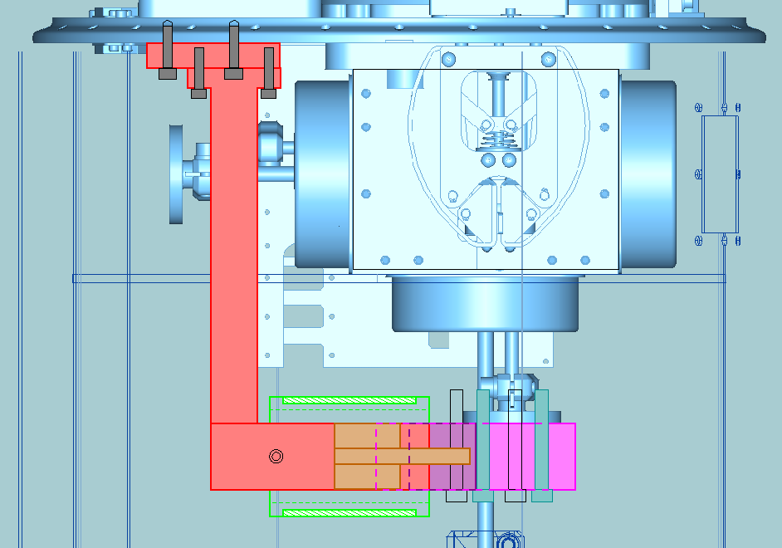
Schematic views of sample chamber with jigs
Support rod
Chip carrier
Sample stage
XY-stage
Fiber head holder

