Slide 1
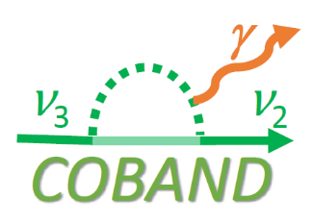

November 21, 2017
Cosmic Background Neutrino Decay Search
– COBAND Experiment –
Continuous Spectral Measurement in Far-Infrared Region using STJ
Shin-Hong Kim （University of Tsukuba, TCHoU）
for COBAND collaboration
at Fermilab

Slide 2
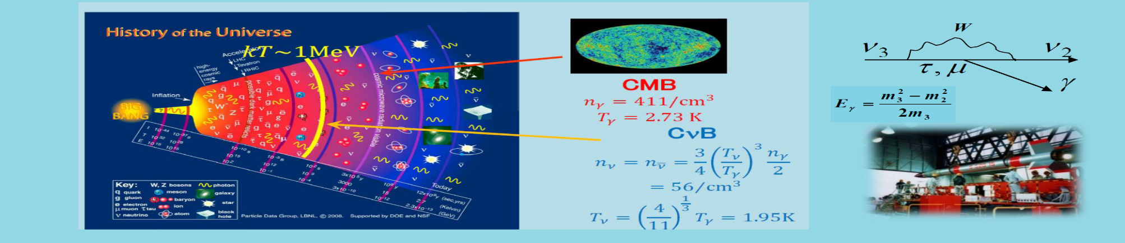
COBAND (COsmic BAckground Neutrino Decay) Collaboration
S.H. Kim, Y. Takeuchi, K. Takemasa, K. Nagata, K. Kasahara, S. Yagi, R. Wakasa, R. Senzaki,
K. Moriuchi, C. Asano, T. Iida (University of Tsukuba),
S. Matsuura (Kwansei Gakuin University),
H. Ikeda, T. Wada, K. Nagase, S.Baba (JAXA),
Y. Arai, I. Kurachi, M. Hazumi (KEK),
T. Yoshida, M. Sakai, T. Nakamura (University of Fukui),
Y. Kato (Kindai University),
K. Kiuchi, S. Mima (RIKEN),
H. Ishino, H. Kibayashi (Okayama University),
S. Shiki, G. Fujii, M. Ukibe, M. Ohkubo (AIST),
S. Kawahito (Shizuoka University),
E. Ramberg, P. Ruvinov, D. Sergatskov (Fermilab),
S.B. Kim (Seoul National University)

Slide 3
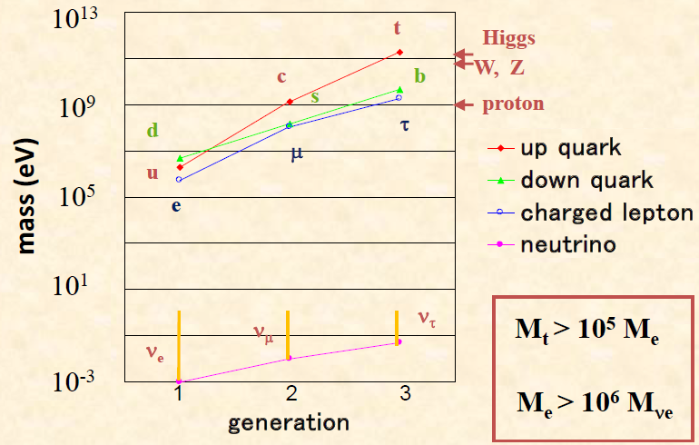
Motivation of Search for Cosmic Background Neutrino Decay
Only neutrino mass is unknown in elementary particles. Detection of neutrino decay enables us to measure an independent quantity of Δm² measured by neutrino oscillation experiments. Thus we can obtain neutrino mass itself
from these two independent measurements.
As the neutrino lifetime is very long, we need use cosmic background neutrino to observe the neutrino decay. To observe this decay of the cosmic background neutrino means a discovery of the cosmic background neutrino predicted by cosmology.
Left-Right symmetric model predicts the neutrino lifetime larger than 10¹⁷ year while the standard model predicts 2 x 10⁴³ year.
Measured neutrino lifetime limit τ > 3 x 10¹² year.

Slide 4
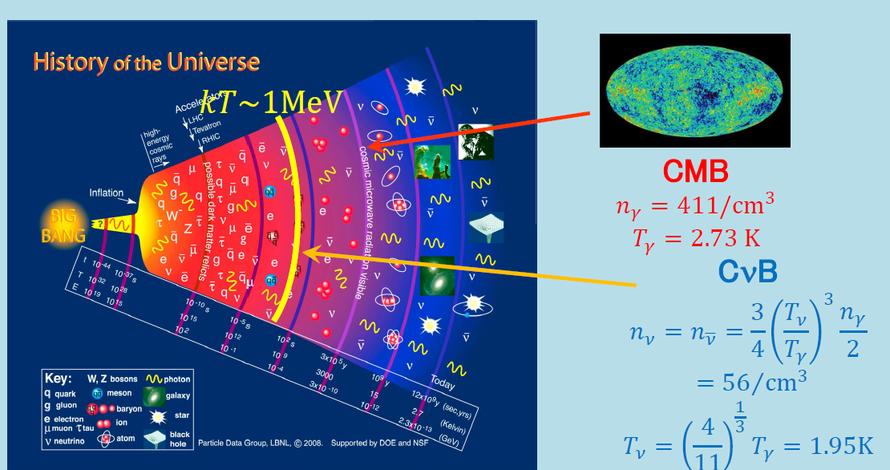
Big-Bang Cosmology and Cosmic Background Neutrino (CνB)
A few seconds after Big Bang → Cosmic Background Neutrino (CνB)
became free.
300,000 years after Big Bang → Cosmic Microwave Background (CMB)
became free.

Slide 5
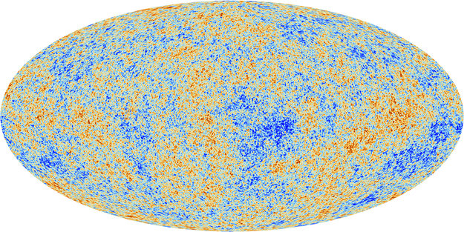
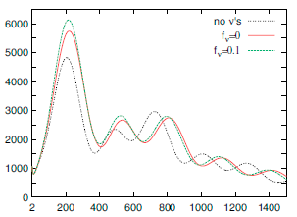
Large Scale Structure of the Universe and CνB
Temperature fluctuation of CMB observed by Planck satellite
Theoretical prediction on Power Spectra of the angular correlation of the CMB temperature fluctuation （depending on the neutrino mass）
no ν’s
m_{ν} = 0
Σm_{ν} = 1eV
Angular correlation at high temperature
Decision Factor of Temperature Fluctuation：
Dark matter, Dark energy, Neutrino
↓
Matter density
or Large scale structure of the Universe
Large Angular scale(180°/l) Small
High Temperature ＝ High Galaxy matter density
CνB exists → large angular correlation at high angle higher neutrino mass → larger angular correlation at high angle
Ref. J. Lesgourgues, S. Pastor Phys. Rep. 429 (2006) 307

Slide 6
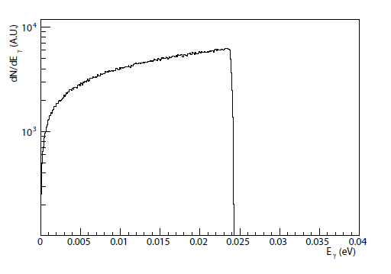


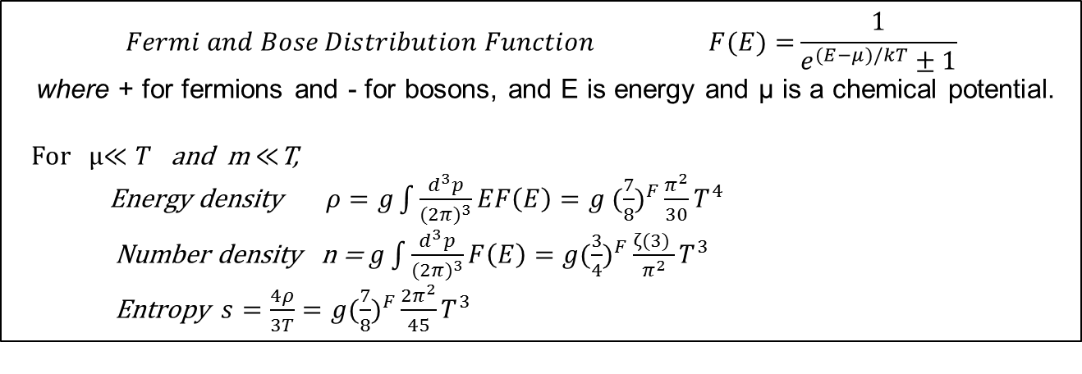




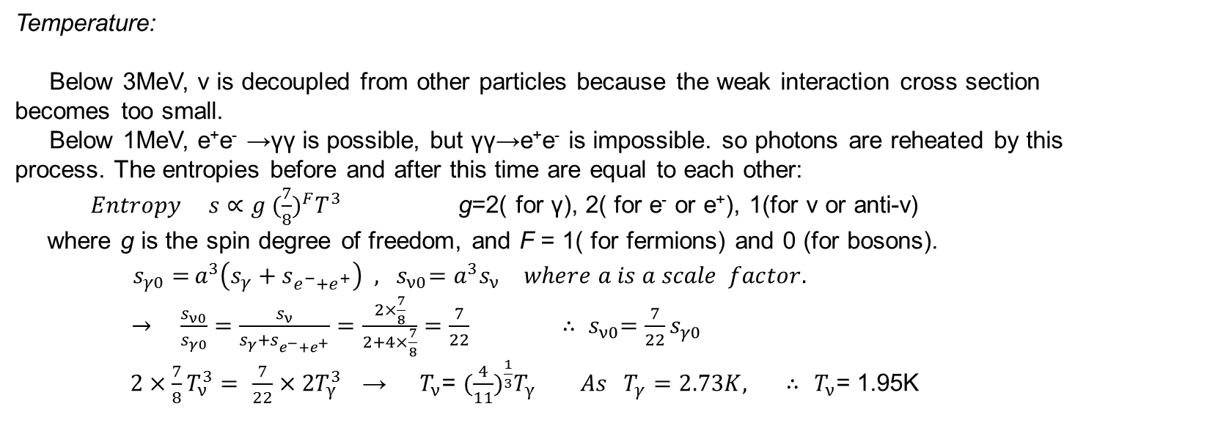


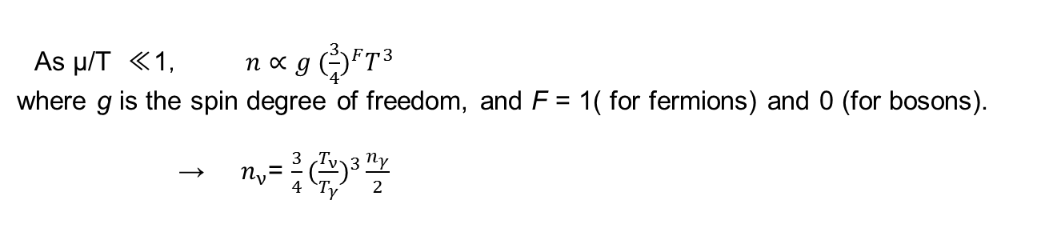
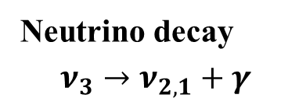
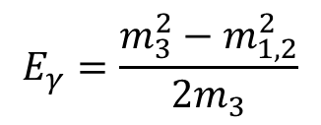
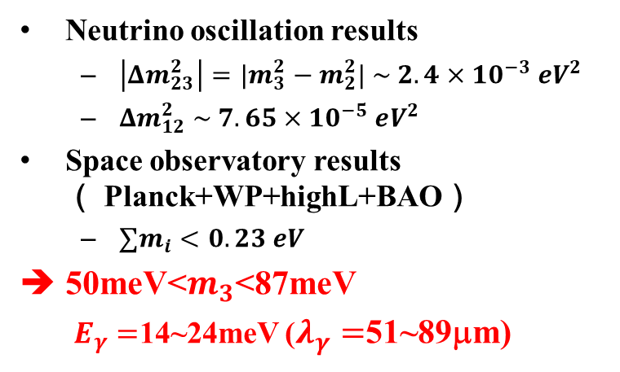
Photon Energy from Neutrino Decay
Neutrino oscillation results
  $\left|Δm_{23}^{2}\right|={|m}_{3}^{2}−m_{2}^{2}| \sim 2.4×{10}^{−3} eV^{2}$
  $Δm_{12}^{2} \sim 7.65×{10}^{−5} eV^{2}$
Space observatory results（ Planck+WP+highL+BAO）
  $∑m_{i}<0.23 eV$
50meV<$m_{3}$<87meV
  $E_{γ}=$14~24meV ($λ_{γ}=$51~89μm)
Neutrino decay
$$ν_{3}→ν_{2,1}+γ$$
$$γ$$
$$E_{γ}$$
$$ν_{3}$$
$$E_{γ}=\frac{m_{3}^{2}−m_{1,2}^{2}}{2m_{3}}$$
$$ν_{2}$$
Photon energy distribution$ν_{3}→ν_{2}+γ$
m₃=50meV
$$m_{3}=50 meV$$
dN/dE(a.u.)
E_{γ} =24.8meV
E_{γ} =24meV
Sharp Edge with 1.9K smearing
Red Shift effect
($50μm$)
($52μm$)
m₂=8.7meV
E_{γ} =4.4meV
$E_{γ}[$meV]
m₁=1meV
($282μm$)
$$25meV( λ=50μm)$$

Slide 7
Cosmic Infrared Background Radiation

Slide 8
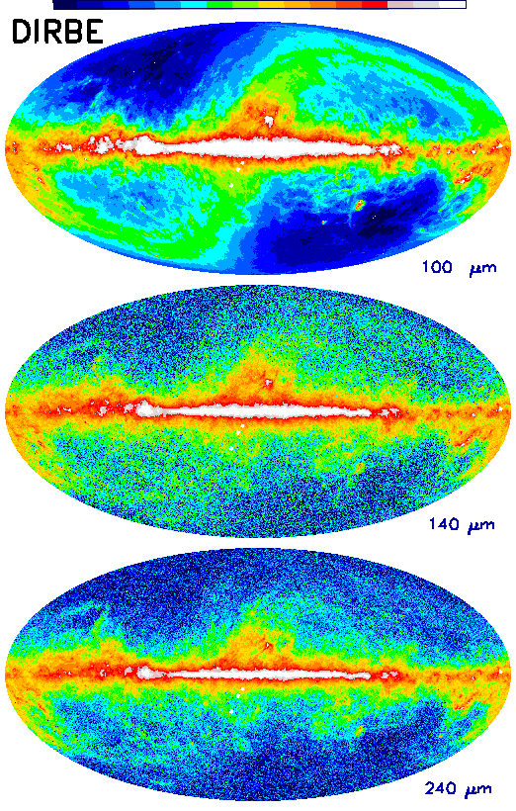
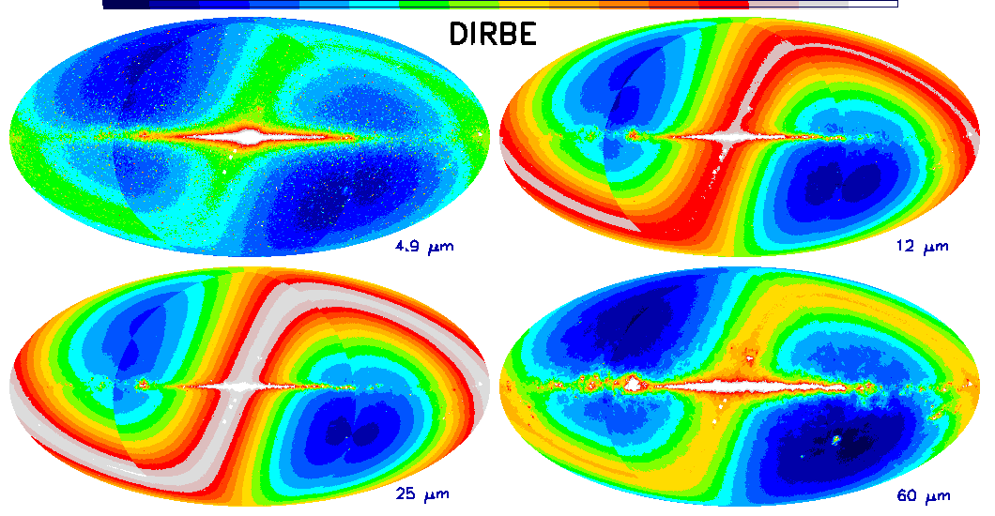
Cosmic Infrared Background Observation by COBE
January 1998 (Press Release): COBE (Cosmic Background Explorer) announced the first observation of the cosmic infrared background (CIB)
Infrared light from star-heated dust in the Milky Way
Infrared light emitted from interplanetary dust heated by the Sun (zodiacal light) : S-shaped

Slide 9
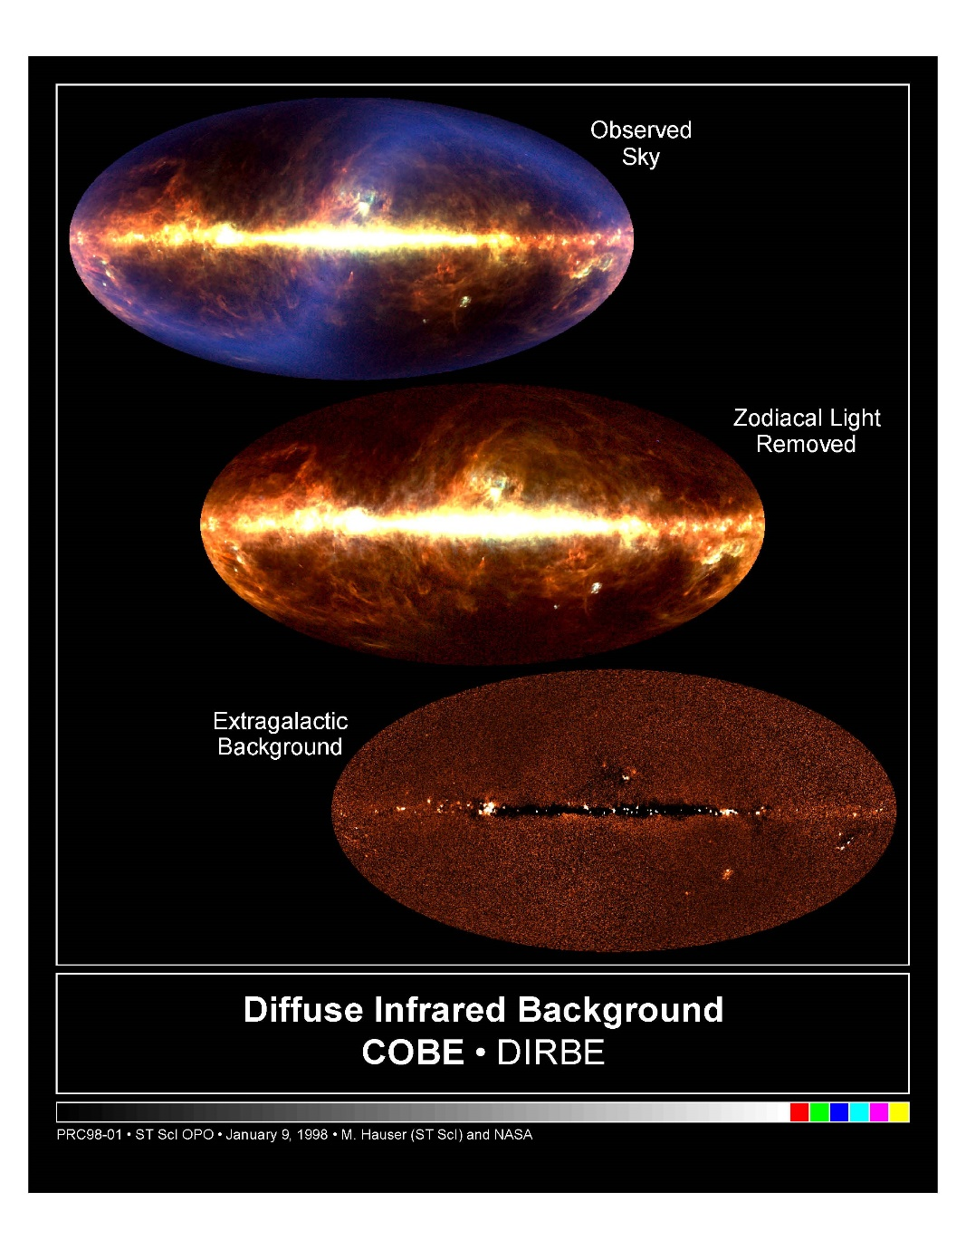
Cosmic Infrared Background Observation by COBE
(Top)
Observed Sky at λ = 60 μm(blue), 100 μm (green) and 240 μm(red).
Horizontal band corresponds to Infrared light from interstellar gas in the plane of our Milky Way Galaxy. The blue S-shaped region corresponds to Infrared light from interplanetary dust in the solar system called zodiacal emission.
(Middle)
After removing the zodiacal emission.
(Bottom)
After removing the infrared light from our solar system and Galaxy at λ = 240μm.
COBE announced that they observed the extragalactic residual infrared light called “Cosmic Infrared Background” at the 240 and 140 micrometer wavelength.

Slide 10
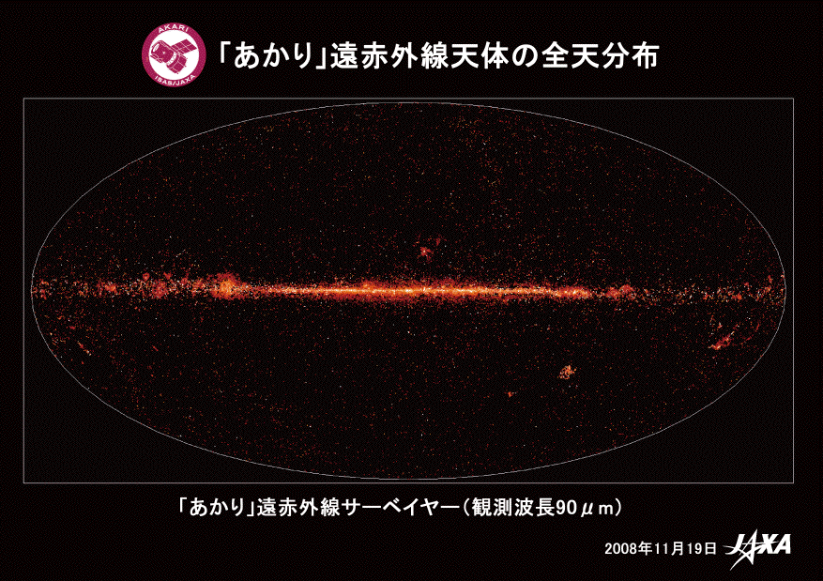
Cosmic Far-Infrared Background Observation by AKARI
November 2008 : AKARI ( JAXA Infrared Imaging Satellite) observed 64,000 stars and galaxies at wavelengths of 65, 90, 140 and 160 μm. Made a whole sky map. They extracted CIB map from this observation.
AKARI whole sky map in far-infrared region
λ = 90 μm

Slide 11
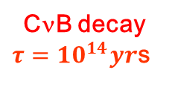
Photon Energy Spectrum from Outer Space
CMB
CIB measurements
(• AKARI,
♦ COBE)
Zodiacal Emission
AKARI
COBE
Zodiacal Light
Surface brightness I_{ν} [MJy/sr]
Galaxy evolution model
Interstellar Dust
Diffuse
Galactic Light
Integrated
Star Light
Integrated flux from galaxy counts
wavelength [μm]
E_{γ} [meV]
There was an excess of the CIB measured by COBE and AKARI over the prediction by galaxy evolution model.
Sources at FIR: dusts of far galaxies or far blackhole, or CνB decay ?
Sources of NIR: first-generation stars Ly-α ?

Slide 12
Our paper published in JPSJ on Jan. 18th, 2012
Search Region: λ＝ 35～250μm （E_{γ} ＝ 35～5meV）
In Rocket experiment, λ＝ 40～80μm （E_{γ} ＝ 31～15meV）
12

Slide 13
Lower Limit of Lifetime from the Energy Spectrum Fit to the CIB measured by COBE and AKARI(1)
χ²= 6.6
τ= (2.8±0.2) x10¹² year
= (0.85±0.06) x10²⁰ sec
νdI/dν (nW m⁻² sr⁻¹)
Photon Energy (eV)
Using the CIB at 60, 100（ ApJ, 544, 81, 2000 ), 140, 240 µm ( ApJ, 508, 25, 1998 ), 65, 90,
140, and 160 µm ( arXiv:1002.3674, 2010 ), the photon energy spectrum from neutrino radiative
decay gives a lifetime lower limit of 2.4 x 10¹² year at 95% C.L. for m₃ = 0.05eV and m₂ = 0.01eV. ( My calculation )

Slide 14
Lower Limit of Lifetime from the Energy Spectrum Fit to the CIB measured by COBE and AKARI(2)
2.4 x 10¹² years
We need 5 order improvements.
ν₃ lifetime limit at 95% C.L. (year)
ν₃ mass (eV)
Δm₂₃² = 0.00243 eV²

Slide 15
Cosmic Background Neutrino Decay Search
(COBAND)

Slide 16
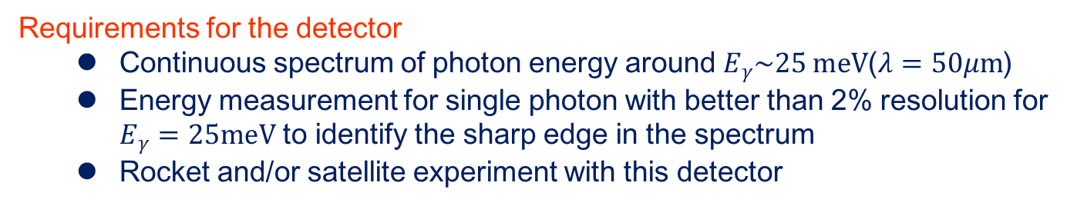
Signal of Cosmic Background Neutrino Decay and its Backgrounds
Rocket experiment coverage (λ＝40～80μm)
CMB
CIB measurements
(• AKARI,
♦ COBE)
Zodiacal Emission
AKARI
COBE
Zodiacal Light
High Energy Cutoff (25meV)
Surface brightness I_{ν} [MJy/sr]
Galaxy evolution model
By measuring the energy spectrum of the Zodiacal Emission with the CνB decay continuously, we can see the CνB decay signal as a high energy cutoff.
Interstellar Dust
DGL
SL
Integrated flux from galaxy counts
wavelength [μm]
E_{γ} [meV]

Slide 17
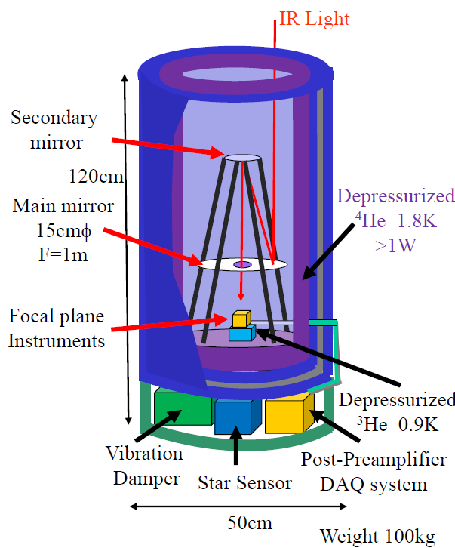
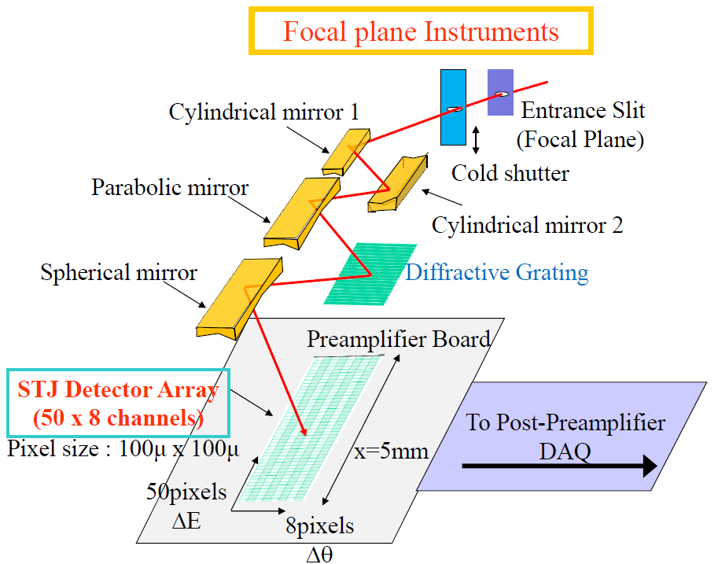
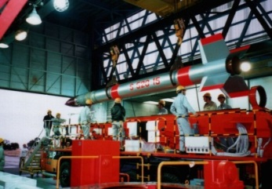
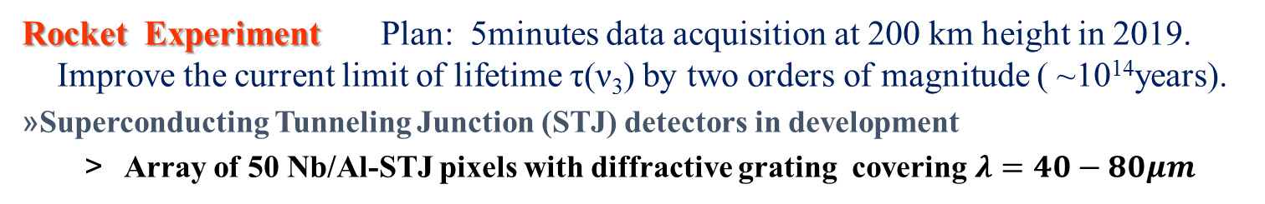
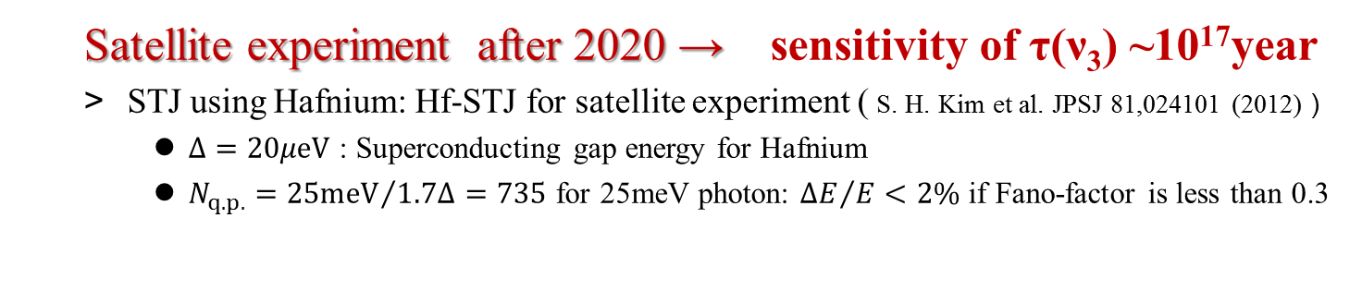
COBAND (COsmic BAckground Neutrino Decay Search) Experiment
Rocket Experiment Plan: 5minutes data acquisition at 200 km height in 2019.
Improve the current limit of lifetime τ(ν₃) by two orders of magnitude ( ~10¹⁴years).
Superconducting Tunneling Junction (STJ) detectors in development
  Array of 50 Nb/Al-STJ pixels with diffractive grating covering $λ=40−80μm$
JAXA Rocket CIB Experiment
（Feb 2, 1992）
³He sorption 0.4K
FOV = 0.006°ｘ 0.05°
  Satellite experiment after 2020 → sensitivity of τ(ν₃) ~10¹⁷year
  STJ using Hafnium: Hf-STJ for satellite experiment ( S. H. Kim et al. JPSJ 81,024101 (2012)）
    $Δ=20μeV$ : Superconducting gap energy for Hafnium
    $N_{q.p.}={25meV}/{1.7Δ}=735$ for 25meV photon: ${ΔE}/E<2\%$ if Fano-factor is less than 0.3

Slide 18
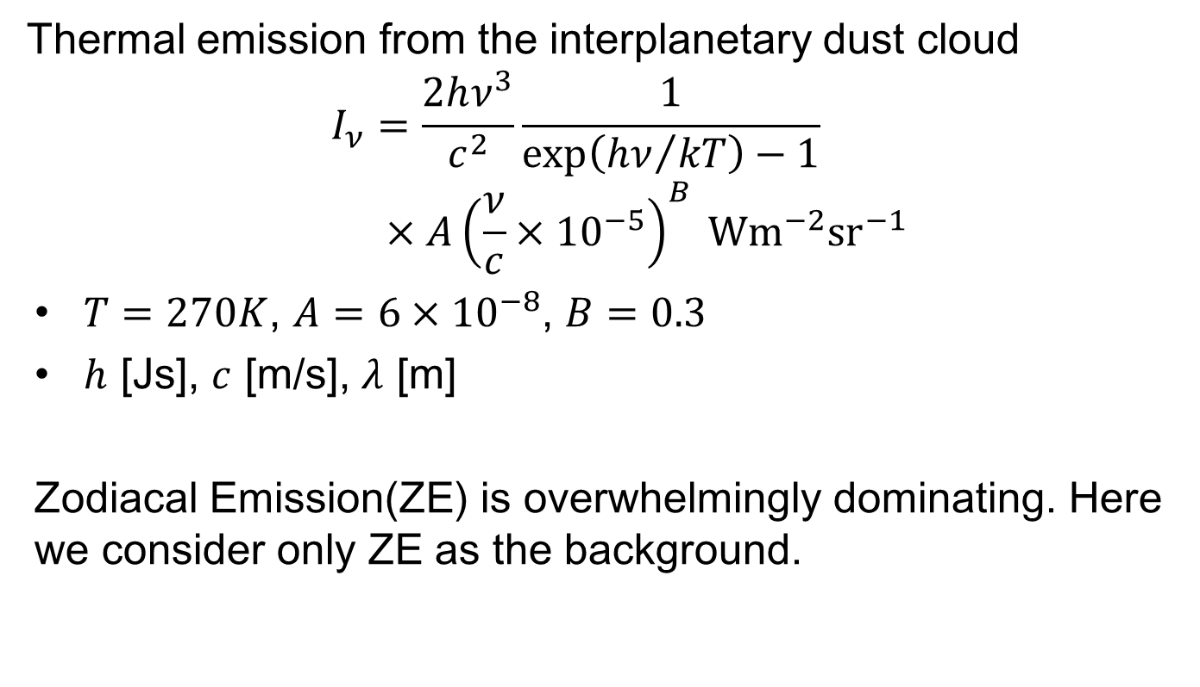
Zodiacal Emission
Thermal emission from the interplanetary dust cloud
$$I_{ν}=\frac{2hν^{3}}{c^{2}}\frac{1}{exp\left({hν}/{kT}\right)−1}×{A\left(\frac{ν}{c}×{10}^{−5}\right)}^{B} Wm^{−2}{sr}^{−1}$$
$T=270K$, $A=6×{10}^{−8}$, $B=0.3$
$h$ [Js], $c$ [m/s], $λ$ [m]
Zodiacal Emission(ZE) is overwhelmingly dominating. Here we consider only ZE as the background.

Slide 19
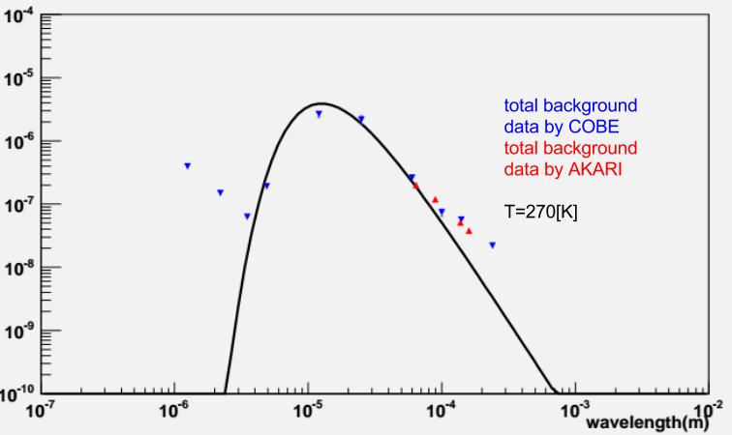
Zodiacal Emission
Surface brightness νI_{ν} [W/m²/sr]
1μm
10μm
100μm
1mm

Slide 20
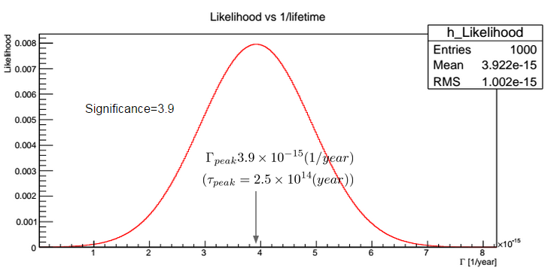
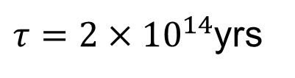
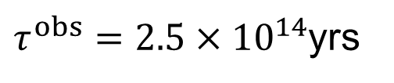
Discovery Potential for Neutrino Decay
Create a pseudo-data for ND and ZE expectation on assumption of ν₃ mass and lifetime: N_{obs}(m^{true}, Γ^{true})
Calculate expected distribution of ND+ZE on assumption of ν₃ mass and lifetime: N_{exp} (m, Γ)
Calculate likelihood of the pseudo-data as a function of the decay width for each neutrino mass
Obtain the most probable decay width and its significance
$τ^{obs}={2.5×10}^{14}$yrs
Significance=3.9
m(ν₃)=50meV
$τ={2×10}^{14}$yrs

Slide 21
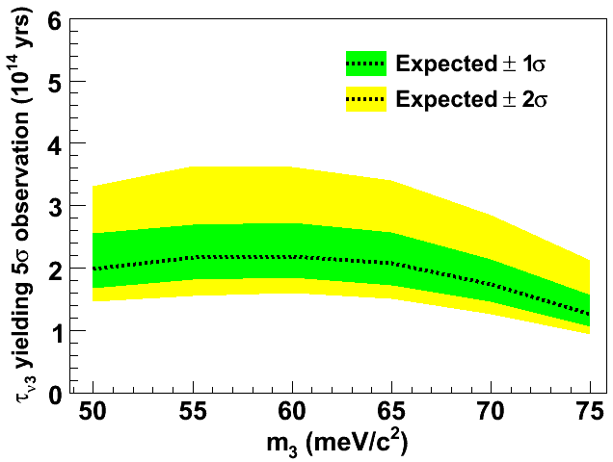
Sensitivity to Neutrino Decay
Parameters in the rocket experiment simulation
telescope diameter: 15cm
50-column (λ: 40μm – 80 μm) × 8-row array
Viewing angle per single pixel: 100μrad × 100μrad
Measurement time: 200 sec.
Photon detection efficiency: 100%
Excess due to Neutrino Decay
Zodiacal Emission
50 60 70 80
λ（μm)
If ν₃ lifetime were 2 × 10¹⁴ yrs, the signal significance is at 5σ level

Slide 22

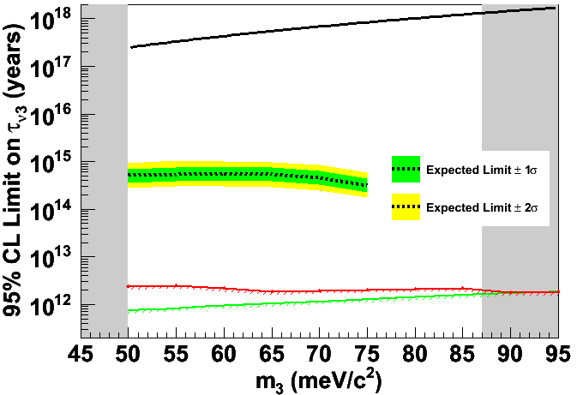
COBAND Experiment Sensitivity to Neutrino Decay
LRS ζ=0.02, M(W₂)=750GeV
∑m_{i} < 0.23eV
Δm₃₁² = 2.5×10⁻³eV²
COBAND Rocket Experiment
x100 Improvement !
S.H.Kim et. al (2012)
Mirizzi et. al (2007)

Slide 23
R&D Status of Superconducting Tunnel Junction Detector for COBAND experiment

Slide 24
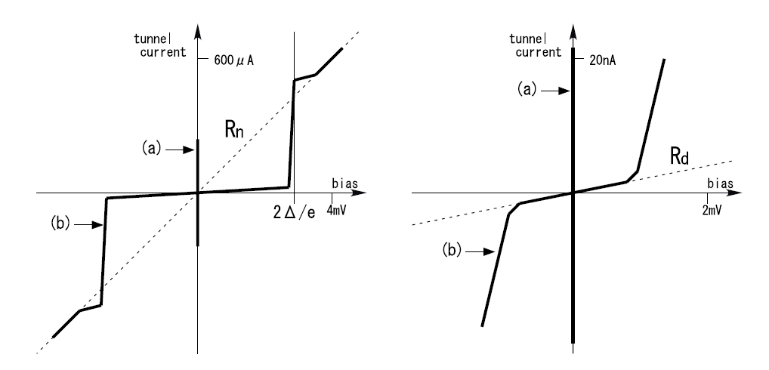
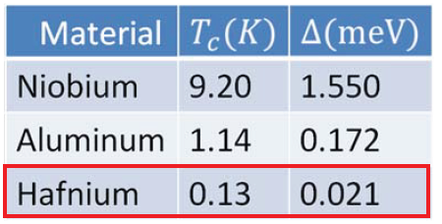
STJ (Superconducting Tunnel Junction）Detector
Superconductor / Insulator / Superconductor Josephson Junction
At the superconducting junction, quasi-particles over their energy gap go through tunnel barrier by a tunnel effect. By measuring the tunnel current of quasi-particles excited by an incident particle, we measure the energy of the particle.
Quasi-particles
Incident Particle
current-voltage (I-V) curve for STJ
2Δ
Josephson Current
Critical current I_{c}
Cooper Pairs
S
I
S
Energy gap Δ
Leakage current
( Dynamic resistance R_{d} in |V| < 2Δ/e)

Slide 25
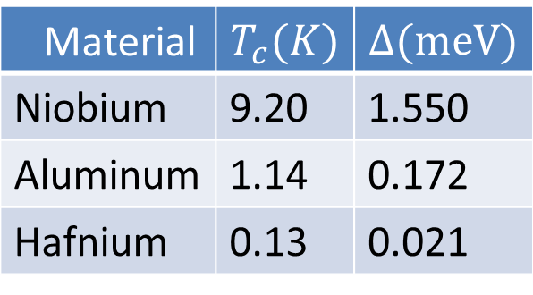
STJ Energy Resolution
STJ Energy Resolution
Δ: Band gap energy
F: Fano factor (= 0.2)
E: Incident particle energy
Material
Niobium | 9.20 | 1.550
Aluminum | 1.14 | 0.172
Hafnium | 0.13 | 0.021
Tc : Critical Temperature
Operation is done at a temperature around 1/10 of Tc
We reported that Hf-STJ worked as a STJ in 2011.

Slide 26
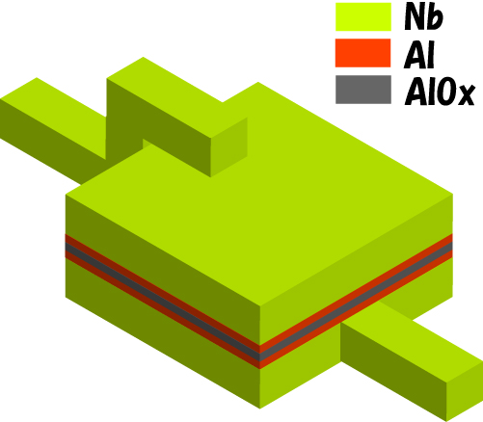
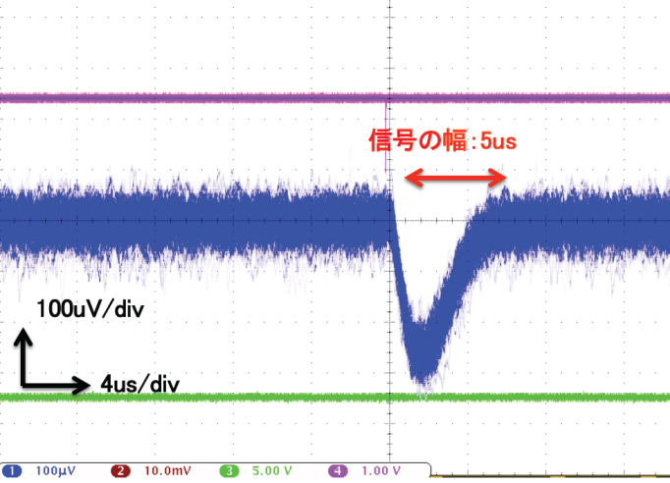
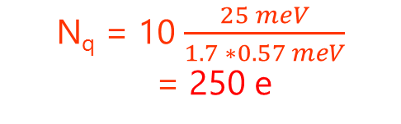
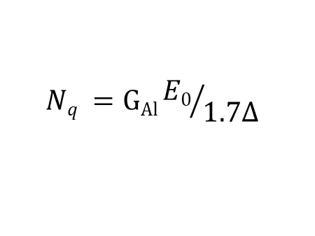
Nb/Al-STJ Photon Detector
Back tunneling Effect → Trapping Gain
Quasi-particles near the barrier can mediate Cooper pairs, resulting in true signal gain
  Bi-layer fabricated with superconductors of different gaps Δ_{Nb}>Δ_{Al} to enhance quasi-particle density near the barrier
  Nb(200nm)/Al(70nm)/AlOx/Al(70nm)/Nb(100nm)
  Δ_{Nb/Al} = 0.57meV
300nm
Number of Quasi-particles in Nb/Al-STJ
Response of Nb/Al-STJ to visible laser light pulse
(λ=465nm) at 350mK
$$Nq =GAl{E0}/{1.7∆}$$
G_{Al} : Trapping Gain in Al(~10)
E₀ : Photon Energy
Δ : E-Gap in superconductor
For 25meV single photon
N_{q} = 10 $\frac{25 meV}{1.7 ∗0.57 meV}$
= 250 e

Slide 27
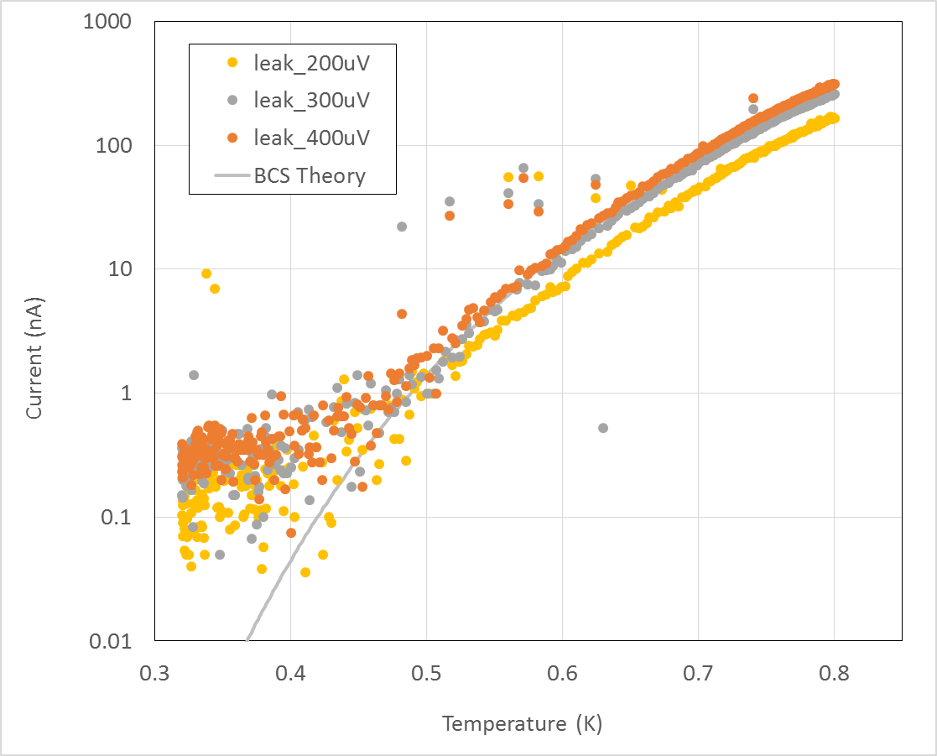
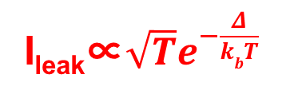
Leakage Current of Nb/Al-STJ
  Leakage current I_{leak} is required to be below 0.1nA to detect a single far-infrared photon (λ= 40 -80μm) .
Temperature Dependence of Leakage Current
50μm x 50μm
  In 2014,
  AIST group joined us and produced Nb/Al-STJ with AIST CRAVITY processing system.
  Leakage current has satisfied our requirement of 0.1nA .
I_{leak}∝$\sqrt{T}e^{−\frac{Δ}{kbT}}$
I_{leak} = 0.2nA
at 300μV
below 400mK
STJ size | # of samples | I_{leak} at 0.3mV
50 x 50μm² | 18 | 224±29 pA
20 x 20 μm² | 7 | 39±13 pA
10 x 10 μm² | 20 | 14±7 pA
by T. Fujii (AIST)

Slide 28
Test Results of Nb/Al-STJ with Far-Infrared laser
Far-Infrared Laser at University of Fukui（λ=57.2μm）
Nb/Al-STJ Response to Far-Infrared Laser
20μm-square Nb/Al-STJ made at AIST CRAVITY system
Laser light was turned on and off with a chopper at a frequency of 200Hz. Measured the change of the I-V curve between the laser on and off to be 50~100nA in current.

Slide 29
R&D Status of SOI Cryogenic Preamplifier for STJ

Slide 30
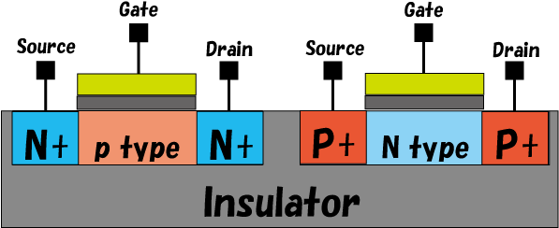
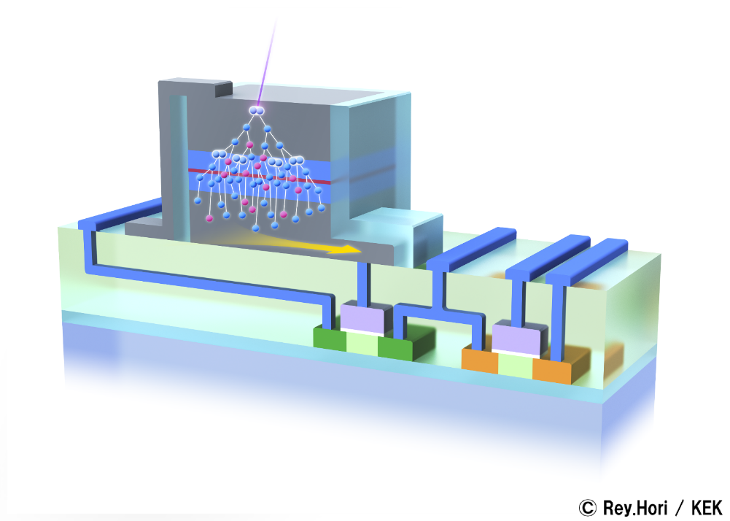
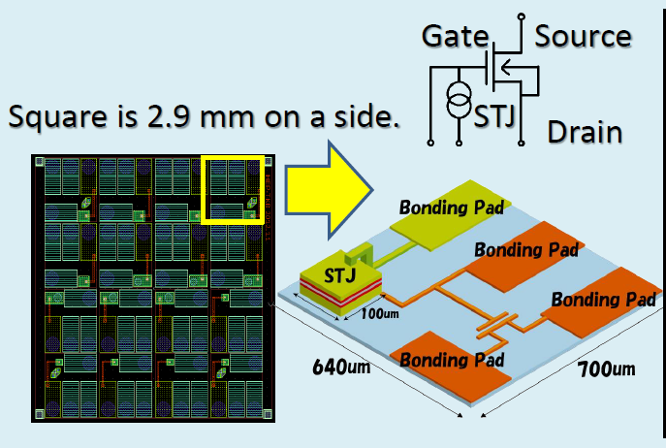
R&D of SOI-STJ Detector
    FD-SOI (Fully Depleted Silicon-On-Insulator) device was proved to operate at 4K by a JAXA/KEK group (AIPC 1185,286-289(200 FD-SOI 9)). It has the following characteristics:
    low-power consumption, high speed, easy large scale integration and suppression of charge-up by high mobility carrier due to thin depletion layer(～50nm).
    FD-SOI -MOSFET
    ～50nm
To improve the signal-to-noise ratio and to make multi-pixel device easily, we made a SOI-STJ detector where we processed Nb/Al-STJ on a SOI transistor board.
    Nb/Al-STJ
    SOI preamplifier

Slide 31
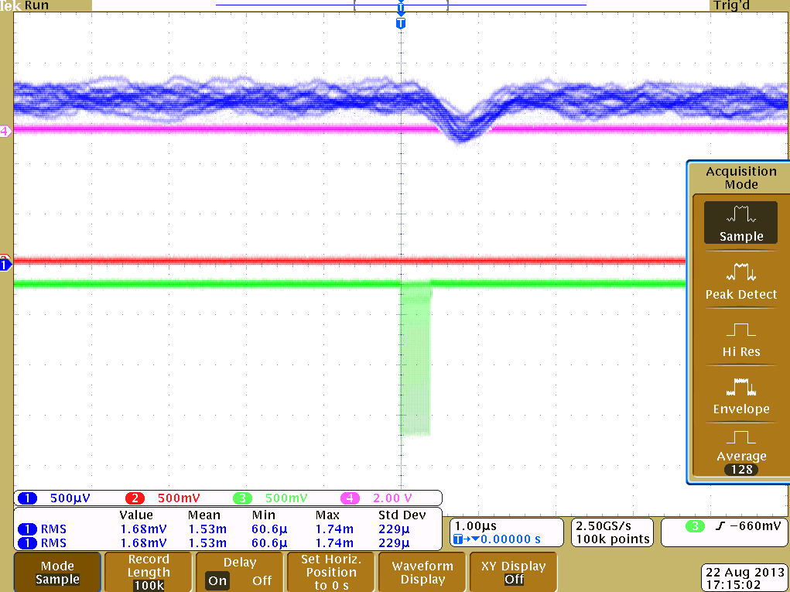
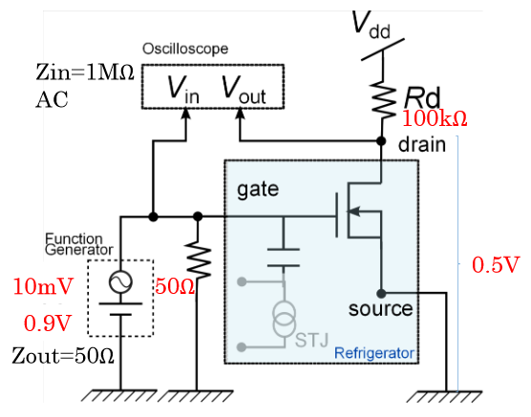
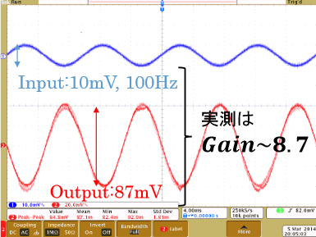
Performance of STJ and SOIFET in SOI-STJ detector
We observed the signal of Nb/Al-STJ processed on the SOI board to 465nm laser pulse at 700mK.
Signal
(1.5μs)
500uV /DIV.
1μs /DIV.
GAIN 8.7 @ LHe temp.
We confirmed that the SOI-FET work as a preamplifier with a gain of 8.7 at 4K up to 100kHz.
r0

Slide 32
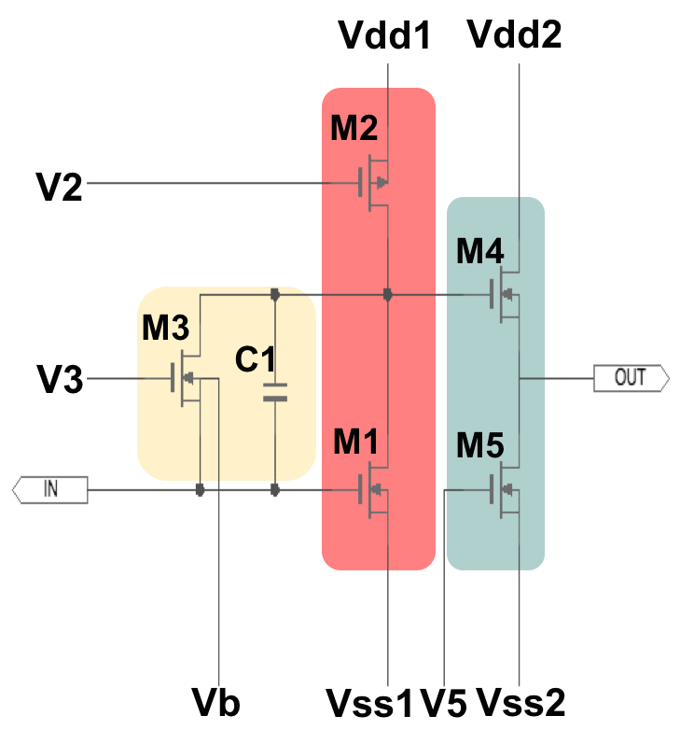
SOI Cryogenic Amplifier
SOI-STJ4 (the 4th prototype)
V_{dd}1
V_{dd}2
We updated the SOI cryogenic Amplifier for Nb/Al-STJ.
V2
Amplification
Replace the resistance by a SOIFET as a current source (M2).
Feedback
Use the feedback between the drain and the gate of M1 to apply a stable bias voltage (M3).
Buffer
Add the follower to reduce the output impedance (M4 and M5).
V3
OUTPUT
INPUT
V_{ss}2
Designed the ratio (W/L) to set the
operation power consumption below 120μW.
V_{b}
V_{ss}1
V5
This SOI amplifier board was made by LAPIS semiconductor company.

Slide 33
Test Results of the SOI Cryogenic Amplifier
Amplifier + Buffer
Input and Amplified Output
Time scale 2ms/div
Output
Input (1mV/div)
Input
Amplified Output (50mV/div)
Gain vs. Frequency
at 300mK
Gain of 80 was achieved for a signal frequency
up to 400kHz signals at 300mK.
400kHz

Slide 34
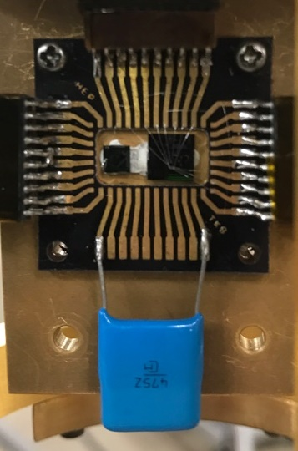
Setup of STJ Signal Amplification with the SOI Cryogenic Amplifier
³He sorption refrigerator
10MΩ
T~350mK
Vdd
STJ
SOI
SOI Amplifier
465nm laser through optical fiber
4.7μF
Vss
Output
GND
STJ
4.7μF
Input Monitor
20μm-square Nb/Al-STJ with SOI-STJ4 amplifier through 4.7μF capacitance.
Input impedance of the SOI amplifier is about 20kΩ.
  STJ operation at a constant current mode.
  STJ bias cable capacitance is around 1nF：Z=160Ω for 1μs signal.

Slide 35
STJ signal amplified with the SOI cryogenic preamplifier
Nb/Al-STJ laser light response signal was amplified with this SOI cryogenic preamplifier at 350mK.
Amplification Gain : 70
S/N improved by a factor of 2
Development of the SOI cryogenic preamplifier is now moving to the stage of the final design for COBAND experiment.

Slide 36
R&D Status of Hf-STJ

Slide 37
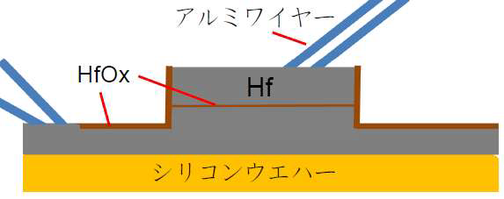
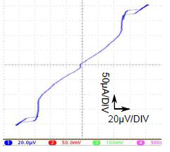

R&D Status of Hf-STJ
Goal: Measure energy of a single far-infrared photon for neutrino decay search experiment within 2% energy resolution.
Micro-calorimeter: Hf-STJ can generate enough quasi-particles from cooper pair breakings to achieve 2% energy resolution for photons with Eγ = 25meV.
Direct wire bonding on Hf layer
I-V curve of Hf-STJ (100x100μm² )
T~40mK, I_{c}=10μA, R_{d}=0.6Ω
B=0 Gauss
B=10 Gauss
STJ size | # of samples | R_{d}
200 x 200μm² | 3 | 0.22±0.01 Ω
100 x 100 μm² | 3 | 0.60±0.10 Ω

Slide 38
Latest Results of Hf-STJ R&D
In 2016, we made a thin aluminum layer (9nm) on the HfO layer (1-2 nm) to improve the insulation of the HfO_{X} layer. Hf/Al/HfO_{X}/Hf-STJ
Al(9nm)
HfO_{X}
Hf
I_{leak} = 5μA at 10μV.
R_{d} = 2Ω
Dynamic Resistance was improved by a factor of 15 in Hf/Al/HfO_{X}/Hf-STJ.

Slide 39
Leakage Current of Hf-STJ
Hf/Al/HfO_{X}/Hf-STJ reduced the leakage current to one-fourth.
By making the size smaller, we will be able to decrease the leakage current by a factor of 1/400.
By decreasing the operation temperature, we will be able to decrease the leakage current significantly.

Slide 40

Response of Hf-STJ to Laser Pulse Light
Hf/Al/HfO_{X}/Hf-STJ
Visible light laser (λ=465nm) 10Hz duration
Response speed (120μs) is slower than Nb/Al-STJ response speed ( around a fewμs).

Slide 41
Schedule
 | 2016 | 2017 | 2018 | 2019 | 2020 | 2021
Experiment Design
Superconducting Tunnel Junction (STJ ) Detector
Preamplifier at 1K and Post-Preamp (Fermilab, JAXA, KEK, AIST, Tsukuba）
Dispersive Element, Optics
Cryostat
Measurements＋Analysis
Experiment design with Satellite such as SPICA
Experiment design with FIR Rocket
R&D
of Nb/Al-STJ
Production
Design and R&D of Hf-STJ Detector (for Satellite Experiment)
Nb/Al-STJ設計・開発
Design and R&D
Production
Design, R&D, Production
Far-Infrared Observatory Rocket Experiment
Design and R&D
Production
Design, R&D, Production
Design and R&D
Production
Design, R&D, Production
Analysis Program
Simulation
41
41
Analysis

Slide 42




Research Core for the History of the Universe
under Center for integrated Research in Fundamental Science and Engineering,
University of Tsukuba (founded on Sep. 1, 2014)
Mission: coordinate the studies in elementary particles, quark nuclear matters and astrophysics to construct an integrated view of the History of the Universe.
Simulation of the Universe Evolution
Superstring
Lattice QCD
Mass Origin
Force Origin
Creation of Structure
Matter Evolution
Critical Point
Genesis of Matters
Illuminate the “Darkness”:
=>Dark matter, Dark energy , Dark galaxies
=>Genesis of matters, creation of structure and their evolution
Higgs Particle
Neutrino
Dark Galaxies
Quark Gluon Plasma
Cosmic Neutrino Background

Slide 43
Schedule of Research Core for the History of the Universe
Cosmic Background Neutrino
Antarctic Astronomy
Quark Gluon Plasma
These five projects were approved as large research projects in Master Plan 2017 by Science Council of Japan.
Higgs
Unstable Nuclei
Simulation on Universe Evolution

Slide 44

Research Core for the History of the Universe
Tomonaga Center for the History of the Universe
Re-Organization
From Oct. 2017
Antarctic Astronomy
Cosmic Background Neutrino
Higgs (ATLAS)
Quark Gluon Plasma
Unstable Nuclei
Particle Detector R&D
Approved for October 2017 to March 2022 (10,500kYen/year).
Budget for Postdocs, Detector R&D and travel expenses.

Slide 45
R&D Budgets for the COBAND in the period of JFY2013-2017
Total : 120.5Myen
(~ $1.1M)
Grant in Aid “Neutrino” from MEXT | R&D of Superconducting Infrared Detector for Neutrino Decay Experiment | JFY2013－2017 | 77.5 MYen
University Support | ³He Sorption Refrigerator | JFY2013, 2016 | 21.0 MYen
KEK Support | Cooperative Project of University of Tsukuba and KEK | JFY2013-2016 | 5.0 MYen
Japan-US Project | Neutrino Decay Search Experiment Cooperative | JFY2012-2014 | 17.0 MYen

Slide 46
Summary
R&D of STJ detectors and the design of the COBAND rocket experiment are underway.
          Determination of the neutrino mass
                origin of elementary particle mass spectra
      Discovery of the cosmic background neutrino
            new probe of the very early universe
New far-infrared photon detector is being developed:
      Nb/Al-STJ satisfied our requirement for leakage current less than 0.1pA
      Cryogenic amplifier with the SOI technology worked at 300mK
      We have succeeded in amplifying the STJ signal with the SOI cryogenic amplifier.
      Aiming at one photon detection in the far-infrared range
      applicable to the other fields such as X-ray energy measurement with higher energy resolution.
      COBAND WEB page http://hep.px.tsukuba.ac.jp/coband/eng/

Slide 47
People who will join COBAND collaboration are very welcome.
Please join us.

Slide 48
BACKUP

Slide 49

Cosmic Background Neutrino
$$Fermi and BoseDistribution Function F(E)={\frac{1}{e^{(E−μ)/kT}±1}}$$
where + for fermions and - for bosons, and E is energy and μ is a chemical potential.
For μ$≪T$ and m $≪$T,
Energy density $ρ=g\int{\frac{d^{3}p}{(2π)^{3}}}EF\left(E\right)=g (\frac{7}{8}{)^{F}\frac{π^{2}}{30}T}^{4}$
Number density n =$g\int{\frac{d^{3}p}{(2π)^{3}}}F\left(E\right)=g(\frac{3}{4}{)^{F}\frac{ζ(3) }{π^{2}}T}^{3}$
Entropy $s=\frac{4ρ}{3T}=g(\frac{7}{8}{)^{F}\frac{{2π}^{2}}{45}T}^{3}$
Temperature:
Below 3MeV, ν is decoupled from other particles because the weak interaction cross section becomes too small.
Below 1MeV, e⁺e⁻ →γγ is possible, but γγ→e⁺e⁻ is impossible. so photons are reheated by this process. The entropies before and after this time are equal to each other:
$Entropy s∝g (\frac{7}{8}{)^{F}T}^{3}$ g=2( for γ), 2( for e⁻ or e⁺), 1(for ν or anti-ν)
where g is the spin degree of freedom, and F = 1( for fermions) and 0 (for bosons).
The present entropies of photons and neutrinos, $s_{γ0}$ and $s_{ν0}$ are given by
$s_{γ0}={a^{3}\left(s_{γ}+s_{e^{−}+e^{+}}\right){{ , s}_{ν0}=a}^{3}s_{ν }where a is a scale factor. }$
${→ \frac{s_{ν0}}{s_{γ0}}=\frac{s_{ν}}{s_{γ}+s_{e^{−}+e^{+}}}=\frac{2×\frac{7}{8}}{2+4×\frac{7}{8}}=\frac{7}{22} ∴ s}_{ν0}={\frac{7}{22}s}_{γ0 }$
${ 2×\frac{7}{8}T}_{ν}^{3}$ $=$ $\frac{7}{22}×2T_{γ}^{3}$ → $T_{ν}$= ${(\frac{4}{11})}^{\frac{1}{3}}T_{γ }{As T}_{γ}=2.73K, ∴$ $T_{ν}$= 1.95K

Slide 50

Cosmic Background Neutrino
Temperature:
$T_{ν}$= 1.95K
Number density:
As μ/T ≪1， $n∝g (\frac{3}{4}{)^{F}T}^{3}$
where g is the spin degree of freedom, and F = 1( for fermions) and 0 (for bosons).
→ $n_{ν}$= ${\frac{3}{4}(\frac{T_{ν}}{T_{γ}})}^{3}\frac{n_{γ}}{2}$

Slide 51


Prototype of Cryostat for the Rocket Experiment
In April 2017, a prototype of the cryostat for the rocket experiment was made. This is a ³He sorption 0.3K refrigerator inside of ⁴He depressurized 1.8K refrigerator. (For now it does not have a ³He sorption 0.3K refrigerator inside yet.)
We will test Nb/Al-STJ inside of this cryostat with far-infrared(50μ) photon beam at Fukui this winter.
Made by Jeck Tohri company.

Slide 52
Near-Infrared Photon Energy Spectrum from Outer Space
April 2017 (Press Release): CIBER rocket experiment measured the energy spectrum of the cosmic infrared background (CIB) in the near-infrared region. They found an excess of the CIB spectrum over the prediction by integrated galaxy light (IGL).
CIBER Extragalactic Background Light (EBL)
Integrated Galaxy Light (IGL)
This excess might be due to first-generation stars Ly-α.
CIBER collaboration plans to do CIBER-2 rocket experiment which has 10 times larger sensitivity.

Slide 53
Astrophysics with NIR and FIR by AKARI
NIR Middle-IR Far-IR
3 4 7 11 15 24 65 90 140 λ(μm)
NIR and FIR from interstellar gas → Formation and evolution of galaxies, stars and dusts
NIR: Search for first-generation stars using Ly-α line.
FIR: Search for first-generation heavy element dusts.
Map of NIR from Milky Way Galaxy measured by AKARI
Molecular cloud IR in the arm of NGC1313 measured by AKARI

Slide 54





Performance of Nb/Al-STJ in SOI-STJ Detector
We measured the I-V curve of the Nb/Al-STJ (50 x 50μm² junction) processed on the SOI wafer
at 700mK with a dilution refrigerator.
I-V curve of Josephson Junction
1 mA /DIV.
I_{c}～200μA
1 mA /DIV.
2 mV /DIV.
2 mV /DIV.
B=35 G
10 nA /DIV.
500μV /DIV.
Ｅｎｌａｒｇｅｄ
Ｅｎｌａｒｇｅｄ
50μA /DIV.
2mV /DIV.
Quality Factor (R_{dynamic}/R_{normal})
On Si wafer : 5 x 10⁵
On SOI wafer : 3 x 10⁵

Slide 55
Performance of SOIFET at Cryogenic Temperature
Saturating current is higher as the temperature becomes lower.
Non-linearity was found at cryogenic temperature near threshold region. This problem was solved by improving LDD(Lightly Doped Drain).
At cryogenic temperature (3K),
Threshold rise in I_{ds}-V_{ds} curve become much sharper.
Subthreshold current is suppressed.
Ids (A)
Ids (A)
̶̶ ROOM
̶̶̶ 3K
̶̶ ROOM
̶̶̶ 3K
Vds (V)
Vgs (V)

Slide 56
Test Results of the cryogenic SOI preamplifier
Amplifier
Amplifier gains are around 50 both at room temperature and 3K with adjusted bias voltages of M2.
Buffer
Bandwidth of buffer is enough high for the amplifier of STJ signal (up to 200kHz) both at room temperature and 3K.

Slide 57
STJ response at a constant current mode
V₀
High impedance voltage amplifier
Laser light pulse
R=1M~100M
I
V₀=V+RI
STJ
V
I=I(V)
C_{STJ}
~1mV
V
STJ I-V curve w/light w/o light
STJ has a large resistance in series.
→ constant current mode
STJ response to light is observed as a voltage drop.

Slide 58
Development of SOI Charge sensitive preamplifier
(SOISTJ5)
STJ capacitance is not so small ( 20pF for 20μm square STJ).
STJ response speed is a few μsec.
STJ operation at a constant voltage mode is favorable.
  → Low input impedance
  charge amplifier
  operational for 1MHz.

Slide 59

Op-amp Circuit for STJ (SOI-STJ5 design)
This cryogenic charge amplifier test is now underway.
telescopic cascode differential amplifier
Feedback C=2pF x R=5MOhm = 10μs
Power consumption ~150μW
Iref
W(μm)/L(μm)
Iref
Iref×2
10/10
10/10
20/10
100/7
100/7
Bias
12/7
Iref
100/1
100/1
Iref/5
Buffer stage
4/1
4/1
2/10
4/10
4/10
V_{DD}=-V_{SS}=1.5V
Iref×2/5
Iref×2/5
Iref>10μA
10/10
Telescopic cascode

Slide 60
COBAND Collaboration
( Cosmic Background Neutrino Decay Search)
A part of the consortium of the History of the Universe
Seoul National Univ.
S. B. Kim
STJ detector
FNAL
E. Ramberg
Electronics
Fukui Univ.
T. Yoshida
FIR photon beam source
Kindai Univ.
Y. Kato
Data transfer
Univ. of Tsukuba
S. H. Kim, Y. Takeuchi
STJ detector,
Electronics,
Cryostat, Optical system
JAXA/ISAS
T. Wada, H. Ikeda
Rocket, Electronics
KEK
Y. Arai, M. Hazumi
Electronics
Kwansei Gakuin Univ.
S. Matsuura
Cryostat, Optical system
AIST
M. Ohkubo, M. Ukibe
SOI-STJ detector
RIKEN
S. Mima
STJ detector
Okayama Univ.
H. Ishino
STJ detector
Shizuoka Univ.
S. Kawahito
Electronics
2015 Shizuoka Univ.
Kwansei Gakuin
Univ.
2014 AIST
2011 FNAL, Okayama Univ., Fukui Univ., Kindai Univ.
2007 Univ. of Tsukuba, JAXA/ISAS, RIKEN, KEK, Seoul National Univ.

