Slide 1
Understanding FNAL Earned Value Management Processes Using Flow Diagrams and Visuals
Presenter’s Name: Rich Marcum, OPSS Project Controls Manager
Meeting Title : EVMS Training – Process Flow Charts and Visuals
10 February 2016

Slide 2
EVMS Official Definition
An Earned Value Management System (EVMS) is the overall methodology that organizations use to plan, manage, control, and analyze the cost and schedule performance of projects. It encompasses organizational policies, business processes, automation support, standards, and accountability for results.
ANSI-EIA Standard 748

Slide 3
Earned Value Management System - Simplified
Earned Value Management System
Management of People (Who)
Management of Project Deliverables (What)
Management Processes (How)

Slide 4
EVM Principles
Control
Plan
Organize
Monitor
Execute
Authorize
Organize
Plan
Authorize
Execute
Monitor
Control

Slide 5
EVMS Responsibility seen from 40,000 Feet
RESPONSIBILITY
BUDGET ELEMENT
Total Project Cost
CUSTOMER
Contingency
Management Reserve
PROJECT MANAGER
Performance Measurement Baseline / Budget at Completion
Undistributed Budget
Control Accounts
CAM Summary Responsibilities on Next Slide
CONTROL ACCOUNT MANAGER
Work Packages
Planning Packages

Slide 6

Control Account Manager (CAM) Responsibilities
High Level Overview of Responsibilities
Oversite & Planning
Establish Baseline Schedule
Establish Baseline Budget
Execution of Work Scope
Manage Risk
Monitor and Analyze
Control Scope Creep
Report and Communicate
SCOPE
Notes:
Plan:
Develop Estimates
Develop Schedule
Execute Plan
Control Change (scope creep)
Control Risks

Slide 7
EVMS Elements

Slide 8
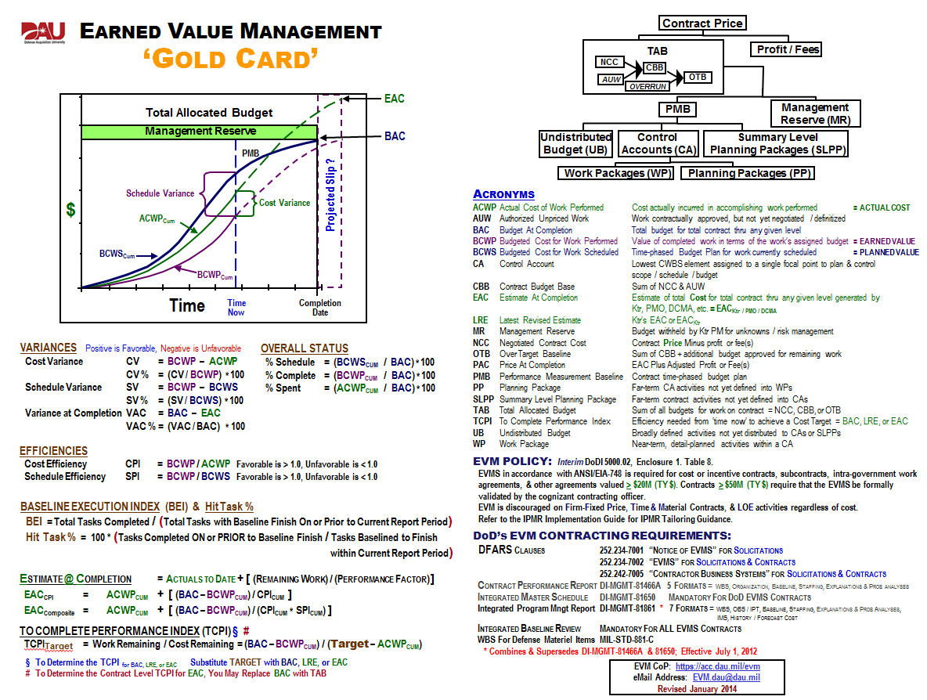
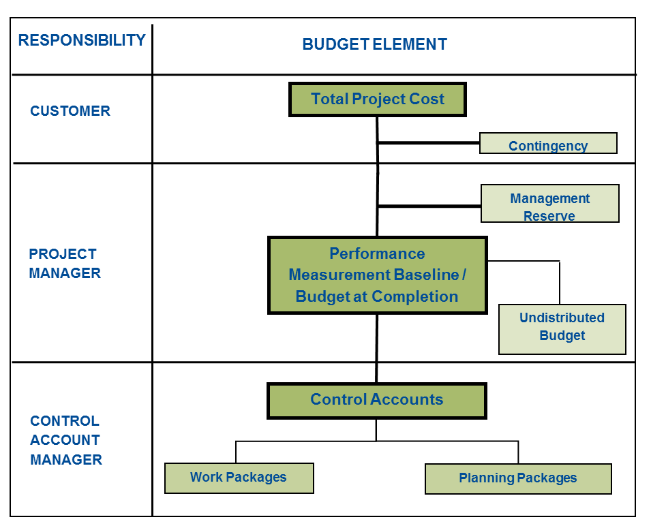
EVM Gold Card – EVMS Terminology/Definitions
This block has been modified to better Represent FNAL

Slide 9
EVM Gold Card – EVMS Calculations

Slide 10
EVM Gold Card – EVMS Terminology/Definitions

Slide 11
Terminology
Components necessary for determining and analyzing earned value performance:
  Planned Value - cost of work that was planned to be accomplished
    Plan
    Budget
    BCWS - Budgeted Cost of Work Scheduled
    Science Related Terminology – Target or Theory
  Earned Value - calculated cost of work that was accomplished
    BCWP - Budgeted Cost of Work Performed
    Science Related Terminology – Results or Outcome
  Actual Value - actual amount it cost to perform the work
    Actuals
    Incurred
    ACWP - Actual Cost of Work Performed

Slide 12
More EVM Terminology
Control Account (CA)
  Lowest WBS element assigned to a single focal point to plan and control scope / schedule / budget
Budget at Completion (BAC)
  Total planned cost for the project
Performance Measurement Baseline (PMB)
  Integrates Scope, Schedule, Cost, Resources, Technical Milestones
  Project time-phased budget plan
  Used to benchmark cost and schedule performance of project
Scope
(Work)
Schedule
(Time)
Budget
(Cost)

Slide 13
More EVM Terminology
Variance
  Deviation from the Baseline (planned) cost or schedule
  Positive Variances are Favorable
  Negative Variances are Unfavorable
Total Project Cost (TPC)
  Total Cost of Performing Project’s Scope of Work from inception to close.
Resource Loaded Schedule (RLS)
  Logical Timeline of Scope to work and Resources to perform the work (Labor & M&S)
Performance Measurement Technique (PMT)
  Use to measure how much work scope is performed
Estimate Uncertainty (EU)
  FNAL standard used to calculate contingency based on estimate quality

Slide 14
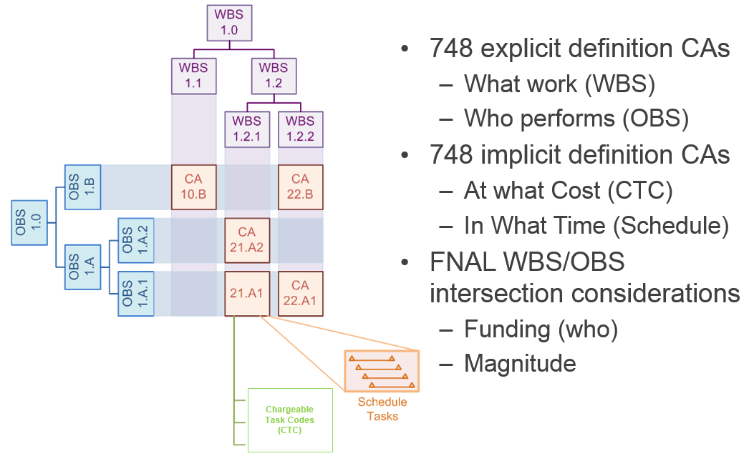
Control Account (Key Element Touched by All Procedures)
Marriage of OBS and WBS (Who & What)
Further Details Next 2 Slides (Planning & Authorization Flow chart and Data Flow)
CA Related to most EVMS Guidelines as it relates to RAM, Schedule, WBS, WAD, Etc.

Slide 15
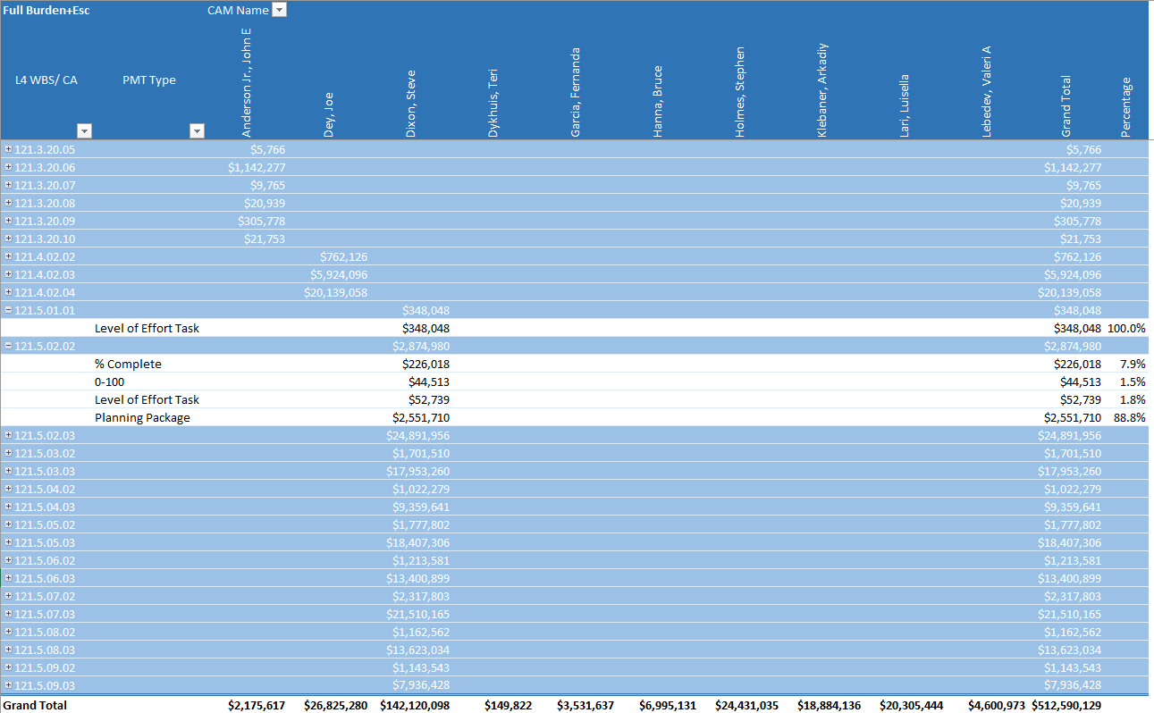
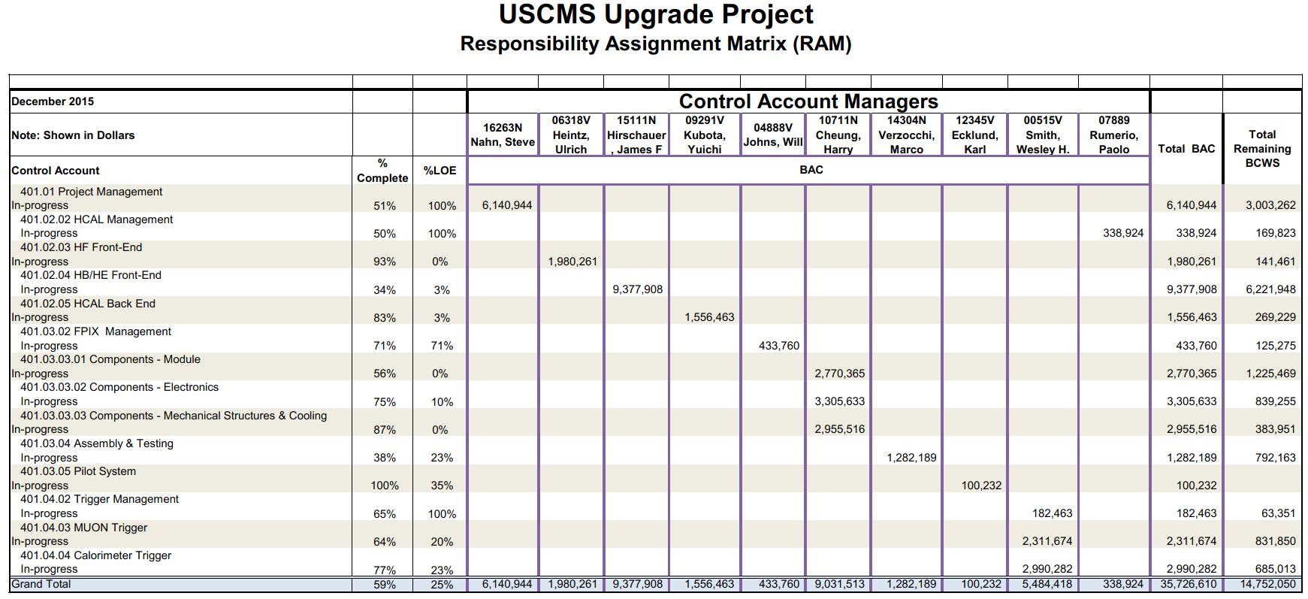
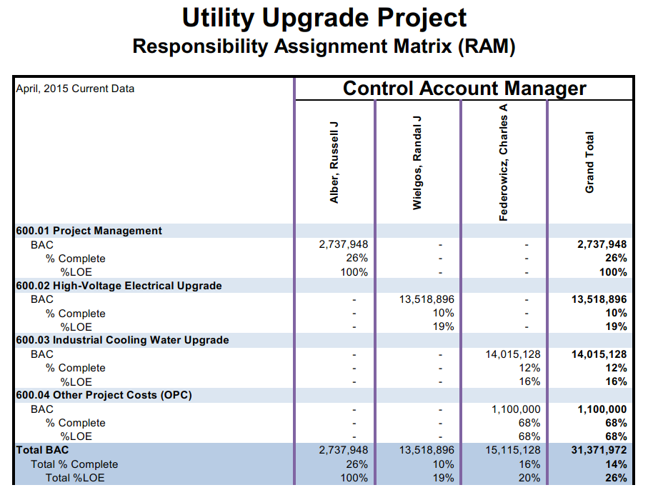
Responsibility Assignment Matrix – RAM (12.PM-001)
Who & What
RAM Related to EVMS Guidelines 2, 3, 5, 9 & 18

Slide 16
Establish Baseline – Data Flow Traceability
Data Flow build on Foundation built by WBS, OBS, RAM
Control Account is Key Control Point
Scope
Establishes boundaries of project work scope and deliverables
Estimate
Answers what will be the base cost of performing Scope
P6 Schedule (Resource Loaded)
Answers how long will it take to perform scope with given base cost constraints
Establish Performance Measurement Baseline (PMB)
Pre CD-2 P6 also used for
Rates & Escalation

Slide 17
Schedule Traceability: Vertical & Horizontal
Summary Schedule Vertical Traceability
FNAL
Vertical traceability ensures that external schedules and dependencies, including the client and subcontractor, are in sync the project schedule
Horizontal traceability ensures project interdependencies and scope, including control accounts, work packages, and planning packages are accounted for

Slide 18
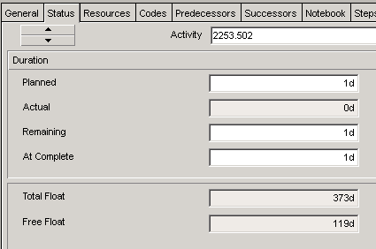
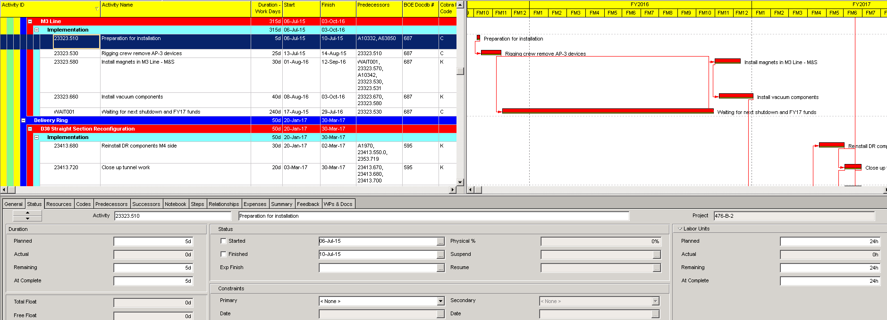
Identify Critical Activities (Float and Critical Path)
Two Key Terms
  Activity Float
  Free - Immediate Relationship
  Total - Project Completion
  Critical Path
Float and Critical Path Details in next two Slides

Slide 19
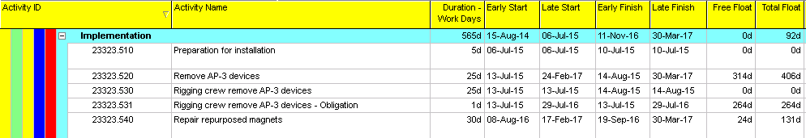
Float
  Float – Difference between early dates and late dates; if difference is >0, the activity has float
Zero float – Longest path of logically related activities through network that cannot slip without impacting project duration
Total float – The amount of time an activity can be delayed before it impacts the project end date
Free float – The amount of time an activity can be delayed before it impacts the succeeding activity

Slide 20
Critical Path
  Critical path – Activities that cannot slip a day without increasing total project duration or delaying completion; if float < 1, the activity is on the critical path
  Technical Critical path – What aspect of the work is critical? IE – piece of equipment needs to be ordered early; foreign order, etc.

Slide 21
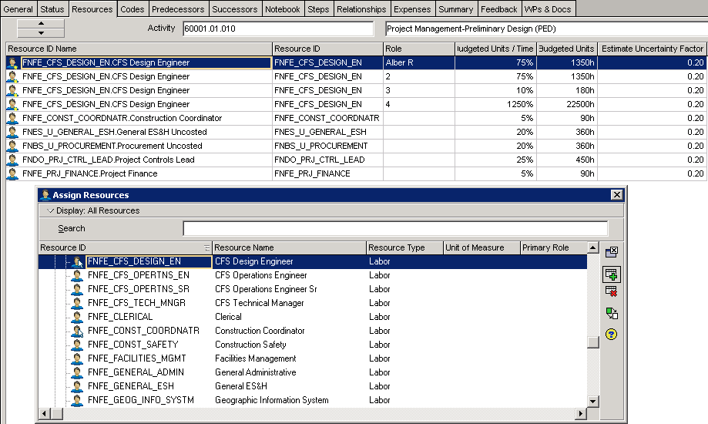
Determine Resources for Activity
Consult with SME’s, Prior Experience, to Determine needed Resources
Reflecting Basis of Estimates (BOE)
Assigned to Tasks or Activities
Resource ID Encoded
Labor
M&S

Slide 22
Burden Cost and Escalation
 | FY15 | FY16 | FY17 | FY18 | FY19 | FY20 | FY21
Labor | 2.9% | 3.0% | 3.2% | 3.3% | 3.4% | 3.5% | 3.6%
M&S | 1.7% | 1.9% | 1.9% | 1.9% | 2.0% | 2.0% | 2.0%
FNAL Budget Office Develops and Determines
  Escalation Rates
  Indirect Rates
The Accounting Department is responsible for developing Labor Burdens to be incorporated in Rates
Rates are Communicates to OPSS to incorporate into systems
  Input into FNALs Cost Processor (Cobra) Rate Tables
  Rate Table Changes are Communicated to Projects for Incorporation and Result in Processed of BCRs

Slide 23
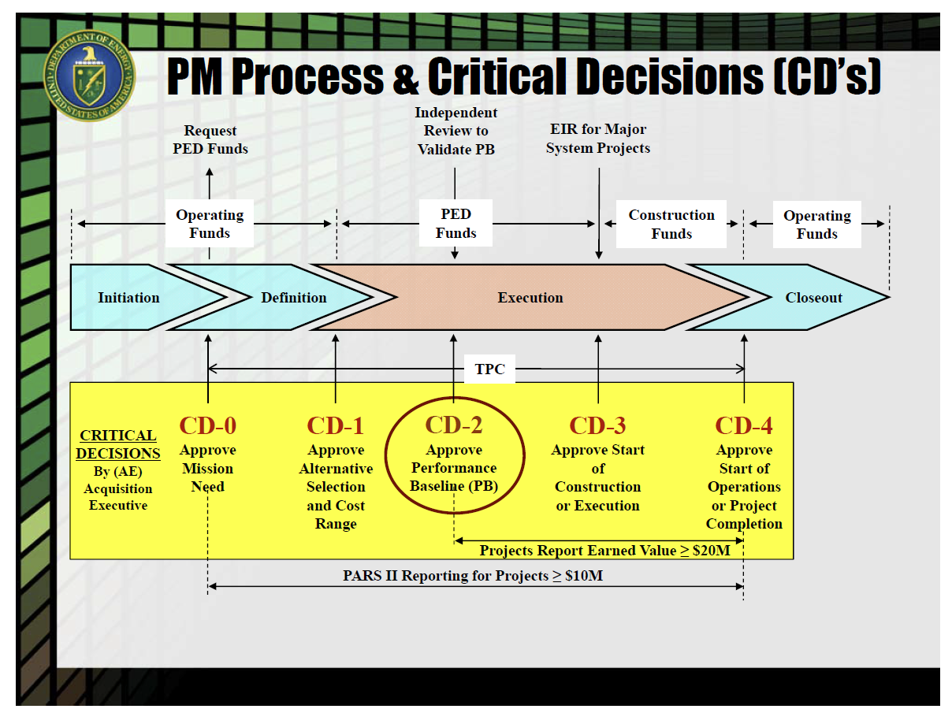
Project Life Cycle – Models
Initiation
Planning
Execution
Close-out

Slide 24
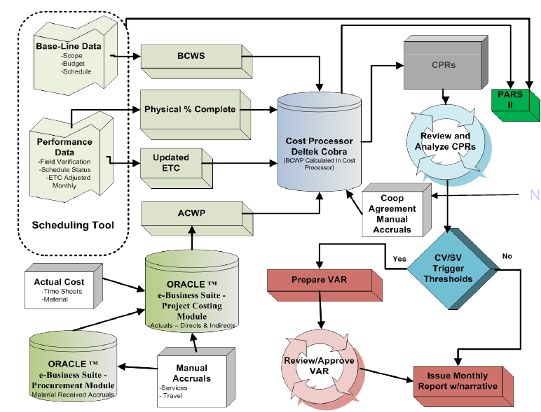
EVMS Tools
CAMs are not expected to be experts at tools used in our EVMS. However, they must know how they are used to control their accounts.
Four primary data tools
  Primavera P6
  Excel/MS Word
  Accounting DB
  Cobra
  Three reporting tools
  Cobra
  P6
  Excel
Next 5 Slides Describe Tool Details

