Slide 1

Decay Station Workshop, East Lansing, Jan. 2018
Neutron-capture constraints and n-γ competition
far from stability
Artemis Spyrou

Slide 2
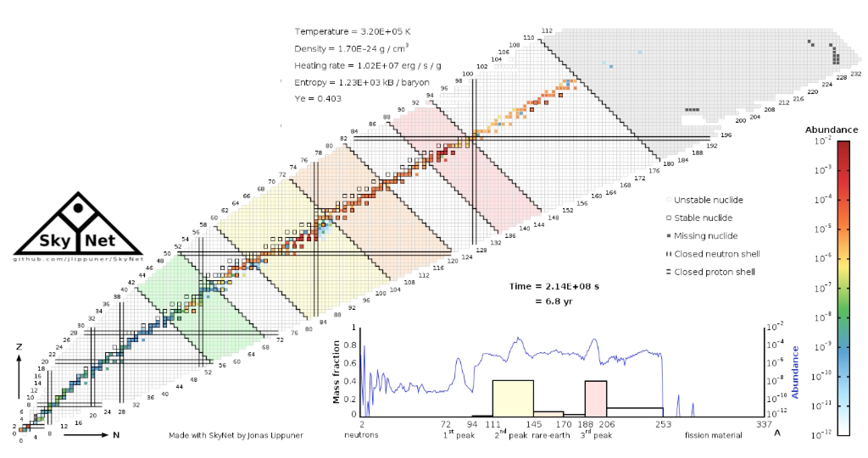
r-process in neutron-star mergers
Blue component:
Light r-process elements
Optical
Bright and brief
“Red” component:
Heavy r-process elements
Lanthanides
Infrared
Longer-lasting
GW170817 observations distinguish between heavy (red) and light (blue) components, but cannot get individual element contributions.
Nuclear physics data needed to figure out the different contributions
Made with SkyNet by Jonas Lippuner

Slide 3
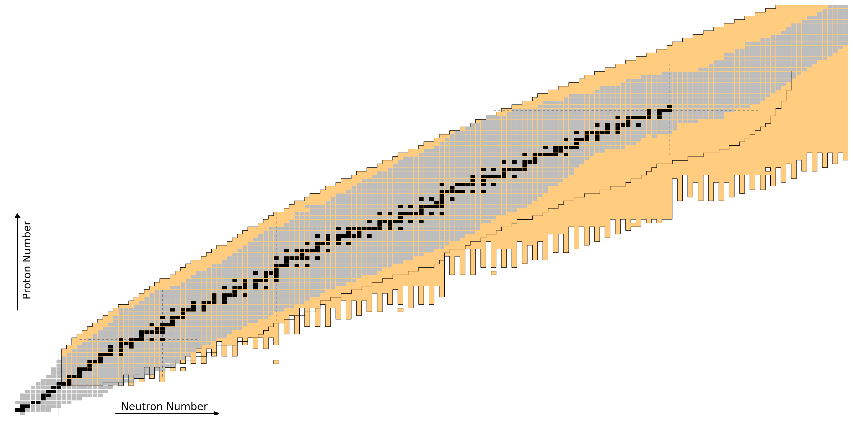
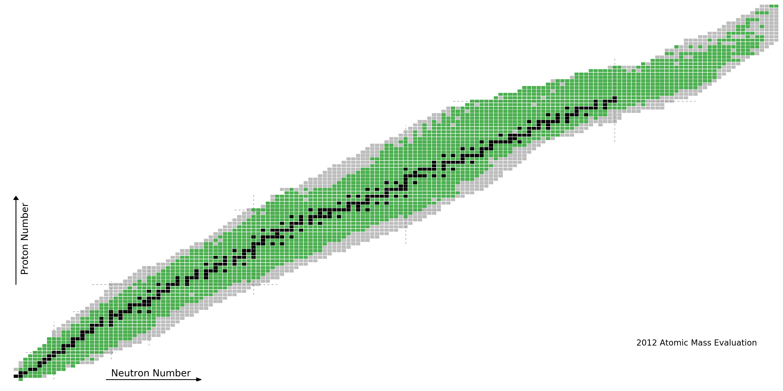
Nuclear Input for r-process
masses
beta-decay rates
beta-delayed neutron emission probabilities
neutron capture rates
fission rates
fission product distributions
neutrino interaction rates
Equation of state
r-process path
Nuclear properties not known for all nuclei that participate in NS merger r-process
Current facilities can access some isotopes
FRIB will give access to the majority of r-process nuclei
figure by M. Mumpower

Slide 4
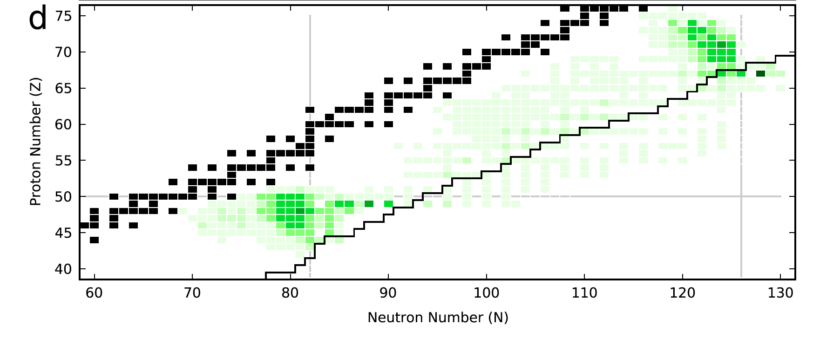
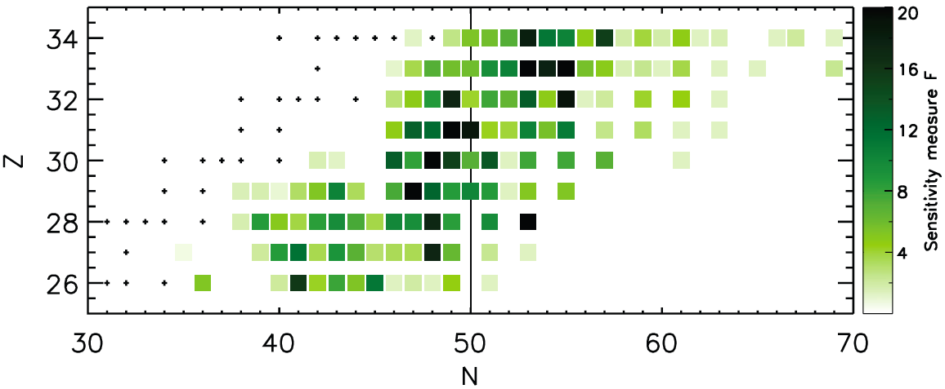
Neutron-capture sensitivity
Main r-process
Neutron-star merger
Supernova
Weak r-process
Mumpower et. al., PPNP 86 (2016) 86
Surman, et al., , AIP Advances 4, 041008 (2014)

Slide 5
Neutron Captures within the Statistical Model
Hauser – Feshbach
Nuclear Level Density (NLD)
γ-ray strength function (γSF)
Optical model potential
(n,γ)
Dominate uncertainties
(A-1, Z)
Large uncertainties further from stability
γ
(A, Z)
β-Oslo method:
Combine traditional Oslo Method with Total Absorption Spectroscopy
Use β-decay to populate the compound nucleus of interest
Advantage: study nuclei far from stability

Slide 6
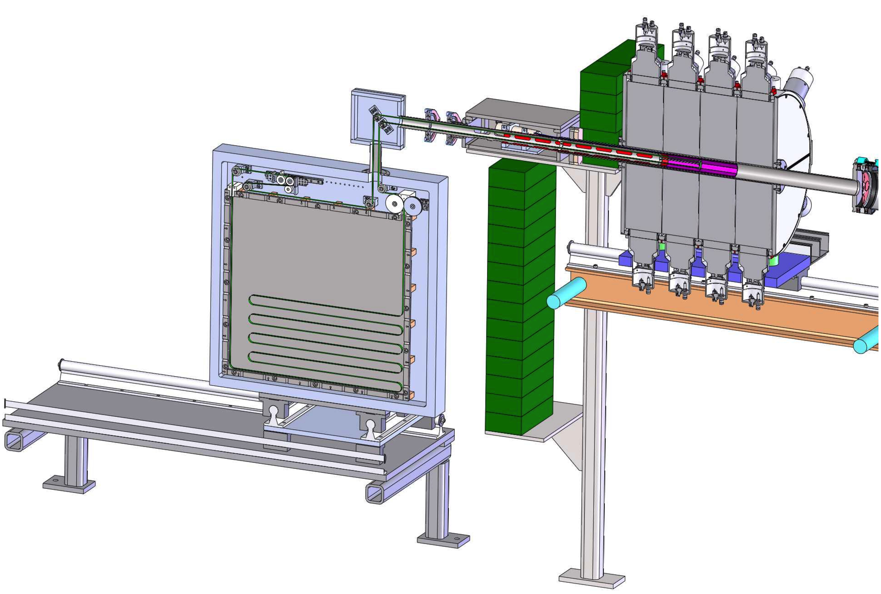
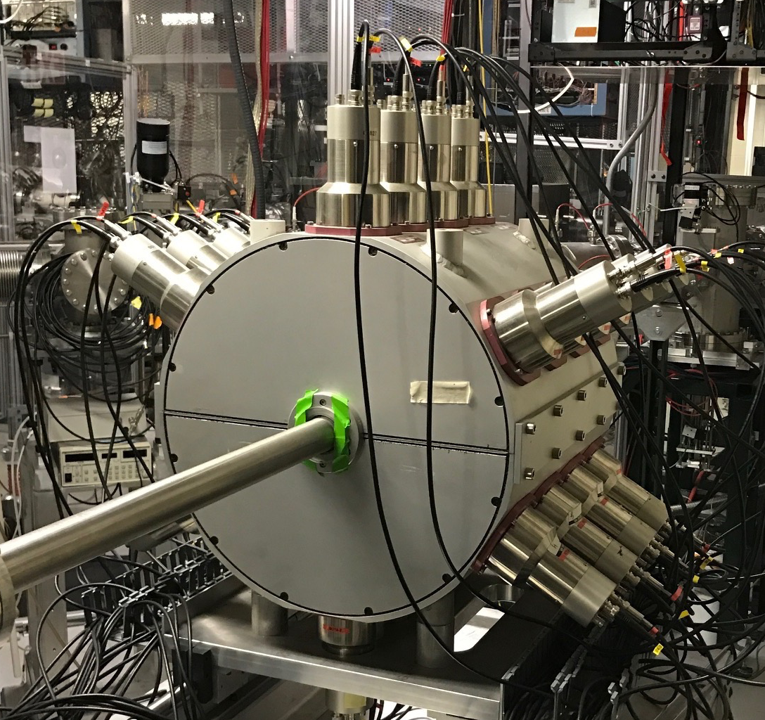
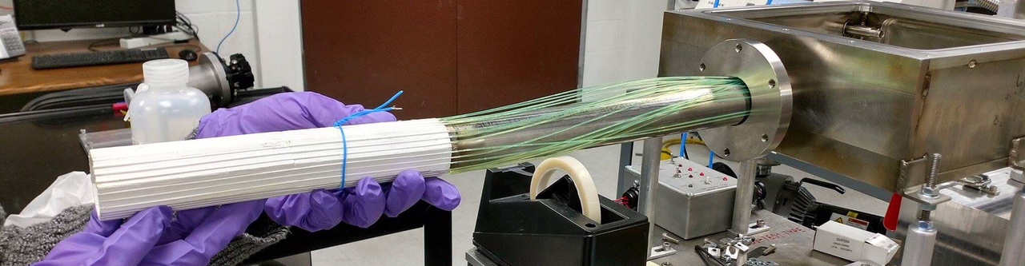
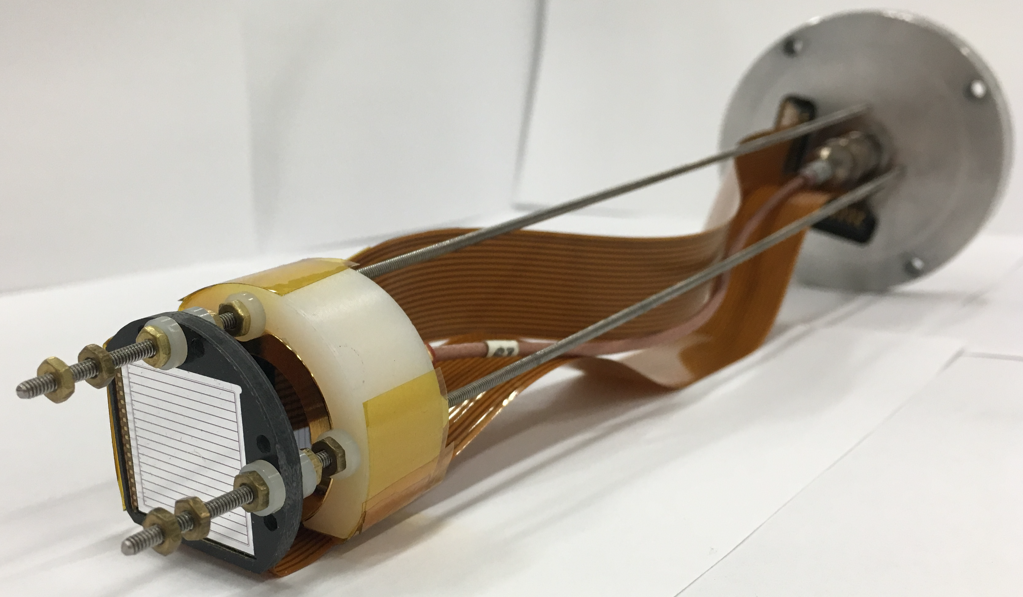
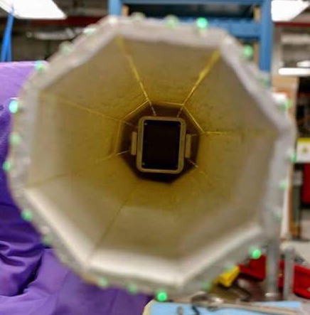
Experimental Setup
SuN
γ-Total Absorption Spectrometer
SuNTAN
Tape Transport System
Design by LSU and ANL
Fiber Detector
β-detection
Hope College
DSSD
Implantation-decay correlation

Slide 7
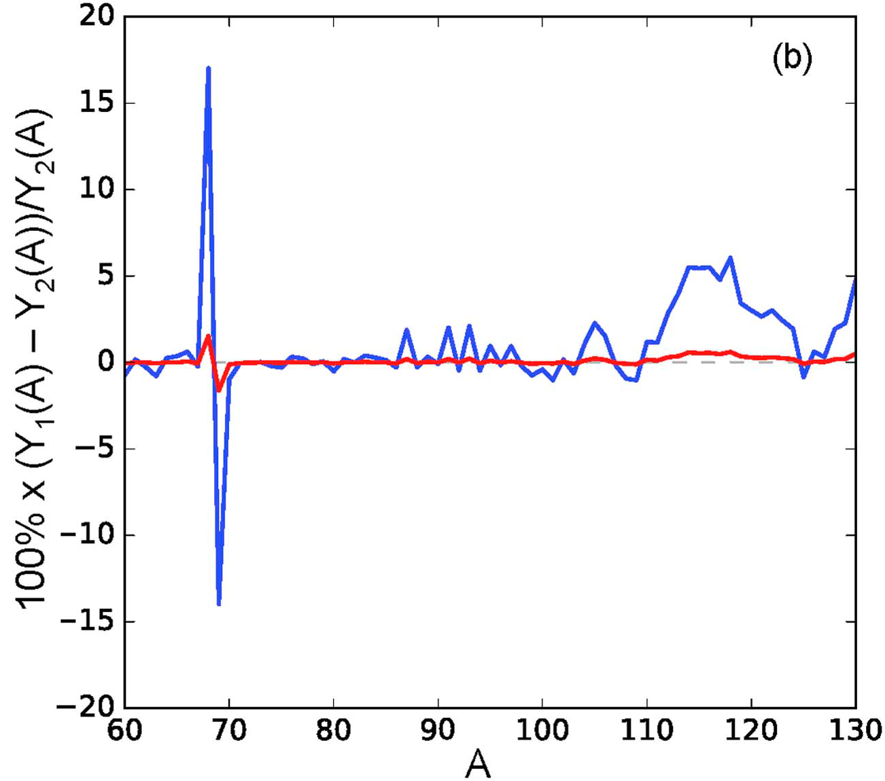
First Results from NSCL
⁶⁹Ni(n,γ)⁷⁰Ni
⁶⁸Ni(n,γ)⁶⁹Ni
Impact on weak r-process abundance calculations
Liddick, Spyrou, et al, PRL 2016
Spyrou, Larsen, et al, JPG 2017

Slide 8
γ emission above the neutron threshold
⁷⁰Co-> ⁷⁰Ni
Q_{β} = 12.3 MeV
S_{n} =7.3 MeV
Observation of γ emission above Sn
Observed previously due to spin mismatch
Here interpretation based on spectroscopic overlap
S_{n}
E_{x} (keV)
Experimental
Full fit
No γ above Sn
Counts
E_{γ} (keV)
Expected right below proton magic numbers
Future experiments to investigate
Summing Energy (keV)
Spyrou, Liddick et al, PRL 2016

Slide 9



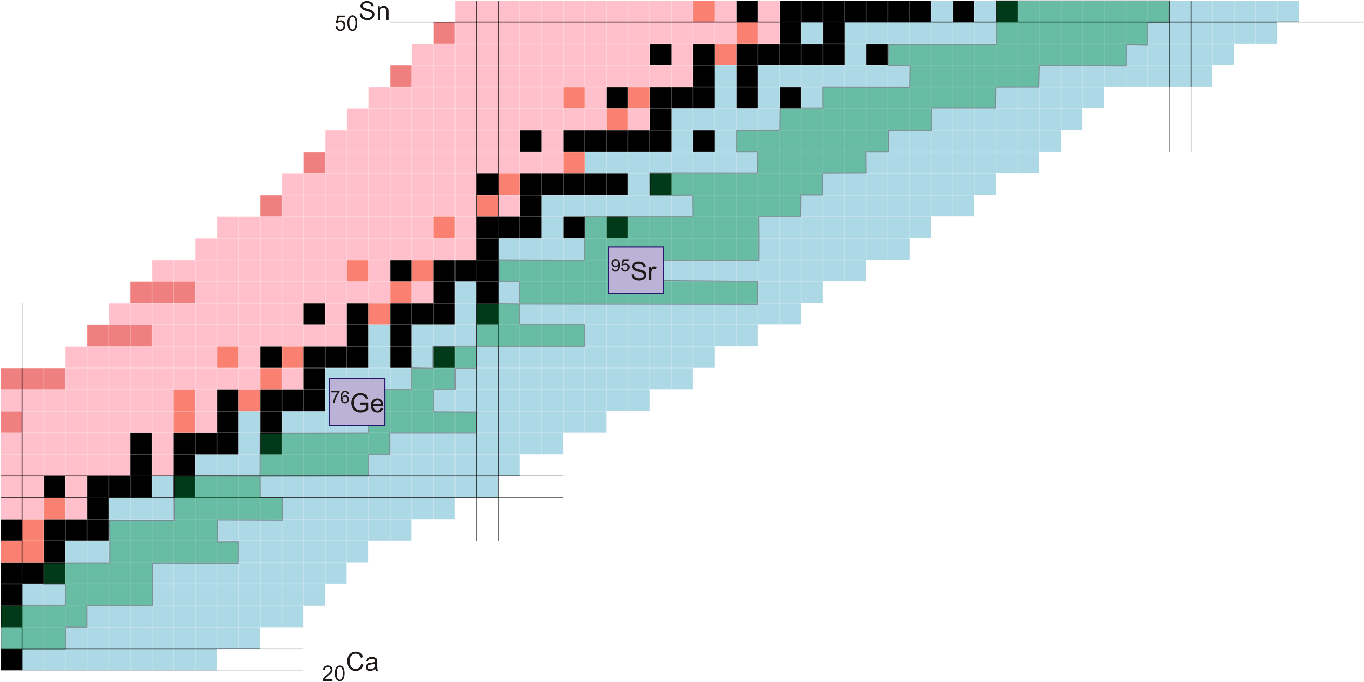
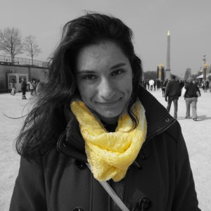
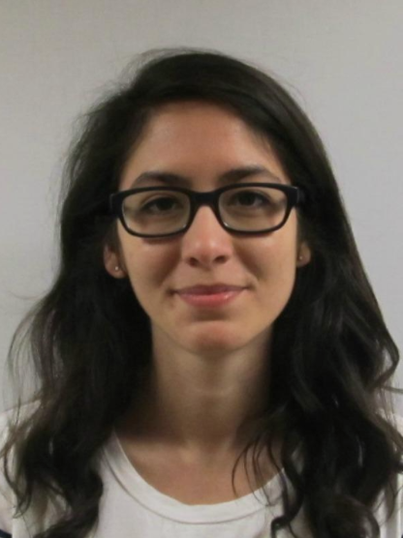
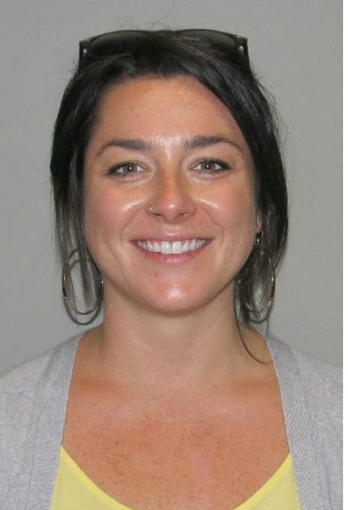
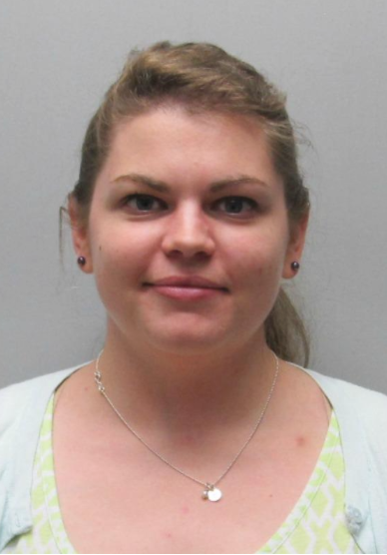
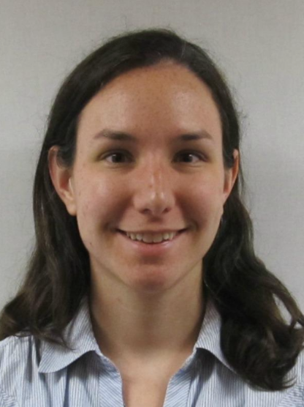
Current and short-term plans
Farheen Naqvi, Notre Dame
Alex Dmobos, MSU
Stephanie Lyons, MSU
Adriana Ureche,
UC Berkeley
Caley Harris, MSU
Becky Lewis, MSU
Mallory Smith, MSU
Debra Richman, MSU

Slide 10
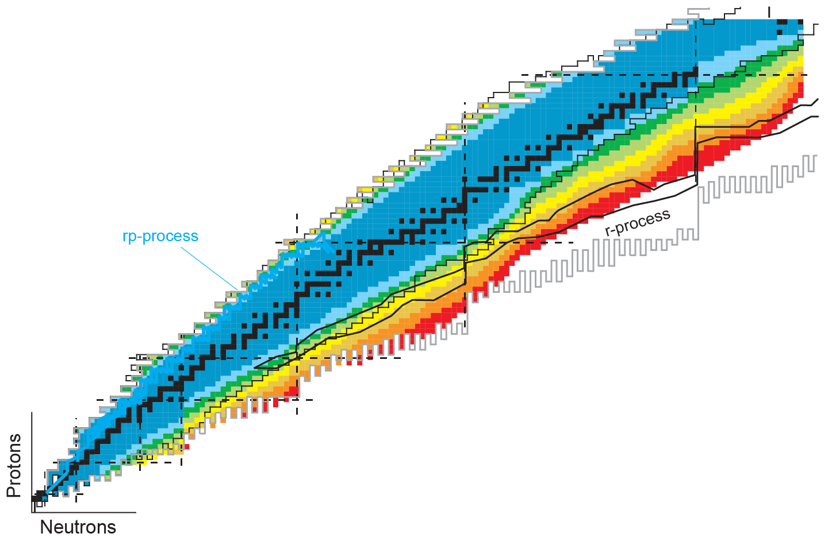
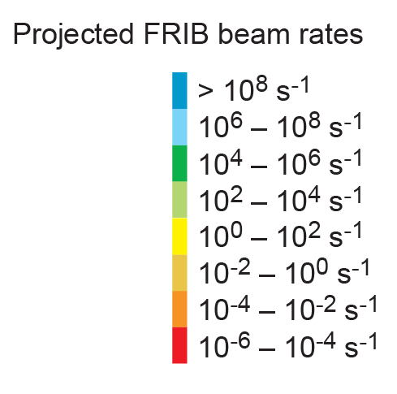
FRB Rates
β-Oslo – (n,γ)
TAS
βn - measurements
Discrete γ Spectroscopy
Half-life

