Slide 1
SURF Space Availability
Joshua Willhite
LBNF Far Site Conventional Facilities Project Manager
14 December 2017

Slide 2
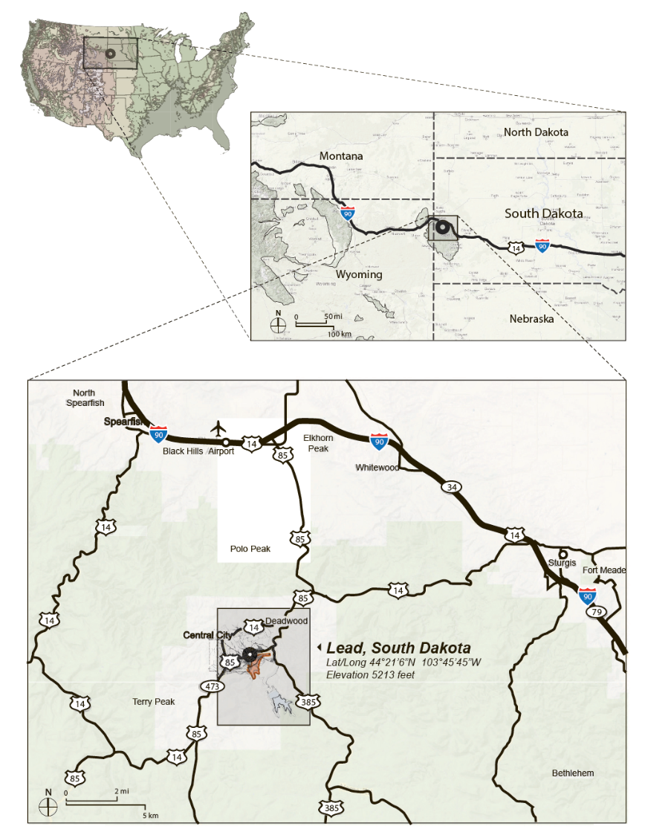

Slide 3
Lead Area

Slide 4
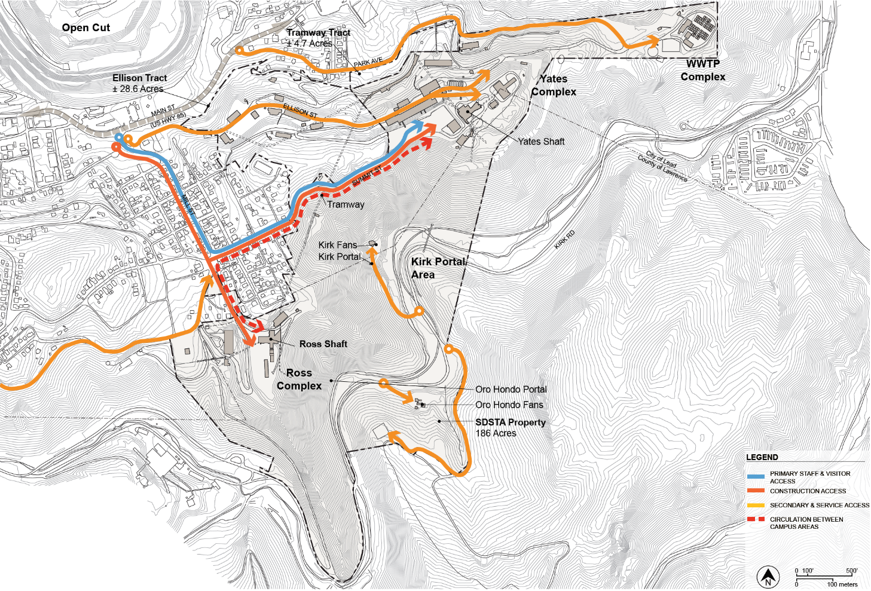
Access

Slide 5
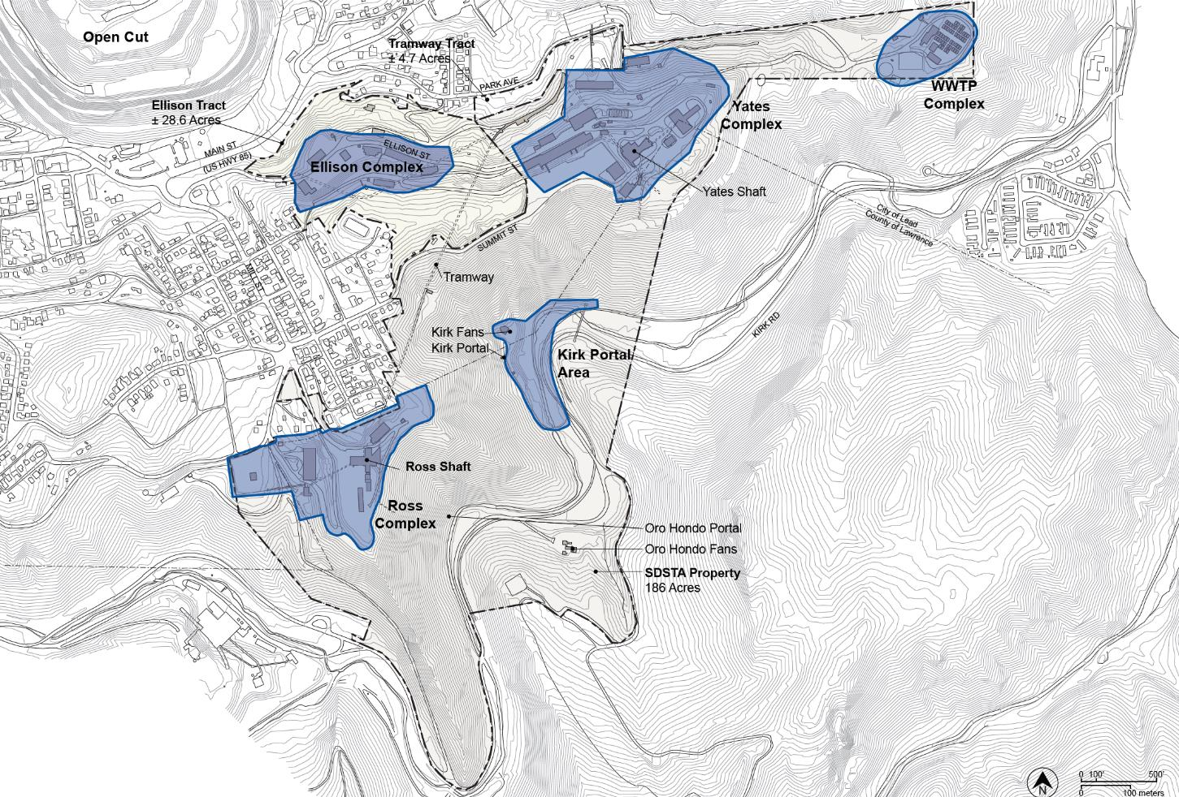
General Areas

Slide 6
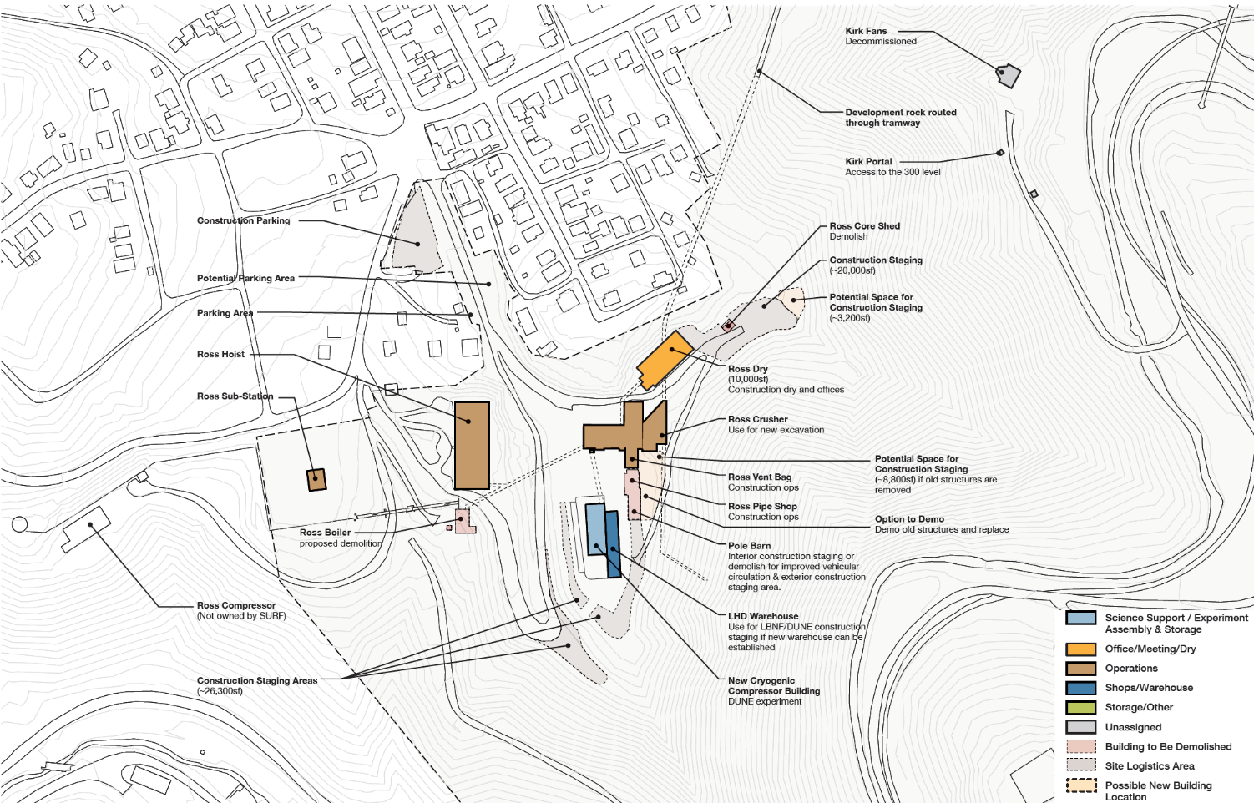
Ross Complex

Slide 7
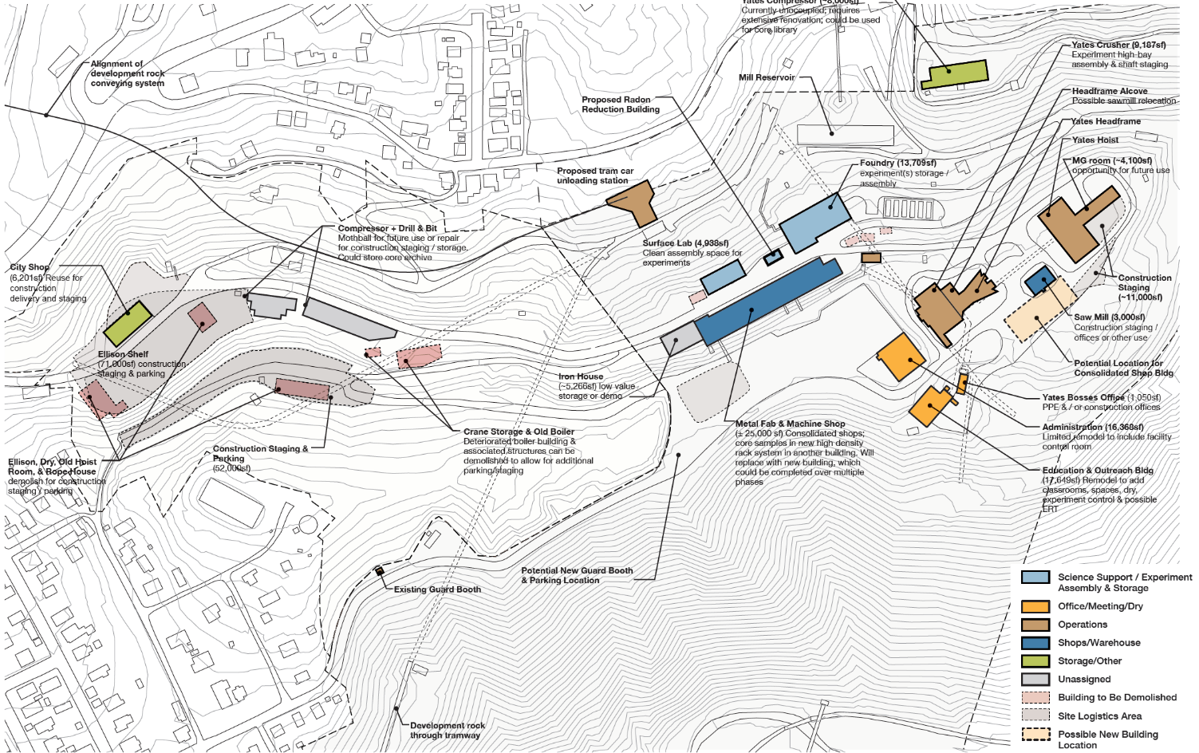
Ellison and Yates Complex

Slide 8
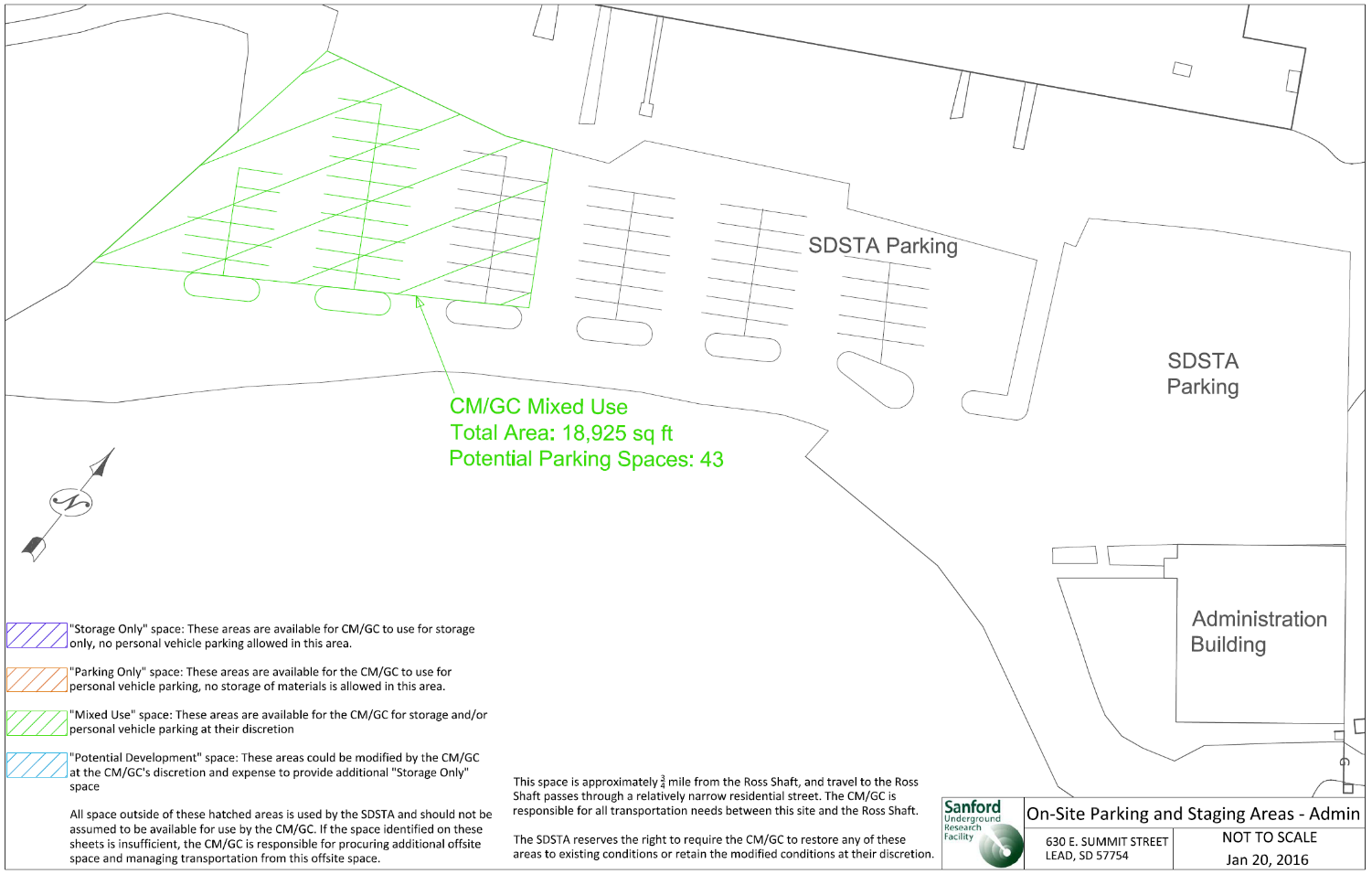
CM/GC Used Space (Admin Parking)

Slide 9
CM/GC Used Space (Ross)

Slide 10
CM/GC Used Space (Yates)

Slide 11
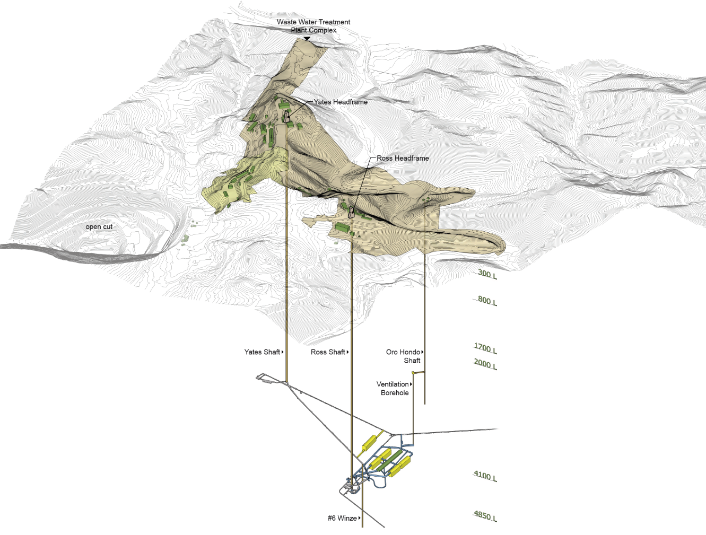
Underground Relationship

Slide 12
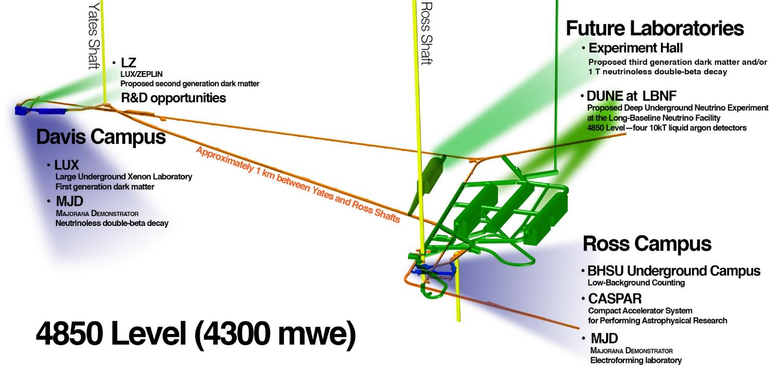
Underground
Existing facilities
Proposed facilities

Slide 13
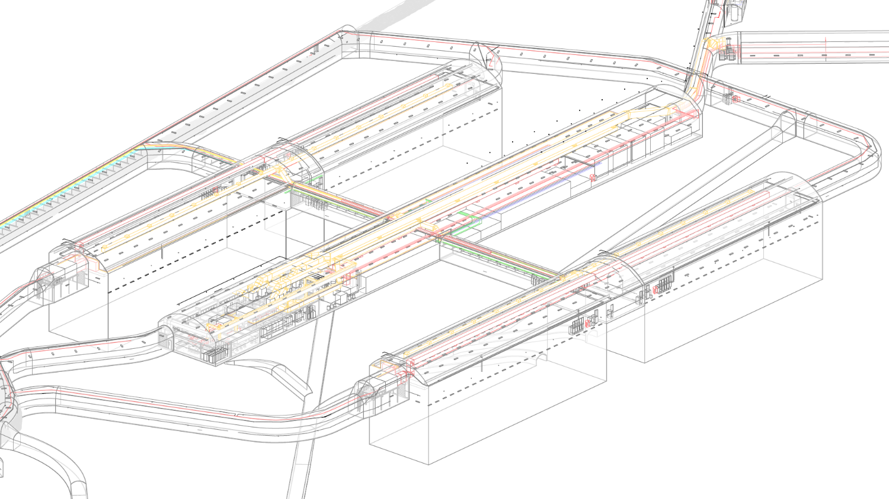
FY20 BSI Scope - Central Utility Cavern Elements
Spray Chamber
LN Booster Blowers
Chamber 2
LN Cold Boxes
LAr Purification
Chamber 1
Chamber 4
Chillers
Emergency
Power Room
Substation
Control Room
And DAQ
Chamber 3

Slide 14
Primary Space Available to DUNE

Slide 15
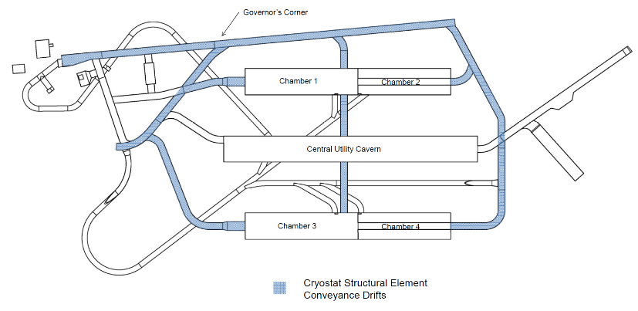
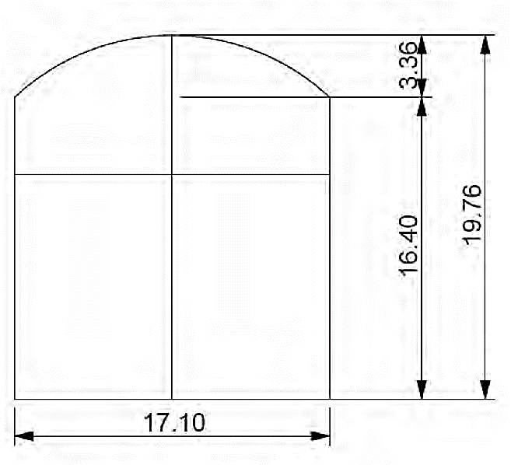
Drift Dimensions
(1m)
(6m)
(5m)
(5.2m)

Slide 16
Timeline
Based on P6 as of today (12/18/17):
Chamber 1 is turned over to cryostat December 29, 2021
Chamber 2 is turned over January 23, 2022
All phase 1 and 2 BSI is done June 2022
Chamber 3 and 4 excavation completes May 19, 2023
Cryogenics in the CUC begins September 2023
currently shown as all four at once
Ross Shaft gas piping is done October 2022

Slide 17
Questions?

