Slide 1
ProtoDUNE Single Phase Data Exploitation Readiness Review Executive Session

Slide 2
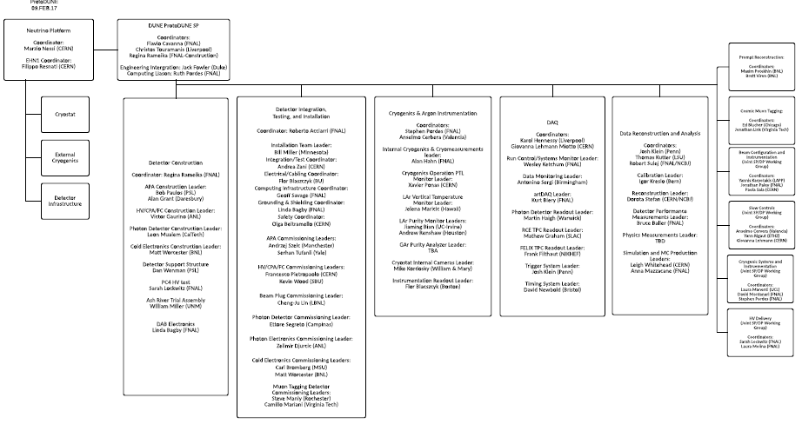
ProtoDUNE-SP Org Chart
~Under review

Slide 3
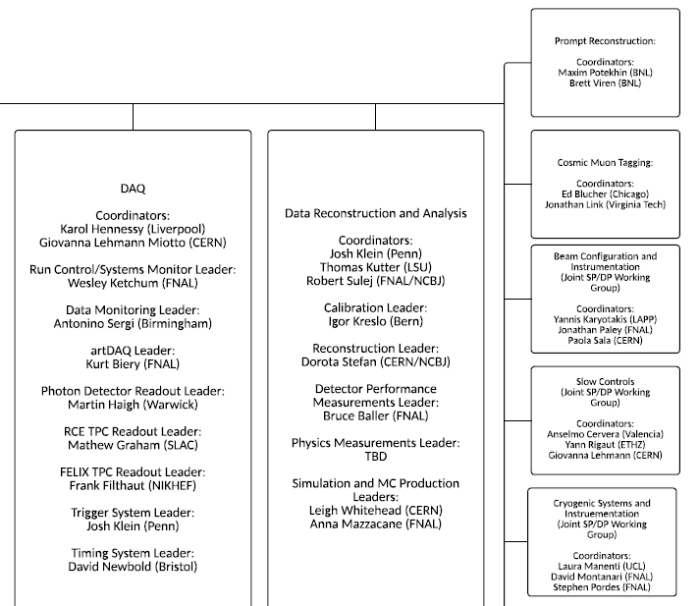
ProtoDUNE-SP Team
DAQ reviewed in Nov 2016
DRA not yet reviewed
Tinjun and Georgios

Slide 4
Charge
Design Review:
ProtoDUNE Single Phase Data Exploitation Readiness Review
10−11 May 2018
Charge
The Committee is requested to review the ProtoDUNE-SP detector plan for exploitation of data and determine if it is robust and complete. The committee is asked to review the plan for operations, data quality and detector performance monitoring, calibration, data transfer, storage and processing and reconstruction and analysis and assess their readiness.
We would like to frame discussions within well-defined phases for detector construction and operations, with timelines and high-level milestones that can be used to correlate requirements for DAQ, monitoring, calibration, reconstruction, and analysis.
In particular, the review team is asked to address the following questions. Where relevant, we would like to see timelines and milestones defined and published.
Is the proposed scope of the ProtoDUNE-SP data analysis program aligned with the needs of the DUNE project? Are the proposed timescales for ProtoDUNE data analysis consistent with their exploitation by the DUNE project and its design efforts?
Are allocated resource, provided by CERN, FNAL and other organizations, sufficient in terms of temporary, long term and archival storage to meet the proposed scope of the ProtoDUNE-SP program? Are the computing resources (CPU cycles) allocated to ProtoDUNE-SP sufficient to meet the proposed scope of the program? Are these storage/compute allocations matched to the schedule of ProtoDUNE-SP run plan? How do resource allocations evolve and match with a post beam running era?
Do the algorithms that have been developed or are planned for development, meet the needs of the planned scope of the ProtoDUNE-SP program?
Are the resource costs associated with the reconstruction/analysis algorithms understood? How will the execution of the data processing and reconstruction be evaluated and prioritized in the context of limited computing resources?

Slide 5
Charge
Do the services in support of ProtoDUNE-SP, as proposed and organized by DUNE S&C, meet the scope, requirements, and schedule of the ProtoDUNE-SP program? Have the services been demonstrated? Are they on track for beam operations?
Is the Data Acquisition system design, implementation, and demonstrated performance appropriate and aligned with the ProtoDUNE-SP run plan? Are well defined timelines, milestones, scope, and contingency in place for advancing the project to a point of data taking readiness?
Does the data quality monitoring system, in terms of both underlying the infrastructure and the routines/payloads for assessing detector performance, meet the requirements and have appropriate scope to fulfil the needs of the ProtoDUNE-SP program? Are the infrastructure, visualization layers, and analysis routines on track for detector commissioning and beam running?
Do the software tools for calibrating the detector meet the requirements and have appropriate scope for the ProtoDUNE-SP program. Are these efforts on track for detector commissioning and beam running?
Do the software tools for assessing detector performance meet the requirements and have appropriate scope for the ProtoDUNE-SP program. Are these efforts on track for detector commissioning and beam running?
Has the scope and cost of running the ProtoDUNE-SP program, past the start of Long Shutdown 2, been assessed and enumerated in terms of its impact on computing infrastructure and resources?
Are the plans for online/offline operations starting in summer 2018 and expected to last “more than a year” appropriate, on track, and adequately resourced/staffed? Has the DUNE collaboration been adequately engaged in the staffing of these operations? Do the plans appropriately leverage tools and services available at the host and other labs supporting the experiment? Are best practices employed?
Did Data Challenge 2 represent a good approximation to ProtoDUNE data processing conditions? How well did the team and systems perform? What is the response to the recommendations originating from the Data Challenge 2 exercise?
The committee should present its findings, comments, and recommendations in a closeout meeting with DUNE and SCD management on May 11. The committee should provide a final written report by May25.

