Slide 1
ProtoDUNE SP (NP04) DAQ
Karol Hennessy, Giovanna Lehmann Miotto
DAQ Status overview
10 May 2018
DAQ “nations”: Netherlands, UK, US, CERN

Slide 2
Introduction
The ProtoDUNE DAQ environment
External interfaces and constraints
DAQ logical architecture
Main DAQ components and their interaction
DAQ status
Summary

Slide 3
Scope of the ProtoDUNE DAQ
Provide service to the detector/electronics validation
Take and store data safely and efficiently
Reuse existing components, experience, …
Evaluate DAQ solutions and technologies that may be suitable for DUNE
TPC readout system
Data storage
Dataflow software (hardware fully COTs servers + switches)
Control and monitoring software

Slide 4
ProtoDUNE SP environment
Detector
6 Anode Plane Assemblies
TPC (15kCh @ 2 MHz)
Photon detectors (720 SiPM/ 240 ch)
On surface
High flux of cosmic ray particles
On SPS beam line
charged particles 0.5 – 7 Gev/c
The rate and volume of data produced by these detectors will be substantial (O(Tb/s))

Slide 5
DAQ in numbers
Data Production at Detector ≈ 450 Gb/s
Readout to DAQ ≈ 450 Gb/s
If continuous readout:
Averaged bandwidth over SPS cycle (and if no data when no beam) ≈ 135 Gb/s
Expected DAQ compression capacity ≈ x 4
Average storage throughput ≈ 34 Gb/s
Triggered readout to control bandwidth and take selected data instead of any data
Design figure TDR => min 25 Hz [max 100 Hz] of triggers during spill
Corresponds to 17 Gb/s [68 Gb/s] of average storage bandwidth (4.2 Gb/s [17 Gb/s] with x4 compression)
Peak ≈ 56 Gb/s [225 Gb/s] (14 Gb/s [56 Gb/s] with x4 compression)
Changed! 2x4.8s extractions in 32.4 s

Slide 6
Interfaces
TPC (WiB)
SPS
Spill Signal
Timing + Trg out
Photon Detectors (SSP)
Data
DAQ
Beam Instrumentation
Trg In
Trg In
Data files + metadata
Timing + Trg out
Data
CRT
Offline Computing

Slide 7
Constraints
Decoupling
The DAQ needs to ensure a proper decoupling between the “online” and the “offline” worlds
Sufficient storage space for raw data files on the DAQ side should be available to store up to 3 days worth of data taking.
Min 135 TB required (25 Hz in spill + x4 compression), 460 TB of usable space installed
The maximum allowed throughput from online to offline is 20 Gb/s
Grounding
Keep all DAQ equipment on building ground
Any link connecting the detector must be isolated -> optical
Direct impact on readout, timing, trigger

Slide 8
The ProtoDUNE DAQ
Off detector readout systems
Ring Buffer
Event size ~70 MB (5ms window, x4 compression)
TPC
Data Compression
Event Building
450 Gb/s
Monitoring
Off detector readout system
Photon Detectors
Summary Info
Temporary Storage
25 Hz in spill
Trg+Timing
DB
Max 20 Gb/s
Cosmic rays tagger
EOS
Beam Instrumentation

Slide 9
ProtoDUNE software
Dataflow software is based on artDAQ developed at FNAL
Customizable “Board Reader” application
Event building
Dispatching to monitoring apps
Aggregation and storage
Data flow control through load balancing & trigger inhibit
Control, operational monitoring, graphical UIs
Joint COntrols Project (JCOP) toolkit developed at CERN originally for control of LHC experiments
Uniform interface also for detector control and safety systems
Software approach
Minimize the risks by relying on existing frameworks
Focus effort only on experiment specific needs

Slide 10
Readout of detectors
PDS
On detector electronics already does data reduction and sends data over TCP/IP (-> DAQ starts at Board Reader)
TPC (point-to-point optical links from WiB)
2 solutions being implemented
Baseline: ATCA platform from SLAC
Prototype alternative: ATLAS FELIX + network connected PCs
5 APAs will be readout via ATCA boards (12800 ch), 1 APA (2560 ch) via FELIX
2 firmware variants in electronics (WiB)
API for transparently treating data at software level
From a software point of view the interface towards the event builder is the Board Reader application for all readout systems

Slide 11
ProtoDUNE data flow
Trg/Timing
1
Board Reader
Board Reader
Board Reader
3
10 Gbps Ethernet
4
Routing Master
2
Event Builder
Event Builder
Aggregator/Storage
6
5

Slide 12
ProtoDUNE trigger throttling
Trg/Timing
Readout full/free
-> BUSY/NBUSY
Inhibit Master
Board Reader
Board Reader
Board Reader
Due to the low trigger rates and the “continuous” readout mode of on-detector electronics, software throttling seems sufficient
-> hardware throttling still possible as an option
DFO full/free
-> BUSY/NBUSY
No storage space or slowed down disk writing
-> EB cannot clear events
Routing Master
EB cannot get rid of events
-> RM cannot assign new events
Event Builder
Event Builder
Aggregator/Storage

Slide 13
EHN1 today
NP02
DAQ
NP04

Slide 14
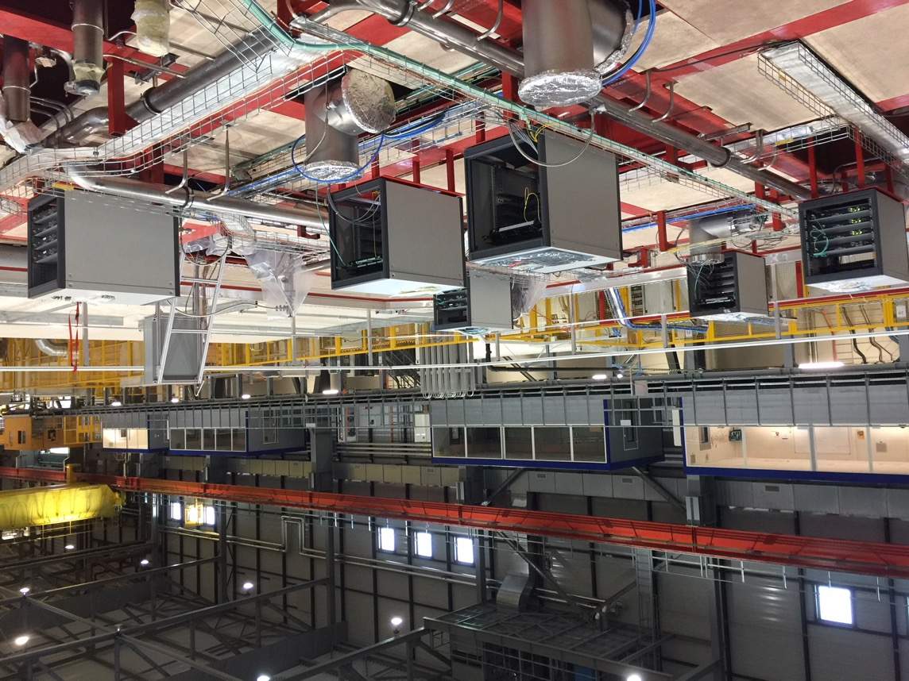
DAQ status - HW
NP04 control room
SSPs and DAQ patch panels
Fiber bundles to DAQ

Slide 15
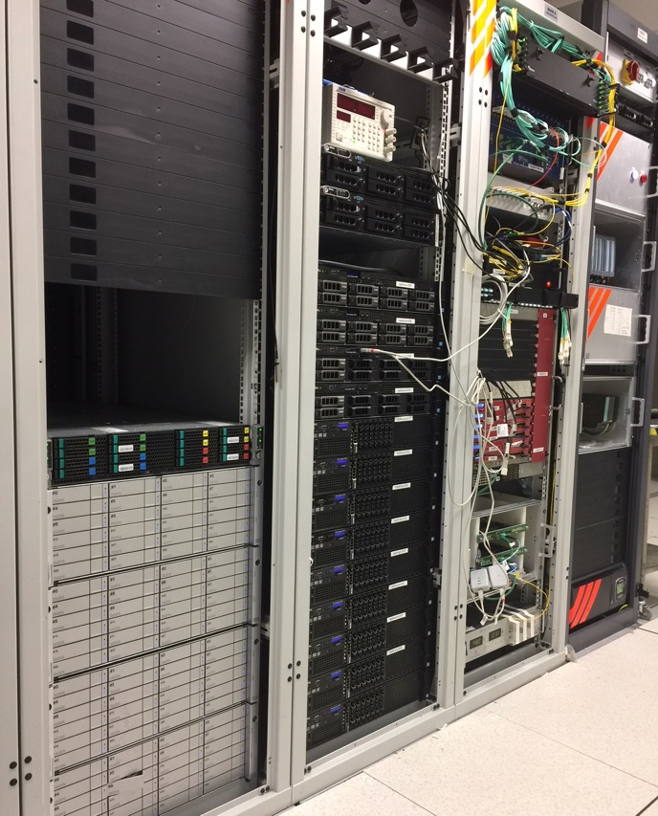
DAQ status - HW
Cryostat fibers
Trigger board
DAQ infrastructure
Timing master
Event builder, data logger, monitoring
RCE readout
Board readers
DAQ storage
FELIX readout

Slide 16
Sub-systems status: Timing
Requirements:
Receive spill signals and global time ✗
Distribute clock and synchronize endpoints ✓
Distribute internally generated triggers ✓
Distribute externally generated triggers ✗
Manage and track dead-time ✗
Support multiple partitions ✓
Drive the data flow ✓
Respond to trigger inhibit commands ✓
Integrate with run control ✓
Provide operational errors and monitoring information ✓
Provide overlay classes do decode data fragments ✓
WIB
SSP
Trigger
RCE
artDAQ
Timing
TriggerInhibit
SPS
CRT
Op Mon
Data Mon
White Rabbit
Run Control

Slide 17
Sub-systems status: Trigger
Requirements:
Receive spill signals ✗
Receive BI signals ✗
Receive CRT signals ✗
Receive SSP signals ✓
Form trigger decision
Pass it to timing master for distribution ✓
Pass data on to data flow ✗
Generate trigger inhibit ✗
Integrate with run control ✗
Provide operational errors and monitoring information ✗
Provide overlay classes do decode data fragments ✓
SSP
BI
Timing
artDAQ
SPS
Trigger
TriggerInhibit
CRT
Op Mon
Data Mon
Run Control

Slide 18
Sub-systems status: WIB readout
Requirements:
Take data from 30 WIBs
5 in coldbox (RCE) ✓
1+1 in test setup (RCE + FELIX) ✓
Pass data on to data flow
without compression ✓
compressed ✗
Continuous readout for noise studies
3 Hz (“equiv.” 40 Hz in spill, compressed )✓
Externally triggered with spill structure ✗
Generate trigger inhibit ✗
Integrate with run control ✓
Provide operational errors and monitoring information ✓
Provide overlay classes do decode data fragments ✓
WIB
Timing
artDAQ
Not needed
TriggerInhibit
RCE FELIX
Op Mon
Data Mon
Run Control

Slide 19
Sub-systems status: SSP readout
Requirements:
Take data from 24 SSPs
Done 23 ✓
Pass data on to data flow without compression ✓
Continuous readout for noise studies (full wave forms)
24 Hz ✓
Externally triggered with spill structure ✗
Generate trigger inhibit ✗
Integrate with run control ✓
Provide operational errors and monitoring information ✓
Provide overlay classes do decode data fragments ✓
SSP
artDAQ
SSP Board Reader
TriggerInhibit
Op Mon
Data Mon
Run Control

Slide 20
Sub-systems status: CRT readout
Development started only recently
Responsibility of CRT group
Requirements:
Take data from CRT ✗
Pass data on to data flow without compression ✗
Generate trigger inhibit ✗
Integrate with run control ✗
Provide operational errors and monitoring information ✗
Provide overlay classes do decode data fragments ✗
CRT
Timing
artDAQ
CRT Board Reader
TriggerInhibit
Op Mon
Data Mon
Run Control

Slide 21
Sub-systems status: artDAQ
Requirements:
Readout framework ✓
Event Building ✓
Data Storage ✓
Files metadata creation ✓
Data dispatching for monitoring ✓
Load balancing and back-pressure ✗
DAQ Configuration ✓
Run history
Integrate with run control ✓
Provide operational errors and monitoring information ✓
RCE Board Reader
SSP Board Reader
FELIX Board Reader
CRT Board Reader
WIB Board Reader
Trg Board Reader
artDAQ
Timing
Op Mon
TriggerInhibit
Data Mon
Run Control

Slide 22
Sub-systems status: Run control
Requirements:
Start/stop processes ✓
Coherently step through finite state machine ✓
Distribute commands to all endpoints ✓
Inhibit/release trigger ✓
Create run number ✓
And set run type ✗
Visualize operational monitoring data ✓
Support multiple concurrent data taking partitions ✓
React to slow control information ✗
RCE Board Reader
SSP Board Reader
FELIXBoard Reader
WIB Board Reader
Timing
Run Control
TriggerInhibit
CRT Board Reader
Op Mon
Trg Board Reader
artDAQ
Slow Control

Slide 23
Sub-systems status: Operational Monitoring
RCE Board Reader
SSP Board Reader
FELIX Board Reader
Requirements:
Provide plugins to publish counters, statistics and messages in a coherent way ✓
Gather counters/statistics data for all endpoints ✓
Archive a selection of data for later analysis ✓
Provide data visualization in run control framework ✓
Further improvements planned
Gather, archive, visualize log messages (info, warnings, errors) ✓
Timing
WIB Board Reader
Operational Monitoring
TriggerInhibit
Trg Board Reader
Web viewer
CRT Board Reader
Run Control
artDAQ

Slide 24
Sub-systems status: Online Data Monitoring
RCE data
SSP data
FELIX data
Requirements:
Analyse events dispatched by artDAQ
Noise, channel maps, data verification, …
Basic event display
Instantaneous, integrated, historical visualization of histograms, graphs, …
Timing data
Data Monitoring
CRT data
Web viewer
Trigger data
Op Mon
artDAQ
Run Control

Slide 25
Status of DAQ integration
Most of the hardware available at CERN
Few more hosts being purchased to increase monitoring and data flow capacity
Final timing master hardware expected in June
Cabling to cryostat complete
Not fully tested
BI cables pulled, to be terminated and tested
Connection to SPS and White rabbit to be done
Status of DAQ sw/fw:
Successfully run WIBs + RCEs + SSPs + timing with low rate continuous triggering for cold-box tests (1 APA at the time)
Successfully run WIB + FELIX+ timing with continuous triggering on vertical slice test HW
Successfully run SSPs + timing for all 6 APAs with periodic trigger
Successfully received SSP trigger signals into central trigger
Successfully established data transfer to EOS
Successfully used run control and operational monitoring to control and monitor DAQ
Successfully used Online monitoring during cold-box tests

Slide 26
Summary and Outlook
The DAQ design presented/reviewed in Nov 2016 has been retained and implemented
The firmware and software components of the DAQ are in an advanced stage of development
Still pending: data compression, integration of trigger board, trigger inhibit, load balancing
All hardware components required for the DAQ are available
Servers, switches, interconnects, storage, ATCA based readout solution, FELIX PCIe based readout solution, preliminary timing master and fanout, central trigger board
Few more servers will be purchased to have more head-room for monitoring and dataflow performance
Integration with the WIBs and SSPs done (still pending: CRT, BI, SPS)
Data transfer to EOS being used routinely (and stress tested during data challenges)
Continued effort to improve stability and performance of data flow
Continuous improvement and extension of online monitoring capabilities
User documentation is being written and updated continuously
The cold-box has been an essential step towards the preparation of the DAQ for NP04
Created excellent links between detectors, daq, offline
Tested operation models and started training the expert shifters of tomorrow!

Slide 27
Celebrating “cold-box 5”

