Slide 1
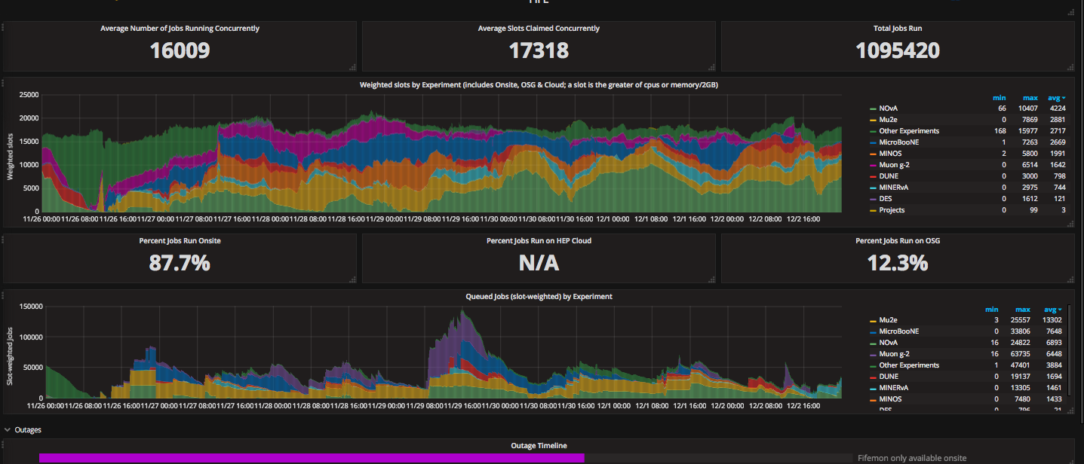
FIFE Operations (combined offsite and onsite)
https://fifemon.fnal.gov/monitor/dashboard/db/scd-summary-fife
Interactive machines needed reboots this morning to recover from dcache overloads over the weekend. Dcache itself autorecovered. Mount points on interactive machines had probems.
Offsite access of FIFE plots available again as of 12/1/2017

Slide 2
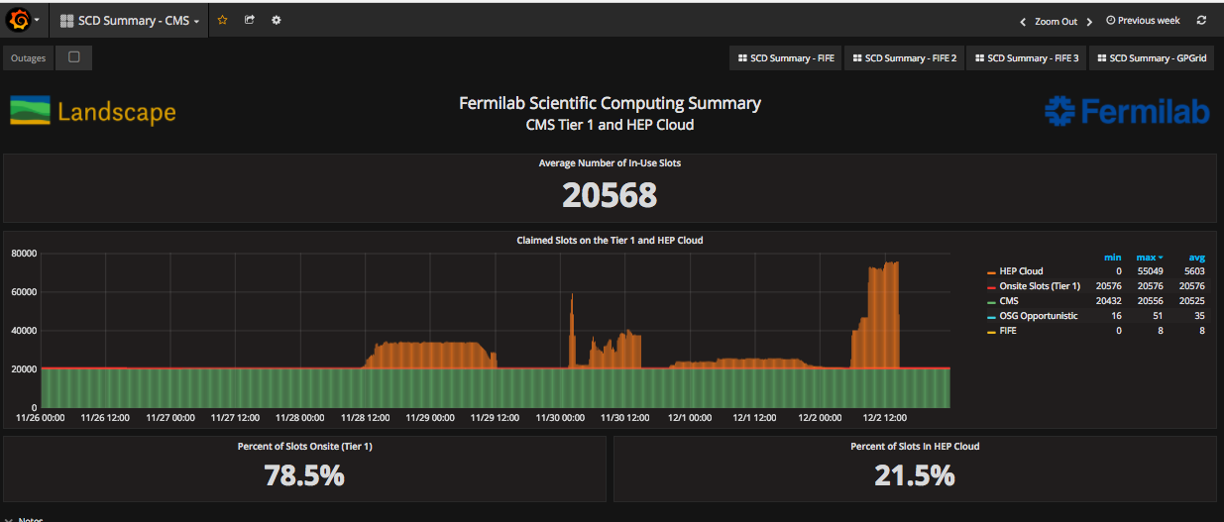
CMS Operations
https://fifemon-pp.fnal.gov/dashboard/db/scd-summary-cms
2017 data taking is over. Resume running in arch.

