Slide 1
Accelerator Division Status
Daniel Johnson
All Experimenters’ Meeting/Lab Status Meeting
04 December 2017

Slide 2
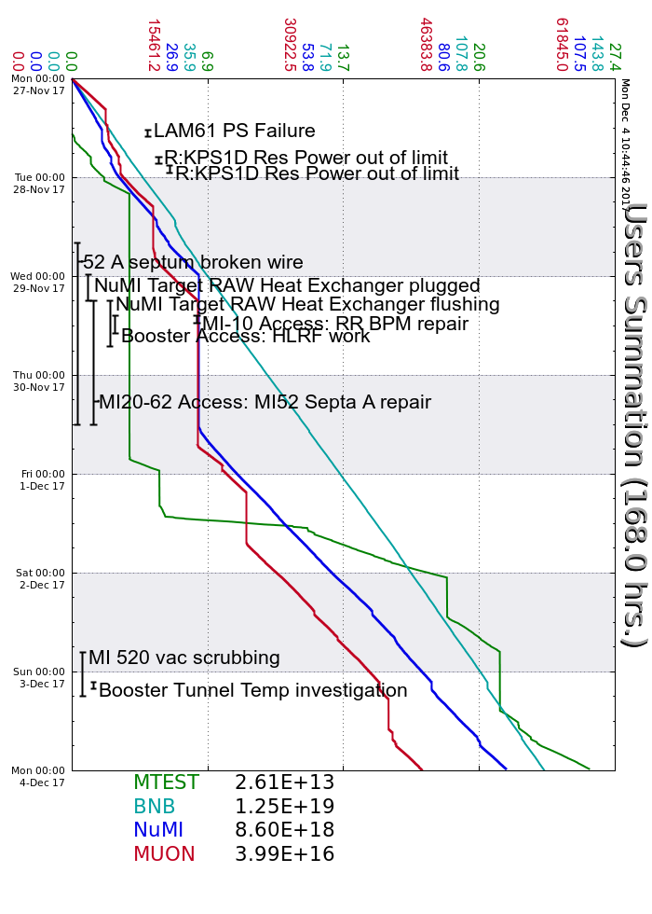
Accelerator Operations Summary
From: November 27, 2017 (0000 hours)
To: December 04, 2017 (0000 hours)
Calendar Week # 48
NuMI Weekly Integrated Intensity 8.60 E18 protons
Beam Hours To NuMI 113.9 hours
BNB Weekly Integrated Intensity 1.25 E19 protons
Beam Hours To BNB 152.6 hours
Muon Weekly Integrated Intensity 3.98 E16 protons
Beam Hours To Muon 52.5 hours
MTest Weekly Integrated Intensity 2.61 E13 protons
Beam Hours To MTest 46.1 hours
MCenter Weekly Integrated Intensity 0.00 E00 protons
Beam Hours To MCenter 0.0 hours

Slide 3
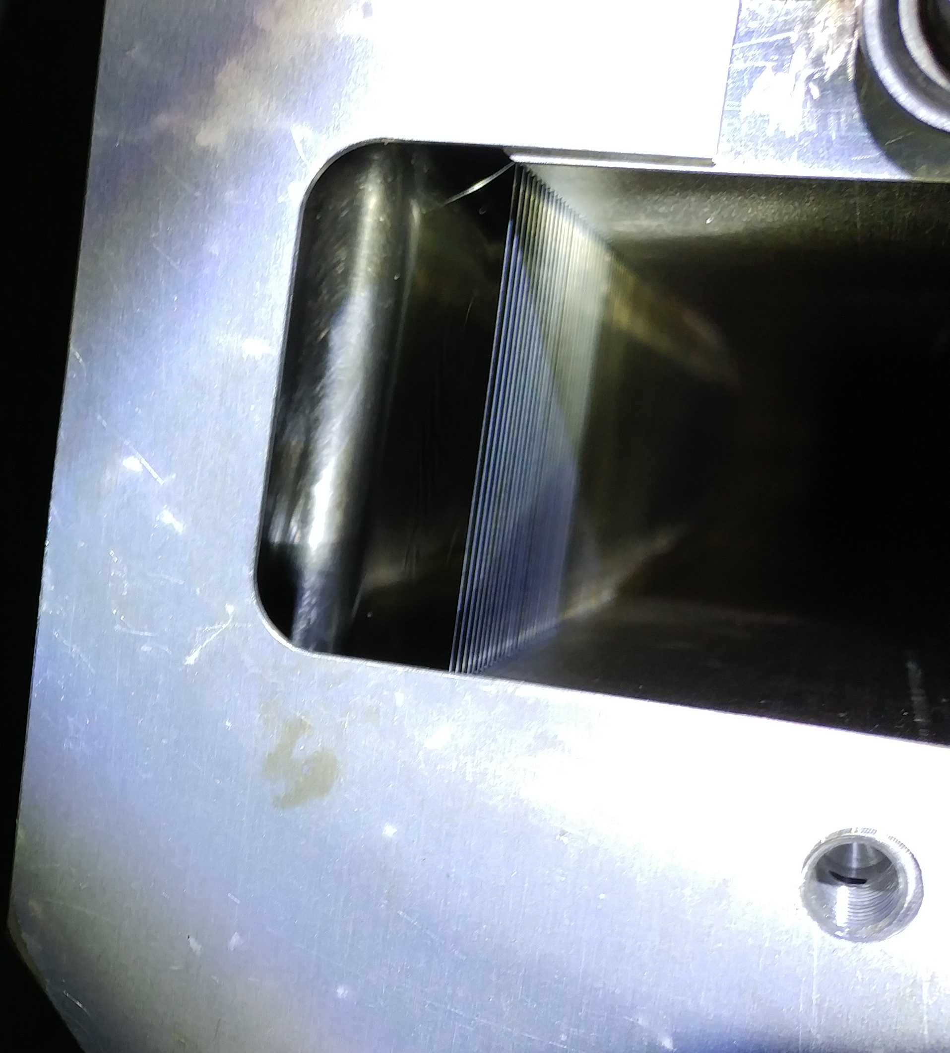
Broken A Septum Wire
Wire shorted on Tuesday
Access Wednesday to fix
  Found 1 shorted wire and 2 broken wires at D/S end of tank A
Back on Thursday afternoon

Slide 4
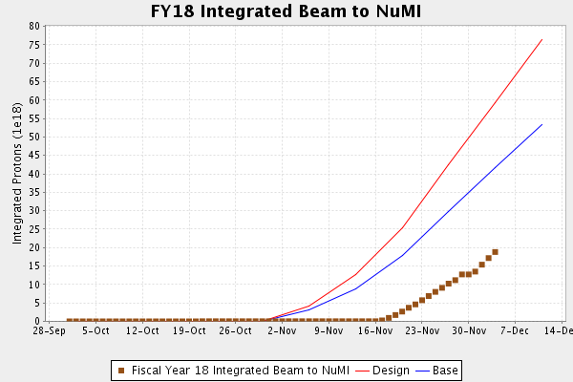
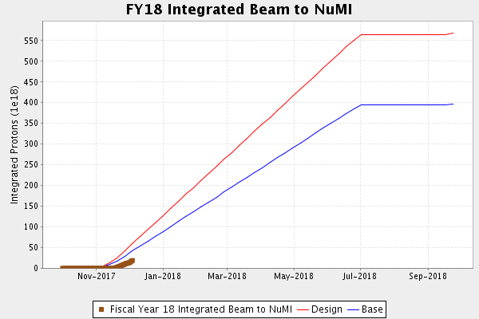
NuMI Operation

Slide 5
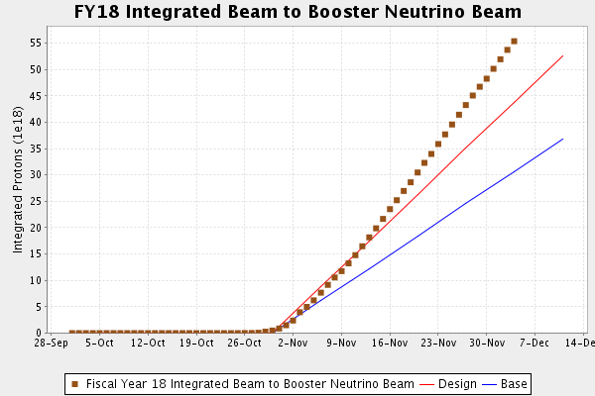
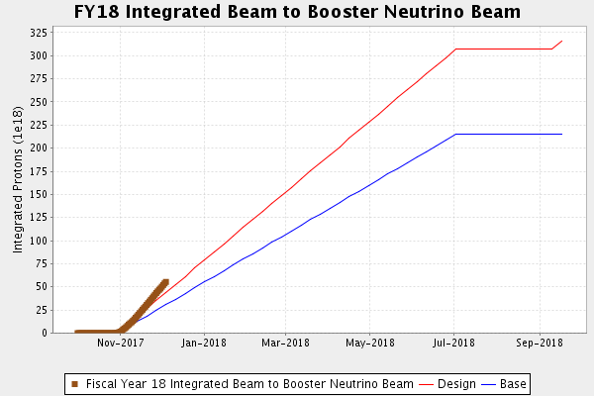
BNB Operation

Slide 6
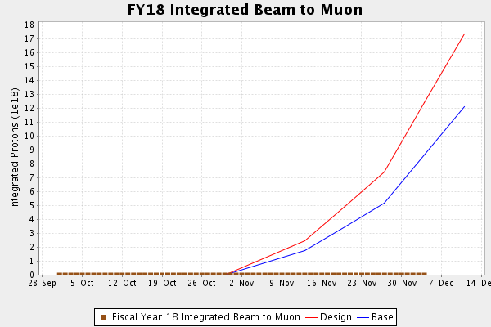
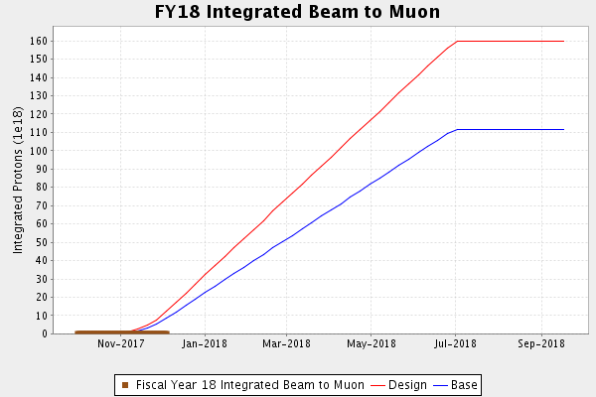
Muon Operation

Slide 7
Complex Status
LINAC
  Investigating LRF3 MARX trips
Booster
  Tuning continues
MI/RR
  RR beam for operation
  Slipstacking
NuMI
  Running at ~550kW (with switchyard)
Booster Neutrino Beamline (BNB)
  Stable operation
  Running at 5 Hz
Switchyard
  Meson Test Operating
    MI-52 Septum
  Meson Center
    Waiting
Muon Campus
  Startup underway
  Tuning & studies
General

Slide 8
PIP-II Injector Test & FAST Status
PIP-II Injector Test
  Startup
    November 27th
    Get beam through new differential pumping section with low losses
    Buncher phasing checks
    Scans and measurements
    50 Ohm Kicker studies
FAST
  Milestone Achievements
      Average design ILC gradient of 31.5 MeV/m for a cryomodule with beam
      300 MeV electron beam energy to the FAST high-energy beam absorber
  300 MeV Commissioning Run Successful
      Turned off December 4th, 2017 in the early morning
      Many studies performed and much data to analyze

Slide 9
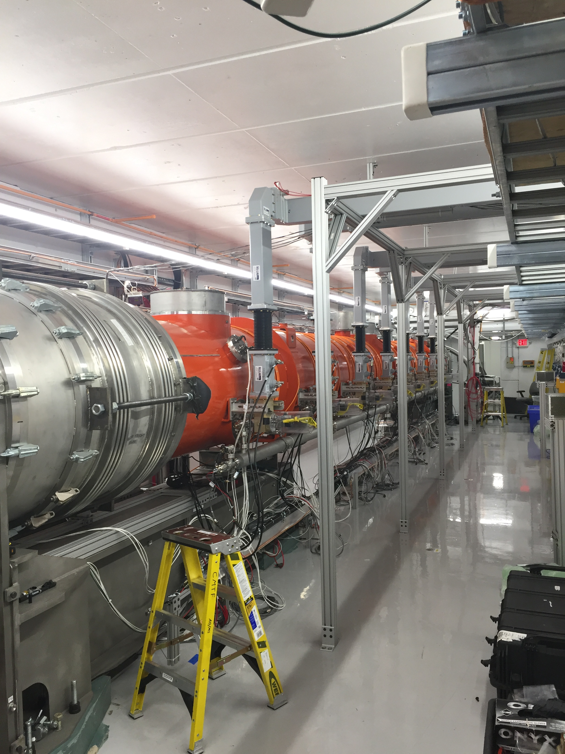
CMTS1 Status
LCLSII Prototype Cryo Module
  F1.3-05
    Cooling Down

Slide 10
Schedules and Links
Schedule can be accessed from the Operations Department Home Page
  Schedules -> Operations Schedule
Direct link to schedule
  http://www-ad.fnal.gov/ops/schedule.html

