Slide 1


MQXFAP2 Readiness Review
Strand data
Lance Cooley – NHMFL / ASC
7 Dec 2017

Slide 2
Content
Coil | Cable | Strand | Spec.
QXFA101 | P43OL1072 | 0.85 mm 108/127 | LARP 8004.D / HiLumi (2015)
QXFA102 | P43OL1073 | 0.85 mm 108/127 | LARP 8004.D / HiLumi (2015)
QXFA104 | P43OL1081 | 0.85 mm 108/127 | LARP 8004.D / HiLumi (2015)
QXFA105 | P43OL1082 | 0.85 mm 108/127 | LARP 8004.D / HiLumi (2015)
QXFA106 | P43OL1084 | 0.85 mm 108/127 | LARP 8004.D / HiLumi (2015)
PxxOLnnnn is the cable ID:
  “xx” is the project and strand type
    30 series = QXF gen 1 with annealed strands;
    40 series = QXF gen 2 with annealed strands;
    Odd = cored cable; x3, x5, x7 determines strand type
  “nnnn” is the cable map number

Slide 3
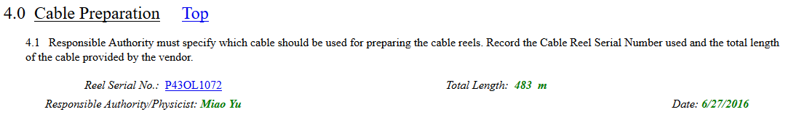
Consult Fermilab Vector System
Coil reports identify the cable used
  Example: S/N QXFA-CL-101-0
    464308-NONE--HL-LHC Magnet QXFA Preparation for Coil Winding and Curing Traveler

Slide 4
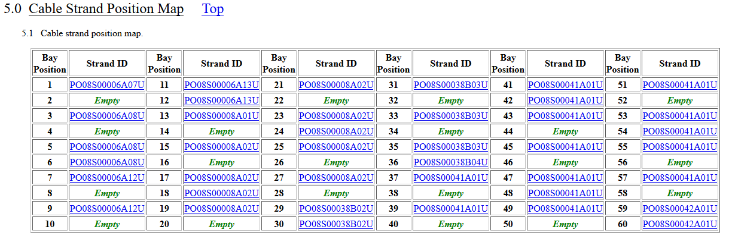
Consult Fermilab Vector System
Cable reports identify the strand map
  S/N P43OL1072

Slide 5
Consult Fermilab Vector System
Strand reports identify the spool and billet reports
  S/N PO08S00006A07U-0
    464269-NONE--HL-LHC: Quality Nb₃Sn Strand Spool Report and Certification
      Contains mechanical property data
      Contains electrical property data
      Links to 464219-NONE—HL-LHC: Quality Nb₃Sn Strand Billet Pedigree Report
        Contains all raw material certs and assembly IDs
    464341-NONE--HL-LHC: Nb₃Sn Strand Shipment Traveler
      Contains Certificate of Compliance and approval records
Graded QC approach means that only certain spools are chosen to receive full characterization → travelers will have blanks
  Usually piece A01 contains representative billet info
  Usually the last spool in billet series has representative property info

Slide 6
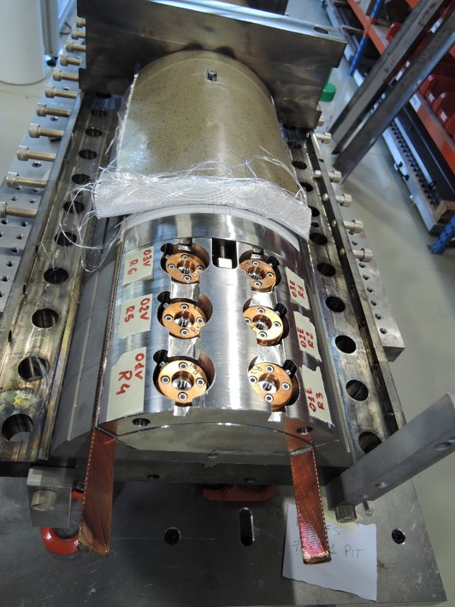
Cable acceptance
Selection of witness samples
Acceptance criteria for cables includes RRR of extracted strands (XS) from each billet
  At least 5 regions: 3 straights and 2 bends
New fixture allows 6 witness samples to be reacted directly with the coil
  Mitigates risk of temperature difference between witness sample retort and coil
4 samples are representative extracted strands (determines SSL)
2 samples are virgin strands (qualifies HT)
3 samples are tested: two XS and one VS
  The other two XS and other one VS are backups

Slide 7
Coil QXFA101, cable 1072 – Witness samples
ID | RRR (293K / 20K) | Ic(12T) | Ic(13T) | Ic(14T) | Ic(15T)
PO08S00008A01U |  | 724 | 596 | 494 | 402
P43OL1072AA03E † | 296 | 699 | 581 | 478 | 386
P43OL1072AA13E | 294 | 711 | 586 | 489 | 397
P43OL1072AA29E | 267 | 712 | 592 | 487 | 395
P43OL1072AA37E | 280 | 700 | 580 | 476 | 382
Dan Turrioni, Al Rusy, Pei Li performed measurements
† Cable degradation < 3.1%
Notice that the cable IDs have “AA” in them, which denotes a sample taken from the FRONT end of the cable. This is not typical. This was the cable that experienced a strand break and received special handling.

Slide 8
Coil QXFA101, Cable 1072 – SSL report
(Note: traveler in development)
1.9 K SSL intercept 14.9 T, 21.9 kA
16.5 kA Operating point at 75% SSL
SSL crosses 11.4 T, 16.5 kA @ T_{CS} = 7.29 K
T_{CS} – T_{OP} = 5.4 K
Cable Ic at 11.4 T = 40.5 kA
16.5 kA I_{OP} = 40.7% Cable Ic

Slide 9
Coil QXFA102, cable 1073 – Witness samples
ID | RRR (293K / 20K) | Ic(12T) | Ic(13T) | Ic(14T) | Ic(15T)
PO08S00042-Unknown |  | 750 | 624 | 512 | 414
P43OL1073AE21E † | 367 | 700 | 588 | 479 | 383
P43OL1073AE55E | 347 | 724 | 600 | 494 | 399
P43OL1073AE25E | 318
P43OL1073AE27E | 329
Dan Turrioni, Al Rusy, Pei Li performed measurements
The full virgin strand ID was not reported by them (lost?)
† Cable degradation < 6.5%

Slide 10
Coil QXFA102, Cable 1073 – SSL report
(Note: traveler in development)
1.9 K SSL intercept 14.8 T, 21.75 kA
16.5 kA Operating point at 76% SSL
SSL crosses 11.4 T, 16.5 kA @ T_{CS} = 7.19 K
T_{CS} – T_{OP} = 5.3 K
Cable Ic at 11.4 T = 39.6 kA
16.5 kA I_{OP} = 41.6% Cable Ic

Slide 11
Coil QXFA104, cable 1081 – Witness samples
ID | RRR (293K / 20K) | Ic(12T) | Ic(13T) | Ic(14T) | Ic(15T)
PO08S00074A01U | 134 | 756 | 634 | 525 | 430
P43OL1081AE25E † | 135 | 703 | 587 | 484 | 391
P43OL1081AE55E | 126 | 718 | 600 | 497 | 405
Dan Turrioni, Al Rusy, Pei Li performed measurements
† Cable degradation < 7.1%

Slide 12
Coil QXFA104, Cable 1081 – SSL report
(Note: traveler in development)
1.9 K SSL intercept 14.8 T, 21.74 kA
16.5 kA Operating point at 76% SSL
SSL crosses 11.4 T, 16.5 kA @ T_{CS} = 7.19 K
T_{CS} – T_{OP} = 5.3 K
Cable Ic at 11.4 T = 38.9 kA
16.5 kA I_{OP} = 42.4% Cable Ic

Slide 13
Coil QXFA105, cable 1082 – Witness samples
ID | RRR (293K / 20K) | Ic(12T) | Ic(13T) | Ic(14T) | Ic(15T)
PO08S00080A03U |  | 729 | 608 | 500 | 407
P43OL1082AE18E |  | 720 | 600 | 495 | 404
P43OL1082AE60E † |  | 700 | 585 | 483 | 393
Dan Turrioni, Al Rusy, Pei Li performed measurements
† Cable degradation < 4.2%

Slide 14
Coil QXFA105, Cable 1082 – SSL report
(Note: traveler in development)
1.9 K SSL intercept 14.9 T, 21.9 kA
16.5 kA Operating point at 73% SSL
SSL crosses 11.4 T, 16.5 kA @ T_{CS} = 7.38 K
T_{CS} – T_{OP} = 5.5 K
Cable Ic at 11.4 T = 39.9 kA
16.5 kA I_{OP} = 40.2% Cable Ic

Slide 15
Coil QXFA106, cable 1084 – Witness samples
ID | RRR (293K / 20K) | Ic(12T) | Ic(13T) | Ic(14T) | Ic(15T)
PO08S00079A01U | 174 | 724 | 603 | -- | 406*
P43OL1084AE39E | 174 | 650* | 538* | 439* | 348*†
P43OL1084AE03E | 156 | 676* | 559* | 459* | 371*
P43OL1084AE41E | 139 | 683* | 571* | 477* | 381*
Dan Turrioni, Al Rusy, Pei Li performed measurements
* Ic was determined by extrapolating voltage rise; sample was not stable enough to achieve voltage at or above the voltage criterion
† Cable degradation 10.2%

Slide 16
Coil QXFA106, Cable 1084 – SSL report
(Note: traveler in development)
1.9 K SSL intercept 14.3 T, 21.0 kA
16.5 kA Operating point at 78.5% SSL
SSL crosses 11.4 T, 16.5 kA @ T_{CS} = 6.75 K
T_{CS} – T_{OP} = 4.85 K
Cable Ic at 11.4 T = 35.3 kA
16.5 kA I_{OP} = 46.7% Cable Ic

Slide 17
Summary of Data
Coil | SSL field (T) | SSL current (kA) | I_{OP}/I_{SSL} (%) | T margin (K) | Cable I_{C} (kA) | I_{OP}/I_{C} (%)
MQXFA101 | 14.9 | 21.9 | 75 | 5.4 | 40.5 | 40.7
MQXFA102 | 14.8 | 21.8 | 76 | 5.3 | 39.6 | 41.6
MQXFA104 | 14.8 | 21.7 | 76 | 5.3 | 38.9 | 40.2
MQXFA105 | 14.9 | 21.9 | 73 | 5.5 | 39.9 | 40.2
MQXFA106 | 14.3 | 21.0 | 79 | 4.8 | 35.3 | 46.7
No RRR data yet for coil 105

