Slide 1

Review Introduction & Charge
Giorgio Ambrosio
Magnets L2
U.S. HL-LHC Accelerator Upgrade Project
MQXFAP2 Conductor & Coils Readiness Review
December 7, 2017

Slide 2

Introduction
MQXFAP2 is the second prototype of the MQXFA magnets to be used in Q1 and Q3 for the High Luminosity LHC.
MQXFAP2 is the first prototype using coils with 4.2 m magnetic length (QXFA coils).
  GOAL: meet all MQXFA requirements
Five QXFA coils (#101/2/4/5/6) were completed for MQXFAP2. The baseline plan is to use coils #101/2/4/5 and to keep #106 as spare coil.
  This is an internal review where L3s in charge of conductor and coil fabrication are going to present the data for coil acceptance.

Slide 3
CHARGE
The committee is requested to answer the following questions:
Is the baseline plan (to use coils #101/2/4/5) for MQXFAP2 assembly and test fine?
Are conductor and coils fabrication and QC data adequate for a thorough evaluation?
Are there major non-conformities? If answer is yes, have they been adequately documented and processed?
Do you have any other comment or recommendation regarding coil selection to assure successful MQXFAP2 assembly and test?

Slide 4
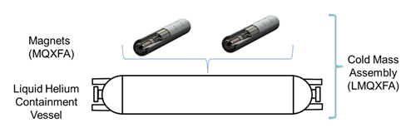
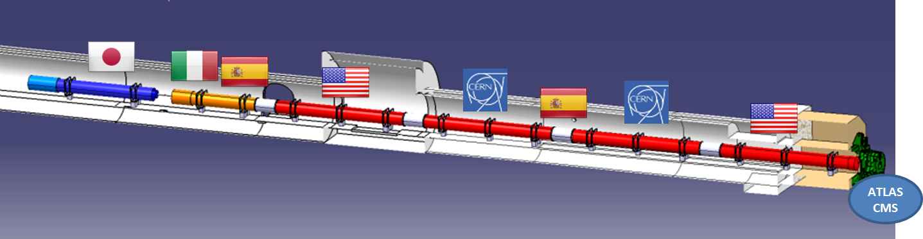
US Contribution to HL-LHC Inner Triplets
Q1/Q3 Cryostated Magnets
  Magnetic length: 4.2 + 4.2 m (MQXFA)
  Cryostat parts provided by CERN (kit)
Q2 cold masses by CERN
  Magnetic length: 7.15 m (MQXFB)
US cold mass

Slide 5
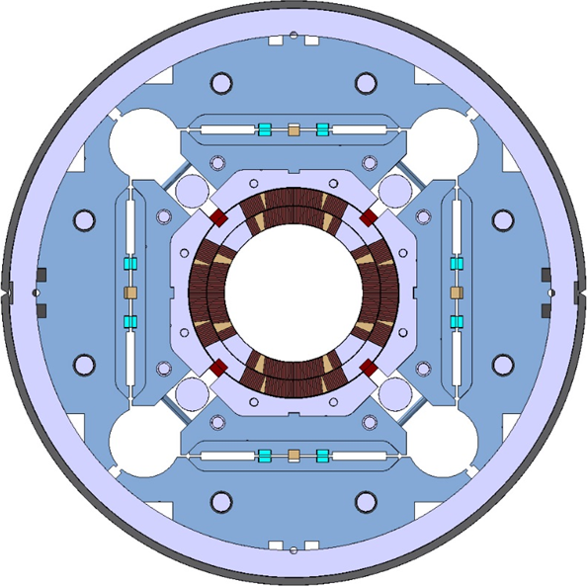
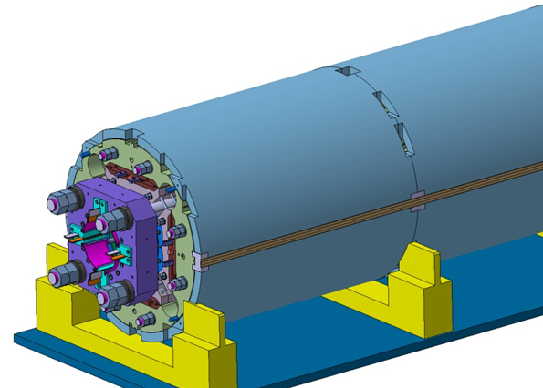
MQXFA/B Main Parameters
Parameter | Unit | MQXFA/B
Coil aperture | mm | 150
Magnetic length | m | 4.2/7.15
N. of layers |  | 2
N. of turns Inner-Outer layer |  | 22-28
Operation temperature | K | 1.9
Nominal gradient | T/m | 132.6
Nominal current | kA | 16.5
Peak field at nom. current | T | 11.4
Stored energy at nom. curr. | MJ/m | 1.2
Diff. inductance | mH/m | 8.2
Strand diameter | mm | 0.85
Strand number |  | 40
Cable width | mm | 18.15
Cable mid thickness | mm | 1.525
Keystone angle |  | 0.4
P. Ferracin et al., “Development of MQXF, the Nb₃Sn Low-β Quadrupole for the HiLumi LHC ” IEEE Trans App. Supercond. Vol. 26, no. 4, 4000207
G. Ambrosio et al., “MQXFS1 Quadrupole Design Report” LARP DocDB 1074

