Slide 1
Cable Candidates for MQXFA2
Ian Pong (ipong@lbl.gov)
2017 12 18

Slide 2
Outline
Cable Overview
Wire Details
Cable Fabrication Details
Cable Summary
Insulation Details
Insulation Summary

Slide 3
Cable Overview
Coil ID | Cable ID | Wire Spec | FNAL PO 624035 | Billets/Spools
QXFA101 | P43OL1072 | HiLumi | Shipments A & B | 5 / 11
QXFA102 | P43OL1073 | HiLumi | Shipment B | 4 / 12
QXFA103 | P43OL1074 | HiLumi | Shipments A & B | 6 / 15
QXFA104 | P43OL1081 | HiLumi | Shipment C1 | 3 / 3
QXFA105 | P43OL1082 | HiLumi | Shipment C2 | 3 / 3
QXFA106 | P43OL1084 | HiLumi | Shipments C1 & C2 | 3 / 9

Slide 4
Wire Details – Summary
All wires are HiLumi spec, purchased under FNAL PO 624035
108/127, 1.5 at% Ti-doped, 3.6:1 reduced Sn ratio, Nb Type I
Shipment | Delivered | No. of Spools | Billable (km)
A | 2016 01 04 | 13 | 31.7
B | 2016 04 05 | 29 | 54.65
C1 | 2016 12 02 | 11 | 27.5
C2 | 2016 12 13 | 18 | 45.7
Supp | 2016 07 05 | 1 | 0.528
Notes:
Supp: 528 m piece was PO08S00038B01U, acquired for P43OL1074 for QXFA103.

Slide 5
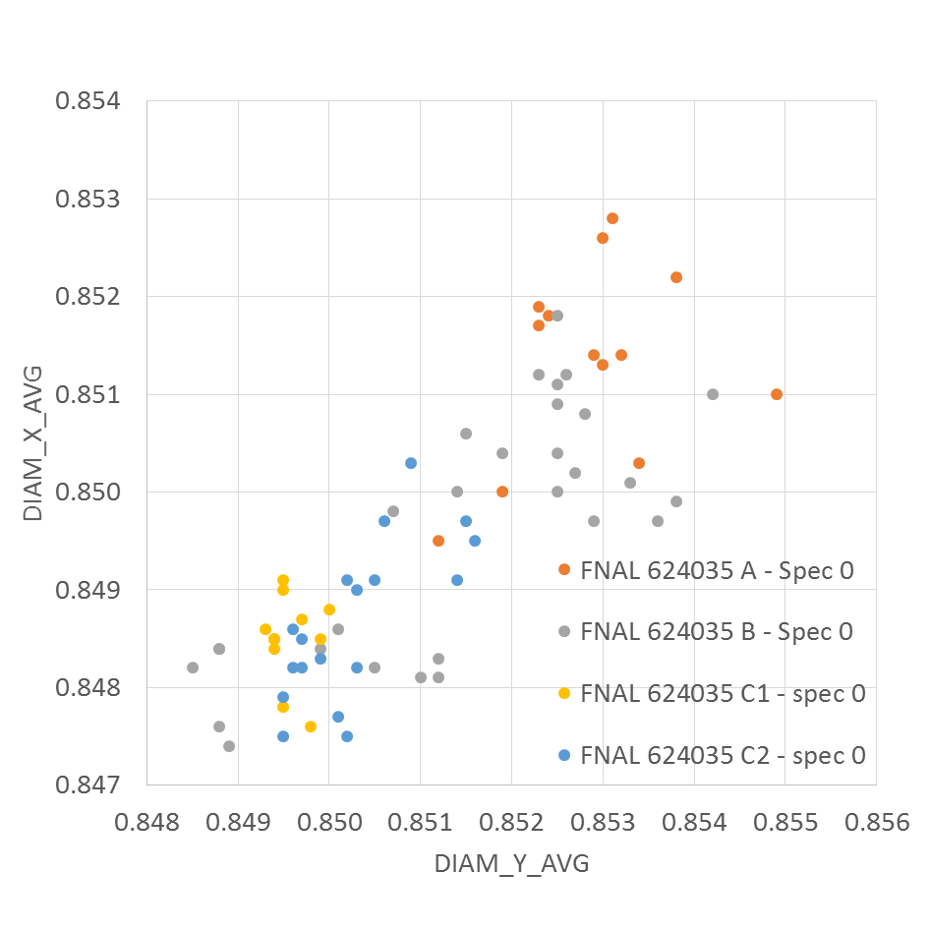
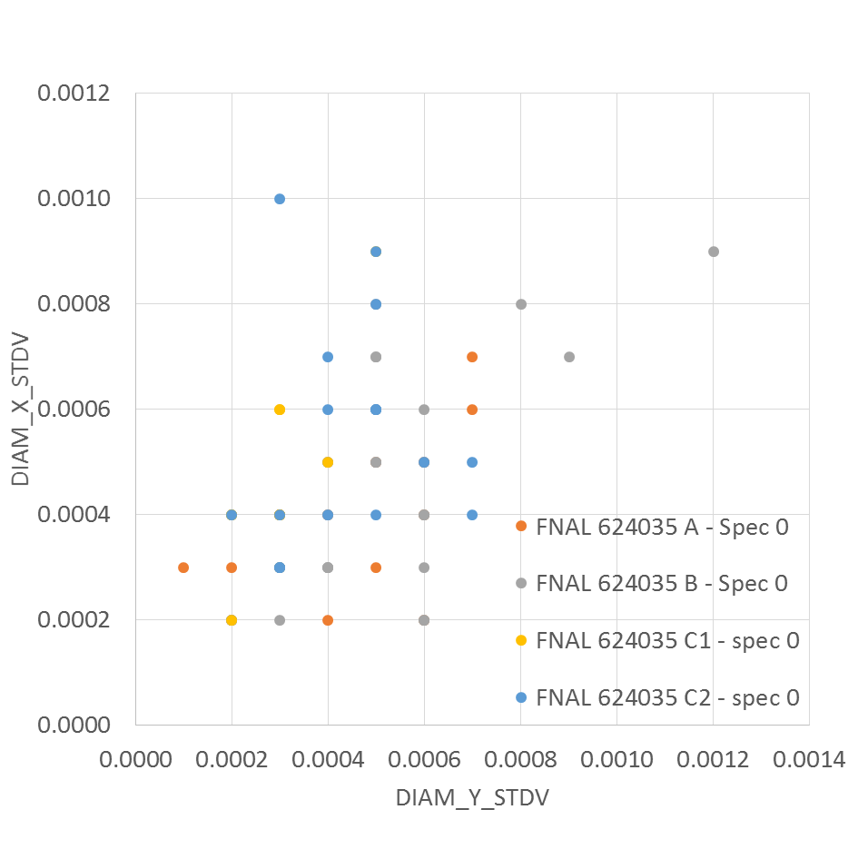
Wire Details: Diameter

Slide 6
Wire Details - RRR
Open circles are 10% rolled samples; open triangles are 15% rolled samples

Slide 7
Cable Fabrication P43OL1072 (1)
Date:
  2016-04-15 (CFP),
  2016-05-10 to 2016-06-02 (CME)
  2016-07-15 (CRN)
Cable Length:
  515 m (Respooled)
  483 m (Manufactured good length)
Core: 119L05A0517863
CME data
Remark:
  Broken strand on top broad face at 3rd m from the point end. [1, 2]
 | Pressure (MPa) | ANGLE (°) | WIDTH (mm) | THICKNESS (mm)
Maximum | 17.0 | 0.434 | 18.170 | 1.536
Average | 17.0 | 0.400 | 18.137 | 1.527
Minimum | 16.9 | 0.367 | 18.131 | 1.524
Sigma | 0.01 | 0.011 | 0.004 | 0.002
References:
[1] LBNL Fractography on the broken strand in cable P43OL1072AA03A 30E 2016 05 24.docx
[2] LARP MS Meeting 2016 05 16 IP on P43OL1072 Status v1.1.pptx

Slide 8

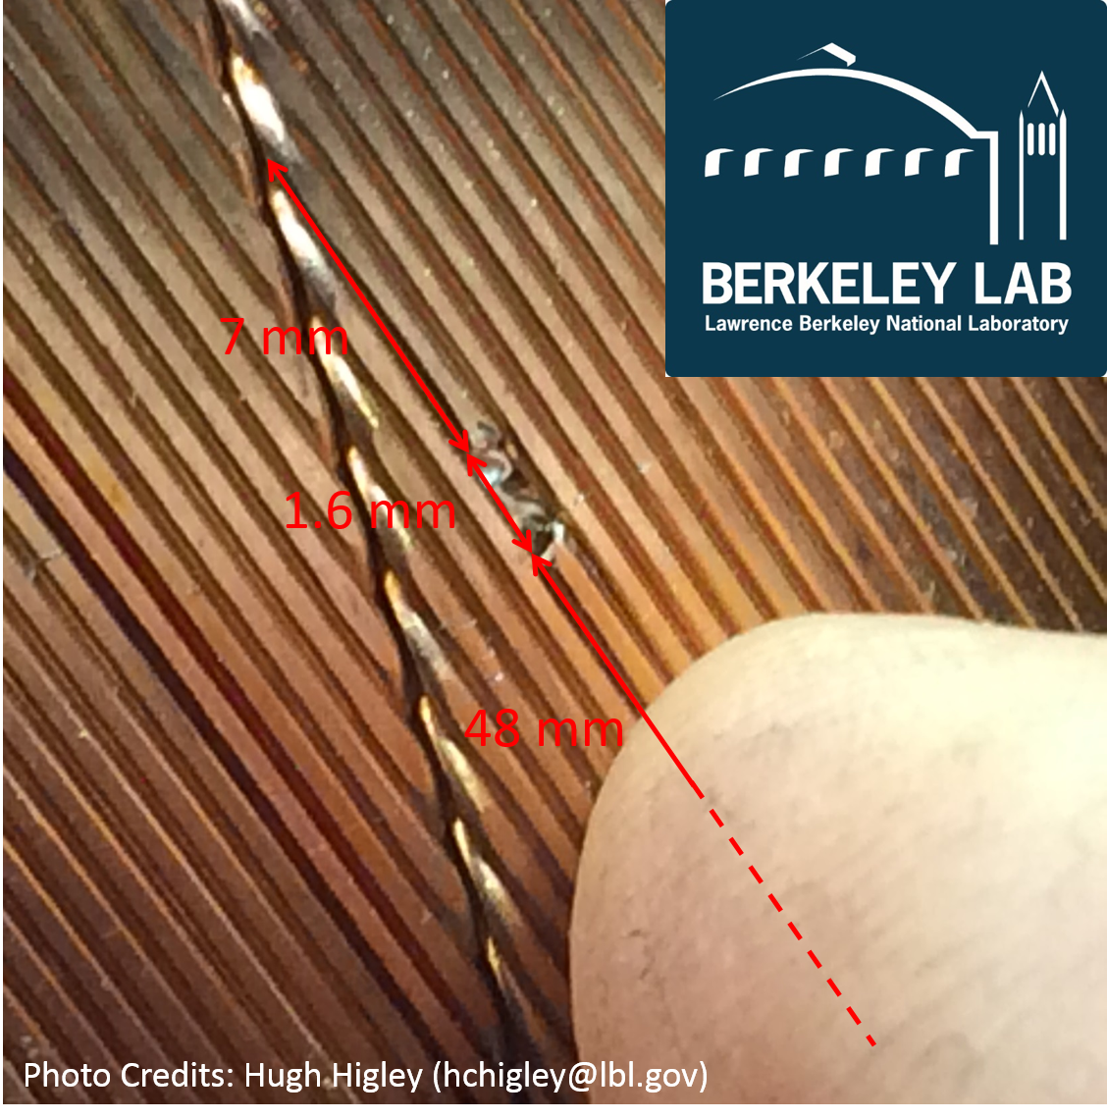

Slide 9
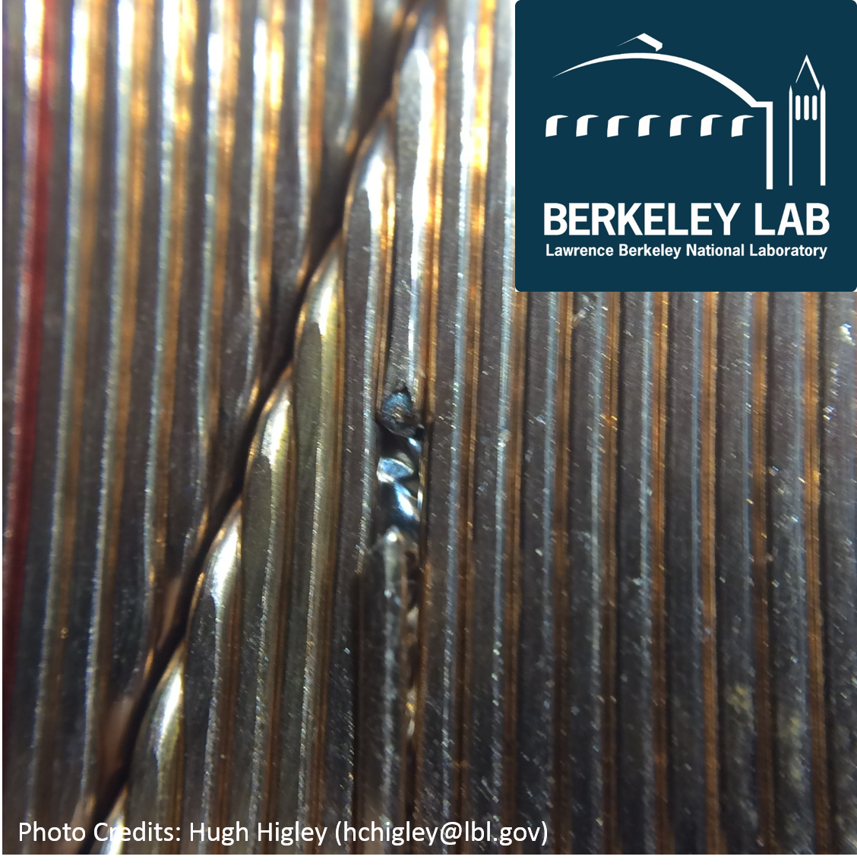
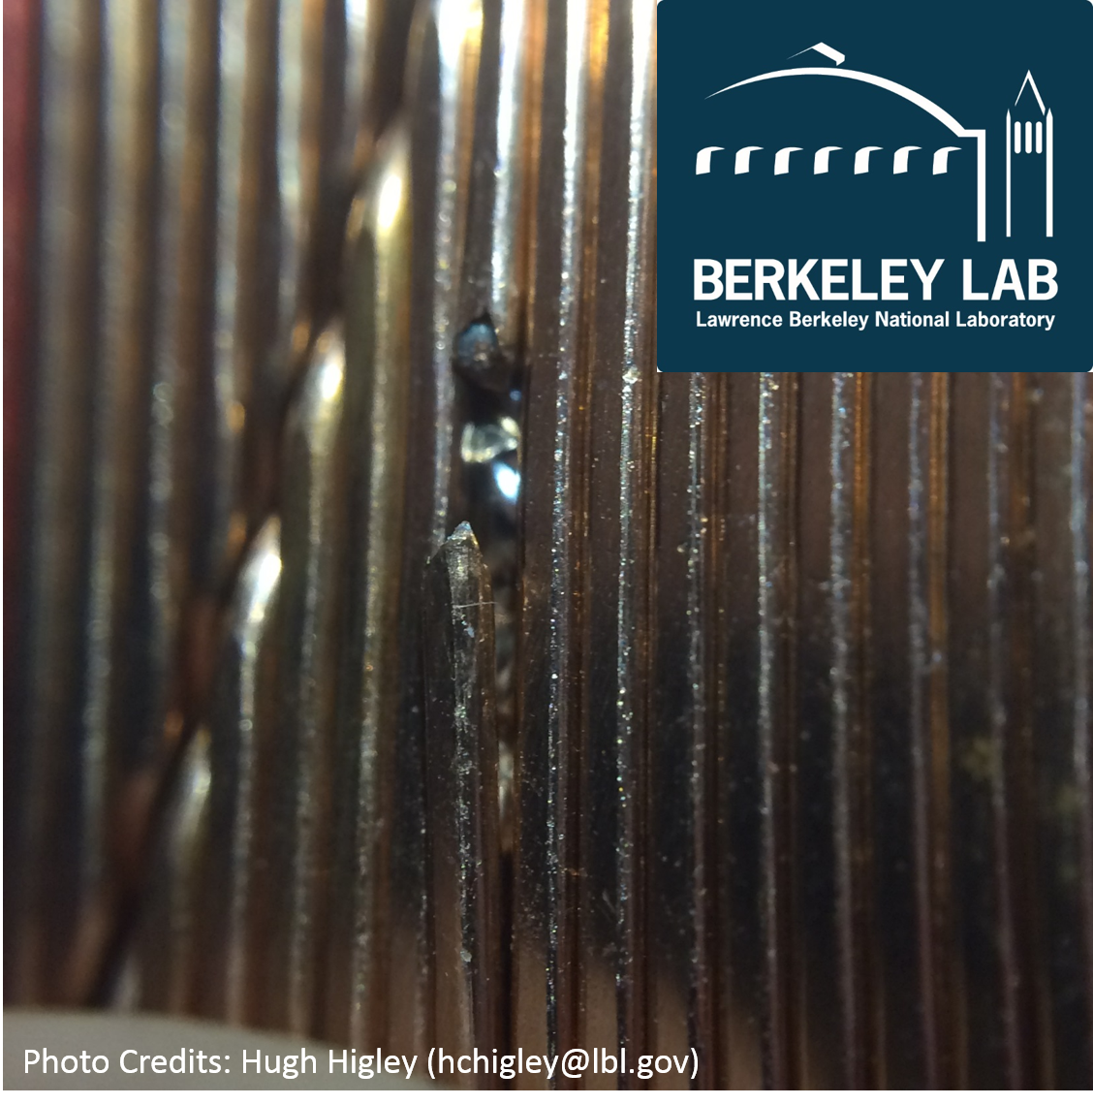

Slide 10
Minor edge side (cable point side, tail facing)

Slide 13
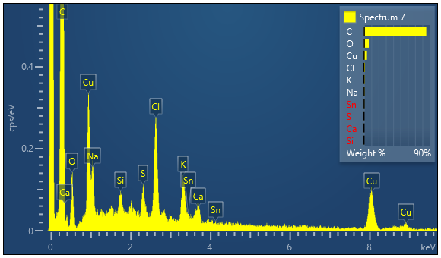

Slide 14
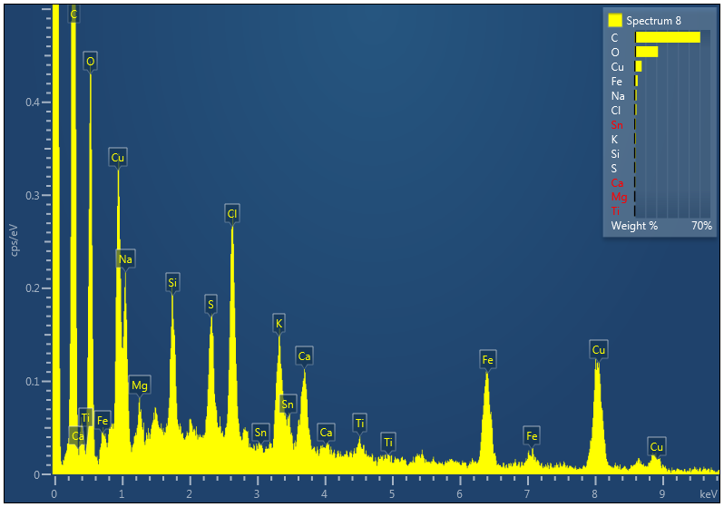

Slide 16
Cable Fabrication P43OL1072 (2)
Key parameters:
Spool ID’s:
PO08S00006A07U x 1 ULs,
PO08S00006A08U x 3 ULs,
PO08S00006A12U x 2 ULs,
PO08S00006A13U x 2 ULs,
PO08S00008A01U x 1 ULs,
PO08S00008A02U x 9 ULs,
PO08S00038B02U x 2 ULs,
PO08S00038B03U x 3 ULs,
PO08S00038B04U x 1 ULs,
PO08S00041A01U x 14 ULs,
PO08S00042A01U x 2 ULs.
Properties | Inspected Average
Wire Diameter¹ | 0.852 mm (LBNL)
Cu ratio² | 54% (OST)
Strand twist pitch² | 18.5 mm (OST)
RRR² | 296 (OST)
¹ All data averaged
² First billet averaged, then weighted average according to the
spool distribution in the cable

Slide 21
Cable Fabrication P43OL1073 (1)
Date:
  2016-06-21 (CFP),
  2016-06-24 to 2016-06-27 (CME)
  2016-07-21 (CRN)
Cable Length:
  520 m (Respooled)
  489 m (Manufactured good length)
Core: 119L06A0517863
CME data
 | Pressure (MPa) | ANGLE (°) | WIDTH (mm) | THICKNESS (mm)
Maximum | 17.0 | 0.455 | 18.160 | 1.535
Average | 17.0 | 0.429 | 18.144 | 1.528
Minimum | 17.0 | 0.398 | 18.135 | 1.524
Sigma | 0.00 | 0.008 | 0.003 | 0.002

Slide 22
Cable Fabrication P43OL1073 (2)
Key parameters:
Spool ID’s:
PO08S00041A04U x 1 ULs,
PO08S00042A02U x 2 ULs,
PO08S00042A04U x 1 ULs,
PO08S00042A05U x 8 ULs,
PO08S00042A06U x 2 ULs,
PO08S00044A01U x 4 ULs,
PO08S00044A02U x 6 ULs,
PO08S00044A03U x 4 ULs,
PO08S00044A04U x 2 ULs,
PO08S00045A03U x 1 ULs,
PO08S00045A05U x 5 ULs,
PO08S00045A08U x 4 ULs.
Properties | Inspected Average
Wire Diameter¹ | 0.852 mm (LBNL)
Cu ratio² | 54% (OST)
Strand twist pitch² | 18.65 mm (OST)
RRR² | 289 (OST)
¹ All data averaged
² First billet averaged, then weighted average according to the
spool distribution in the cable

Slide 27
Cable Fabrication P43OL1074 (1)
Date:
  2016-06-21 (CFP),
  2016-07-15 to 2016-07-18 (CME)
  2016-07-22 (CRN)
Cable Length:
  502 m (Respooled)
  474 m (Manufactured good length)
Core: 119L07A0517863
CME data
 | Pressure (MPa) | ANGLE (°) | WIDTH (mm) | THICKNESS (mm)
Maximum | 17.0 | 0.434 | 18.159 | 1.532
Average | 17.0 | 0.416 | 18.150 | 1.524
Minimum | 17.0 | 0.390 | 18.145 | 1.520
Sigma | 0.01 | 0.008 | 0.002 | 0.003

Slide 28
Cable Fabrication P43OL1074 (2)
Key parameters:
Spool ID’s:
PO08S00046A03U x 2 ULs,
PO08S00006A10U x 2 ULs,
PO08S00038A02U x 2 ULs,
PO08S00038A04U x 1 ULs,
PO08S00038B01U x 1 ULs,
PO08S00040A01U x 9 ULs,
PO08S00040A04U x 1 ULs,
PO08S00040A05U x 6 ULs,
PO08S00041A04U x 1 ULs,
PO08S00045A06U x 4 ULs,
PO08S00046A01U x 2 ULs,
PO08S00046A02U x 2 ULs,
PO08S00046A05U x 4 ULs,
PO08S00046A07U x 1 ULs,
PO08S00046A08U x 2 ULs.
Properties | Inspected Average
Wire Diameter¹ | 0.851 mm (LBNL)
Cu ratio² | 54% (OST)
Strand twist pitch² | 18.45 mm (OST)
RRR² | 296 (OST)
Supp DR Shipment
¹ All data averaged
² First billet averaged, then weighted average according to the
spool distribution in the cable

Slide 33
Cable Fabrication P43OL1081 (1)
Date:
  2016-11-23 (CFP),
  2016-12-13 to 2016-12-14 (CME)
  2017-01-26 (CRN)
Cable Length:
  520 m (Respooled)
  482 m (Manufactured good length)
Core: 119L09A0517863
CME data
 | Pressure (MPa) | ANGLE (°) | WIDTH (mm) | THICKNESS (mm)
Maximum | 17.0 | 0.430 | 18.167 | 1.534
Average | 16.9 | 0.413 | 18.143 | 1.528
Minimum | 16.3 | 0.382 | 18.136 | 1.524
Sigma | 0.03 | 0.007 | 0.003 | 0.002

Slide 34
Cable Fabrication P43OL1081 (2)
Key parameters:
Spool ID’s:
PO08S00074A01U x 18 ULs,
PO08S00075A01U x 19 ULs,
PO08S00076A02U x 3 ULs.
Properties | Inspected Average
Wire Diameter¹ | 0.849 mm (LBNL)
Cu ratio² | 55% (OST)
Strand twist pitch² | 19.9 mm (OST)
RRR² | 253 (OST)
¹ All data averaged
² First billet averaged, then weighted average according to the
spool distribution in the cable

Slide 39
Cable Fabrication P43OL1082 (1)
Date:
  2016-12-20 (CFP),
  2017-01-04 to 2017-01-05 (CME)
  2017-03-10 (CRN)
Cable Length:
  500 m (Respooled)
  473 m (Manufactured good length)
Core: 119L10A0517863
CME data
Remark:
  Minor irregularity of the major edge facet size over 4 strands at ~392nd m
 | Pressure (MPa) | ANGLE (°) | WIDTH (mm) | THICKNESS (mm)
Maximum | 17.0 | 0.421 | 18.152 | 1.537
Average | 17.0 | 0.397 | 18.133 | 1.526
Minimum | 16.9 | 0.378 | 18.129 | 1.522
Sigma | 0.01 | 0.007 | 0.002 | 0.003

Slide 40
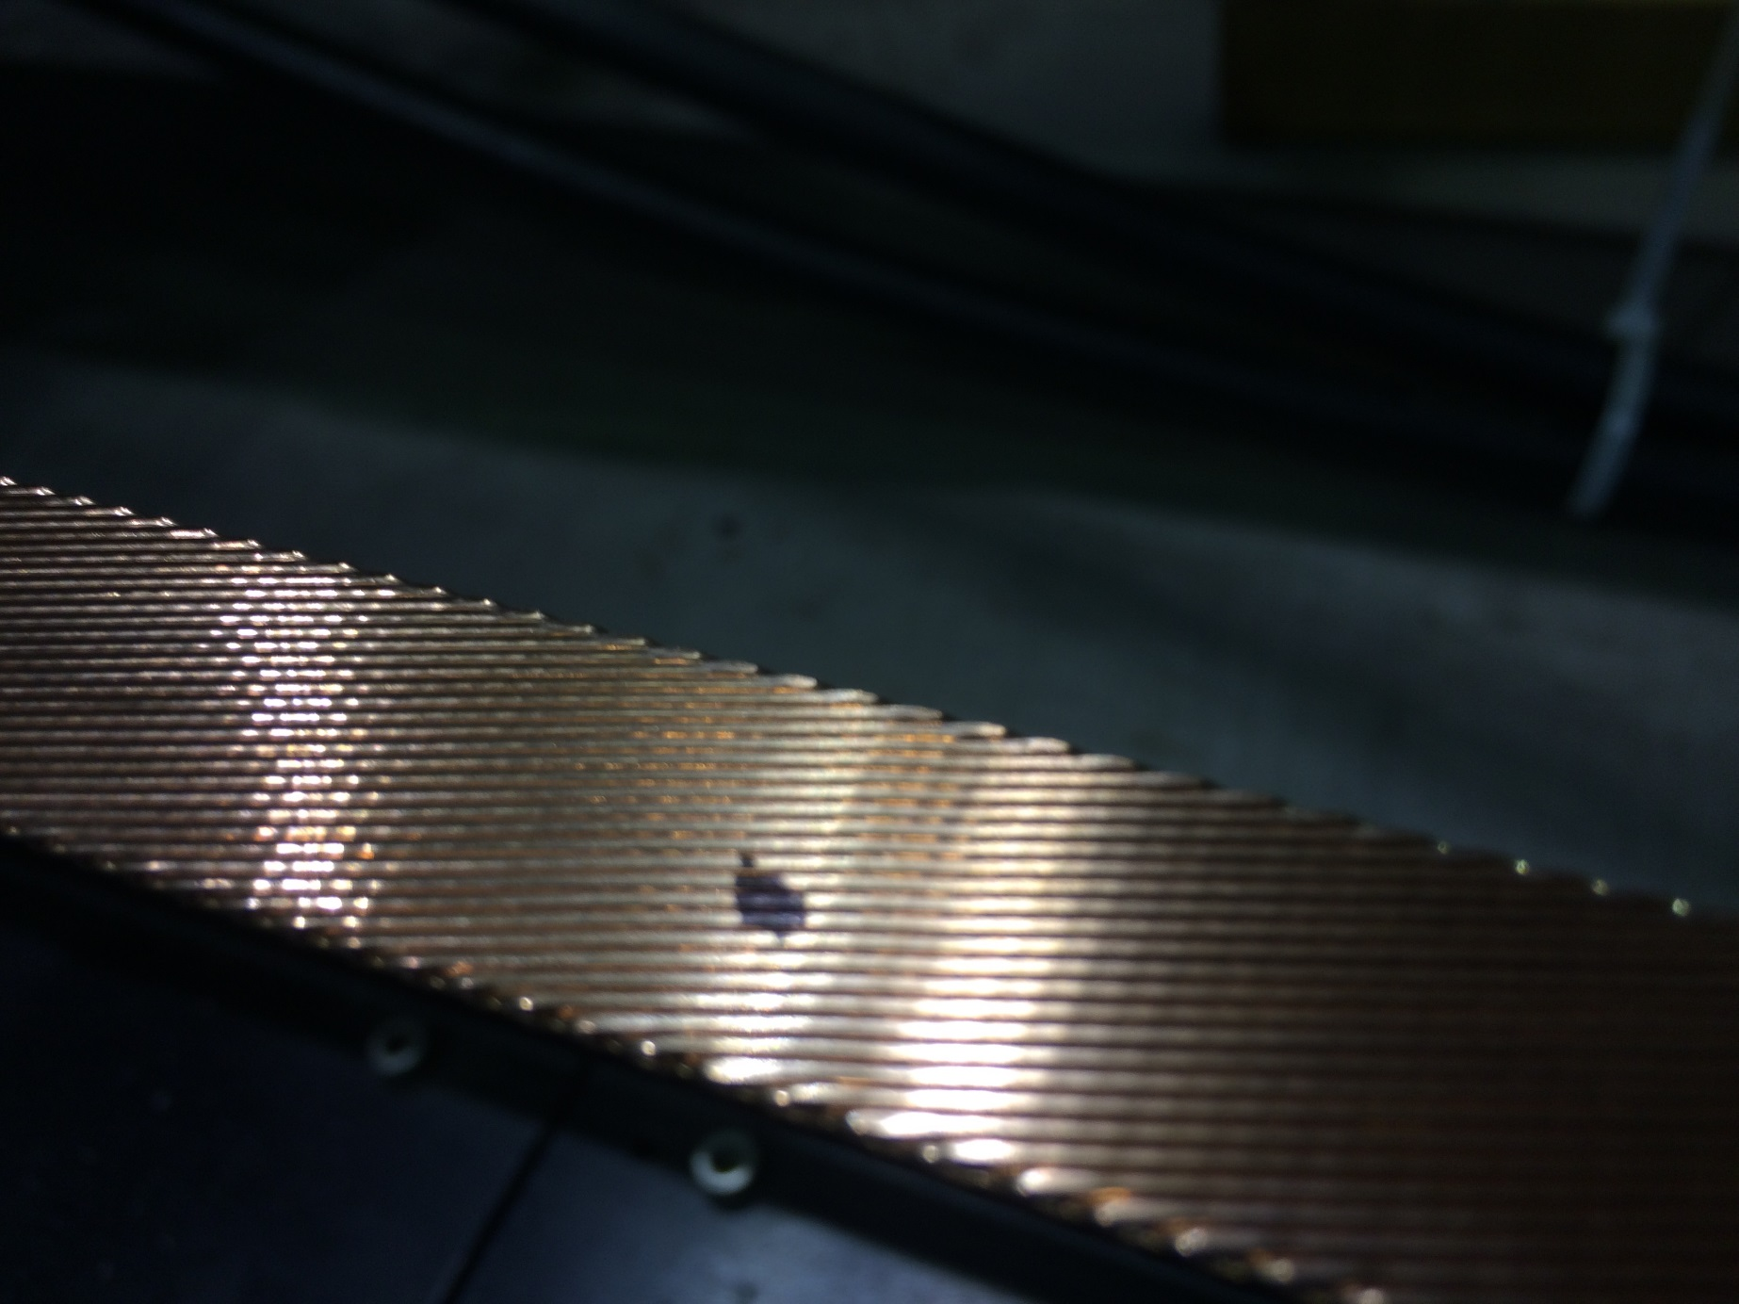

Slide 41
Cable Fabrication P43OL1082 (2)
Key parameters:
Spool ID’s:
PO08S00077A03U x 14 ULs,
PO08S00080A03U x 16 ULs,
PO08S00081A02U x 10 ULs.
Properties | Inspected Average
Wire Diameter¹ | 0.850 mm (LBNL)
Cu ratio² | 54% (OST)
Strand twist pitch² | 19.1 mm (OST)
RRR² | 275 (OST)
¹ All data averaged
² First billet averaged, then weighted average according to the
spool distribution in the cable

Slide 46
Cable Fabrication P43OL1084 (1)
Date:
  2017-03-03 (CFP),
  2017-03-10 to 2017-03-15 (CME)
  2017-03-31 (CRN)
Cable Length:
  500 m (Respooled)
  465 m (Manufactured good length)
Core: 120L59A7322313
CME data
 | Pressure (MPa) | ANGLE (°) | WIDTH (mm) | THICKNESS (mm)
Maximum | 17.0 | 0.421 | 18.154 | 1.534
Average | 16.9 | 0.404 | 18.142 | 1.529
Minimum | 16.9 | 0.388 | 18.135 | 1.524
Sigma | 0.0 | 0.006 | 0.003 | 0.002

Slide 47
Cable Fabrication P43OL1082 (2)
Key parameters:
Spool ID’s:
PO08S00079A05U x 1 ULs,
PO08S00076A03U x 3 ULs,
PO08S00076A04U x 2 ULs,
PO08S00076A05U x 1 ULs,
PO08S00076A08U x 1 ULs,
PO08S00078A02U x 17 ULs,
PO08S00079A01U x 4 ULs,
PO08S00079A02U x 4 ULs,
PO08S00079A03U x 7 ULs,
Properties | Inspected Average
Wire Diameter¹ | 0.850 mm (LBNL)
Cu ratio² | 54% (OST)
Strand twist pitch² | 18.3 mm (OST)
RRR² | 294 (OST)
¹ All data averaged
² First billet averaged, then weighted average according to the
spool distribution in the cable

Slide 52
Summary (1)
P43OL1072 in QXFA101
  Some strands have diameter above spec
  suffered wire breakage during beginning of run, a couple of metres at the point end of the bare cable had mid-thickness 1 µm above spec
P43OL1073 in QXFA102
  Some strands have diameter above spec
  Braid tension surge at 203rd m due to weekend stop
P43OL1081 in QXFA104
  Some strands have diameter under spec
  Braid cleanliness issues and suspected bobbin cleaning and feed-in issues

Slide 53
Summary (2)
P43OL1082 in QXFA105
  Minor irregularity of the major edge facet size over 4 strands at ~392nd m
  Several points along first ~40 metres of the bare cable had mid-thickness up to 2 µm above spec
  Braid worn issues
P43OL1084 in QXFA106:
  Good

Slide 54
Cable Summary – Residual Twist

Slide 55
Cable Summary – Angle
Upper Specification Limit (USL)
Maxima
± 3 σ
Specification
Lower Specification Limit (LSL)
Minima
(average)

Slide 56
Cable Summary – Width

Slide 57
Cable Summary – Mid-thickness

Slide 58
SS Core Details
Coil ID | Cable ID | Core Width | Core Material | PO | Heat/Lot
QXFA101 | P43OL1072 | 11.9 mm | 316L | LBNL 517863 | 842189/14-363
QXFA102 | P43OL1073 | 11.9 mm | 316L | LBNL 517863 | 842189/14-363
QXFA104 | P43OL1081 | 11.9 mm | 316L | LBNL 517863 | 842189/14-363
QXFA105 | P43OL1082 | 11.9 mm | 316L | LBNL 517863 | 842189/14-363
QXFA106 | P43OL1084 | 12.0 mm | 316L | LBNL 7322313 | 844979/16-597
Remark: Chemical properties according to CoT/CoC
842189/14-363: Co 0.14 wt% (CoT/CoC# 147790-1)
844979/16-597: Co 0.14 wt% (CoT/CoC# 172660-1)
Notes:
833643/11-501: Co 0.22 wt%
842189/14-363: Co 0.14 wt%

Slide 59
Insulation – General
Braiding per specification LARP-MAG-R-8006-A (2014), by New England Wire Technologies, 130 North Main Street, Lisbon, NH
Using a high-strength glass yarn (S‑2 Glass® direct sized yarn) made of 9 μm continuous glass strands twisted together and treated with an inorganic sizing (“933”)
Single-ply “Z” twist yarn supplied by AGY, 2558 Wagener Road, Aiken, South Carolina, USA 29801.
2‑ply with a specification “S” twist pitch of 3 inches (i.e. 0.34 twist per inch) by an undisclosed subcontractor of NEWT

Slide 60
Cable Insulation QXFA102
P43OL1073:
  startup sample 1st reading was high, but averaged value (according specification) is within tolerance.
  during coil winding, a section ~16” long at 203rd m from the blue/green end had noticeably different braid tightness causing popped strands. Location corresponds to a Friday stop and tension change over the weekend.
Notes:
Good morning Ian,
I’ve reviewed our P-card and there is no note that anything changed during the process. Each bobbin’s tension is controlled by a spring and the operator shouldn’t have a reason to change springs mid run. If there was a reason to change the springs, it would have been a process change that would need to be approved by engineering before proceeding. Based on the footage and when this cable was setup, my guess is that particular stop would have been on Friday, so the line may have relaxed over the weekend. The increase in tension may just be from everything being brought back under tension on startup Monday morning. I’m not sure there’s much of a change that we can make to keep things under tension over a weekend, as everything in the factory gets powered down on Friday night.
When you turn the take-up tension off, the braid point will drop over time. It typically returns to normal shortly (within a few feet) after resuming the braiding process.
Regards,
Erik
From: Ian Pong [mailto:ipong@lbl.gov]
Sent: Friday, September 30, 2016 1:11 PM
To: Erik Flum <erik.flum@newenglandwire.com>
Cc: 'Lance D Cooley' <ldcooley@fnal.gov>; Cindy Derosia <cindy.derosia@newenglandwire.com>
Subject: RE: P43OL1073A insulation quality issues -- requesting records and QA response
Dear Erik,
We are looking around the stop at 203 m. Our preliminary information suggests that when braiding resumed at that point, the braid tension became unusually high (we do not yet know how long a cable section is affected from that point on, whether it is transient or a parameter setting issue).
Any insight you can provide would be much appreciated.
With many thanks,
Ian.
Cable Map piece 1
NEWT WO #
345595
Cable #
1073Z
Finished Cable Length =
469
m
Machine Stops
Reason
Length (m) from hub
Cut samples
9
Operator Break
31
Lunch
69
End of Day
110
Operator Break
150
Lunch
183
End of Day
203
Operator Break
250
Lunch
280
End of Day
307
Operator Break
334
Lunch
368
Feedin bobbins
368
Operator Break
375
Lunch
396
End of Day
427
End of Run
469
From: Erik Flum [mailto:erik.flum@newenglandwire.com]
Sent: 29 September 2016 13:14
To: Ian Pong <ipong@lbl.gov>
Cc: 'Lance D Cooley' <ldcooley@fnal.gov>; Cindy Derosia <cindy.derosia@newenglandwire.com>
Subject: RE: P43OL1073A insulation quality issues -- requesting records and QA response
Good afternoon Ian,
Could you let me know at which stop you’re seeing a difference in the braid? I’ll look into what might have changed at that point.
Regards,
Erik
From: Ian Pong [mailto:ipong@lbl.gov]
Sent: Thursday, September 29, 2016 3:48 PM
To: Erik Flum <erik.flum@newenglandwire.com>
Cc: 'Lance D Cooley' <ldcooley@fnal.gov>; Cindy Derosia <cindy.derosia@newenglandwire.com>
Subject: P43OL1073A insulation quality issues -- requesting records and QA response
Importance: High
Dear Erik,
I am sorry that I am writing to you regarding some quality issues again.
This time it is about P43OL1073A braiding (invoice 212074). Yesterday FNAL informed me that during coil winding they are experiencing mechanically instability in a section of the braided cable, and they reported that the braid tightness around the cable appeared noticeably different. The start of this section was identified to match exactly with a stop in the log, so it suggests that parameters may have been modified.
I recall you mentioned that you use a P-card and Q-card system to record tension details. Do you have the log of this specific run? If you do, could you send me a copy please. If you do not, could you look into controlling and recording the tension parameters (of the payout, pickup, as well as the bobbins) and speed please? We would like to review the implementation plan, if the system is not already in place, as well as what happens when there is a braiding stop, when we come in November. We need to understand what may affect the tightness of the insulation around the cable, and hence the quality of the braid. Our management is asking to have this set in the specification in order to prevent similar issues in future cables.
I value your input and look forward to hearing what you find and what can be done.
With best regards,
Ian.
Ian Pong
Materials Project Scientist,
47 Building Manager, LARP Cable Task Leader
047-0114 Accelerator Technology & Applied Physics
Lawrence Berkeley National Laboratory
1 Cyclotron Road MS 47R0112
Berkeley, CA 94720-8201
U.S.A.
Phone: (001) 510-486-7866, Fax: (001) 510-486-5392

Slide 61
Cable Insulation QXFA103
P43OL1074:
  NEWT QC was in spec; but LBNL verification found sample out of spec
  Re-measurements by NEWT and LBNL using drops from coil winding both were out of spec (too thick)
  Insulation amount of oversize is less than the available tolerance from the cable. Decided no risk, NCR approved to accept cable as-is.
  NEWT was required to perform additional measurements and submit a video recording for our assessing their techniques. NEWT subsequently found an equipment problem (“battery exploded”).
Notes:
Dear Ian,
I have some bad news. I had our calibration technician inspect our 10-stack fixture and gauges on Friday when I went to perform the test just to make sure there were no issues with our equipment. The tech discovered one of the batteries had exploded in one of the gauges making it operate incorrectly. We don't have any spare gauges so he's ordering a new one which he said could take a couple of weeks.
I was hoping to have the testing resolved last week, as I am currently out of the office for the next 3 weeks, but will be checking email periodically. I will work to perform the 10-stack samples and video as soon as the new gauge arrives and I'm back in the office. I think any variation in the last couple of tests are probably due to the broken gauge; however, were there specific details you were looking for in the video that maybe we could clarify over email?
Sorry for the bad news first thing Monday morning, but we are working to resolve this situation as quickly as possible.
Regards,
Erik
-----Original Message-----
From: Ian Pong [mailto:ipong@lbl.gov]
Sent: Friday, September 23, 2016 6:49 PM
To: Erik Flum <erik.flum@newenglandwire.com>
Cc: Cindy Derosia <cindy.derosia@newenglandwire.com>
Subject: RE: Ten-stack cross check sample - FedEx pkg. 784099384660
Dear Erik,
Hello. Sorry to be asking you again.
I am just wanting to get this resolved soon -- it is holding up payment which is causing inconvenience to both NEWT and LBNL. Could you try your best to have the data and video sent to me before Tuesday please? Thanks very much!
Have a good weekend.
With best wishes,
Ian.
-----Original Message-----
From: Erik Flum [mailto:erik.flum@newenglandwire.com]
Sent: 22 September 2016 05:17
To: Ian Pong <ipong@lbl.gov>
Cc: Cindy Derosia <cindy.derosia@newenglandwire.com>; 'Lance D Cooley'
<ldcooley@fnal.gov>
Subject: RE: Ten-stack cross check sample - FedEx pkg. 784099384660
Good morning Ian,
Sorry, my schedule has been busy as we're finishing up the production of the ITER TF cables. I will perform the 10-stack measurements tomorrow and send over the results once complete. We did find some left over single ply material so I will send those samples out today.
Regards,
Erik
-----Original Message-----
From: Ian Pong [mailto:ipong@lbl.gov]
Sent: Wednesday, September 21, 2016 6:58 PM
To: Erik Flum <erik.flum@newenglandwire.com>
Cc: Cindy Derosia <cindy.derosia@newenglandwire.com>; 'Lance D Cooley'
<ldcooley@fnal.gov>
Subject: RE: Ten-stack cross check sample - FedEx pkg. 784099384660
Dear Erik,
Hello. I am just writing to follow up your cross check measurements.
When you have the two sets of data and the video, please send them / share on Google Drive or Dropbox with us ASAP.
Please also let me know if you have sent the single ply (if any left) and the 2-ply material as requested earlier (see email 2016 09 13 at 7:01 p.m.)
Keep us informed.
With many thanks,
Ian.
-----Original Message-----
From: Ian Pong [mailto:ipong@lbl.gov]
Sent: 16 September 2016 09:16
To: Erik Flum <erik.flum@newenglandwire.com>
Cc: Cindy Derosia <cindy.derosia@newenglandwire.com>; Lance D Cooley <ldcooley@fnal.gov>
Subject: Ten-stack cross check sample - FedEx pkg. 784099384660
Dear Erik,
I am writing to inform you that the ten-stack cross check sample has been delivered to NEWT.
Please perform the two 10-stack measurements (for statistics) on the 4 m sample. LBNL has measured the 2 m pieces on either side of this sample and we will compare results.
Please video record the process and share the video with us for our assessment. As mentioned, recording using a mobile phone should suffice.
If you have any questions, please feel free to contact me.
With many thanks,
Ian.
-----Original Message-----
From: kus.netshipadmin@kewill.com [mailto:kus.netshipadmin@kewill.com]
Sent: 16 September 2016 09:11
To: ipong@lbl.gov
Subject: Netship Delivery Notification - FedEx pkg. 784099384660
This is an automatic notification from Kewill Inc. Please do not respond to this message as this email was sent from an unattended mailbox.
The FedEx package '784099384660' has been DELIVERED.
The delivery details are as follows:
* Delivery Location : Receptionist/Front Desk
* Delivery Signatory : D.PETERSON
* Delivery Date/Time : 2016-09-16T12:07:00
* Message from Sender : P43OL1072AA06B to NEWT
* Service Type : FedEx Priority Overnight
* Package Weight : 2.5000 lbs.
* Package Reference :
** SENDER :
Andy Lin
LBNL
One Cyclotron Road, Building 69
Berkeley, CA 94720
US
** RECEIVER:
Erik Flum
New England Wire Technologies
130 N Main St
Lisbon, NH 03585-6603
US
*** You can double-check with the tracking number '784099384660' in the carrier's webpage: http://www.fedex.com/tracking
If you have any questions regarding this notification, please contact us at 1-866-649-1900. Thank you for using Kewill Netship.
-- END OF NOTIFICATION --
Dear Ian,
We’re sorry this last insulation run fails to meet the specified requirement. Based on results from previous runs, we had no reason to expect a different outcome this time.
Our specified TPI for the 2 end fiberglass is 0.34. The vendor was only able to achieve 0.35-.040 TPI on the first order of twisted material. Their standard tolerance is +/-10%, but due to the TPI being such a small number, they feel the tolerance needs to be higher for this product. We’ve asked if we could target a smaller TPI (0.29-0.30) to reduce the build of the fiberglass. They said they would need to run some tests to see if it’s possible.
We currently do not have any of the single ply material as we sent out the remaining ~100 lbs. of fiberglass to be twisted a few weeks ago. The glass has been twisted and is on its way back to us. Unfortunately, this last insulation run happened after we had already sent out the glass for twisting, so the vendor’s process will have been the same as the first batch of material. I will wait to see when we receive the material back if there is any excess to send you a single ply sample.
As for the video, I’ve already used the sample we received so I can’t record a full test. I did keep the bare stack sample, so I could perform a 10-stack on bare cable if you’d like to see that. Let me know if that is suitable to you.
We welcome a visit and look forward to having you witness a production run. Please coordinate with Cindy when you’d like to arrange your visit.
Regards,
Erik
From: Ian Pong [mailto:ipong@lbl.gov]
Sent: Monday, September 12, 2016 1:15 PM
To: Erik Flum <erik.flum@newenglandwire.com>
Cc: Cindy Derosia <cindy.derosia@newenglandwire.com>; 'Lance Cooley' <ldcooley@fnal.gov>
Subject: RE: Cable P43OL1074 FedEx Shipment Tracking [783623403128]
Dear Erik,
Thank you for your email and communication.
We are disappointed, naturally, to see that this insulation run seems to have failed to match the specification requirement. We are working on a QA solution -- so a heads-up that the invoice approval will be on hold until resolved.
The LBNL result this time is consistent with our last measurement. I would like to request the following items to be transmitted/sent to LBNL:
a video recording of your 10-stack measurement for our assessment (by email if <15 MB, or via Google drive, dropbox, or on a DVD by mail); and
a small amount (several grams to a couple ounces) of the single-ply S-2 glass as received from AGY and of the two-ply glass as processed by the subcontractor. Please send to
Ian Pong
Lawrence Berkeley National Laboratory
1 Cyclotron Road MS 47R0112
Berkeley, CA 94720-8201.
Lance and I have been considering a site visit in the coming months – date to be decided and coordinated with you, preferably when we have a braiding run – to discuss QA. The visit, as communicated with you before, has been intended for some time, and is not precipitated by the current event, but it would also be an appropriate opportunity for us to explore and discuss details and options related to this event.
Please keep us posted regarding your purchasing department’s finding. We appreciate your pro-active communication.
With many thanks and best wishes,
Ian.
-----Original Message-----
From: Erik Flum [mailto:erik.flum@newenglandwire.com]
Sent: 08 September 2016 11:29
To: Ian Pong <ipong@lbl.gov>
Subject: RE: Cable P43OL1074 FedEx Shipment Tracking [783623403128]
Good afternoon Ian,
I've received the sample and performed another 10-stack test; the results are above the maximum tolerance. Were the results at LBNL similar?
I've compiled the data readings from all previous samples and on average it looks like the braid thickness is higher using the new vendor's material when compared to the old vendor. I think the TPI of the new vendor is slightly higher than the previous vendor causing the glass to build more. I'm having our purchasing department check with the new vendor to see what the limits of their process might be and if we can tweak the TPI of the fiberglass enough to better match the old material.
Regards,
Erik
-----Original Message-----
From: Ian Pong [mailto:ipong@lbl.gov]
Sent: Tuesday, August 30, 2016 1:07 PM
To: Erik Flum <erik.flum@newenglandwire.com>
Subject: RE: Cable P43OL1074 FedEx Shipment Tracking [783623403128]
Dear Erik,
Thanks very much for your quick reply.
I will ask Miao Yu from FNAL to send it to your attention.
Let me know when you receive it. I look forward to receiving the data.
With best wishes,
Ian.
-----Original Message-----
From: Erik Flum [mailto:erik.flum@newenglandwire.com]
Sent: 30 August 2016 10:05
To: Ian Pong <ipong@lbl.gov>
Subject: RE: Cable P43OL1074 FedEx Shipment Tracking [783623403128]
Hello Ian,
That address is correct; please have the sample sent to my attention.
Regards,
Erik
-----Original Message-----
From: Ian Pong [mailto:ipong@lbl.gov]
Sent: Tuesday, August 30, 2016 12:34 PM
To: Erik Flum <erik.flum@newenglandwire.com>
Subject: RE: Cable P43OL1074 FedEx Shipment Tracking [783623403128]
Dear Erik,
Good morning. FNAL is going to send you a 2 m piece of insulated 1074 for 10-stack re-measurement. Could you let me know to which address you would prefer that it be shipped?
I have your general address as
NEW ENGLAND WIRE TECHNOLOGIES
130 N MAIN ST
LISBON NH 03585-6603
Please let me know how it can get to you directly.
With many thanks,
Ian.
-----Original Message-----
From: Erik Flum [mailto:erik.flum@newenglandwire.com]
Sent: 24 August 2016 05:08
To: Ian Pong <ipong@lbl.gov>
Cc: 'Lance Cooley' <ldcooley@fnal.gov>; Cindy Derosia <cindy.derosia@newenglandwire.com>
Subject: RE: Cable P43OL1074 FedEx Shipment Tracking [783623403128]
Good morning Ian,
The only adjustment we can make is to the picks per inch. When a textile braid is designed near 100% coverage, increasing or decreasing the picks per inch will cause a slight build change in the braid, either stacking up material or spreading the braid further apart. The thickness specification for this braid is so small, I wouldn't imagine needing more than a 2-4 pick per inch change to see a slight change in thickness.
Please let me know if and when to expect a sample and I'll make sure to get it tested.
Regards,
Erik
-----Original Message-----
From: Ian Pong [mailto:ipong@lbl.gov]
Sent: Tuesday, August 23, 2016 4:11 PM
To: Erik Flum <erik.flum@newenglandwire.com>
Cc: 'Lance Cooley' <ldcooley@fnal.gov>; Cindy Derosia <cindy.derosia@newenglandwire.com>
Subject: RE: Cable P43OL1074 FedEx Shipment Tracking [783623403128]
Dear Erik,
Thanks for your reply. Let me communicate with Fermilab to see if we can send you a 2 m piece for re-measurement.
Cable P43OL1074 was actually made thinner than P43OL1073.
Incidentally, could you let us know what the operator can do to the set up if he finds the insulation thickness is too high or too low? How can it be adjusted one way or the other?
with many thanks,
Ian.
-----Original Message-----
From: Erik Flum [mailto:erik.flum@newenglandwire.com]
Sent: 23 August 2016 13:01
To: Ian Pong <ipong@lbl.gov>
Cc: 'Lance Cooley' <ldcooley@fnal.gov>; Cindy Derosia <cindy.derosia@newenglandwire.com>
Subject: RE: Cable P43OL1074 FedEx Shipment Tracking [783623403128]
Hello Ian,
I'm sorry to say, but the 10-stack samples are discarded after testing. I do see the difference in the left and right side readings were higher this time around than previous runs, however the average cable thickness at 1.55mm seems to be in line with previous samples so I would be inclined to say the cable pieces were stacked correctly.
Please let us know how you'd like to proceed. If you would like to send us another cable sample to verify measurements, we would be happy to do so.
Regards,
Erik
-----Original Message-----
From: Ian Pong [mailto:ipong@lbl.gov]
Sent: Tuesday, August 23, 2016 3:12 PM
To: Erik Flum <erik.flum@newenglandwire.com>
Cc: 'Lance Cooley' <ldcooley@fnal.gov>; Cindy Derosia <cindy.derosia@newenglandwire.com>
Subject: RE: Cable P43OL1074 FedEx Shipment Tracking [783623403128]
Importance: High
Dear Erik,
I hope you still have the bare cable samples from the 10-stack measurements.
LBNL has just completed the verification on the sample you sent us, and there is a larger than usual discrepancy, sending LBNL verification data just out of spec. When I looked into your data again, it seems that the 10-stack QC performed by NEWT did not have the cables stacked correctly.
The keystoned cable edge thickness differs from the mid-thickness by about
0.06 mm. In the NEWT QC data, I now see that the left indicator values and the right indicator values are off by about 0.6 mm.
I gave you the go-ahead when you sent the data on Aug 11. It is therefore my responsibility, but I have to request a re-measurement in line with the
procedure.
If you have any questions, please feel free to contact me.
With best wishes,
Ian.
-----Original Message-----
From: Erik Flum [mailto:erik.flum@newenglandwire.com]
Sent: 23 August 2016 05:18
To: Ian Pong <ipong@lbl.gov>
Cc: 'Lance Cooley' <ldcooley@fnal.gov>; Cindy Derosia <cindy.derosia@newenglandwire.com>
Subject: RE: Cable P43OL1074 FedEx Shipment Tracking [783623403128]
Good morning Ian,
We completed braiding cable 1074 on Friday 8/19. I've attached the completed 10-stack sheet. The Fedex tracking number is 2097361781.
Regards,
Erik
-----Original Message-----
From: Ian Pong [mailto:ipong@lbl.gov]
Sent: Thursday, August 11, 2016 2:00 PM
To: Erik Flum <erik.flum@newenglandwire.com>
Cc: 'Lance Cooley' <ldcooley@fnal.gov>; Cindy Derosia <cindy.derosia@newenglandwire.com>
Subject: RE: Cable P43OL1074 FedEx Shipment Tracking [783623403128]
Dear Erik,
Thank you very much for your email. The numbers look fine. Please proceed with the braiding and keep us posted regarding the schedule.
As usual, please send the verification sample piece to:
Hugh Higley / Andy Lin
B77A-101
Accelerator Technology & Applied Physics Lawrence Berkeley National Laboratory
1 Cyclotron Road
Berkeley, CA 94720-8201
U.S.A.
and provide tracking numbers
- when the verification sample piece is sent to LBNL
- when the braided cable is sent to FNAL.
With many thanks and best wishes,
Ian.
-----Original Message-----
From: Erik Flum [mailto:erik.flum@newenglandwire.com]
Sent: 11 August 2016 10:31
To: Ian Pong <ipong@lbl.gov>; Cindy Derosia <cindy.derosia@newenglandwire.com>
Subject: RE: Cable P43OL1074 FedEx Shipment Tracking [783623403128]
Good afternoon Ian,
We've begun braiding cable 1074Z. Please see the attached 10-stack measurements.
Regards,
Erik
-----Original Message-----
From: Ian Pong [mailto:ipong@lbl.gov]
Sent: Wednesday, July 20, 2016 1:38 PM
To: Cindy Derosia <cindy.derosia@newenglandwire.com>; Erik Flum <erik.flum@newenglandwire.com>
Subject: Cable P43OL1074 FedEx Shipment Tracking [783623403128]
Dear Cindy and Erik,
I am writing to send you the tracking number of our latest cable P43OL1074, toll number T2555 under PO7266610. See http://www.fedex.com/tracking, tracking number "783623403128".
Please let me know when you receive the shipment and keep me posted regarding the braiding. (Thanks to Cindy for providing the estimated date of 8/19).
With many thanks and best wishes,
Ian.
-----Original Message-----
From: kus.netshipadmin@kewill.com [mailto:kus.netshipadmin@kewill.com]
Sent: 20 July 2016 10:06
To: ipong@lbl.gov
Subject: A FedEx shipment [783623403128] was created.
This is an automatic notification from the Kewill Netship Software.
A FedEx shipment was created as follows:
* Message from sender:
* Content Description: QXF P43OL1074AA00A 470m
* Tracking Number : 783623403128
* Ship Date : 7/20/2016 12:00:00 AM
* Service Type : FedEx 2Day Freight
* Package Weight : 301.0000
* Reference :
** SENDER :
Andy Lin
LBNL
One Cyclotron Road, Building 69
Berkeley, CA 94720
US
** RECEIVER :
Cindy Derosia
New England Wire Technologies
130 North Main Street Toll# T2555
Lisbon, NH 03585
US
*** You can continue to track your package with the tracking number "783623403128"
at the carrier's website: http://www.fedex.com/tracking
If you have any questions regarding this notification, please contact us at 1-866-649-1900. Thank you for using Kewill Netship.
--END OF NOTIFICATION--

Slide 62
Cable Insulation QXFA104
P43OL1081
  FNAL found black dirt on the insulation at ~319th m from the blue/red end (one side only) that was removable with alcohol. NEWT identified that as a spot of oil from the machine.
  FNAL reported some winding instability. The location appears to possibly correspond to a section that saw bobbin cleaning and feed-in.
Notes:
Good morning Ian,
That looks like a spot of oil from the machine. We do try to keep the machine as clean as possible, however, there is always the potential of something like this on the equipment we use. The operator most likely didn’t notice it during the run, otherwise we would have noted the spot in the log and attempted to clean it.
Regards,
Erik
From: Ian Pong [mailto:ipong@lbl.gov]
Sent: Friday, January 20, 2017 3:29 PM
To: Erik Flum <erik.flum@newenglandwire.com>; Cindy Derosia <cindy.derosia@newenglandwire.com>
Subject: P43OL1081 dark spot at 319th m
Dear Erik and Cindy,
I am writing to forward to you some photos taken by our Fermilab colleagues who were performing acceptance inspection on the braided cable P43OL1081.
They reported a dark spot at the 319th m from the blue/red end (which is the hub end of the spool from LBNL to NEWT, and therefore the top end of spool from NEWT to FNAL). Please see photos below. They inspected the cable section that was on top of the dark spot on the spool but found that that other side was clean. They were not sure what it is but managed to remove the mark using alcohol. (See picture below after cleaning.) Did your operator mark that part intentionally to register some observation or parameter change?
With many thanks,
Ian.

Slide 63
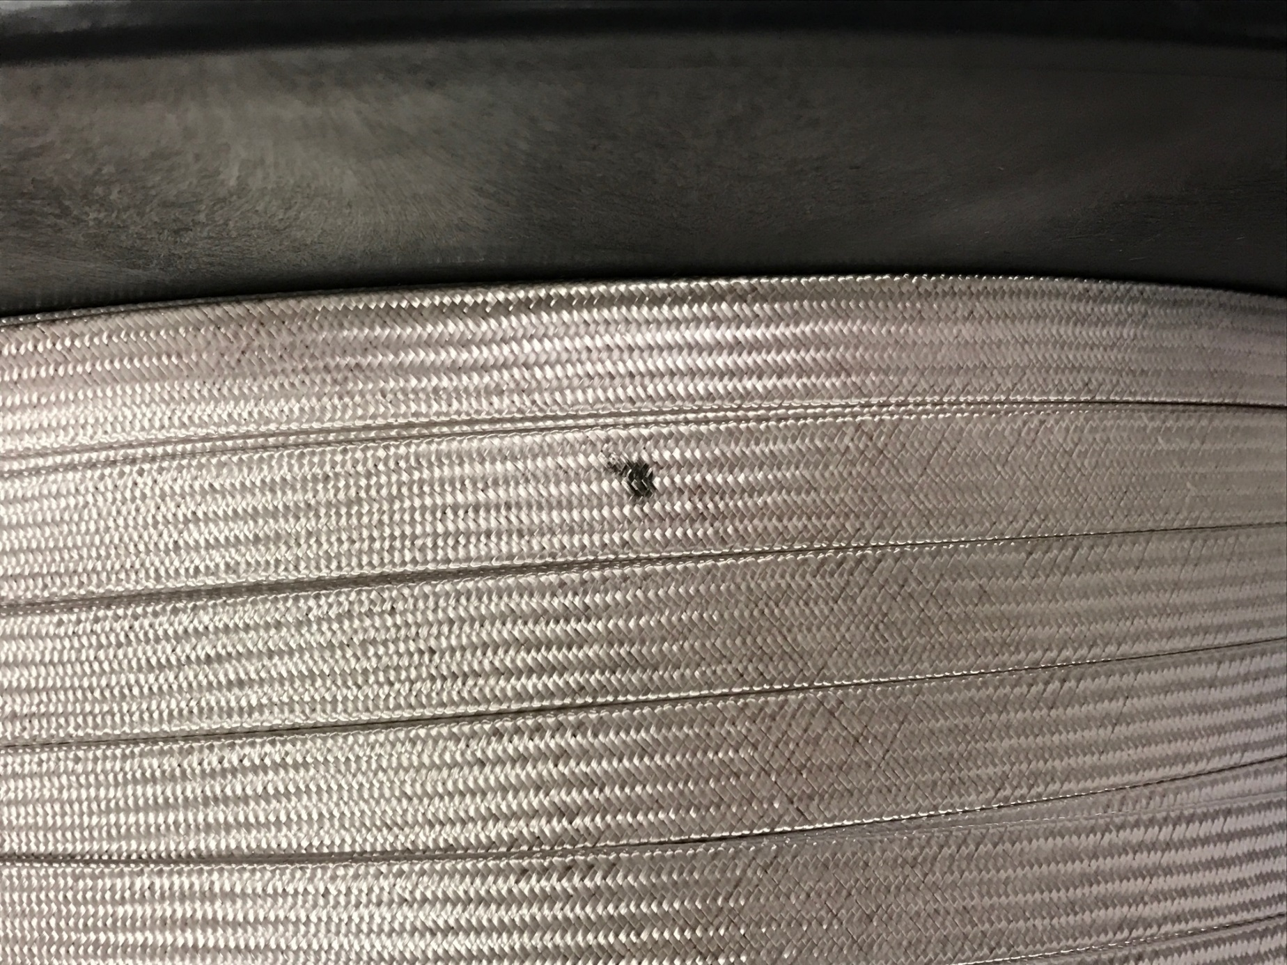
Before cleaning
Photo credit:
Miao Yu FNAL

Slide 64
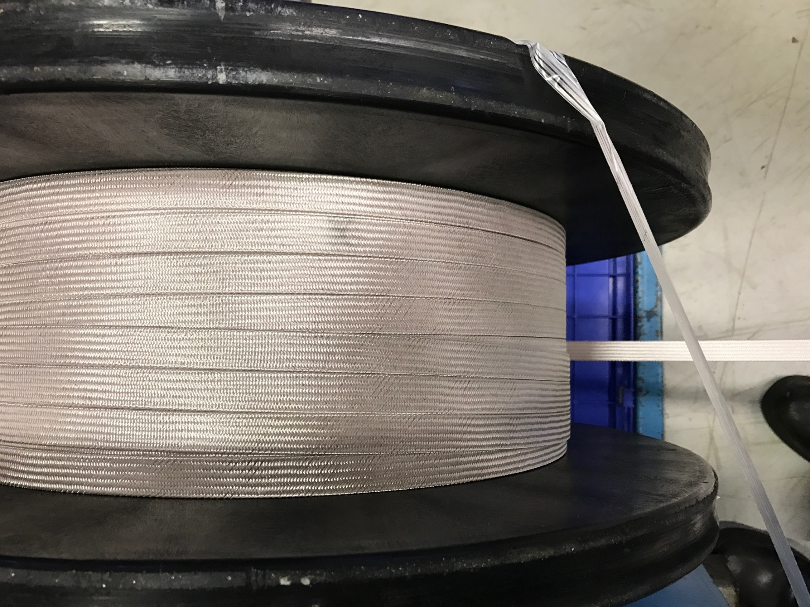
After cleaning
Photo credit:
Miao Yu FNAL

Slide 65
Cable Insulation QXFA105
P43OL1082:
  NEWT initial QC was out of spec; re-measurement was also too thick; a verification sample was sent to LBNL, which confirmed the results.
  NEWT lowered the P/I, which was then too thin.
  Finally, 4th sample at NEWT is acceptable, confirmed by a 2nd LBNL sample. Braiding continued after LBNL verification.
  FNAL reported the insulation was worn at a few locations
Notes:
Dear Erik,
I am writing to provide a quick update on status and to summarize our results for record:
The 18.9 P/I sample was received by LBNL on Monday
The 18.0 P/I sample was received by LBNL on Tuesday
Both have now been measured by LBNL
The 18.9 P/I 10-stack data are 156 microns (LBNL), 155 microns (1st NEWT) and 152 microns (2nd NEWT)
The 18.0 P/I 10-stack data are 140 microns (LBNL), 142 microns (NEWT)
For comparison, the 17.0 P/I 10-stack datum is 137 microns (NEWT)
LBNL will monitor the braiding thickness uniformity when FNAL finishes coil winding and sends drops to archive
One QC for monitoring the 2-ply twist pitch LBNL is considering is by weight of a known length. A shorter pitch yarn would have a higher mass, assuming the yarn linear density uniformity is better than the pitch uncertainty.
If braiding had not resumed after our last communication, then please proceed, closely monitoring the P/I. Please also keep us informed about the latest expected ship date.
For your information, cable P43OL1082 has a marking at the 392nd m from the cable fabrication point end (blue/red strand combination) or ~63rd m from the braiding point end (blue/green strand combination) taking into account of the samples taken. It is marked with a black dot on the top broad face (as shown in the attached photo). Two pairs (large-small, large-small) of major edge facets there are slightly different in size. If you could instruct the operator to take photos of the bare cable and of the braided cable of this particular section, and note in case there are irregularities in braiding parameters over this part, we would be very grateful. I am not expecting any, but thought of informing you anyway. If the operator cannot tell any facet size difference, that’s alright too. It may not be entirely obvious.
If you have any questions, please do not hesitate to contact me. And thank you very much again for your communication and prompt action on the re-measurement and shipment.
With best wishes,
Ian.
From: Ian Pong [mailto:ipong@lbl.gov]
Sent: 27 January 2017 12:06
To: Erik Flum <erik.flum@newenglandwire.com>
Cc: Cindy Derosia <cindy.derosia@newenglandwire.com>; 'Lance Cooley' <ldcooley@fnal.gov>; 'Dan Dietderich' <drdietderich@lbl.gov>
Subject: RE: LARP Cable P43OL1082 FedEx Shipment Tracking [785288598921]
Dear Erik,
Thanks very much for your communication and congratulations on getting the braid thickness in spec. LBNL will verify the data as soon as we receive the sample.
If you have a tracking number, please forward it to me.
Have a good weekend.
With best wishes,
Ian.
From: Erik Flum [mailto:erik.flum@newenglandwire.com]
Sent: 27 January 2017 11:24
To: Ian Pong <ipong@lbl.gov>
Cc: Cindy Derosia <cindy.derosia@newenglandwire.com>; 'Lance Cooley' <ldcooley@fnal.gov>; 'Dan Dietderich' <drdietderich@lbl.gov>
Subject: RE: LARP Cable P43OL1082 FedEx Shipment Tracking [785288598921]
Dear Ian,
Here are the test results at 18.0 P/I. I’ve forwarded a sample to our shipping department, so hopefully that will go out overnight today.
Regards,
Erik
From: Ian Pong [mailto:ipong@lbl.gov]
Sent: Friday, January 27, 2017 1:16 PM
To: Erik Flum <erik.flum@newenglandwire.com>
Cc: Cindy Derosia <cindy.derosia@newenglandwire.com>; 'Lance Cooley' <ldcooley@fnal.gov>; 'Dan Dietderich' <drdietderich@lbl.gov>
Subject: RE: LARP Cable P43OL1082 FedEx Shipment Tracking [785288598921]
Dear Erik,
Thank you very much for the update.
Yes, please proceed at 18.0 P/I, and express send a sample to me ASAP.
Have a good weekend.
With best wishes,
Ian.
From: Erik Flum [mailto:erik.flum@newenglandwire.com]
Sent: 27 January 2017 07:49
To: Ian Pong <ipong@lbl.gov>
Cc: Cindy Derosia <cindy.derosia@newenglandwire.com>; 'Lance Cooley' <ldcooley@fnal.gov>; 'Dan Dietderich' <drdietderich@lbl.gov>
Subject: RE: LARP Cable P43OL1082 FedEx Shipment Tracking [785288598921]
Good morning Ian,
I have some good news. We’ve run another sample at 17.0 P/I and actually came out too thin on the braid. Looking at the results, I think if we run at 18.0 P/I we’ll be able to hit the target of 145 microns. We also changed out the 13 bobbins that were from the previous lot, so all of the material is from the latest lot.
Please let me know how you would like to proceed. I’m assuming you’d like us to run another two samples at 18 P/I, one for NEWT and one for LBNL?
Regards,
Erik
From: Erik Flum
Sent: Tuesday, January 24, 2017 3:14 PM
To: 'Ian Pong' <ipong@lbl.gov>
Cc: Cindy Derosia <cindy.derosia@newenglandwire.com>; 'Lance Cooley' <ldcooley@fnal.gov>; 'Dan Dietderich' <drdietderich@lbl.gov>
Subject: RE: LARP Cable P43OL1082 FedEx Shipment Tracking [785288598921]
Dear Ian,
We will plan to strip the braid and re-setup the braid with a 17-17.5 P/I range in the morning.
Regards,
Erik
From: Ian Pong [mailto:ipong@lbl.gov]
Sent: Tuesday, January 24, 2017 2:24 PM
To: Erik Flum <erik.flum@newenglandwire.com>
Cc: Cindy Derosia <cindy.derosia@newenglandwire.com>; 'Lance Cooley' <ldcooley@fnal.gov>; 'Dan Dietderich' <drdietderich@lbl.gov>
Subject: RE: LARP Cable P43OL1082 FedEx Shipment Tracking [785288598921]
Dear Erik,
Thanks very much for your reply.
I checked the tracking, FedEx shows that the scheduled delivery is 1/27, as it is shipped by ground -- just alerting you in case it was supposed to have come quicker like overnight by air.
Regarding going forward:
Thank you for concurring to try a lower P/I. However, I won’t go as low as 14. Please see the attached presentation by Dan summarizing some earlier R&D.
If the relationship between thickness and P/I is still valid with the “vendor 2” 2-ply (which seems to be the case as 18.9 P/I would give 152-153 microns), 16 P/I would already be under spec. I would try 17-17.5 P/I, if you agree.
We have cut three 5-foot samples already. I can only authorize a maximum of four more, i.e. 2 more attempts, as NEWT and LBNL will need a sample each. It will then have to go to our L2 manager, and the risk of not having enough for a coil will begin to go up.
On this occasion, I authorize one cut for NEWT QC only. We will decide whether to take an LBNL sample later.
Yes please strip the current braid and run a sample with a target ~17-17.5 P/I. We will want to preserve as much cable as possible, but please do follow the standard procedure. 10-stack samples should not be shorter than required.
Keep me posted with the results.
With best wishes,
Ian.
From: Erik Flum [mailto:erik.flum@newenglandwire.com]
Sent: 24 January 2017 06:35
To: Ian Pong <ipong@lbl.gov>
Cc: Cindy Derosia <cindy.derosia@newenglandwire.com>; 'Lance Cooley' <ldcooley@fnal.gov>
Subject: RE: LARP Cable P43OL1082 FedEx Shipment Tracking [785288598921]
Good morning Ian,
The tracking number for the sample is Fedex 709909657839.
I would recommend we braid a section at lower P/I. Our current setup is 18.9 P/I and the fibers from each carrier touch each other. If we drop to something around 14 P/I or less where the fibers are not touching, that may give the fibers enough room to spread as much as possible. A 10-stack at that point would give us the thinnest the raw material will come out to. So, if you’ll authorize us to cut one more 5’ sample, I’ll have the current braid stripped and run a sample with the lower P/I. I’ll photograph the coverage so you can have an idea of what the braid looks like with the lower P/I.
If that does not work, we’ll have to discuss the option of opening up the tolerance on the braid, as at that point, the raw material is what it is.
Regards,
Erik
From: Ian Pong [mailto:ipong@lbl.gov]
Sent: Monday, January 23, 2017 7:11 PM
To: Erik Flum <erik.flum@newenglandwire.com>
Cc: Cindy Derosia <cindy.derosia@newenglandwire.com>; 'Lance Cooley' <ldcooley@fnal.gov>
Subject: RE: LARP Cable P43OL1082 FedEx Shipment Tracking [785288598921]
Dear Erik,
Thank you very much for the detailed reply.
If you have a tracking number for the sample to LBNL, please kindly let me know. We have not received it yet – but as soon as we do, we will perform a 10-stack measurement and let you know how we would like to proceed from there.
Meanwhile, to help us consider options:
what can you do to reduce the braid thickness, given the raw material?
if it is confirmed that it is the raw material that is causing the braid thickness to be out of tolerance, what is your response plan?
With best wishes,
Ian.
From: Erik Flum [mailto:erik.flum@newenglandwire.com]
Sent: 20 January 2017 06:03
To: Ian Pong <ipong@lbl.gov>
Cc: Cindy Derosia <cindy.derosia@newenglandwire.com>; 'Lance Cooley' <ldcooley@fnal.gov>
Subject: RE: LARP Cable P43OL1082 FedEx Shipment Tracking [785288598921]
Good morning Ian,
Please see below.
Regards,
Erik
From: Ian Pong [mailto:ipong@lbl.gov]
Sent: Thursday, January 19, 2017 7:35 PM
To: Erik Flum <erik.flum@newenglandwire.com>
Cc: Cindy Derosia <cindy.derosia@newenglandwire.com>; 'Lance Cooley' <ldcooley@fnal.gov>
Subject: RE: LARP Cable P43OL1082 FedEx Shipment Tracking [785288598921]
Dear Erik,
Thanks very much for your communication reporting an insulation thickness outside our specification 8006-B and for following the requirement to bring the issue to our attention for resolution prior to commencing further work.
Yes, I authorize the use of additional length of ~2 m to perform a second 10-stack to confirm these results. I also have a few comments/questions/requests:
Request:
Please immediately ship a sample adjacent to the piece to be measured at NEWT (i.e. it can be from either side of the second supplier QC piece authorized above) to LBNL for verification measurement.
I will take another sample this morning and collect a 2m sample to ship to LBNL.
Comment:
your reported bare cable thickness is in the range we expected at 5 MPa. I agree it appears that it is the fiberglass that may be causing the oversize. However, I recall that 1074 was out of specification due to a battery problem. Therefore I recommend checking the equipment for anomaly.
I double checked the equipment and all seems operational. The digital indicators are brand new, as we replaced them after the battery issue.
Question:
could you confirm whether the 1-ply material used here is the same batch as in recent runs?
my record says that it should come from the stock of “vendor 1” as under invoice 208650? I recall we started using this material from cable P43OL1070.
This is the same 1-ply material as used over the past several runs. All of the 1-ply material has been twisted, so there is no stock left of 1-ply material.
could you confirm whether the 2-ply material used here is from the “remaining ~100 lbs.” (or elsewhere “133 lbs”) twisted ~2016 09 by “vendor 2”?
I recall that you were investigating their TPI to target around 0.3 to reduce the build of glass, but at the time of discussion that ~100-lb lot has already been done and so the process was the same as the first batch of material.
This setup is a mix of the first twisting (the 74lbs.) and the second twisting. I’m not sure how much of each lot, but the operator noted that they didn’t have enough material left from the first lot for a full setup so some of the bobbins are from the new lot. I will check how many bobbins of each this morning.
Request:
Please also provide an update regarding the inventory. My record shows that:
since PO7266610, we have used up ~50 lbs. of 2-ply fiberglass: 5 runs of ~450-470 m each, ~10 lbs. per run.
the 200 lbs. of 1-ply material purchased under PO7266610 was sent out to “vendor 2” for 2-ply twisting in 2 batches. The first batch you sent out 80 lbs., and received ~74 lbs. (“vendor 2” claimed a loss of about 6 lbs.). The second batch you sent out the remaining material to “vendor 2” around 2016 08. You estimated an 8-10% scrap rate.
your latest email mentioned the fiberglass from the last lot is used up and this setup uses material from the latest twisting. I gather that means the 74 lbs. (“first batch” above) is depleted. Now we are using the 100 or 133 lbs. “second batch”.
Therefore, please confirm the amount of 2-ply in inventory (100 lbs.? 133 lbs.? or 90 lbs. / 120 lbs. assuming 10% scrap rate?)
Our system indicates 149 lbs. in stock of the 2-ply material, though I’m guessing that hasn’t been updated since last week’s order. Our system doesn’t track material by lot#, by rather by part number, so the two twistings are lumped into one inventory amount. I’ll have to do a physical inventory to check how much of each lot we have.
Please update us on the “burn rate” – 5 runs (cables 1070, 1072, 1073, 1074, 1081) appear to have consumed 74 lbs. but past record has been ~10 lbs. per run.
I will check on our usage this morning.
Question: could you tell us the NEWT QA on incoming 2-ply please? I recall you originally performed no inspection but rely sole on the CoC. Have any QA steps been added recently, following our communication around 2016-09-08?
I have not added any additional QA steps for the 2-ply material. We don’t have an established method for measuring the TPI of the 2-ply material, so I looked into implementing a method, but was unsuccessful in finding a method that gave consistent or accurate results.
Question: could you provide evidence that the received 2-ply material has a twist pitch of 3” in the S direction please?
This would be a good topic to discuss during a visit, to see if we can establish an agreeable test method for measuring the 2-ply yarn. Or we can send a bobbin to LBNL to see if you can establish a good method. Additionally, I had asked the supplier if they could meet a TPI of .33 +0 / -XXX. Their reply was that their measuring equipment isn’t accurate enough to guarantee that +0 tolerance. Also, they can’t target .33 TPI. Their target is .35-.40. They said the gears necessary to achieve a lower TPI don’t fit on their equipment without significant modifications and investment.
Question: could you tell us the length of conductor between the braid point and the point you take samples please? I recall the NEWT setup is such that the braided cable goes round a 24” capstan down towards a guide pulley before being taken up by a spool, and that length is ~9m? I would like to know when you take a sample how much cable is already braided with the setup parameter, and if you need to change the P/I, how much cable will be used up. This is very important for us to keep track of the available length of conductor FNAL can use and hence for us to make decision on further actions.
We typically stop at 29’ to take the two 5’ samples. If a change in P/I is necessary, we can certainly strip the braid without too much hassle and start over. In this instance, however, I don’t know that a modification in P/I will result in a large enough change. If the braid build were over 100%, we could reduce the thickness some by reducing the P/I, or we can increase the thickness by increasing the P/I. This setup, however, is about 95% coverage, so reducing the P/I won’t yield a thinner braid as the dimensions are driven by the fiberglass thickness.
With many thanks,
Ian.
-----Original Message-----
From: Erik Flum [mailto:erik.flum@newenglandwire.com]
Sent: 19 January 2017 11:54
To: Ian Pong <ipong@lbl.gov>
Cc: Cindy Derosia <cindy.derosia@newenglandwire.com>
Subject: RE: LARP Cable P43OL1082 FedEx Shipment Tracking [785288598921]
Good afternoon Ian,
We've setup cable 1082Z and I've attached the 10-stack results. The insulation on this cable is coming out oversized, similar to the sample from cable 1074. We've used up most of the fiberglass from the last lot and this setup uses primarily material from the latest twisting. Would you like me to perform a second 10-stack to confirm these results? Let me know how you would like us to proceed.
Regards,
Erik
-----Original Message-----
From: Ian Pong [mailto:ipong@lbl.gov]
Sent: Friday, January 13, 2017 6:20 PM
To: Erik Flum <erik.flum@newenglandwire.com>
Cc: Cindy Derosia <cindy.derosia@newenglandwire.com>
Subject: RE: LARP Cable P43OL1082 FedEx Shipment Tracking [785288598921]
Dear Erik,
Thanks very much for your email.
If you have a tracking number for P43OL1081 to FNAL, please let me know.
It sounds great that cable P43OL1082 can be insulated sooner. Please keep me posted regarding its schedule: Lance and I are still planning to come and witness one of the upcoming cable braiding operations and to discuss QA, although we haven't managed to find a spot in our schedule yet.
Have a good weekend.
With best wishes,
Ian.
-----Original Message-----
From: Erik Flum [mailto:erik.flum@newenglandwire.com]
Sent: 13 January 2017 06:30
To: Ian Pong <ipong@lbl.gov>; Cindy Derosia <cindy.derosia@newenglandwire.com>
Subject: RE: LARP Cable P43OL1082 FedEx Shipment Tracking [785288598921]
Good morning Ian,
We completed cable 1081 on Wednesday; here is the completed cable map.
Looks like delivery of cable 1082 should be on Monday, so we should be able to get it on the machine later next week, or early the following week.
Regards,
Erik
-----Original Message-----
From: Ian Pong [mailto:ipong@lbl.gov]
Sent: Wednesday, January 11, 2017 4:43 PM
To: Cindy Derosia <cindy.derosia@newenglandwire.com>; Erik Flum <erik.flum@newenglandwire.com>
Subject: LARP Cable P43OL1082 FedEx Shipment Tracking [785288598921]
Dear Cindy and Erik,
I am writing to send you the tracking number of our latest cable P43OL1082, toll number T2638 under PO7266610. Please see http://www.fedex.com/tracking, tracking number 785288598921.
Please let me know when you receive the shipment and please keep me posted regarding the braiding. (Thanks to Cindy for providing the estimated date of 2/6.)
With many thanks and best wishes,
Ian.
-----Original Message-----
From: kus.netshipadmin@kewill.com [mailto:kus.netshipadmin@kewill.com]
Sent: 11 January 2017 12:16
To: ipong@lbl.gov
Subject: A FedEx shipment [785288598921] was created.
This is an automatic notification from the Kewill Netship Software.
A FedEx shipment was created as follows:
* Message from sender: Superconducting Cable P43OL1082AA00A 465m
* Content Description: Superconducting Cable P43OL1082AA00A 465m
* Tracking Number : 785288598921
* Ship Date : 1/11/2017 12:00:00 AM
* Service Type : FedEx 2Day Freight
* Package Weight : 300.0000
* Reference :
** SENDER :
Andy Lin
LBNL
One Cyclotron Road, Building 69
Berkeley, CA 94720
US
** RECEIVER :
Cindy Derosia
New England Wire Technologies
130 North Main Street Toll# T2638
Lisbon, NH 03585
US
*** You can continue to track your package with the tracking number "785288598921"
at the carrier's website: http://www.fedex.com/tracking
If you have any questions regarding this notification, please contact us at 1-866-649-1900. Thank you for using Kewill Netship.
--END OF NOTIFICATION--

Slide 66
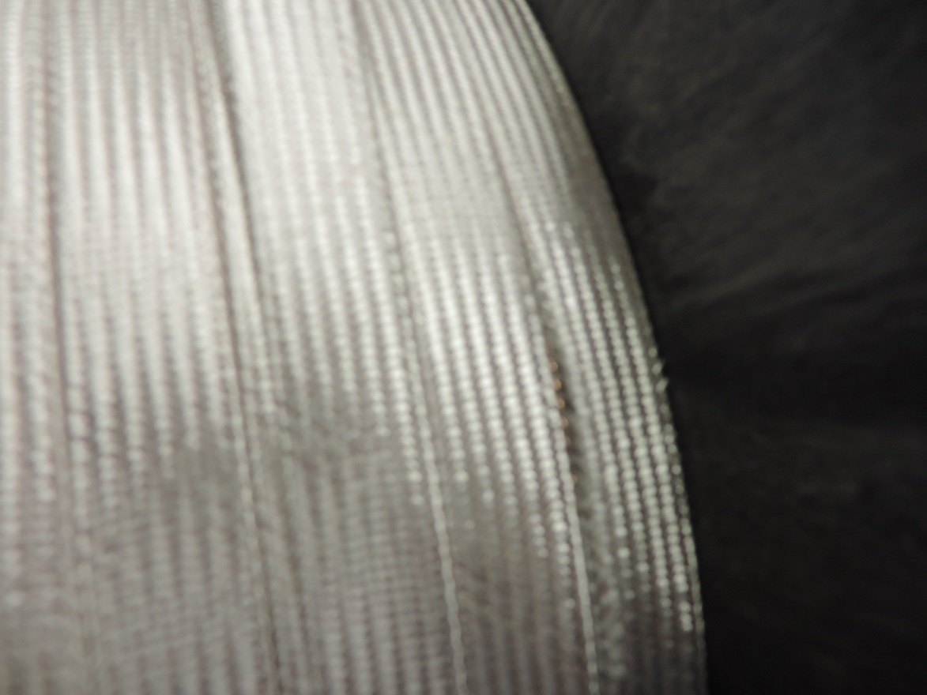
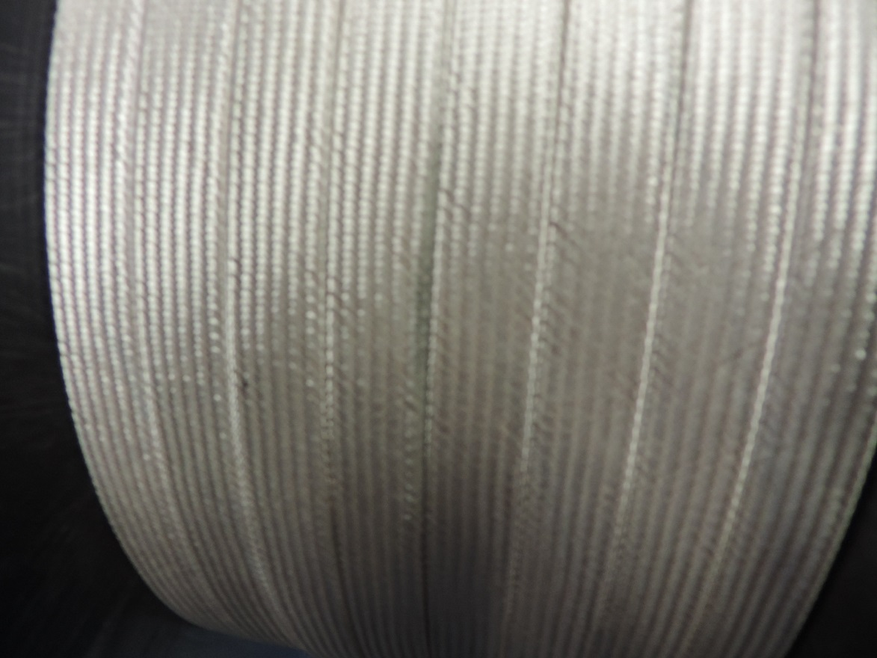
Notes:
Hi Ian,
We finished respooling the cable, and the overall length is 452.8 meters (not 465 meters labeled on the vendor spool)
We also found that the insulation was worn at couple of spot,
25.1 m from blue/red end: worn on thin edge (black edge)
36.8 m from blue/red end: worn out and bare cable exposed on thin edge (attached picture, little blur but still can see the shining color)
47.4 m from blue/red end: worn on thin edge (black edge)
87 m from blue/red end: worn on thin edge (black edge)
In the previous reels, we also saw some black mark on the thin edge or thick edge of the cable. Please talk to the vendor to know how they spool the insulated cable.
Thanks.
Miao
From: Ian Pong [mailto:ipong@lbl.gov]
Sent: Tuesday, February 14, 2017 4:17 PM
To: Miao M Yu <miaoyu@fnal.gov>
Subject: RE: P43OL1082
Dear Miao,
Thanks for your note. Please provide me an update asap.
With many thanks,
Ian.
From: Miao M Yu [mailto:miaoyu@fnal.gov]
Sent: 14 February 2017 14:15
To: Ian Pong x 31265V <ipong@lbl.gov>
Subject: RE: P43OL1082
Hi Ian,
We are unable to respool the cable this week, so we accept it and will do the re-spool later.
Miao
From: Miao M Yu
Sent: Thursday, February 09, 2017 3:22 PM
To: Ian Pong <ipong@lbl.gov>
Subject: RE: P43OL1082
OK.
Miao
From: Ian Pong [mailto:ipong@lbl.gov]
Sent: Thursday, February 09, 2017 3:21 PM
To: Miao M Yu <miaoyu@fnal.gov>
Subject: RE: P43OL1082
Dear Miao,
The payment is due on Monday the 20th. If you could let me know before that, that would be great.
With many thanks,
Ian.
From: Miao M Yu [mailto:miaoyu@fnal.gov]
Sent: 09 February 2017 13:19
To: Ian Pong x 31265V <ipong@lbl.gov>
Subject: RE: P43OL1082
Hi Ian,
Today we received the cable. If it is not hurry to make the payment, we would like to accept it after we respool the cable sometime next week.
Miao
From: Ian Pong [mailto:ipong@lbl.gov]
Sent: Wednesday, February 08, 2017 4:45 PM
To: Miao M Yu <miaoyu@fnal.gov>
Subject: P43OL1082
Dear Miao,
Hello. I am writing to let you know that NEWT has completed the braiding of P43OL1082.
I have not received the tracking number, but the cable should be arriving at FNAL end of this week. Please let me know when you accept the cable.
With many thanks,
Ian.
Ian Pong
Project Scientist
LARP Cable Task Leader
047-0114 Accelerator Technology & Applied Physics
Lawrence Berkeley National Laboratory
1 Cyclotron Road MS 47R0112
Berkeley, CA 94720-8201
U.S.A.
Phone: (001) 510-486-7866, Fax: (001) 510-486-5392

Slide 67
Insulation – Summary (1)
Cable ID | PO | Date (LBNL to NEWT)
P43OL1072 | LBNL 7266610 | 2016 06 03
P43OL1073 |  | 2016 06 28
P43OL1081 |  | 2016 12 15
P43OL1082 |  | 2017 01 06
P43OL1084 |  | 2017 03 17

Slide 68
Insulation – Summary (2)
Cable ID | NEWT QC Data (mm, at 5 MPa) |  |  | LBNL Verification (mm, at 5 MPa)
 | 1st Cycle | 2nd Cycle | 3rd Cycle | 1st Cycle | 2nd Cycle | 3rd Cycle
P43OL1072 | 0.149 | 0.147 | 0.145 | 0.150 | 0.148 | 0.147
P43OL1073 | 0.151 | 0.149 | 0.147 | 0.144 | 0.143 | 0.142
P43OL1081 | 0.147 | 0.145 | 0.144 | 0.147 | 0.146 | 0.145
P43OL1082 | 0.145 | 0.143 | 0.142 | 0.143 | 0.141 | 0.140
P43OL1084 | 0.144 | 0.141 | 0.140 | 0.145 | 0.144 | 0.142
Specification: 145 ± 5 μm
NEWT-LBNL agreement: within 2 μm
Except P43OL1073 – it was found after this cable that the NEWT gauge had an exploded battery
Notes:
10. Determine the average of the 3 measurements of the insulated cables.
11. Determine the average of the 3 measurements of the bare cable.
12. Subtract the insulated average from the bare cable average and divide by 2 to obtain the insulation thickness per side.

