Slide 1

Coil Reaction & Impregnation at FNAL
Coils QXFA101,104,106 for Magnet MQXFAP2
Fred Nobrega
Coil Fabrication at FNAL, L3
U.S. HL-LHC Accelerator Upgrade Project
MQXFAP2 Conductor & Coils Readiness Review
December 7, 2017

Slide 2


Outline of Talk, Coils QXFA101, 104, & 106
Notes & Photos
Coil heat treatment plots
Coil CMM results
Final electrical measurements and discrepancy reports (DR’s) covered in Carlo’s talk

Slide 3
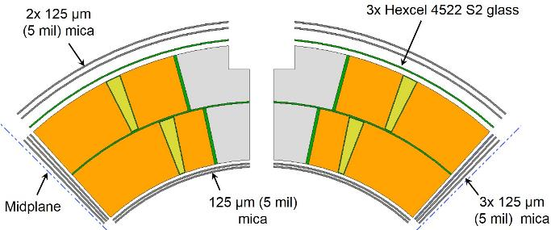
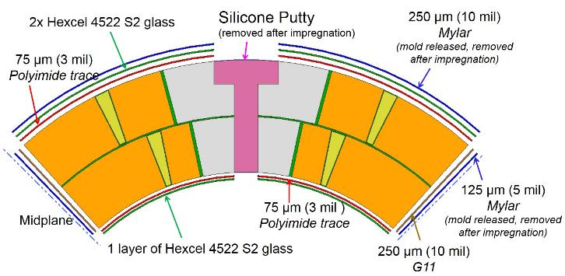
Materials Used
  Reaction:
    3 layers Hexcel 4522 glass cloth on coil OD
    2 layers mica on coil OD & ID
  Impregnation:
    3 mil instrumentation trace on coil OD
    2 layers Hexcel 4522 glass cloth on coil OD + 10 mil Mold released 10 mil Mylar
    3 mil instrumentation trace on coil ID
    1 layer Hexcel 4522 glass cloth on coil ID
    10 mil G11 shims on midplane
    Instrumentation wires (A104 & A106):
    - QH Wires - 8X Axon 18 AWG (Yellow)
    - VT Wires -7X Axon 26 AWG (Red)
    - 2850 Stycast

Slide 4
Coil QXFA101 Heat Treatment
(ramp, plateau T, dwell)
(ramp, plateau T, dwell)
(ramp, plateau T, dwell)
Recipe: 25°C*210°C /48h +50°C*400° C/48h + 50°C*665°C/50h

Slide 5
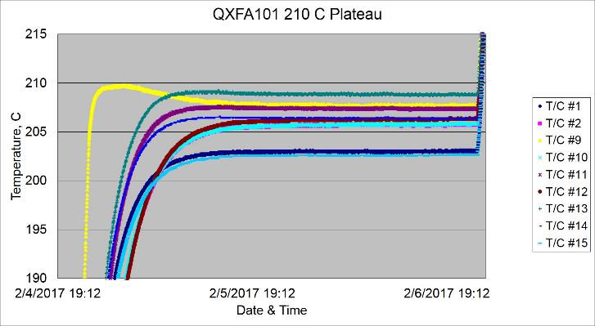
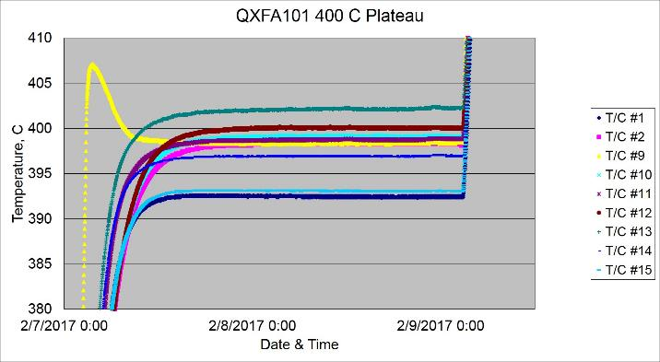
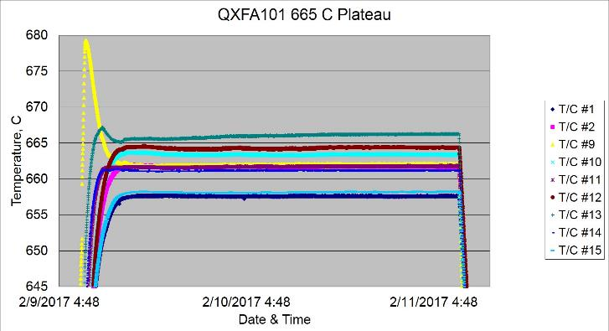
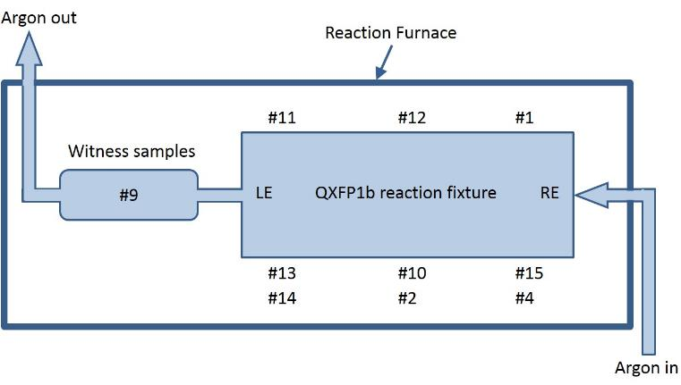
Coil QXFA101 Heat Treatment
210° C Plateau
400° C Plateau
6.3° C
T/C #9
T/C # 13
T/C # 13
9.6° C
T/C # 1,15
T/C # 1, 15
665° C Plateau
T/C #9
4.6° C
T/C # 13
QXFA101 Reaction Fixture
T/C # 1,15

Slide 6
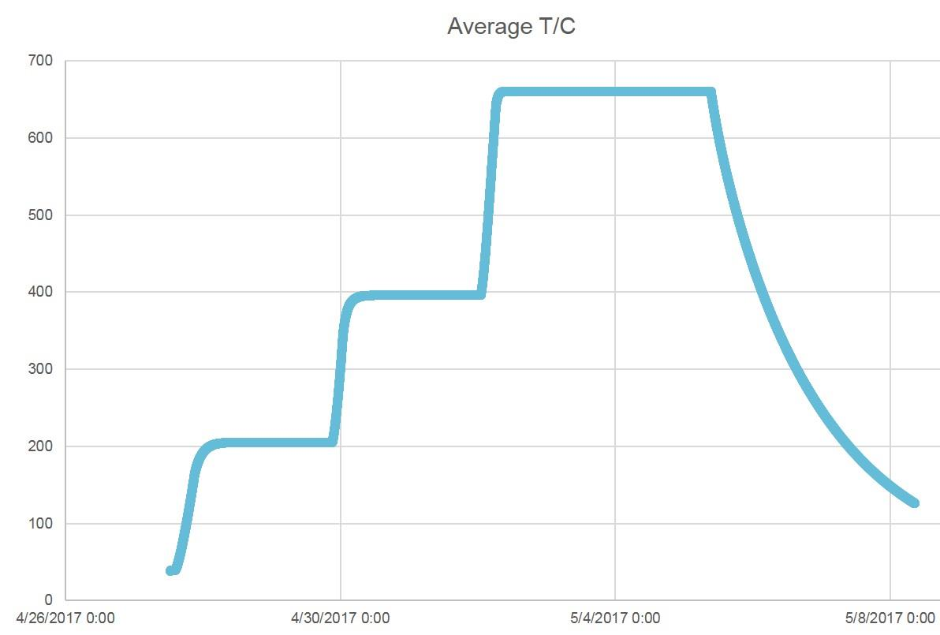
Coil QXFA104 Heat Treatment
(ramp, plateau T, dwell)
(ramp, plateau T, dwell)
(ramp, plateau T, dwell)
Recipe: 25°C*210°C /48h +50°C*400° C/48h + 50°C*665°C/50h
Results:
1-2 Ramp 14 hrs
2-3 210 °C plateau 205° C hrs & 43 hrs
3-4 Ramp 8 hrs
4-5 400 °C plateau 396° C & 44 hrs
5-6 Ramp 6 hrs
6-7 665 °C plateau 660° C & 74 hrs
6
7
4
5
2
3
1

Slide 7
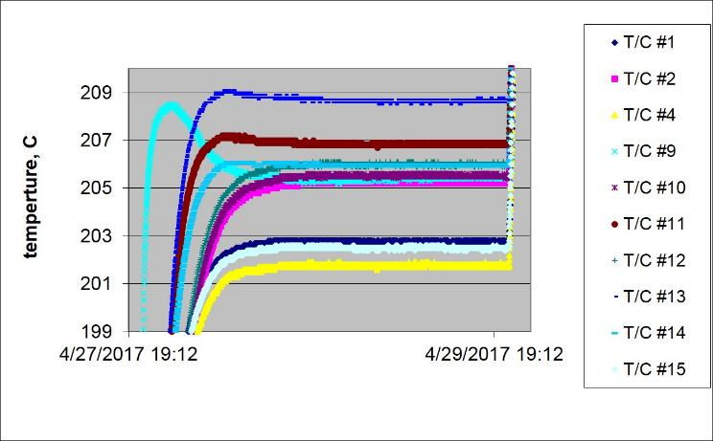
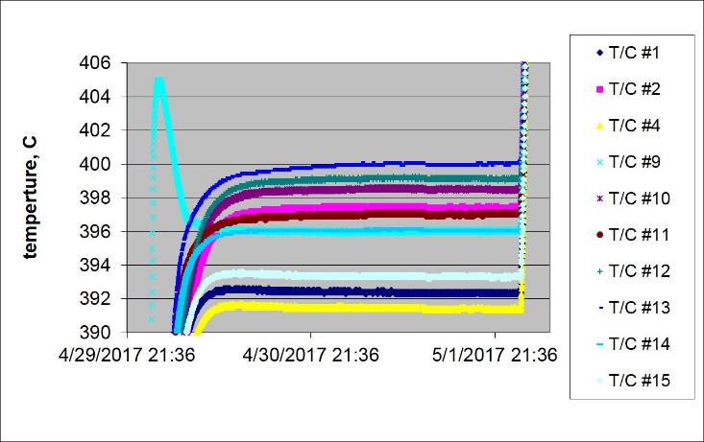
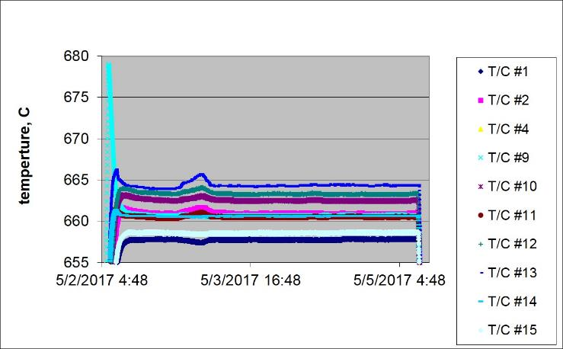
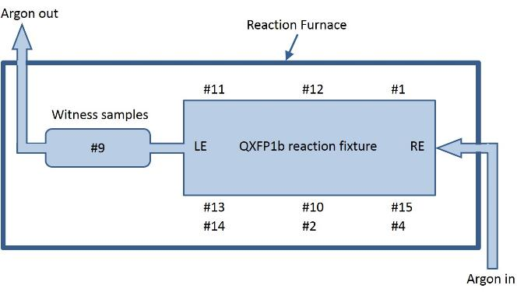
Coil QXFA104 Heat Treatment
210° C Plateau
400° C Plateau
T/C #9
T/C #13
6.9° C
T/C #9
T/C #13
8.5° C
T/C # 1, 4, 15
T/C # 1, 4, 15
665° C Plateau
T/C #9
T/C #13
6.7° C
QXFA104 Reaction Fixture
T/C # 1,15

Slide 8
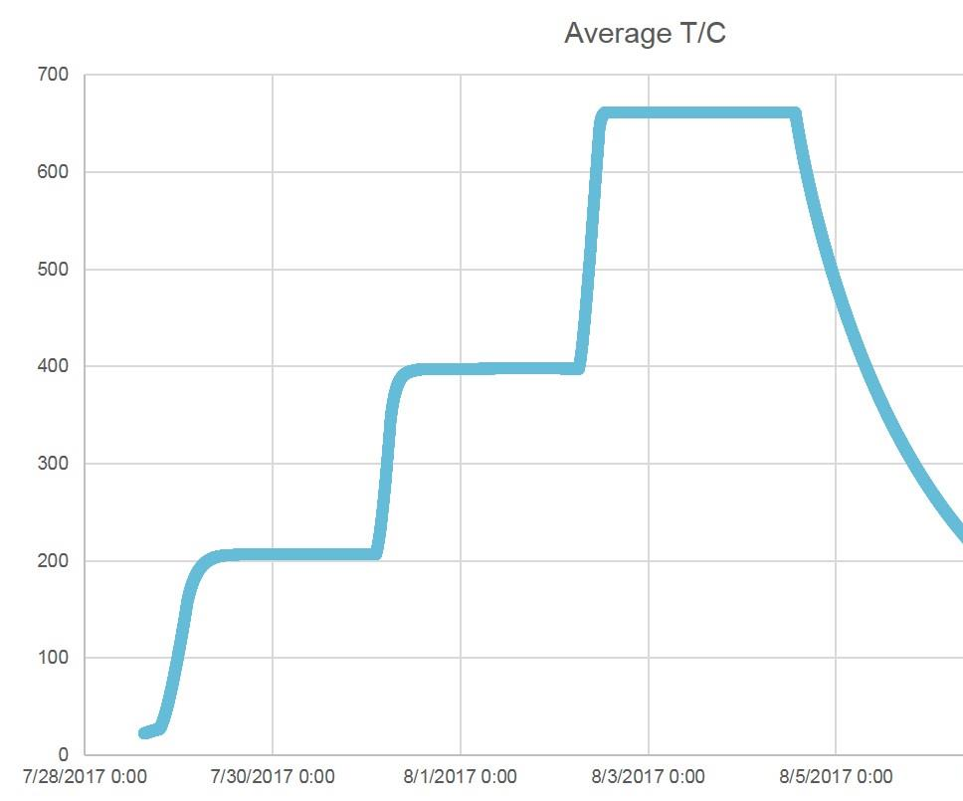
Coil QXFA106 Heat Treatment
(ramp, plateau T, dwell)
(ramp, plateau T, dwell)
(ramp, plateau T, dwell)
Recipe: 25°C*210°C /48h +50°C*400° C/48h + 50°C*665°C/50h
Results:
1-2 Ramp 14 hrs
2-3 210 °C plateau 207° C hrs & 43 hrs
3-4 Ramp 7 hrs
4-5 400 °C plateau 398° C & 44 hrs
5-6 Ramp 6 hrs
6-7 665 °C plateau 661° C & 55 hrs
6
7
4
5
2
3
1

Slide 9
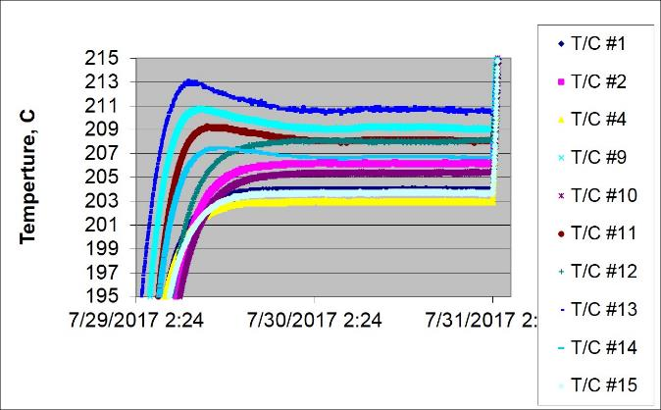
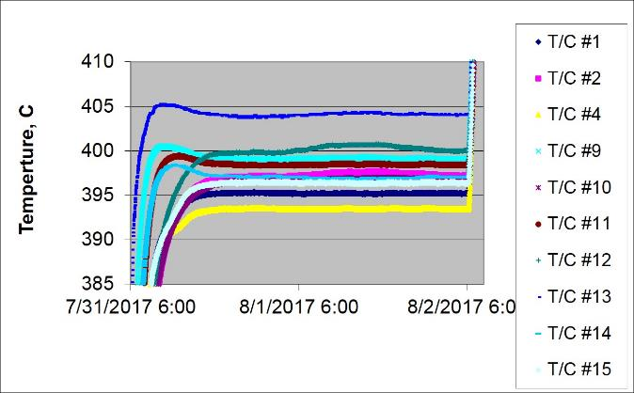
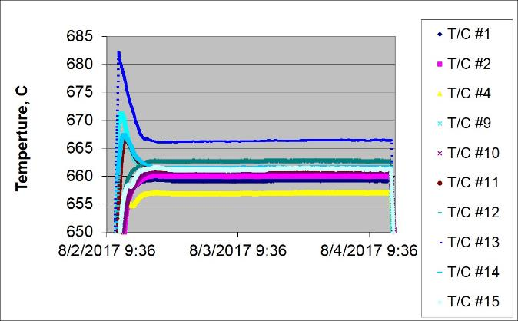

Coil QXFA106 Heat Treatment
210° C Plateau
400° C Plateau
T/C #13
T/C #1,4,15
6.9° C
10.7° C
665° C Plateau
T/C #13
9.5° C
T/C #4
QXFA106 Reaction Fixture

Slide 10
Coil Reaction Summary
Nominal Values | A101 | A104 | A106
210° C & 48 hr | 206° C & 42 hr | 205° C & 43 hr | 207° C & 43 hr
400° C & 48 hr | 398° C & 43 hr | 396° C & 44 hr | 396° C & 44 hr
665° C & 50 hr | 662° C & 47 hr | 660° C & 74 hr* | 661° C & 55 hr*
210 spread, 6 °C | 6.3° C | 6.9° C | 6.9° C
400 spread, 6 °C | 9.6° C | 8.5° C | 10.7° C
665 spread, 6 °C | 4.6° C | 6.7° C | 9.5° C
* Time at 665° C plateau extended after consultation with conductor group.

Slide 11
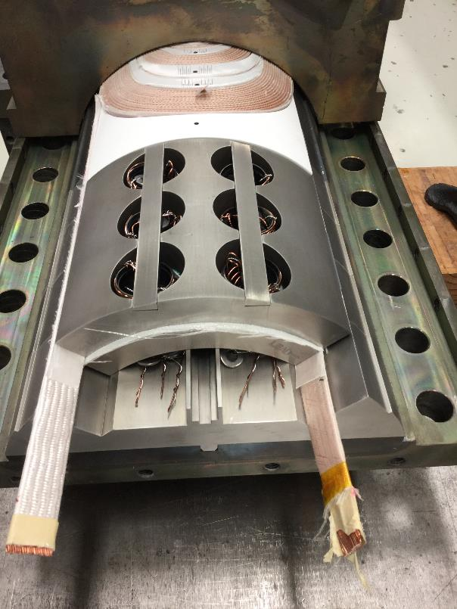
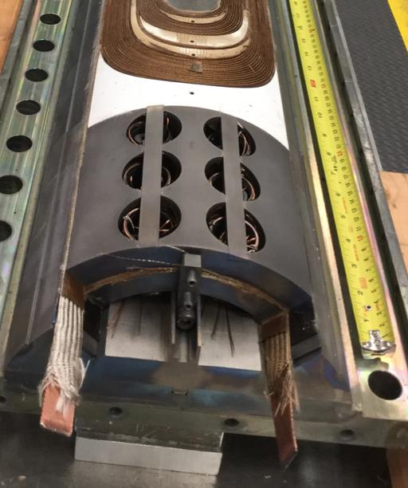
Witness Sample Holder
QXFA106 & Subsequent Coils

Slide 12
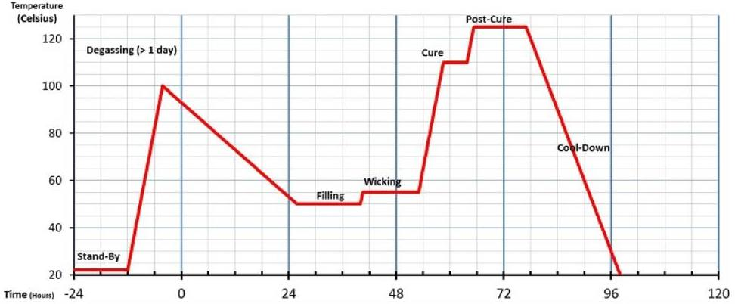
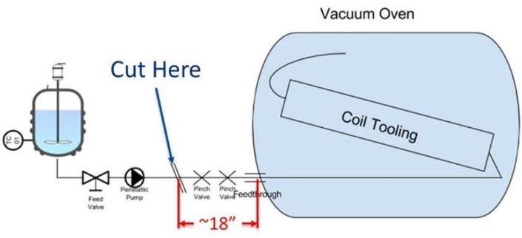
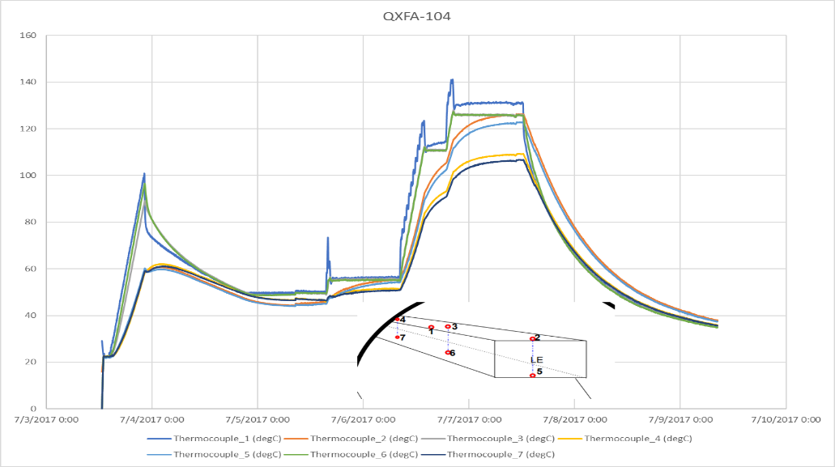
Impregnation Process
Strip heaters on tooling

Slide 13
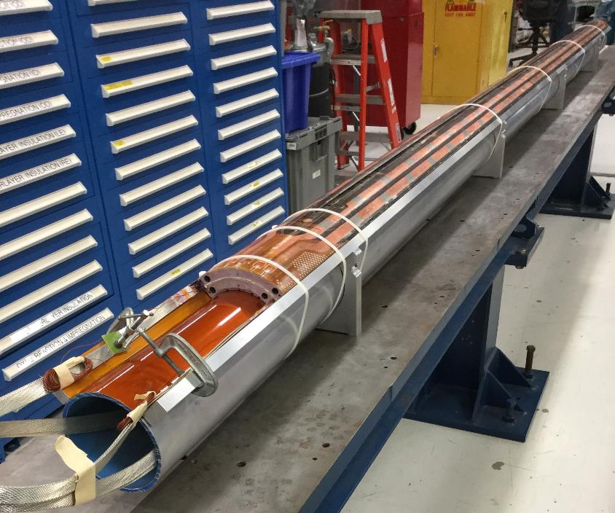
Coil QXFA101 CMM Results
Measured cross sections in
mm from Lead End Key Datum hole.
Station 1 -70
Station 2 -270
Station 3 -327
Station 5 -1140
Station 6 -1540
Station 7 -1940
Station 8 -2340
Station 9 -2740
Station 10 -3140
Station 11 -3540
Station 12 -3940
Station 13 -4323
Station 14 -4426
Lead End of Coil
View of Profile scans along length of coil
Mid-planes only

Slide 14
Coil QXFA101 CMM Results
4 mils/square
4 mils/square
Sample Number: QXFA 101 Cross Section Station 05 at -1140mm from LEAD END. X100
Alignment is: this Cross-Section only -Z- to O.D. & -X- to Sides
Sample Number: QXFA 101 Cross Section Station 07 at -1940mm from LEAD END. x100
Alignment is: this Cross-Section only -Z- to O.D. & -X- to Sides
4 mils/square
4 mils/square
Sample Number: QXFA 101 Cross Section Station 09 at -2740mm from LEAD END. x100
Alignment is: this Cross-Section only -Z- to O.D. & -X- to Sides
Sample Number: QXFA 101 Cross Section Station 12 at -3940mm from LEAD END. x100
Alignment is: this Cross-Section only -Z- to O.D. & -X- to Sides

Slide 15
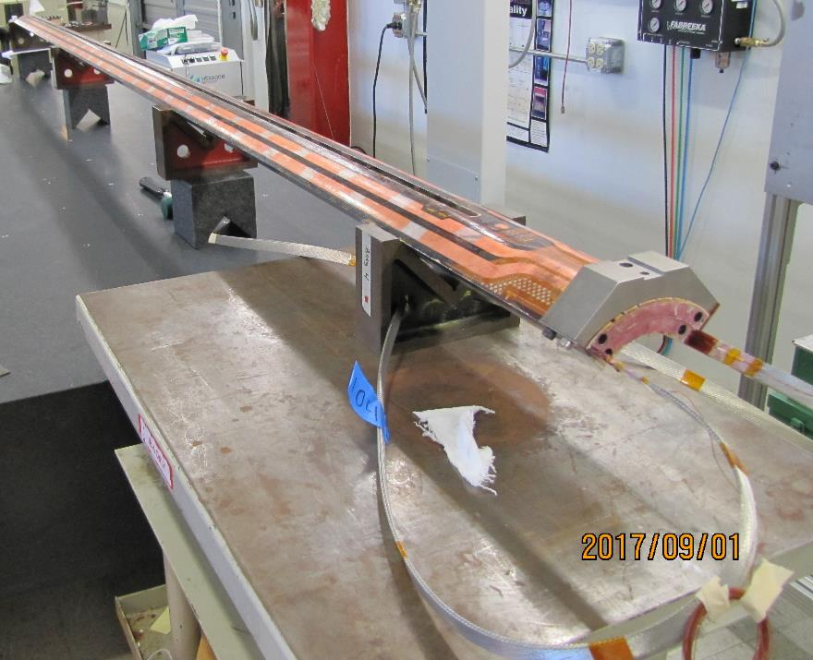
Coil QXFA104 CMM Results
Measured cross sections in
mm from Lead End Key Datum hole.
Station 1 -70
Station 2 -270
Station 3 -327
Station 5 -1140
Station 6 -1540
Station 7 -1940
Station 8 -2340
Station 9 -2740
Station 10 -3140
Station 11 -3540
Station 12 -3940
Station 13 -4323
Station 14 -4426
Lead End of Coil
View of Profile scans along length of coil
Mid-planes only

Slide 16
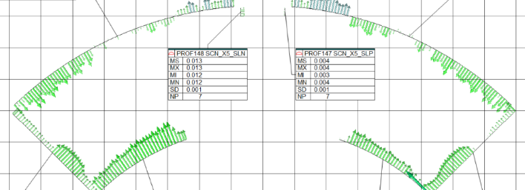
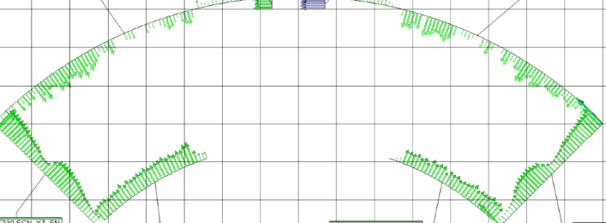
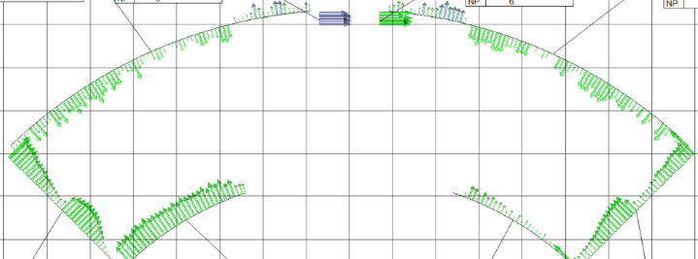
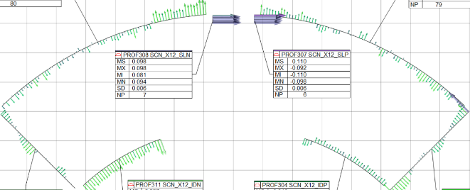
Coil QXFA104 CMM Results
4 mils/square
4 mils/square
Sample Number: QXFA 101 Cross Section Station 05 at -1140mm from LEAD END. X100
Alignment is: this Cross-Section only -Z- to O.D. & -X- to Sides
Sample Number: QXFA 101 Cross Section Station 07 at -1940mm from LEAD END. x100
Alignment is: this Cross-Section only -Z- to O.D. & -X- to Sides
4 mils/square
4 mils/square
Sample Number: QXFA 101 Cross Section Station 09 at -2740mm from LEAD END. x100
Alignment is: this Cross-Section only -Z- to O.D. & -X- to Sides
Sample Number: QXFA 101 Cross Section Station 12 at -3940mm from LEAD END. x100
Alignment is: this Cross-Section only -Z- to O.D. & -X- to Sides

Slide 17
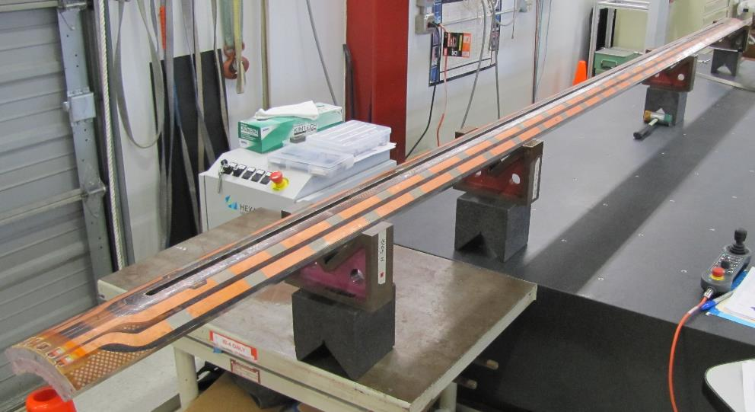
Coil QXFA106 CMM Results
Measured cross sections in
mm from Lead End Key Datum hole.
Station 1 -70
Station 2 -270
Station 3 -327
Station 5 -1140
Station 6 -1540
Station 7 -1940
Station 8 -2340
Station 9 -2740
Station 10 -3140
Station 11 -3540
Station 12 -3940
Station 13 -4323
Station 14 -4426
Lead End of Coil
View of Profile scans along length of coil
Mid-planes only

Slide 18
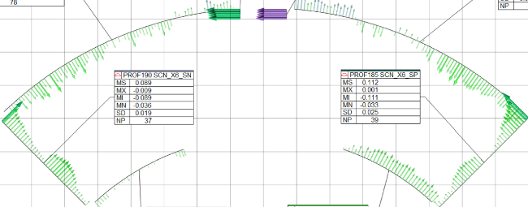
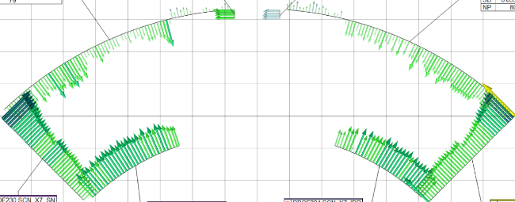
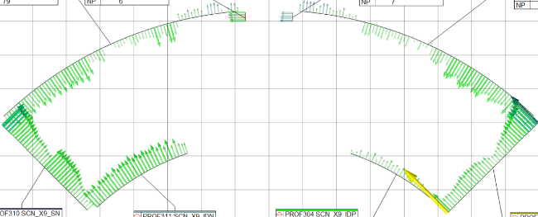
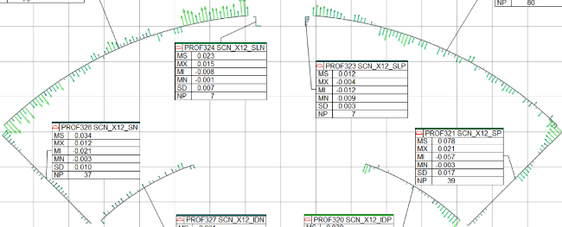
Coil QXFA106 CMM Results
4 mils/square
4 mils/square
Sample Number: QXFA 101 Cross Section Station 05 at -1140mm from LEAD END. X100
Alignment is: this Cross-Section only -Z- to O.D. & -X- to Sides
Sample Number: QXFA 101 Cross Section Station 07 at -1940mm from LEAD END. x100
Alignment is: this Cross-Section only -Z- to O.D. & -X- to Sides
4 mils/square
4 mils/square
Sample Number: QXFA 101 Cross Section Station 09 at -2740mm from LEAD END. x100
Alignment is: this Cross-Section only -Z- to O.D. & -X- to Sides
Sample Number: QXFA 101 Cross Section Station 12 at -3940mm from LEAD END. x100
Alignment is: this Cross-Section only -Z- to O.D. & -X- to Sides

Slide 19


Slide 20
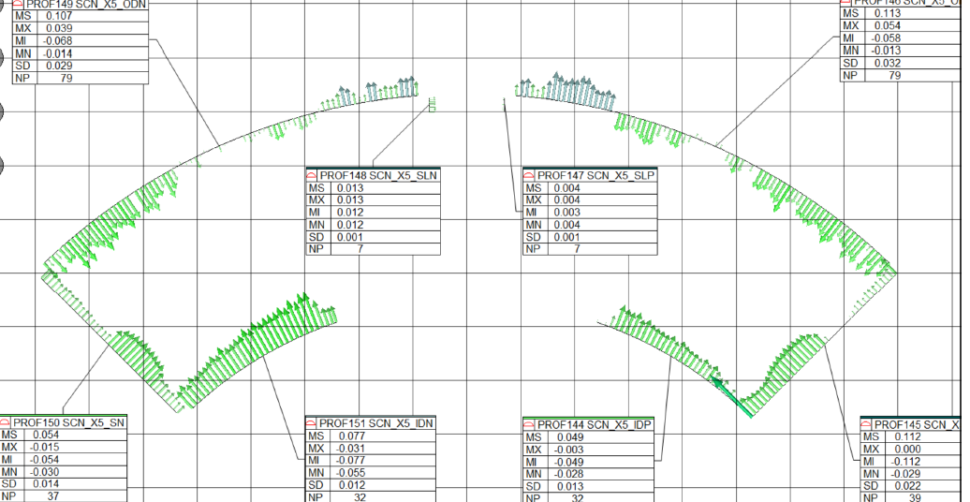
MS measurement deviation, mm
MX maximum, mm
MI minimum, mm
MN mean, mm
SD std dev, mm
NP number of points

