Slide 1

MQXFAP2 Coils Readiness Review
FNAL Discrepancy Reports
Carlo Santini
U.S. HL-LHC Accelerator Upgrade Project
MQXFAP2 Conductor & Coils Readiness Review
December 7, 2017

Slide 2
Discrepancy Report Summary
DR | QXFA101 |  |  | QXFA102 |  |  | QXFA104 |  |  | QXFA105 |  |  | QXFA106
 | W&C | R | S&I | W&C | R | S&I | W&C | R | S&I | W&C | R | S&I | W&C | R | S&I
Irrelevant | 2 | 1 | 2 | 4 |  |  | 0 | 0 | 2 | 0 |  |  | 1 | 2 | 1
Low | 3 | 1 | 7 | 8 |  |  | 1 | 2 | 2 | 1 |  |  | 4 | 0 | 3
Medium | 0 | 0 | 2 | 0 |  |  | 0 | 0 | 2 | 0 |  |  | 0 | 0 | 1
Tot | 3 | 1 | 9 | 8 |  |  | 1 | 2 | 4 | 1 |  |  | 4 | 0 | 4
TOT | 13 |  |  |  |  |  | 7 |  |  |  |  |  | 8
Irrelevant DR: no coil’s damages or irregularities
Low Risk DR: coil’s damages or irregularities fixed
Medium Risk DR: coil’s damages or irregularities not fixed
High Risk DR: coil compromised

Slide 3
QXFA101: Impregnation (2 Irr – 7 Low – 2 Med)
Medium DR (#11181)
Irregularities? Yes
Fixed? No
DR Description
After Impregnation, some of the outer pole pins were sticking out of the key alignment area (0.9 mm in the worst case).
Dispositions
The G11 alignment bar that is used in the magnet structure will need to be modified to accommodate the new profile.
Possible reasons
The differential thermal expansion between the pins and the pole (SS vs Titanium) allowed the pins to “push” the Teflon fillers during the Impregnation cycle.
Corrective Actions to Prevent Recurrence
- Push the pins deeper (toward the ID) before impregnation
- Add some “patty” to the Teflon filler to help in keeping the pins down

Slide 4
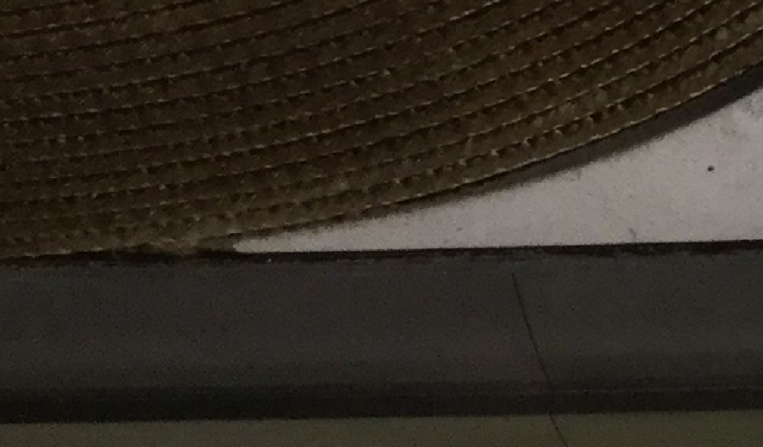
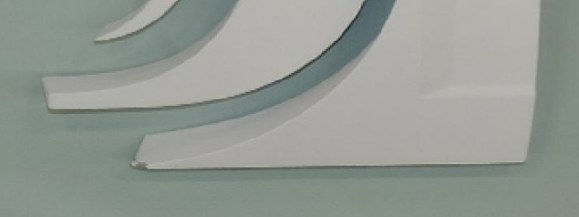
QXFA101: Impregnation (2 Irr – 7 Low – 2 Med)
Medium DR (#11271)
Irregularities? Yes
Fixed? No
DR Description
Hipot Test Coil to RE OL Saddle failed at 10V (7 µA leakage).
Measurements made with FLUKE Multimeter after the test showed 10 MΩ resistance.
Possible reasons
The cause can be the sharp edge of the saddle with chipped off plasma coating.
The SS edge could have cut the S2 glass insulation and the slightly conductive binder on the cable S2 glass could have caused the 10 MΩ R.

Slide 5
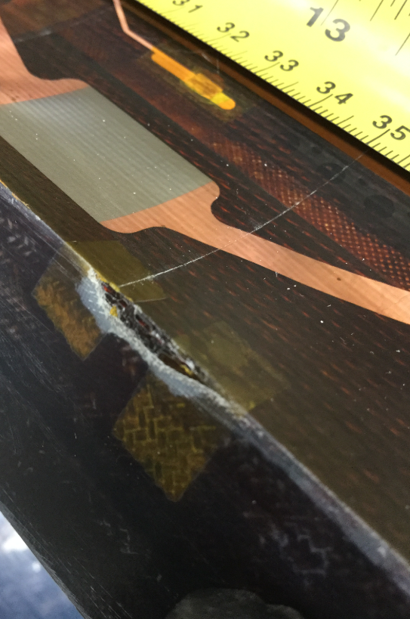
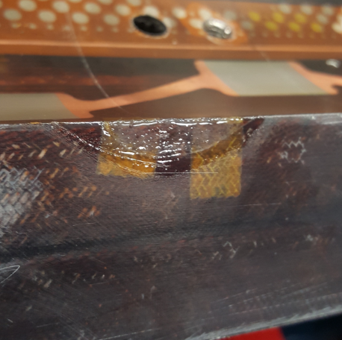
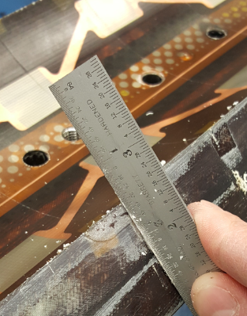
QXFA104: Impregnation (1 Irr – 3 Low – 2 Med)
Medium DR (#11226)
Damages? Yes
Fixed? Probably yes
DR Description
There is a piece of midplane G10 broken off the edge of the coil. During cleaning/filing the epoxy lip, a piece of G10 detached.
Dispositions Taken
Develop a repair procedure using S2 glass and CTD101 epoxy putty to be similar to G-11 by S2 glass volume. Use QXFP1b coil sections to verify process. The process is being developed by Steve Krave and Fred Nobrega. Initial test on a coil section worked very well and included a cold shock in LN2. After peer review, the process will be implemented on coil QXFA104 and tested in the second prototype magnet.

Slide 6
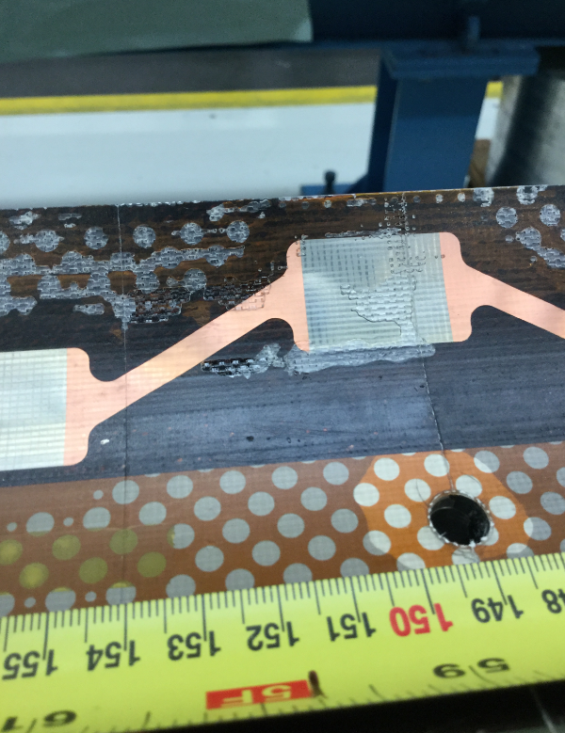
QXFA104: Impregnation (1 Irr – 3 Low – 2 Med)
Irregularities? Yes
Medium DR (#11227)
Fixed? No
DR Description
There is imperfection in the filling of epoxy on the coil (close to the RE).
Corrective Actions for the next Coils
During the full Impregnation cycle (degassing, filling, curing, and cool down) the coil tooling is usually kept inclined.
For the next coils we will start the cycle with the inclined tooling (degassing and filling) and set the tooling horizontally for the last part of the cycle (curing and cool down).
We tried with QXFA106 and it was successful.

Slide 7
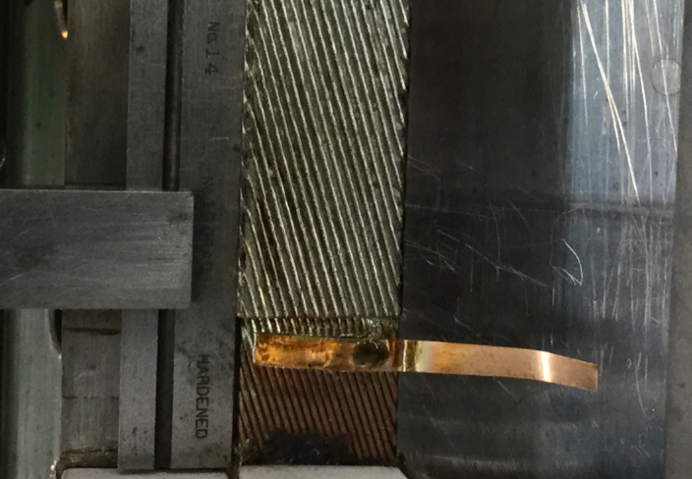
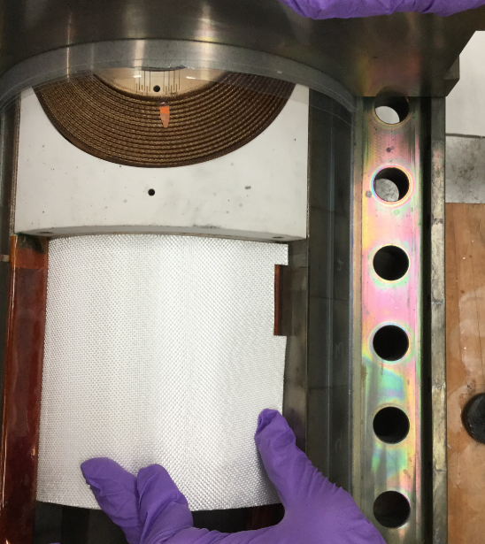
QXFA106: Splice (1 Irr – 3 Low – 1 Med)
Irregularities? Yes
Medium DR (#11263)
Fixed? No
DR Description
After splicing the NbTi power leads, we discover the inner Nb3Sn & NbTi are not parallel to each other.
Dispositions
Replace spacer with a slightly larger spacer ~1-2 mils in width. Attempt to re-position the NbTi lead while the solder fixture is hot.
The process was attempted 4 times without success.
Cut a window in the blanket to provide clearance for the misaligned lead between the slice blocks.

Slide 8
Appendix
Recurrent and Remarkable Low Risk DRs

Slide 9
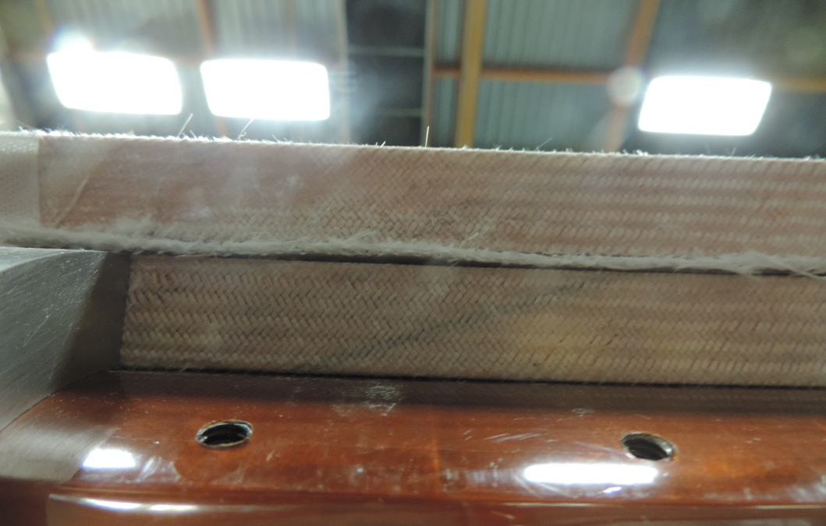
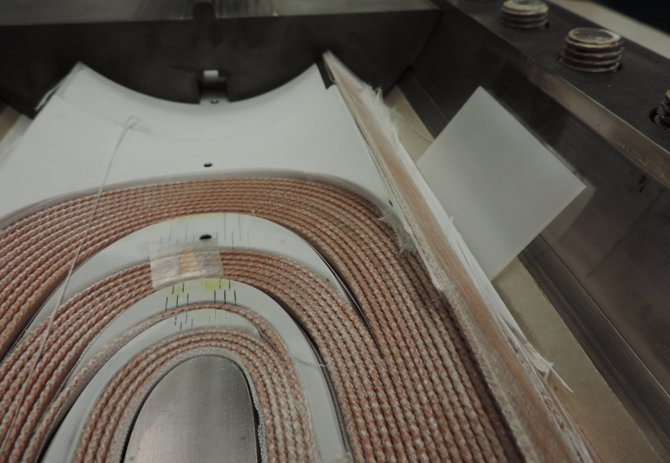
QXFA101-QXFA102-QXFA104
Not Enough Binder
Low DRs
Irregularity? Yes
Fixed? Yes (with Reaction)
DRs Description
During coil preparation for reaction for 101, 102, and 104 was noticed a detachment of the inner layer last turn from the coil and a gap between IL and OL along the midplane.
Dispositions Taken
Leave the coil as it is and have the gap closed by the reaction process. Put the lead back and support it with sector pushers.
Origin
We are trying to optimize the binder quantity to have a good adhesion between turns and avoid binder excess.
These 3 DRs were caused by this optimization process.

Slide 10
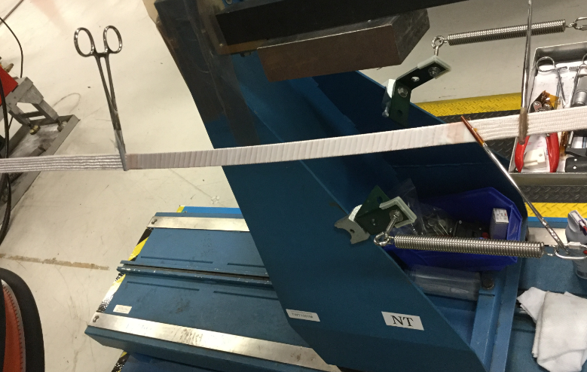
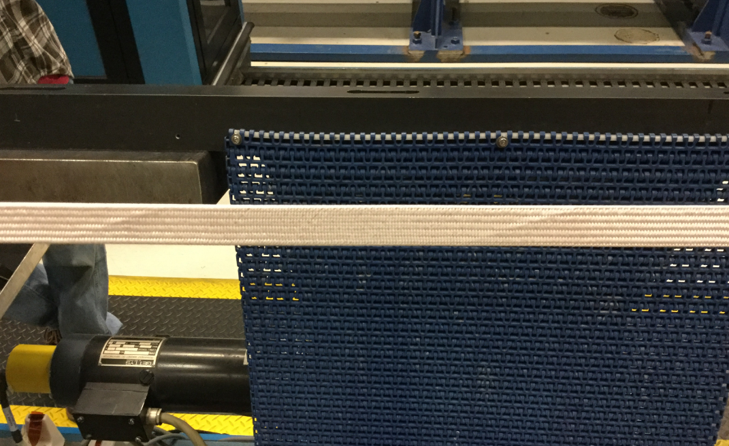
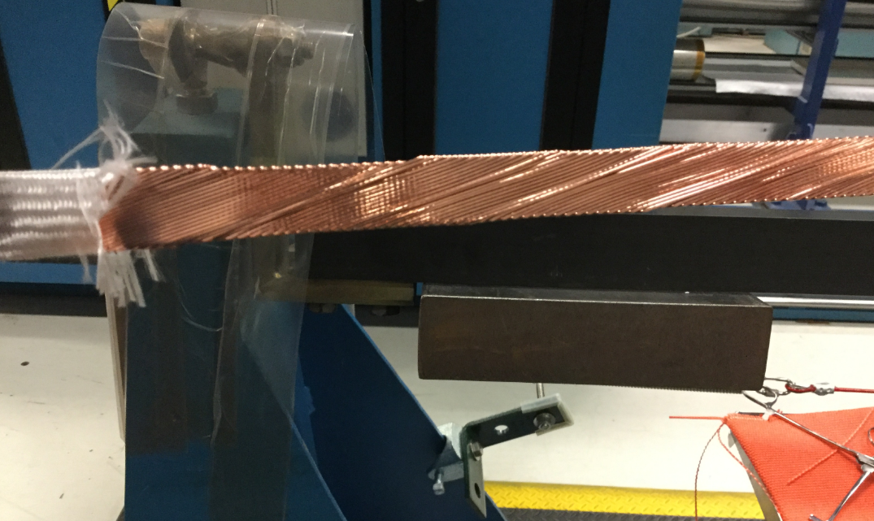
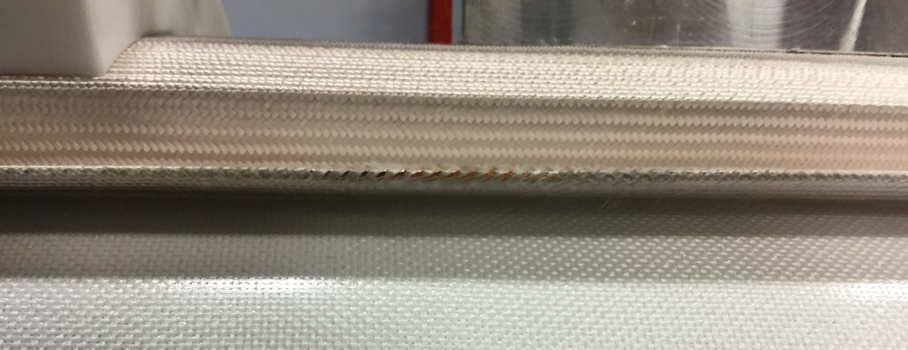
Cable S2 Glass Cut and Fixed with E Glass
Several Low DRs were caused by cable imperfections (popped strands and bare cable exposed). The solution is: cut, fix, and cover with E Glass.
 | QXFA101 | QXFA102 | QXFA104 | QXFA105 | QXFA106
Popped Strand | 0 | 3 | 1 | 0 | 2
Cable Exposed | 0 | 2 | 0 | 1 | 1

Slide 11
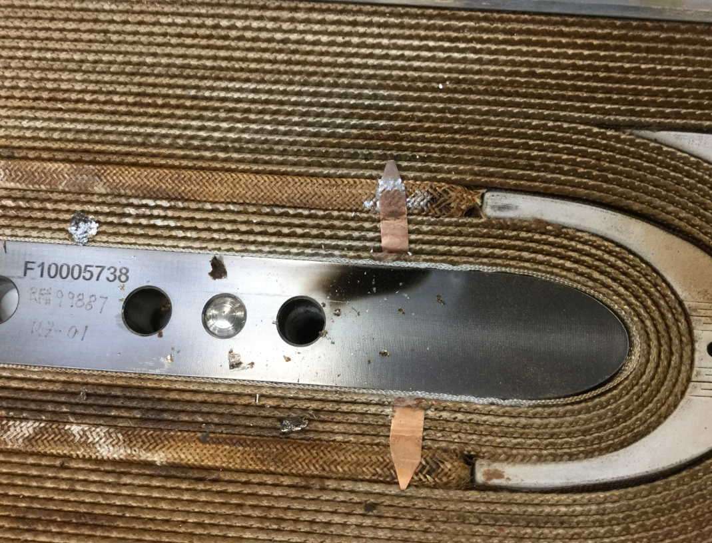
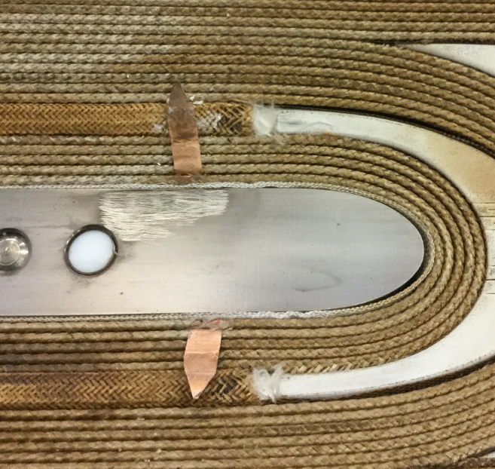
QXFA101: Black Spot After Reaction
Low DR (#11143)
Irregularities? Yes
Fixed? Yes
DR Description
After the mica was removed from the inner layer of the coil, there was a dark, charred spot on the pole piece at the RE of the coil on the non transition side.
Dispositions Taken
Clean the spot.
Hope for a better future
The outlet pipe system of the coil argon line was checked and a lot of black carbonized build up was found inside. This black build up was probably caused by years of binder, cable sizing, and cable lubricant slowly deposited by the argon flow. The clogged pipes probably caused the black spots that we saw on several coils’ poles. New pipes have been installed.

Slide 12
Modification to the Temperature Cycles
Several DRs (considered Low because they did not have a tangible effect on coils) regarded the Reaction and Impregnation cycles temperature readings.
 | QXFA101 | QXFA104 | QXFA106
Reaction | - | 74 h at 660C | 55 h at 661C
Impregnation | Repeated Post Curing Cycle | - | Repeated Heat Cycle

Slide 13
Appendix – High Risk DR

Slide 14
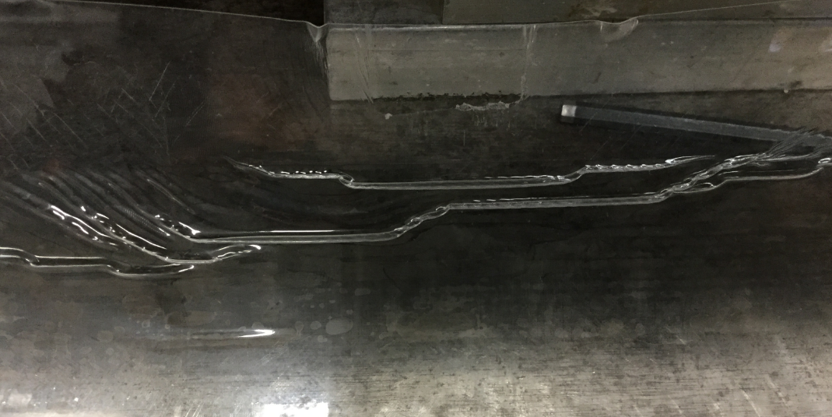
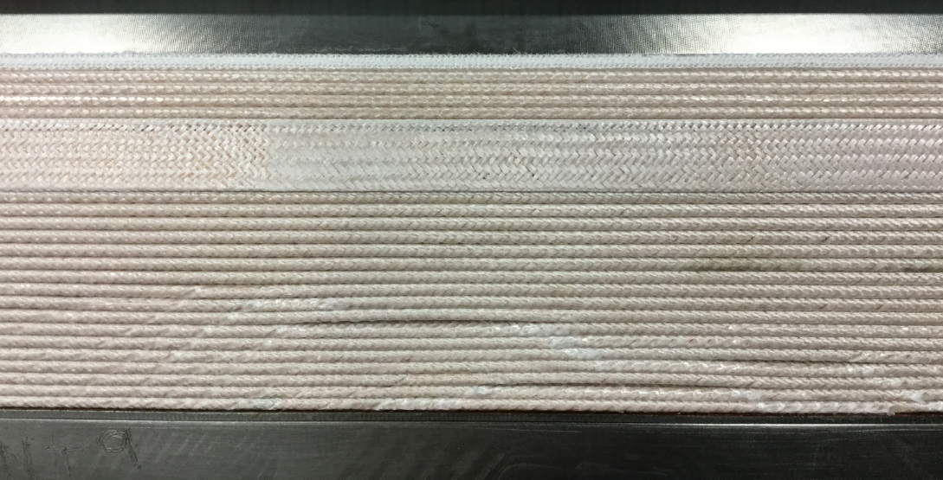
QXFA103: Winding (2 Irr – 3 Low – 1 High)
Appendix – High Risk DR
High DR (#11034)
Damages? Yes
Coil compromise
Fixed? No
DR Description
After removal of the Mylar it was noticed that the Mylar had bunched up in some areas where Kapton tape was used to secure the Mylar to the radial sector pushers. The areas that were bunched up were pushed into the area between cable turns causing an uneven surface and spacing between turns.
Dispositions Taken
Remove the 10 mil Mylar, cure the L1 coil again (hopefully will have some recovery).
Final Decision
The recovery was partial. The strands can be damaged. Fabrication terminated.

