Slide 1
MQXFAP2 Coils Readiness Review Final Electrical Measurements Before Shipping to LBNL
Carlo Santini
U.S. HL-LHC Accelerator Upgrade Project
MQXFAP2 Conductor & Coils Readiness Review
December 7, 2017

Slide 2
Final Electrical checks

Slide 3
Final Hipot and Impulse Tests
*RE Outer Layer Endshoe (R=10 MΩ)

Slide 4
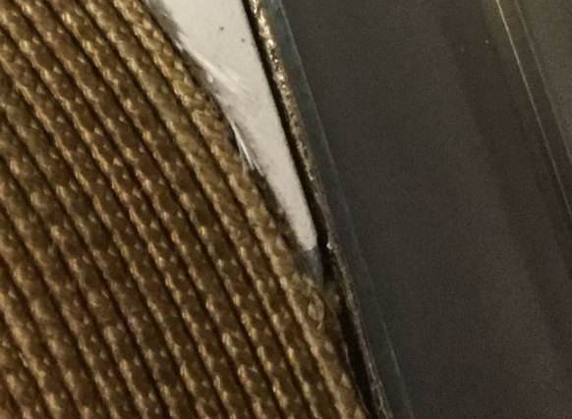
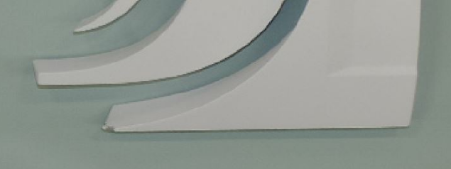
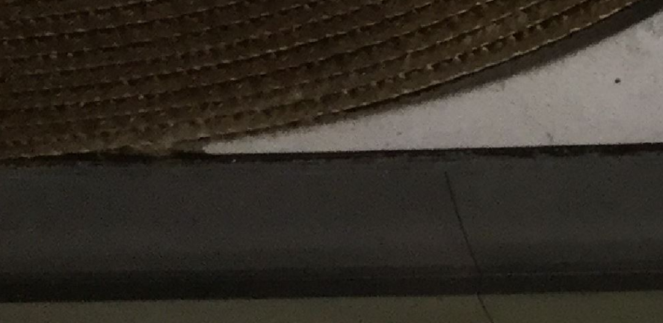
QXFA101 Coil to OL Endshoe Hipot Failure – Hypotesis
Measurements taken after failed Hipot showed a R=10 MΩ
The cause can be the sharp edge of the saddle with chipped off plasma coating.
The SS edge could have cut the S2 glass insulation and the slightly conductive binder on the cable’s S2 glass could have caused the 10 MΩ R.

Slide 5
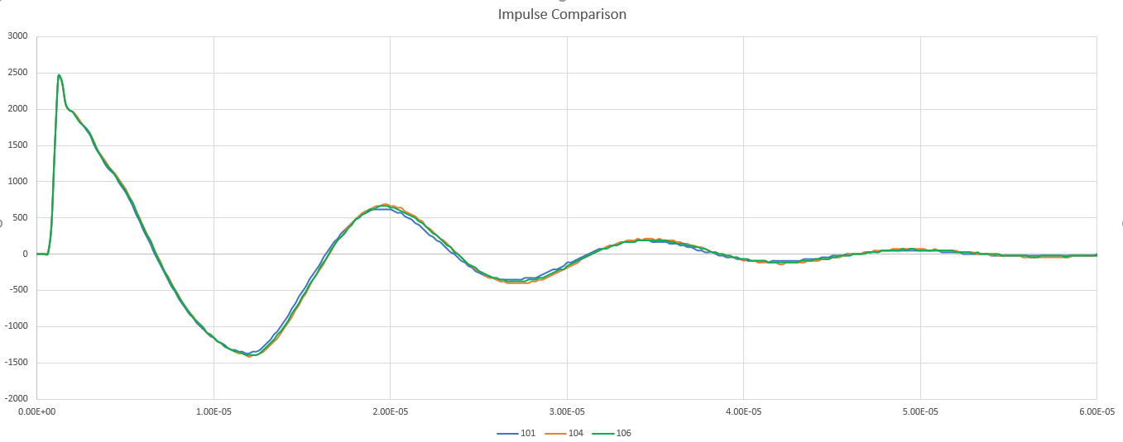
Impulse Tests 101-104-106

