Slide 1
MQXFAP2 Coil Review
Coils QXFA102 & QXFA105
React & Impreg at BNL
J. Schmalzle
December 7, 2017

Slide 2
Outline
Notes / photos
Reaction plots
Electrical Data
CMM
DRs

Slide 3
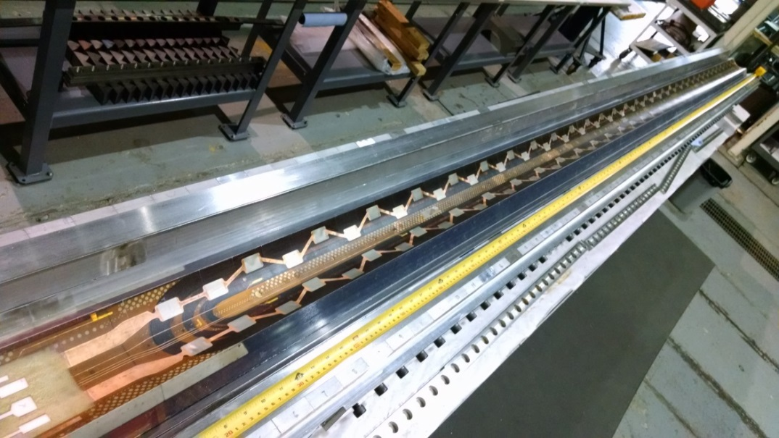
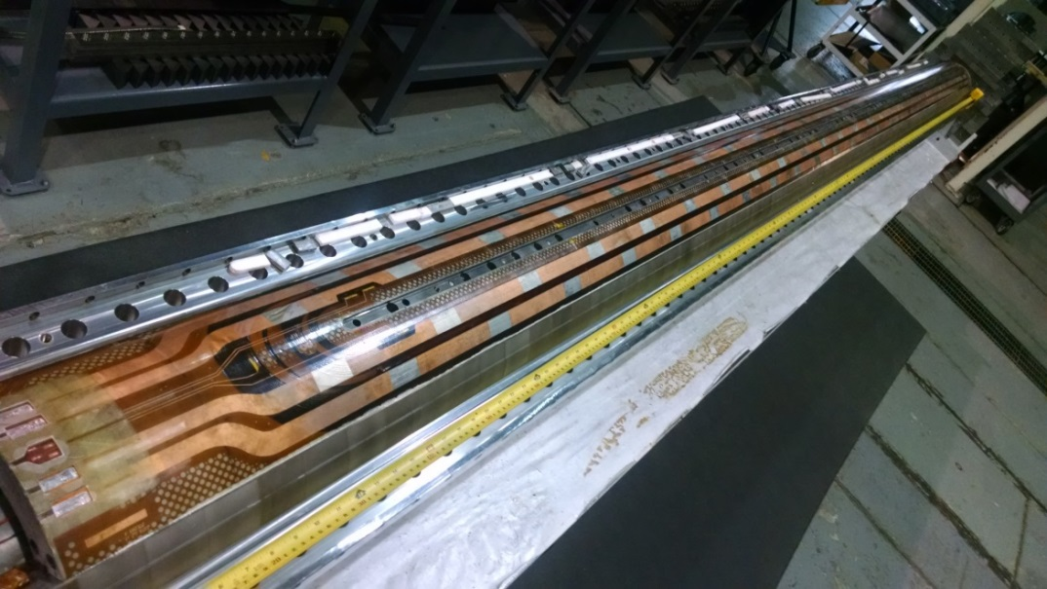
QXFA102
2nd generation coil
  Reaction:
    3 layers Hexcel 4522 glass cloth on coil OD
  Impregnation:
    2 layer Hexcel 4522 glass cloth on coil OD
    1 layer Hexcel 4522 glass cloth on coil ID
    10 mil G11 shims on midplane

Slide 4
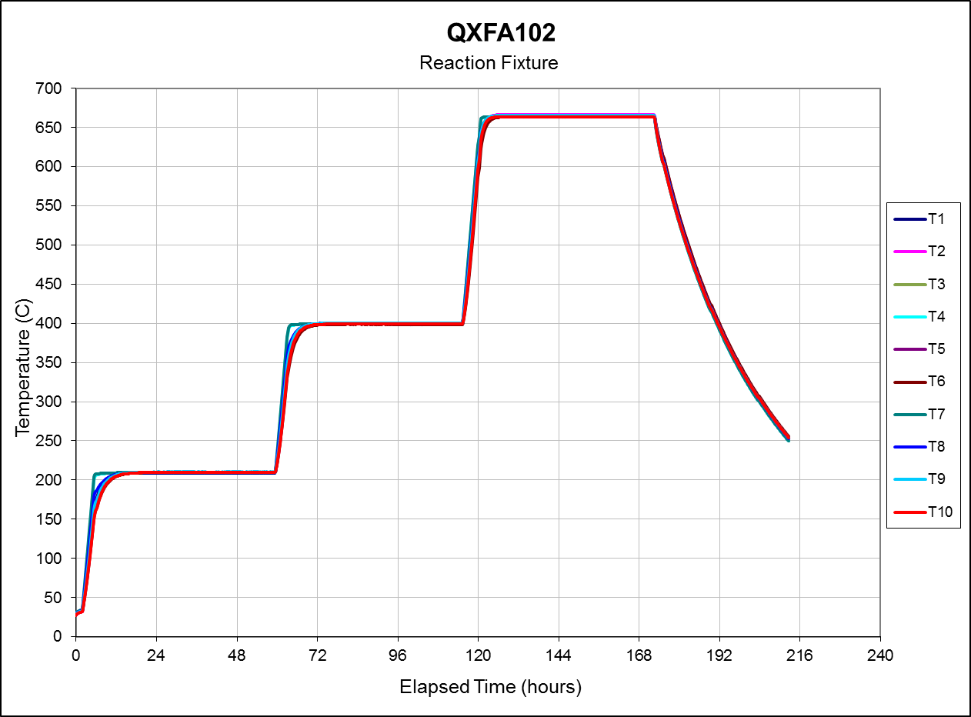
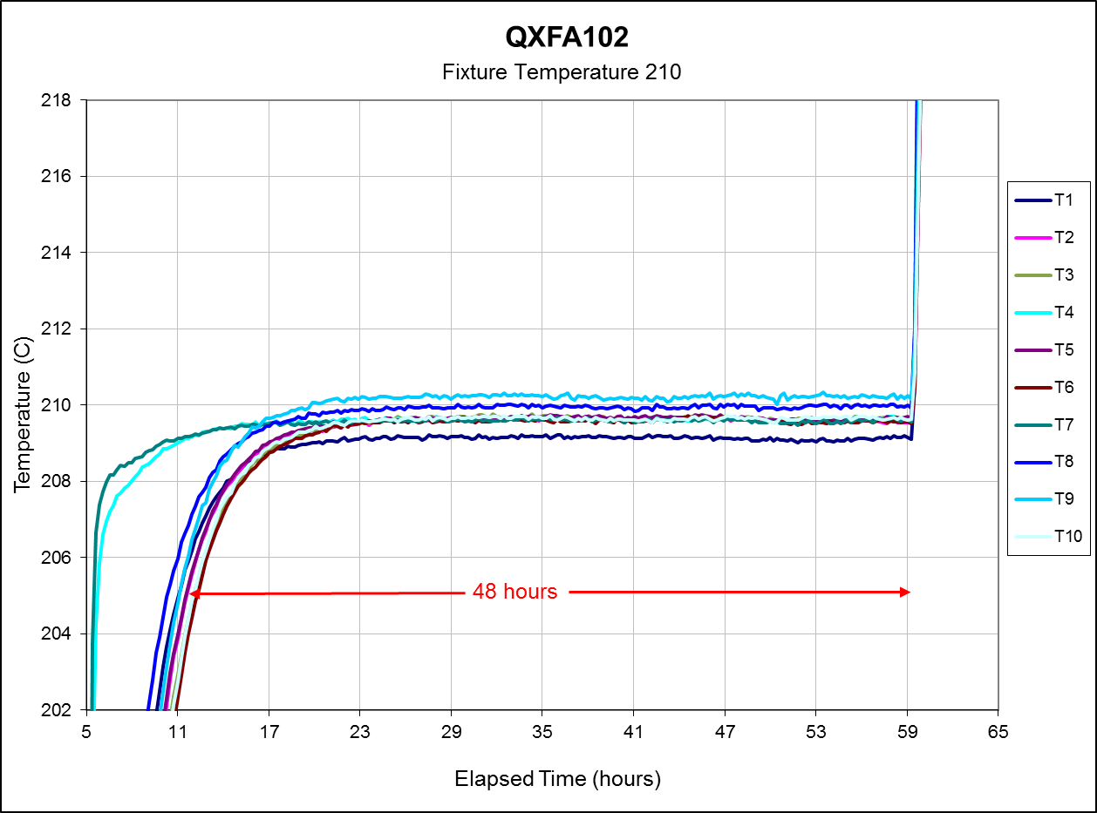
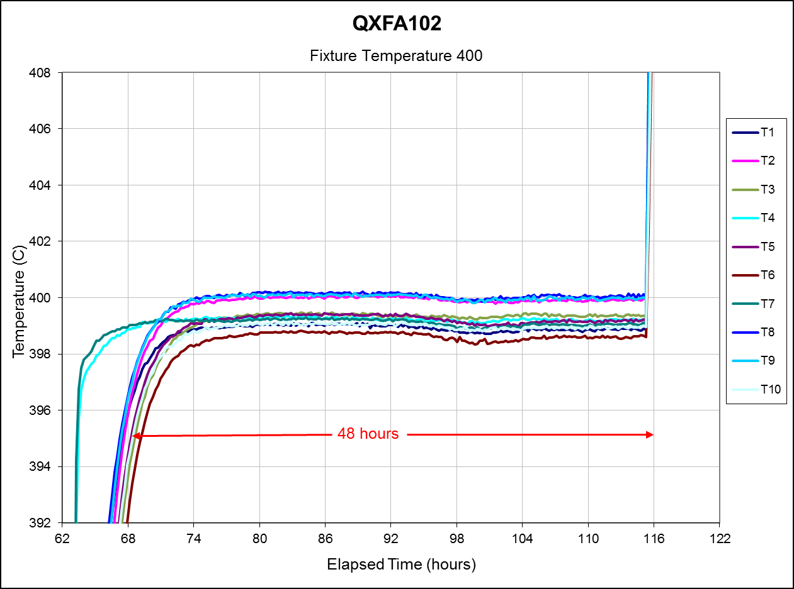
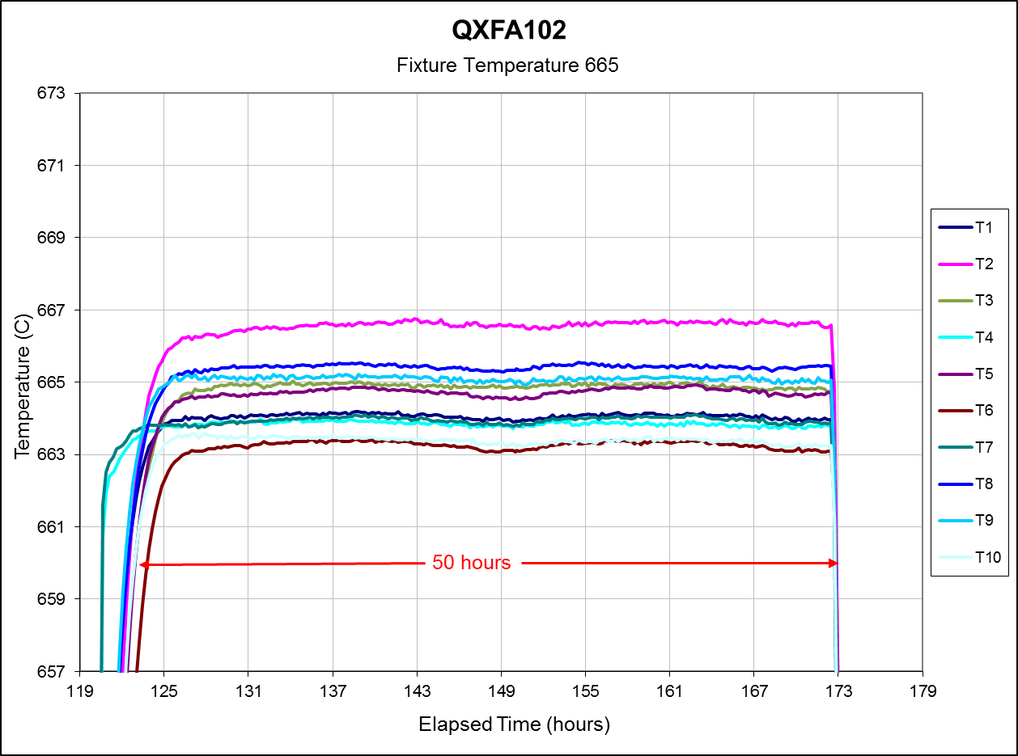
QXFA102
Reaction Cycle:
48 Hours at 210 C
48 hours at 400 C
50 hours at 665 C
Witness samples in separate canister.

Slide 5
QXFA102

Slide 6
QXFA102

Slide 7
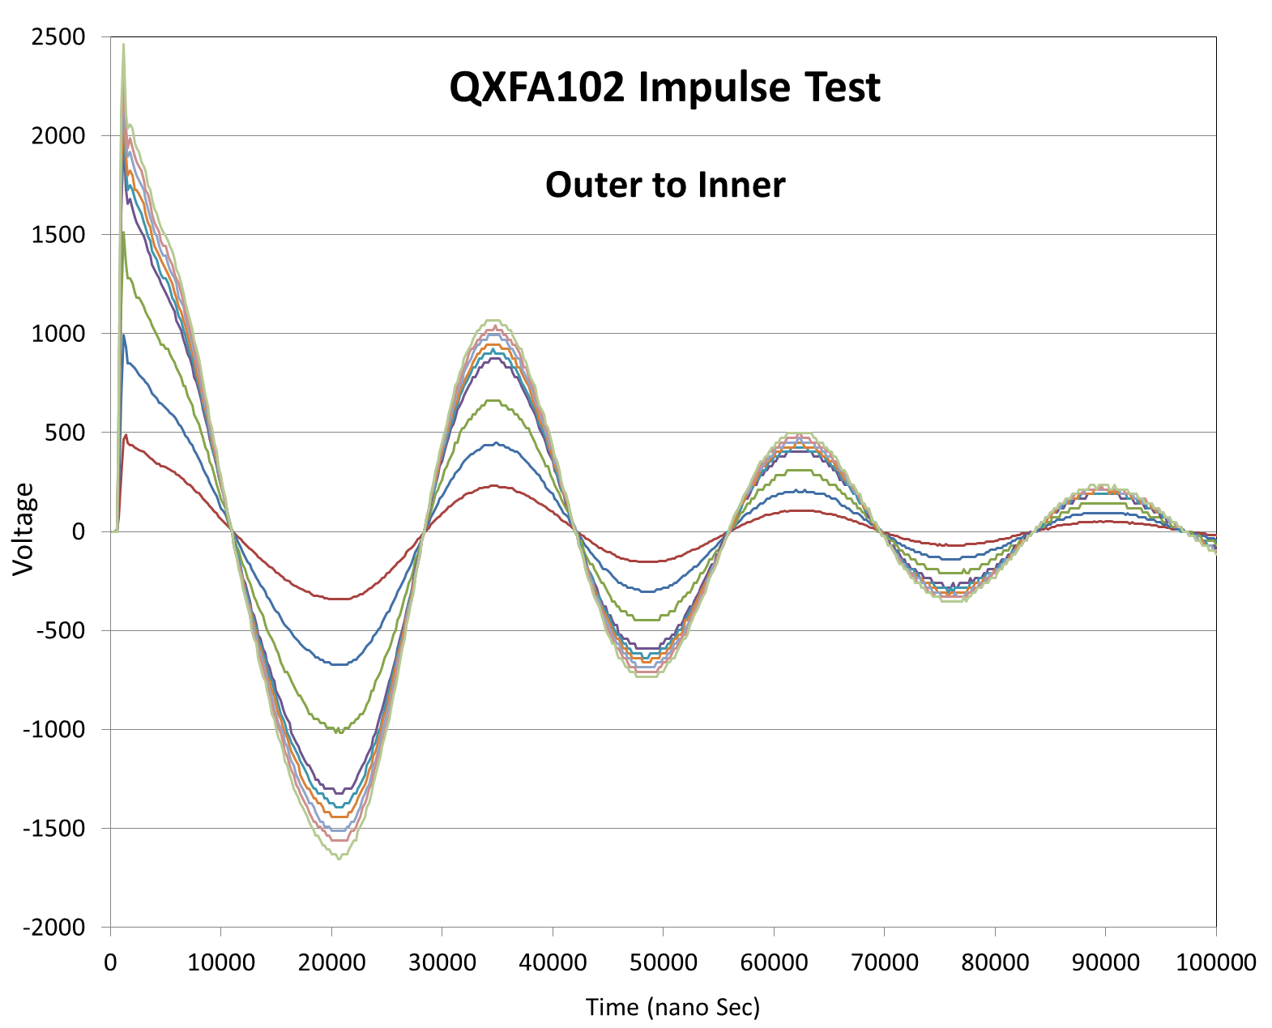
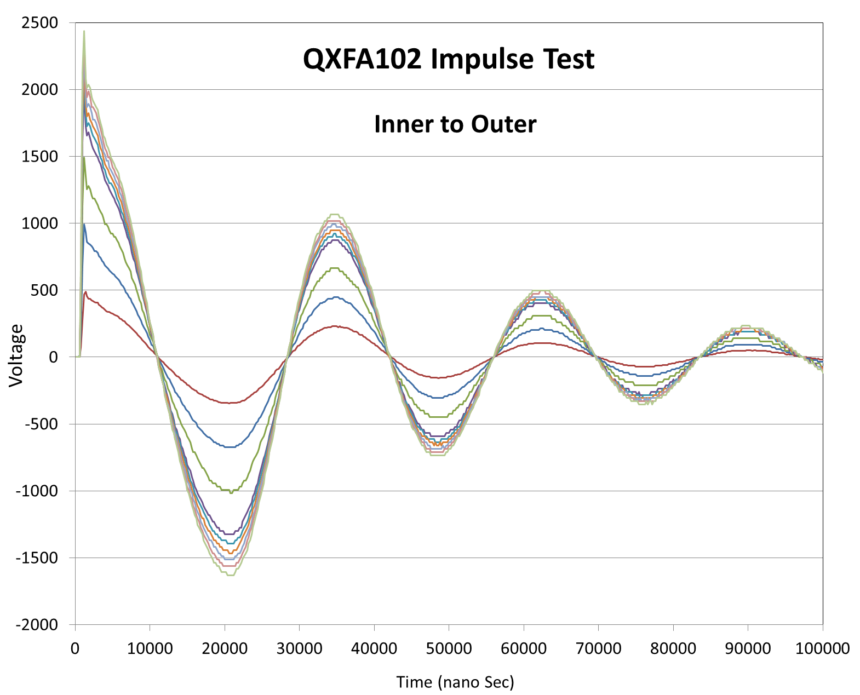
QXFA102

Slide 8
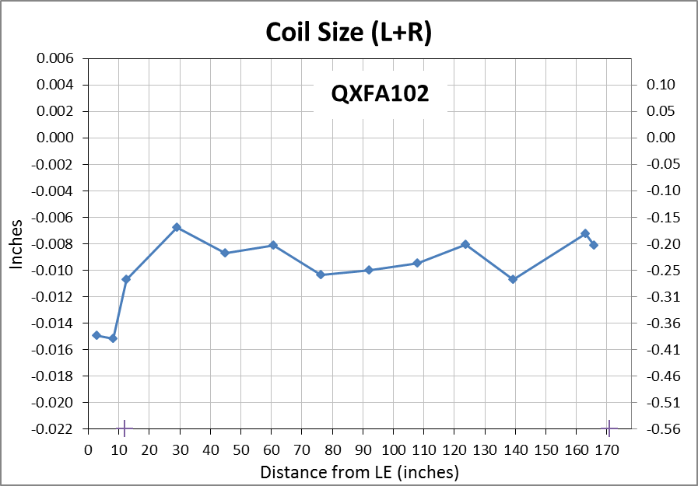
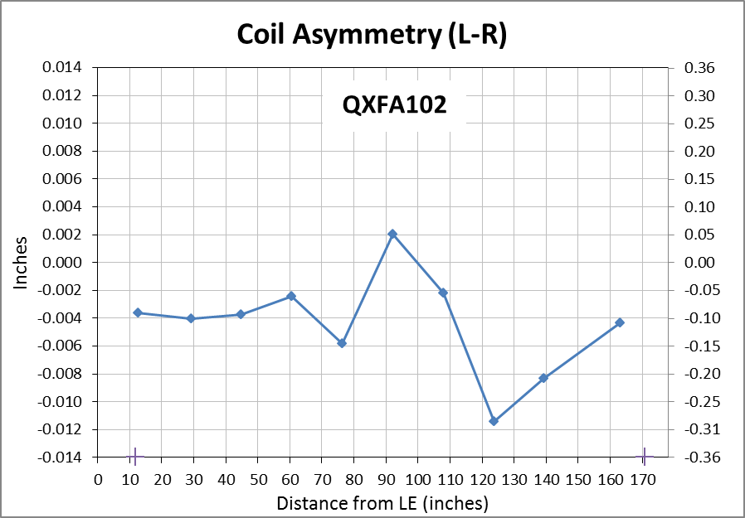
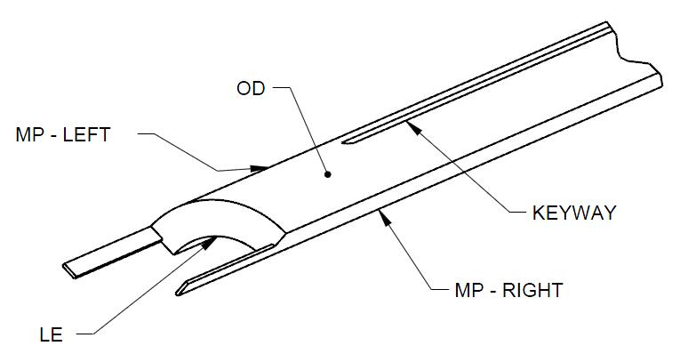
QXFA102
Faro arm coil size measurements:
  Primary best fit to coil OD, secondary to keyway (midplane where no keyway).
Nominal Coil Dimensions:
Outer Radius = 113.376 mm
Midplane offset = .125 mm
Keyway Width = 14.00 mm

Slide 9
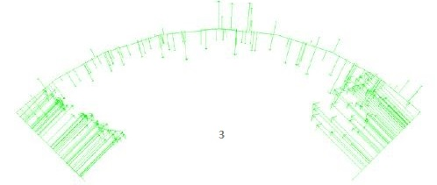
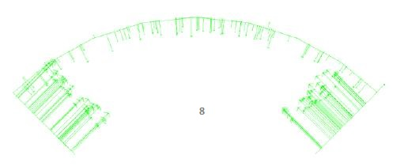
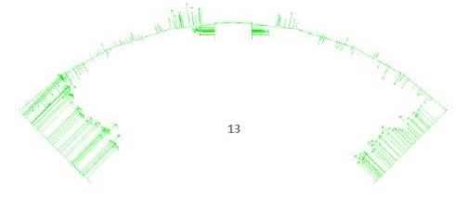
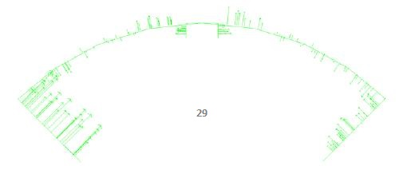
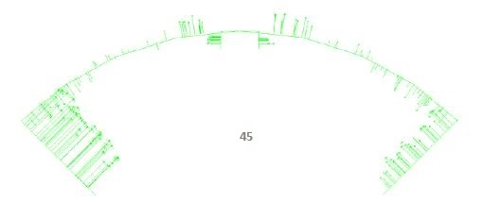
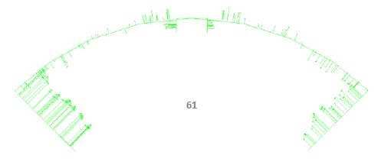
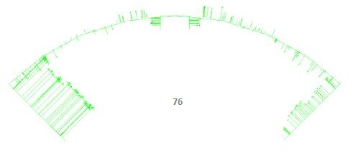
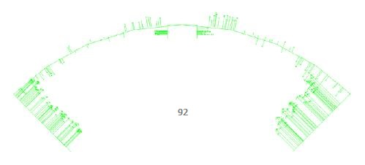
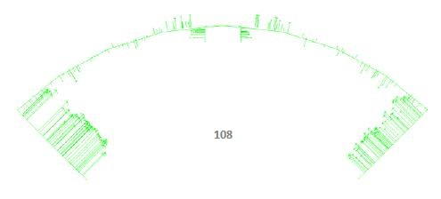
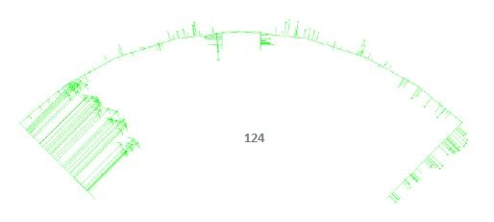
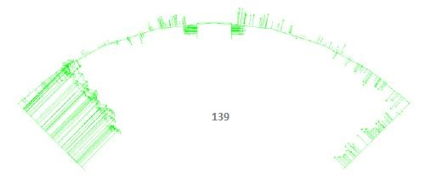
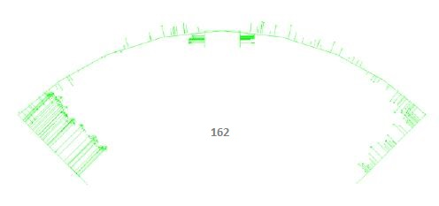
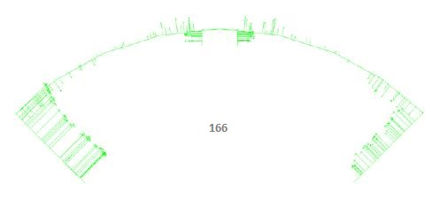
QXFA102

Slide 10
QXFA102
No DRs noted.

Slide 11
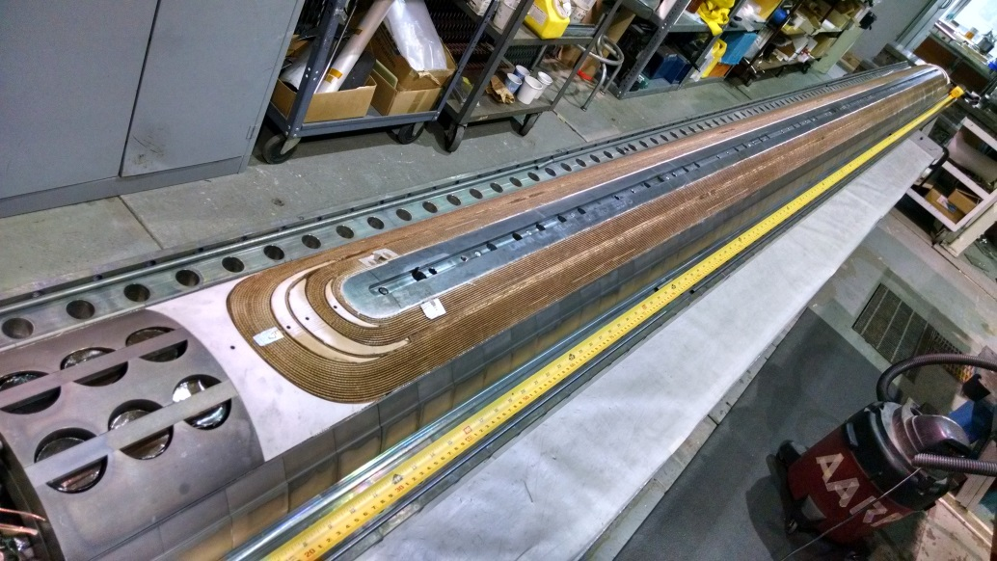
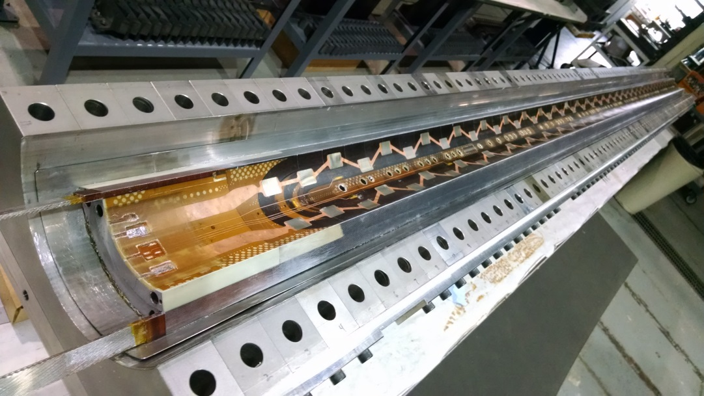
QXFA105
2nd generation coil
  Reaction:
    3 layers Hexcel 4522 glass cloth on coil OD
  Impregnation:
    2 layer Hexcel 4522 glass cloth on coil OD
    1 layer Hexcel 4522 glass cloth on coil ID
    10 mil G11 shims on midplane
CERN approved wires.
  AXON HH2619 / HH1819
Shorter pole pins to accommodate tube support bumpers (pions).

Slide 12
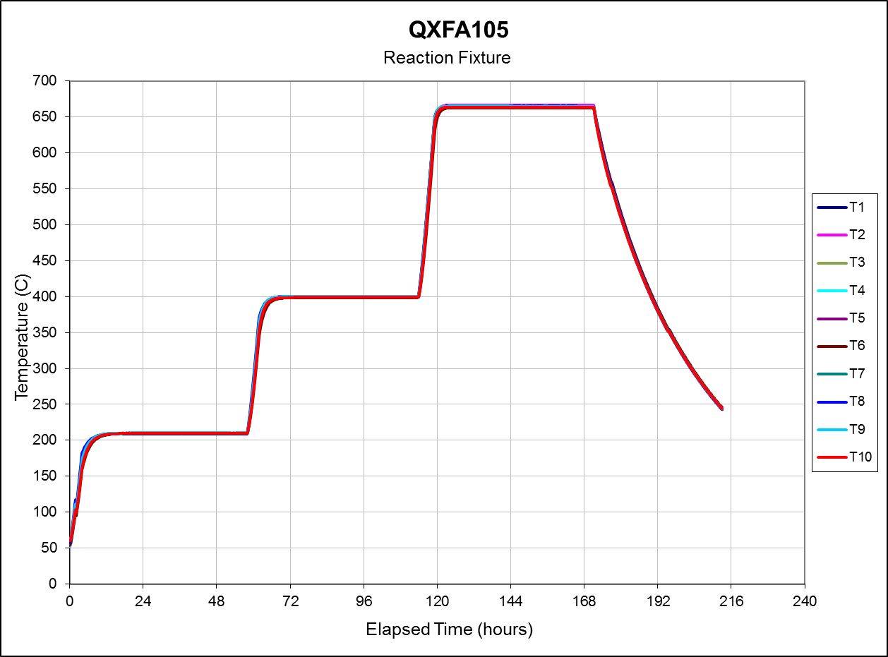
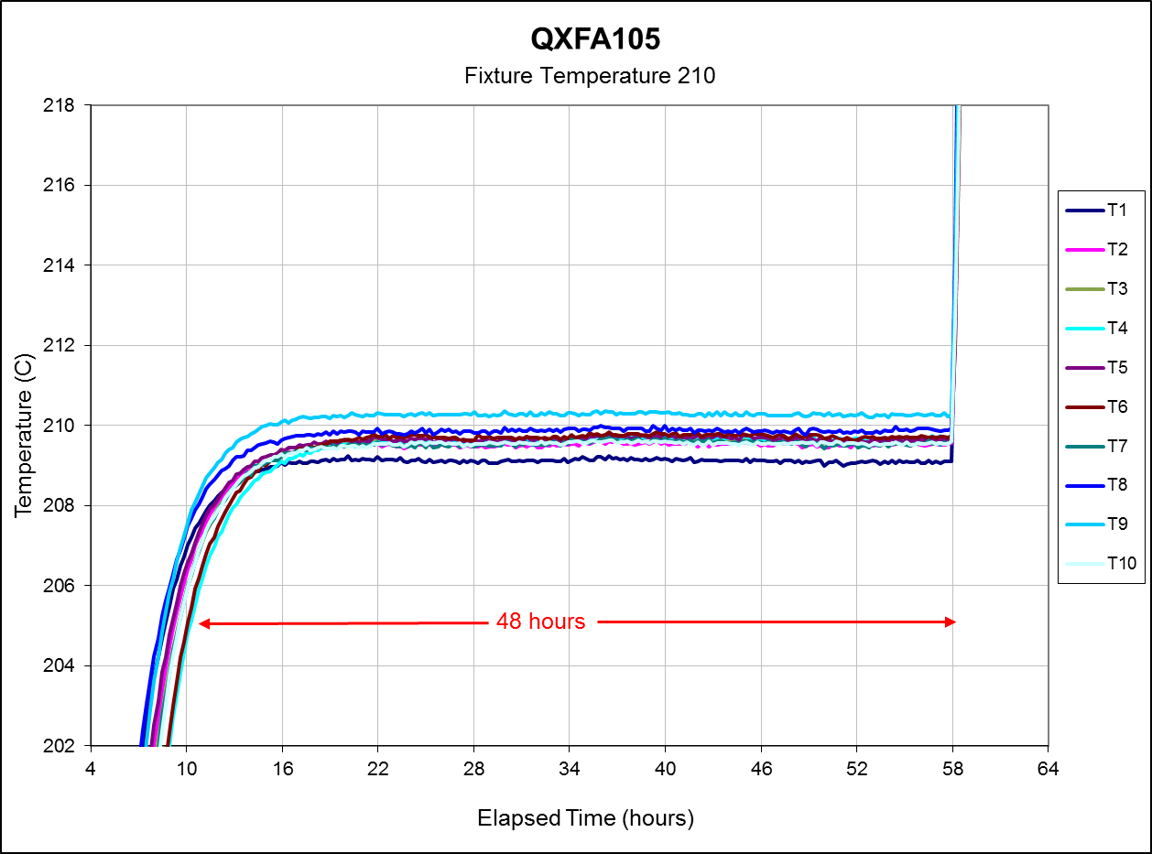
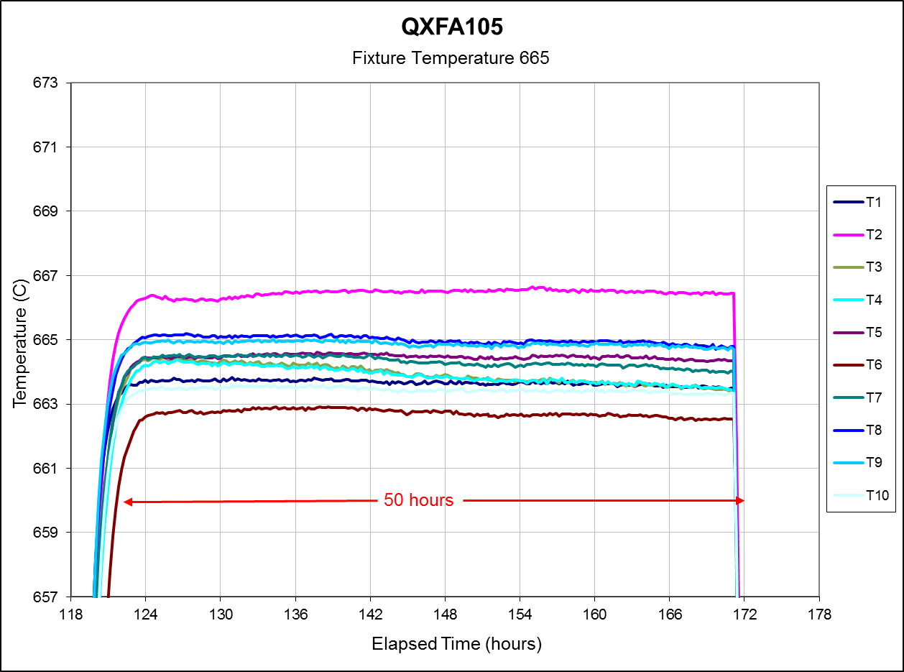
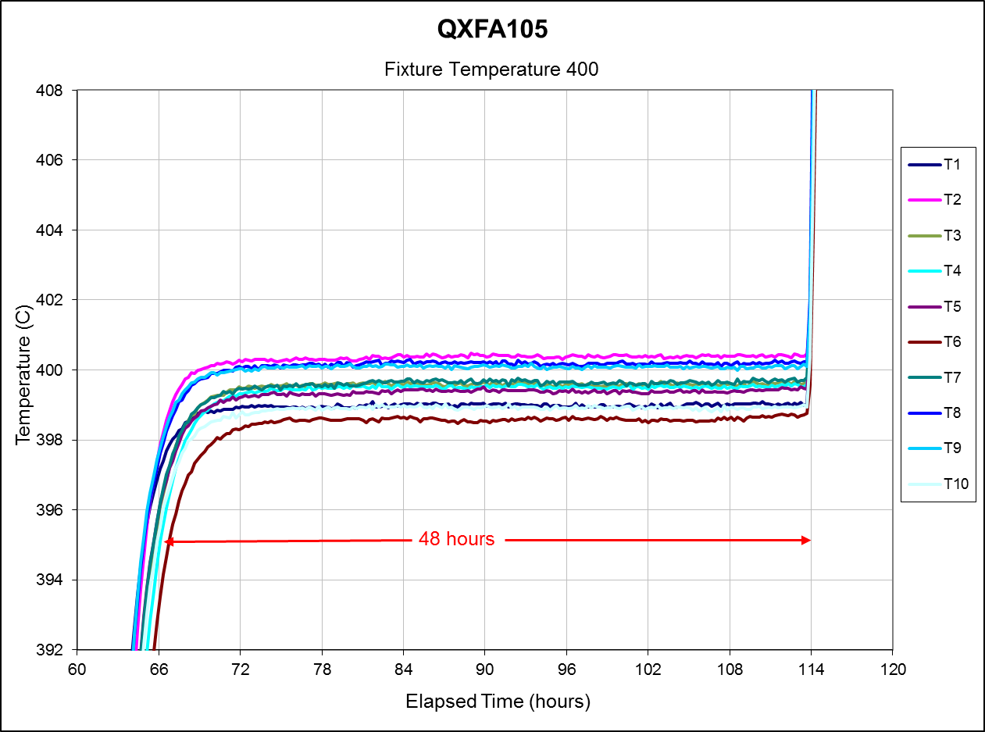
QXFA105
Reaction Cycle:
48 Hours at 210 C
48 hours at 400 C
50 hours at 665 C
Witness samples inside reaction fixture.

Slide 13
QXFA105

Slide 14
QXFA105

Slide 15
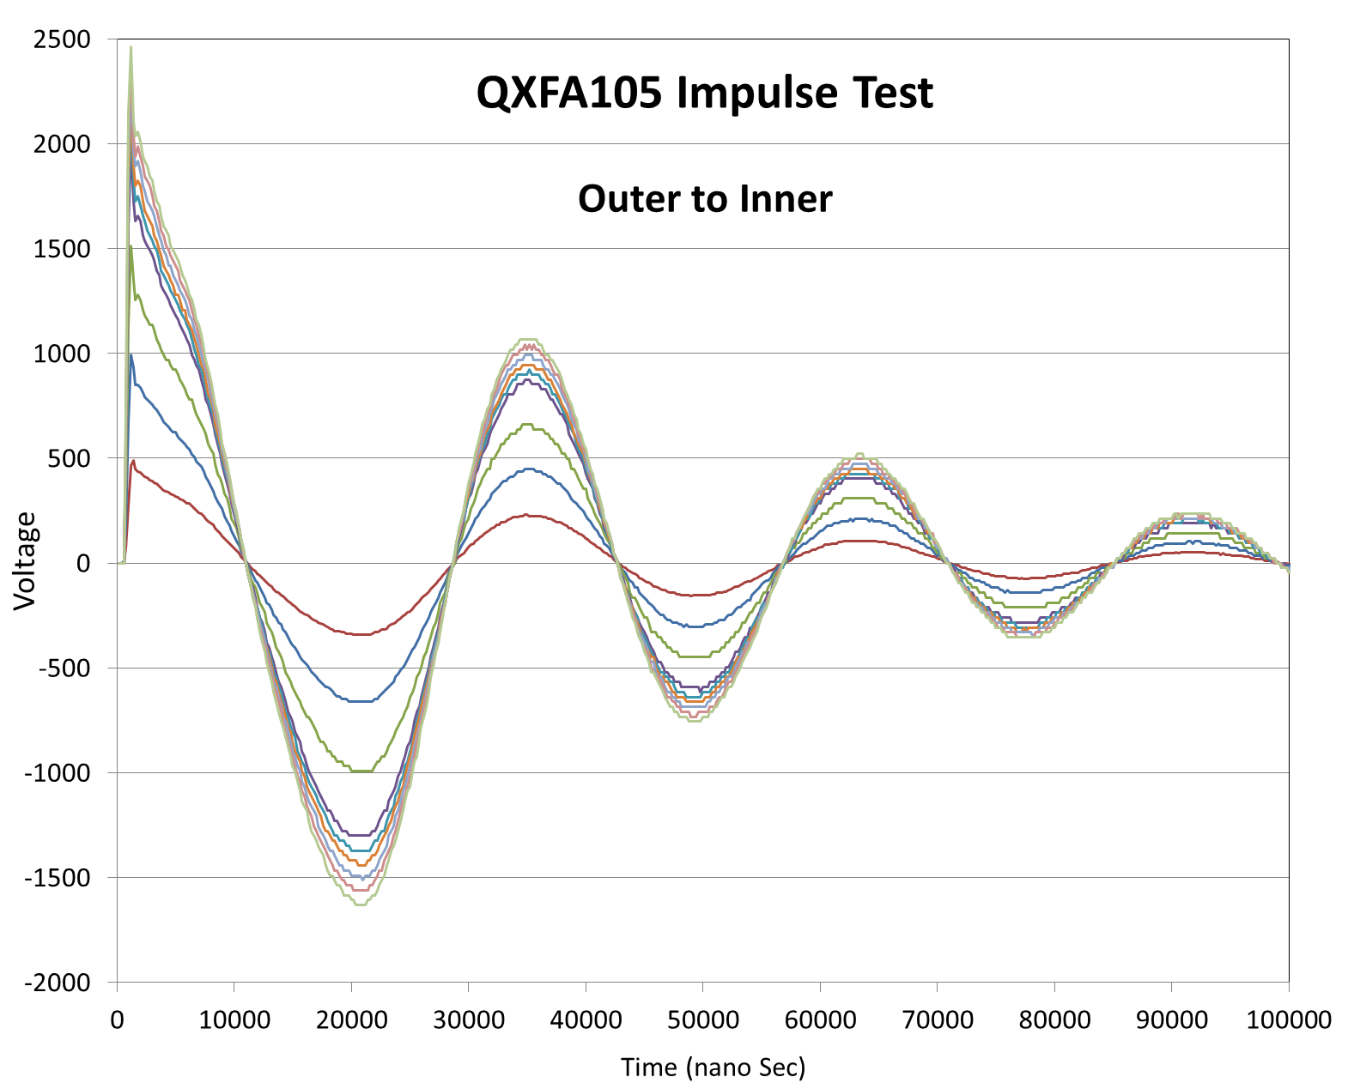
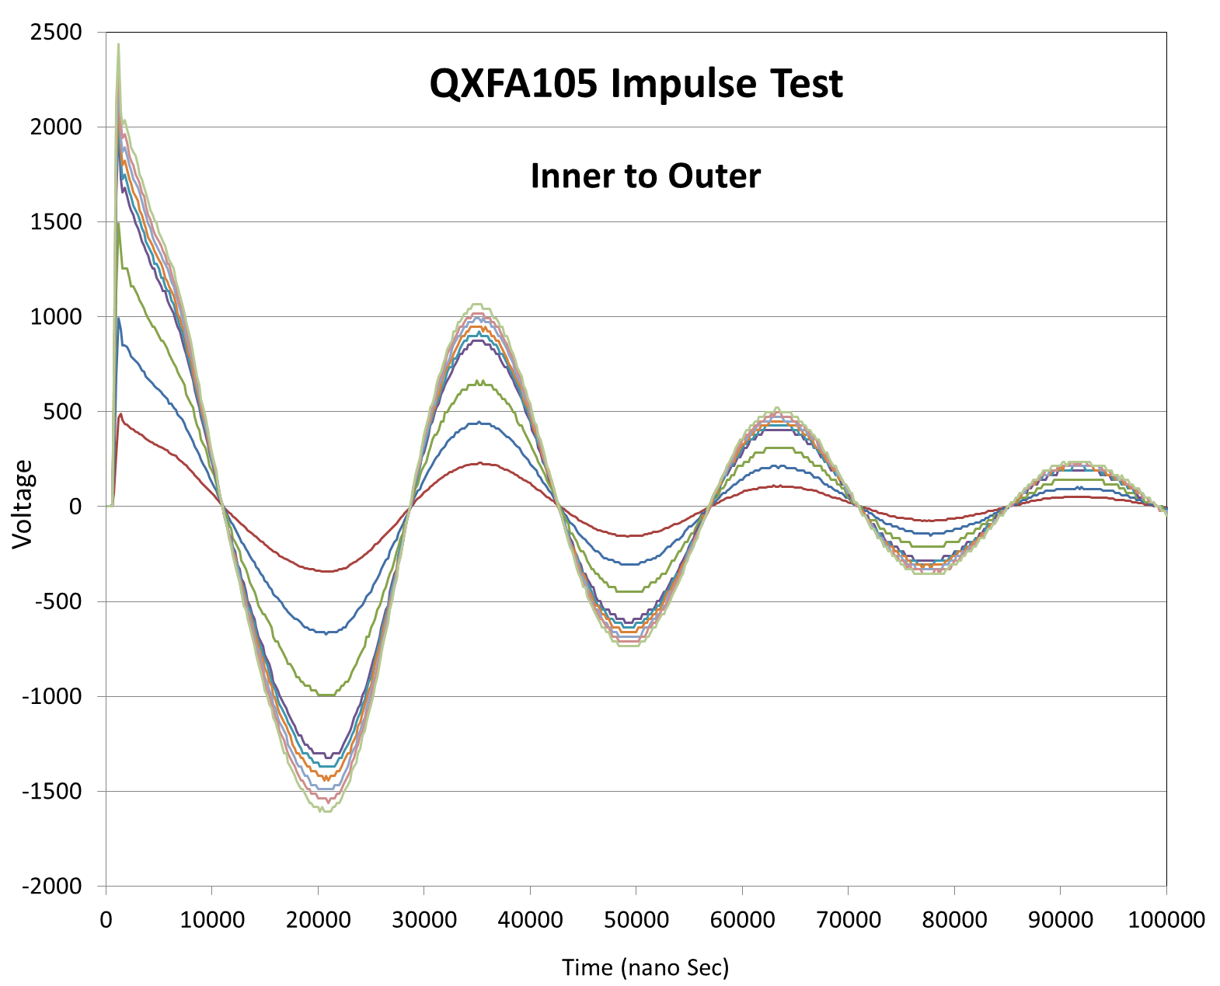
QXFA105

Slide 16
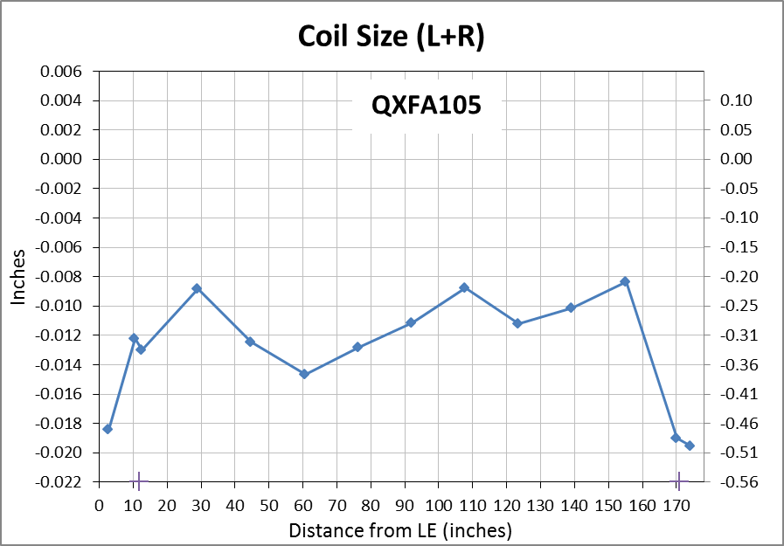
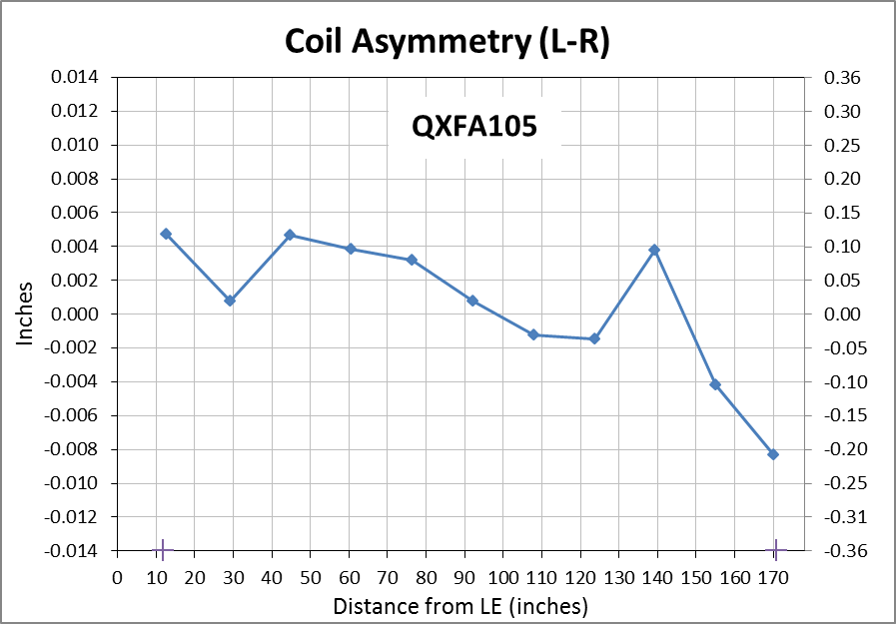
QXFA105
Faro arm coil size measurements:
  Primary best fit to coil OD, secondary to keyway (midplane where no keyway).
Nominal Coil Dimensions:
Outer Radius = 113.376 mm
Midplane offset = .125 mm
Keyway Width = 14.00 mm

Slide 17
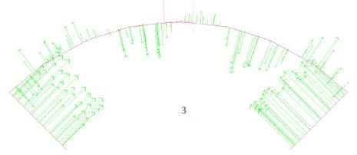
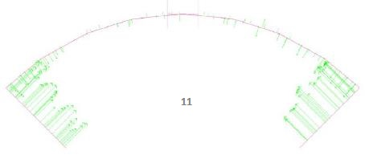
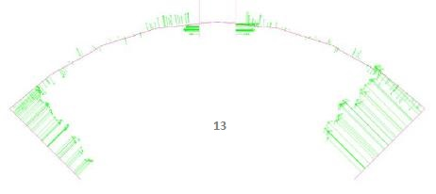
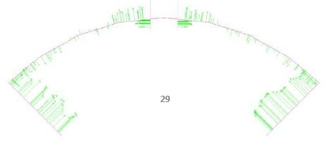
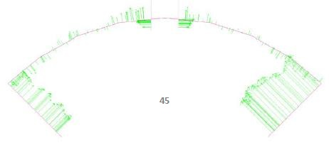
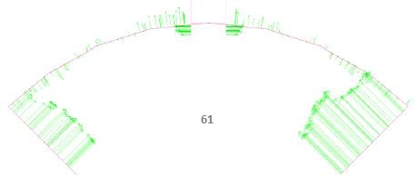
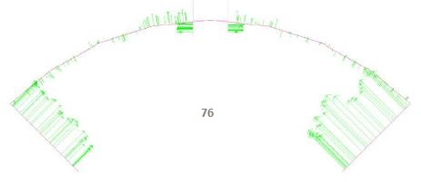
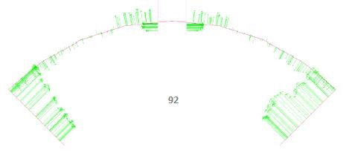
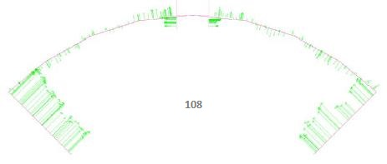
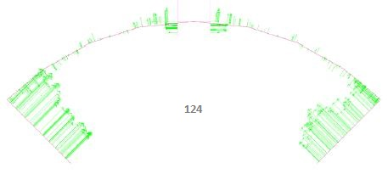
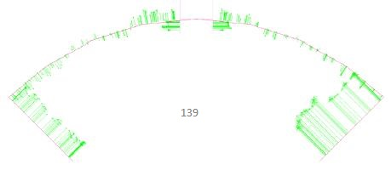
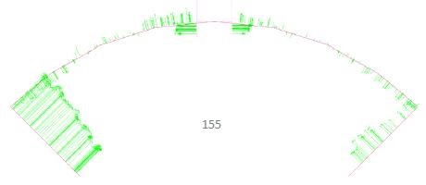
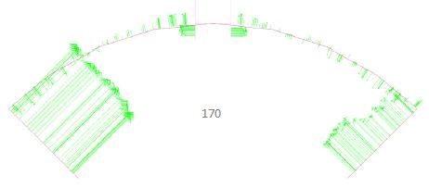
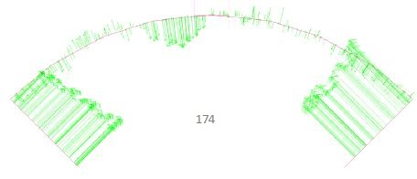
QXFA105

Slide 18
QXFA105
DRs:
  Ceramic coating on edge of OL saddle tip was chipped and insulation on IL coil lead was chafed in a small area by OL saddle tip.
    Fluffy coil and loose saddle likely created a pressure point that rubbed during shipping.
    No damage to conductor.
    Loose chips of ceramic were removed.
    Double layer of 2 mil kapton added to cover insulation damage area.

Slide 19
Extra slides…

Slide 20
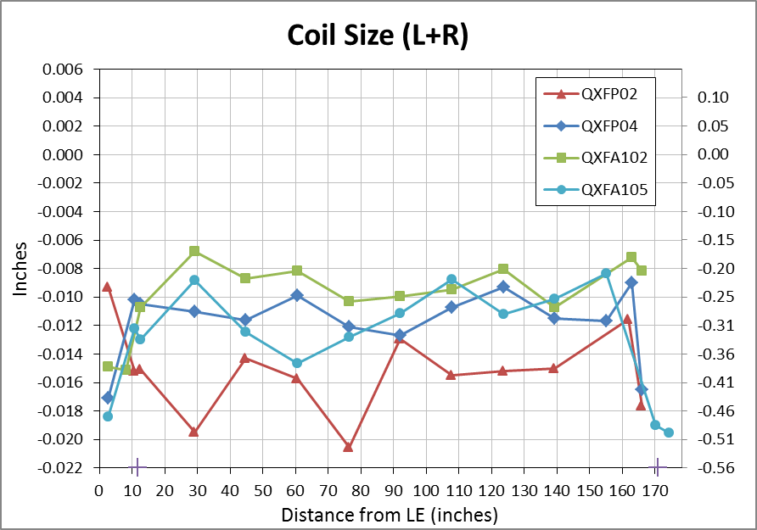
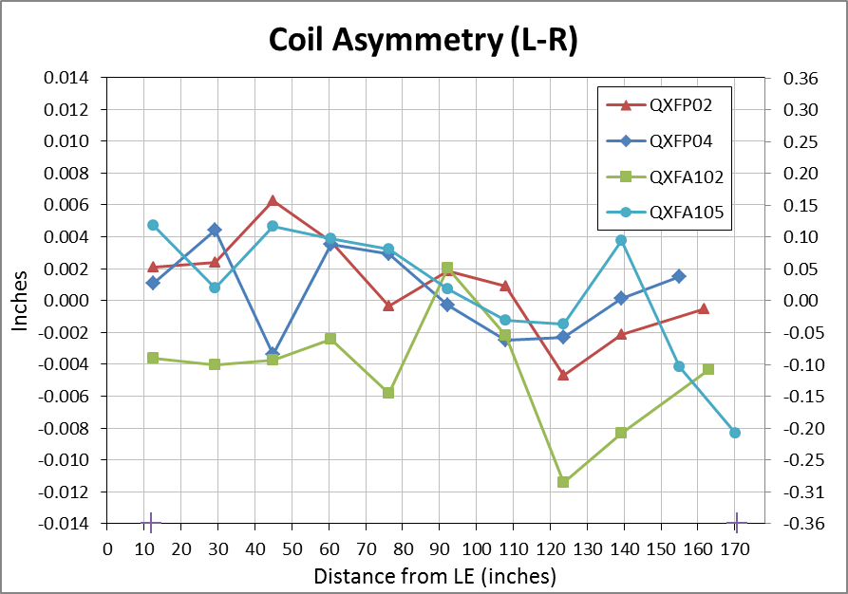
QXF Coils
Coil size comparison:

