Slide 1
MQXFAP2 coil measurements at SG locations LBNL
Heng Pan, Dan Cheng
12/07/2017

Slide 2
Outline
Cross section Measurements Overview
Post-processing

Slide 3
CMM Measurements
All LBNL data was taken using a Zeiss Accura for CMM
Calypso software post-processed data
All surfaces were “best-fit” to reference geometry with equal weight, Radial and Mid-planes only (no alignment key slot)

Slide 4
Coil Cross Section Measurements
Data was only processed at a subset (SG locations) of all the cross section measurements available (though all profiles were measured):
740 mm
1940 mm
3140 mm
3140 mm
CMM Model Standard:
Inner Radius: 74.75 mm
Outer Radius: 113.376 mm
Midplane offset: 0.125 mm
740 mm
1940 mm

Slide 5
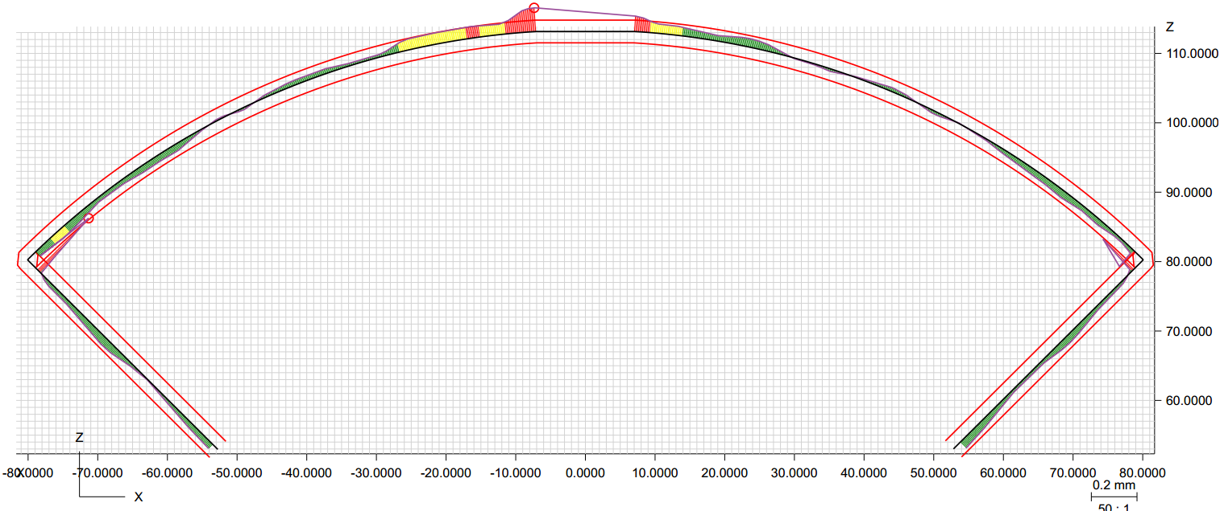
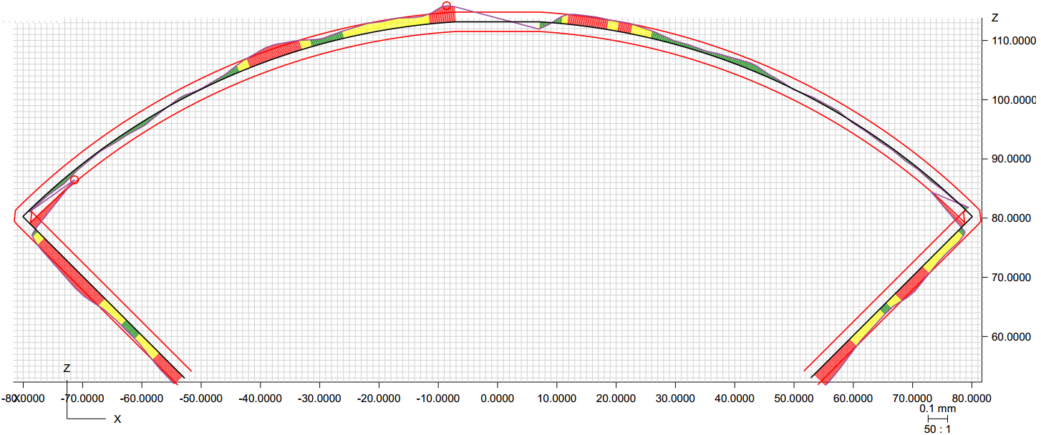
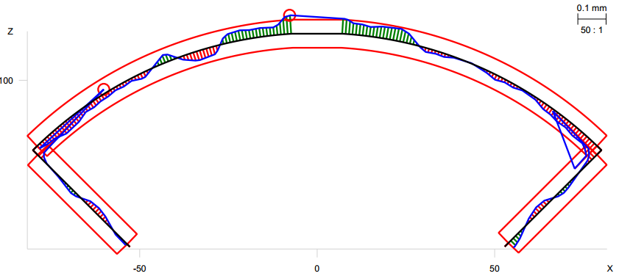
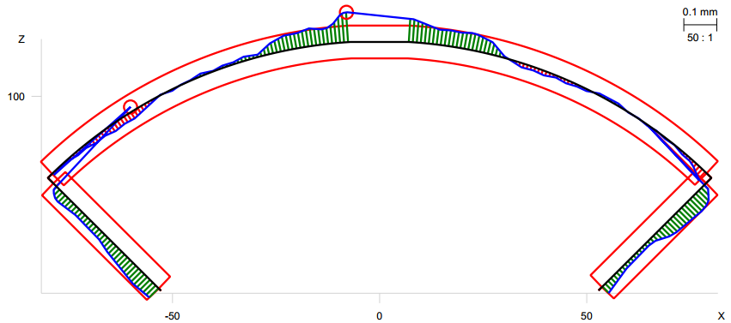
Post-processing at 740 mm from LE
Profile: ± 2 mil
Radial: +0.0005”
Midplane: +0.001”
Radial: +0.001”
Midplane: +0.002”
Coil 101
Coil 102
Radial: -0.0005”
Midplane: -0.0005”
Radial: +0.0005”
Midplane: +0.0015”
Coil 104
Coil 105

Slide 6
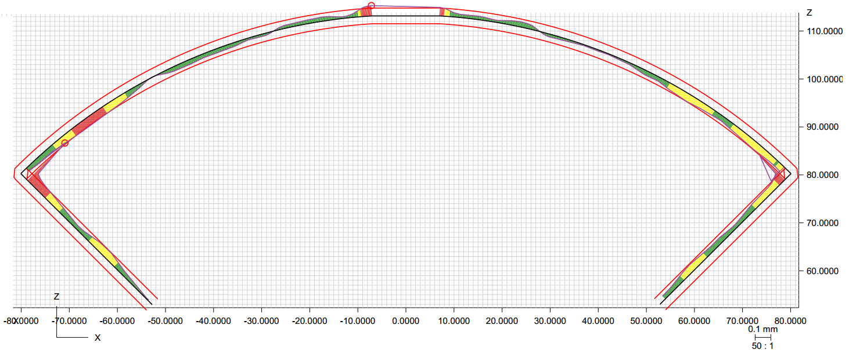
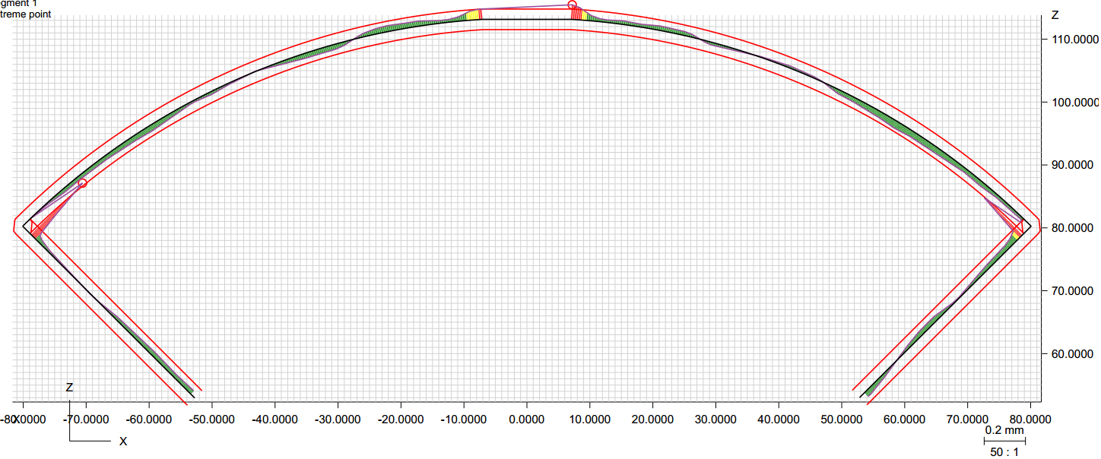
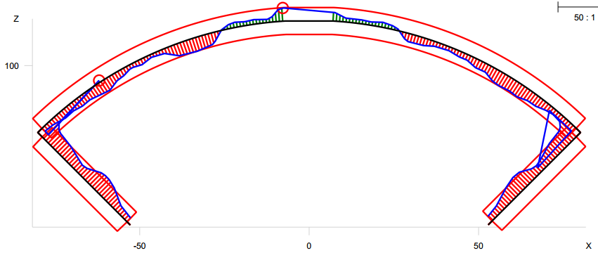
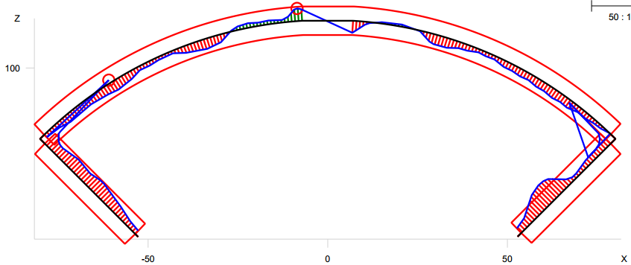
Post-processing at 1940 mm from LE
Profile: ± 2 mil
Radial: -0.0015”
Midplane: -0.0015”
Radial: -0.0005”
Midplane: -0.0005”
Coil 101
Coil 102
Radial: -0.001”
Midplane: -0.0015”
Radial: -0.001”
Midplane: -0.0015”
Coil 104
Coil 105

Slide 7
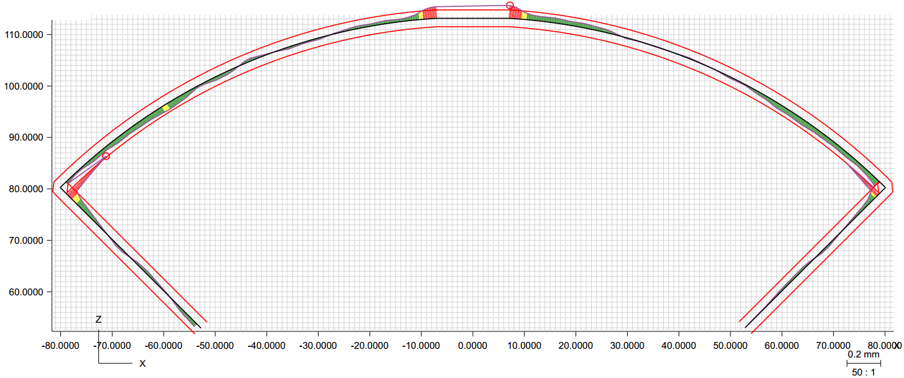
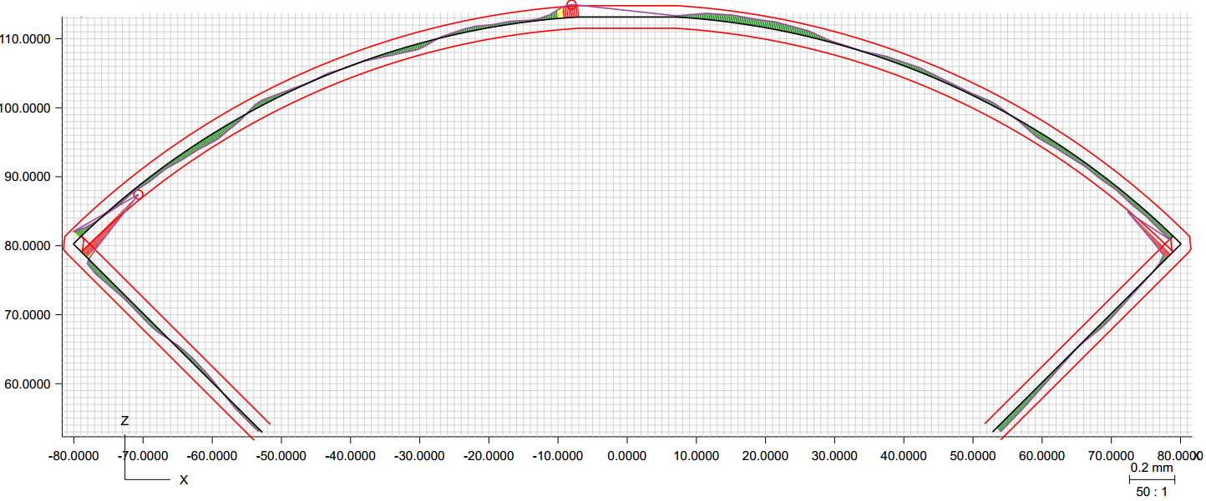
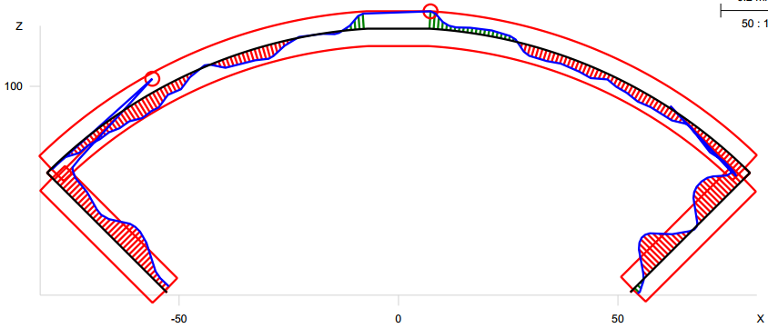
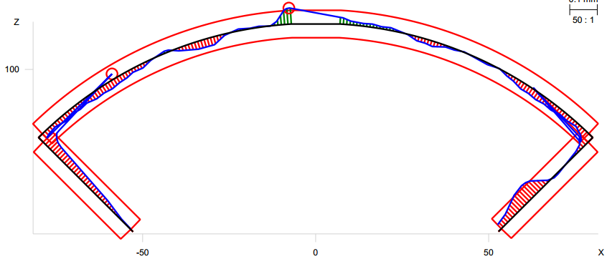
Post-processing at 3140 mm from LE
Profile: ± 2 mil
Radial: -0.0005”
Midplane: 0”
Radial: 0”
Midplane: 0”
Coil 101
Coil 102
Radial: -0.001”
Midplane: -0.002”
Radial: -0.0005”
Midplane: -0.001”
Coil 104
Coil 105

Slide 8
MQXFAP2 Coil CMM Measurements Table
Radial Size deviations (inches)
Loc (mm) | Coil 101 | Coil 102 | Coil 104 | Coil 105
70 | -0.003 | -0.002 | -0.004 | -0.006
207 | -0.002 | -0.002 | -0.002 | -0.0015
320 | 0.0015 | -0.001 | 0.0005 | -0.0005
740 | 0.0005 | 0.001 | -0.0005 | 0.0005
1140 | -0.0005 | -0.0005 | -0.0005 | -0.001
1540 | 0 | 0 | -0.001 | -0.001
1940 | -0.0015 | -0.0005 | -0.001 | -0.001
2340 | -0.001 | -0.0005 | -0.0015 | -0.0015
2740 | -0.0005 | -0.0005 | -0.001 | -0.001
3140 | -0.0005 | 0 | -0.001 | -0.0005
3540 | 0 | 0 | -0.0005 | 0.0005
4110 | -0.0005 | 0.0005 | -0.0005 | 0
4323 | -0.001 | -0.001 | -0.0015 | -0.0015
4426 | -0.0015 | -0.001 | -0.002 | -0.002
Avg 320-4110 | -0.00025 | -0.00015 | -0.0007 | -0.00055
RMS | 0.00082 | 0.00057 | 0.00087 | 0.00085
St. Dev. | 0.00082 | 0.00058 | 0.00054 | 0.00069
Max | 0.0015 | 0.001 | 0.0005 | 0.0005
Min | -0.0015 | -0.001 | -0.0015 | -0.0015
Mid-plane Size Deviations (inches)
Loc (mm) | Coil 101 | Coil 102 | Coil 104 | Coil 105
70 | -0.01 | -0.004 | -0.008 | -0.006
207 | -0.005 | -0.004 | -0.004 | -0.003
320 | 0.0015 | -0.0005 | 0.0005 | -0.0015
740 | 0.001 | 0.002 | -0.0005 | 0.0015
1140 | 0.0003 | 0 | -0.001 | -0.001
1540 | 0.0005 | 0 | -0.0005 | -0.001
1940 | -0.0015 | -0.0005 | -0.0015 | -0.001
2340 | -0.0015 | 0 | -0.0015 | -0.001
2740 | -0.0005 | -0.0005 | -0.001 | -0.001
3140 | 0 | 0 | -0.002 | -0.001
3540 | 0.0005 | 0.0005 | 0 | 0
4110 | 0.0005 | 0.002 | 0 | 0
4323 | -0.0015 | -0.002 | -0.002 | -0.003
4426 | -0.0035 | -0.003 | -0.004 | -0.004
Avg 320-4110 | 0.00008 | 0.0003 | -0.00075 | -0.0006
RMS | 0.00094 | 0.00095 | 0.00106 | 0.00102
St. Dev. | 0.00099 | 0.00095 | 0.00079 | 0.00088
Max | 0.0015 | 0.002 | 0.0005 | 0.0015
Min | -0.0015 | -0.0005 | -0.002 | -0.0015
Averaged deviations from measured profiles between 320 mm and 4110 mm (coil straight section only):
Radial deviations from ~0.0002” to 0.001”
Mid-plane deviations from ~0.0001” to 0.001
RMS values show relatively good consistency compared with MQXFA01

Slide 9
MQXFAP2 Coil CMM Measurements Summary
Based on visual CMM data:
FNAL coils (101, 104) in their straight section are:
Coil 101 is slightly oversized by about 0.0002” (~0.005 mm) on average on mid-plane
Coil 104 is undersized by about -0.001” (0.025 mm) on average on mid-plane
Coil 101 Undersized on OR by about 0.0003” (0.008 mm)
Coil 104 Undersized on OR by about 0.0007” (0.018 mm)
BNL coils (102, 105) in their straight section are:
Coil 102 is slightly oversized by about 0.0004” (~0.01 mm) on average on mid-plane
Coil 105 is undersized by about -0.001” (0.025 mm) on average on mid-plane
Coil 102 undersized on OR by about 0.0002” (~0.005 mm)
Coil 105 undersized on OR by about 0.0006” (~0.015 mm)

