Slide 1
mu2e → mu2e-II and wedge emittance exchange
David Neuffer
December 2017

Slide 2
Outline
Introduction
Over view of mu2e
PIP-II and mu2e-II
mu2e-II challenges
  Workshop on Dec. 8
  Letter of Intent → Proposal
Final “Cooling” Emittance Exchange
  wedge absorbers
  g-2 and mu2e-II

Slide 3
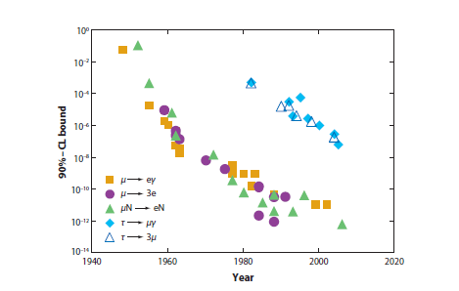
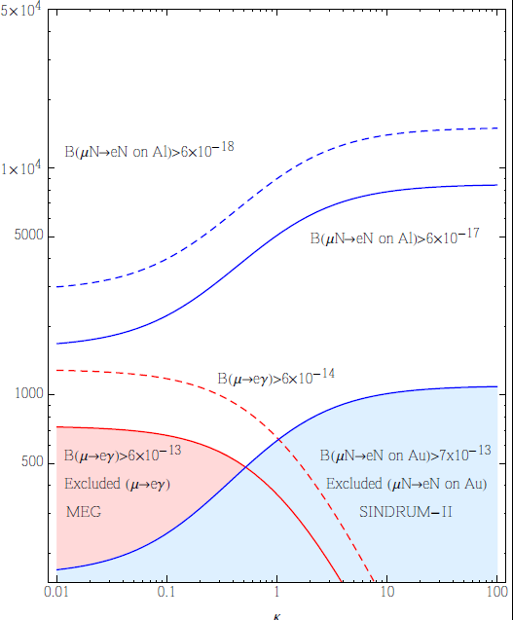
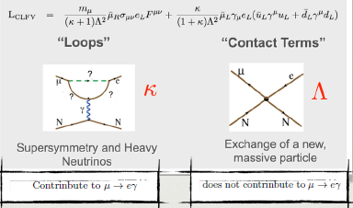
Physics goals
Lepton flavor violation history
  μN → eN < 7*10⁻¹³
  μ → eγ < 5.7*10⁻¹³
μN → eN Goal
  μN → eN < 10⁻¹⁶
    mu2e Fermilab
  μN → eN < 10⁻¹⁸
    Stage 2 mu2e
physics at ~10000 TeV
TeV
κ
Λ

Slide 4
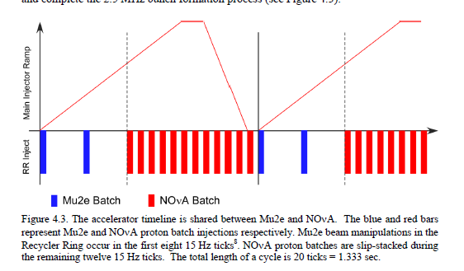
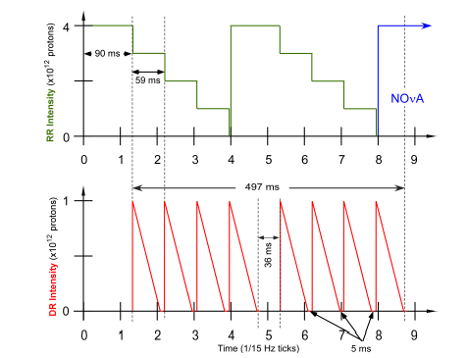
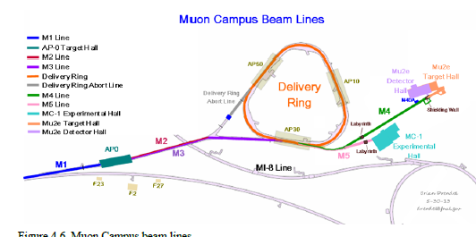
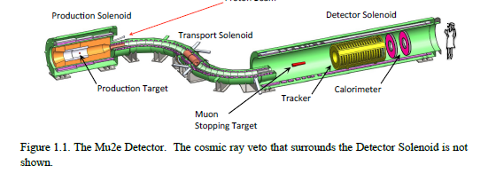
mu2e Beam Scenario
Parameters of μ→e
  Proton beam – 8GeV (~5ma)
    8∙10¹²/ 1.33s
      2 Booster batches/cycle
    6 ∙10¹⁹/ 10⁷ s
  6 years (10⁷ s)→ 3.6 ∙10²⁰ p
Form 4 bunches in Recycler
  extract one by one into Delivery Ring
  Slow extract into mu2e line
  0.0016 stopped μ/p
    5 ∙10¹⁷ μ / experiment

Slide 5
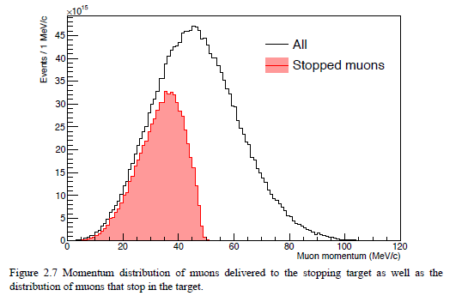
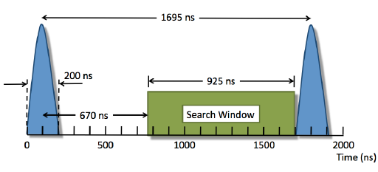
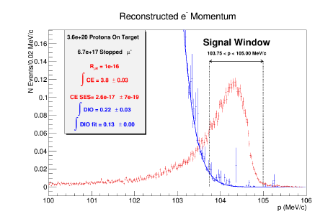
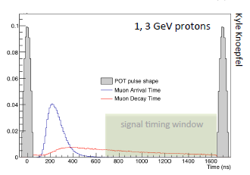
mu2e scenario
Signal is monoenergetic
  105 MeV electron
  background is μ decay in orbit
    π capture, μ, π decay in flight, p-bar, e⁻, cosmic rays …
    0.4 Background Events

Slide 6
PIP-II status
800 MeV-2ma cw-capable H⁻ linac
On trajectory toward construction –completion in 2026
  CD-0 → CD-1 – (CD-1 review next week)
  the major accelerator project for Fermilab
Purpose of PIP-II
  upgraded intensity of injector for LBNF/DUNE
    uses ~8--15 kW to produce > 1MW at 60—120 GeV
  Platform for future high-intensity program
    upgradeable to ~1.6MW
  Provides up to 100 kW beam for mu2e-II
    starting in 2026
  with “PIP-III” (8 GeV RCS?) can provide >2MW at 60—120 GeV
PIP-II motivation relies on mu2e-II
  only identified user of cw linac

Slide 7
PIP-II Performance Goals
Performance Parameter | PIP | PIP-II
Linac Beam Energy | 400 | 800 | MeV
Linac Beam Current | 25 | 2 | mA
Linac Beam Pulse Length | 0.03 | 0.54 | msec
Linac Pulse Repetition Rate | 15 | 20 | Hz
Linac Beam Power to Booster | 4 | 17 | kW
Linac Upgrade potential | N/A | CW
Mu2e Upgrade Potential (800 MeV) | N/A | >100 | kW
Booster Protons per Pulse | 4.3×10¹² | 6.5×10¹²
Booster Pulse Repetition Rate | 15 | 20 | Hz
Booster Beam Power @ 8 GeV | 80 | 166 | kW
Beam Power to 8 GeV Program (max) | 32 | 83 | kW
Main Injector Protons per Pulse | 4.9×10¹³ | 7.5×10¹³
Main Injector Cycle Time @ 60-120 GeV | 1.33* | 0.7-1.2 | sec
LBNF Beam Power @ 60-120 GeV | 0.7* | 1.0-1.2 | MW
LBNF Upgrade Potential @ 60-120 GeV | NA | >2.0-2.4 | MW
*NOvA operations at 120 GeV

Slide 8
PIP-II and Next Generation Mu2e
India is planning to provide a cryoplant with sufficient capacity to support CW operations
PIP-II front end can produce arbitrary bunch structures with:
  Peak current ≤10 mA
  Average current ≤2 mA
  This provides an opportunity for delivering 800-MeV protons directly from the SCL to a second generation Mu2e
Mu2e-II
  Use PIP-II (800 MeV) as beam source
  Reuse as much as possible of the baseline Mu2e experiment
    Follow similar experimental scenario
    Improve if possible
  Need strong Letter of Intent to support PIP-II
    LOI will support R&D on second generation changes and improvements

Slide 9
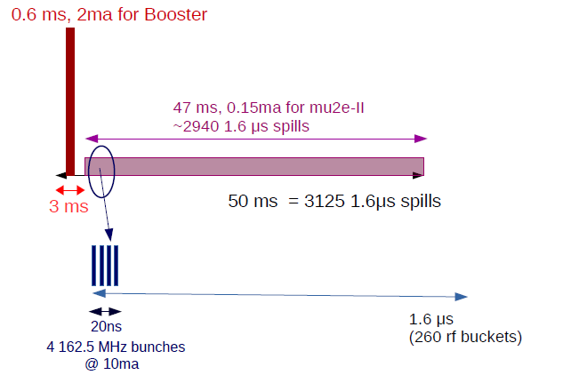
PIP-II and Next Generation Mu2e
Possible beam structure:
  162.5 MHz chopped beam
  Beam pulse length: ~20 nsec (4 bunches)
  Pulse repetition period: 1.6 μsec
  Beam power: >100 kW
  Three-year run achieves
  single event sensitivity of 2×10⁻¹⁸
‘Missing’ bunches

Slide 10
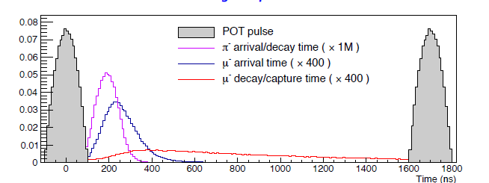
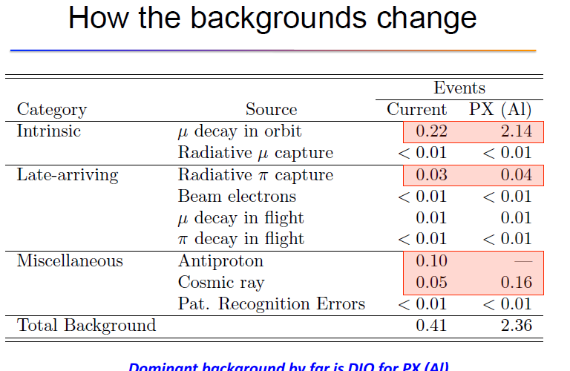
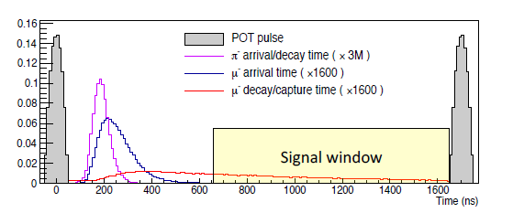
mu2e→mu2e-II
mu2e →mu2e-II
  shorter pulses
timing comparison
  K. Knoepfel

Slide 11
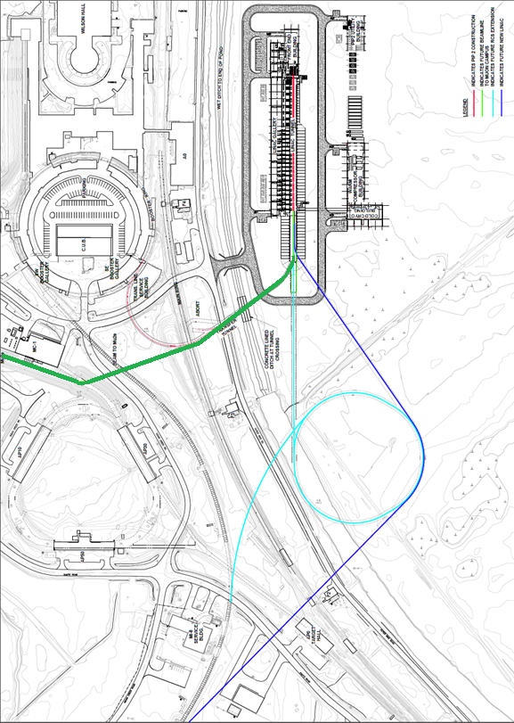
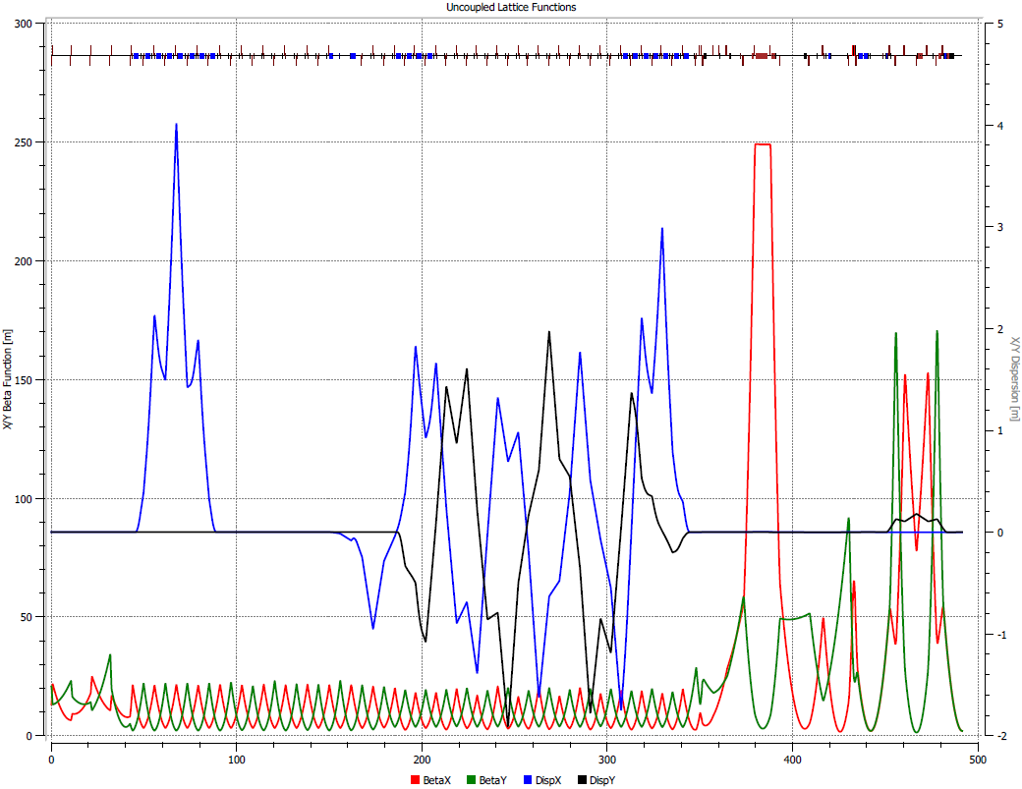
New beamline to mu2e experiment
800 MeV beam line from linac
  directly to production target
  no recycler, DR, slow extraction, no extinction
  initial beam width shorter
    400ns FW → 20ns
  0.3 mm-mrad emittance
  pulse to pulse chopping
    switchyard kicker to (Booster/mu2e/dump)
    )
PIP-II
Booster
mu2e-II transport
PIP-III
RCS or linac
A. Vivoli

Slide 12
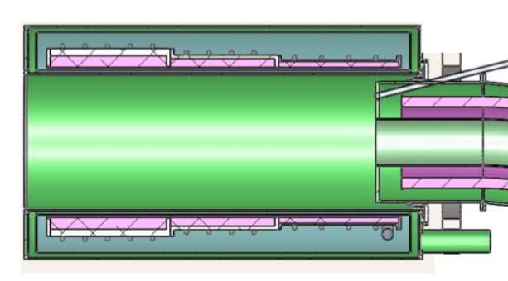
PIP –II delivery on target
Linac is H⁻
  beam enters ~4T field
    13º → 0.9 T along direction
    H₋ stripping time
    cτ = ~8cm
  Beam should be stripped upstream
    orbit bump onto stripper foil could add to extinction (Roberts ….)
    should give much improved extinction

Slide 13
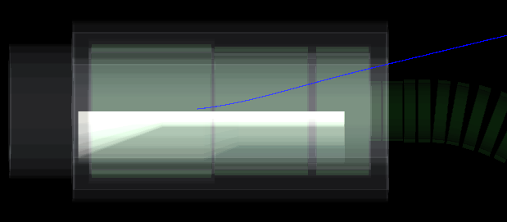
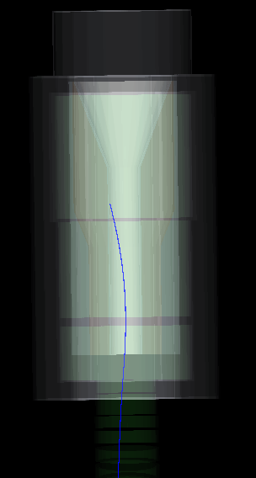
PIP-II beam delivery onto target
800 MeV beam line from linac
  initial beam width shorter
    200ns FW → 20ns
  0.3 mm-mrad emittance
    smaller than 8 GeV beam
But 800 MeV p will not follow 8 GeV path
  would hit HRS shielding after target
    modify magnet/shielding ?
  more power deposited in target, shielding
    new target and shielding needed
  Will we need new Production solenoid?
side
T. Roberts
top

Slide 14
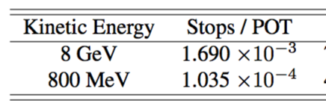
mu2e→mu2e II changes
new injection beam line
  from linac
Production target
  8kW→100kW; 8GeV→0.8
Production solenoid
  internal shielding
Transport solenoid
  collimation …
  →
Detector solenoid
  stopping target
LOI → Proposal R&D
mu/p estimates
    (Matsuzawa 2015)
3 yr-100 kW =>
  1.5 ×10¹⁹ μ after TS
  5×10¹⁸ stopped μ
Stopped Muons

Slide 15
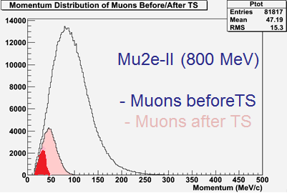
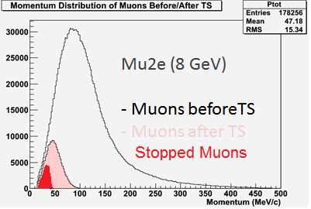

Improving stopped μ acceptance ?
Only small fraction of μ’s are stopped
  P_{μ} < ~40 MeV/c (or E_{μ} < 7 MeV)
Can we reduce muon momenta to < ~40MeV/c?
If only there were a way to sort the muons by momentum and give higher momentum muons more energy loss …
Stopped Muons
    (Matsuzawa, Roberts, Prebys 2015)

Slide 16
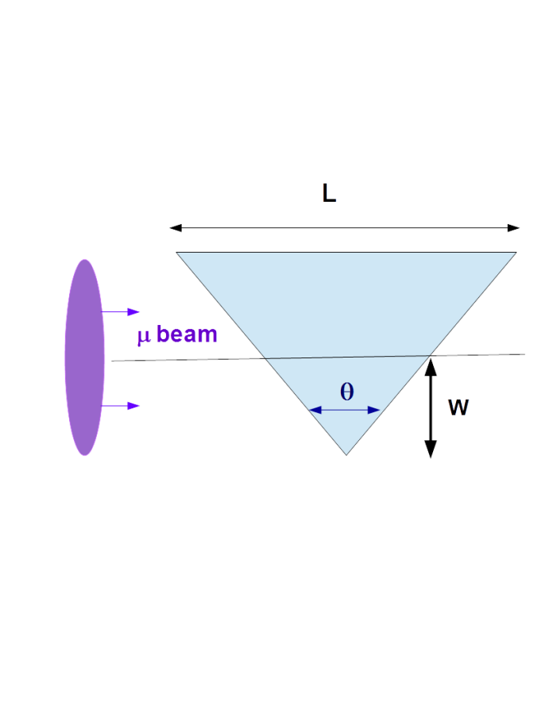
Wedge absorbers and emittance exchange
Wedge absorbers can exchange transverse and longitudinal emittances
  With dispersion η , can reduce energy spread
    decreases ε_{L}, increases ε_{x}
  with zero or opposite sign η, can increase δE
    increases ε_{L}, decreases ε_{x}
Thick wedge exchange formalism:
Dispersion + wedge is product of two matrices
(in x – dp/p)
  wedge is δ′ = dp/ds 2 tan[θ /2]/p
transport through wedge is transport of [x, δ] phase space ellipse,
  can get large emittance exchange
+ηδ₀
-ηδ₀
→

Slide 17
Results of wedge transform
  mucool note-003(1996)/FN-1046(2017)
new δp/p width (ε_{L,1} = ε_{L,0} (δ₁/δ₀))
new transverse emittance (ε_{x,1} = ε_{x,0} (δ₀/δ₁))
new η, β_{x},
By choosing η₀, δ’ (and δ₀, σ₀)
Can decrease ε_{x} and increase ε_{L} (or vice versa)

Slide 18
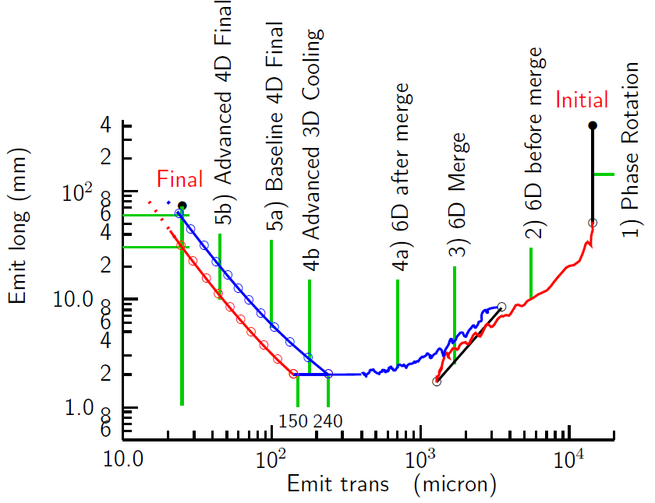
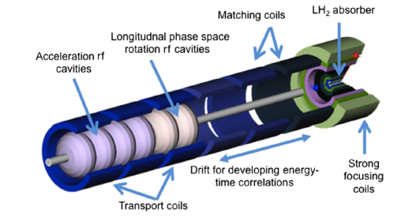
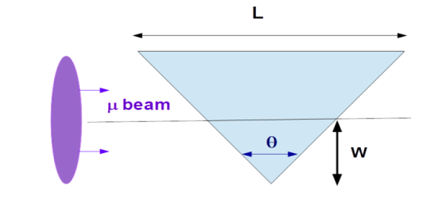
Wedges for Final Cooling
TeV Collider wants small ε_{t}
  ε → 25 μm
“Mice” 6-D Cooling gets
  ε_{t} → 200 μm
Much further is difficult
  …..
  Mostly emittance exchange
Can do most of this with wedge absorbers …

Slide 19
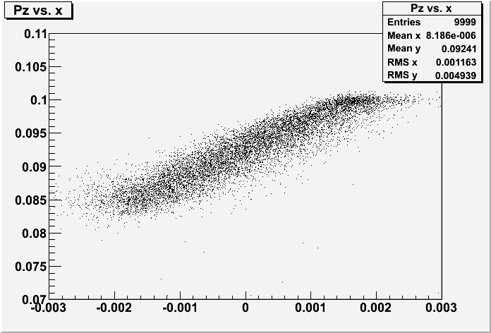

Numerical example
Wedge parameters
  Diamond, w=1.75mm, θ = 100°(4.17mm thick at center)
  reduces ε_{x} by factor of 4.3, ε_{L} increases by factor of 7.0
    first half of wedge more efficient than second half …
Second wedge
  if matched to same optics (P_{z} → 100 MeV/c, σ_{E}→0.46 MeV)
    ε_{x} : 23 →27μ; ε_{y} :97 → 23 μ
z(cm) | P_{z} | ε_{x}(μ) | ε_{y} | ε_{L}(mm | σ_{E} MeV | 6-D ε increase
0 | 100 | 97 | 95.5 | 1.27 | 0.46 | 1.0
0.4 | 96.4 | 33.4 | 96.3 | 4.55 | 1.64 | 1.24
0.8 | 92.4 | 22.7 | 96.5 | 8.94 | 3.22 | 1.65
Pz – x plot

Slide 20
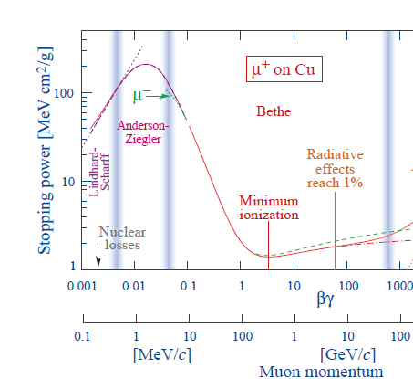
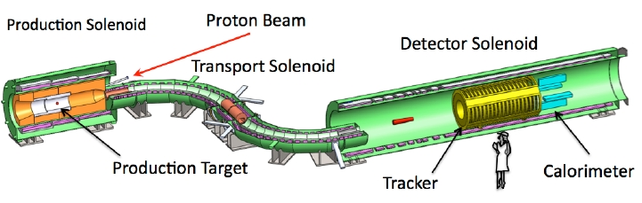
Application to mu2e
mu2e accepts only low-E μ
  < 40 MeV/c (7.3 MeV)
  nearly stopped μ
    non linear dE/dx
Transport accepts up to >100 MeV/c (40 MeV)
Goal is not smaller momentum spread but more nearly stopped μ’s
stopping target

Slide 21
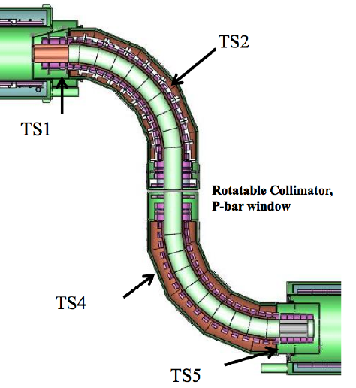
Beam momentum sorter
Transport solenoid
  bent solenoid introduces vertical dispersion
  position proportional to P_{μ}
  At P-bar window y = ~0.21 P/100
  (s=4.5m, ρ₀=3m, B₀=2.5T)
  dispersion is used to collimate muon beam
    Could also be used to shape momentum spread

Slide 22
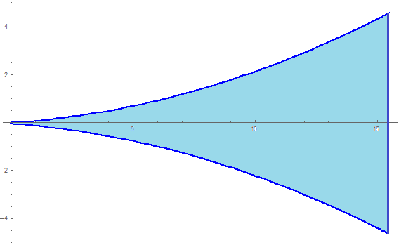
Wedge at TS center
wedge is designed to place
  40 < P_{μ} < 100 MeV/c
  at ~40 MeV/c
Example: Polyethylene wedge
  (~C₂H₄)
  thickness ~0 at y< ~8.5cm
  increases ~parabolically to aperture
    w(y) = ~ 0.133(y-8.5) + 0.0296(y-8.5)² cm
  at y=20cm , thickness ~6cm
want low-Z material
  Poly, C, Be, LiH,
y(p₂) = ~0.213 (p₂ (MeV/c)/100) m
15.5cm
9 cm
24cm
μ

Slide 23
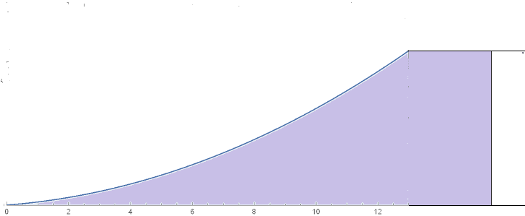
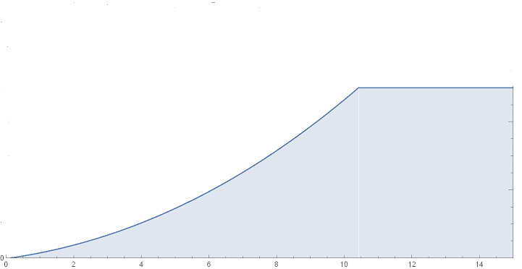
Possible wedge parameters
Choose Be wedge:
  (one sided rather than symmetric)
  need only ~5cm thick
    matched to P_{μ}< 100 MeV/c
  poly wedge only reaches to 88 MeV/c
    could try poly in initial studies
5 cm
Be
21.cm
μ
poly absorber

Slide 24
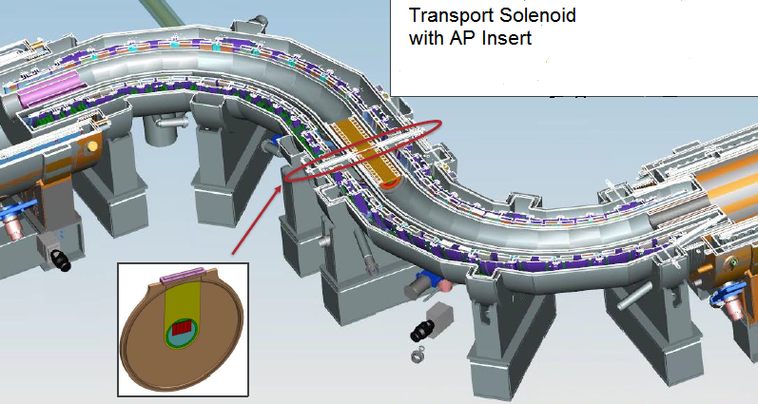
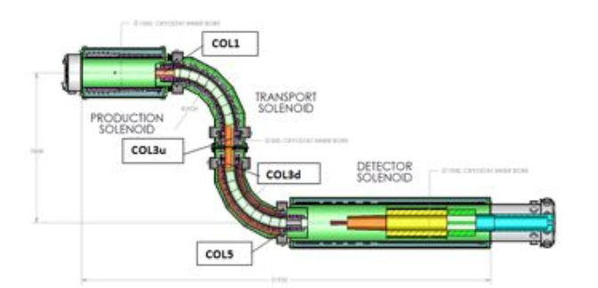
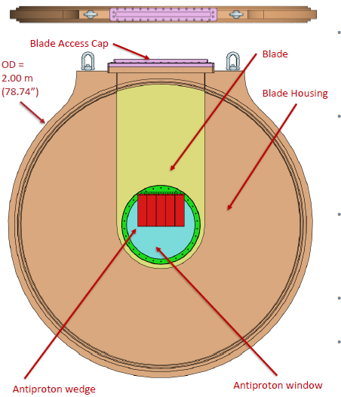
location at ~AP insert ??
AP insert is 10cm Thick
would like 5cm within that
for Be/poly blade

Slide 25
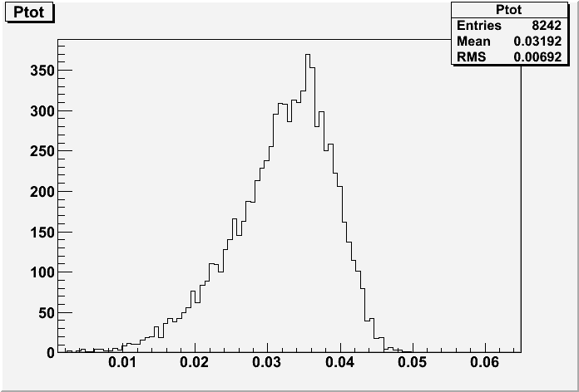
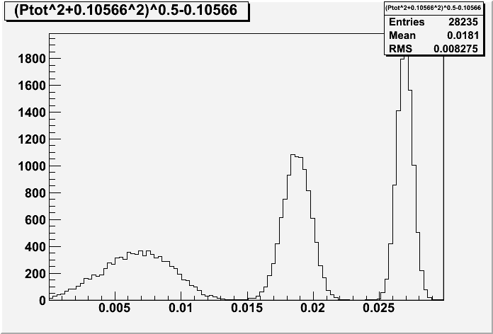
Effects of New Wedge
Momentum distribution of “nearly stopped” μ’s exiting the wedge is the same as that stopped in Al target
  ~25% lost in wedge

Slide 26
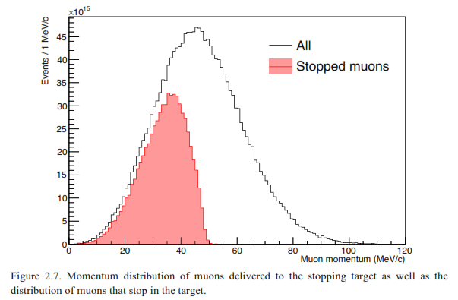
Potential Gain
baseline mu2e stops only ~3% of muons produced
  ~ all with P_{μ} < ~40MeV/c
Tailored wedge could place ~50% of produced μ at Pμ < ~ 40 MeV/c
  How many of these can stop for mu2e (II)?
  reoptimize downstream fields and collimation and stopping target …
Muons stopped

Slide 27
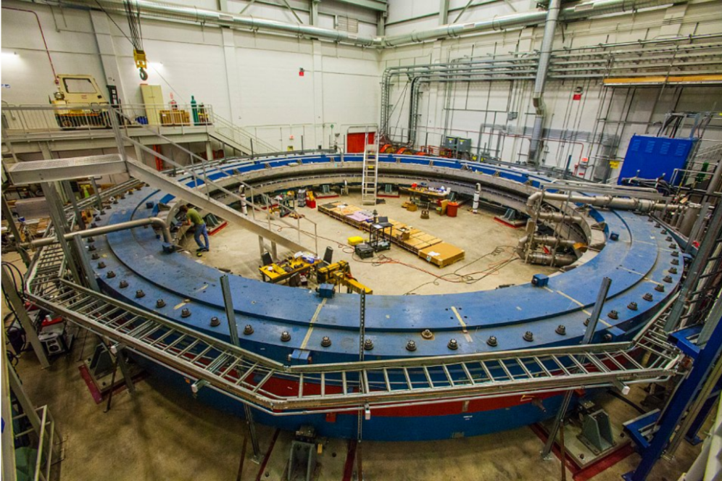
g-2 experiment at Fermilab
Ring accepts 3.1 GeV/c μ
  δp/p = 0.1 %
Beam source and transport to Ring accepts ±1%
  Increase beam within 0.1 %
  with wedge absorber at dispersion (0.5—1.0 m)
  Polyethelene absorber
    `dp/ds = 2.56 MeV/c/cm
μ
θ

Slide 28
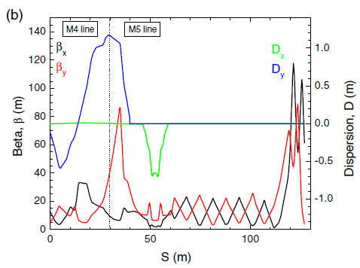
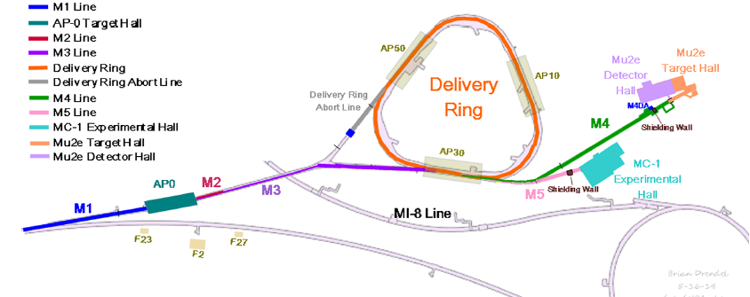
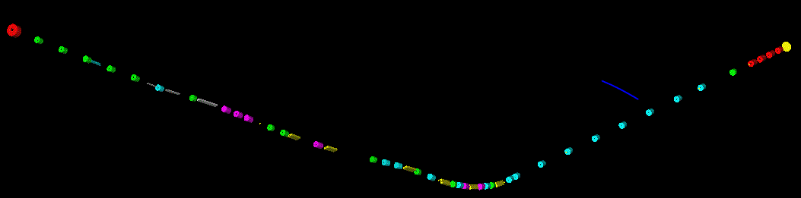
Wedge for g-2 (w. Stratakis et al.)
Place wedge at large dispersion, small β

Slide 29
g-2 performance
For η=0.6m, δ₀=0.01, P₀=3.1GeV/c, ε_{x,g}= 16 mm-mrad, β_{x}= 2m :
  θ_{opt}/2 =79º
  δ₁/ δ₀ =0.69 → 46% more μ’s
estimate does not include multiple scattering, energy straggling
  δε_{geom} ≅ 4—6mm-mrad at β_{t}=10m
exchange is limited by ηδ/σ_{x}
  At η =1.2m, δ₁/ δ₀= 0.43
    2.3 x more μ’s

Slide 30
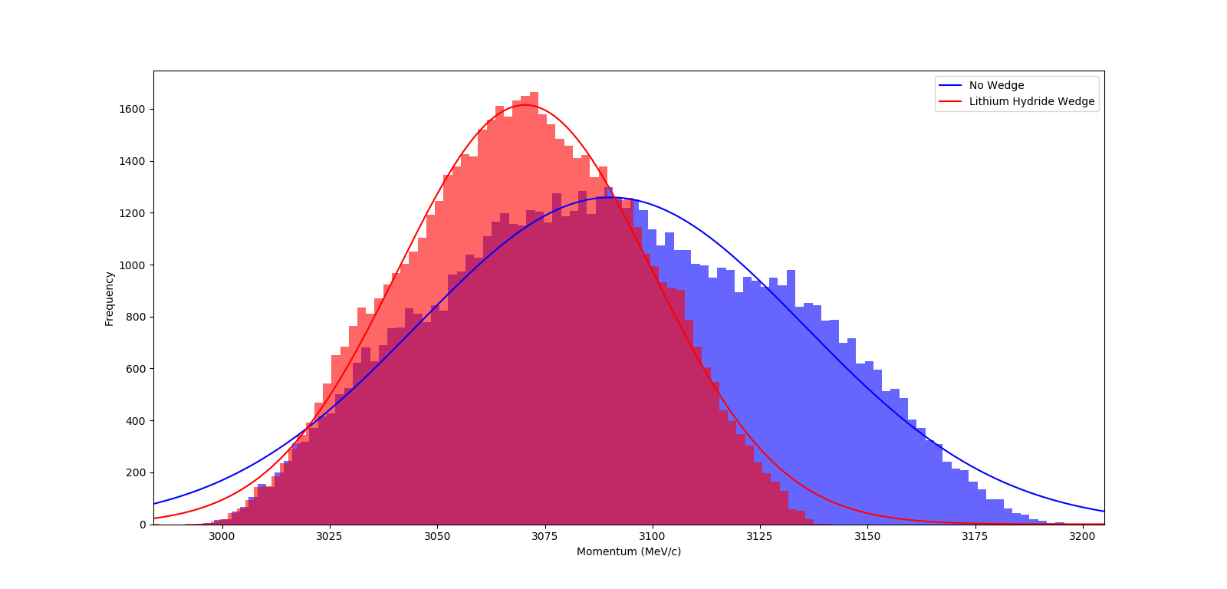
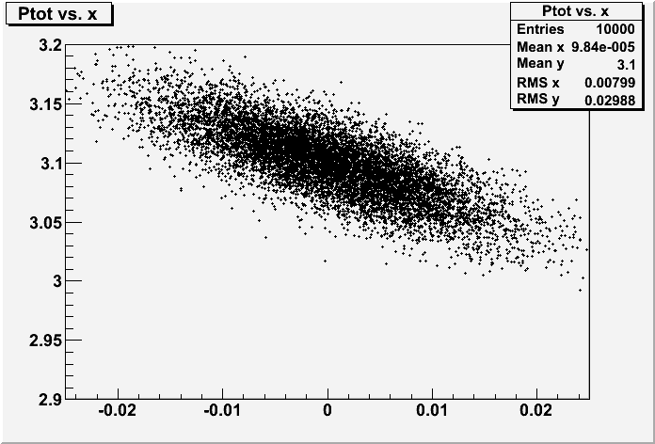
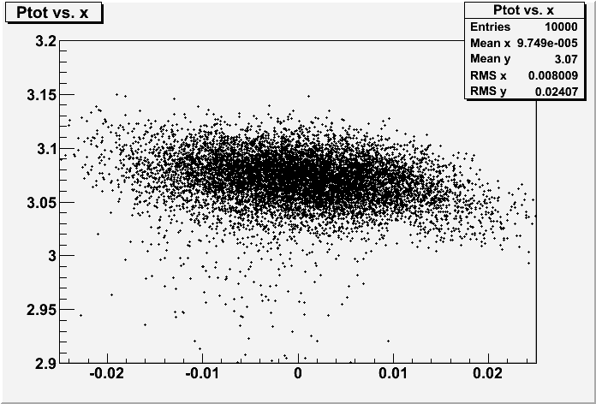
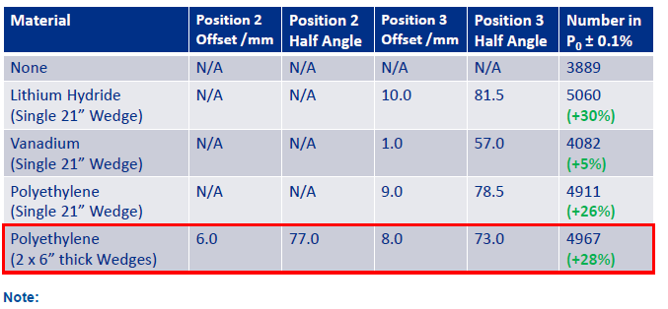
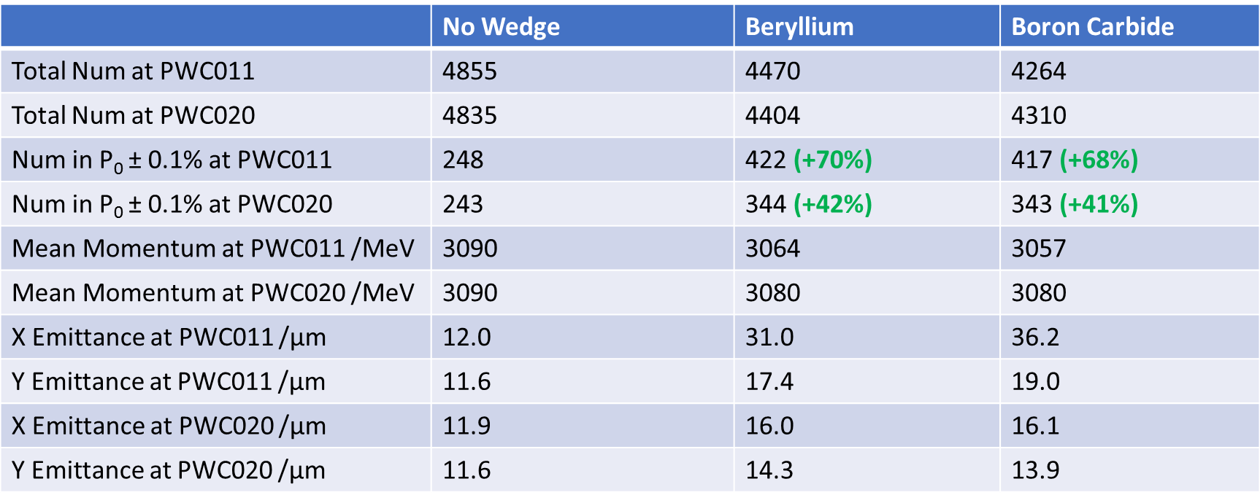
Simulation/optimization results
Simulation results w Bradley, Stratakis

Slide 31
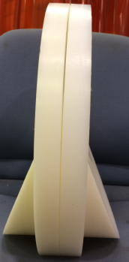


MICE experiment (RAL)
Wedge absorber designed and built to be put into MICE experiment
  D. Summers, P. Snopok, T. Mohayai, ..
Polyethelyne 45º, radius ~20cm
  to be inserted between focus coils of MICE expt.
  Scheduled to run December 17-20
μ-beam →

Slide 32



Simulations (T. Mohayai)
Longitudinal cooling exchange settings:
Longitudinal
Transverse

Slide 33

Transverse cooling…
Beam at 200 MeV/c
  ε_{t} =0.003m, δp/p=1%
  η_{in} = 0; β_{t} → 0.75m
Wedge reduces transverse mode by factor of ~3;
increases longitudinal by factor of ~3
effect should be measurable in MICE
ε_{t1}
ε_{t2}
ε_{L}

Slide 34

Questions?
Thanks for your Attention !

