Slide 1
Status of IIFC Activities at Fermilab
A. Rowe, J. Steimel
IIFC Joint R&D Meeting
7-8 December 2017

Slide 2
Outline
Overview
SRF & Cryogenics Activities
  Cryogenics Plant
  SSR1/SSR2
  LB650/HB650
PIP2IT Activities
  Warm Front-end
  RF Amplifiers
  LLRF & RFPI
  Instrumentation
  Controls
Summary

Slide 3
Overview
High-level R&D goals summarized as follows:
  Develop and demonstrate critical technologies for a pulsed and CW capable 800 MeV SRF LINAC
  Establish within the DAE SRF and RF capabilities to natively produce SRF LINAC elements both for PIP-II and for DAE projects.
To accomplish the above:
  Design, prototype, and test to PIP-II performance parameters all critical devices and sub-systems prior to construction start.
  SRF cavities, RF couplers, tuners - both 325 MHz spoke and 650 MHz elliptical varieties
  Cryomodule systems – 325 MHz SSR1 and 650 MHz high-beta
  RF Sources
  Develop mature set of documentation required to produce and test critical devices through the following cycle:
    CDR → FRS/TRS → PDR → FDR → PRR → ORC
    …and relevant engineering documentation to successfully pass the above reviews
Notes:
PIP2IT overview slide?

Slide 4
Cryoplant & Cryogenics System Status
Fully segmented Linac
Single cold box with turbines and cold compressors
Distribution box located in the refrigerator room
Cryogenic transferline with bayonet cans that runs parallel to the cryomodules

Slide 5
Requirements flow down
PIP-II Conceptual Design Report
PIP-II Conceptual Design Report
➔Engineering Manual, Fermilab ESH&Q Manual
➔Cryomodules requirement documents
TC#ED0001313, TC#ED0001316, TC#ED0001829, TC#ED0001830, TC#ED0001322
➔Cryogenic System
Functional Requirements Specifications (TC#ED0003531)
Engineering Specifications (TC#ED0005493,5587, etc.)
Design Criteria Documents (TC#ED0004748, 6895, etc.)
Engineering Notes (TC#ED0003531,6860, 6901, etc.)
Interface Control Documents (TC#ED0006893)

Slide 6
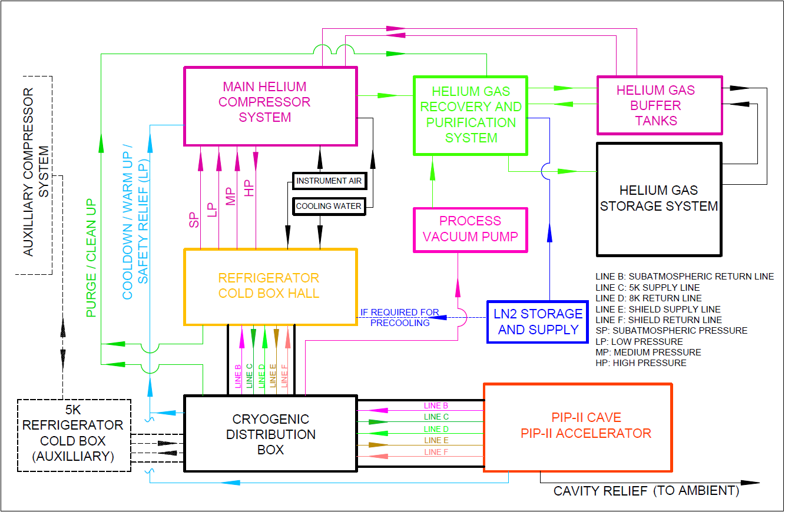
Cryogenic System Conceptual Design
*
* - Used for pulsed mode only

Slide 7

Cryogenic Plant Design – Conceptual Design
Baseline
Alternative
Hybrid cycle design
Cold compression design

Slide 8
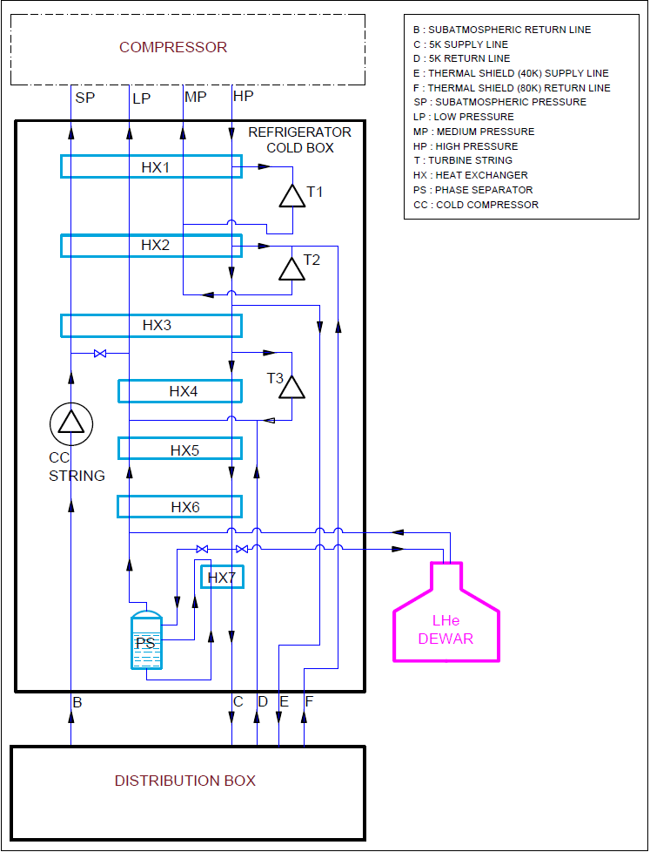
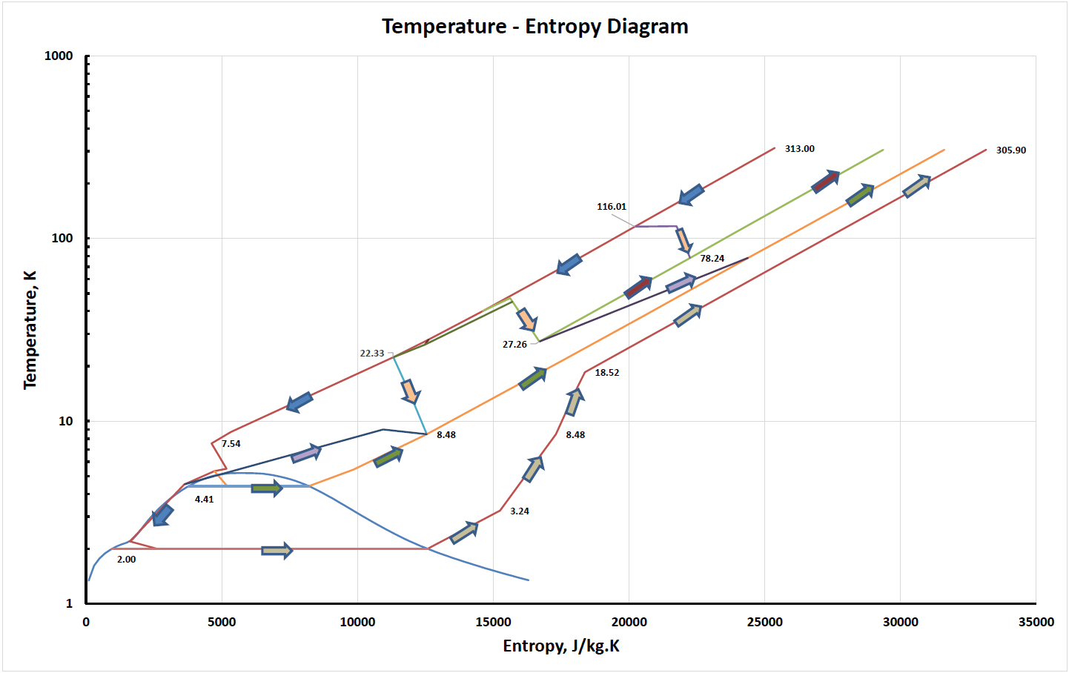
Technical Progress to Date - Cryogenic Plant
Comprehensive cryogen plant simulation model is in place.
The model was validated using similar systems actual performance parameters.
Hybrid compression cycle

Slide 9
Technical Progress to Date - PIP-II Cryogenic Distribution System
Developed preliminary detailed list of requirements
Defined preliminary loads, steady-state and transient modes ➔ TC#ED0003531
Defined preliminary interfaces and boundaries ➔ TC#ED0006893
Surveyed similar designs
Refined heat load estimates ➔ TC#ED0003531
Interface Control Document ➔ TC#ED0006893
Valve and Instrument List ➔ TC#ED0006894
CDS Functional Analysis ➔ TC#ED0006895
Bayonet Box Functional Analysis ➔ TC#ED0006896
Cryomodule Bayonet Boxes P&ID ➔ TC#ED0006897
Site Layout of Cryogenic Distribution Lines ➔ TC#ED0006898
Pressure drop calculations ➔ TC#ED0006899
Preliminary relief valves calculations ➔ TC#ED0006900
Preliminary piping layout ➔ TC#ED0006901

Slide 10

Design Review Plan
Cryogenic System is subject to Project Reviews
Divi/Dept review procedures based on the Fermilab Engineering Manual
Technical reviews (PDR, FDR, PRR whenever appropriate)
PIP2IT CDS Internal Review – April 2017
  all recommendations are closed
PIP2IT Cave TL
  Preliminary Design Review – October 2017
  Final Design Review – November 2017
  Production Readiness Review – January 2018
Cryogenic Plant
  ESD review – April 2016
  BARC committee review – May 2016
  All recommendations are closed, RFP was issued December 2016
  PO likely to be released by mid 2018

Slide 11
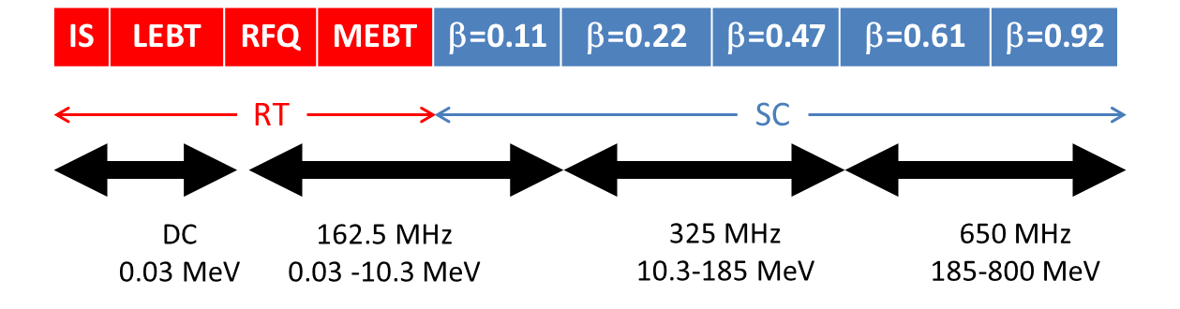
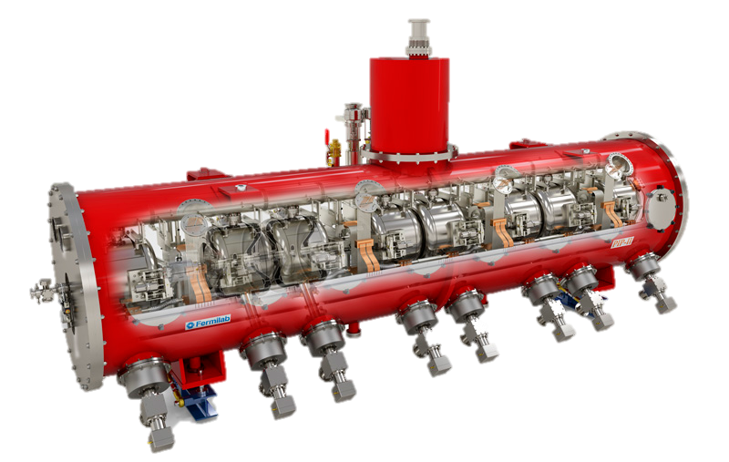
SSR1, SSR2: Overview
SSR: Single Spoke Resonator
PIP-II Conceptual Design Report: DocDb# 113
 | SSR1 | SSR2
# CMs | 2 | 7
Cavities per CM | 8 | 5
Solenoids per CM | 4 | 3
CM configuration c: cavities; s: solenoids | 4x (csc) | sccsccsc
CM length (m) | 5.2 | 6.5
SSR1 cryomodule
SSR CMs capable of operating in both pulsed and CW modes with a beam current of 2 mA avg.

Slide 12
SSR1,2 Cavities and Cryomodules – Requirements & Partner Interfaces
Functional Requirement Specification (FRS) are defined and traceable in Teamcenter:
SSR1 Cryomodule/Cavities: TC# ED0001316 / TC# ED001317
SSR2 Cryomodule/Cavities: TC# ED0001829 / TC# ED0001854
Partner Interfaces.
SPC/SPM and POC direct communication through bi-weekly update meetings.
Doc transfer through Teamcenter/Librarians and Sangam
SSR1 Cavities partner: DAE-BARC/IUAC
  fabrication of two dressed cavities
SSR2 Cavities partner: DAE-BARC
  Bare and dressed cavities design and production
  Tuners design and fabrication
  Solenoids, leads and BPS design and fabrication

Slide 13
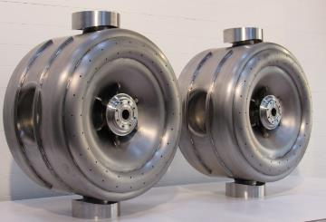
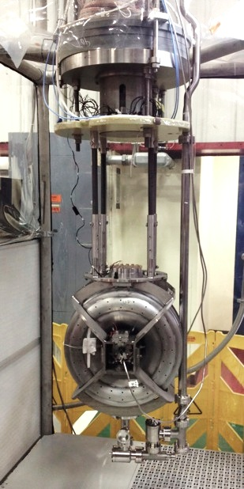
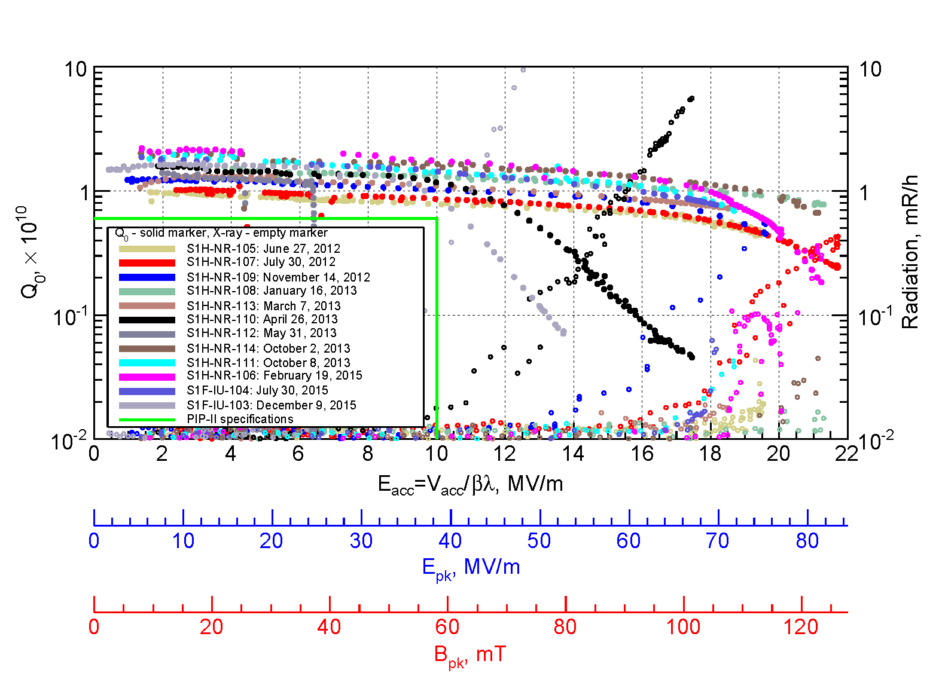
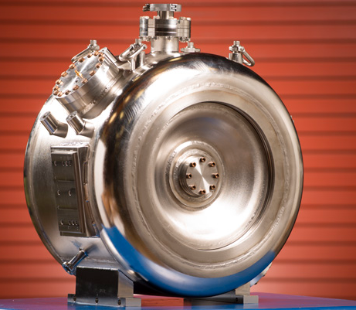
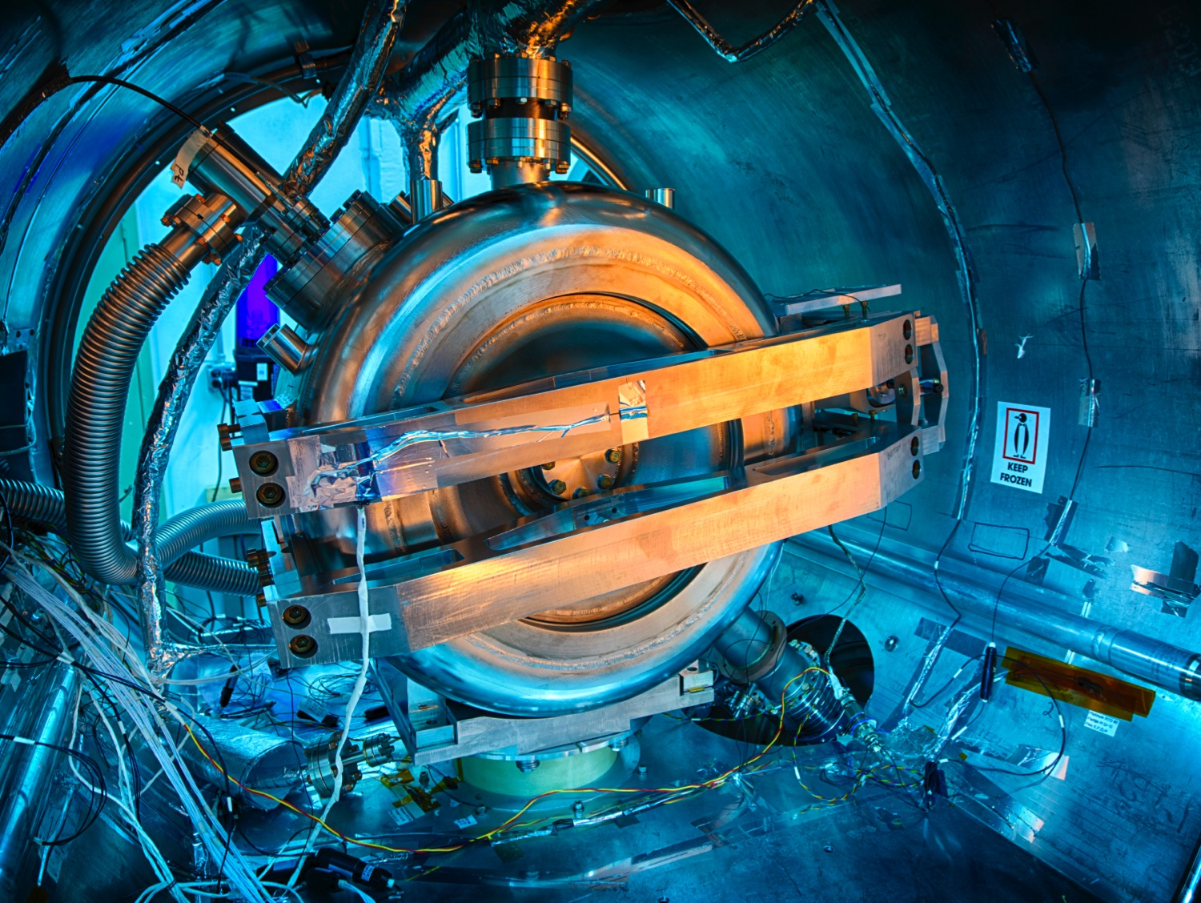
121.3.5 SSR1: Cavities Design Maturity
SSR1 CM1 is well beyond the conceptual design.
  SRF technology enabled: 12 bare SSR1 cavities (10 FNAL and 2 DAE BARC/IUAC) met PIP-II requirements in VTS.
  10 FNAL cavities were jacketed with stainless steel vessels.
  2 DAE BARC cavities are currently receiving the He- vessel
  Current activities: qualification of jacketed cavities by cold testing at Spoke Test Cryostat (STC) to meet SSR1 cavities FRS (TC# ED0001317)

Slide 14
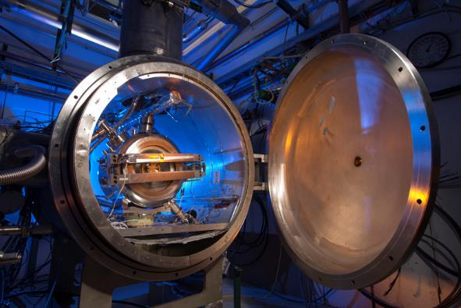
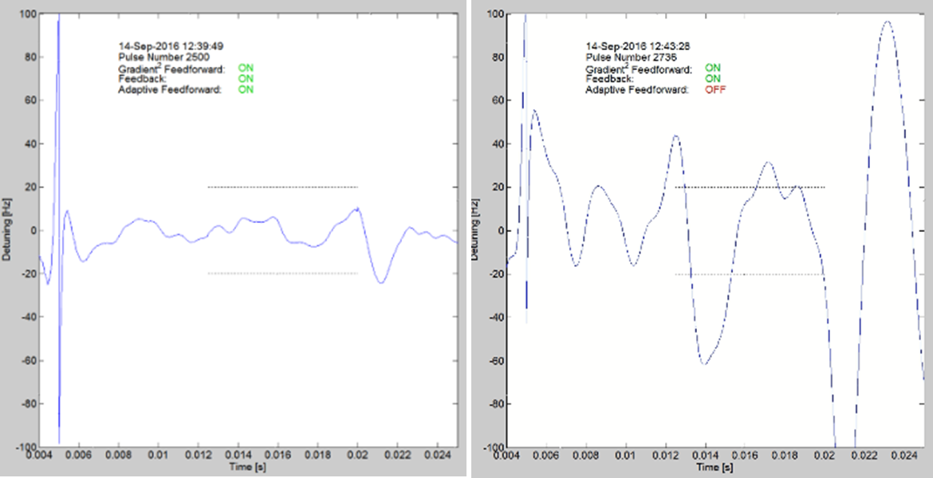
121.3.5 SSR1: Tuner and resonance control
Prototype SSR1 tuner
Design completed and one unit was prototyped
Successfully tested at 293K and cold temperature
Production SSR1 tuner
Design completed
1 out of 10 units was received and currently used for resonance control of SSR1 cavities
Resonance control studies
  Requirements: microphonics <20 Hz
  Requirements nearly achieved….

Slide 15
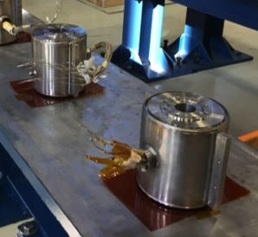
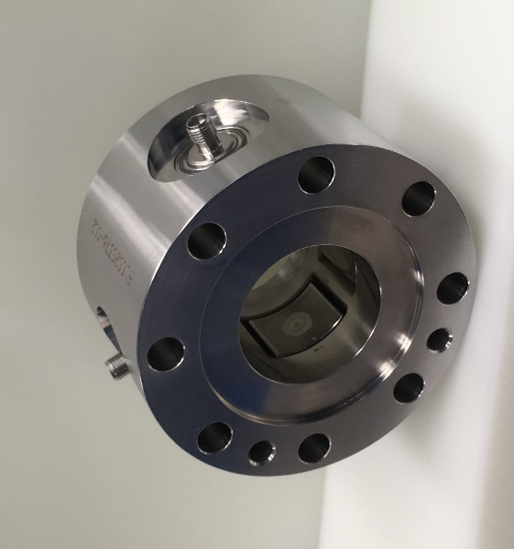
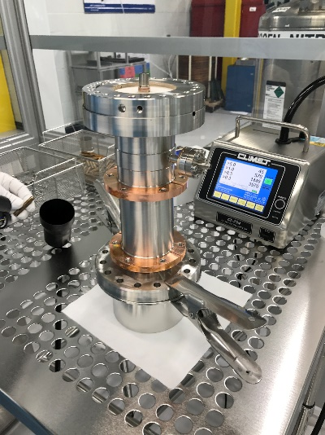
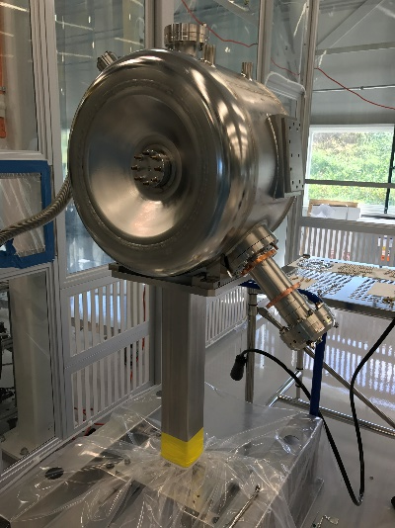
121.3.5 SSR1: Solenoid, BPMs, couplers
Four production solenoids were successfully designed, procured and qualified.
Four production BPMs were successfully designed, procured and qualified.
Joint collaboration ANL &FNAL
TC# ED0005680
TC# ED0001264
Prototype main power couplers
Design, procurement and testing: completed
Three prototypes were procured and successfully tested
Production main power couplers
Design completed
Procurement: in progress
  The procurement of coupler antennas presented a series of technical issue that led them to be on the critical path.

Slide 16
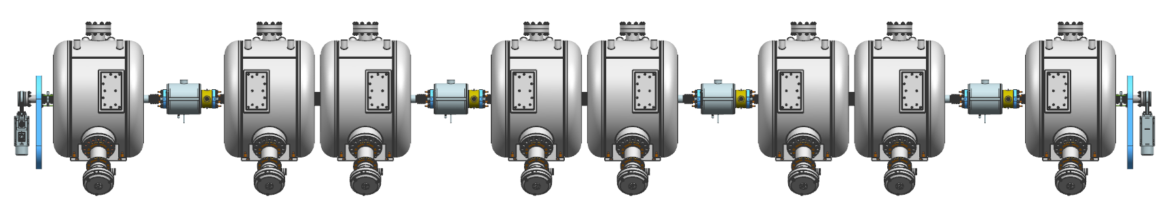
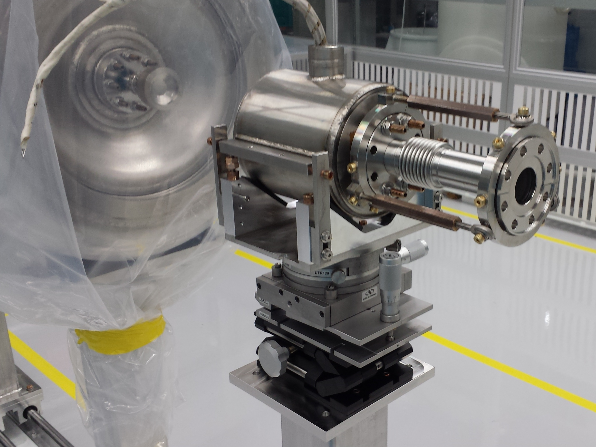
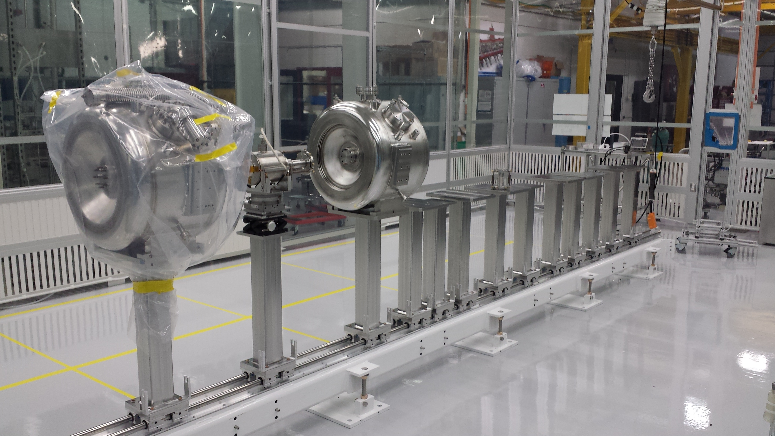
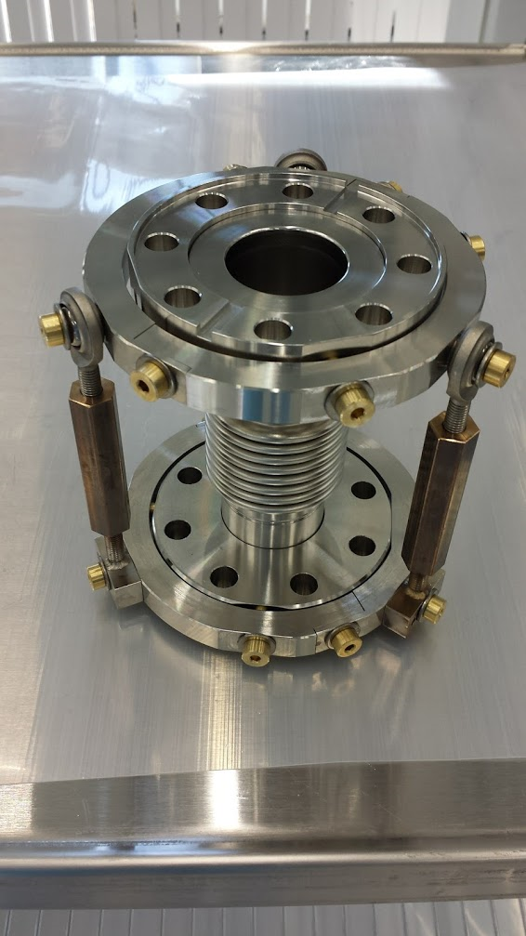
121.3.5 SSR1: cavity string assembly
20mm
IIFC SSR1 cavity
IIFC SSR1 cavity
BPM
Solenoid
SSR1
Type A
SSR1 Type B
SSR1
Type A
SSR1 Type B
SSR1
Type A
SSR1 Type B
SSR1
Type A
SSR1 Type B
Gate Valve
Coupler
(vacuum-end)
Gate Valve
Free particle assembling procedure for cleanroom activity at Lab 2

Slide 17
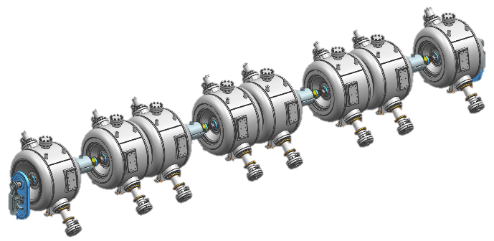
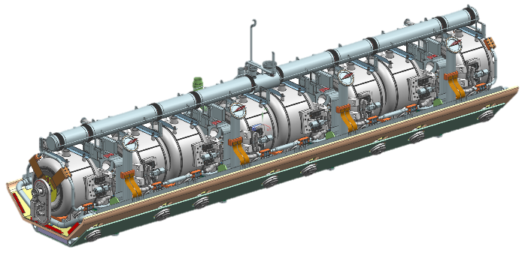
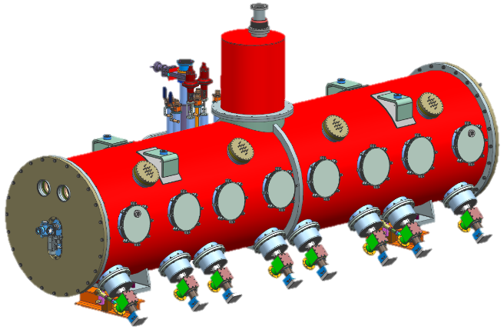
SSR1 CM Design Maturity
SSR1 1st cryomodule
SSR1 cavity string assembly
Design: completed
Procurement: completed
Assembly starts in March 2018
SSR1 coldmass
Design: completed
Procurement: in progress
Assembly starts in July 2018
SSR1 final cryomodule
FDR in Jan. 2018
Procurement: in progress
Assembly starts in Nov. 2018
  SSR1 2nd cryomodule
  We are collecting lessons learned and list of improvements from the experience in designing and developing the SSR1 1st cryomodule.

Slide 18
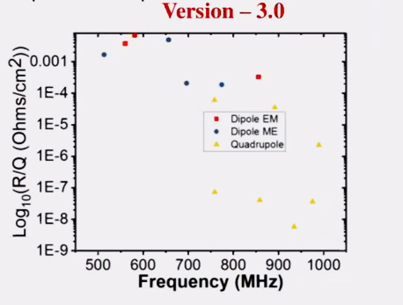
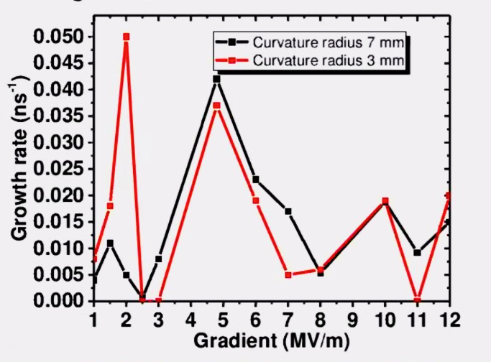
SSR2: Design Maturity
SSR2 cavities:
  RF Design Initially developed by Fermilab
  DAE (BARC) is currently working on RF and Mechanical design.
  Bare Cavity Design Status Review held at BARC Nov 7th 2017
  PDR at BARC is scheduled for March 2018
Structural analyses performed by BARC
SSR2 Electric and Magnetic fields
HOM Analysis
Multipacting Analysis
Design of SSR2 cryomodule will be based on SSR1 cryomodule (including solenoids, couplers, tuners, etc.)
SSR2 Cavity & Cryomodule development is on the critical path for the SRF Linac because it is the least mature of the SRF CMs

Slide 19
SSR1, SSR2: Design Review Plan
Critical component design review cycle
CDR → FRS/TRS → PDR → FDR →PRR
Critical Reviews are tracked in P6 as milestones.
Non-critical components or subsystems are managed within the Division or Department review process as required by the FNAL Engineering Manual.
Design reviews planned for Partner deliverables as appropriate to ensure technical and ESH&Q requirements are met. Partner milestones identified and implemented in P6.
SSR1 1st cryomodule
  PDR, FDR and PRR of the key-components up to the string assembly were successfully held and documented.

Slide 20
LB650/HB650 Overview
Cryomodule type | Cavities per CM | # CMs | CM length (m) | Q₀ at 2K (10¹⁰)
HWR | 8 | 1 | 5.93 | 0.5
SSR1 | 8 | 2 | 5.2 | 0.6
SSR2 | 5 | 7 | 6.5 | 0.8
LB650 | 3 | 11 | 3.9 | 2.15
HB650 | 6 | 4 | 9.5 | 3
PIP-II Conceptual Design Report: DocDb # 113
Eleven β_{g}=0.61 and four β_{g}=0.92 650 MHz SRF cryomodules, capable of operating in both pulsed and CW modes, that provide an energy gain from 185 MeV to 800 MeV with a beam current of 2 mA average to the Beam Transfer Line.

Slide 21
LB650/HB650 Requirements & Partner Interfaces
β_{g}=0.61, 650 MHz Elliptical Cryomodules
CM FRS: TC# ED0001830, SRF Dressed Cavity FRS: TC# ED0001834
β_{g}=0.92, 650 MHz Elliptical Cryomodules
CM FRS: TC# ED0001322, SRF Dressed Cavity FRS: TC# ED0001321
Partner Interfaces.
SPC/SPM and POC direct communication through bi-weekly update meetings.
Doc transfer through Teamcenter/Librarians and Sangam
LB650 partners: VECC, RRCAT, BARC
  VECC - Design, fabrication, and testing of prototoype LB650 dressed cavities
  RRCAT – Design of LB650 Cryomodule based on SSR1 and HB650
  BARC – RF coupler production
HB650 partner: RRCAT, BARC
  RRCAT - Bare and dressed cavities design and production
  RRCAT - Tuner fabrication
  BARC – RF coupler production

Slide 22
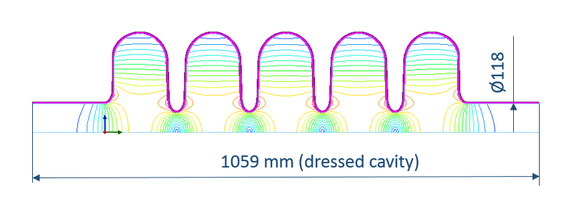
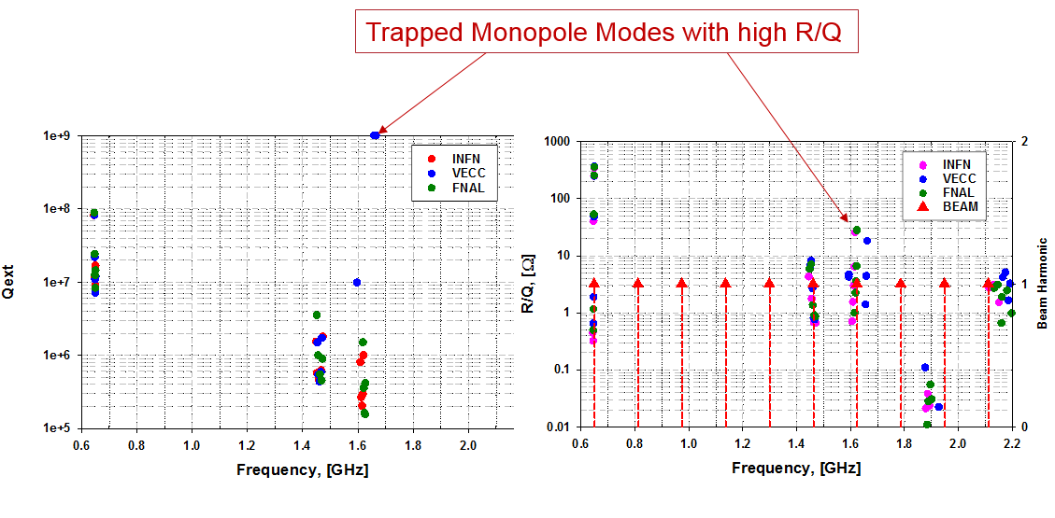
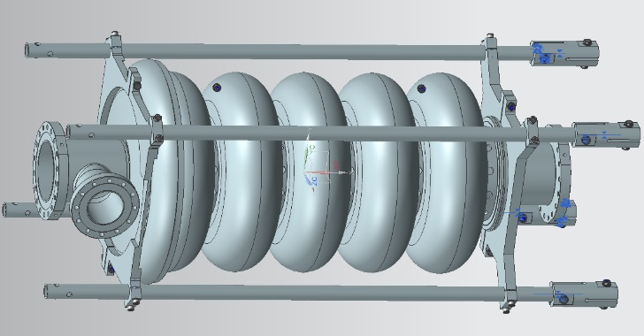
LB650 Cavity Design/Maturity
LB650 Dressed Cavity Design through the PDR TC# ED0006010
  PDR of VECC cavity resulted in subtle alternative EM design modifications. Three designs pursued (VECC, FNAL, INFN-Lasa) were very similar in critical parameter performance.
  LB650 cavity Electromagnetic Design (INFN-Lasa) chosen.
INFN-Lasa LB650 Cavity Model
FNAL analysis of Trapped HOMs with broad beam spectrum.

Slide 23
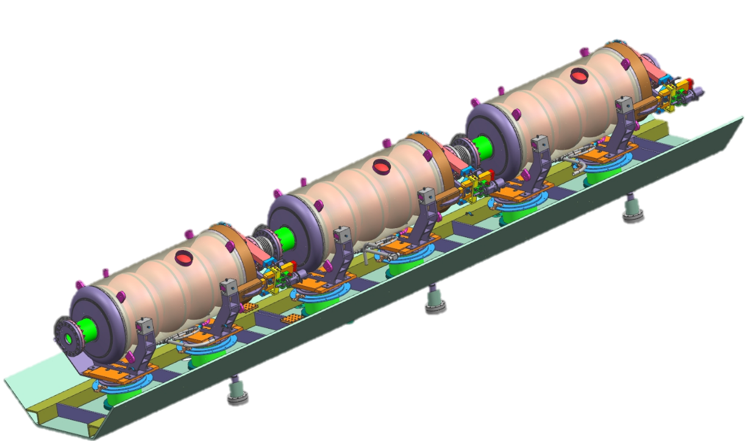
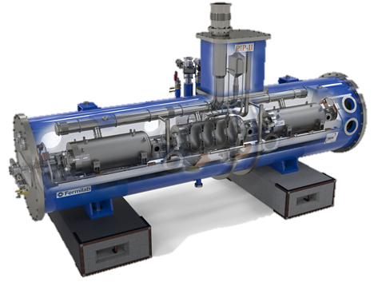
LB650 Cryomodule Design/Maturity
CM Design is DAE-deliverable: RRCAT
  Design concept based on FNAL SSR1 and preliminary HB650 CM
  CM Design maturity is conceptual.
  Design review schedule elaborated in P6.
LB650 CMs
(DAE/EU Deliverable)
S. Gilankar: NSCS 26 VECC Kolkata
Conceptual 3-cavity strongback/support post design based on SSR1 CM

Slide 24
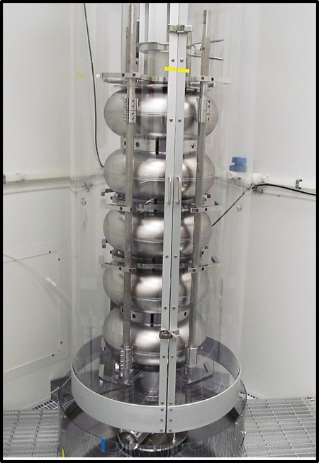
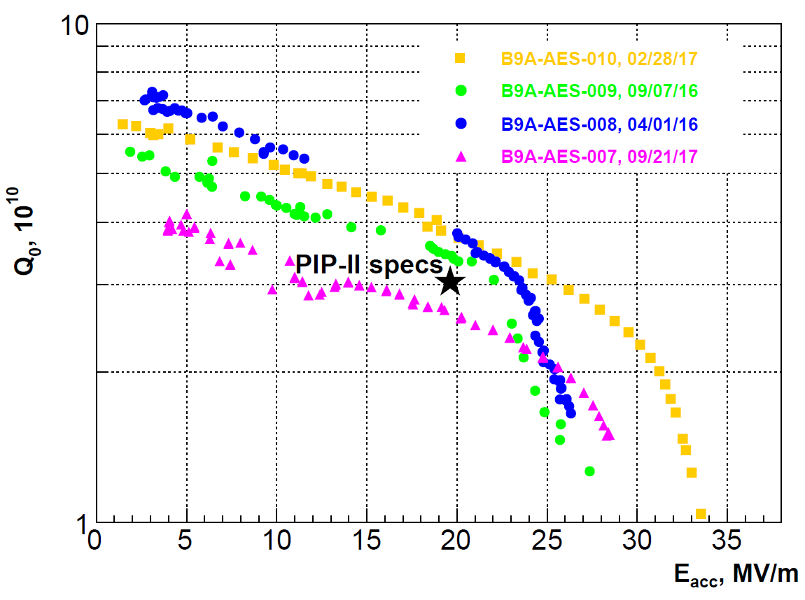
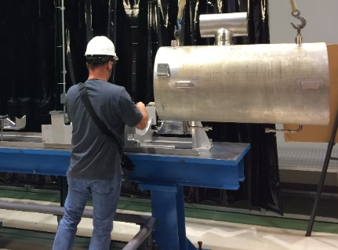
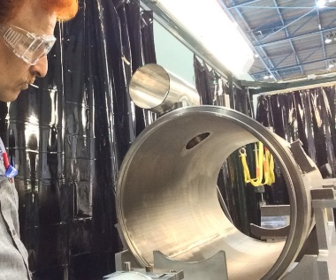
HB650 Cavity Design Status
Cavity Design Status
  β_{g}=0.92 650 MHz bare cavity design has completed the FDR: TC# ED0003861, TRS for cavity system ED# ED0003153 is in draft form.
  Dressed cavity mechanical design is advanced, awaiting FDR of dressed cavity system.
  Design review schedule elaborated in P6.
  Performance of β_{g}=0.90 cavities demonstrated above specification.
  Processing/Q0 recipe refinement still required.
Three of four multi-cell B.90 cavities qualified through VTS.
Q₀ > 3.5 E10 @ 20 MV/m demonstrated
Minimal radiation due to FE induced X-Rays during tests up to E_{acc} < 25 MV/m.
*
*
N-doped cavities
5-cell B.90
*Negligible radiation < 23 MV/m

Slide 25
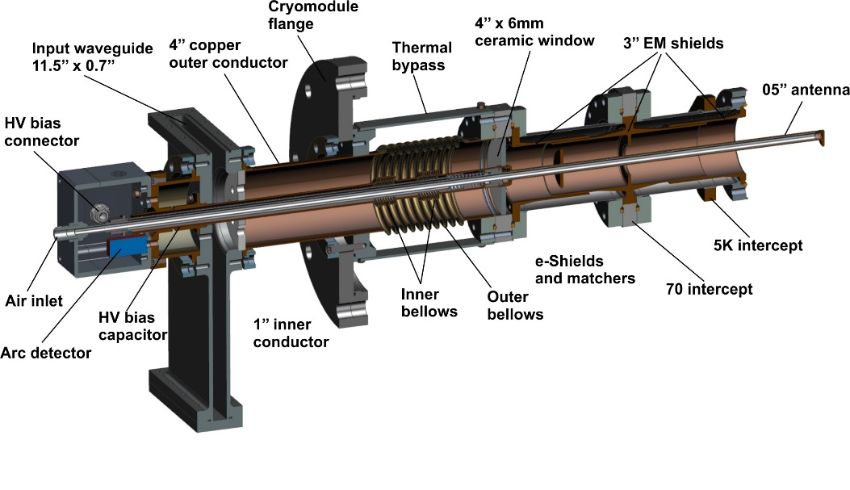
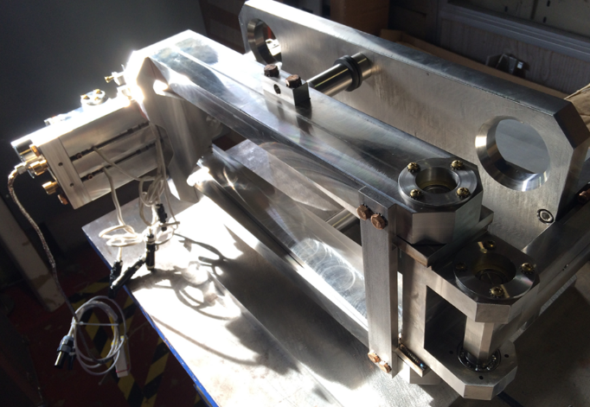
HB650 RF Coupler/Tuner Design
High Power 650 MHz 120 kW RF coupler FRS, TRS TC#s ED0003645, ED0005689
  Prototypes through FDR/PRR.
  Two cold-end designs in procurement cycle, expected to arrive 04/2018
Prototype tuner – Engineering Specification TC# ED0005146
  Version 1 procured and tested at room temp. Initial testing yielded opportunity to optimize design for stiffness improvement.
EM Shielded Prototype
Prototype 650 MHz tuner during bench testing.

Slide 26
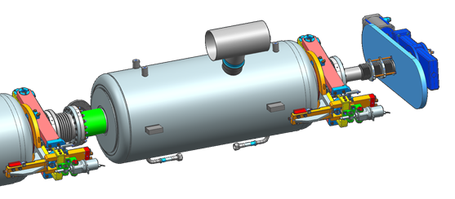
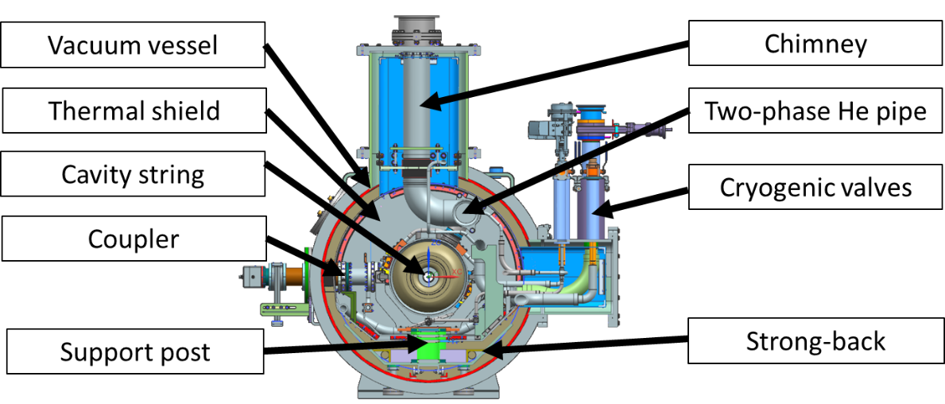
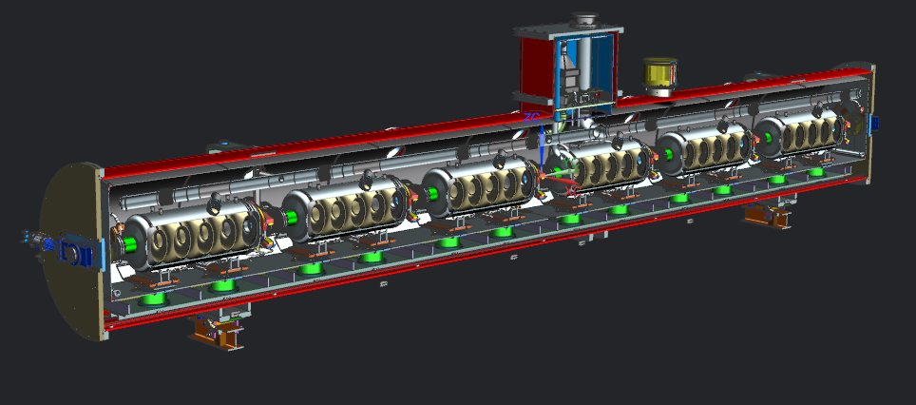
HB650 CM Design/Maturity
HB650 CM Design Status - FRS: TC# ED0001322
  Status is preliminary. 3D model is well developed. Design is currently in the analysis/design iteration phase pre-PDR.
  Design review schedule elaborated in P6.
HB650 String Details
~10m
HB650 Model

Slide 27
Design Review Plan
Critical component design review cycle
CDR → FRS/TRS → PDR → FDR →PRR
Critical Reviews are tracked in P6 as milestones.
Non-critical components or subsystems are managed within the Division or Department review process as required by the FNAL Engineering Manual.
Design reviews planned for Partner deliverables as appropriate to ensure technical and ESH&Q requirements are met. Partner milestones identified and implemented in P6.
Next series of reviews include PDRs of LB650 dressed cavity, LB650 cryomodule, HB650 cryomodule

Slide 28
PIP-II LB650 CM1 Summary Schedule

Slide 29
PIP-II LB650 CM2-11 Summary Schedule

Slide 30
Schedule – HB650 CM1

Slide 31
Schedule – HB650 CM2-4

Slide 32
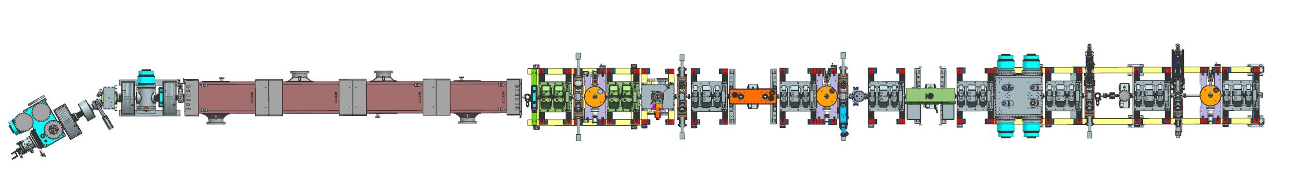
Presently assembled: PIP2IT WFE
IS + LEBT
RFQ
MEBT
Beam to dump or HWR cryomodule
30 keV, 15 mA H⁻ Ion Source (from 5 µs to DC)
LEBT (3 – solenoids; 30º bend to accommodate 2 ion sources in PIP-II)
  Chopper to form macro-pulses
CW-compatible 2.1 MeV RFQ (produced by LBNL)
10-m long MEBT with fast chopper
  2 quadrupole doublets and 7 triplets (produced by BARC, India)
  3 bunching cavities
  Collimation system (4 sets x 4 scraper plates)
  Differential pumping system

Slide 33
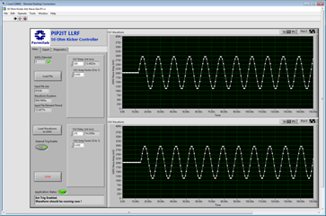
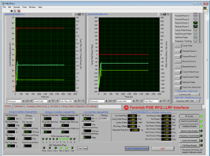
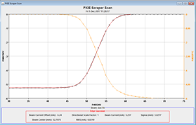
PIP2IT WFE Achievements
Beam at “CDR parameters” through a full-length MEBT
LEBT with un-neutralized section
RFQ reliably operating at CDR parameters
CW – compatible MEBT
Prototype elements of the fast chopping system
CW-compatible Machine Protection System
Diagnostics
And other development that will not be presented here, e.g.
  LLRF, control programs, 20 Hz operation …

Slide 34
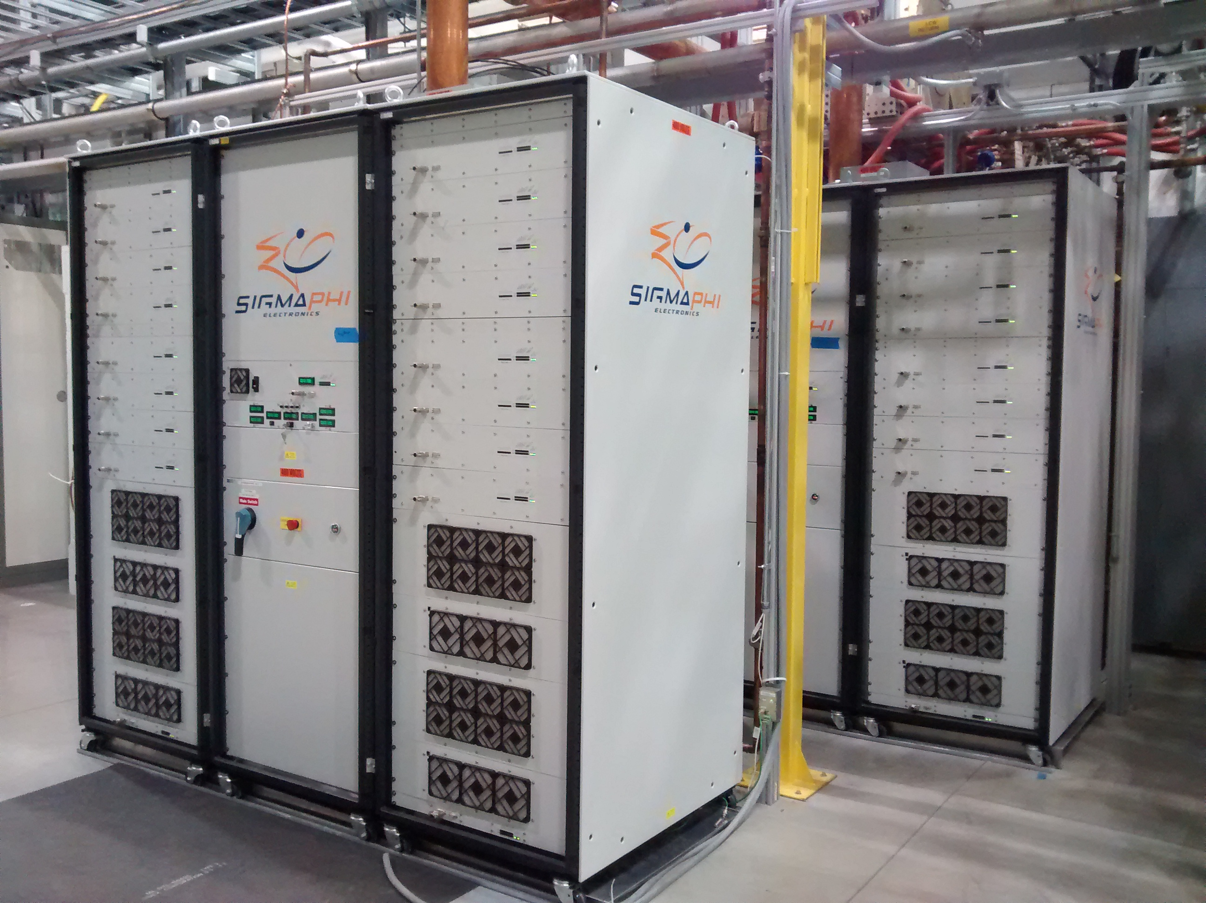
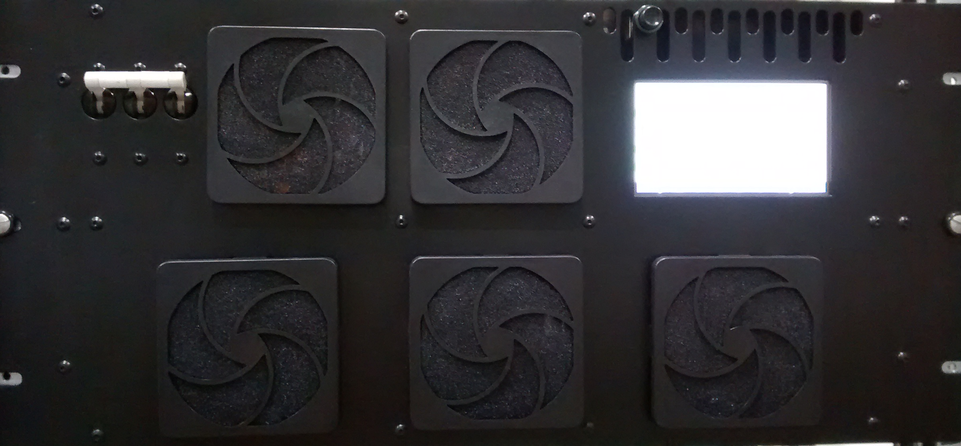
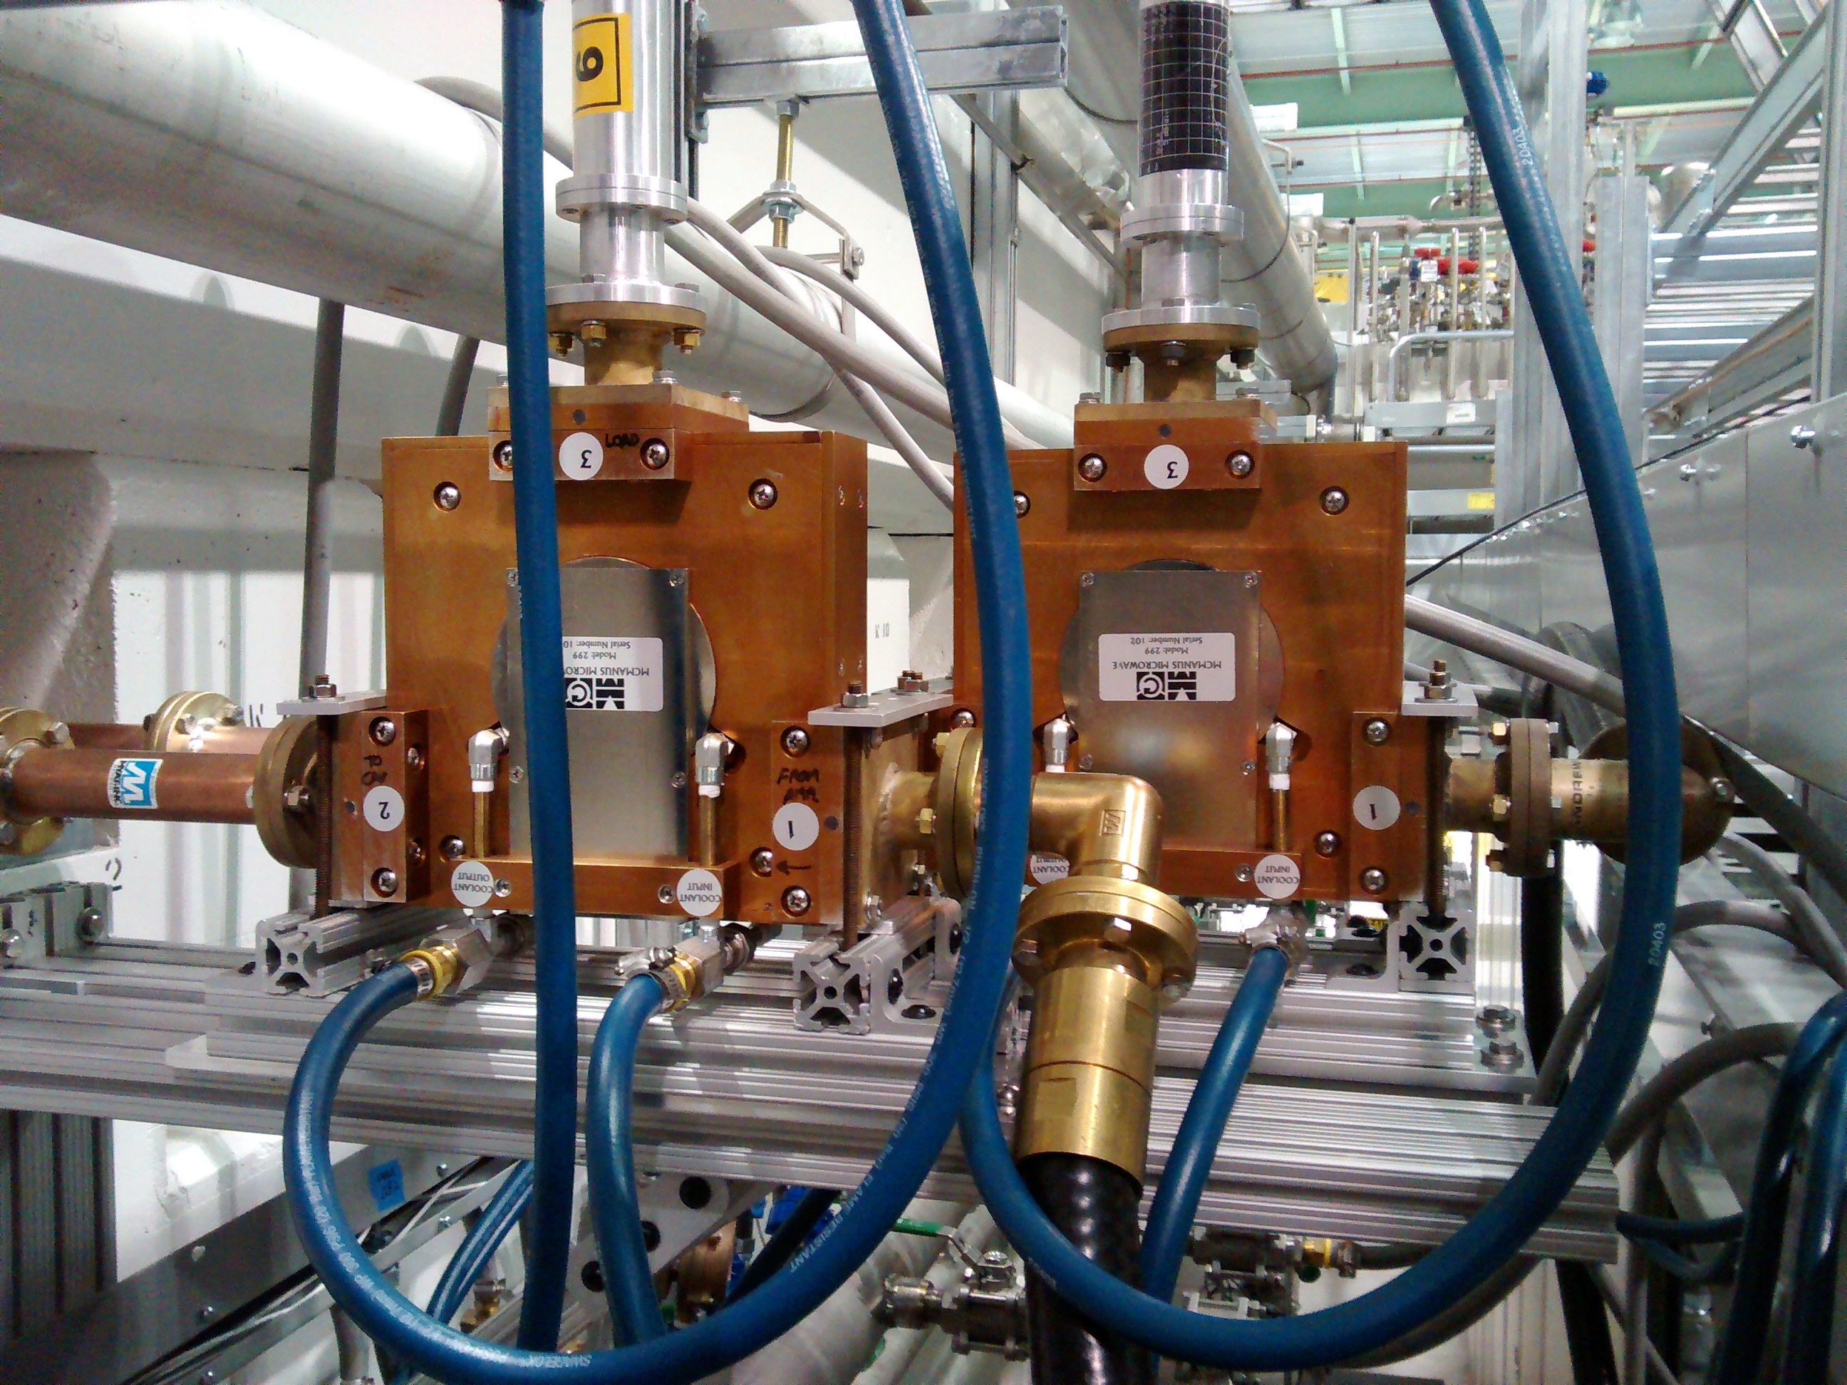
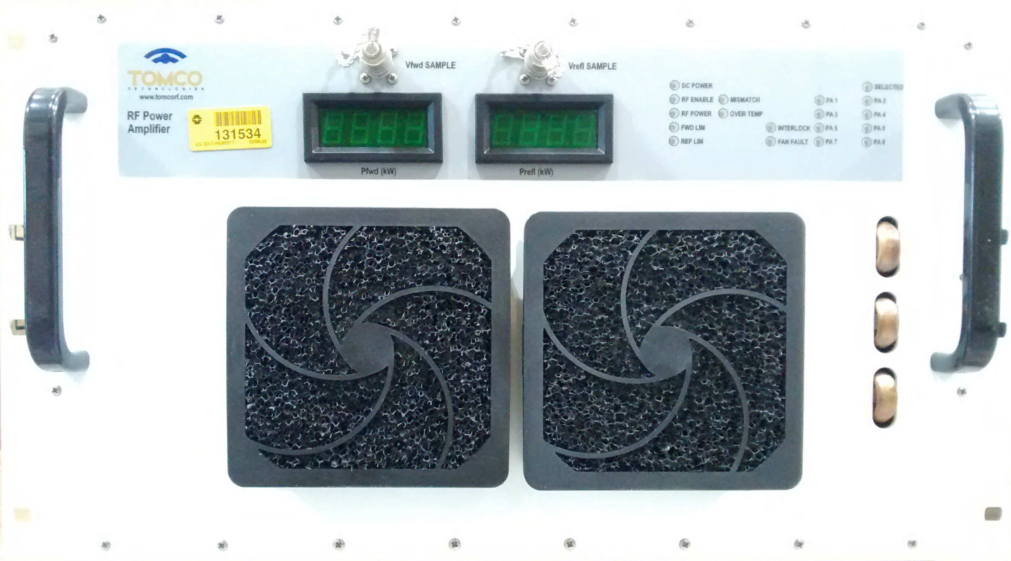
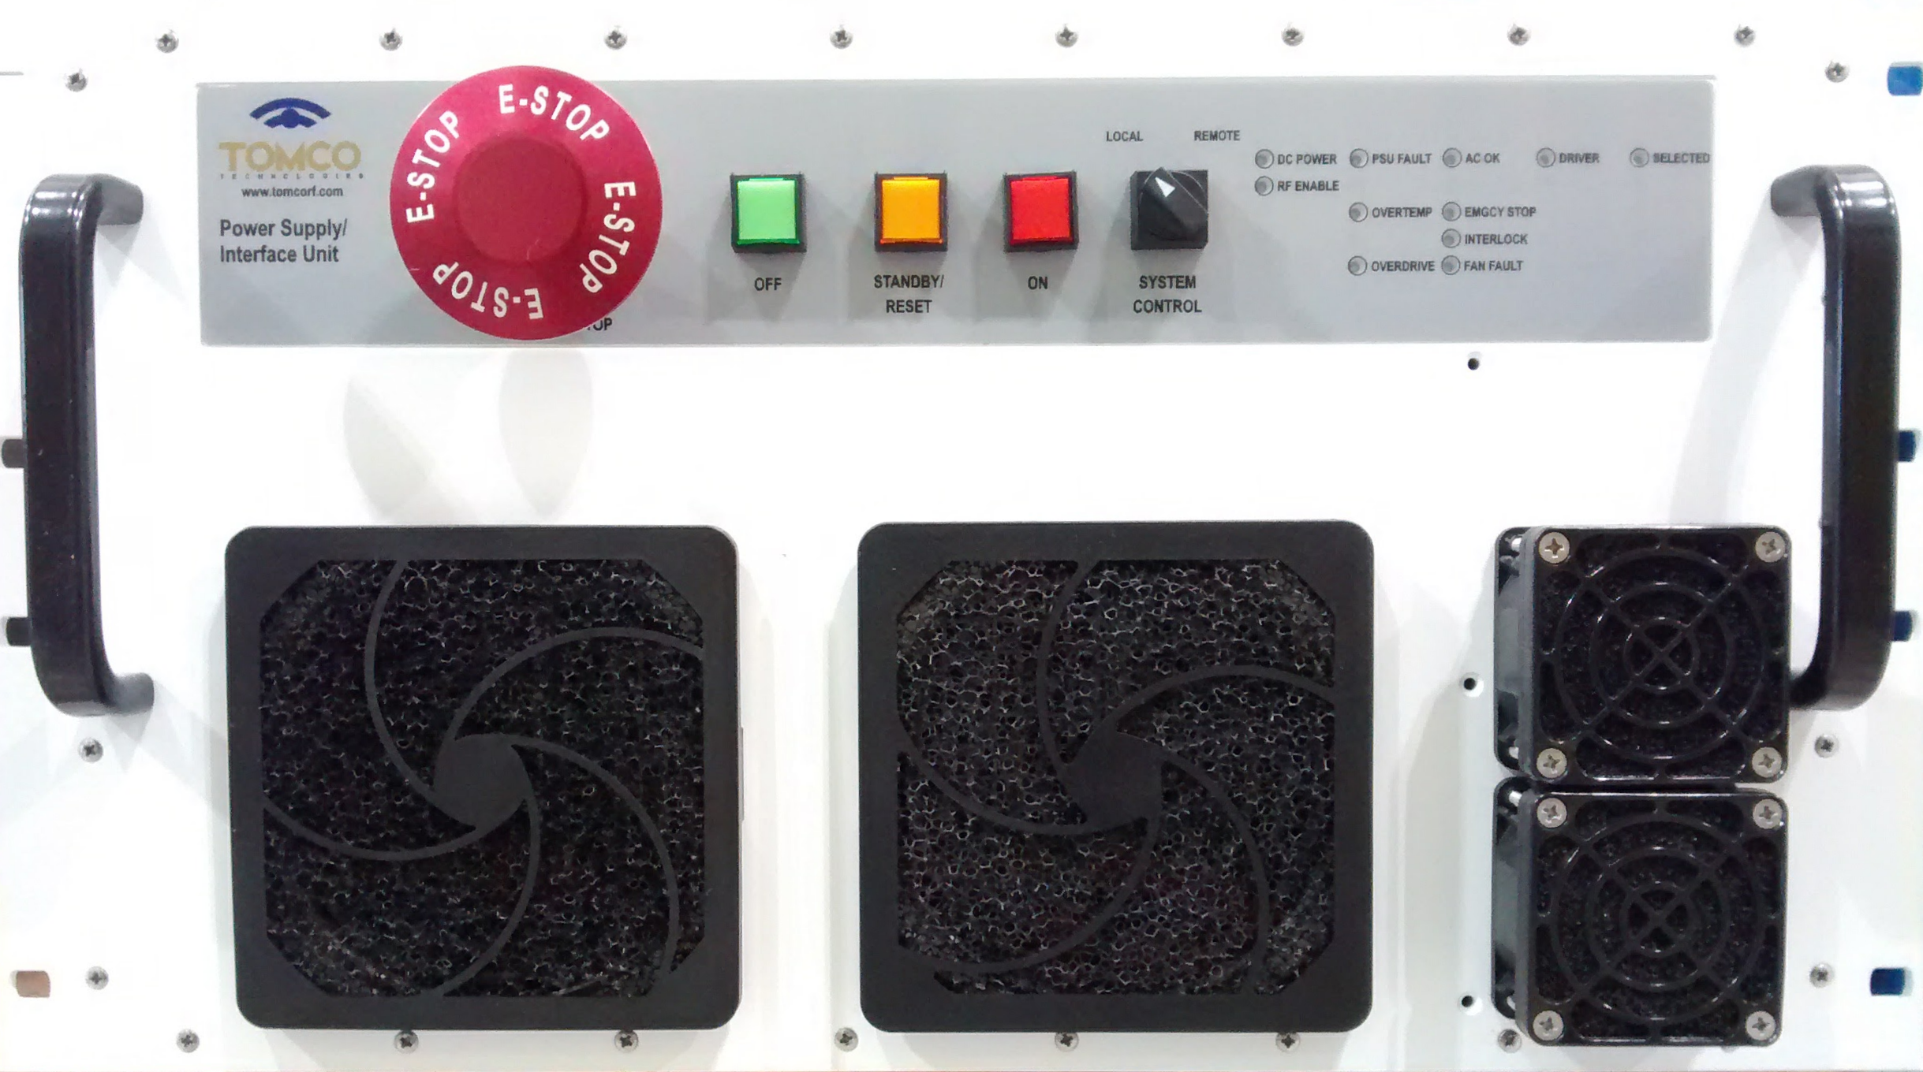
PIP2IT RF Power Progress to date
SigmaPhi 162.5 MHz, 75 kW amplifiers for RFQ have been operational at PIP2IT since 2014.
Comark/Technalogix 162.5 MHz, 3 kW amplifiers
    Buncher 1, 2 & 3 operational
    All five amplifiers at Fermilab
RF Distribution in place for RFQ and Buncher 1, 2 & 3.
Four McManus 162.5 MHz, 7 kW circulators arrived in May. Two are in use for Buncher 2 and Buncher 3.
First 162.5 MHz, 7 kW CW amplifier has arrived. Up to 7 more units to be procured in FY2018.

Slide 35
Technical Progress to Date - PIP-II 325 MHz RF Power Amplifiers
Functional Requirements Specification 7kW ➔ TC#ED0003408-A Approved
Interface Control Document 7kW ➔ TC#ED0006356-
Approved
Technical Requirements Specification 7kW ➔ TC#ED0003531-B Approved
1kW Module Testing Procedure ➔ TC#ED0006484-
Approved
7kW Amplifier Testing Procedure ➔ TC#ED0006507-
Approved
Functional Requirement Specification 20kW ➔ TC#ED0003669-

Slide 36
Technical Progress to Date - PIP-II 650 MHz RF Power Amplifiers
Functional Requirements Specification 40kW ➔ TC#ED0003413-B
Interface Control Document 40kW ➔ TC#ED0006360-
Technical Requirements Specification 40kW ➔ TC#ED0005489-A
500W Module Testing Procedure ➔ TC#ED0006585-
20kW Module Testing Procedure ➔ TC#ED0006596-
Functional Requirement Specification 70kW ➔ TC#ED0003680-

Slide 37
PIP2IT LLRF Progress to date
Complete FNAL systems operating on the RFQ and two bunching cavities supporting CW and pulsed mode validating many design decisions
Collaborations
  Two DAE engineers on site for two years
  Weekly meetings with DAE team
  Partnership agreement with Berkeley in progress
System studies including:
  Noise and feedback analysis
  Longitudinal sensitivity analysis
  Performance analysis
  RFQ resonance control

Slide 38
Progress to date: LLRF Systems and Chassis
Resonance Control Chassis
Operational LLRF at PIP2 IT(FNAL)
Seven joint FRSs Approved (two more near approval)
  TRS in process (DAE/FNAL)
8-Channel Down-Converters
  DAE version is in test
4-Channel Up-Converters
  DAE version in test
FPGA Board
  In layout
ADC-DAC FMC Module
  In Layout
Resonance Control Chassis
  Leverage from FNAL LCLS-II design and is in progress
Master Oscillator and Reference line in design
Digitizer Chassis

Slide 39
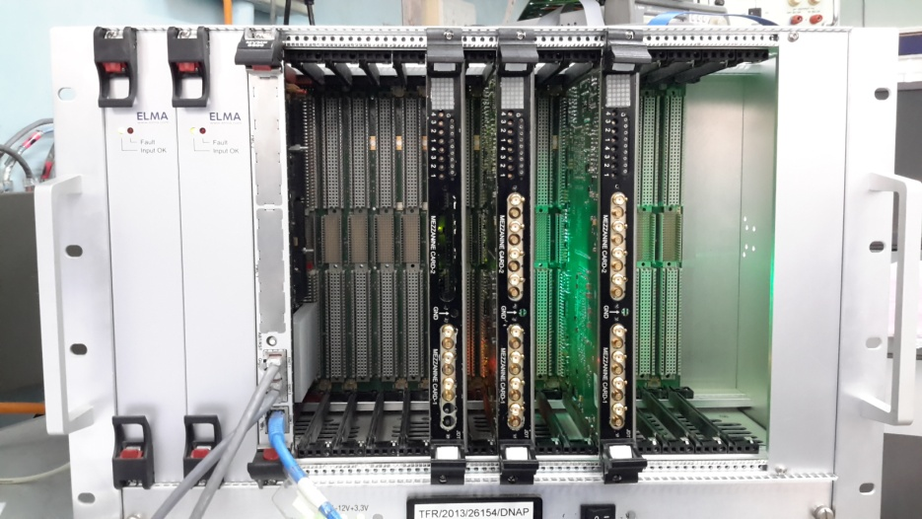
Progress to date: RFPI
RFPI Hardware Prototype Delivered by DAE

Slide 40
IIFC Collaboration Personnel
Vyaghri Lalitha Sanyasirao Sista
  Part of physicist team that operated, commissioned, and debugged linac warm front-end.
  Part of engineering team that simulated and debugged issues with RFQ.
  Created software that automatically measures beam lattice.
  Provided detailed analysis of the accuracy and precision of BPM system.

Slide 41
IIFC Collaboration Personnel
Shailesh Khole, Deeraj Sharma
  Developed and deployed UI and algorithm for 200 Ohm and 50 Ohm kickers in PIP2IT
  Began design of digitizer and FPGA boards for PIP2 prototypes
    Included filter, noise, and circuit simulation
    Documentation and support packages for FRS/TRS and design packages
  Updated FNAL VxWorks to version 6.9 as upgrade for newer VME systems
  Created testing procedures and became familiarized with LLRF concepts

Slide 42
PIP-II Scope and Deliverables – Beam position
Deliverables:
  Beam position monitor pickups
    89 warm 4-button pickups
    37 cold 4-plate pickups in HWR, SSR1 and SSR2
  Signal processing electronics, crates and cables
  Fermilab provides
    All cold BPMs
    12 MEBT 4-button BPMs
  We propose to have DAE provide
    R&D prototype signal processing electronics
    78 4-button warm BPM for construction
    512 channels of analog and digital electronics for construction

Slide 43
PIP-II Scope and Deliverables – Beam loss
Deliverables:
  Beam loss monitor pickups
    115 ionization chamber pickups
    115 PMT-based scintillator pickups
    25 neutron detectors
  Signal processing electronics, crates and cables
  We propose to have DAE provide
    115 assembled and tested ionization loss monitor detectors
    115 assembled and tested PMT-based fast loss monitor detectors
    25 assembled and tested neutron detectors
    Analog and digital DAQ electronics, electronic crates and software to support basic operation of above loss monitor detectors
    HV power supplies to operate above list of loss monitor detectors

Slide 44
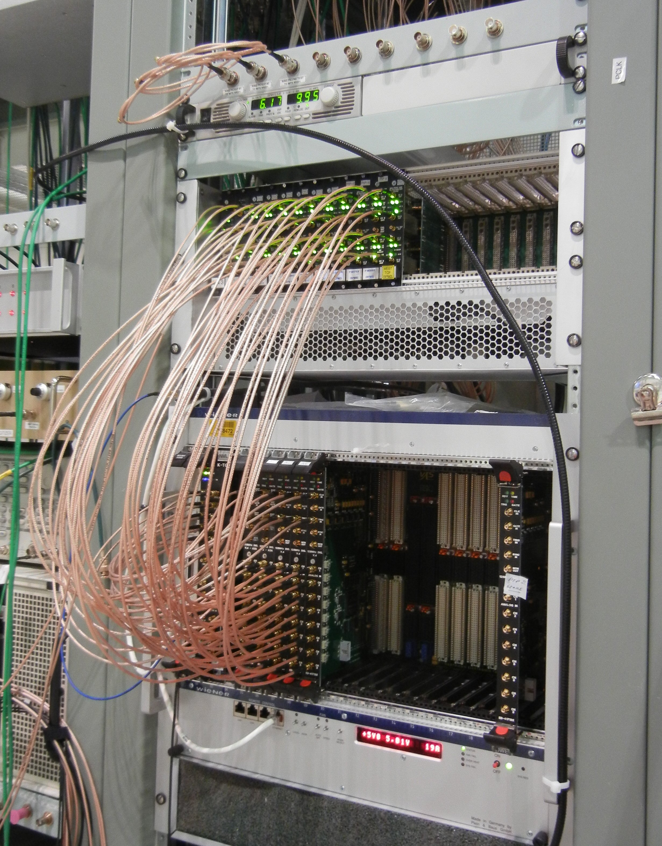



Tech. Prog. to date – Beam position
Installation and testing of BPMs in PIP2IT MEBT
  4-button BPMs attached to quad magnet
  DAQ with FPGA-based electronics for CW and pulsed beam
  Analog filter & amp boards
  8 channel, 14 bit, 125 MSPS boards
4-buttom BPM

Slide 45


Controls: PIP2IT Displays

Slide 46
Controls: Collaboration Effort
Working with multiple SPC’s to confirm communication interface between different systems.
  Verifying the communication protocol compatibility between RF power amplifiers and FNAL ACNET control system.
  Verifying alternative crate controller operating systems to VxWorks (due to contract/cost issues).

Slide 47
Summary

Slide 48
END

