Slide 1
Activities at RRCAT
650 MHz SCRF cavity
650 MHz Cryomodule
650 MHz RF Power supply
HTS-2 Development
S C Joshi, IIFC Review Meeting 7-8 Dec. 2017 at Fermilab

Slide 2
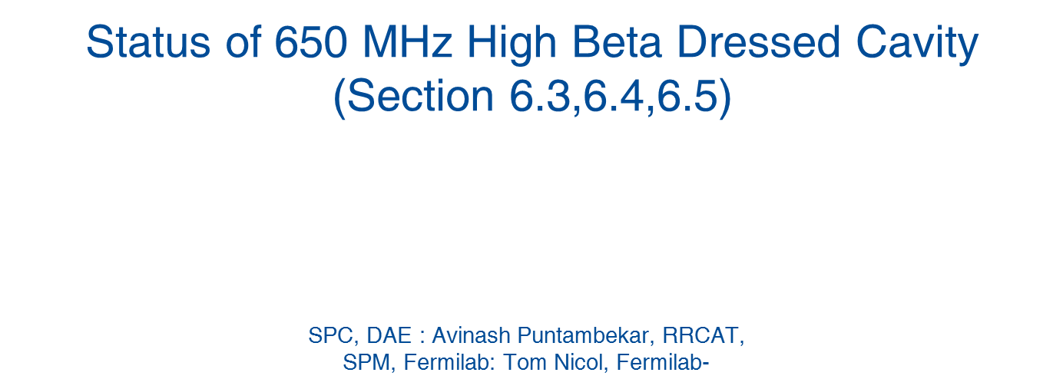
650 MHz (b=0.92) cavity

Slide 3
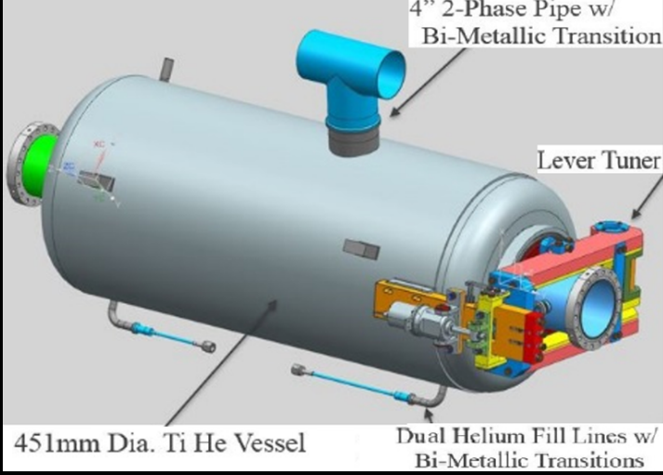
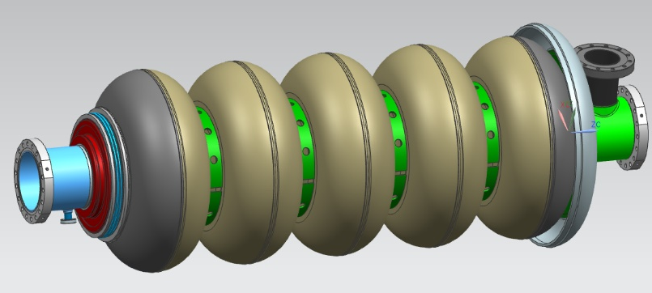
650 MHz High Beta (β=0.92) Dressed Cavity
(Section 6.3,6.4,6.5)
HB 650 MHz Five-cell bare Cavity
HB 650 MHz Dressed Cavity
A dressed cavity consist of five-cell bare cavity, Helium vessel, Tuner (slow and fast) with Bellows, Magnetic shield, Cryogenic interface, Cavity support, alignment system and Power coupler.
Sub-Project Coordinator :
Avinash Puntambekar, RRCAT, Allan Rowe, FNAL
Review meeting on IIFC activities, December 2017, RRCAT

Slide 4
6.3: HB650 MHz Dressed Cavity
Scope of work (Page # 10 of Joint Project Document)
Mile stone | Major Milestone | Qty | Delivery date | New Delivery date (as proposed for discussion)
1 | Fabricate 5-cell HB650 Cavity | 1 | 30 Sep 2016 | 31 Aug. 2017 Completed March 2017
 | Process and test 5-cell HB650 Cavity at DAE laboratories |  | 31 Mar. 2017 | March 2018
 | Dressing of 5-cell HB650 |  | 31 Oct, 2017 | Dec, 2018^{#1}
 | Testing of 5-cell dressed HB650 at DAE laboratories/Fermilab |  | 31 Mar, 2018 | Jan, 2019^{#2}
2 | Fabrication, Processing, Vertical Testing, dressing and high power testing of 5-cell HB650 at DAE laboratories | 1 | Sep, 2018 | Aug, 2019
3 | Fabrication, Processing, Vertical Testing, dressing and high power testing of 5-cell HB650 at DAE laboratories | 2 | Dec, 2018 | Dec, 2019
#1: Subject to receipt of approved documents on cavity dressing and qualification by June 2018.
#2: Subject to operationalization of integrated HTS-2 at DAE laboratories by Dec 2018
4

Slide 5
6.4: Helium Vessel and Cavity End group
  Scope of work (Page # 10, 11 of Joint Project Document)
Mile stone | Major Milestone | Qty | Delivery date | New Delivery date (as proposed for discussion)
1 | Design of SSR1 Helium Vessel | 1
 | Design of SSR2 Helium Vessel
 | Design of LB650 Helium Vessel
 | Design of HB650 Helium Vessel
 |  |  | Dec. 2015 | 30 June 2016
2 | Design of 5-cell LB650 End Group | 1
 |  |  | Dec. 2015 | Feb, 2016
 | Design of 5-cell HB650 End Group
3 | Fabrication of SSR1 Helium Vessel | 2
 | Fabrication of SSR2 Helium Vessel | 2
 | Fabrication of 5-cell LB Helium vessel and its interface to the end group at DAE laboratories | 2
 | Fabrication of 5-cell HB Helium vessel and its interface to the end group at DAE laboratories | 4 | 30 April, 2017 | Sep. 2018

Slide 6
6.5: Slow and Fast Tuner
  Scope of work (Page # 11 of Joint Project Document)
Milestone | Major Milestone | Qty | Delivery date | New Delivery date (as proposed for discussion)
1 | Design of SSR1 Slow and Fast Tuner
 | Design of SSR2 Slow and Fast Tuner
 | Design of LB650 Slow and Fast Tuner
 | Design of HB650 Slow and Fast Tuner |  | March 2016 | June 2016
2 | Design of 5-cell LB650 Tuner interface
 | Design of 5-cell HB650 Tuner interface |  | March 2016 | June 2016
3 | Fabrication of SSR2 Tuner | 2
 | Fabrication of 5-cell LB Tuner, motor, readout and its interface to the end group at DAE laboratories | 2
 | Fabrication of 5-cell HB Tuner, motor, readout and its interface to the end group at DAE laboratories | 4 | Sept. 2017 | Dec. 2018^{#1}
#1: Subjected to supply of reviewed design report, model and drawings of modified tuner by January 2018.

Slide 7
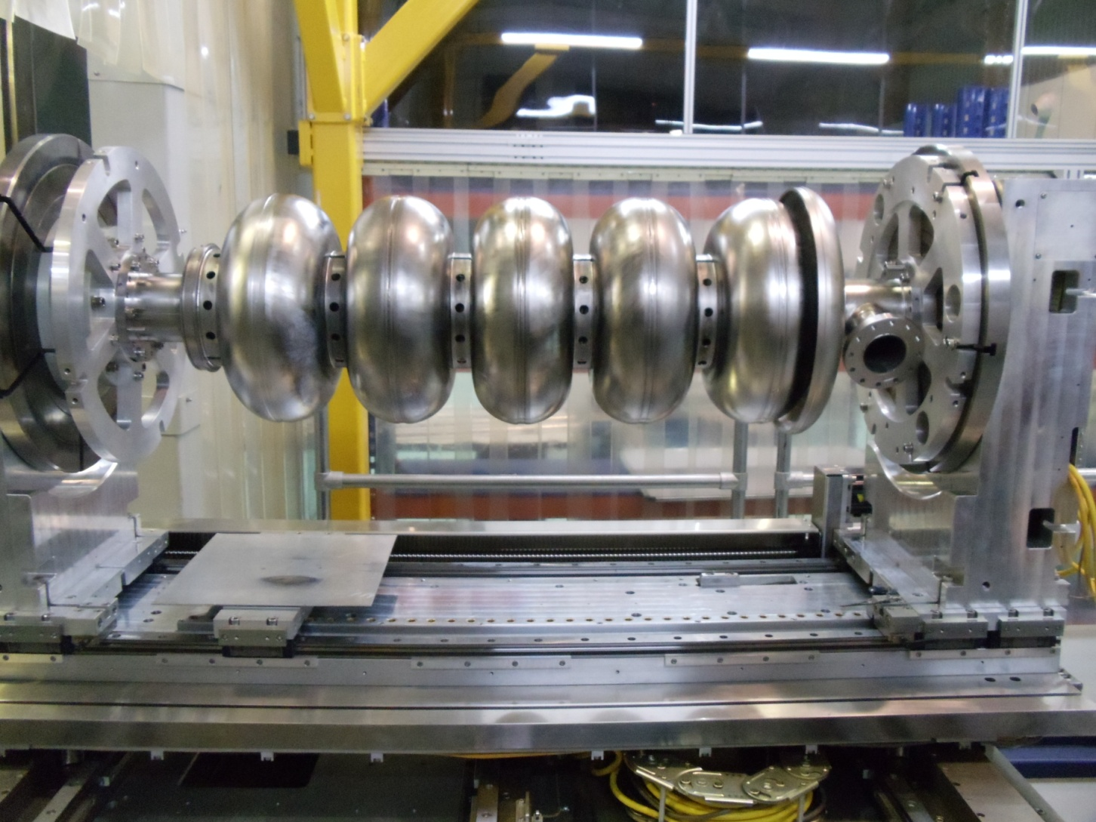
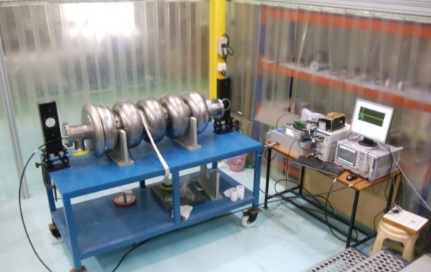
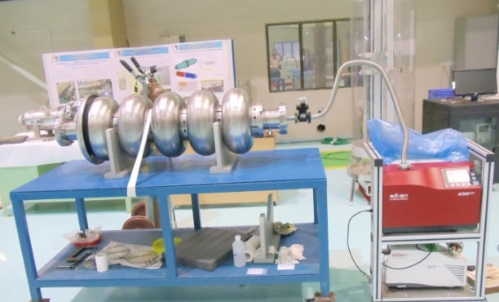
Status of HB650 MHz Five-cell (beta 0.92) SCRF cavity
Fabrication of 1st HB650 Five cell bare cavity has been completed on 31 March 2017.
It has undergone mechanical, RF and vacuum leak testing at 300K.
“Completed 1st Five-cell SCRF cavity
RRCAT-HB92-5001”.
“RF qualification
“Vacuum leak testing
Frequency at 300 K: 649.5922 MHz
Leak rate < 10⁻¹⁰ mbar/litres/second
Total length 1400 +/- 1 mm
Field Flatness ( as fabricated) ~ 40%.
After Initial tuning > 90 %
HB650 Five cell SCRF cavity is currently undergoing processing to be followed by VTS test.

Slide 8
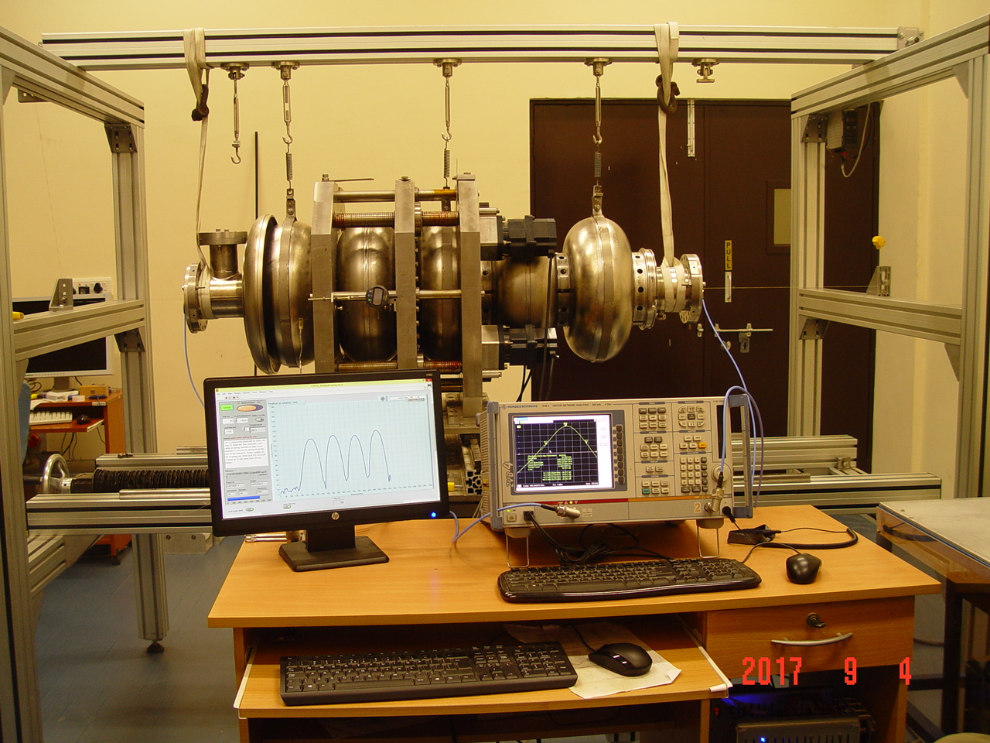
Indigenous development of a semi-automatic cavity tuning machine for tuning of five-cell 650 MHz SRF cavities
Cavity Suspension System
Tuning Machine Frame
Tuning Jaws
Five cell 650 MHz SCRF cavity
VNA
GUI

Slide 9
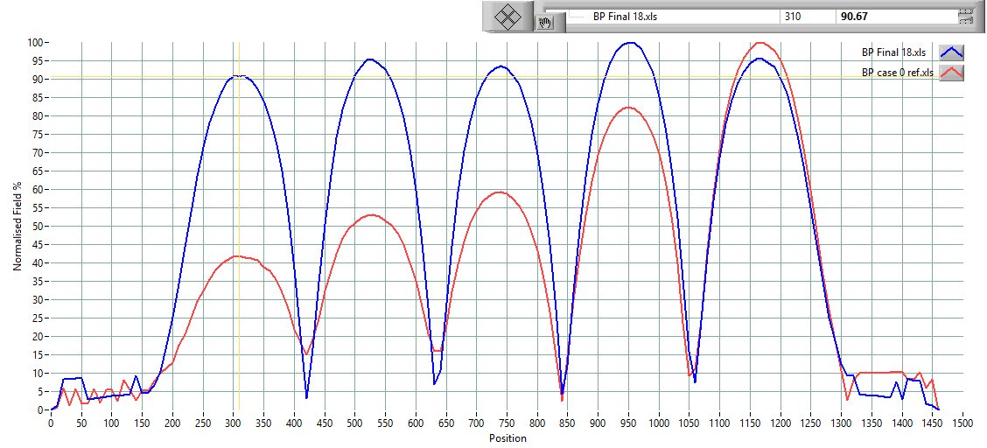
Tuning of five-cell ( β 0.92) 650 MHz SCRF cavity
Electric field distribution after tuning
Electric field distribution before tuning
Fig.:- Normalised electric field distribution
RF parameter | Initial | Final
Frequency | 649.615 MHz | 649.264 MHz
Field Flatness | 42 % | 90.6 %

Slide 10
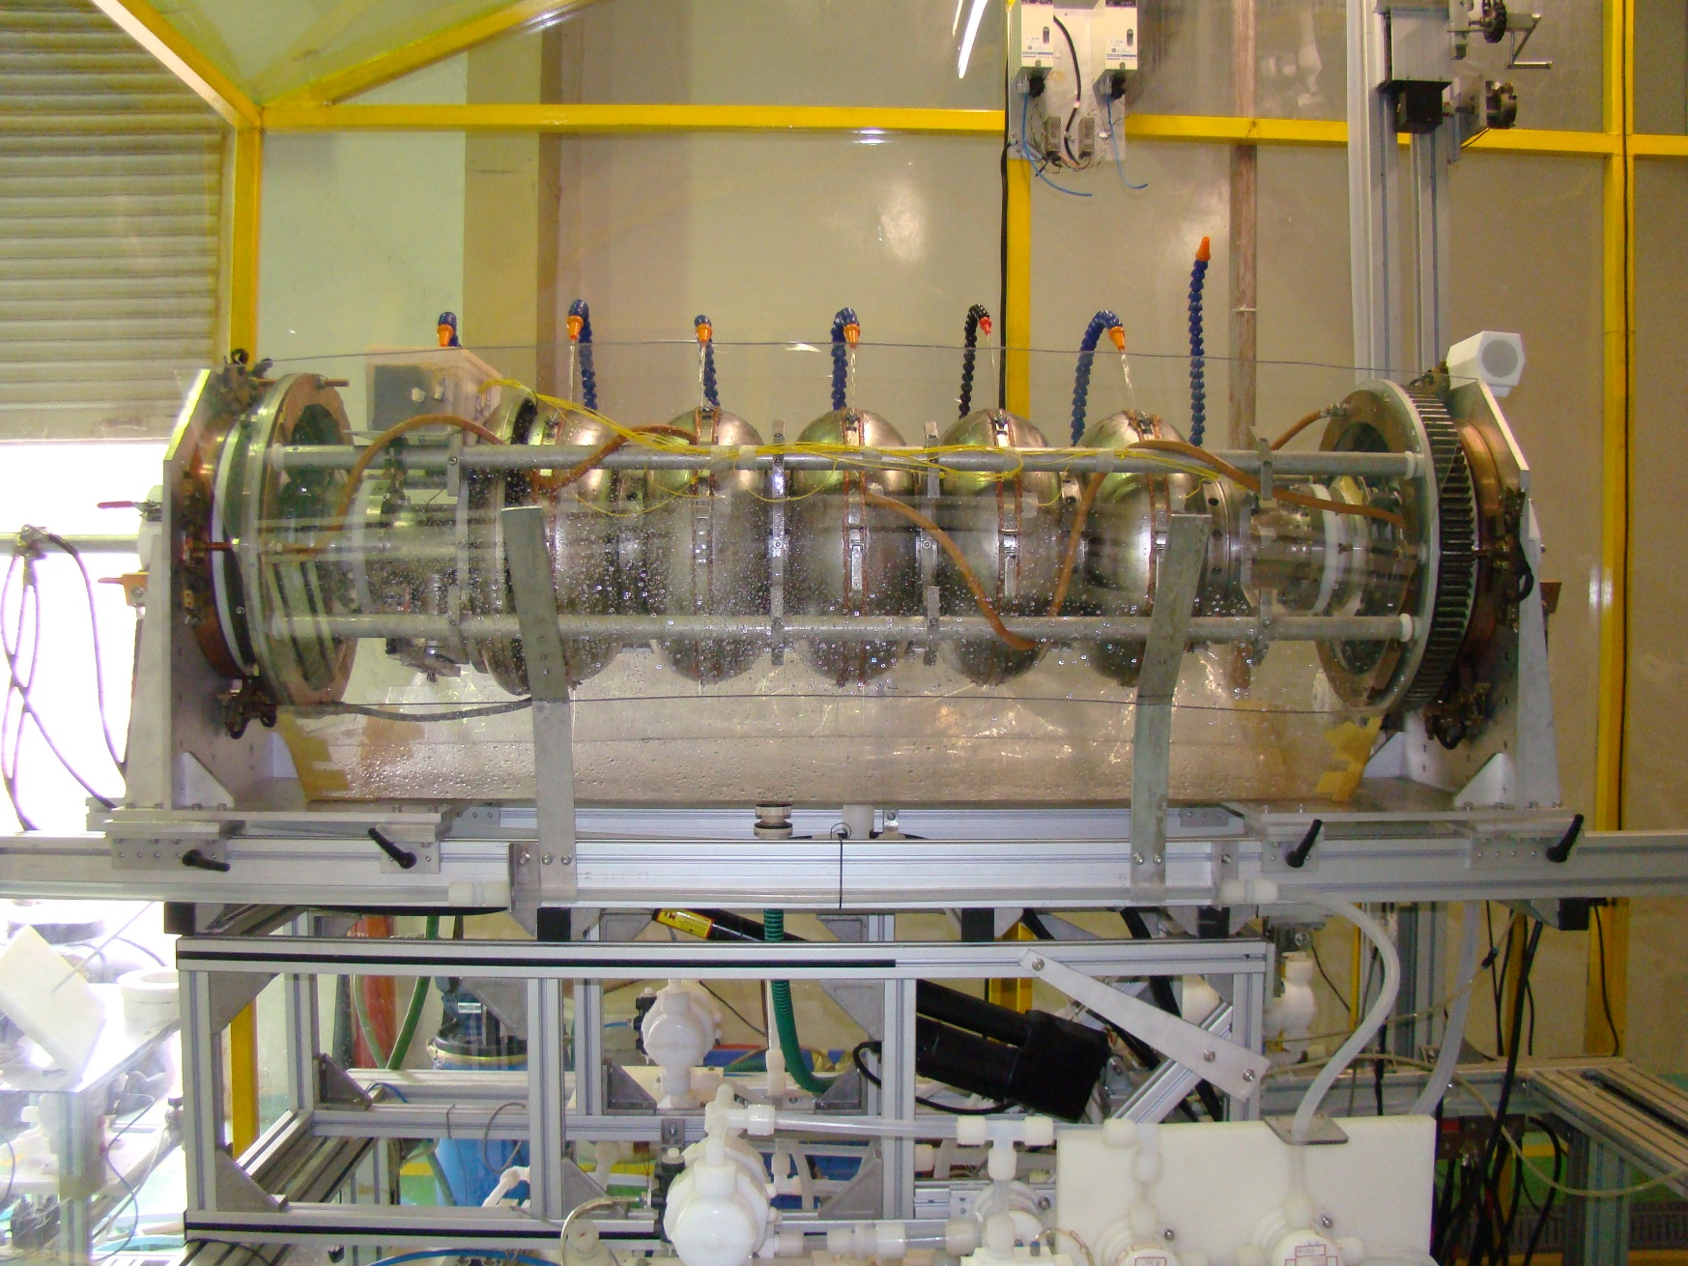
Electropolishing of Five-cell 650 MHz SCRF Cavity
Electropolishing of Five-cell 650 MHz SCRF Cavity

Slide 11
Issues for discussion
Foreseen changes in Beam Pipe length and Nb-Ti Transition (on FP end ) to accommodate modified tuner design.
  RRCAT is progressing with Fabrication of 2nd Five-cell SCRF cavity and components for 3rd are under machining. FNAL to finalise and supply the modified design/drawings at earliest for incorporation of changes in 3rd cavity components.
FNAL to share a tested single cell 650 MHz cavity to benchmark VTS facility at RRCAT.
FNAL to provide design and drawings of modified HB 650 Tuner.
  FNAL to share approved documents on cavity dressing and qualification.

Slide 12
650 MHz HB/LB Cryomodule
650 MHz HB/LB Cryomodule
(Section 6.8)
DAE-SPC: Prashant Khare, RRCAT,
Fermilab-SPM: Tom Nicol,

Slide 13
LB 650 cryomodule

Slide 14
Scope and schedule
DAE Deliverables (As per Section 6.8)
MILESTONE | MAJOR MILESTONE | QUANTITY | DELIVERY DATE | New Delivery dates (As proposed for revision)
1 | Design of325 MHz SSR1 cryomodule |  | Done
2 | Design of325 MHz SSR2 cryomodule by DAE laboratories and Fermilab |  | 31 Jan 2018
3 | Technical requirement specification (TRS) by Fermilab |  | 31 Oct 2015
4 | Design of 650MHz LB/HB cryomodule by DAE laboratories and Fermilab. # |  | Feb 2017 | LB Nov 2018 #
# Design completion for LB cryomodule is possible by November 2018 provided detailed design of cryogen distribution system (distribution system, feed can etc.) are made available by March 2018 .The work on systems like vacuum vessel, thermal shield etc. of LB cryomodule has been taken up already, as information was available about these systems.

Slide 15
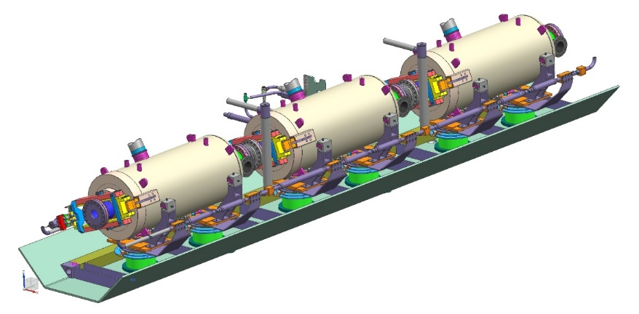
Design of LB 650 MHz SCRF Cavity Cryomodule
Design of LB 650 MHz SCRF Cavity Cryomodule is currently under progress at RRCAT. Following sub-systems of cryomodule has been designed:
Vacuum Vessel
Cavity Support System (CSS)
70K Thermal Shield
Piping layout and cryogen distribution for the cryomodule has to be designed. These systems are based on the LB 650 cryomodule solid model taken from FNAL team centre.
Design of three above mentioned major sub-systems of LB 650 MHz SCRF Cavity Cryomodule has been completed.
15

Slide 16
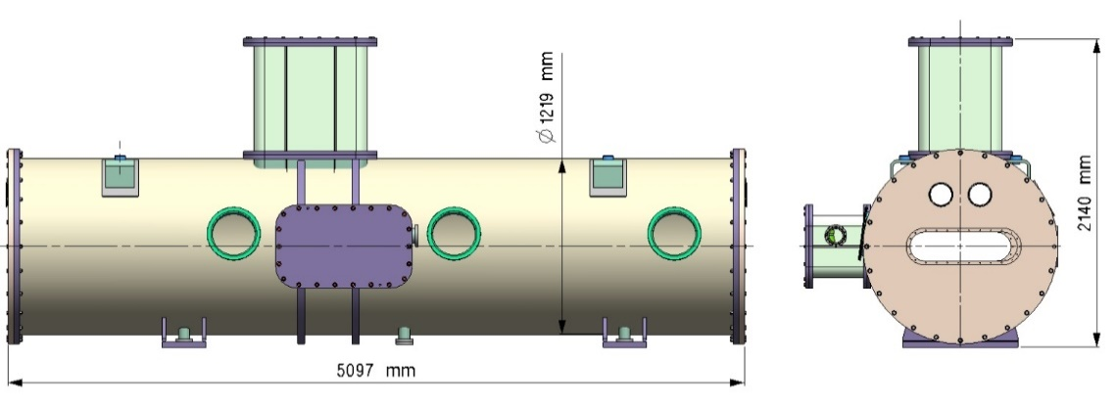
Design of Vacuum vessel for LB 650 MHz SCRF Cavity Cryomodule
Following have been calculated:
  Vacuum Vessel Shell Thickness
  Permissible Out of Roundness of Vessel Shell Thickness
  Calculations for Stiffening Ring
  Calculations and Analysis for the main vessel Shell Openings (As per Sec VIII)
  Saddle support of Vacuum Vessel
  Calculation for Flanges, Bolts and Welds for the Vacuum Vessel
Design Note for Vacuum Vessel of LB 650 MHz Cryomodule has been prepared and is now ready to be reviewed.
16

Slide 17
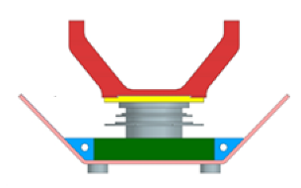
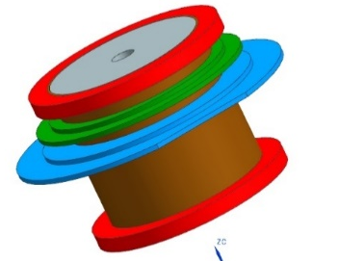
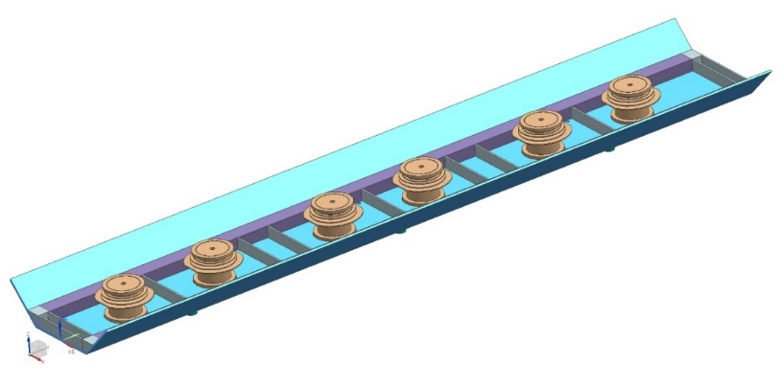
Design of CSS for LB 650 MHz SCRF Cavity Cryomodule
Cavities will be supported here
Design of cavity support system for LB 650 MHz SCRF Cavity Cryomodule has been carried out.
Following components have been designed:
Strongback structure
Cryogenic Support Post
Shape hangers will be designed after LB 650 MHz dressed cavity drawings are received.
Similar needle bearing block as used in HTS-2 will be used to support cavities over shape hangers.
Strongback will be supported on vacuum vessel
Cryogenic Support Post
Cavity Support System
Design Note for Strongback and Cryogenic Support Post of LB 650 MHz Cryomodule has been prepared and can now be reviewed.
17

Slide 18
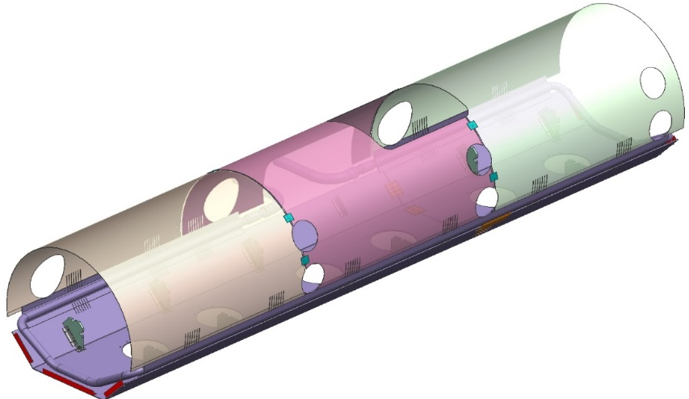
Design of 70K Thermal Shield for LB 650 MHz Cryomodule
Design of 70K thermal shield for LB 650 MHz SCRF Cavity Cryomodule has been carried out.
Design of 70K shield includes:
Optimization of finger welds
Design of cooling pipe layout
Cool down time estimation for shield
Estimation of maximum gradient during cool down
Estimation of stresses during cool down
3-D Model of 70K Thermal Shield
Design Note for 70K Thermal Shield of LB 650 MHz Cryomodule has been prepared and can now be reviewed.
18

Slide 19
650 MHz RF Power
650 MHz RF Power
(Section 7.1)
DAE-SPC: Mahendra Lad, RRCAT,
Fermilab, SPM: James Steimel, Fermilab

Slide 20
650 MHz RF Power Systems (Section 7.1)
Milestone | Major Milestone | Quantity | Responsibility | Delivery date | New Delivery Dates
1 | Design of 650 MHz 30 kW RF System
 |  |  | DAE | Done | Completed mmm/yy
 | Design of 650 MHz 40 kW RF System |  | DAE | 31 Dec 2015 | 31 Dec 2017
2 | Fabrication and testing of 2 nos. of 40 kW, 650 MHz RF System for HTS-2 for Fermilab and 2 nos. for HTS-2 for DAE laboratories. | 4 | DAE | 30 Jun 2017 | 31Dec 2019
 | Fabrication of 6, 40 kW 650 MHz RF System for CMTF being fabricated by DAE laboratories for Fermilab | 7 | DAE | 31 Jan 2018 | 31 March 2020

Slide 21
Design Changes from 30 kW to 40 kW Power in 650 MHz SSRFA
Compact design was explored in order to accommodate 48+2=50 PA modules in a euro rack compared to 32 PA modules, used in 15kW unit of 30 kW SSRFA
500W PA Modules
Compact 48 port design explored in order to get 20 kW power from a single rack instead of using three 15 kW units
Power divider and combiner
Euro rack design was completely reviewed to accommodate 48 PA modules and also 48 SMPS, as compared to earlier design using 32 modules. Water circuit was also modified.
Enclosure for 20 kW unit
In order to incorporate functional requirement and to control two units in master-slave made, major changes were done by incorporating microcontroller based control boards in new 40kW SSRFA.
Distributed Embedded data acquisition

Slide 22
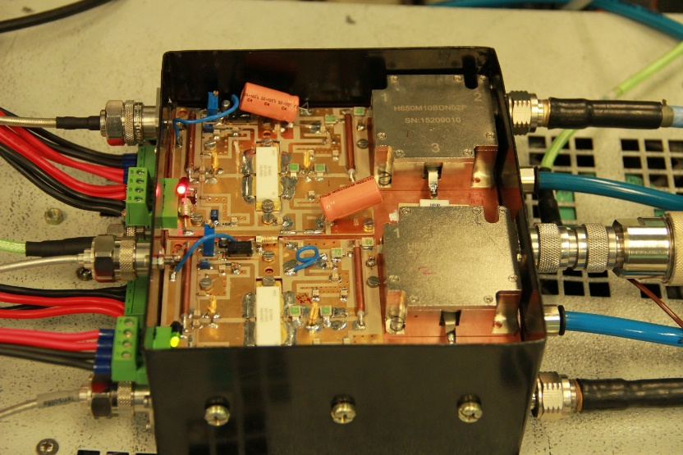
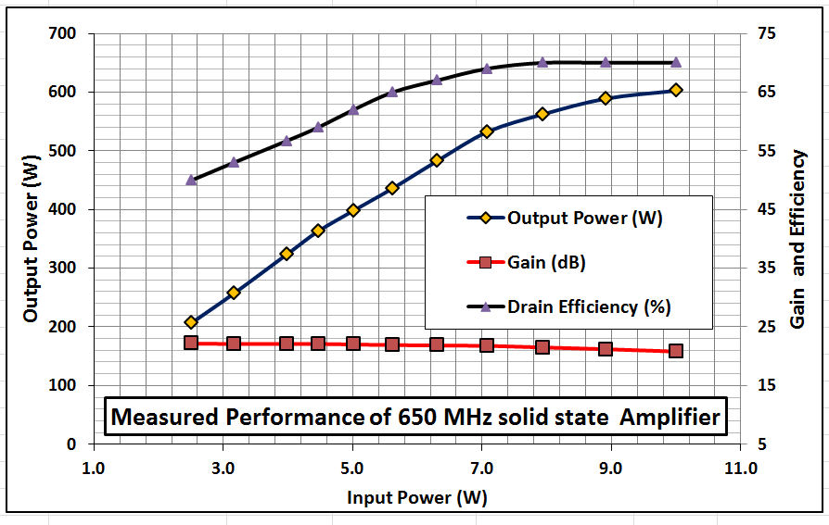
500 W RF Power Module
Compact PA modules with 4*500W (four modules of 500 W each) was recently qualified with RF & thermal. It has two 500W PA modules back to back on each side of a common copper cold plate.
Operating frequency:650 MHz
Output Power: 500W (CW)
Gain: 18 dB
Bias Voltage: 50 V DC
Drain Efficiency: > 67%
Input/Output:N type connector
Cooling: Water Cooled

Slide 23
Scheme for 650 MHz 40 kW RF Power Source
Driver
1
+
RF Generator
1
RF Generator
500 W
modules
24
+
+
40 kW
21
20 kW
Driver
+
2
39
20 kW Units
48
20 kW Unit scheme used in 30kW Amplifier
40kW Amplifier Scheme
Proposed scheme for 40kW solid state amplifier -
  40kW power will be obtained by summing output of two 20 kW units.
  Each 20 kW unit will be housed in a single euro rack with 48 amplifier modules, each one using LDMOS giving output RF power of 500 W.
23
Notes:
23
23

Slide 24
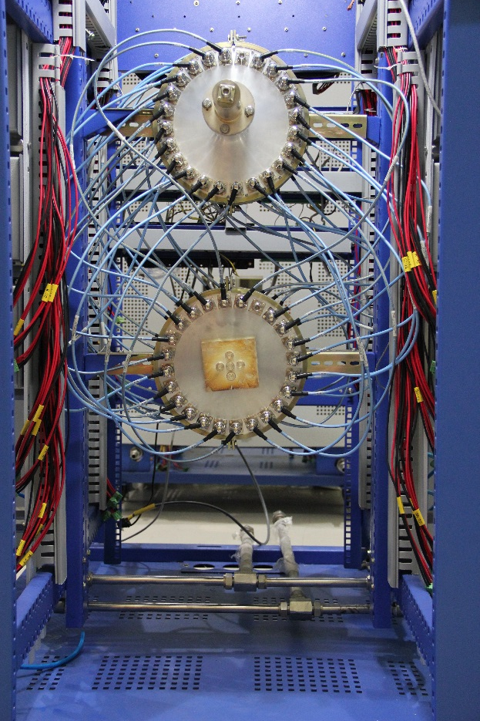
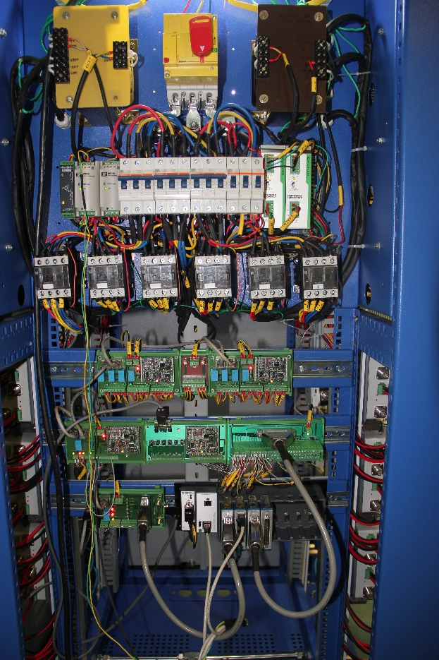
650 MHz, 40 kW Solid state RF Amplifier:
Major Sub systems
48 way Power divider and combiner
Electrical and embedded control sub systems

Slide 25
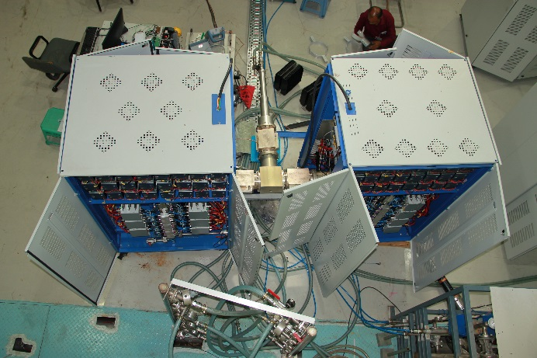
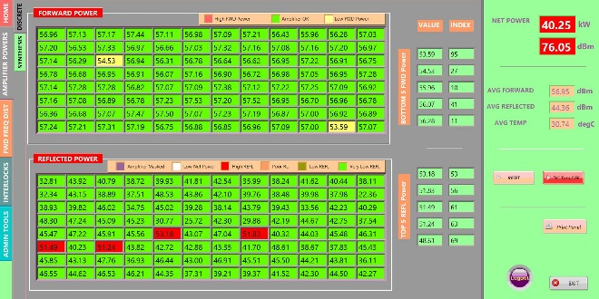
650 MHz, 40 kW CW Solid state RF Amplifier
(as per TRS under finalization)
Snap shot of display panal while testing at 40 kW ,top half shows forward powers of all 48 modules and bottom half shows reflected powers of all 48 modules in dBm
Test Results: Output Power (650 MHz) : 40 kW ,harmonics < -30 dBc
Gain: 70 dB, RF radiation<0.1 mW/cm2 at 1m, Input Mains supply: 3 Phase AC

Slide 26
HTS-2 Cryostat
HTS-2 Cryostat
(Section 8.1)
DAE, SPC : Pradeep Kush, RRCAT,
Fermilab SPM : Joe Ozelis, Fermilab

Slide 27
Section 8.1. Horizontal Test Stand
Milestone | Major Milestone | Quantity | Responsibility | Delivery date | New Delivery Dates | Remarks
1 | Design of HTS-2 Cryostat |  | FNAL | Done | Completed Oct 2014
 | Review of HTS-2 Cryostat Design |  | FNAL | Done | Completed Nov 2014
 | Procurement Review of HTS-2 Cryostat Design |  | FNAL | Done | Completed Mar 2015
2 | Fermilab to supply necessary software and hardware required for integration of HTS-2 | 2 sets | FNAL | 31 Dec 2015 | March 2017 | #1
3 | Fabrication of HTS-2 Cryostats, one for Fermilab and one for DAE laboratories | 2 | DAE | 31 Dec 2016 | Feb 2018 | #2
4 | Development of controls for HTS-2 | 2 sets | DAE + FNAL | 31 Dec 2016 | Jan 2018 | #3
5 | Integration of first HTS-2 Cryostat at DAE laboratories | 1 | DAE + FNAL | 31 Jul 2017 | Dec 2018 | #4
6 | Delivery of HTS-2 cryostat to Fermilab | 1 | DAE | 30 Sep 2017 | Apr 2019
#1: Hardware to be received from FNAL for two HTS cryostats by Jan 2017 at the time of confirmation of purchase order by the fabricator.
#2: TIS - Technical Interface Specification: Should be available at the earliest, as based on the TIS document, equipment have to be procured or fabricated such as cryogenic interface components (Interfacing with cryogen distribution).
#3: Availability of FRS for HTS-2 control system integration at Fermilab & RRCAT required by 30th April, 2017. The information includes - information on system (HTS-2 and its sub-systems).
#4: Commissioning plan should be available from Fermilab by Dec 2017.

Slide 28
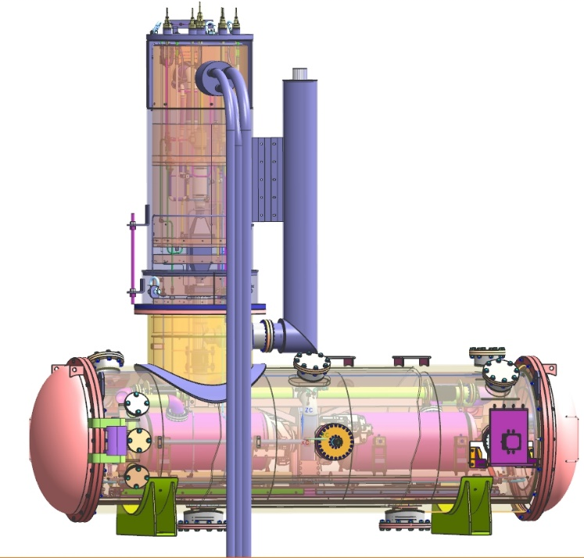
Status of Fabrication of Horizontal Test Stand-2 (HTS-2)
Purchase order for HTS-2 has been released on 06 Sept 2017.
Drawings of vacuum vessel has been reviewed and finalized.
Drawings of other subsystems are under preparation and will be reviewed.
QAP and Assembly sequence has been received from vendor.
Kick off Meeting has been carried out with the vendor for cryostat fabrication, on 20th Nov 2017.
4184 mm
ϕ 1290 mm
4293 mm
3-D Model of HTS-2
Fabrication work for vacuum vessel and other systems is about to start.
28

Slide 29
Inputs required from Fermilab (For HTS-2 Fabrication)
Following inputs are required from Fermilab, USA:
QAP and assembly sequence has been sent to FNAL on 30/10/2017. Inputs if any, are required before 10th Dec 2017.
Vacuum vessel fabrication to start from 1st Dec 2017. This would be done as per drawings sent to FNAL on 3/11/2017.
Plug compatibility issues for power coupler e.g. diameter of coupler port ring flange , position with respect to support post ring flange etc. to be seen by FNAL.
Vendor has requested an alternate brand for brazing filler material instead of "Handy and Harmen Braze 560“ mentioned in fabrication specs. FNAL to confirm the same.
Some queries related to Feedcan have been put by the vendor. FNAL is requested to clear these before 31st Dec 2017.
Information on number of cable harnesses and locations needs to be provided.
FNAL to inform about the list of items and date of dispatch of free issue material, along with installation information and other catalogue information.

Slide 30
Tentative Time Schedule of HTS2 Cryostat Fabrication with Major Activities
(based on inputs from INOX and based on progress till date)
Main Activities | Time period | Remark
Verification of Cryostat vacuum vessel design | Oct-Nov 2017 | Already approved by AI BUREAU VERITAS
Detailed QAP | Oct-Nov 2017 | RRCAT reviewed and sent back with suggestions.
Fabrication of Cryostat vacuum vessels | Dec 2017 –March 2018
Fabrication of Feedcan assly. | Jan - April 2018
Pressure test of vacuum vessel | Mar- April 2018 | FNAL Expert to witness
Start of Final assembly and testing (All major hold points) | May–July 2018 | FNAL Expert to witness
Packing and shipment | Aug 2018
Assembly and testing at site (RRCAT) | Sept- Oct 2018 | FNAL Expert to participate in testing
Next Slide

Slide 31
HTS-2 Control Electronics

Slide 32
Overall Control Integration of HTS-2 at RRCAT: Inputs needed from Fermilab
Fermilab to supply necessary software and hardware required for integration of HTS-2
FRS for HTS-2 overall control system integration at RRCAT
Information & Documentation on HTS system operation, cavity testing and characterisation.
HTS-1 LabVIEW software for cavity testing and characterisation.
System Interface specifications for HTS-2 at FNAL.
Software requirement specifications for HTS-2 overall control system integration at FNAL.
Installation & commissioning plan for HTS-2 at RRCAT.
Design review of overall control integration for HTS-2 at RRCAT.
Safety Review of overall control integration for HTS-2 at RRCAT.
Operational readiness review of overall control integration for HTS-2 at RRCAT

Slide 33
Issues and how we propose to tackle them
The main issues being faced are the lack of information/specifications/ system requirements and no participation from RRCAT team in HTS-1 testing which is making it difficult for us to have first hand assessment of the system requirements and chalk out the controls system design.
We have been putting up repeated requests to FNAL for the information needed through SPC &TCs.
Overall Control Integration of HTS-2: Summary
Fermilab to provide required information at the earliest .
We will circulate a document to various sub-systems to internally gather information from them

Slide 34
Overall Control Integration of HTS-2: Summary
However, Information available about the system is grossly insufficient.
Fermilab to provide required information at the earliest.
We will circulate a document to various sub-systems to internally gather information from them.

Slide 35
Thank You
35

