Slide 1
Visitor Program
Steve Holmes
Fermilab Technical Coordinator
7 December 2017

Slide 2
DAE Visitors at Fermilab/Background
We have had two kinds of DAE visitors at Fermilab
Long-term (2-year) assignments
Short-term (<3 months) visits
Visits are administered differently
Long-term visitors carry a Fermilab staff appointment (Guest Engineer) and a local supervisor, in addition to their DAE home lab supervisor
Short-term visitors are treated like any collaborating “user” by Fermilab, and are recognized as full employees of their DAE home lab.
During the PIP-II DOE reviews we have highlighted the long-term visitors program as a particular success of the collaboration
Visits provide real value to both Fermilab and DAE.

Slide 3
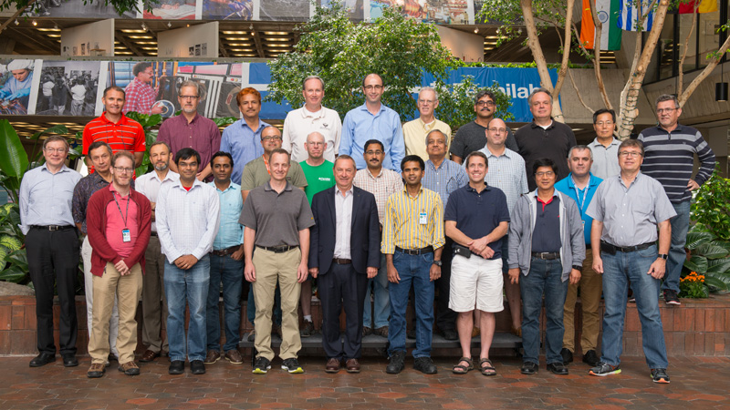
Long Term Visitors – First Cohort

Slide 4
Long Term Visitors – First Cohort
First cohort arrived in fall of 2015 and departed in fall of 2017
Six (of seven initial) visitors here for the entire period
Assignments
SRF: HB650 cavity – V. Jain (RRCAT)
Accel Phys: V.L.S. “Sunny” Sista (BARC)
Cryo: A. Chakravarty (BARC), T. Rane (BARC)
LLRF: S. Khole (BARC), D. Sharma (RRCAT)
In addition to benefiting Fermilab and DAE we believe the visits benefited the individuals both personally and professionally
Supplemental tours (Fermilab PIP-II, g-2, Main Injector; Argonne/APS)
Vacation destinations: Total solar eclipse, Grand Canyon, Hawaii
One Issue
There are U.S. tax consequences for being resident in three calendar years → we will avoid this with second cohort, i.e. visits will be <2 years, nominally 18 months

Slide 5
Long Term Visitors – Second Cohort
Technical Coordinators have been working to identify second cohort following reauthorization of the program by DAE.
Agree on five positions:
Linac accelerator physics – Scientist (1)
SSR1,2 Cavities and Cryomodules – Mech Eng (2)
HB650 Cavities and Cryomodules – Mech Eng (1)
Cryogenic systems – Cryo Eng (1)
Fermilab has provided job descriptions to DAE
DAE to nominate single candidate for each position and provide CV for review by Fermilab.
Goal is to identify the second cohort by ~January 1

