Slide 1
Precision Physics at Colliders
How to choose wisely, measure carefully, and exploit ruthlessly

Slide 2
Precision Physics at Colliders 3:
The Mystery of flavor

Slide 3
Most major direct discoveries have been heralded by a lower energy measurement!
N. Tuning,
ICHEP 2018

Slide 4
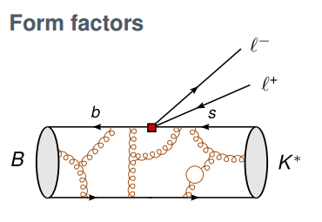
Probing electroweak scale physics with hadron decays
Use the effective field theory approach:
Compute short distance matrix element at the electroweak scale for fermion initial and final states of interest
  b → s l+ l-
  b → c l ν
  bs ◊ μμ
  Etc.
WLOG, the short distance calculations can be characterized by a general operator product expansion over all allowed combinations of lowest-dimension fermion operators weighted by Wilson coefficients
Wilson coefficients can be evolved down to the mhad scale and convolved with long-distance form factors which connect quarks to initial and final state hadrons (this part is difficult!)
Wilson coefficients can be measured experimentally from decay rates and kinematics of hadron decays, and then interpreted with your favorite UV-complete theory (SM, SUSY, leptoquarks, Z’, etc.).
Can also extract CKM matrix elements and CP violating phases as a precision SM test

Slide 5
b-hadron basics
Lowest mass mesons are B⁰ (db) and B⁺ (ub), with a mass of 5.28 GeV and a lifetime of ~1.5 ps (~100 μm)
At hadron colliders, produced along with B_{s} (sb), B_{c} (cb) and Λ_{b} (udb).
Distinguished from light quarks by a displaced decay vertex (>100 μm), and reconstructed mass close to MB.
Produced with a large cross section at hadron colliders (100s of μb) peaking at forward rapidities
For general purpose experiments (ATLAS/CMS), these can easily overwhelm their trigger/DAQ unless there is high purity selection (decays to single or di-muons)
LHCb geometry, detectors, computing model, and trigger/DAQ optimized to identify and collect b-hadrons
LHCb
CMS/ATLAS

Slide 6
LHCb
Rapidity coverage from η = 2 to 5 (one side only)
Luminosity levelling to keep pileup low (~ 10x less lumi than CMS/ATLAS), but trigger/DAQ to read out a much larger fraction of accepted b hadrons.
Tracking, calorimetry, muons comparable to CMS/ATLAS
(can do precision electroweak!)
Ring-imaging Cherenkov detectors to provide π/K particle ID (95% K ID at 5% pion fake rate)

Slide 7
Strange Penguins: The Case of
B⁰ → K*⁰ l⁺l⁻

Slide 8
b→ s Operator Product Expansion
general Hamiltonian
of b→s transitions
C7 “photon penguin”
C8 “gluon penguin”
C9 “Z penguin”
C10 “W box”. etc.
C7’, C9’, C10’ = opposite helicity projection of C7, C9, C10
Plus:
CS, CP = scalar and pseudoscalar FCNCs (e.g. Higgs-like penguin)
In SM, “top-penguins” dominate b→s; u- and c-penguins non-negligible for b→d
b→s, b→d, s→d, etc. could all have different C_{i} from new physics

Slide 9
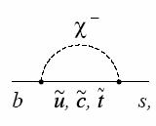
B →K ll, B →K* ll
Photon penguin (C7)
Vector EW (C9)
Axial-vector EW (C10)
Exclusive decays from three b→ sll penguin diagrams
New physics possible for each diagram, and also new operators
(scalar penguins, right-handed currents)
For K*ll, four-body kinematic distributions, angular distributions, and decay rates to measure all three (complex) penguin amplitudes
Rare process with BF ~ 10⁻⁶

Slide 10
Measuring decay angles
For B⁰, θ_{l} is the angle between the μ+ in the dimuon rest frame and the dimuon momentum in the B⁰ rest frame.
θ_{K} is the angle between the K+ in the K* rest frame and the K* momentum in the B⁰ rest frame.
φ is the angle between the two decay planes in the B⁰ rest frame

Slide 11
B → K* ll observables of interest
A general angular decomposition can be performed for the CP-summed normalized decay rate as a function of dilepton q²
Each of the 8 independent coefficients probes a different bilinear dependence on amplitudes encoding K* transversity and lepton chirality which in turn have different C_{i} dependence.
FL : longitudinal polarization of the K*
AFB: forward-backward asymmetry of the lepton decay angle
S_{i} φ-dependent angular coefficients
S6 = 4/3*AFB

Slide 12
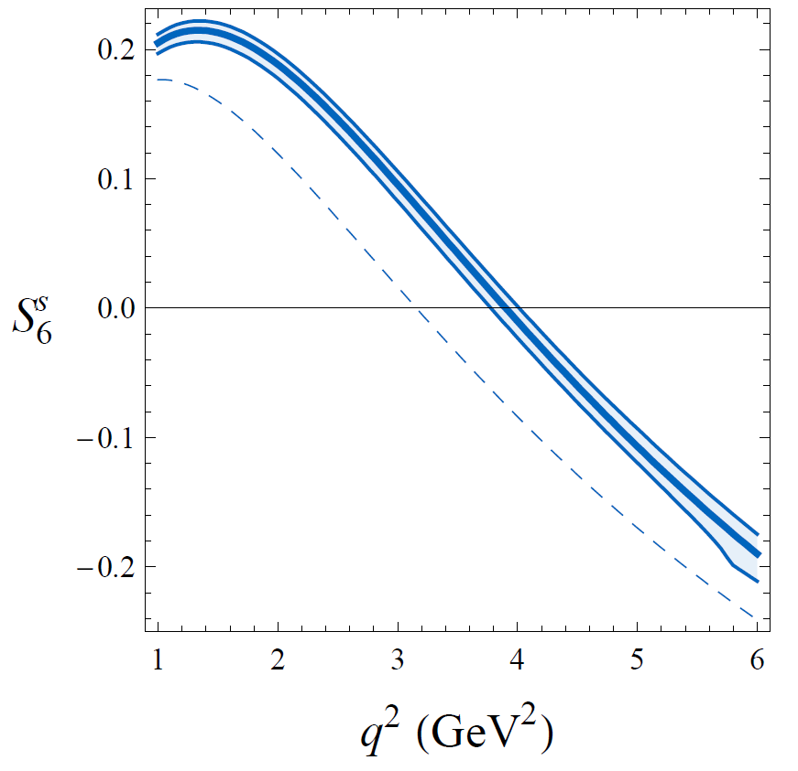
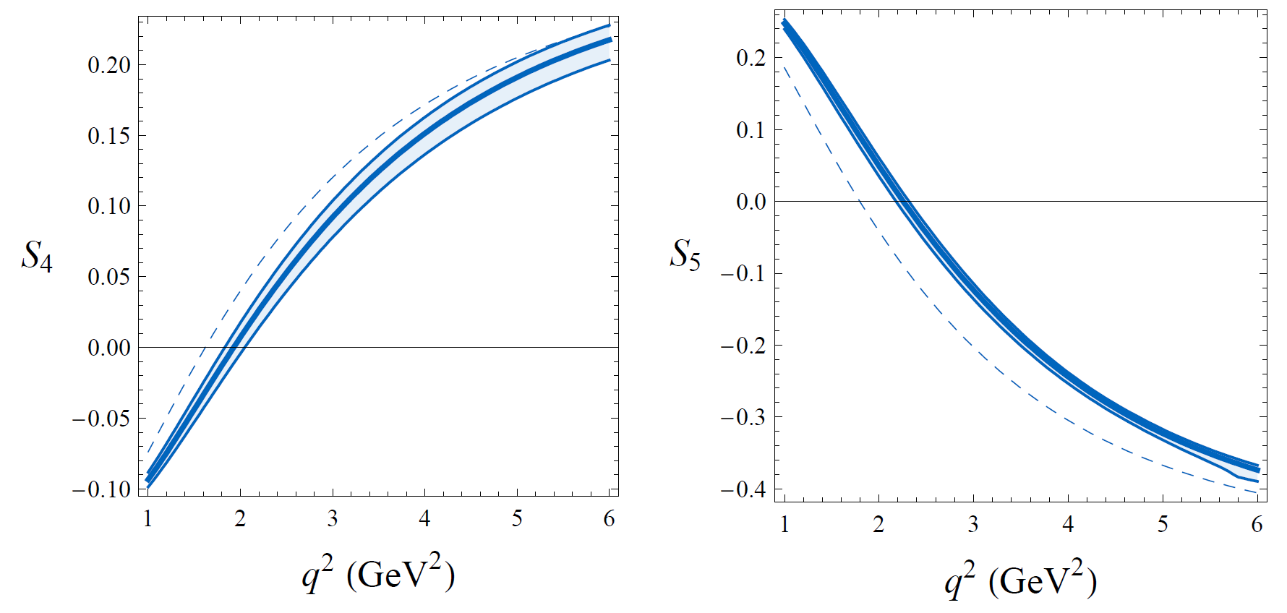
B → K* ll observables of interest
NLO QCD-factorization
predictions
arxiv:0811.1214
AFB=3S₆/4
AFB precisely predicted, as well as a precise 0-point
Some are more and less precisely predicted, mostly due to form factor uncertainty
S4-S6 observably large

Slide 13
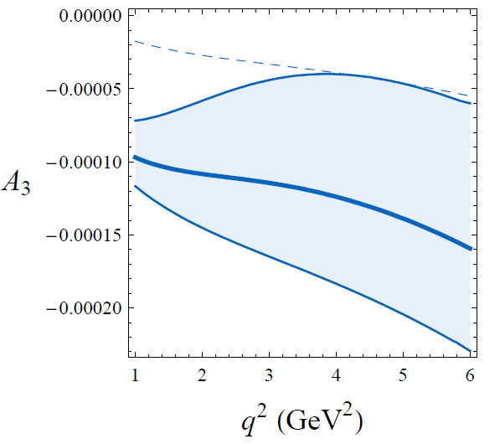
B → K* ll observables of interest
NLO QCD-factorization
predictions
arxiv:0811.1214
Each Si can be CP-subtracted (B – B) to provide CP-asymmetries
Ai = Si – Si, all tiny in SM

Slide 14
B → K* ll observables of interest
NLO QCD-factorization
predictions
arxiv:0811.1214
Overall CP
asymmetry vs. q2

Slide 15
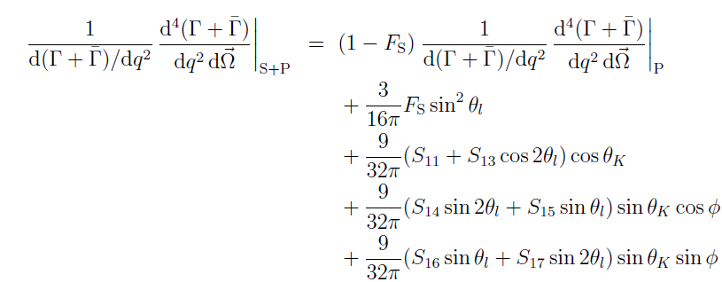
B → K* ll observables of interest
Si, FL and AFB can have significant form factor dependence as well.
Can attempt to minimize form factor role by defining quotients of coefficients, Pi which are less model-dependent.
A scalar, S-wave component to the Kπ system (~5% expected)
can modify the angular distributions further
FS fraction of S-wave Kπ
S11-S17: angular coefficients of S-wave/P-wave interference

Slide 16
Event selection
Use 3/fb collected during Run 1 (~1/fb @7 TeV, ~2/fb at 8 TeV)
Trigger selects events with a single muon PT > 1.46 (1.78) GeV , at least one of the four candidate tracks with d0 > 100 μm, two tracks with a good SV
Offline B candidate reconstruction:
  Two oppositely charged muons + a Kπ opposite sign pair, with particle ID applied to all
  Good common vertex for the 4-track system, with significant d₀ to PV
  Angle θ_{DIRA} between B-momentum and vector connecting PV and SV is small
  B mass cut 5170 MeV < mB < 5700 MeV (detected mass resolution ~50 MeV, big sidebands for fitting)
  K* mass cut 796 MeV < mK* < 996 MeV (K* natural width = 50 MeV, so mK*0 +/- 2 widths)
Dilepton mass peaks from b→ccs, ψ → l+l-
B → J/ψ K*
B → ψ(2S) K*
B-meson mass peak

Slide 17
Event selection
Combinatorial background rejection
  Most important background is random combinations of tracks from B meson decays (esp. B → Dμν + pions, D → Kμν) and from other nearby b/c/light hadrons, creating a 4-track background flat in mB and a poor vertex fit
  BDT trained on B → J/ψ K* data and mB sideband background data
    B vertex fit quality, B lifetime, B P and PT, cos θDIRA, PID data, signal tracks’ isolation
    Reject 97% background at 85% efficiency, flat in MB and MK*
Peaking background rejection
  Veto charmonium J/ψ and ψ(2S) with dilepton mass vetoes q² = 8-11 GeV² and 12.5-15 GeV²
  And also veto “double-swap” possibility of J/ψK* or ψ(2S)K* where muon and a hadron are misid’d
  Veto Bs → K* φ, φ→μμ with φ veto on dilepton mass 0.98-1.10 GeV2
  Veto Λb → pKμμ if a poor ID pion is in range of Λb mass when assigned proton mass
  Veto Bs → φ μμ if a misid’d pion hits the Bs and φ mass windows
  “Feed-up” veto B+ → K+ μμ is Kμμ mass is close to mB
  Residual peaking background is at ~2% level (Λb, signal swap, Bs), not explicitly subtracted
2398 +/- 57 signal candidates

Slide 18
Likelihood fit and validation
  Fit signal+bkg to MB, MK*, cosθ_{l}, cosθ_{K}, φ in seven bins in q²
    5 below J/ψ mass (probes zero of AFB)
    one between J/ψ and ψ(2S)
    one above ψ(2S)
  Angular acceptance will vary significantly in the 4-dimensional space of (q², cosθ_{l}, cosθ_{K}, φ) due to lifetime and momentum cuts suppressing softer tracks.
  4D acceptance function needed from high-stats simulation
  Can be validated by measuring angular coefficients in 150x larger B → J/ψ K* sample and comparing with other experiments (BaBar, Belle, etc.)
  MB, MK* line shapes also validated with J/ψ K*
For angles:
Red: high q²,
black low q²

Slide 19
Likelihood fit and validation
  Fit signal+bkg to MB, MK*, cosθ_{l}, cosθ_{K}, φ in seven bins in q²
    5 below J/ψ mass (probes zero of AFB)
    one between J/ψ and ψ(2S)
    one above ψ(2S)
  Angular acceptance will vary significantly in the 4-dimensional space of (q², cosθ_{l}, cosθ_{K}, φ) due to lifetime and momentum cuts suppressing softer tracks.
  4D acceptance function needed from high-stats simulation
  Can be validated by measuring angular coefficients in 150x larger B → J/ψ K* sample and comparing with other experiments (BaBar, Belle, etc.)
  MB, MK* line shapes also validated with J/ψ K*

Slide 20
Background shape and fits
  Background MB shape is exponential
  Background angular shape is an uncorrelated product of free-floating 2nd-order polynomials
  Background angular shape validated in MB upper-sideband
  Background K* shape is linear
  S-wave component to MKπ allowed for signal, with scalar fraction F_{S} floating
  Projections of 5-d fit with +/- 50 MeV MB cut describe the data well!

Slide 21
High Q² fit result

Slide 22
Systematic uncertainties
  Generally subleading to the statistical uncertainties.
  Fit model is modified in various ways due to hypothetical biases, and a pseudoexperiment method determines the mean bias associated with not having quite the right model.
    Effect of neglecting peaking backgrounds
    Different control samples for background shape determination
    Observed differences in data/MC agreement (low PT pion efficiency, e.g.)
    Different polynomial order for free-floating shapes
    Variations in S-wave shape
    Detector CP-asymmetries in efficiency

Slide 23
Results
  Predictions with form-factor uncertainties combining lattice and LCSR
  5th and 6th bins near charmonium are unreliable due to contamination from long-distance/ccs effects.
  AFB crossing zero is clearly seen and measured!
arxiv:hep-ph/0412400

Slide 24
Results
  Predictions with form-factor uncertainties combining lattice and LCSR
  5th and 6th bins near charmonium are unreliable due to contamination from long-distance/ccs effects.
  S7-9 are predicted to be ~0
  S5 starting to see a problem?

Slide 25
Results
  Predictions with form-factor uncertainties combining lattice and LCSR
  5th and 6th bins near charmonium are unreliable due to contamination from long-distance/ccs effects.
  Ai are predicted to be ~0
  No significant Ai or ACP seen

Slide 26
Results
arxiv:1407.8526
  Predictions with partially cancelling form factor uncertainties for low q2
  Good agreement for the P1-P4!

Slide 27
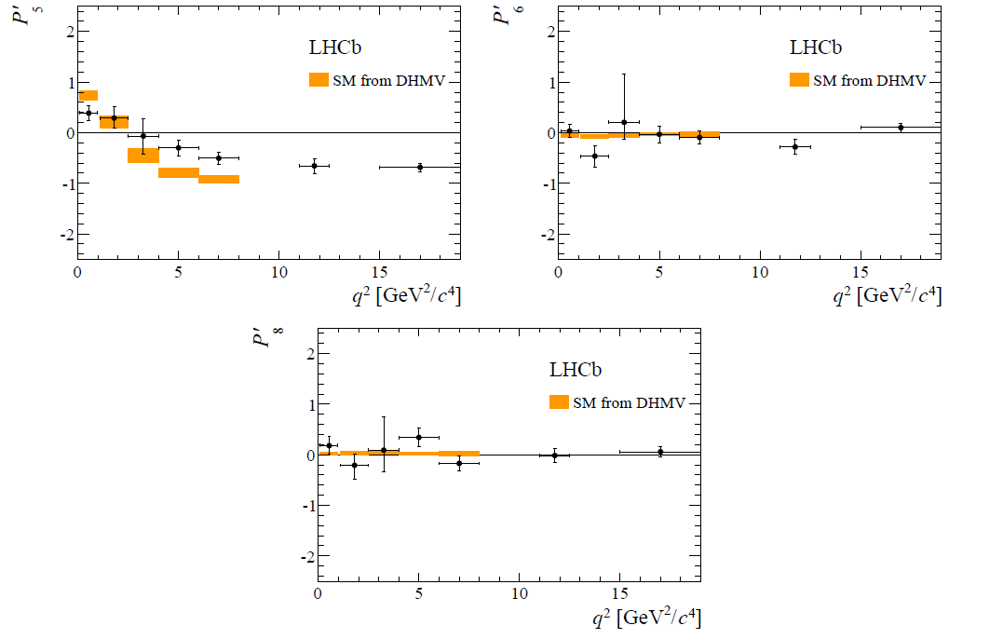
Results
arxiv:1407.8526
  Predictions with partially cancelling form factor uncertainties
  P5’ deviation in 4th and 5th bins are 2.8σ and 3.0σ, resp.

Slide 28
Interpretations as Wilson coefficients
  A global analysis of C7, C9, and C10 with b → sll and b→sγ data suggest there is mostly room for new physics in Re(C9). C7 and C10 are constrained by b→sγ and Bs → μμ decay rates, resp.
  LHCb exercise: Fit all of the measurements, float Re(C9), and nuisance parameters for form factors and other theory parameters within errors
Re(C9) is found to be shifted downward by 3.4σ relative to the SM
Appropriately coupled Z’ or leptoquarks could satisfy this and other constraints
Or “an unexpectedly large hadronic effect”

Slide 29
Interpretations as Wilson coefficients
  ATLAS, CMS, Belle can all weigh in as well
  CMS data is more SM-like, but not as precise
  CMS will have a competitive K*ll trigger capability with Run 2 data; Belle2 will be competitive in ~2 years. LHCb Run 2 results are coming. Stay tuned!

Slide 30

Kll, K*ll and lepton universality
LHCb has the capability to measure K⁺ll, K*⁰ll in both electron and muon final states. Test lepton universality in b→sll via a ratio R_{K(*)}
Lepton-universal B→J/ψK(*) can be used to normalize decay rates and relative lepton efficiencies!
Main difference for electron channel is understanding of higher electron FSR
2.6σ deficit of mu vs. e for K⁺ll!
Main systematics are J/ψK model and trigger efficiency

Slide 31
K*ll and lepton universality
arxiv:1705.05802
LHCb has the capability to measure K⁺ll, K*⁰ll in both electron and muon final states. Test lepton universality in b→sll via a ratio R_{K(*)}
Lepton-universal B→J/ψK(*) can be used to normalize decay rates and relative lepton efficiencies!
K*ee channel is also larger than K*μμ in two different bins in q²! Statistics limited.
2.1σ muon deficit
2.4σ muon deficit

Slide 32
Leptons out of Balance:
Semi-leptonic B decays

Slide 33
b → c semi-leptonic B decays
One of the most common ways a b-hadron decays is through a semi-leptonic “beta decay” b → clν, proportional to CKM |Vcb|².
Decays to light leptons are well-studied and accurately predicted. BF(B⁰ → D*⁻μ⁺ν) = 4.88+/-0.10%
Decays to taus are not as experimentally accessible and have only come into focus over the past 10 years.
In SM, the canonical “beta decay” of the b quark
Type II 2-Higgs doublet model is 3-gen and tan²β
enhanced
Leptoquark,
W’, etc.,
w/3-gen enhancement

Slide 34
B⁰ → D⁻*lν
D*- hadronic final state is popular due to the simple 3-hadron final state D*⁻ → D⁰ π-, D⁰ → K⁺π⁻ with narrow mass peaks in mD (8 MeV) and mD*-mD (0.8 MeV!)
ν_{μ}
HQET simplifies form factor F(B→D*) in terms of four-velocity product w.
Lattice estimation of F(1) allows experimental measurement of |Vcb|
BF for tau is ~¼ that of mu due to smaller phase space P
ν_{τ}
τ+ν ◊e/μνν+ν
ν_{μ}
Unc. from form factor sampling different w
ν_{μ}

Slide 35
Event selection
Hardware trigger selects charm mesons or unrelated high PT tracks. NO muon trigger to ensure low PT acceptance.
D⁰ software trigger accepts Kπ pairs with D meson PT > 2 GeV.
D candidate daughters pass PID requirements, have a common SV, and mD within 3xresolution (24 MeV)
Add a slow pion, perform kinematic fit to get a D* candidate within 2 MeV of mD*-mD.
Select muon > 3 GeV with common SV with D*, and a combined mu-D* mass < mB.
B candidate momentum must point to a good PV
“Wrong-sign” combinations mu/D*, D/pi retained for background studies
D*h sample, >mB sample, mD*-mD sidebands retained for background studies.
Require isolation of D*mu from other tracks to reduce higher mass D state background
D** → D*ππ
π
π
ν_{μ}
Higher D mass state background
Missed pions fake missing mass!
Track kinematics and geometry used for MVA which classifies events w/0/1/2 extra pions for signal and control samples

Slide 36
Kinematic discrimination of mu and tau
Tau events have a softer muon energy spectrum in the B rest frame.
Mu events have one neutrino and hence =0 missing mass in the B rest frame. Taus have 3ν and a broad mass.
The q² of the lepton system (PB^{μ} – PD*^{μ})² is higher for tau.
Signal is extracted via a 3D likelihood fit to these three variables.
B momentum is approximated by
PV-SV direction and rescaled PB_{z}
(B boost >> decay boost in B frame)

Slide 37
Signal and background models
D*τν and D*μν modeled from simulation with HQET form factors
Known one-pion higher D resonances modeled also from form factors with a floating form factor slope determined from the +1 pion control sample.
+2 pion backgrounds estimated from form
Factors and constrained by +2 pion control
sample

Slide 38
Signal and background models
A D*mu+K sample is used to normalize
backgrounds from B → D*H_{c}X, H_{c}→Xμν
D*h sample normalize and shape
misid’d muon bkg.
Wrong-sign combinations normalize and
shape combinatorial background.
B → D*D_{S}X, D_{s} → φμν e.g.

Slide 39
Fit Results
1D projections of M²_{miss} and E_{μ}* of the 3D fit to signal-like final states in slices of leptonic q²
-0.4-2.85 GeV²
2.85-6.10 GeV²
Mostly D*μν and D**μν in these slices.

Slide 40
Fit Results
1D projections of M²_{miss} and E_{μ}* of the 3D fit to signal-like final states in slices of leptonic q²
6.10-9.35 GeV²
9.35-12.60 GeV²
Signal is most prominent in these slices.
D*H_{c} component (green) is -68% anticorrelated with signal!
+2.1σ from SM prediction 0.252+/-0.003

Slide 41
Systematic uncertainties
Systematics mostly arising from MC statistics and fake muon template shape, which will improve over time.
Efficiency systematics and form factor systematics sub-leading due to mostly cancelling in the ratio
~9% uncertainty total for the ratio of BFs

Slide 42
Another way: 3-prong tau decays
arxiv:1708.08856
Use hadronic tau decays
Use different
normalization mode
3D fit in t_{τ}, q², BDT
Tau vertex and lifetime reconstruction suppresses B→DD_{x}X backgrounds
+1.1σ from SM prediction, same precision as leptonic result with very different S/B and systematics (+2.2σ when averaged)

Slide 43
A global τ problem
BaBar and Belle have also measured tau excesses in both B→Dτν and B→D*τν
Global fit to all data results in a 4.1σ discrepancy with the SM.
arxiv:1612.07233
4σ contour!!
LHCb, CMS Run 2, Belle II will all have another say soon!

Slide 44
A global τ problem
Type II two-Higgs doublet interpretation seems to be ruled out due to differing R(D) and R(D*)
An EFT analysis can fit the data best with “right-right vector and right-left scalar” operators. i.e., right-handed new physics.
arxiv:1206.1872

Slide 45
Conclusions for Lecture 3
Theory machinery exists to infer new physics at the electroweak scale (and higher) from exclusive b hadron decays (and s and c…), accessible through multiple decay channels. A comprehensive program is well underway to systematically analyze the EFT operators changing quark flavor.
The right choice of decay mode and observable is important. Angular coefficients, flavor universality ratios, CP-asymmetries, or near-null tests are attractive experimentally.
Exploit the hard-won knowledge of similar, higher-rate decay modes as a control for more rare processes.
Multiple experiments can get in on the game, LHCb does not have a monopoly. There is usually more than one way to do it!
The sensitivity of these measurements is unique and surprising, and historically herald a new direct discovery!

Slide 46
References
LHCb K^{*0}μμ angular analysis
K*ll angular coefficients predictions
LHCb B → D* τν analyses
LHCb K(*)ll lepton universality tests
PDG review of b →clν, ulν
arxiv:1512.04442
arxiv:0811.1214
arxiv:1407.8526
arxiv:hep-ph/0412400
arxiv:1506.08614
arxiv:1708.08856
arxiv:1711.02505
arxiv:1406.6482
arxiv:1705.05802
PDG review of semi-leptonic B decays

