Slide 1
Precision Physics at Colliders
How to choose wisely, measure carefully, and exploit ruthlessly

Slide 2
Precision Physics at Colliders 2:
The VISE of electroweak Precision

Slide 3
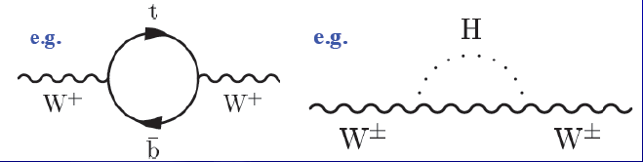
Theory vs. Experiment: Global Electroweak Fits
Recall that the electroweak theory gauge boson sector has three independent parameters, e.g.:
  GF, MZ, sinθ_{W}
  g, g’, v
  and other ways
The Higgs/Yukawa sector has many more: MH, fermion masses and mixings
The high precision available experimentally in the gauge boson sector makes the observed effective masses and couplings accessible to higher-order radiative corrections.
This induces a non-trivial dependence between precision electroweak observables in the SM:
  MW and MZ as effective physical observables now also have Mtop and MH dependence
  sinθ_{W} and other precision Z observables have different dependencies, which allows a global fit to constrain all of the underlying parameters.

Slide 4
Theory vs. Experiment: Global Electroweak Fits
arxiv:1803.01853
Measured ingredients:
MH, Mt
MW,MZ, ΓW, ΓZ
Partial widths of Z to heavy quarks, all hadrons, or leptons
Angular asymmetries of Z decays to fermions
Strong and electromagnetic couplings

Slide 5
Theory vs. Experiment: Interpretation of fits
A large “pull” tells you that the global fit prefers a different value than observed.
If the measurement disagrees with the prediction obtained from all of the other measurements (Indirect determination) that indicates a theory inconsistency.
A dramatic enough difference is evidence of BSM phenomena participating in the radiative corrections (or we need more sophisticated SM predictions)

Slide 6
Theory vs. Experiment: Mt and MH hunting
Historically, this has been used to predict Mt and MH before they were discovered!
Mt, MW, MH interrelation was the most popular way to track this.
Mt and MH are now so well-measured that higher precision has minimal impact on the indirect determination of the others!
Ingredients:
MH, MW, MZ, Mtop
Z width,

Slide 7
Theory vs. Experiment: Time for W and Z to catch up
What measurements will tighten the vise with the next 2X in precision?
The W mass is now better known indirectly (blue) than directly (points), and its improvement will affect the global chi2.
Similarly, the weak mixing angle is in a similar state, and would benefit from a third opinion to resolve the discrepancy between LEP and SLD.
Resolving AFB_{b} will probably require ILC/FCC-ee/CepC ☹

Slide 8
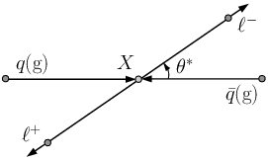
The weak mixing angle at hadron colliders
qq → Z/γ* → ll differential cross section at LO:
In the di-lepton CM, lepton angle with respect to axis of quark momentum is sensitive to interference effects: vector with axial-vector Z couplings, Z with photon (or Z with new physics)
The A4 term odd in cos θ* is very sensitive to the weak mixing angle when M = MZ.
The odd term coefficient A4 can be obtained from an angular fit or computed from the forward-backward asymmetry
AFB = (σ(cosθ*>0) – σ(cosθ*<0))/σ
= 3/8∗Α4

Slide 9
How to measure the scattering angle
Unlike a lepton collider, we cannot perfectly divine the incoming fermion/anti-fermion directions.
  For non-zero PT, cannot identify “which” incoming parton radiated
PT effect is minimized by choosing the Collins-Soper frame
For l- four vector P1, l+ four vector P2:
Suppression of odd cos θ*
term due to dilution
at 7 TeV LHC
Q = P1+P2
In dilepton CM frame:
z-axis bisects proton1 and –proton2 angle,
x-axis is Z PT direction

Slide 10
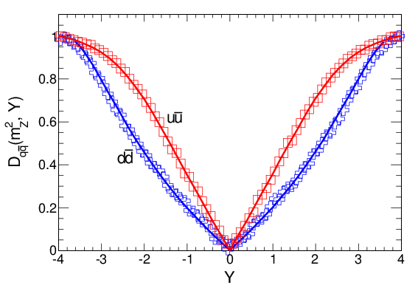
How to measure the scattering angle
Unlike a lepton collider, we cannot perfectly divine the incoming fermion/anti-fermion directions.
  Which proton (or antiproton) originates the quark or antiquark is ambiguous
The parton ambiguity is unavoidable, and there is a parton-dependent dilution to the ideal case.
At the Tevatron, valence quark/anti-valence quark annihilation dominates, therefore the proton carries the quark a very large fraction of the time.
At LHC, Z production is predominantly valence quark-sea quark annihilation
The valence quark usually carries more of the proton momentum, so the Z Pz direction is correlated with the quark direction
Suppression of A4 cos θ*
term due to dilution
at 7 TeV LHC
The more forward the Z production the less ambiguous the quark direction is

Slide 11
SM behavior of AFB and the weak mixing angle
The weak mixing angle sensitivity arises from the Z vector and axial-vector coupling diagrams self-interfering, giving a small positive AFB of a few percent. The photon diagram also interferes with the Z, giving very large effects above and below the Z pole.
Virtual electroweak corrections modify the LO relation between A4 and sin²θ_{W}, leading to an “effective” mixing angle as the baseline observable:
A4 ~ ¼ - sin²θ_{eff}, so
A4 precision of 0.001 → mixing angle precision of 20x10⁻⁵

Slide 12
A4 measurement strategy
At NNLO QCD, up to 9 different non-zero angular terms to consider including A4.
Dilepton PT dependence is especially hard to model, so integrate that out
For several bins of y and m, construct 8x8 bin templates for each of the 9 angular polynomials, modified for detector acceptance and higher-order corrections to the baseline MC (POWHEG-BOX), i.e, a four-dimensional histogram.
Differential dilepton data along with nuisance parameters are included in a grand likelihood hit to determine A4.

Slide 13
Likelihood fit design
1280 bins in (m, y) x θ x φ = 20x8x8
Nuisance priors
Poisson probability for data Nobs
Poisson probability for template MC Neff
Cross section x lumi in bin j
Ang. Coeff. i
in bin j
Backgrounds and their nuisance parameter dependence
9 angular templates for bin j
and their nuisance parameter dependence
A4 mixing angle dependence (linear interpolation in each bin j, w/nuisances)

Slide 14
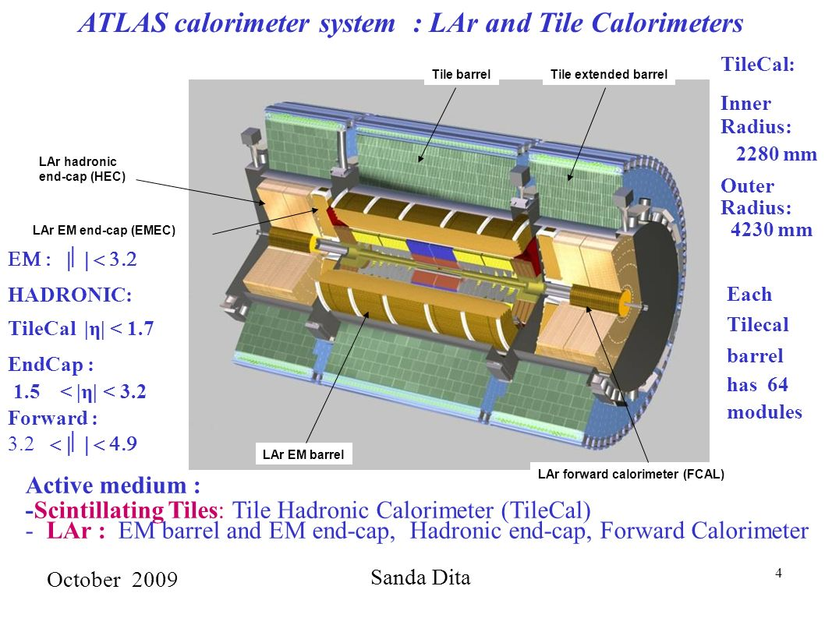
Event selection and categorization
ee_{CC} : two electrons in the central tracking and calorimetry (|η|<2.4)
  12 GeV dielectron trigger
  25 GeV PT requirement of =2 opposite sign electrons
μμ_{CC} : two muons in the central tracking and muon systems (|η|<2.4)
  24 GeV single muon trigger
  25 GeV PT requirement of =2 opposite sign muons
ee_{CF} : one electron in central tracking/calorimetry (|η|<2.4), one in endcap/forward calorimetry (2.5 < |η| < 4.9)
  24 GeV single central electron trigger
  25/20 GeV C/F PT requirement with tighter ID than ee_{CC}

Slide 15
Event selection and categorization
ee_{CC} : two electrons in the central tracking and calorimetry (|η|<2.4)
  12 GeV di-electron trigger
  25 GeV PT requirement of =2 opposite sign electrons
μμ_{CC} : two muons in the central tracking and muon systems (|η|<2.4)
  24 GeV single muon trigger
  25 GeV PT requirement of =2 opposite sign muons
ee_{CF} : one electron in central tracking/calorimetry (|η|<2.4), one in endcap/forward calorimetry (2.5 < |η| < 4.9)
  24 GeV single central electron trigger
  25/20 GeV C/F PT requirement with tighter ID than ee_{CC}
About 6-7M events each for CC categories,
1M for CF

Slide 16
Pre-fit angular distributions
Data/MC agreement for μμ_{CC} and ee_{CF} in the Z pole mass region for all y.
Only a small raw AFB is visible for CC; a larger one emerges for CF, as expected.
S/B at the Z pole is very high
cos2φ modulation from A2 can be clearly seen

Slide 17
Fit results and uncertainties
Consistent results for all three categories
ee_{CF} is as powerful as ee_{CC}+μμ_{CC}
All three categories systematics limited, predominantly by PDF uncertainty affecting relation between A4 and mixing angle

Slide 18
Internal consistency across categories
Using eeCF outermost bin as a reference, compute pulls of other categories
Innermost CC Z pole category is an outlier, others are consistent

Slide 19
Comparison with ROTW
About 2.2X less precise than LEP/SLD
Comparable to Tevatron final results
Superior to CMS 8 TeV, which does not include ee_{CF} category.
Superior to LHCb due to luminosity/statistics (LHCb has lower PDF unc.!)

Slide 20
Uncertainty analysis, prospects for 13 TeV
Systematics limited (29 vs. 21 E-5 stat. unc.)
Affects of PDF uncertainties on sin²θ_{eff}(A4) predominate (24E-5)
  Admixture of partons determines A4 dilution
  External improvement or simultaneous constraint with more data needed to improve upon this!
  These unfortunately worsen at 13 TeV
Stat (21) and MC stat (12) unc. will improve together with 13 TeV data
QCD scales improvement will need beyond NNLO (!) prediction
PTZ modelling with data can be introduced to ee_{CF} sample with larger datasets.

Slide 21
The mass of the W boson
In the electroweak theory, α, GF, MZ, MW related at tree-level via a simple algebraic relation. With radiative corrections Δr, there is also a dependence on Mt and MH at high precision.
New fermions or bosons coupling to W can shift observed MW from SM predictions 10’s of MeV

Slide 22
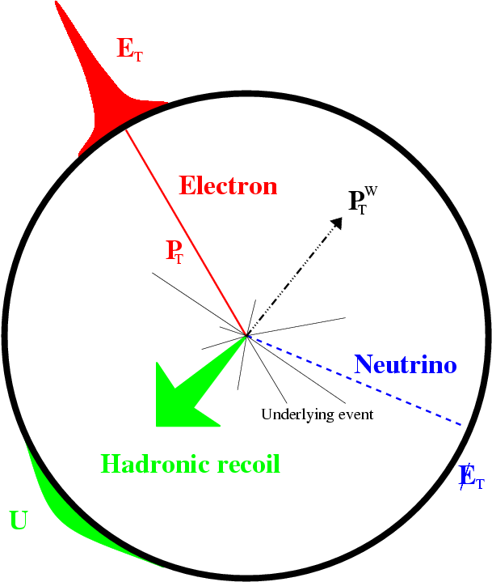
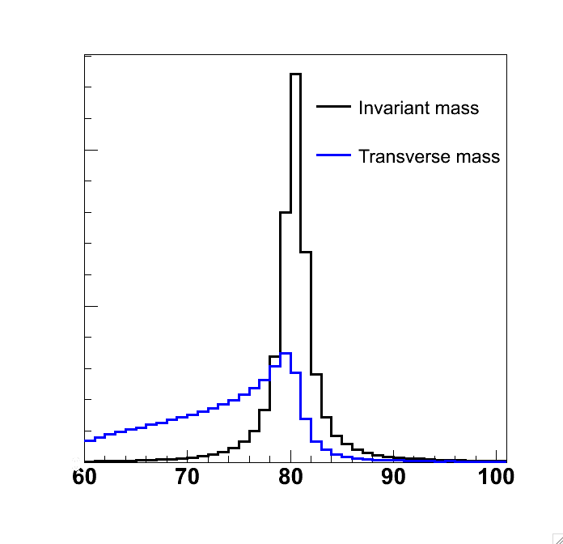
W production at the LHC
U||
Two main experimental observables are the lepton transverse momentum and the transverse momentum of everything recoiling against it
It is useful to analyze uT in components parallel and perpendicular to the lepton. The neutrino transvers momentum is inferred from –vector sum
Invariant mass cannot be measured directly. The “transverse mass” mT can be computed in the transverse plane, with a kinematic edge terminating at MW.
Lepton PT alone has great resolution and its distribution (peaking at MW/2) is a good estimator of MW, but has strong dependence on W PT modelling.
MT has much weaker W PT dependence, but has worse resolution from Ptmiss. Let’s measure both!
U⊥

Slide 23
W production at the LHC
W production is majority valence quark/sea anti-quark annihilation, but at least 1/3 is from sea quark/sea anti-quark of various flavors.
The proton has twice as many ups as downs, so W+ cross section is higher than W-, and the kinematics and PDF dependence differ
Higher rapidity → stronger valence quark component → better known PDFs. Charge and rapidity dependence of PDFs motivates a binned MW analysis.
W PT is predominantly less than 30 GeV, where theory prediction relies critically on soft gluon resummation.
Production model is sensitive to sea quark distribution of the different flavors, including heavy flavor combinations not probed by the Z (cs, cb)
W+ and W- lepton η

Slide 24
Event selection and categorization
W selection
  Single muon trigger with 18 GeV PT OR single electron trigger with 20-22 GeV PT
  Measure leptons out to a pseudo-rapidity of 2.4.
  6M W → enu, 8M W→ munu selected in 4.1-4.6 /fb at 7 TeV
  Electron channel has 2% background from W → taunu, Z →ee, 0.4% other
  Muon channel has 6% background from W/Z, 0.3% other
Z selection: 2 opposite sign leptons with PT > 25 GeV (0.6M ee, 1.2M μμ)
Categorize by lepton, charge, and rapidity. Measure MW separately from 1D templates of MT and PT, and combine with correlations (~50% correlated)

Slide 25
Electron energy scale calibration
ATLAS EM calorimetry consists of 3 depth layers of LAr
  L1 has high-granularity η strips for lateral shape, L2 has larger square cells and most of the X0, L3 is a tail catcher
  Preshower detector in the barrel estimates pre-radiation upstream
Simulation-based response corrections
Electron and unconverted photon longitudinal response studied to correct the upstream material model
Minimum-ionizing muons are used to intercalibrate different depth layers and analyze crosstalk
Excluded!

Slide 26
Electron energy scale calibration
Residual data-driven corrections obtained from W electrons, J/psi or Z di-electron data.
Azimuthal distortions (mechanical sagging, e.g.) corrected with E/p relative corrections
Energy scale vs. h calibrated to center the Z mass at the expected value
Resolution simultaneously adjusted to match the observed linewidth

Slide 27
Electron efficiency calibration
Z → ee data also used to estimate efficiency corrections (tag and probe method)
Resulting corrected MC η distribution matches the data
Energy scale, efficiency corrections have largest impact on MW
Resolution also important at high η

Slide 28
Muon momentum scale calibration
Muon momentum is determined by the ATLAS Inner Detector tracking
Three classes of biases to correct for
  α(η,φ): momentum scale
  β(η): intrinsic resolution (radial)
  δ(η,φ): sagitta (twists or curls)
α,β, and δ can be calibrated to the observed Z → μμ mass
Linear extrapolation estimated for α to calibrate MW PT range (dominant uncertainty, δPT/PT = 2-7 x 10-4)
δ independently estimated from
W→eν E/p mean behavior, exploiting charge-independence of E

Slide 29
Muon efficiency calibration
Z di-muon data calibrates efficiencies
Binned in PT and η
Momentum scale, trigger efficiency corrections have largest impact on MW

Slide 30
Recoil calibration
Mean pileup in simulation is adjusted to the observed distribution.
Simulated recoil sumET distribution for Z is transformed into the observed one via Smirnov transform (transforming x to match the CDFs).
The simulated W recoil sumET is then transformed similarly to match the data-driven estimate
Azimuthal anisotropies in recoil are corrected to match Z → μμ data

Slide 31
Recoil calibration
Residual correction of uperp and u|| needed to agree with data
Z PT data precisely estimates these components
b additively corrects the mean difference in response scale of
r multiplicatively corrects the response resolution
Correction binned in pileup, V PT, and sumET to create a response model for W

Slide 32
Recoil calibration
As a closure test, this procedure can successfully transform POWHEG+HERWIG6 into POWHEG+PYTHIA8
Dominant systematic is the sumET correction: difference between correction binned in PT or performed inclusively is 10 MeV

Slide 33
Building a signal template
5-dimensional model with all-order effects included is not available at this time!
Relevant factors are built up separately from data and MCs
Boson
mass
Boson
rapidity
Normalized PT and y
Normalized angular dist.
Mass is a relativistic Breit-Wigner distribution (with width recomputed vs. mass…); Z boson case includes photon diagram and interference
Rapidity and angular distributions are estimated from fixed-order NNLO calculations (DYNNLO)
PT estimation requires resummed soft-gluon emission and non-perturbative effects. PYTHIA 8 + PS with some re-tunings used to predict this (in agreement with dedicated NLO+PS and resummed calculations).
Fully simulated+corrected POWHEG+PYTHIA8, w/AZNLO tune and CT10 PDF, is reweighted to match these.

Slide 34
Building a signal template: V PT
PYTHIA 8 has 3 parameters to tune PS showering
  Intrinsic parton PT
  Strong coupling for ISR
  ISR infrared cutoff
“AZ tune” gave the best description of 7 TeV data; other tunes, NLO+PS, and resummed predictions did not agree well with data and give big variations in lepton PT.
AZ tune also describes well the measured W PT/Z PT ratio

Slide 35
W template systematic uncertainties
PDF uncertainty in the templates has the largest impact on MW (8-9 MeV)
CT10NNLO PDF is the baseline. Its Hessian error matrix has 25 error eigenvectors which can be varied independently. All 25 +/- variations are used to regenerate or reweight each piece of the signal template.
Combining charges reduces PDF uncertainty due to anti-correlated u-sea and d-sea!
Similarly, binning by lepton rapidity also reduces PDF uncertainty.
MMHT14 and CT14NNLO are also used to bound the uncertainty (4 MeV)

Slide 36
W template systematic uncertainties
Parton shower tuning is largely correlated between W and Z for light-quark initiated production
Therefore Z PT tuning uncertainties are a suitable proxy for W PT modelling
Heavy quarks participate differently for W and Z production, however.
Independent QCD matching scales for charm and bottom quark in VFNS PDF evolution
Varying the heavy scales independently from the light quark ISR scale leads to 5-7 MeV MW shift
More extreme decorrelation of W and Z scales can lead to much larger shifts (up to 30 MeV!)
There is no popular theory prescription for this. Direct W PT modelling will be an important ingredient of future measurements.

Slide 37
MZ as a test case
In Z events, one lepton can be ignored, as a neutrino, and the W mass measurement technique performed.
Best-fit templates to PT, MT agree with data
Best-fit MZ agrees with LEP 1 measurement

Slide 38
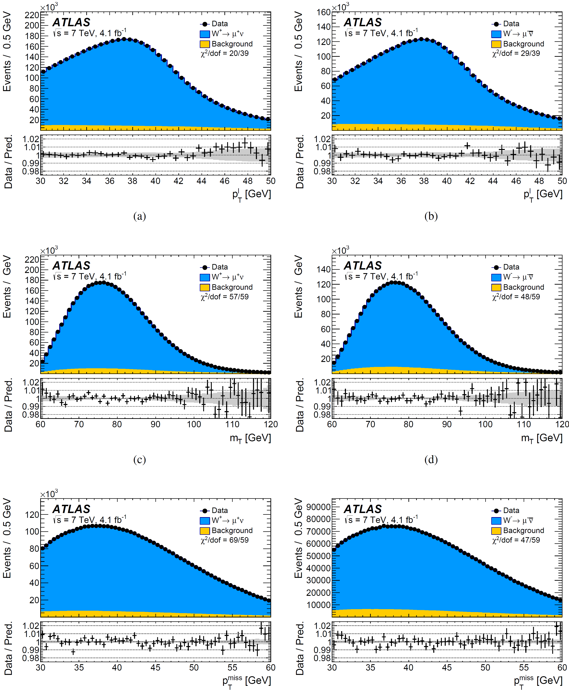
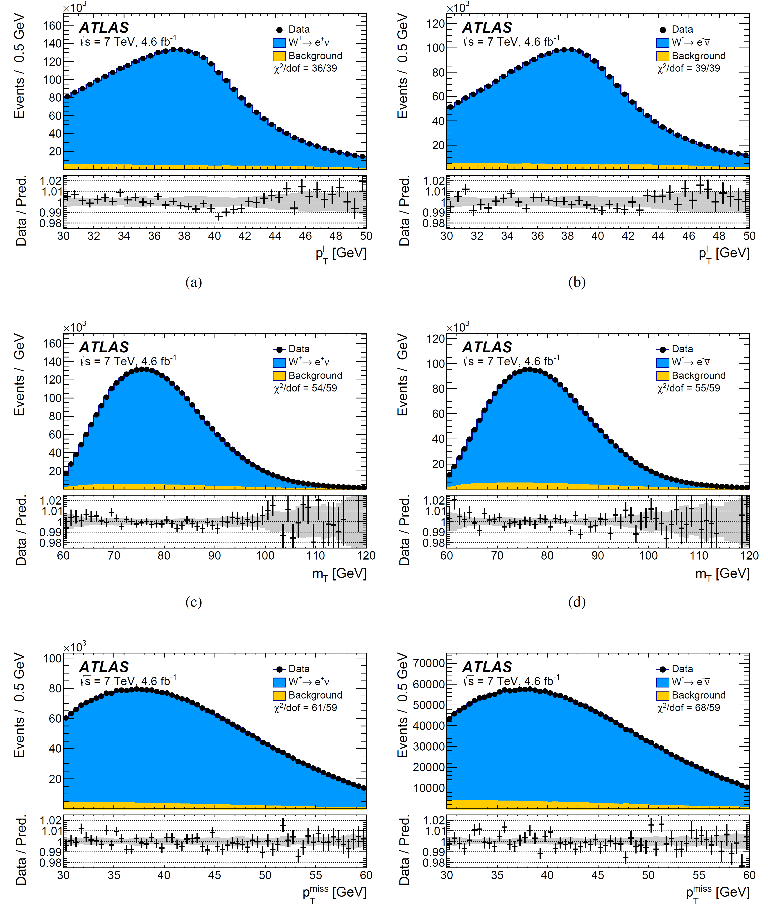
W fit results: data vs. post-fit model
W⁺ → μ⁺ν
W⁻ → μ⁻ν
W⁺ → e⁺ν
W⁻ → e⁻ν
PT
MT
PTmiss

Slide 39
W fit results: by category
N.B. PT and MT results are ~50% correlated
No bias trend in + vs. -, MT vs. PT, e vs. mu, or rapidity

Slide 40
W fit results: MT uncertainties
High-rapidity muons have larger momentum unc.
High-rapidity electrons have larger momentum and bkg. unc.

Slide 41
W mass consistency checks
Consistent partial and full combinations for each channel/measurement

Slide 42
W mass consistency checks
PT and MT ranges are scanned
Categories of pileup, uT, u||, and excluding the Ptmiss cut are also tested separately

Slide 43
W mass results
The initial ATLAS measurement is about 25% less precise than the world average.
It is consistent with the world average and a bit closer to the indirect Electroweak Fit prediction.

Slide 44
W mass uncertainty analysis and outlook
In this design, leading uncertainties are statistical and PDF
Improved external or simultaneous PDF constraint will improve future measurements
But PDF uncertainties will be larger at 13 TeV
Lepton momentum scale, which will tend to improve with more data and more sophisticated modelling
QCD modelling uncertainties will likely best improve via semi-empirical methods (direct W PT measurement, e.g.) coupled with theory improvements

Slide 45
Conclusions for Lecture 2
After decades of chasing Mt and MH, different fundamental parameters come into focus in order to tighten the electroweak vise of constraints on new physics.
Copious W and Z data statistics can be traded in to eliminate a lot of the theory modelling systematics.
In situ studies of detector performance can also evolve with statistics to improve energy scales and resolution.
PDFs and low PT phenomenology need to be aggressively tuned by the data, either beforehand or simultaneously.
Which one will crack first??

Slide 46
Syllabus: Review of six measurements
Lecture 1, Friday Aug. 24
The miracle of QCD: jets, tops, and α_{S}
Lecture 2, Sunday Aug. 26
The vise of precision electroweak: sin²θ_{W} and M_{W}
Lecture 3, Monday Aug. 27
The mystery of flavor: Capturing Wilson coefficients and testing lepton universality

Slide 47
References
gFitter 2018 update
ATLAS weak-mixing angle at 8 TeV
ATLAS W mass at 7 TeV
ATLAS Run 1 electron/photon calibration
ATLAS Run 1 muon performance
arxiv:1803.01853
ATLAS-CONF-2018-037
arxiv:1701.07240
arxiv:1407.5063
arxiv:1407.3935

