Slide 1
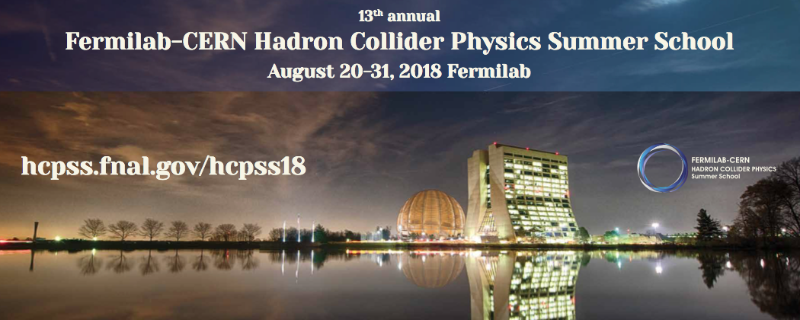
Accelerators B
Eric Prebys, UC Davis

Slide 2
Twiss Parameterization (left out yesterday)
The transfer matrix over any period (s➔s+C) must be stable over infinite passes
  Must have purely imaginary eigenvalues
Any such matrix can be represented as
where all parameters are real
  α, β, and γ are “Twiss parameters” we talked about yesterday, evaluated as position s
  μ is the phase advance over the period

Slide 3
Further Reading
You can check out the material from the USPAS course “Accelerator Physics Fundamentals” from June, 2018 at
  http://home.fnal.gov/~prebys/misc/uspas_2018/
In particular, see “Tricks of the Trade”, wich has a lot of miscellaneous info about accelerators

Slide 4
Longitudinal Motion
We will generally accelerate particles using structures that generate time-varying electric fields (RF cavities), either in a linear arrangement
or located within a circulating ring
In both cases, we want to phase the RF so a nominal
arriving particle will see the same accelerating voltage
and therefore get the same boost in energy
cavity 0
cavity 1
cavity N
Synchronous phase
“harmonic number”

Slide 5
Slip Factor
The longitudinal behavior of particles depends on the relationship between the period and momentum
Special cases
  Linac: (always negative, but approaches zero)
  Simple cyclotron: (starts at zero and goes positive)
  “Isochronous” cyclotron:
  Synchrotron: (starts negative, and goes positive at “transition”)
Period of circular machine or time between cells in linac
Slip factor

Slide 6
Slip Factors and Phase Stability
The sign of the slip factor determines the stable region on the RF curve.
η<0 (linacs and below transition)
η>0 (above transition)
“bunch”
Particles with lower E arrive earlier and see greater V.
Particles with lower E arrive later and see greater V.
Nominal Energy
Nominal Energy

Slide 7
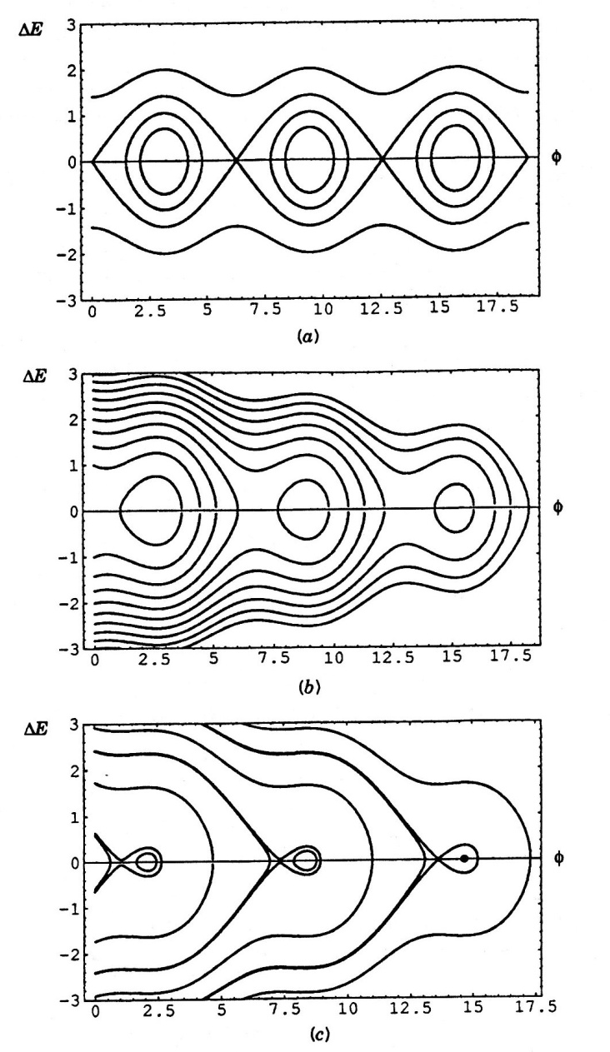
Synchrotron Motion
Particles will oscillate about the
stable energy in the ΔtΔE “longitudingal
phase space” plane
Particles take many revolutions to complete one longitudinal oscillation
  Can treat multiple RF cavities as a vector sum
We can increase the acceleration by increasing the synchronous phase, but this shrinks the stable region in phase space (“bucket area”)
  60° is typical

Slide 8
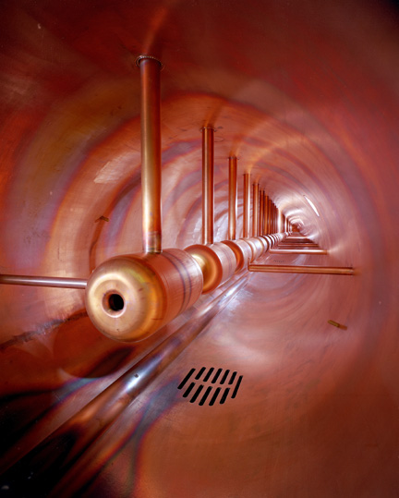
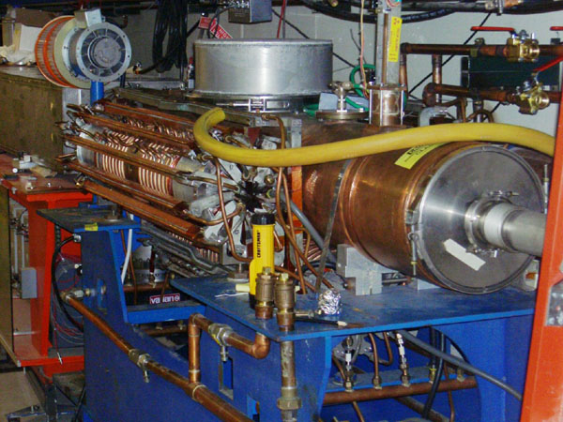
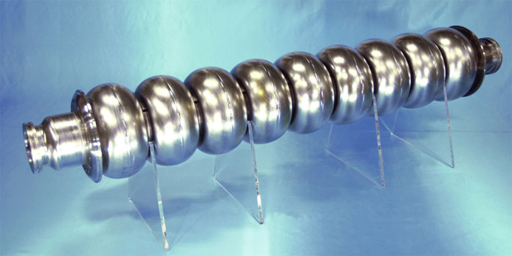
Examples of Accelerating RF Structures
37->53MHz Fermilab Booster cavity
Biased ferrite frequency tuner
Fermilab Drift Tube Linac (200MHz): oscillating field uniform along length
ILC prototype elipical cell “π-cavity” (1.3 GHz): field alternates with each cell

Slide 9
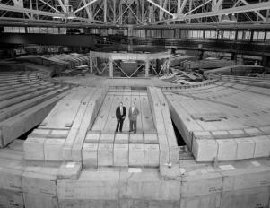
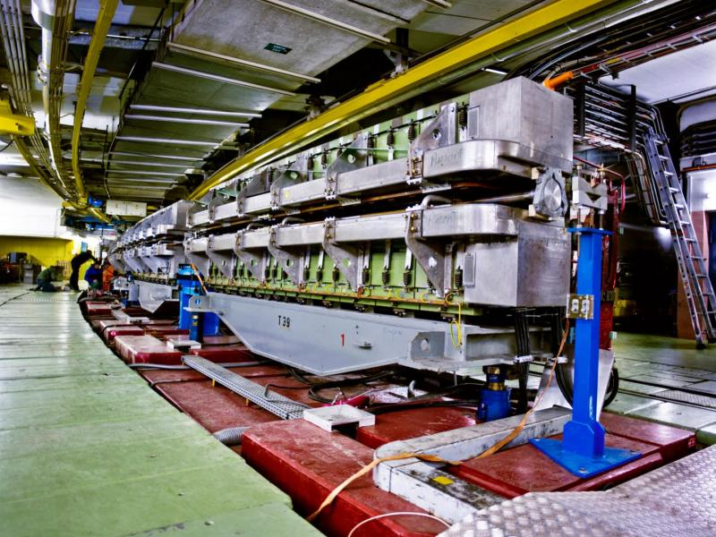
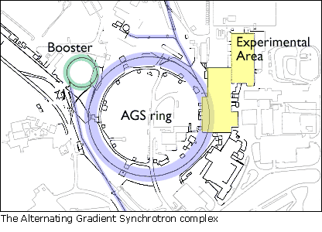
Some Important Early Synchrotrons
Berkeley Bevatron,
1954 (weak focusing)
6.2 GeV protons
Discovered antiproton
CERN Proton Synchrotron (PS)
1959
628 m circumference
28 GeV protons
Still used in LHC injector chain!
Brookhaven Alternating Gradient Synchrotron (AGS)
1960
808 m circumference
33 GeV protons
Discovered charm quark, CP violation, muon neutrino

Slide 10
Getting the Most Energy: The Case for Colliders
If beam hits a stationary proton, the “center of mass” energy is
On the other hand, for colliding beams (of equal mass and energy) it’s
To get the 14 TeV CM design energy of the LHC with a single beam on a fixed target would require that beam to have an energy of 100,000 TeV!
  Would require a ring 10 times the diameter of the Earth!!
Getting to the highest energies requires colliding beams

Slide 11
Colliding Beam Luminosity
Beams are typically bunched
Think of one bunch of N₁ particles as a “thin target”.
The probability of a particle from the other bunch interacting is
The total number of interactions per crossing
is then
So the total rate is
Transverse area
reaction cross section
Number of bunches
Luminosity
Revolution frequency

Slide 12
Luminosity of Colliding Beams
Particles in a bunch
For equally intense Gaussian beams
Using we have
Number of bunches
Geometrical factor:
- crossing angle
- hourglass effect
Revolution frequency
Transverse size (RMS)
Betatron function at collision point
prop. to energy
Normalized emittance
➔ want a small β*!
Record e+e- Luminosity (KEK-B): 2.11x10³⁴ cm⁻²s⁻¹
Record p-pBar Luminosity (Tevatron): 4.06x10³² cm⁻²s⁻¹
Record Hadronic Luminosity (LHC): 2.06x10³⁴ cm⁻²s⁻¹

Slide 13
Limits to β*
β
β distortion of off-momentum particles
(affects collimation)
s
➔ small β* means large β
(aperture) at focusing triplet

Slide 14
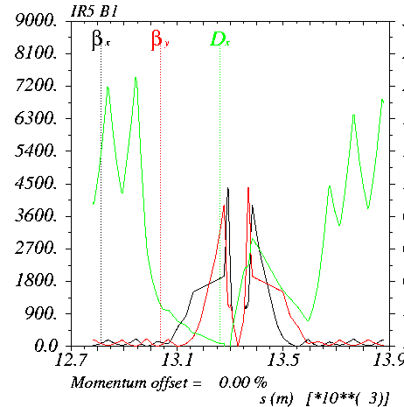
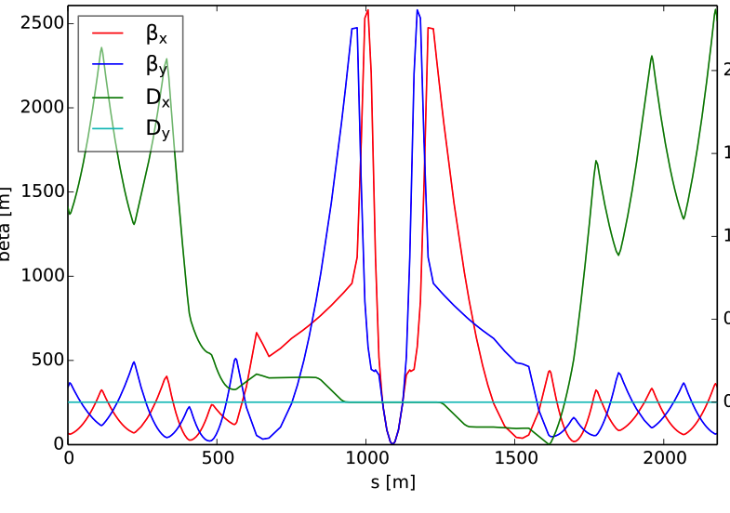
What’s the “squeeze”?
In general, synchrotrons scale all magnetic fields with the momentum, so the optics remain constant during acceleration – with one exception…
Recall that because of adiabatic damping, beam gets smaller as it accelerates.
This means all apertures must be large enough to
accommodate the injected beam.
  This a problem for the large β values in the final focus
  triplets
For this reason, injection optics have a larger
value of β*, and therefore a smaller value of β
in the focusing triplets.
After acceleration, beam
is “squeezed” to a
smaller β* for collision
factor of ~4 for LHC
Note different vertical scales!

Slide 15
Beam Beam Effects
When one beam bunch passes
through another other beam, it
looks like a little lens
This results in a “tune-shift” that can drive the beam onto a resonance.
This is the ultimate limitation to the luminosity of any collider.
  The more imperfections, the more resonances and the smaller the allowed tuneshift.
Tuneshifts add, so we cannot allow any crossings outside of the collision regions! (more about this shortly)
Depends only on the “brightness”, not on whether the beam is focused!

Slide 16
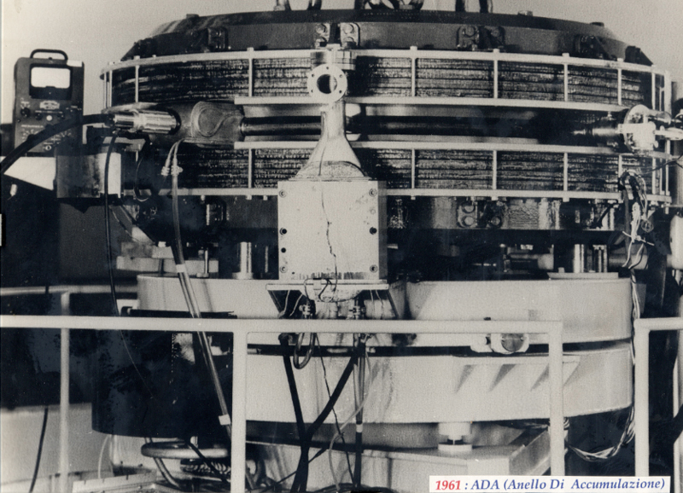
First e⁺e⁻ Collider
ADA (Anello Di Accumulazione) at INFN, Frascati, Italy (1961)
  250 MeV e⁺ x 250 MeV e⁻
It’s easier to collide e+e-, because synchrotron radiation naturally “cools” the beam to smaller size.

Slide 17
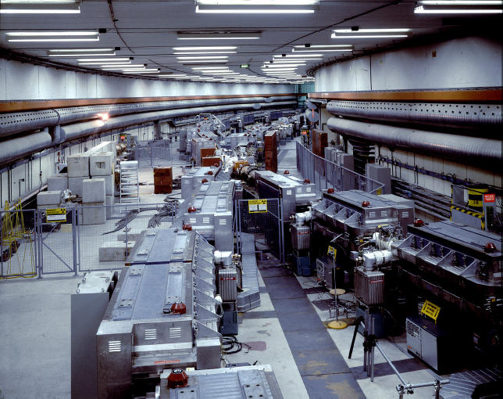
First Proton Collider: CERN Intersecting Storage Rings (ISR)
1971
31 GeV + 31 GeV colliding proton beams.
  Highest CM Energy for 10 years
Set a luminosity record that was not broken for 28 years!

Slide 18
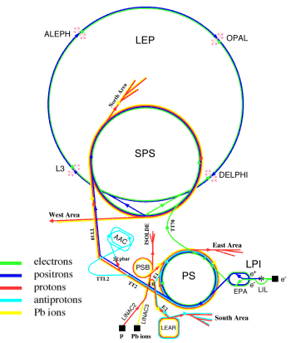
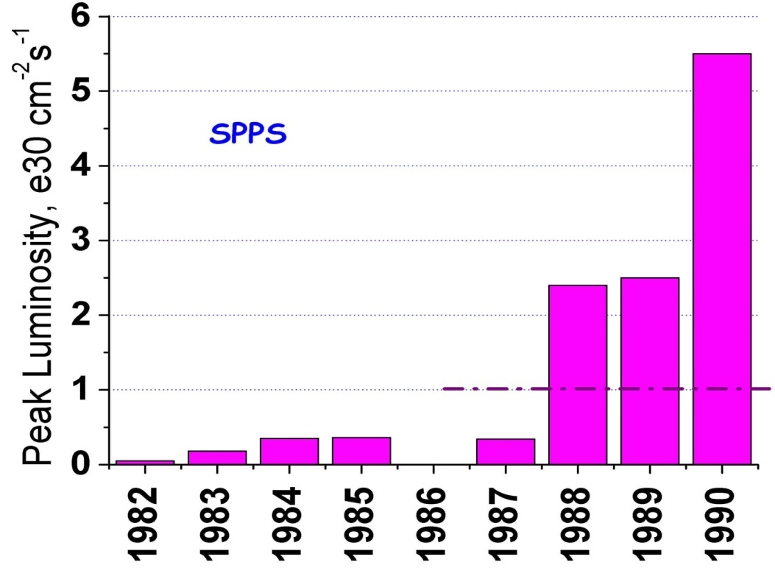
SppS: First Proton-Antiproton Collider
Protons from the SPS were used to produce antiprotons, which were collected
These were injected in the opposite direction (same beam pipe) and accelerated
First collisions in 1981
Discovery of W and Z in 1983
  Nobel Prize for Rubbia and Van der Meer
Energy initially 270+270 GeV
Raised to 315+315 GeV
  Limited by power loss in
  magnets!
design

Slide 19
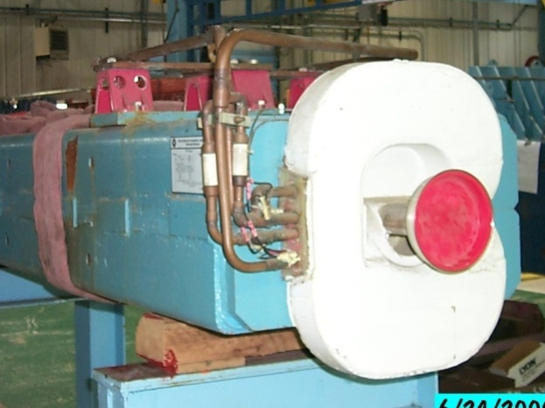
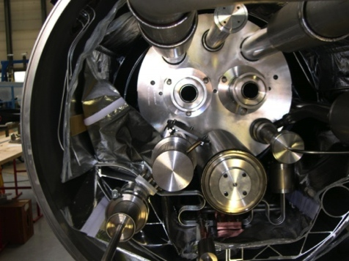
Superconductivity: Enabling Technology
The maximum SppS energy was limited by the maximum power loss that the conventional magnets could support.
  LHC made out of such magnets would be roughly the size of Rhode Island!
Highest energy colliders only possible using superconducting magnets
Must take the bad with the good
  Conventional magnets are Superconducting magnets are
  simple and naturally dissipate complex and represent a great
  energy as they operate deal of stored energy which must
  be handled if something goes wrong
R&D into superconducting technology is absolutely critical in the quest for the highest energies (made Tevatron and LHC possible!)
Machine protection is one of the biggest challenges.

Slide 20
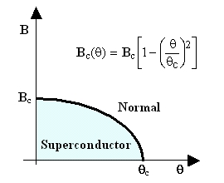
When is a superconductor not a superconductor?
Superconductor can change phase back to normal conductor by crossing the “critical surface”
When this happens, the conductor heats quickly, causing the surrounding conductor to go normal and dumping lots of heat into the liquid Helium➔“quench”
  all of the energy stored in the magnet must be dissipated in some way
Dealing with quenches is the single biggest issue for any superconducting synchrotron!
Can push the B field (current) too high
Can increase the temp, through heat leaks, deposited energy or mechanical deformation
T_{c}

Slide 21

Quench Example: MRI Magnet*
*pulled off the web.
We recover our Helium.

Slide 22
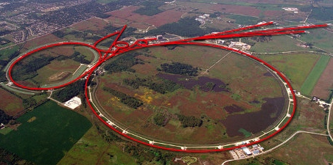
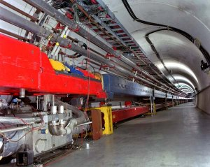
Tevatron: First Superconducting Synchrotron
1968 – Fermilab Construction Begins
1972 – Beam in Main Ring
  (normal magnets)
Plans soon began for a superconducting collider to share the ring.
  Dubbed “Saver Doubler”
  (later “Tevatron”)
1985 – First proton-antiproton collisions in Tevatron
  Most powerful accelerator in the world for the next quarter century
1995 – Top quark discovery
2011 – Tevatron shut down after successful LHC startup
Main Ring
Tevatron

Slide 23
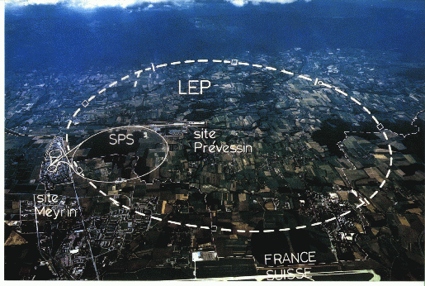
Back the present: Large Hadron Collider
My House (1990-1992)
/LHC
Straddles French/Swiss border near Geneva, Switzerland
Tunnel originally dug for LEP
  Built in 1980’s as an electron positron collider
  Max 100 GeV/beam, but 27 km in circumference!!

Slide 24
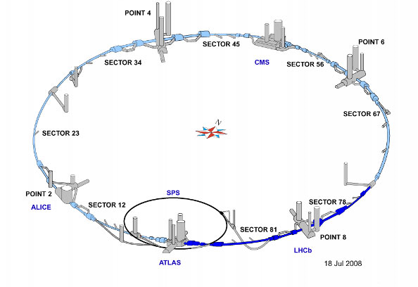
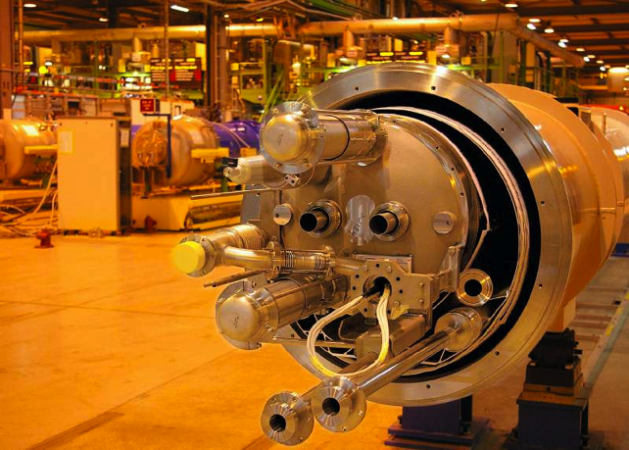
LHC Layout and Numbers
Design:
7 TeV+7 TeV proton beams
  7 times Fermilab Tevatron
  Magnets have two beam pipes, one going in each direction.
Stored beam energy 150 times more than Tevatron
  Each beam has only 5x10⁻¹⁰ grams of protons, but has the energy of a train going 100 mph!!
These beams are focused to a size smaller than a human hair to collide with each other!
27 km in circumference
2 major collision regions: CMS and ATLAS
2 “smaller” regions: ALICE and LHCb

Slide 25
LHC Optics
Injection straights/higher β collisions
Low β collisions
Arc transport optics (string of FODO cells)

Slide 26
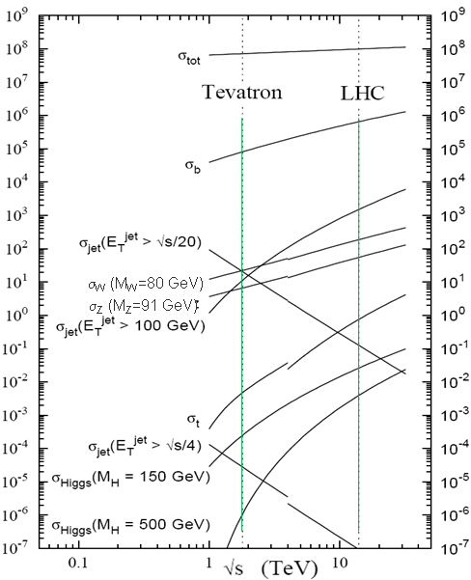
LHC (Design) vs. Fermilab Tevatron
Parameter | Tevatron | “nominal” LHC
Circumference | 6.28 km (2*PI) | 27 km
Beam Energy | 980 GeV | 7 TeV
Number of bunches | 36 | 2808
Protons/bunch | 275x10⁹ | 115x10⁹
pBar/bunch | 80x10⁹ | -
Stored beam energy | 1.6 + .5 MJ | 366+366 MJ*
Magnet stored energy | 400 MJ | 10 GJ
Peak luminosity | 3.3x10³² cm⁻²s⁻¹ | 1.0x10³⁴ cm⁻²s⁻¹
Main Dipoles | 780 | 1232
Bend Field | 4.2 T | 8.3 T
Main Quadrupoles | ~200 | ~600
Operating temperature | 4.2 K (liquid He) | 1.9K (superfluid He)
Increase in cross section of up to 5 orders of magnitude for some physics processes
*Each beam = TVG@150 km/hr ➔ very scary numbers
1.0x10³⁴ cm⁻²s⁻¹ ~ 50 fb⁻¹/yr= ~5 x total TeV data

Slide 27
2018 LHC Beam Parameters*
Parameter | Design | 2018
Bunch population N_{b} [10¹¹ p] | 1.15 | ~1.2 (→ 1.4)
No. bunches per train | 288 | 144
No. bunches | 2780 | 2556
Emittance 𝜀 [mm mrad] | 3.5 | ~2.2
Full crossing angle [𝜇rad] | 285 | 300 → 260
𝛽* [cm] | 55 | 30 → 27.5 → 25
Peak luminosity [10³⁴ cm⁻²s⁻¹] | 1.0 | ~2
Integrated luminosity [fb⁻¹] |  | ~60
*Rende Steerenberg, “LHC Operations”, 30-May-2018

Slide 28
LHC Luminosity
46.5 fb⁻¹ as of 27-Aug-2018
Total: ~140 fb⁻¹ at CM Energy 13 TeV

Slide 29
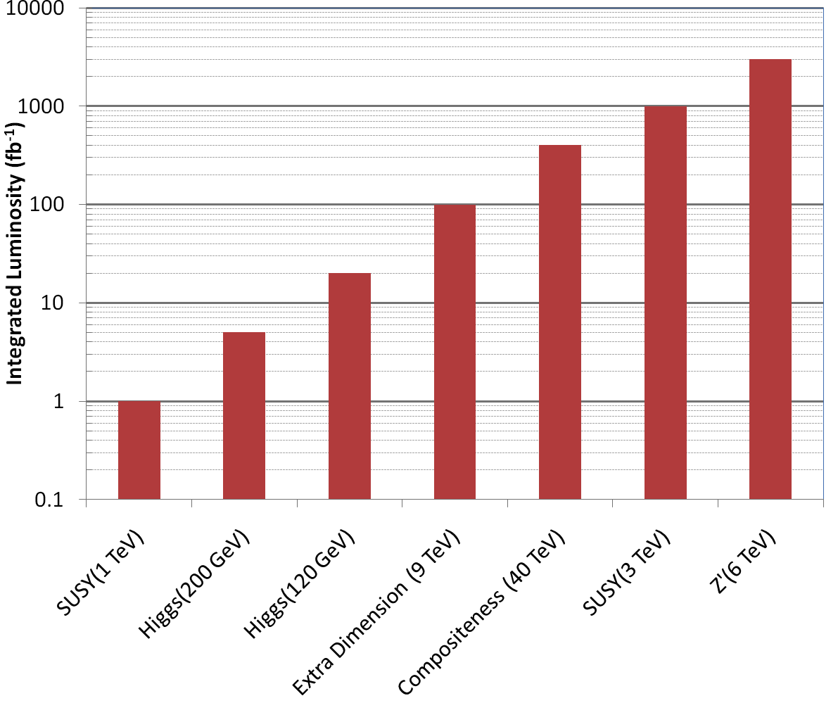
LHC Long Term Physics Goals
3000 fb⁻¹
~ 25 years at current LHC luminosity!
The future begins now
How can we increase the luminosity??

Slide 30
Limits to LHC Luminosity*
Brightness, limited by
PSB injection energy
PS
Max tune-shift
Total beam current, limited by machine protection(!), e-cloud and other instabilities
β*, limited by
magnet technology
chromatic effects
Geometric factor, related to crossing angle…
*see, eg, F. Zimmermann, “CERN Upgrade Plans”, EPS-HEP 09, Krakow, for a thorough discussion of luminosity factors.

Slide 31
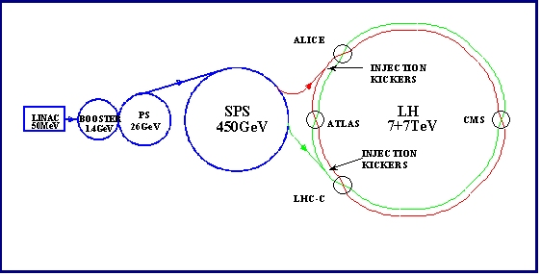
Current LHC Acceleration Sequence and Brightness Issues
Space Charge Limitations at Booster and PS injection
Transition crossing in PS and SPS
Schematic ONLY. Scale and orientation not correct

Slide 32
Addressing brightness issues
There are plans to address two of the major sources of emittance blowup in the injector chain
  Injection from the LINAC into the PS Booster
    The current linac uses proton painting at 50 MeV
    New LINAC4 will use ion injection at 160 MeV
  Space charge at injection into PS
    Extraction energy of the PS Booster will be increased from 1.4 to 2.0 GeV
These upgrades are scheduled to take place during the next long shutdown.

Slide 33
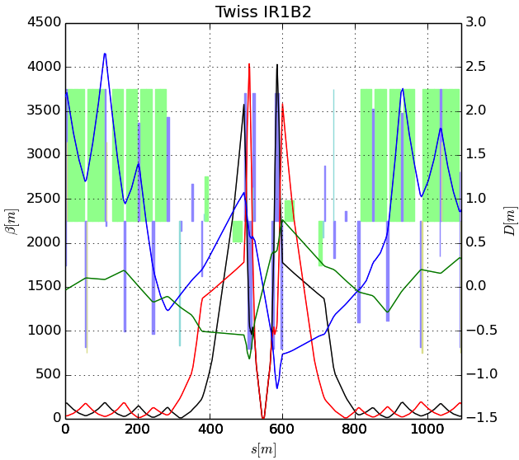
The Case for New Quadupoles
HL-LHC Proposal: β*=55 cm ➔ β*=10 cm
Just like classical optics
  Small, intense focus ➔big, powerful lens
  Small β*➔huge β at focusing quad
  Need bigger quads to go to smaller β*
Existing quads
70 mm aperture
200 T/m gradient
Proposed for upgrade
150 mm aperture
200 T/m gradient
Field 70% higher at pole face
➔ Beyond the limit of NbTi

Slide 34
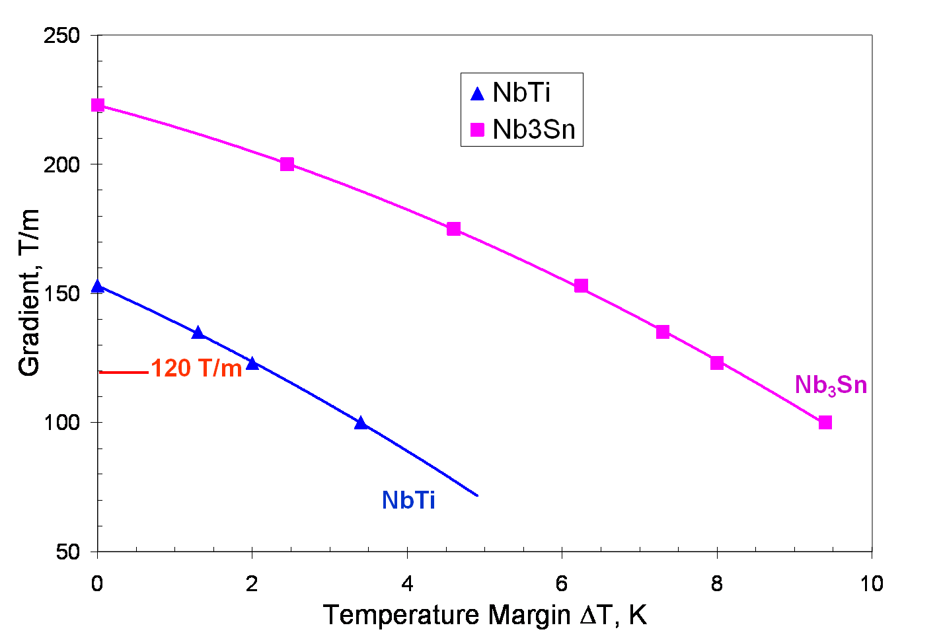
Motivation for Nb₃Sn
Nb₃Sn can be used to increase aperture/gradient and/or increase heat load margin, relative to NbTi
Limit of NbTi magnets
Very attractive, but no one has ever built accelerator quality magnets out of Nb₃Sn
Whereas NbTi remains pliable in its superconducting state, Nb3Sn must be reacted at high temperature, causing it to become brittle
  Must wind coil on a mandril
  React
  Carefully transfer to yolk
120 mm aperture

Slide 35
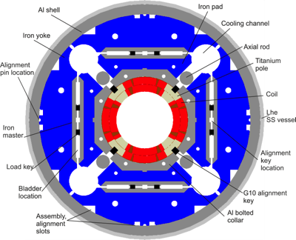
US-LARP Magnet Development Tree
Successfully
tested
LHC Prototype
4 m long
150 mm bore
Designed jointly with CERN. Under test

Slide 36
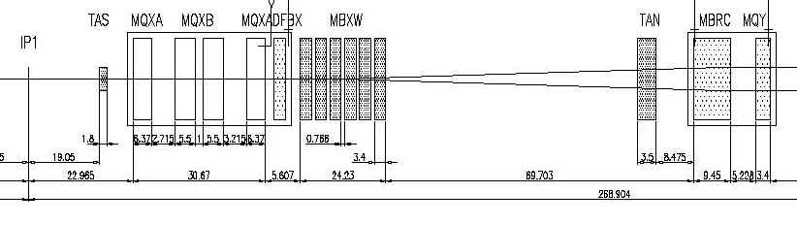
IR Layout: the need for a crossing angle
Separation Dipole
Final Triplet
IP
~59 m
Nominal Bunch spacing: 7.5 m
Collision spacing: 3.75 m
~2x15 parasitic collisions per IR
  Remember: ALL of these would
  cause equal tune shifts
Need Crossing Angle

Slide 37
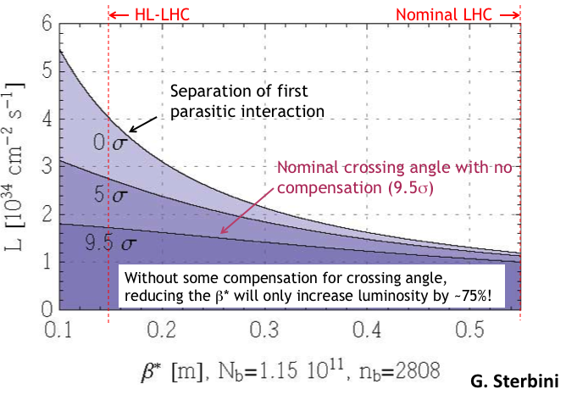
Crossing Angle Considerations
“Piwinski Angle”
Crossing angle reduces luminosity
Minor effect at current β*, but largely cancels benefit of lowering β*

Slide 38
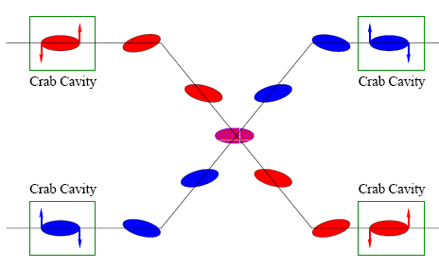
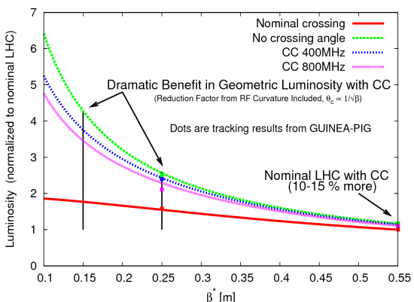
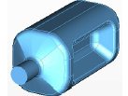
Crab Cavities
Technical Challenges
  Crab cavities have only barely been shown to work.
    Never in hadron machines
  LHC bunch length ➔ low frequency (400 MHz)
  19.2 cm beam separation ➔ “compact”
  (exotic) design
Additional benefit
  Crab cavities may help level luminosity!
Currently being tested in SPS

Slide 39
Luminosity Leveling
Original goal of luminosity upgrade: >10³⁵ cm⁻²s⁻¹
  Leads to unacceptable pileup in detectors
New goal: 5x10³⁴ leveled luminosity
Options
  Crab cavities
  β* modifications
  Lateral separation
“Crab kissing” – sort of complicated

Slide 40
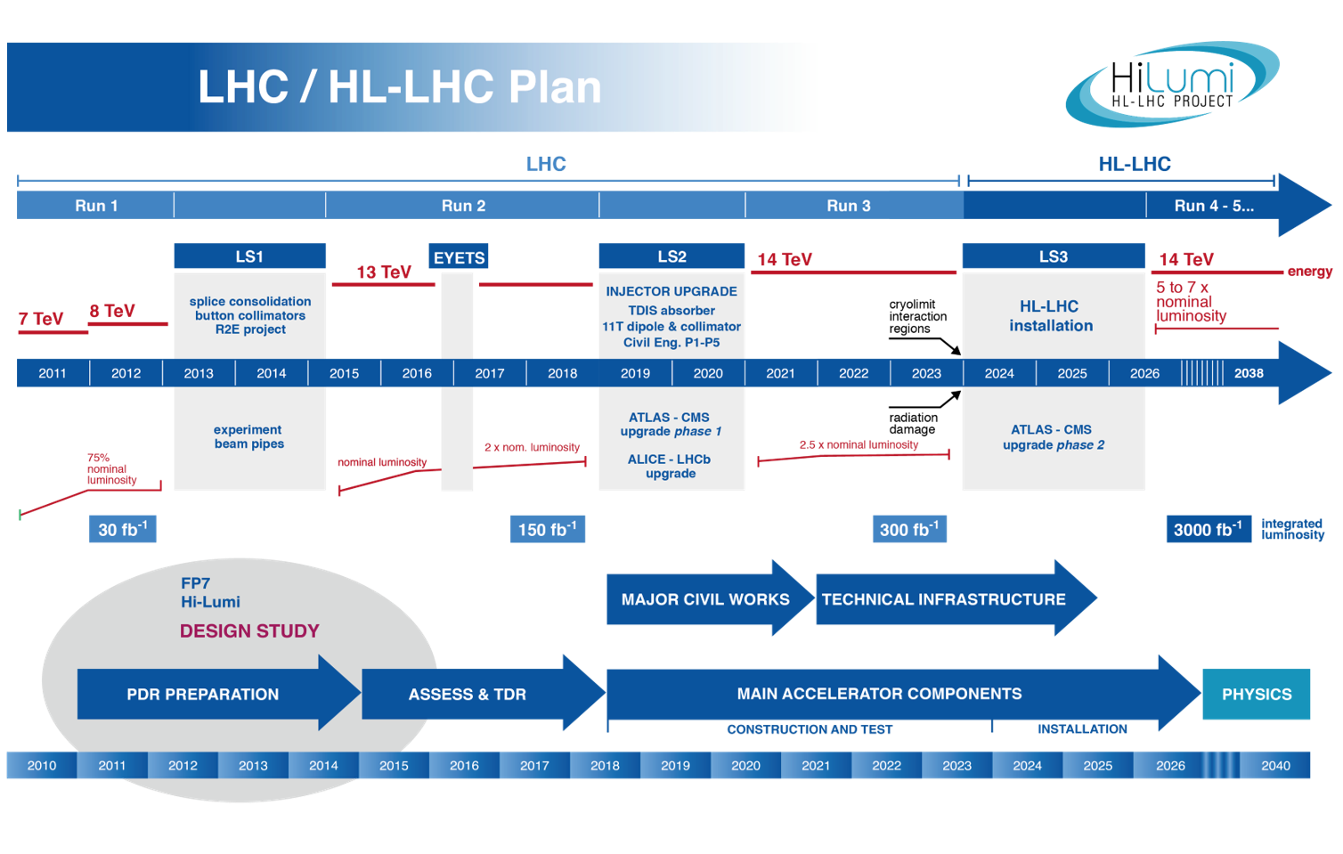

Slide 41
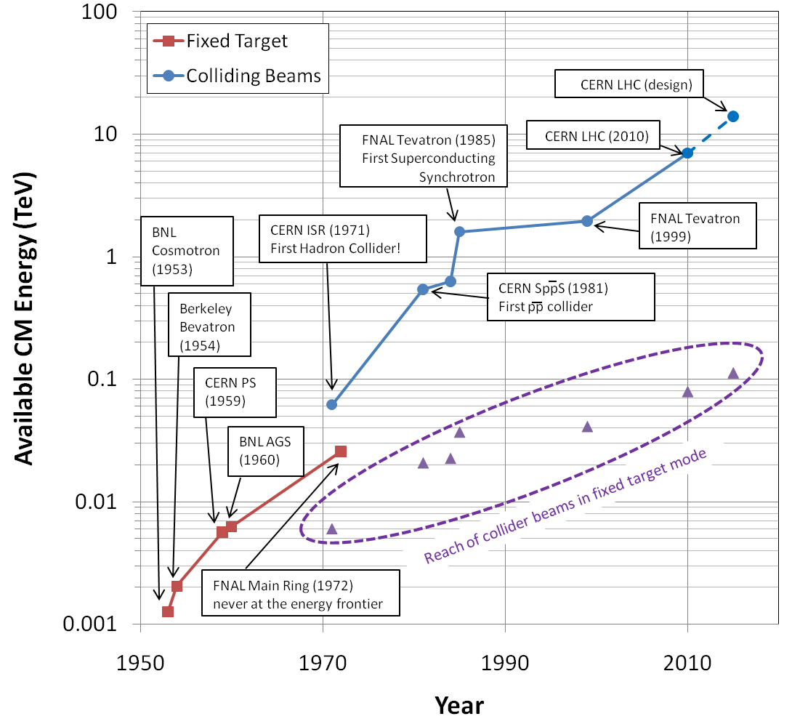
Summary: Evolution of the Energy Frontier
~a factor of 10 every 15 years
This will not continue

Slide 42
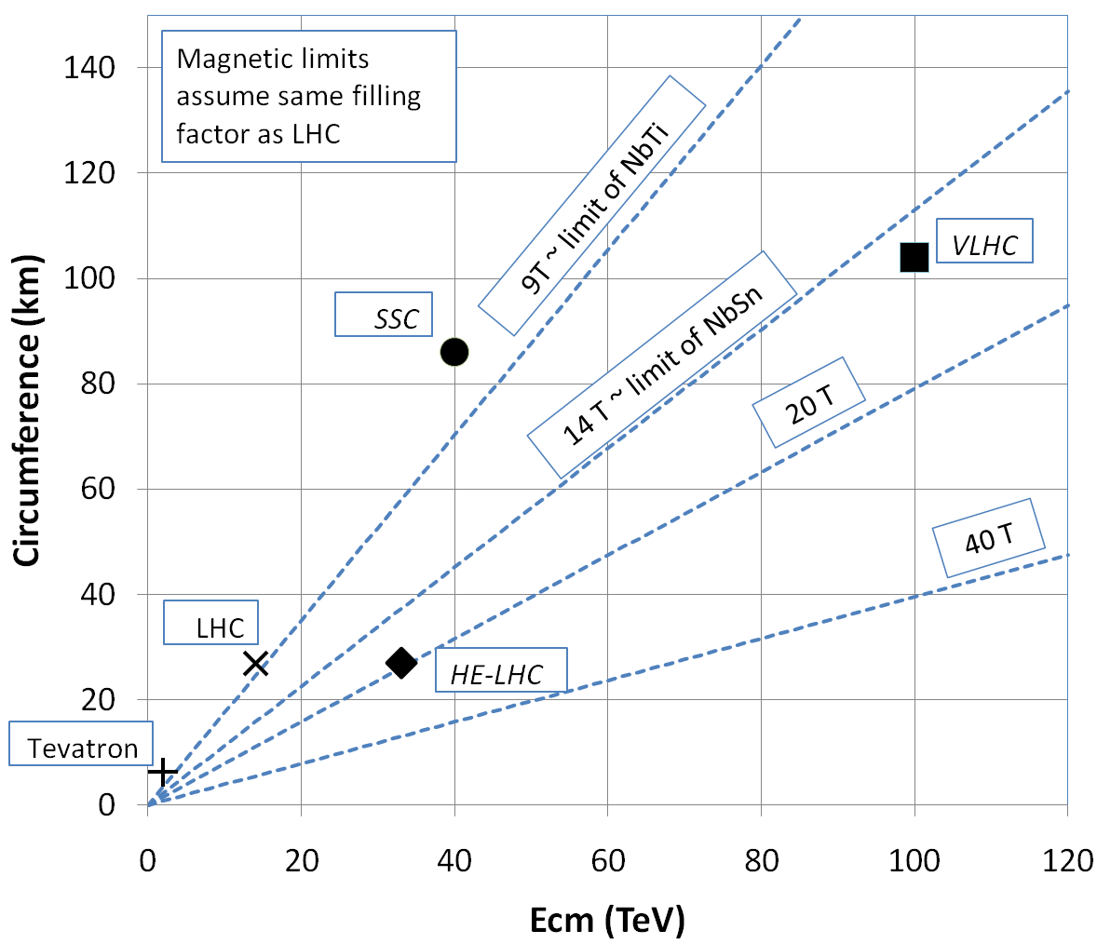
What next?
The energy of Hadron colliders is limited by feasible size and magnet technology. Options:
  Get very large (~100 km circumference)
  More powerful magnets (requires new technology)
All accelerator magnets based on this
Future magnets could be based on this

Slide 43
Superconductor Options
Traditional
  NbTi
    Basis of ALL superconducting accelerator magnets to date
    Largest practical field ~8T
  Nb₃Sn
    Advanced R&D
    Being developed for large aperture/high gradient quadrupoles
    Larges practical field ~14T
High Temperature
  Industry is interested in operating HTS at moderate fields at LN₂ temperatures. We’re interested in operating them at high fields at LHe temperatures.
    MnB₂
      promising for power transmission
      can’t support magnetic field.
    YBCO
      very high field at LHe
      no cable (only tape)
    BSCCO (2212)
      strands demonstrated
      unmeasureably high field at LHe
Focusing on this, but very expensive
➔ pursue hybrid design

Slide 44
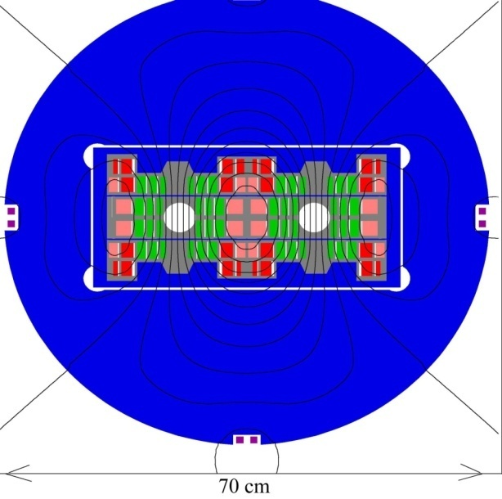
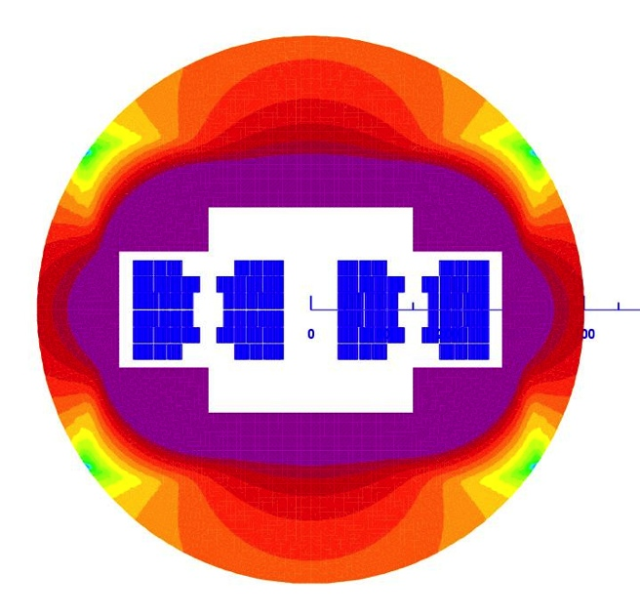
Potential Designs
P. McIntyre 2005 – 24T ss Tripler, a lot of Bi-2212 , Je = 800 A/mm2
E. Todesco 2010
20 T, 80% ss
30% NbTi
55 %NbSn
15 %HTS
All Je < 400 A/mm2

Slide 45
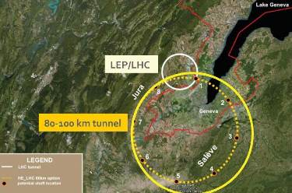
Future Circular Collider (FCC)
Currently being discussed for ~2030s
80-100 km in circumference
Niobium-3-Tin (Nb₃Sn) magnets.
~100 TeV center of mass energy

Slide 46
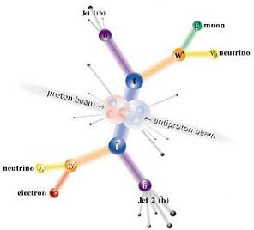
Other Paths to the Energy Frontier
Leptons vs. Hadrons revisited
  Because 100% of the beam energy is available
  to the reaction, a lepton collider is
  competitive with a hadron collider of ~5-10
  times the beam energy (depending on the
  physics).
  A lepton collider of >1 TeV/beam could compete with the discovery potential of the LHC
    A lower energy lepton collider could be very useful for precision tests, but I’m talking about direct energy frontier discoveries.
  Unfortunately, building such a collider is VERY, VERY hard
    Eventually, circular e⁺e⁻ colliders will radiate away all of their energy each turn
      LEP reached 100 GeV/beam with a 27 km circuference synchrotron!
    ➔ Next e⁺e⁻ collider will be linear

Slide 47
International Linear Collider (ILC)
LEP was the limit of circular e⁺e⁻ colliders
  Next step must be linear collider
  Proposed ILC 30 km long, 250 x 250 GeV e⁺e⁻ (NOT energy frontier)
We don’t yet know whether that’s high enough energy to be interesting
  Need to wait for LHC results
  What if we need more?

Slide 48
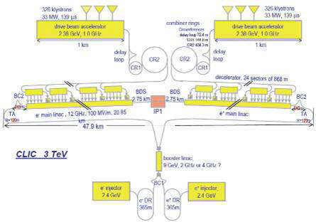
“Compact” (ha ha) Linear Collider (CLIC)?
Use low energy, high current electron beams to drive high energy accelerating structures
Up to 1.5 x 1.5 TeV, but VERY, VERY hard

Slide 49
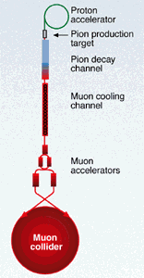
Muon colliders?
Muons are pointlike, like electrons, but because they’re heavier, synchrotron radiation is much less of a problem.
Unfortunately, muons are unstable, so you have to produce them, cool them, and collide them, before they decay.

Slide 50
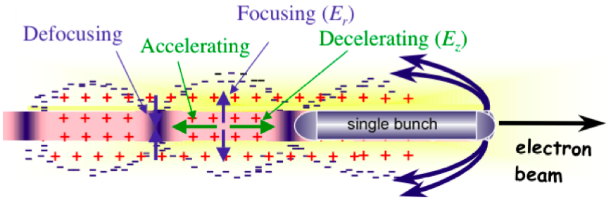
Wakefield accelerators?
Many advances have been made in exploiting the huge fields that are produced in plasma oscillations.
Potential for accelerating gradients many orders of magnitude beyond RF cavities.
Still a long way to go for a practical accelerator.

Slide 51
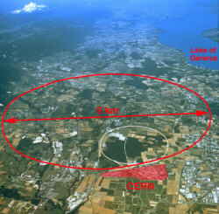
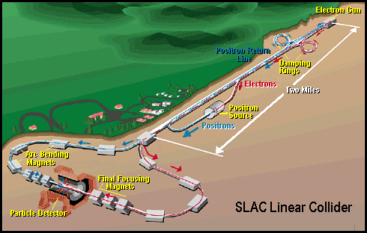
Some other important accelerators (past):
LEP (at CERN):
  27 km in circumference
  - e+e-
  - Primarily at 2E=M_{Z} (90 GeV)
  - Pushed to E_{CM}=200GeV
  - L = 2E31
  - Tunnel now houses LHC
SLC (at SLAC):
  2 km long LINAC accelerated electrons AND positrons on opposite phases.
  - 2E=M_{Z} (90 GeV)
  - polarized
  - L = 3E30
  - Proof of principle for linear collider

Slide 52
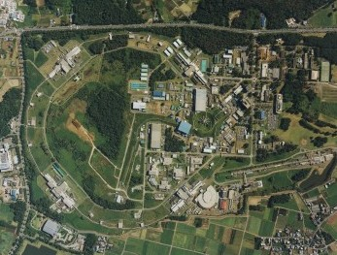
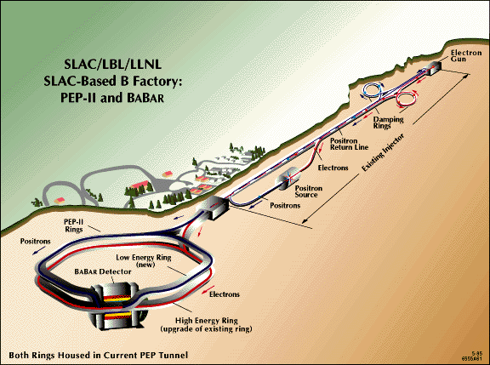
B-Factories
- B-Factories collide e+e- at E_{CM} = M(ϒ(4S)).
-Asymmetric beam energy (moving center of mass) allows for time-dependent measurement of B-decays to study CP violation.
KEKB (Belle Experiment):
- Located at KEK (Japan)
- 8GeV e- x 3.5 GeV e+
- Peak luminosity >1e34
PEP-II (BaBar Experiment)
- Located at SLAC (USA)
- 9GeV e- x 3.1 GeV e+
- Peak luminosity >1e34

Slide 53
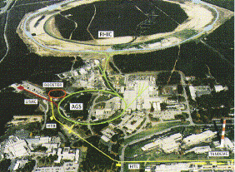
Relativistic Heavy Ion Collider (RHIC)
- Located at Brookhaven:
Can collide protons (at 28.1 GeV) and many types of ions up to Gold (at 11 GeV/amu).
Luminosity: 2E26 for Gold
Goal: heavy ion physics, quark-gluon plasma, ??

Slide 54
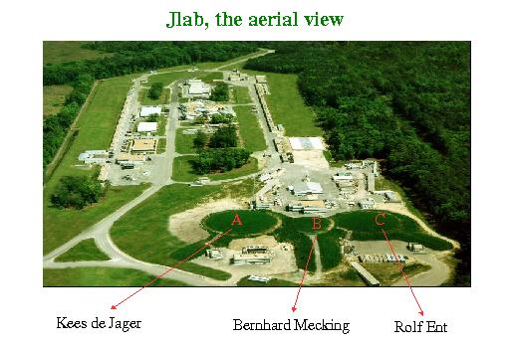
Continuous Electron Beam Accelerator Facility (CEBAF)
Locate at Jefferson Laboratory, Newport News, VA
12GeV e- at 200 uA continuous current
Nuclear physics, precision spectroscopy, etc

Slide 55
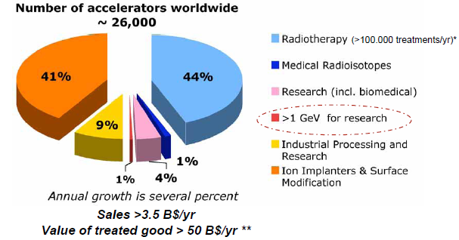
Research Machines: Just the Tip of the Iceberg

Slide 56

Example: Spallation Neutron Source
(Oak Ridge, TN)
A 1 GeV Linac loads 1.5E14 protons into a non-accelerating synchrotron ring.
These are fast extracted onto a Mercury target
This happens at 60 Hz -> 1.4 MW
Neutrons are used for biophysics, materials science, industry, etc…

Slide 57


Light sources: too many to count
Put circulating electron beam through an “undulator” to create synchrotron radiation (typically X-ray)
Many applications in biophysics,
materials science, industry.
New proposed machines will use
very short bunches to create coherent light.

Slide 58

Other uses of accelerators
Radioisotope production
Medical treatment
Electron welding
Food sterilization
Catalyzed polymerization
Even art…
In a “Lichtenberg figure”, a low energy electron linac is used to implant a layer of charge in a sheet of lucite. This charge can remain for weeks until it is discharged by a mechanical disruption.

