Slide 1
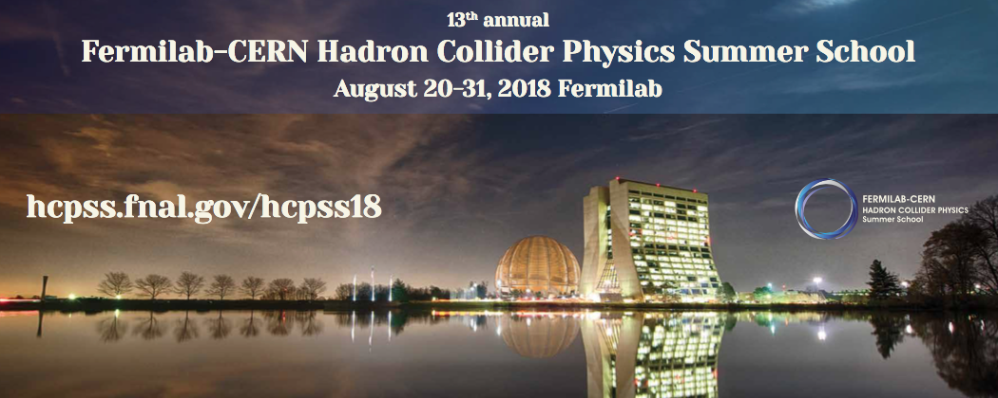
Accelerators A
Eric Prebys, UC Davis

Slide 2
Goals of these lectures
Provide a reasonably quantitative introduction to the fundamental concepts in particle physics
  Strong focusing
  Betatron motion
  Twiss Parameters (α, β, γ)
  Emittance
  Phase stability
  RF
  Etc
Provide a qualitative overview of the history, status, and prospects for the field.
Discuss some specific topics relevant to the LHC and its future upgrades.

Slide 3
Relativity and Units
Remember forever!
Basic Relativity
Units
  For the most part, we will use SI units, except
    Energy: eV (keV, MeV, etc) [1 eV = 1.6x10⁻¹⁹ J]
    Mass: eV/c² [proton = 1.67x10⁻²⁷ kg = 938 MeV/c²]
    Momentum: eV/c [proton @ β=.9 = 1.94 GeV/c]
  In the US and Europe, we normally talk about the kinetic energy (K) of a particle beam, although we’ll see that momentum really makes more sense
Some Handy Relationships
These units make these relationships really easy to calculate

Slide 4
Kinetic Energy
A body in motion will have a
total energy given by
The difference between this
and mc² is called the “kinetic
energy”
Here are some examples of
kinetic energy
For v<<c (speed of light),
Kinetic energy ~ ½mv²
Kinetic Energy
Rest Energy
Example | Velocity | Velocity/ Speed of light | Kinetic Energy/(mc²)
Race car | 150 mph | .0000002 | .000000000000025
Apollo 12 (fastest men) | 24,791 mph | .000037 | .00000000068
Proton in the LHC (full energy) | Light minus 2.7 m/s | .999999991 | 7500
Electron in LEP | Light minus 3.6 mm/s | .999999999988 | 203,000

Slide 5
State of the Art: Large Hadron Collider (LHC)
Built at CERN, straddling the French/Swiss border
27 km in circumference
Currently colliding beams of 6.5 TeV/beam
  Design energy of 7 TeV
That’s where we are. Now let’s see how we got here…

Slide 6
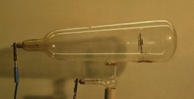
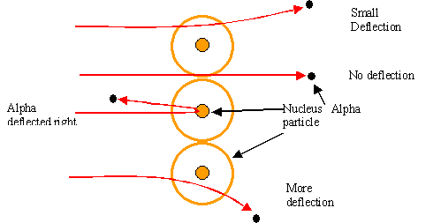
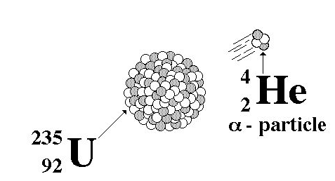
Some Pre-History
The first artificial acceleration of particles
was done using “Crookes tubes”, in the
latter half of the 19th century
  These were used to produce the first X-rays (1875)
  At the time no one understood what was going on
The first “particle physics experiment” told Ernest Rutherford the structure of the atom (1911)
In this case, the “accelerator” was a
naturally decaying ²³⁵U nucleus
Study the way radioactive particles “scatter” off of atoms

Slide 7
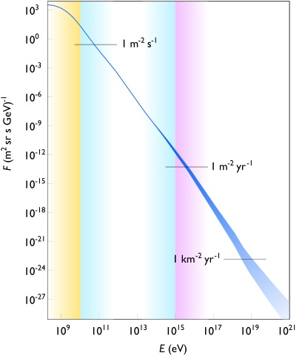
Natural Particle Acceleration
Max LHC energy
Radioactive sources produce maximum energies of a few million electron volts (MeV)
Cosmic rays reach energies of ~1,000,000,000 x LHC but the rates are too low to be useful as a study tool
  Not enough “luminosity”
However, low energy cosmic rays are extremely useful for detector testing, commissioning, etc.

Slide 8
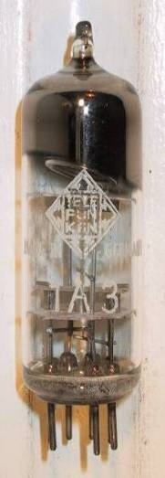
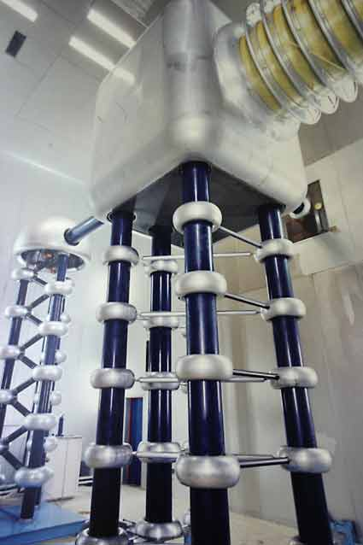
Man-made Particle Acceleration
The simplest accelerators accelerate charged particles through a static electric field. Example: vacuum tubes (or CRT TV’s)
Anode
Cathode
Limited by magnitude of electric field:
  - CRT display ~keV
  - X-ray tube ~10’s of keV
  - Van de Graaf ~MeVs
Solutions:
  Alternate fields to keep particles in
  accelerating fields -> Radio Frequency (RF) acceleration
  Bend particles so they see the same accelerating field over and over -> cyclotrons, synchrotrons
Old FNAL Cockroft-Walton = 750 kV

Slide 9
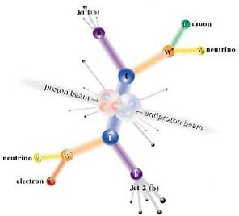
Interlude: Electrons vs. Protons
Electrons are point-like
  Well-defined initial state
  Full energy available to interaction
Protons are made of quarks and gluons
  Interaction take place between these constituents.
  Only a small fraction of energy available, not well-defined.
  Rest of particle fragments -> big mess!
So why not stick to electrons?

Slide 10
Synchrotron Radiation
As the trajectory of a charged particle is deflected, it emits “synchrotron radiation”
Radius of curvature
An electron will radiate about 10¹³ times more power than a proton of the same energy!!!!
Protons: Synchrotron radiation does not affect kinematics very much
  Energy limited by strength of magnetic fields and size of ring
Electrons: Synchrotron radiation dominates kinematics
  To to go higher energy, we have to lower the magnetic field and go to huge rings
  Eventually, we lose the benefit of a circular accelerator, because we lose all the energy each time around.
Since the beginning, the “energy frontier” has belonged to proton (and/or antiproton) machines, while electrons are used for precision studies and other purposes.
Now, back to the program…

Slide 11
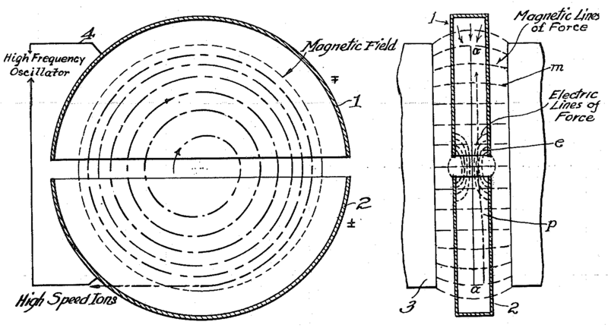
The Cyclotron (1930’s)
would not work for electrons!
side view
top view
A charged particle in a uniform magnetic field will follow a circular path of radius
“Cyclotron Frequency”
For a proton:
i.e. “RF” range
Accelerating “DEES”: by applying a voltage which oscillates at f_{c}, we can accelerator the particle a little bit each time around, allowing us to get to high energies with a relatively small voltage.

Slide 12
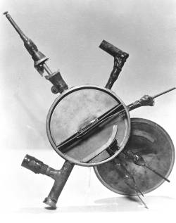
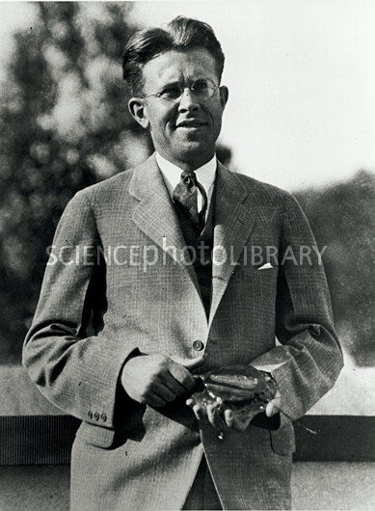
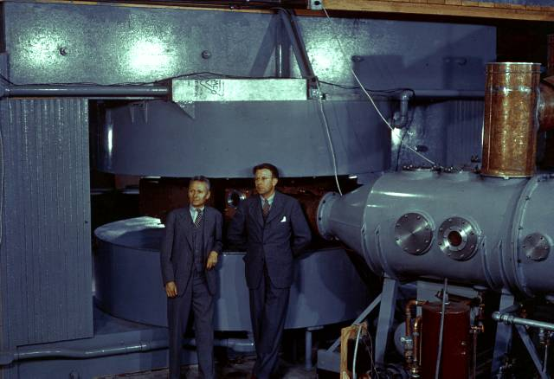
Round and Round We Go: the First Cyclotrons
~1930 (Berkeley)
  Lawrence and Livingston
  K=80 keV
  Fit in your hand
1935 - 60” Cyclotron
  Lawrence, et al. (LBL)
  ~19 MeV (D2)
  Prototype for many

Slide 13
Onward and Upward!
Cyclotrons were limited by three problems
  Constant frequency breaks down at ~10% speed of light
    Solved with variable frequency “synchro-cyclotrons”
    ➔ phase stability (more about this later)
    Later “isochronous cyclotrons” (had to solve stability problems)
  As energy goes up, magnet gets huge
  Beams are not well focused and get larger with energy
Two major advances allowed accelerators to go beyond the energies and intensities possible at cyclotrons
  “Synchrotron” – in which the magnetic field is increased as the energy increases (proportional to momentum), such that particles continue to follow the same path .
  “Strong focusing” – a technique in which magnetic gradients (non-uniform fields) are used to focus particles and keep them in a smaller beam pipe than was possible with cyclotrons.
Note: still plenty of uses for cyclotrons (simple, inexpensive, rapid cycling)
  Medical treatments
  Isotope production
  Nuclear physics

Slide 14
Understanding Beam Motion: Beam “rigidity”
The relativistically correct form of Newton’s Laws for a particle in an electromagnetic field is:
A particle of unit charge in a uniform
magnetic field will move in a circle
of radius
side view
top view
constant for fixed energy!
T-m²/s =V
units of eV in our usual convention
Beam “rigidity” = constant at a given momentum (even when B=0!)
Remember forever!
If all magnetic fields are scaled with the momentum as particles accelerate, the trajectories remain the same
➔“synchrotron” [E. McMillan, 1945]

Slide 15
Example Beam Parameters
Compare Fermilab LINAC (K=400 MeV) to LHC (K=7000 GeV)
Parameter | Symbol | Equation | Injection | Extraction
proton mass | m [GeV/c²] |  | 0.938
kinetic energy | K [GeV] |  | .4 | 7000
total energy | E [GeV] |  | 1.3382 | 7000.938
momentum | p [GeV/c] |  | 0.95426 | 7000.938
rel. beta | β |  | 0.713 | 0.999999991
rel. gamma | γ |  | 1.426 | 7461.5
beta-gamma | βγ |  | 1.017 | 7461.5
rigidity | (Bρ) [T-m] |  | 3.18 | 23353.
This would be the radius of curvature in a 1 T magnetic field or the field in Tesla needed to give a 1 m radius of curvature.

Slide 16
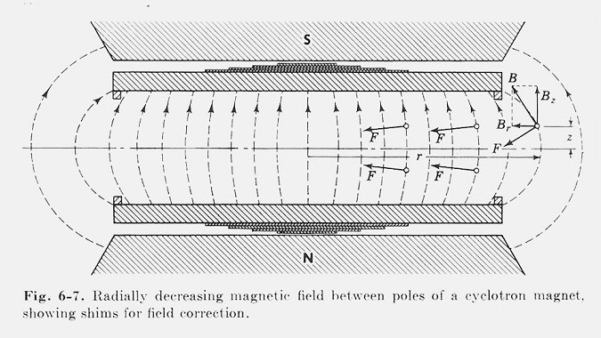
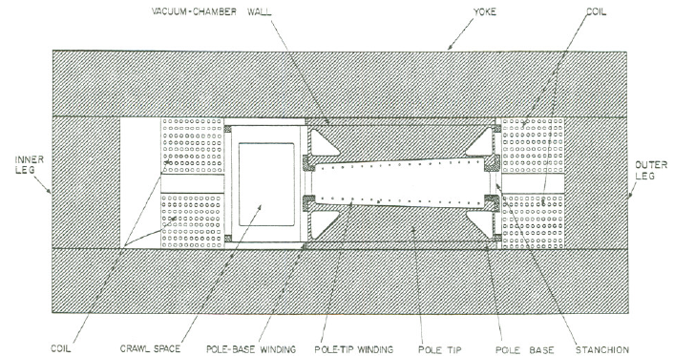
Weak Focusing
Cyclotrons relied on the fact that
magnetic fields between two pole
faces are never perfectly uniform.
This prevents the particles from
spiraling out of the pole gap.
In early synchrotrons, radial field
profiles were optimized to take advantage of this effect, but in
any weak focused beams, the beam size grows with energy.
The most famous weak
focusing accelerator was the
Berkeley Bevatron, which had
a kinetic energy of 6.2 GeV
  High enough to make antiprotons
  (and win a Nobel Prize)
  It had an aperture 12”x48”!

Slide 17
Strong Focusing
Strong focusing utilizes alternating magnetic gradients to precisely control the focusing of a beam of particles
  The principle was first developed in 1949 by Nicholas Christofilos, a Greek-American engineer, who was working for an elevator company in Athens at the time.
  Rather than publish the idea, he applied for a patent, and it went largely ignored.
  The idea was independently invented in 1952 by Courant, Livingston and Snyder, who later acknowledged the priority of Christophilos’ work.
  Courant and Snyder wrote a follow-up paper in 1958, which contains the vast majority of the accelerator physics concepts and formalism in use to this day!
Although the technique was originally formulated in terms of magnetic gradients, it’s much easier to understand in terms of the separate functions of dipole and quadrupole magnets.

Slide 18
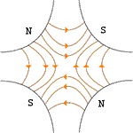
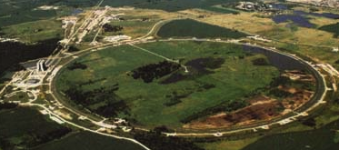

Combined Function vs. Separated Function
Strong focusing was originally implemented by building magnets with non-parallel pole faces to introduce a linear magnetic gradient
=
+
dipole
quadrupole
CERN PS (1959, 29 GeV)
Later synchrotrons were built with physically separate dipole and quadrupole magnets.
The first “separated function” synchrotron was the Fermilab Main Ring (1972, 400 GeV)
+
=
dipole
quadrupole
Fermilab
Strong focusing is also much easier to teach using separated functions, so we will…

Slide 19
Thin Lens Approximation and Magnetic “kick”
If the path length through a
transverse magnetic field is short
compared to the bend radius of the particle,
then we can think of the particle receiving a
transverse “kick”, which is proportional to the integrated field
and it will be bent through small angle
In this “thin lens approximation”, a
dipole is the equivalent of a prism in
classical optics.

Slide 20
Quadrupole Magnets* as Lenses
A positive particle coming out of the page off center in the horizontal plane will experience a restoring kick
proportional to the displacement
just like a “thin lens” with focal length
*or quadrupole term in a gradient magnet

Slide 21
What About the Other Plane?
Defocusing!
Luckily, if we place equal and opposite pairs of lenses, there will be a net focusing regardless of the order.
➔pairs give net focusing in both planes -> “FODO cell”

Slide 22
Formalism: Coordinates and Conventions
We generally work in a right-handed coordinate system with x horizontal, y vertical, and s along the nominal trajectory (x=y=0).
Define derivatives wrt s
Note: s (rather than t) is the independent variable

Slide 23
Initial Conditions and Phase Space
Our general equations of motion are
These are 2nd order linear homogenous equations, so we need two initial conditions to fully determine the motion
“Hill’s Equation”
“centripetal” term from curvature
“phase space”
unique initial phase space point ➔ unique trajectory

Slide 24
Transfer matrices
The simplest magnetic lattice consists of quadrupoles and the spaces in between them (drifts). We can express each of these as a linear operation in phase space.
By combining these elements, we can represent an arbitrarily complex ring or line as the product of matrices.
Quadrupole:
Drift:

Slide 25
Periodic Systems
The formalism of accelerator physics is based on periodic systems
This allows us to decouple the transport of particles into two parts:
  The “lattice”: a mathematical description of the machine itself, based only on the magnetic fields, which is identical for each identical cell
  The “emittance”: A mathematical description of the ensemble of particles circulating in the machine.
Circular machines generally have several levels of periodicity
  Individual FODO cells
  Symmetric superperiods
  The total periodicity of the machine.
Single pass beam lines have their lattice functions constrained by matching them to periodic systems.
Periodic “cell”

Slide 26
Betatron motion
Particles undergo “pseudo-harmonic” motion around the equilibrium orbit, defined by a “beta function”, which is only a function of position.
Position dependent amplitude and phase
x
Lateral deviation in one plane
s
The “betatron function” β(s) is effectively the local wave number and also defines the beam envelope.
Phase advance
Closely spaced strong quads -> small β -> small aperture, lots of wiggles
Sparsely spaced weak quads -> large β -> large aperture, few wiggles

Slide 27
Behavior Over Multiple Turns
The general expressions for motion is
Two other lattice parameters fully define the lattice at each point
For a given particle, these define an ellipse of a constant amplitude
Area = πA²
Particle will return to a different point on the same ellipse each time around the ring.

Slide 28
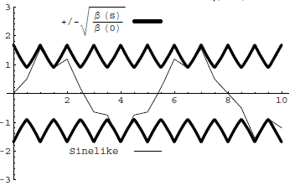
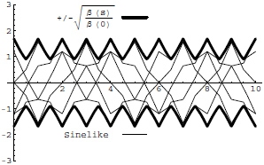
Conceptual understanding of β
It’s important to remember that the betatron function represents a bounding envelope to the beam motion, not the beam motion itself
Normalized particle trajectory
Trajectories over multiple turns
Closely spaced strong quads ➔ small β ➔ small aperture, lots of wiggles
Sparsely spaced weak quads ➔ large β ➔ large aperture, few wiggles

Slide 29
Betatron Tune
Particle trajectory
As particles go around a ring, they will undergo a number of betatrons oscillations ν (sometimes Q) given by
This is referred to as the “tune”
Ideal orbit
We can generally think of the tune in two parts:
6.7
Integer : magnet/aperture optimization
Fraction: Beam Stability

Slide 30
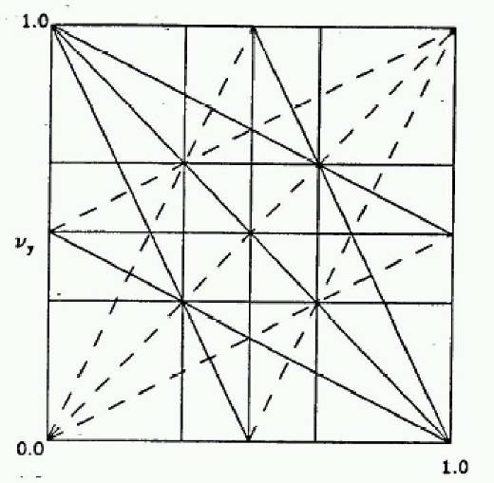
Tune, Stability, and the Tune Plane
If the tune is an integer, or low order rational number, then the effect of any imperfection or perturbation will tend be reinforced on subsequent orbits.
When we add the effects of coupling between the planes, we find this is also true for combinations of the tunes from both planes, so in general, we want to avoid
Many instabilities occur when something perturbs the tune of the beam, or part of the beam, until it falls onto a resonance, thus you will often hear effects characterized by the “tune shift” they produce.
“small” integers
➔Avoid lines in the “tune plane”
fract. part of Y tune
fract. part of X tune

Slide 31
Characterizing an Ensemble: Emittance
If each particle is described by an ellipse with a particular amplitude, then an ensemble of particles will always remain within a bounding ellipse of a particular area:
Area = πε
Either leave the π out, or include it explicitly as a “unit”. Thus
  microns (CERN) and
  π-mm-mr (FNAL)
Are actually the same units (you’ll never have to explicity use π in the calculation)
These are really the same

Slide 32
Definitions of Emittance
Because distributions normally have long tails, we have to adopt a convention for defining the emittance. The two most common are
  Gaussian (electron machines, CERN):
  95% Emittance (FNAL):
In general, emittance can be different in the two planes, but we won’t worry about that for now.

Slide 33
Emittance and Beam Distributions
As we go through a lattice, the bounding emittance remains constant
large spatial distribution
small angular distribution
small spatial distribution
large angular distribution

Slide 34
Adiabatic Damping
Beam is accelerated forward, which decreases the angular distribution, and therefore the emittance.
The following product remains constant
This means the true emittance goes down
Which means the physical beam size goes down as well
Note: the concept of normalized emittance doesn’t exist for electrons, because synchrotron radiation determines the emittance.
“normalized emittance”
betatron function
RMS emittance
(factor of 4 in LHC)
v/c

Slide 35
Backup Slides

Slide 36
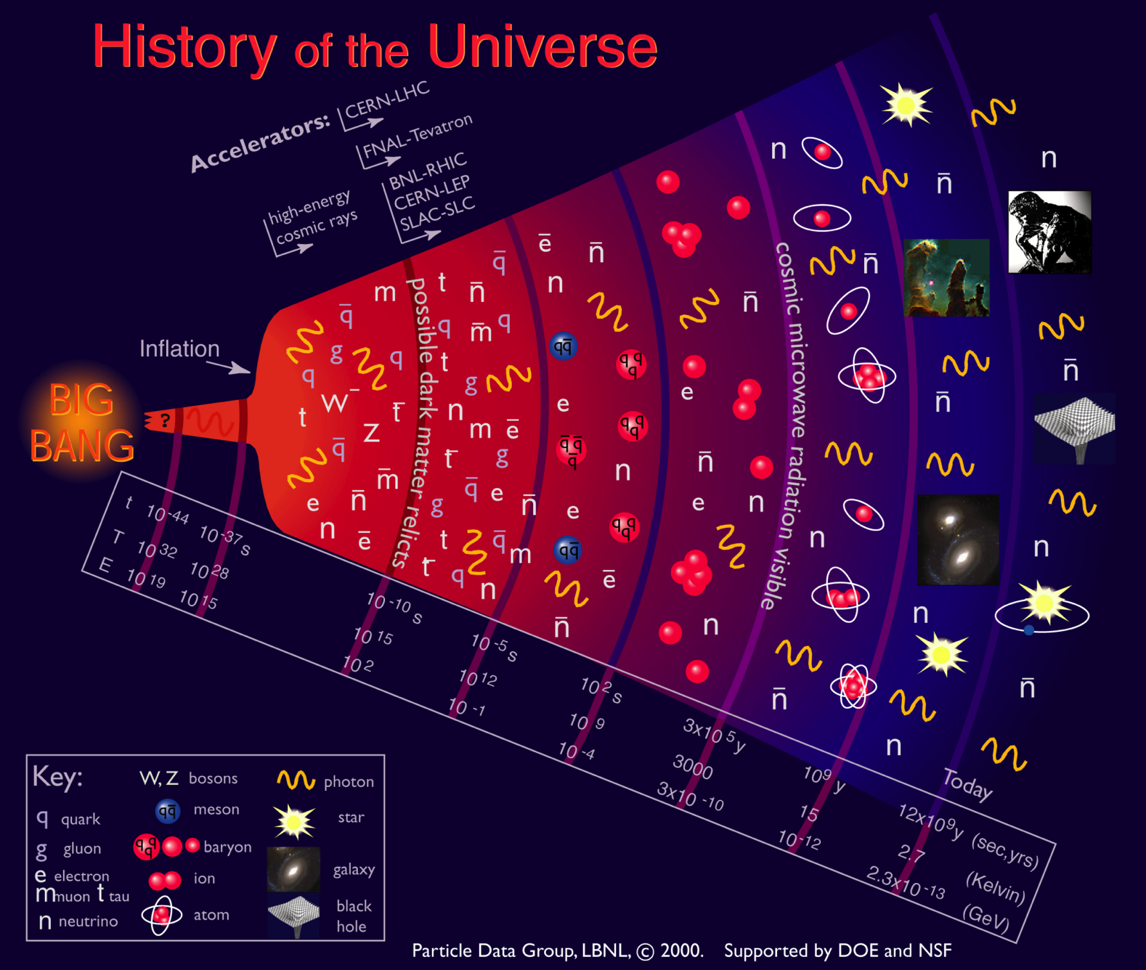
Motivation
Going to higher energies = going back in time

Slide 37
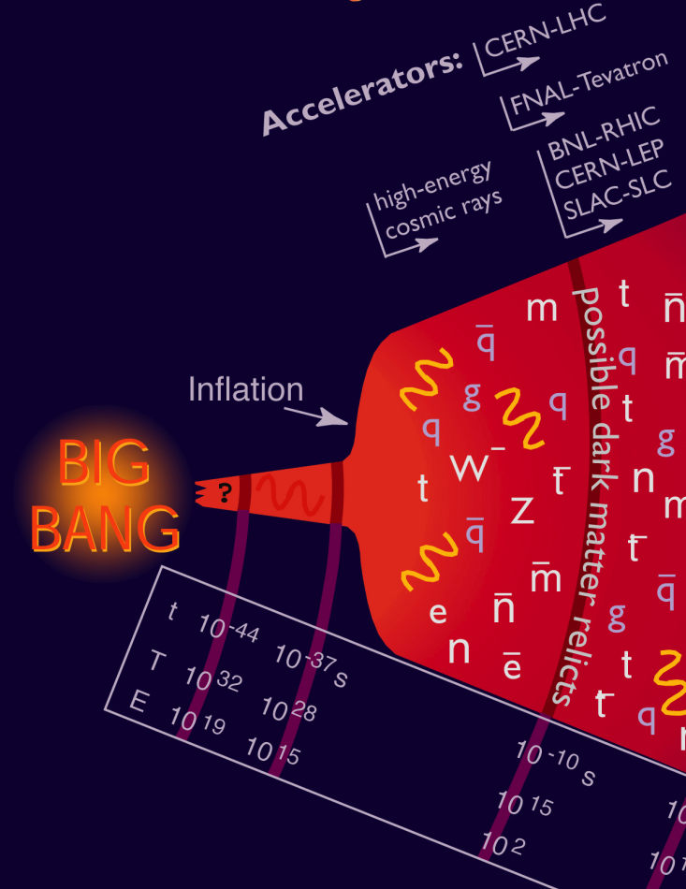
Where We Are…
Accelerators allow us to go back 13.8 billion years and recreate conditions that existed a few trillionths of a second after the Big Bang
  the place where our current understanding of physics breaks down.
In addition to high energy, we need high
“luminosity”
that is, lots of particles interacting, to see rare processes.

Slide 38
Units of energy: Electron Volts
An “electron-volt” is the energy gained by a particle
of unit charge is accelerated over 1V potential
It is really small
  1eV =1.6x10⁻¹⁹ (=.00000000000000000016) Joules - our usual
  unit of energy.
  A 1 kg weight dropped 1m would have 6x10¹⁸ eV of energy!
On the other hand, it’s a very useful unit when talking about individual particles
  If we accelerate a proton using an electrical potential, we know exactly what the energy is.
  It’s also useful when thinking about mass/energy equivalence

Slide 39
Another way to look at energy…
Quantum mechanics tells us all particles have a wavelength
So going to higher energy allows us to probe smaller and smaller scales
If we put the high equivalent mass and the small scales together, we have…
“Planck Constant”
momentum
as v approaches c

Slide 40
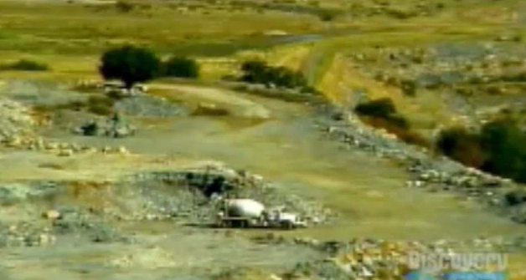


Understanding Energy
High Energy Physics is based on Einstein’s equivalence of Mass and Energy
All reactions involve some mass changing either to or from energy
If we could convert a kilogram of mass
entirely to energy, it would supply all
the electricity in the United States for
almost a day.
Chemical Explosion
Hydrogen Bomb
.00000005% of mass converted to energy.
~.1% (of just the Hydrogen!) converted.

