Slide 1
Dual Phase Electronics Consortium expected activities in 2018-2019
Framework:
The electronics in production for PD-DP is directly applicable to the 10 kton DP (no milestones for technological decisions)
Main activities in 2018-2019 are the commissioning of PD-DP (final prototype for the 10 kton DP) and the writing of the TP/TDR
Activities:
Costing, already in advanced state: expected to be completed by the end of 2017 for the Technical Proposal, further costs optimization may continue beyond the baseline costs.
Development of installation schedule
Editing of the TP/TDR
Installation and commissioning of PD-DP (see PD-DP schedule)
Finalization of the number of channels needed for Light Readout (currently assumed of the order of 1000). Input needed from PD consortium → no impact on design (which is largely modular) impact on costing. Present costing based on 1000 channels. Timescale summer 2018
For Light Readout: implementation of final routing of AMC cards, inherited from the design of the Charge readout cards. The Light Readout AMC cards built for ProtoDUNE-DP are based on the architecture of the former Charge Readout demonstrator AMC card built in 2015 (based on a S4-AMC bittware kit). For the 10 kton the LRO architecture should be integrated in the final existing scheme of the Charge Readout AMC cards. The design exists already, it is mainly a routing technical effort. Timescale 2018-2019 for completion of routing and tests.
Charge readout firmware developments for 10 kton: actual firmware and DAQ are trigger based, DAQ in 10 kton will be continuous data streaming organized in time-frames with controls, scheme exists to define DAQ interface, the hardware is designed for that, firmware should be finalized , implemented and tested in parallel with finalization of DAQ schemes (Timescale 2019). These software details have no impact on DAQ hardware/costing.
6-7 are minor refinements/activities. TDR design can be already written with actual information. TDR will contain as option for cost reduction for charge readout based on a AMC design with increased channel density (this design is an augmentation of the current design and it can be prototyped in 2020)

Slide 2
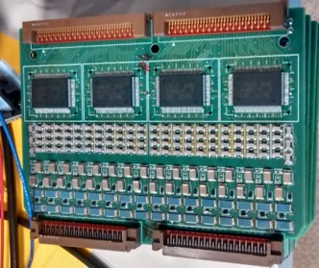
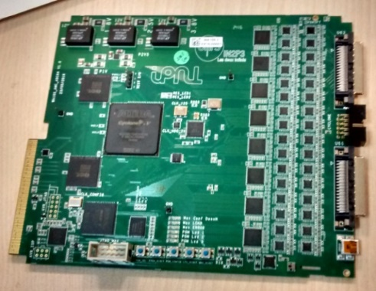
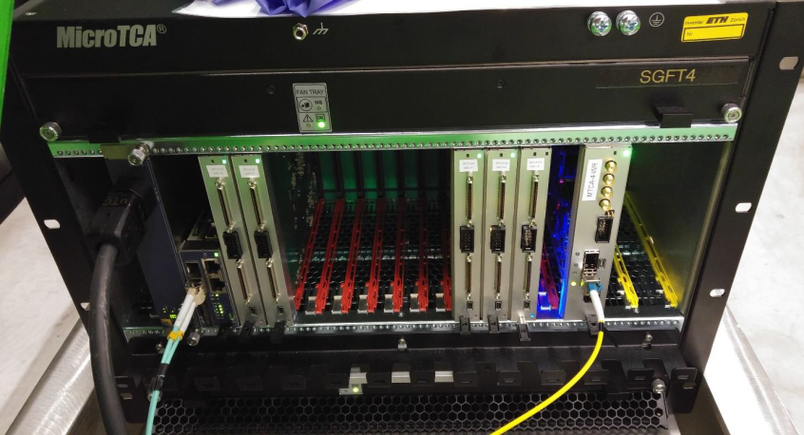
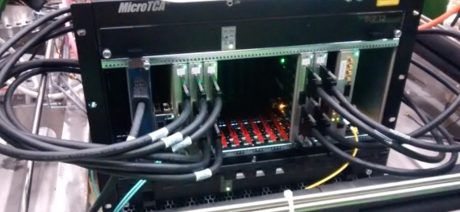
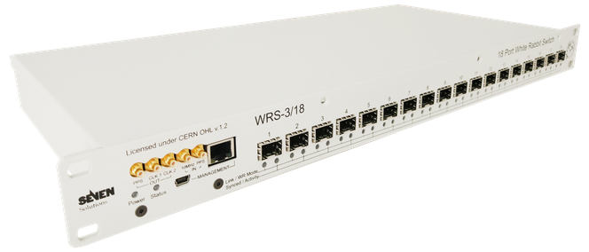
Components for a 10 kton dual-phase module
(list based on current 6x6x6 design, possible optimizations on channels density increase)
Total number of charge readout channels: 153600
Cryogenic ASICs (16 ch): 9600
Cryogenic FE cards (64 ch): 2400
AMC cards (64 ch): 2400
uTCA White-Rabbit cards: 240
uTCA crates (including MCH,PU,FU): 240
10 Gbe optical links to backend: 240
VHDCI cables (32 ch) 4800
White-Rabbit switches (18 ports): 16

