Slide 1
Next Steps towards Technical Proposal
Eric James
Far Detector Technical Board Meeting
November 9, 2017

Slide 2
Current Status
Thanks to everyone for their efforts towards putting together the first draft of the global WBS and in making the first assignments of institutional interests to the lowest-level WBS elements
This information was well-received by the funding agency representatives at the RRB meeting on November 2-3

Slide 3
Next Major Milestone
Submission of Technical Proposal to LBNC in May 2018 with complete draft available a month earlier for internal collaboration review
Technical Proposal should broadly follow the structure of the TDRs with almost identical chapter/section headings but compressed content (~5 times shorter than that envisioned for TDR sections)
Envisioned as path to TDR (not detour)

Slide 4
Consortia Deliverable #1
Each consortia needs to identify an editor for their section(s) of the Technical Proposal and TDRs
This individual should be identified by next Technical Board meeting (week of November 20th)
Complete Table of Contents for the Technical Proposals and TDRs (down to the section level headings) due in December

Slide 5
Technical Proposal Structure
Volume I : Executive Summary
Volume II : Single-phase DUNE Far Detector
Volume III : Dual-phase DUNE Far Detector
Volume IV : Software & Computing

Slide 6
Technical Proposal Structure (cont.)
Volumes II & III :
Design Motivation (~5 pages)
Detector Overview (~10 pages)
APA/CRP (~30 pages)
HV System (~30 pages)
TPC Electronics (~30 pages)
Photon Detection System (~30 pages)
DAQ (~30 pages)
Slow Controls & Beam Instrumentation (~20 pages)
Technical Coordination (~30 pages)
Detector Performance (~10 pages)
Responsibilities ( ~10 pages)
There will also be an overall editor for both Volume II & III

Slide 7
Other Required Deliverables
Updated global WBS with better fleshed-out institutional interests
Preliminary cost estimates
Preliminary risk register
Preliminary interface documentation
Draft project schedule

Slide 8
Activities in 2018/2019
Each consortia should be in process of producing a schedule of activities for 2018 and 2019 that allows for submission of the TDRs to the LBNC in April 2019
As part of this exercise, DUNE management would like to develop internal milestones for each of the consortia during this time period
In particular, want to have milestones that lay out the process for making key technological decisions

Slide 9
Time scale for technological decisions
At the time of Technical Proposal, the presentation of alternative detector designs is acceptable
In these cases, will need to lay out a plan in the Technical Proposal for how the necessary technological decisions will be made on the time frame of the TDRs
At the time of the TDRs, a clear baseline design needs to be presented (hopefully there will be convergence on most of the choices by this point)

Slide 10
Consortia Deliverable #2
Schedule of activities for 2018 and 2019 with tracking milestones
Due at December 7th Technical Board meeting
Will be integrated into common MS Project schedule by the end of the calendar year
Initiates discussions with DUNE management about locating resources for needed activities

Slide 11
Further WBS Development
Good start here but further iteration required
Need to make sure that we provide full descriptions for each WBS element (some consortia more advanced here than others)
Need to further flesh out interfaces between consortia
Steve will continue to work with consortia leadership teams on developing the WBS
As part of this process, we will work with the consortia to develop preliminary interface docs

Slide 12
Interface Documents
Needed between each of the consortia (as appropriate) and for each of the consortia with Technical Coordination
At time of Technical Proposal, these should basically provide a description of the boundaries between detector subsystems
By the time of the TDRs, these should advance to contain all of the needed mechanical drawings, cable layouts, etc…
An interface document template will be produced to serve as a starting point

Slide 13
Consortia Deliverable #3
Rough drafts of all required interface documents
Due at December 21st Technical Board Meeting
Requires consortia leadership teams to meet individually with some number of their counterparts and with members of the Technical Coordination team

Slide 14
Preliminary Cost Estimates
Far Detector cost estimates should benefit greatly from the ProtoDUNE experience (full-scale module production)
Up to now, have been working with ProtoDUNE construction teams to start documenting production costs
Attempting to capture both M&S costs and the required number of labor hours (example on next two slides)
Will work with Neutrino Cost Group (NCG) to define exactly what is needed in terms of supporting documentation and the procedures for rolling-up the costs associated with each deliverable – initial iteration will occur between now and end of calendar year

Slide 15
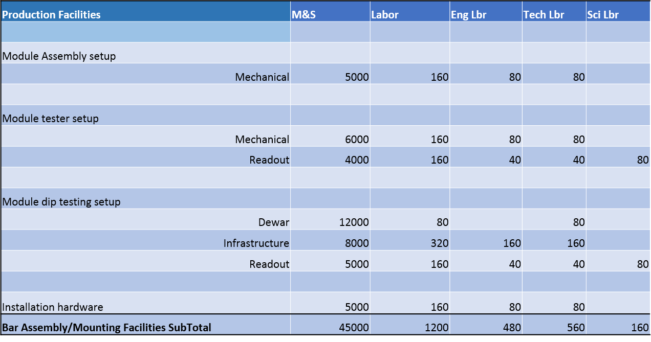
Example: Single-phase Photon Detectors
Production Facility Setup Costs

Slide 16
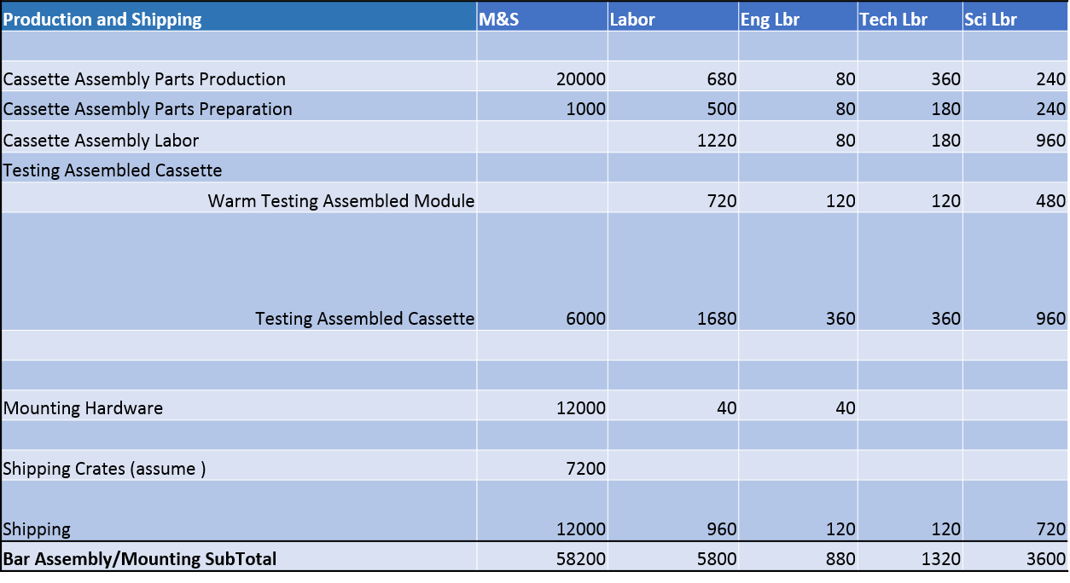
Example: Single-phase Photon Detectors
Fabrication Costs (60 PD bars)

Slide 17
Developing FD Cost Estimates
Between now and end of calendar year, we will continue to work with ProtoDUNE managers to collect cost details
Will also iterate with NCG to understand expectations for the preliminary cost estimates that will be submitted in conjunction with the Technical Proposals
Plan for consortia leadership teams to take ownership of their cost estimates in early 2018
Submission of preliminary cost estimates to NCG is targeted for one month after submission of Technical Proposal to LBNC

Slide 18
Risk Registry
There is an expectation that cost estimates will be accompanied by some accounting of associated risks
Not a quantitative accounting of risks as in the US-DOE project world, but rather a qualitative assessment with proposed mitigation strategies
Tentatively planning to hold a risk workshop in January to start developing what is needed
Also requires further iteration with NCG and LBNC

Slide 19
Far Detector Construction Schedules
As part of the process for producing the Technical Proposal, we will need to start developing a schedule for Far Detector construction, installation, and commissioning (2020 and beyond)
Expected to map to developed WBS structure
Will provide a set of target dates for the start and finish of the installation process for each detector module
These dates will remain fixed over the next year and then revisited in early 2019 (prior to the release of the TDRs)

Slide 20
Current “Stakes-in-the-Ground”
High-level international project milestones :
Technical Coordination will establish other lower-level milestones from these as needed to assist in the planning process.

Slide 21
Next Technical Board Meetings
Due to the Thanksgiving holiday in the US, propose to have our next meeting on Monday, November 20th starting at 10am Chicago-time.
December meetings would be on Thursday, December 7th and Thursday, December 21st at the regular (9am Chicago-time) starting time

